Slide 1
ITEC 102 INTRODUCTION TO INFORMATION SYSTEMS
DANIEL OBUOBI, DCSIT, CU
INFORMATION SYSTEMS

Slide 2
IS in Organisations
Information Systems are primarily concerned with providing information to support people taking actions
The lecture is fundamentally about:
introducing students to some key IS concepts
giving them the tools to describe business processes in which information systems are embedded, and
exposing them to some typical information systems about which they should be thinking critically using the information systems material they have been exposed to along the way.

Slide 3
IS in Organisations
In more detail, IS is concerned with:
organisational processes and how they relate to information systems and technology
we will be interested in how these processes can be described, through the use of modelling tools
we will look at some typical business systems such as transaction processing, decision support, groupware and workflow
we will look at other IS issues such as interaction (or user interface) design, systems development, controls and security and the social context.
we will also give practical hands-on exposure to typical systems and tools for producing models

Slide 4
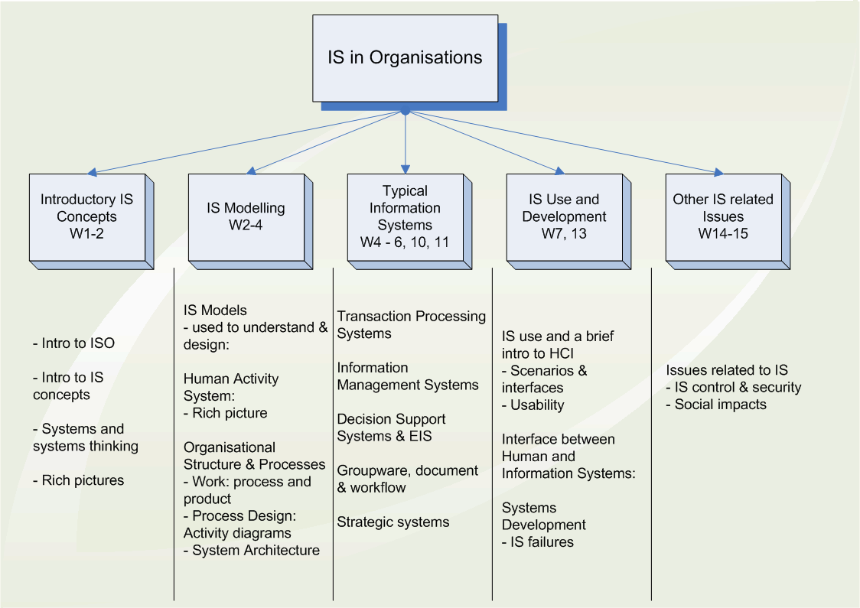
Roadmap

Slide 5
What is an information system?
IT-based information systems can be thought of as data processing systems which support and serve people who are taking actions within a particular context
IS units put the emphasis on people and the actions that need to be supported
we can think of information systems as social systems that have embedded in them information technology

Slide 6
Some other views might include:
an information system is a system of communication between people
information systems are systems involved in the gathering, processing, distribution and use of information
information systems are one form of organisational memory
information systems support human activity systems!
information systems are often named after the human activity system/organisational process they support

Slide 7
Examples of information systems
student administration
accounting information systems
Others?

Slide 8
Examples of information systems
student administration
Who are the people being supported and what are the actions they are taking?
students - enrolling in courses, units, tutorials, viewing/checking enrolment, results etc
academic staff - getting lists of students in units, viewing academic histories of students etc
admin staff . . .
other people?

Slide 9
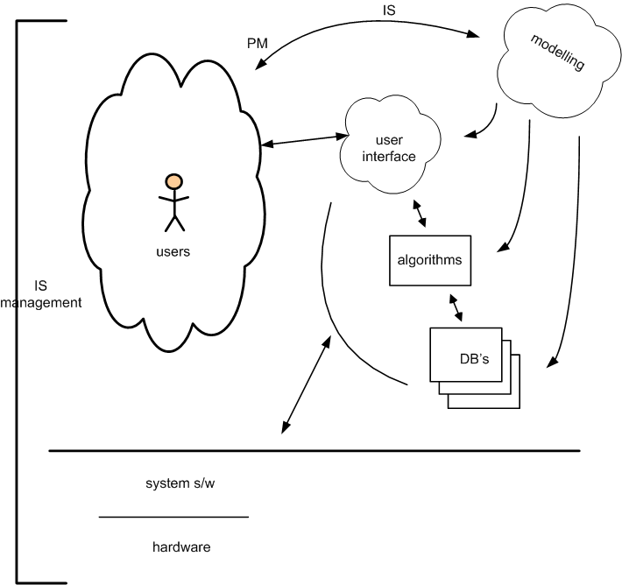
A context for IS

Slide 10
Why IS Matters?
Information systems are pervasive in our everyday lives
IS is essential for work in organisations
IS impacts employees at work
IS provides quality of life improvements
Information systems are used by all organisations
IS for competitive advantage
Why information systems matter for:
Accounting and finance
Operations management
Marketing
Human resource management
Information systems

Slide 11
Informatics
Informatics is the field that considers the nature information (in its various forms including and data and articulated knowledge).
Informatics examines the use of information by humans to achieve various ends; the technologies of its management (how it is created, stored, processed, communicated and mobilised), the issues it raises (validity, privacy, IP) and the repercussions of information for people, organisations and society.
Applied Informatics examines the above topics in relation to a particular knowledge domain. Health Informatics is the most advanced of the applied informatics disciplines. Health informatics examines topics from the GP looking after patient records to expert systems for diagnosis, remote medicine, to medical research.
Kling and Allen have used the term “organisational informatics” to encompass the application of information, IS, and IT within organisations – ie what this unit is about.

Slide 12
Data, information, knowledge
Making sense of information systems requires a clear concept of what information is
remember – information systems are concerned with providing information to support people taking actions
within IS related texts, there are multiple views of the various terms – we will present a fairly simple view of them here
Most of these viewpoints start out by attempting to describe “data”

Slide 13
Data
data (or datum) – one of more symbols that are used to represent something.
data – facts about the world
myriad of facts about the world, only some are significant or of interest to people.
some might be agreed by all, some are disputed, some accepted as meaningful by all, and some private to an individual or group who defines them as a result of particular interests
distinction between the great mass of facts and the sub-set of them we select for attention – sometimes called “capta”
it would generally be the capta that we might store in our computer systems.
data (or capta) are the raw inputs of information systems, facts of some interest to the information systems users.

Slide 14
Information
information is processed, or value-added data
can also see information as data interpreted in some meaningful context.
implies one or more people having an interest in the data and doing some form of interpretation
so can't have information without there being people with interests and some sort of context in which it is placed
this is essentially “meaning attribution”
the attribution of meaning in a context converts data into something different, ie. information
the process of meaning attribution can be individual or group based
information has a temporal dimension
what might be meaningful at some time may be completely irrelevant at another time.
What might be information to one person may not be to another – these people may have different interests at different times.

Slide 15
Knowledge
The process by which data is converted into meaningful information can lead to larger structures of related information.
These larger, longer living structures are referred to as knowledge.
these larger structures are often integrated with existing knowledge to create an improved knowledge within that context.
Knowledge can also be thought of as being an understanding of what the information means, or implies
Knowledge is then information that has been incorporated into our way of understanding the world around us
it is the sense we have made of the world, and it helps us decide to act in a certain way when we want to have an effect on the world.

Slide 16
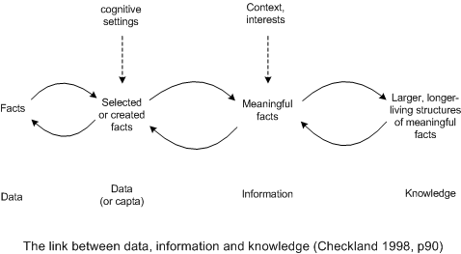
Data, Information, and knowledge

Slide 17
Quiz
Think about whether each of the following is information, data or knowledge?
A list of tax file numbers
A exception report of all accounts that are more than 90 days past-due, which is sent to the accounts receivable manager
A monthly production report that is sent to shop floor supervisors who don’t use the report because they believe the figures reported are outdated and inaccurate

Slide 18
IT - IS - Organisations
IS mediates between Technology and Organisations
IS
IT
Orgs

Slide 19
IT and IS
information systems are distinct from IT systems, with IT systems being a component elements of most modern IS
the systems concept has been applied both to technology and to human activity
an information technology system has data as input, manipulates such data as a process and outputs manipulated data
IT provides the means to construct aspects of information systems
IT includes computer software, hardware, data storage and communication technology
information systems have existed in organisations prior to the invention of IT
hence information systems do not need modern IT to exist
but modern information systems rely on IT to some degree.
in principle you could think out the fundamentals of information systems without reference to the technology used in actual systems, but
it is now necessary to think of IS in relation to IT
the rapidly changing technology offers the possibility for new kinds of information systems well beyond the capability of earlier technology.
This then makes possible new activities, new ways of doing things and new thinking, none of which would have been possible without new technologies.

Slide 20
IT and IS
IT experts ought to be conscious of the nature of information systems and their context
many IT professionals not really interested in IS and its influence on organisations - some even assume IS and IT and much the same thing
an example of business analysts and IT professionals and whether they should work together (from Checkland, 1998):
the business analysts were keen on joint working
the IT experts were not, with a view expressed of their role as being taking a precise specification of what was required, and they would provide an efficient and elegant system
Checkland argued that the IT experts were wrong – just as IS cannot ignore IT, so work on IT needs to be done in relation to the human and social context
This essentially means that IT work needs to be interactive – with business analysts and users
this is a strong rationale for modern user centred design approaches.

Slide 21
What are information systems for?
one view of what information systems are for is that they fulfil the following basic functions:
remembering the past – keeping historical data, as a record of what has happened and for facilitating various analysis
handling the present – recording various transaction and automating various processes
preparing for the future – providing information to facilitate various decision-making and planning processes
we will look at examples of each of these when we come back to look at typical information systems.

Slide 22
Stakeholders
the group of people to which an IS is relevant is the system's users, but other groups may be involved in an information system
people with an interest in an information system are referred to as “stakeholders”
the more common stakeholders for an IS might include:
users – there are usually multiple users and/or user groups, often with different interests
clients of the system – eg. customers are clients of a banking system
user management and system “owners”
system developers
system administrators and user support
other technical support people such as database administrators, network managers, IS security, etc
computer auditors
IS managers

Slide 23
Business analysis
ISO can be thought of as providing an introduction to business analysis
business analysts bridge the gap between the various stakeholders to accurately define project requirements and carefully control scope.
the business analyst is skilled at working with end-users to determine what their needs are.
the business analyst has some technical experience which is useful in determining if a user's requests are feasible
the business analyst is more than just a glorified note taker as he is also responsible for drilling down in to each business requirement to ensure that what is being asked is actually what is needed
it is also the business analysts role to translate what the user is asking for into a technical form that the client/server programmer or web developer can understand.
proactive in identifying potential projects which may help to improve the business
the business analysts have a role to understand the business and its processes, and know about the business direction, while at the same time, understanding IS and IT issues sufficiently to be able to define requirements and to offer potential solutions to end users
One person’s view of what Business analysts are: http://www.sdmagazine.com/documents/s=6977/sdmam0602/

Slide 24
Further reading
Beynon-Davies, P. 2002, Information systems : an introduction to informatics in organisations. Basingstoke, Palgrave. Chapter 1
Available in E-reserve
Pearlson, K. & Saunders, C. 2006, Managing and using information systems, 3rd Ed, Wiley, Chapter 1
Available in E-reserve

Slide 25
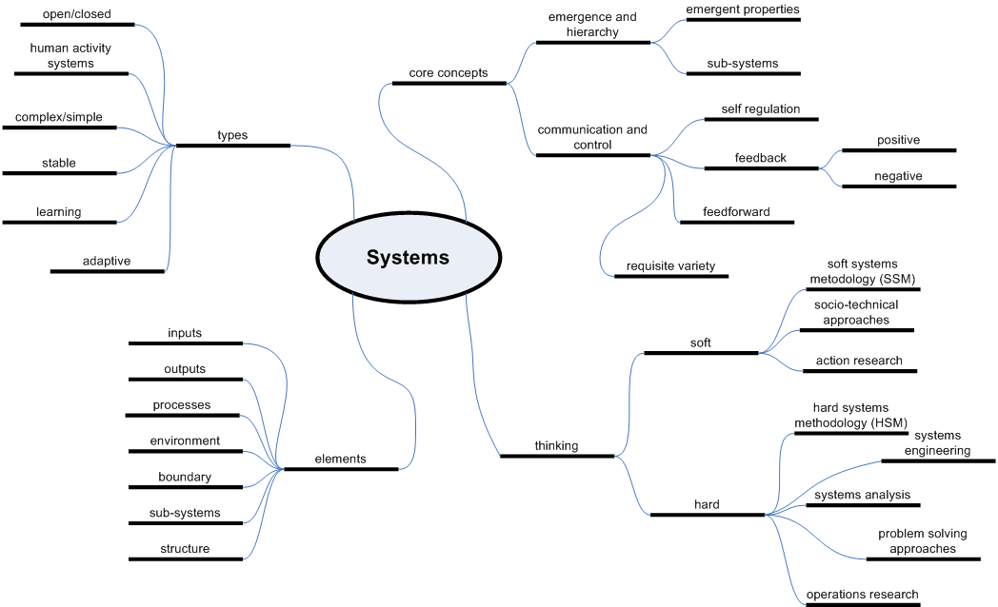
A concept map

Slide 26
Systems
examples
the commonality of these is that they have a distinct identity and are all assemblies of different parts richly interconnected with each other
systems thinking is a way of looking at real world systems for the purpose of understanding and/or improvement.
there are two pairs of ideas that are at the core of systems thinking:
emergence and hierarchy
communication and control

Slide 27
Boulding’s Framework
Level of Complexity | Example | Characteristics
Level 1 | Structural Framework | The organisational chart
Level 2 | Clockwork | Dynamic, moving, predictable, must be controlled externally
Level 3 | Cybernetic device such as thermostat | Dynamic, predictable, capable of self-regulation within certain limits.

Slide 28
Boulding’s Framework
Level of Complexity | Example | Characteristics
Level 4 | The cell | Open, dynamic, self-maintaining under changing conditions
Level 5 | The plant system | Open, dynamic, self-regulating through wide range of external & internal conditions.
Level 6 | The animal system | Open, dynamic, adjusts to its environment by making internal adjustments, forms simple social groups.

Slide 29
Boulding’s Framework
Level of Complexity | Example | Characteristics
Level 7 | Humans | Level 6 + ability to think abstractly and communicate symbolically
Level 8 | The social system | More complex than an individual, more open to env influence, more adaptive to circumstance because of collective experience and wider reservoir of skills.
Level 9 | The transcen-dental | Most freely adaptable - rises above and extends beyond the boundaries of both individuals and social systems.

Slide 30
A basic definition
an assembly of parts or components connected together in an organised way
in general, the parts are affected by being in the system and they are changed if they leave the system
addition or removal of a component changes the system
the assembly of parts does something (but behaviour may be not doing something when the environment changes) – there are processes and outputs
the particular assembly has been identified by a human being as of particular interest – in essence, the system is owned by someone

Slide 31
Systems
systems have an “out-there” aspect, and an “inside-us” aspect
control and communication which promote system survival
boundary, environment, inputs and outputs
closed and open systems

Slide 32
Systems methodologies
systems analysis approaches
hard systems methodology and systems engineering
soft systems methodology (SSM) and human activity systems
other approaches including systems failure thinking
should note a distinction between “method” versus “methodology”

Slide 33
Structures and processes
structures and processes are two important kinds of system components – system structure is represented by relatively stable, lasting components and these carryout processes
organisational structures, locations, projects
relationship between structure and process – important for understanding system behaviour

Slide 34
Other issues
Sub-systems and hierarchy
Interactions between sub-systems – coupling
Control and regulation
Emergent properties
System ownership

Slide 35
System concepts

Slide 36
System concept & information systems
What constitutes a system and what types of systems are available?
By the end of this chapter you should be able to answer these questions.
What is a system?
There are many definitions of the term ‘system’.

Slide 37
Defining a system
A system is an assembly of parts where:
The parts or components are connected together in an organized way.
The parts or components are affected by being in the system (and are changed by leaving it).
The assembly does something.
The assembly has been identified by a person as being of special interest.

Slide 38
Examples of a system
We are surrounded by the ff systems:
the railway system or transportation system
a hospital
an accounting system or tax system
a manufacturing company
Educational system etc
Any arrangement which involves the handling, processing or manipulation of resources of whatever type can be represented as a system.

Slide 39
Features of the System
All systems are composed of inter-related parts or sub-systems and the system can only be explain as a whole.
Systems are hierarchical in that the parts are the parts of sub-systems are made up of other smaller parts.
The part of the system cannot be altered without affecting other parts.
The sub-system should work towards the goal of their higher systems and not pursue their own objectives independently.

Slide 40
Features of the System
Organizational systems contain both hard and soft properties.
Hard properties are those that can be assessed in some objective way. E.g. the size of a product.
The soft aspects of a system are a matter of individual values or taste.
They cannot be assessed by an objective standard or measuring process.
Examples are; the appearance of a product.

Slide 41
The Environment of System
A system’s environment is all those elements not in the system.
System environment are those external elements whose changes in attitudes, behaviours or properties affect the state of the system.
And those external elements which are changed by the system’s behaviour.
Environment of any system comprises those elements with which it has some connection or relationship.

Slide 42
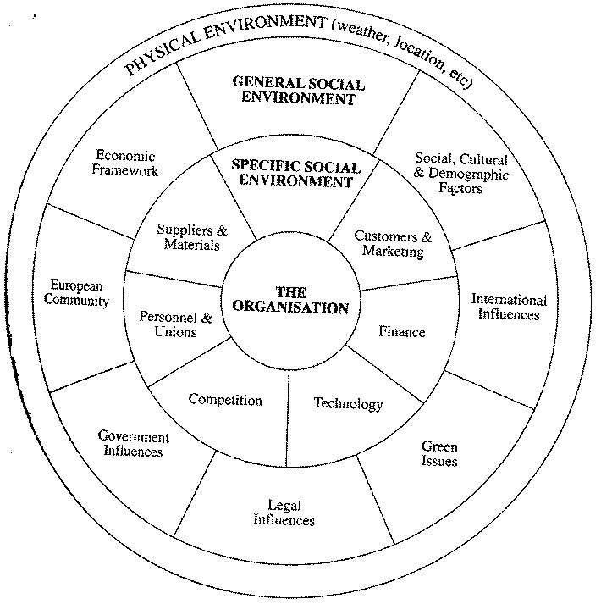
The organization’s environment

Slide 43
Closed Systems and Open Systems
A closed system is one that is isolated from its environment.
Closed systems are self contained so that the external environment does not influence the behaviour of the system, nor does the system influence its environment.
An open system is a system which interacts with its environment.
It receives inputs and influences from the environment and, in turn, passes back outputs and influences to the environment.
All social organizations are open systems.

Slide 44
Purpose and Objectives
The primary purpose of any organization is to satisfy the needs of its clients or market.
The purpose of the organization reflects the long term nature and characteristics of the organization and this purpose is expressed in its objectives.
Objectives express the direction and level of achievement expected from the organization as a whole.
and, at lower levels, from the individual parts, sections and departments which make up the organization.

Slide 45
The system approach
The top-down approach is one where objectives are clarified first before considering how they are achieved.
What must be done must be decided before considering how it should be done.
The bottom-up approach starts from a detailed analysis of the workings of particular parts of the system.
This latter approach tends to produce solutions which find better ways of organizing unnecessary activities or cheaper ways of producing unwanted products.

Slide 46
Objective setting
Personal and Organizational Objectives
Organizational objectives are for the most part non-personal yet they are developed and implemented by people.
Individuals have goals and if they are to accept organizational objectives they must at least not conflict with, their own personal objectives.
Motivation plays a key role here.

Slide 47
Objective setting
Multiple Objectives
Organizations, especially large ones, are diverse and complex and operate in an uncertain and changing environment.
They have to meet many, often competing, demands from their clients or customers, their employees, their social environmental responsibilities, their shareholders (where appropriate) and so on.
Organizations have to develop a series of objectives to cope with their various responsibilities.

Slide 48
Objective setting
Conflicting Objective
All systems have conflicting objectives so that some form of compromise is necessary.
For example, there may be conflicting requirements of low initial capital costs, low operating costs.
Constraints
Constraints are the limitations, shortages or difficulties which restricts the capacity of the organization to achieve its objectives.
Constraints represent the problems management has to overcome, or learn to live with, if the organization is to operate successfully.

Slide 49
Hard and Soft Properties
Hard properties are those that can be defined, measured or assessed in an objective way.
Soft properties are more imprecise and are matters of individual values and taste.
Most problems contain both hard and soft features.
For example, an organization is thinking of re-locating its offices from a town to the other

Slide 50
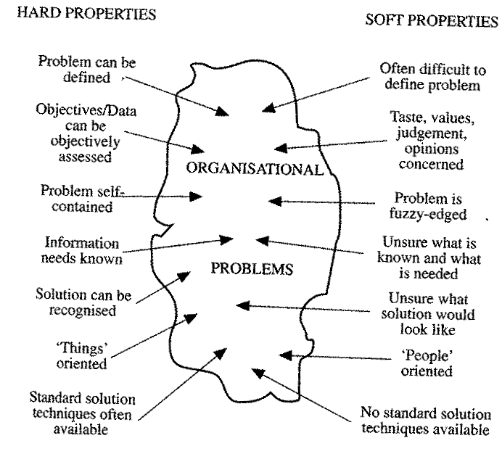
Hard and Soft Properties

Slide 51
Hard Uncertainty and Softness
Aspects of a system which are measurable in some objective way are hard whether or not they are accurate or certain.
For example, the sale of a company for last year can be calculated and are known with certainty (i.e. they are hard property).
Examples of hard uncertainties are.
Actuarial calculations in insurance company.
Forecasts of electricity demand on National Grid.
Population and morbidity forecasts.

Slide 52
Hard Uncertainty and Softness
Soft systems are thus those which incorporate and demand on some facet of human nature.
The behaviour of people, their relations, their objectives and their motivations cannot be predicted with certainty but nevertheless are critical importance in developing and using information systems.

