Slide 1
ITEC 102 INTRODUCTION TO INFORMATION SYSTEMS
DANIEL OBUOBI, DCSIT, CU
RE-DESIGNING THE ORGANISATION WITH INFORMATION SYSTEMS

Slide 2
modeling and designing systems
The most prominent methodologies for modeling and designing systems are:
Structured methodologies and
object-oriented development
Structured methodologies have been used since the 1970s to document, analyze, and design information systems.
Structured development methods are process-oriented, ------focusing primarily on modeling the processes, or actions that capture, store, manipulate, and distribute data as the data flow through a system.
These methods separate data from processes.
A separate programming procedure must be written every time someone wants to take an action on a particular piece of data.

Slide 3
Structured Methodologies (development)
Tools used in structured development include data:
Data flow diagrams,
data dictionaries,
process specifications, and
structure charts.
A data flow diagram (DFD) offers a logical graphic model of information flow, partitioning a system into modules that show manageable levels of detail.
It specifies the processes or transformations that occur within each module and the interfaces that exist between them.
Leveled data flow diagrams break systems into high-level data flows and additional diagrams for subsystems at lower levels. [see next slide]

Slide 4
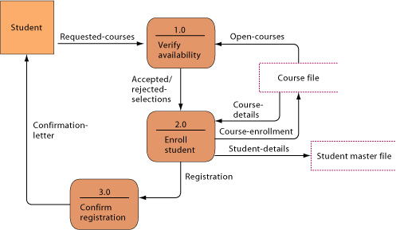
Data flow diagram
Data flow diagram for mail-in university registration system The system has three processes: Verify availability (1.0), Enroll student (2.0), and Confirm registration (3.0). The name and content of each of the data flows appear adjacent to each arrow. There is one external entity in this system: the student. There are two data stores: the student master file and the course file.

Slide 5
Other tools
A data dictionary defines the contents of data flows and data stores so that systems builders understand exactly what pieces of data they contain.
Process specifications describe the transformation occurring within the lowest level of the data flow diagrams.
The structure chart is a top-down chart, showing each level of design, its relationship to other levels, and its place in the overall design structure.
The design first considers the main function of a program or system, then breaks this function into subfunctions. [see next slide]

Slide 6
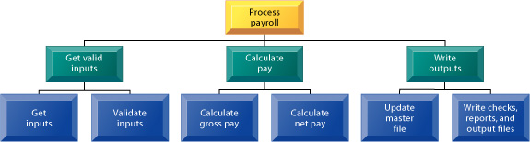
High-level structure chart
High-level structure chart for a payroll system This structure chart shows the highest or most abstract level of design for a payroll system, providing an overview of the entire system.

Slide 7
Object-oriented Methodologies
Object-oriented development uses the object as the basic unit of systems analysis and design.
An object combines data and the specific processes that operate on those data.
Data encapsulated in an object can be accessed and modified only by the operations, or methods, associated with that object.
Instead of passing data to procedures, programs send a message for an object to perform an operation that is already embedded in it.
The system is modeled as a collection of objects and the relationships among them.

Slide 8
Object-oriented modeling
Object-oriented modeling is based on the concepts of class and inheritance.
Objects belonging to a certain class, or general categories of similar objects, have the features of that class.
Classes of objects in turn can inherit all the structure and behaviors of a more general class and then add variables and behaviors unique to each object. [Figure 14-9]

Slide 9
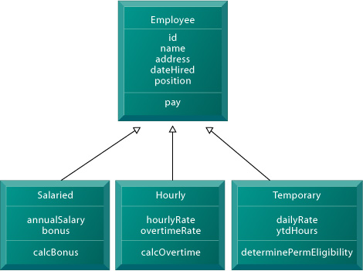
Class and inheritance
FIGURE 14-9 Class and inheritance This figure illustrates how classes inherit the common features of their superclass.

Slide 10
phases of object-oriented development
The phases of object-oriented development are similar to those of conventional systems development, consisting of analysis, design, and implementation.
However, object-oriented development is more iterative and incremental than traditional structured development.
In object-oriented development, a system is implemented by translating the design into program code, reusing classes that are already available in a library of reusable software objects and adding new ones created during the object-oriented design phase.
Implementation may also involve the creation of an object-oriented database.
Because objects are reusable, object-oriented development could potentially reduce the time and cost of writing software because organizations can reuse software objects that have already been created as building blocks for other applications.

Slide 11
Unified Modeling Language (UML)
Unified Modeling Language (UML) has become the industry standard methodology for analysis and design of an object-oriented software system.
UML uses two principal types of diagrams:
Structural diagrams, which describe relationships between classes, and
behavioral diagrams, which describe interactions in an object-oriented system. [Figure 14- 10]

Slide 12
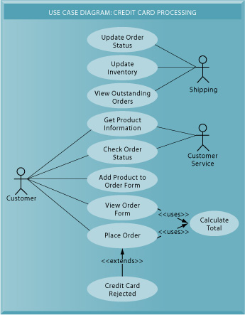
A UML use case diagram
FIGURE 14-10 A UML use case diagram Use case diagrams model the functions of a system, showing how objects interact with each other and with the users of the system.
Illustrated here is a use case diagram for credit card processing that was created with SmartDraw software.

Slide 13
Computer-aided software engineering (Case Tool)
Computer-aided software engineering (CASE)--sometimes called computer--aided systems engineering-- is the automation of step-by-step methodologies for software and systems development to reduce repetitive work.
CASE tools attempt to increase productivity and quality by facilitating the creation and revision of design specifications and program code.
CASE tools provide automated facilities for producing charts and diagrams, screen and report generators, data dictionaries, analysis and checking tools, code generators, and document generators.
The best CASE tools enforce common methods and standards, improve communication between users and technical specialists, organize and correlate design elements, automate tedious and error-prone portions of analysis and design, and automate code generation, testing, and control rollout.

Slide 14
Resource allocation and Software metrics
Resource allocation determines the way the costs, time, and personnel are assigned to different phases of a systems project.
Over the years, system builders have learned to shift project resources to earlier in the project cycle.
More time is spent on specifications and systems analysis, decreasing the proportion of programming time and reducing the need for so much maintenance time.
Software metrics play a vital role in increasing the quality of a project, measuring input, output, capacity, performance/quality, and value.
A widely used output metric is function points, which helps measure the productivity of software developers.

Slide 15
More on Object oriented analysis

Slide 16
Use Cases
Use Cases
Elements of a use case.
Alternative use case formats.
Use cases and functional requirements.
Use cases and testing.
Building use cases.

Slide 17
INTRODUCTION
Use cases are a means of expressing user requirements.
Use cases are used extensively in the analysis phase.
A use case represents how a system interacts with its environment by illustrating the activities that are performed by the users and the system’s responses.
The text-based use case is easy for the users to understand, and also flows easily into the creation of process models and the data model.

Slide 18
USE CASES
A use case depicts a set of activities that produce some output result.
Each use case describes how an external user triggers an event to which the system must respond.
With this type of event-driven modeling, everything in the system can be thought of as a response to some triggering event.
Creation of use cases is often done as a part of interview session with users or a part of JAD sessions.

Slide 19
Elements of a Use Case
Basic Information
Each use case has a name and number, and brief description.
The priority may be assigned to indicate the relative significance.
The actor refers to a person, another system, or a hardware device that interacts with the system to achieve a useful goal.
The trigger for the use case – the event that causes the use case to begin.

Slide 20
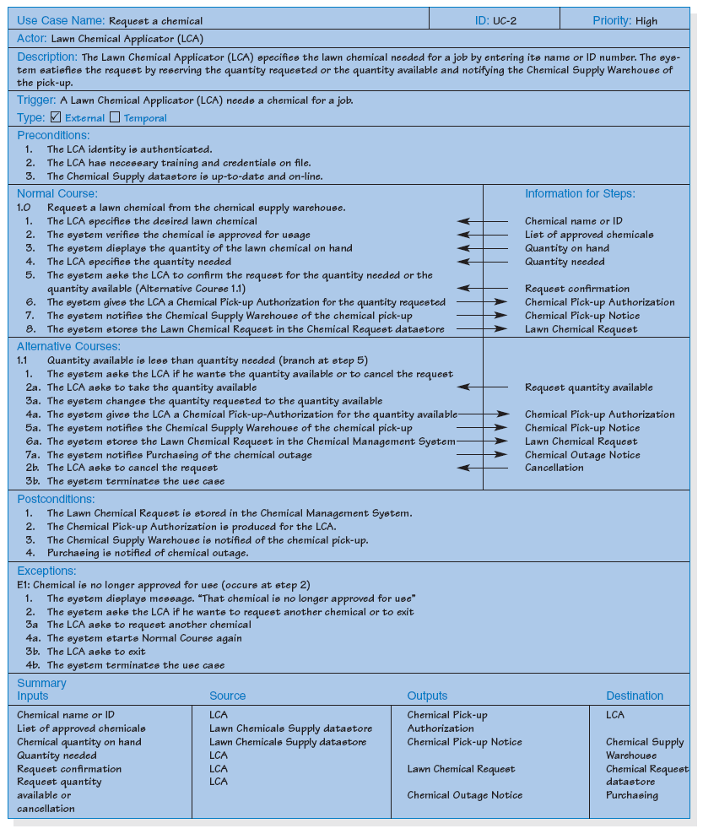
Example

Slide 21
Preconditions
It is common practice to create smaller, more focused use cases breaking the whole process down into parts.
It is important to define clearly what needs to be accomplished before each use case begins.
The preconditions define the state the system must be in before the use case commences.

Slide 22
Normal Course
The next part of a use case is the description of the major steps that are performed to execute the response to the event, the inputs used for the steps, and the outputs produced by the steps.
The normal course lists the steps.

Slide 23
Alternative Courses
Alternative courses depict branches (alternative paths of the steps) in logic that also will lead to a successful conclusion of the use case.

Slide 24
Postconditions
The postconditions section of defines the final product of the use case.
These postconditions also serve to define the preconditions for the next use case in the series.

Slide 25
Exceptions
A use case should describe any error conditions or exceptions that may occur as the use case steps are performed.
These are not normal branches in decision logic, but are unusual occurrences or errors that could potentially be encountered and will lead to an unsuccessful result.

Slide 26
Summary of Inputs and Outputs
The final section of the use case summarizes the set of major inputs and outputs of the use case, along with their source or destination.

Slide 27
Additional Use Case Issues
Additional sections may be included, e.g.,
- Frequency of use
- Business rules
- Special requirements
- Assumptions
- Notes and issues

Slide 28
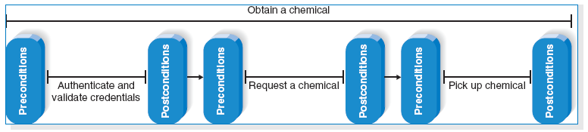
Chain of use cases – an example

Slide 29
Alternative Use Case Formats
A full-dressed use case is very thorough, detailed, and highly structured.
The project team may decide that a more casual use case format is acceptable.

Slide 30
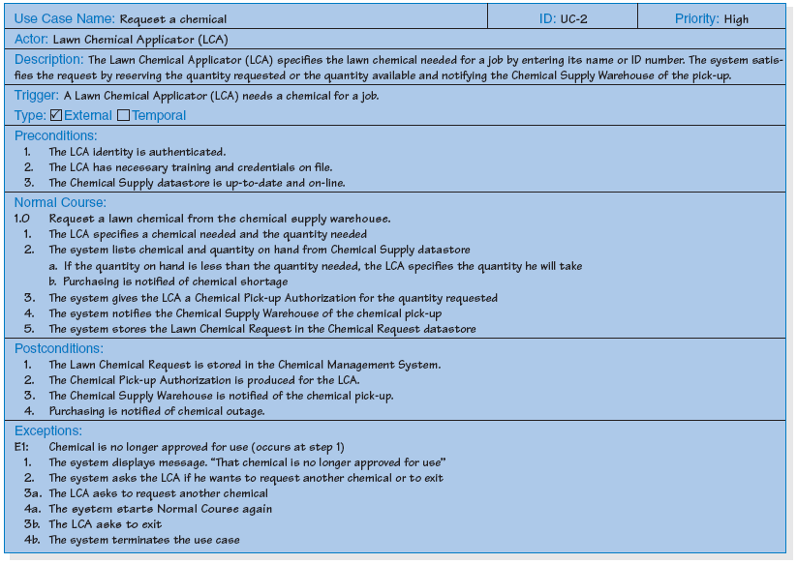
Example

Slide 31
Use Cases and the Functional Requirements
Use cases are very useful tools to us to understand user requirements. However, use cases only convey the user’s point of view.
Transforming the user’s view into the developer’s view by creating functional requirements is one of the important contributions of system analyst.
The derived functional requirements give more information to the developer about what the system must do.

Slide 32
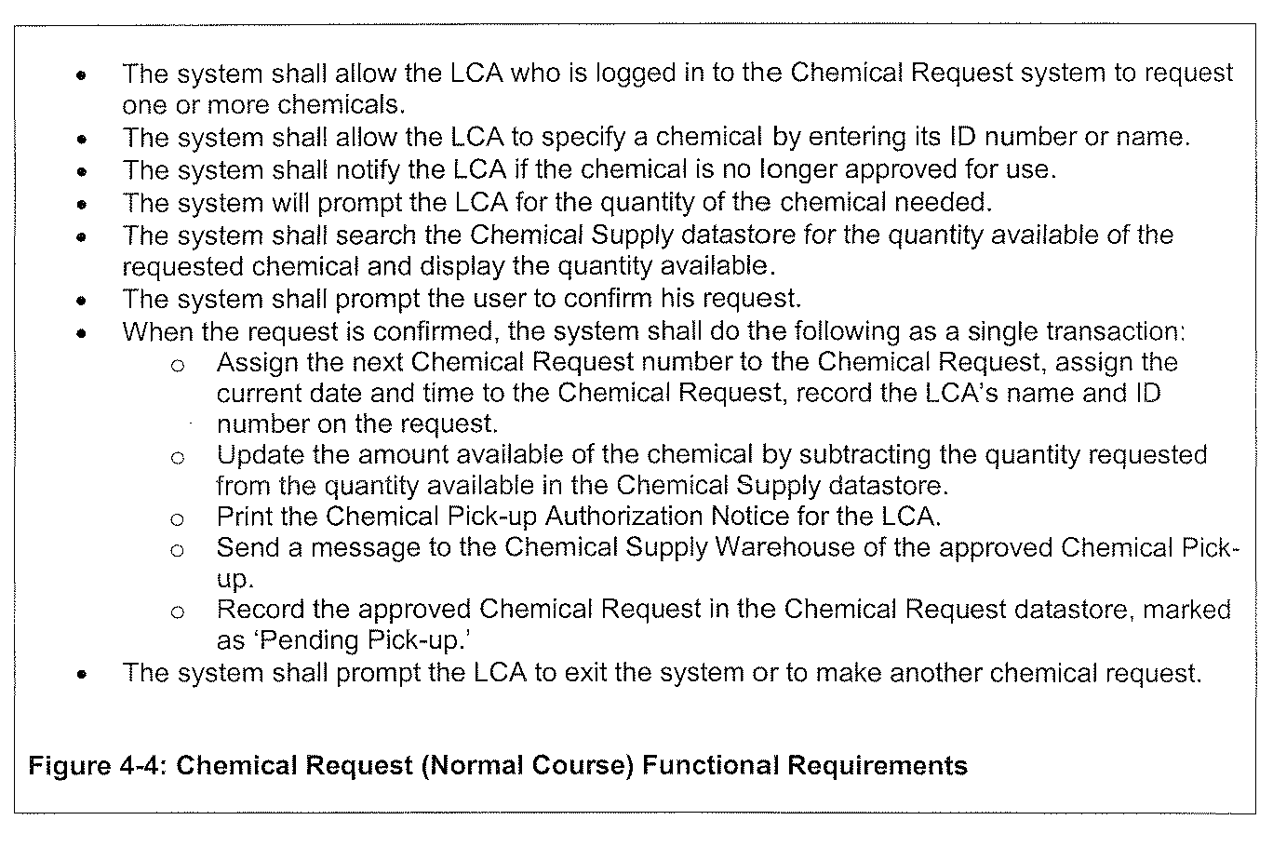
Example

Slide 33
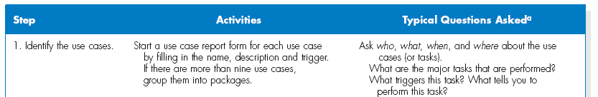
Use Cases and Testing
Building Use Cases
Step 1: Identify the major use cases

Slide 34
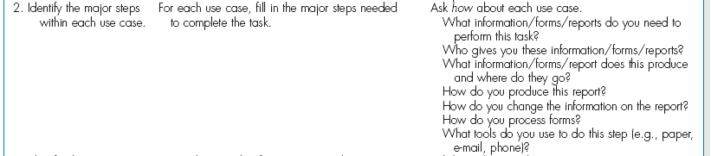
Step 2: Identify the major steps for each use case

Slide 35
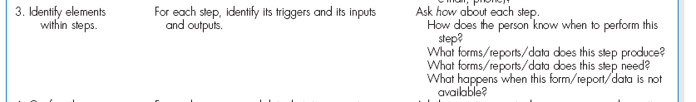
Step 3: Identify elements within steps

Slide 36
Step 4. Confirm the use case

Slide 37
Revise functional requirements based on use cases
The functional requirements in the requirements definition may be modified to reflect the more detailed understanding and to provide insight to the development team on some “back-end” processing.

Slide 38
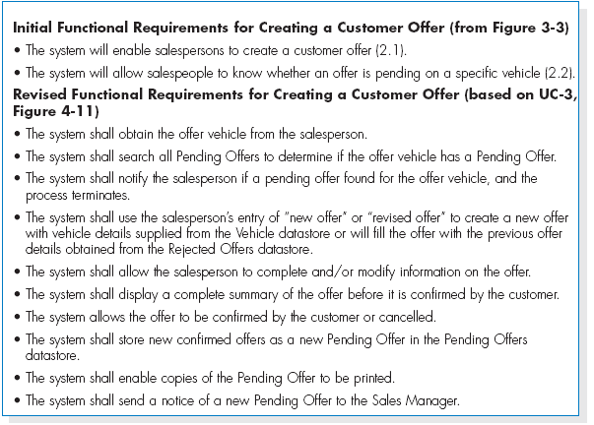
Example

Slide 39
SUMMARY
A use case contains all the information needed to build one part of a process model, expressed in an informal, simple way.
When writing a use case,
- identify the triggering event,
- develop a list of the major steps,
- identify the input(s) and output(s) for every step,
- have the users role-play the use case to verify.

