Slide 1
ITEC 102 INTRODUCTION TO INFORMATION SYSTEMS
DANIEL OBUOBI, DCSIT, CU
TYPES OF INFORMATION SYSTEMS

Slide 2
LECTURE 5 Types of information systems & their relationship

Slide 3
Major Types of Systems in Organizations
Because there are different interests, specialties, and levels in an organization, there are different kinds of systems.
No single system can provide all the information an organization needs.
The organization is divided into
strategic,
management, and
operational levels.

Slide 4
FUNCTIONAL AREAS
4
It is further divided into functional areas, such as
sales and marketing,
manufacturing and production,
finance and accounting, and
human resources.
Information systems serve each of these levels and functions.

Slide 5
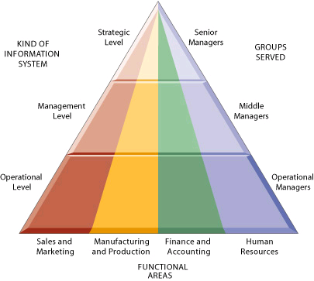
Types of information systems

Slide 6
Different Kinds of Systems
Three main categories of information systems serve different organizational levels:
operational-level systems,
management-level systems,
and strategic-level systems.

Slide 7
Operational level Systems
Operational-level systems support operational managers by keeping track of the elementary activities and transactions of the organization, such as
sales,
receipts,
cash deposits,
payroll,
credit decisions etc.
7

Slide 8
Management-level Systems
Management-level systems serve the monitoring, controlling, decision-making, and administrative activities of middle managers.
Management-level systems typically provide periodic reports rather than instant information on operations.

Slide 9
Strategic-level Systems
9
Strategic-level systems help senior management tackle and address strategic issues and long-term trends, both in the firm and in the external environment.

Slide 10
Four Major Types of Systems
The 4 major types of systems are
executive support systems (ESS)
management information systems (MIS)
decision-support systems (DSS) and
transaction processing systems (TPS)
Others are
Office automation systems
Knowledge work systems

Slide 11
Major Types of Systems + level
The 4 major types of systems serve different levels
ESS ➔ at the strategic level;
MIS and DSS ➔ at the management level;
TPS ➔ at the operational level.
11

Slide 12
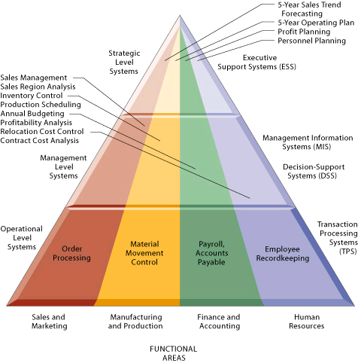
The four major types of information systems

Slide 13
Transaction Processing Systems
TPS are the basic business systems that serve the operational level of the firm.
It is a computerized system that
performs and records the daily routine transactions necessary to conduct business.
Examples are
sales order entry, hotel reservation systems, payroll, employee record keeping, and shipping.

Slide 14
Transaction Processing Systems
TPS are often so central to a business that TPS failure for a few hours can lead to a firm’s demise and perhaps that of other firms linked to it.
Managers need TPS to monitor the status of internal operations and the firm’s relations with the external environment.
TPS are also major producers of information for the other types of systems.

Slide 15
Management Information Systems
MIS is the study of information systems in business and management.
MIS serve the management level of the organization,
MIS provides managers with reports and often online access to the organization’s current performance and historical records.

Slide 16
Management Information Systems
MIS primarily serve the functions of planning, controlling, and decision making
MIS depend on underlying TPS for data.
MIS usually serve managers primarily interested in weekly, monthly, and yearly
MIS use simple routines such as summaries and comparisons, as opposed to sophisticated mathematical models or statistical techniques.

Slide 17
Decision-Support Systems
DSS also serve the management level of the organization.
DSS help managers make decisions that are unique, rapidly changing, and not easily specified in advance.
DSS use internal information from TPS and MIS, also they often bring in information from external sources, such as current stock prices or product prices of competitors.

Slide 18
Executive Support Systems
Senior managers use ESS to help them make decisions.
ESS serves the strategic level of the organization.
They address non-routine decisions requiring
judgment, evaluation, and insight because there is no agreed-on procedure for arriving at a solution.

Slide 19
Executive Support Systems
ESS are not designed primarily to solve specific problems.
Instead, ESS provides a generalized computing and communications capacity that can be applied to a changing array of problems.

Slide 20
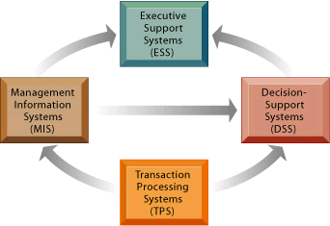
Relationship of Systems to One Another

Slide 21
Relationship of Systems to One Another
The various types of systems in the organization have interdependencies.
TPS are major producers of information that is required by the other systems.
These different types of systems have been loosely coupled in most organizations.

Slide 22
Information System and Application to Business Process

Slide 23
Sales and Marketing Systems
The sales and marketing function is responsible for selling the organization’s products or services.
At the strategic level, sales and marketing systems monitor trends affecting new products and sales opportunities,
It also support planning for new products and services, and monitor the performance of competitors.

Slide 24
Sales and Marketing Systems
At the management level, sales and marketing systems support market research, advertising and promotional campaigns, and pricing decisions.
At the operational level, sales and marketing systems assist in locating and contacting prospective customers, tracking sales, processing orders, and providing customer service support.

Slide 25
Manufacturing and Production Systems
The manufacturing and production function is responsible for actually producing the firm’s goods and services.
At strategic-level manufacturing systems deal with the firm’s long-term manufacturing goals.
At the management level, manufacturing and production systems analyze and monitor manufacturing and production costs and resources.

Slide 26
Manufacturing and Production Systems
At the operational manufacturing and production systems deal with the status of production tasks.
Most manufacturing and production systems use some sort of inventory system.
The system produces reports that give information about such things as the number of each item available in inventory, etc.

Slide 27
Product Life-cycle Management
Product life cycle management (PLM) systems are one type of manufacturing and production system.
PLM systems are based on a data repository that organizes every piece of information that goes into making a particular product, such as:
formula cards,
packaging information,
shipping specifications, and patent data.

Slide 28
Finance and Accounting Systems
The finance function is responsible for managing the firm’s financial assets, such as:
cash, stocks, bonds, and other investments, to maximize the return on these financial assets.
The finance function is also in charge of managing the capitalization of the firm.
The accounting function is responsible for maintaining and managing the firm’s financial records such as
receipts, disbursements, depreciation, payroll—to account for the flow of funds in a firm

Slide 29
Finance and Accounting Systems
At the Strategic-level systems for the finance and accounting function establish long-term investment goals for the firm and provide long-range forecasts of the firm’s financial performance.
At the management level, information systems help managers oversee and control the firm’s financial resources.

Slide 30
Finance and Accounting Systems
At the Operational level systems in finance and accounting track the flow of funds in the firm through transactions such as pay-checks, payments to vendors, securities reports, and receipts.

Slide 31
Human Resources Systems
The human resources function is responsible for attracting, developing, and maintaining the firm’s workforce.
Human resources information systems support activities, such as:
Identifying potential employees,
maintaining complete records on existing employees,
And creating programs to develop employees’ talents and skills.

Slide 32
Business Processes and Information Systems
Business processes refer to sets of logically related activities for accomplishing a specific business result.
Business processes also refer to the unique ways in which organizations and management coordinate these activities.
Some business processes support the major functional areas of the firm, others are cross-functional.

Slide 33
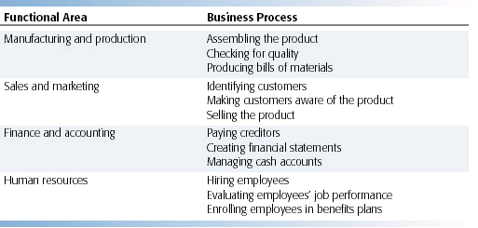
Examples of Functional Business Processes

Slide 34
Overview of Enterprise Systems
A large organization typically has many different kinds of information systems that support different functions, organizational levels, and business processes.
Managers might have a hard time assembling the data they need for a comprehensive, overall picture of the organization’s operations.
Enterprise systems, also known as enterprise resource planning (ERP) systems solve this problem by providing a single information system for organization-wide coordination and integration of key business processes.

Slide 35
Overview of Enterprise Systems
Enterprise systems integrate the key business processes of an entire firm into a single software system that enables information to flow seamlessly throughout the organization.

Slide 36
NOW

