Slide 1
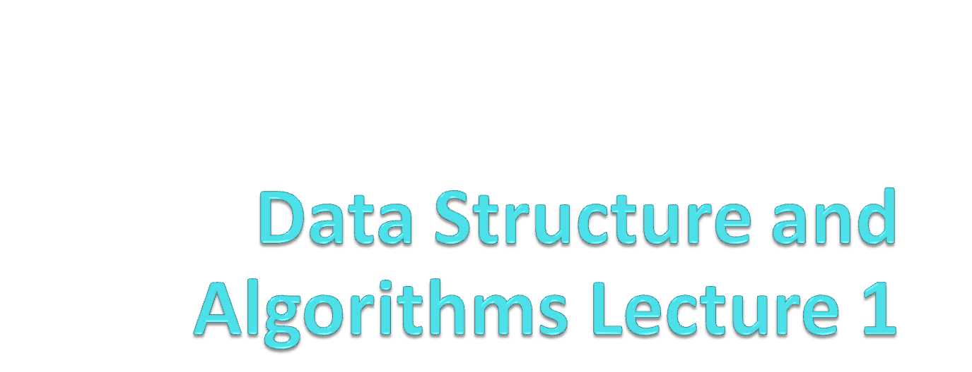
Lecture 1

Slide 2
Course Information
Textbooks
  Introduction to Data Structures in C
  by Ashok N. Kamthane
  Data Structures and Algorithms
  by A. V. Aho, J. E. Hopcroft, J. D. Ullman
  Data Structures Using C and C++
  by Y. Langsam, M. J. Augenstein, A. M. Tenenbaum
  Algorithms in C++
  by Robert Sedgewick

Slide 3
Course Outline
Introduction to Data Structure
Algorithms
Recursion
Stacks
Queues
Lists and linked lists
Trees
Sorting
Searching
Graphs
Hashing

Slide 4
Grading
Theory
  Quizzes ---------------10%
  Assignments---------10%
  Mid Term-------------- 30%
  Final-------------------- 50%
Labs
  Assignments/Exercises and Project------ 50%
  Mid term------------------------------ 20%
  Final----------------------------------- 30%

Slide 5
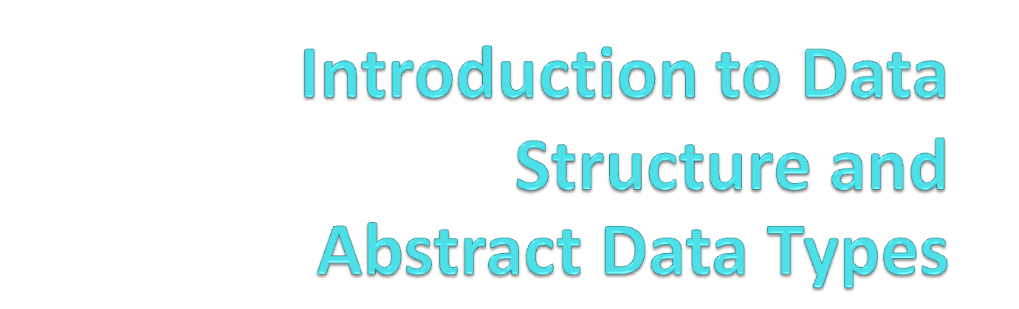

Slide 6
What is Data Structure?
Data structure is a representation of data and the operations allowed on that data.
  A data structure is a way to store and organize data in order to facilitate the access and modifications.
  Data Structure are the method of representing of logical relationships between individual data elements related to the solution of a given problem.

Slide 7
Basic Data Structure
Basic Data Structures
Linear Data Structures
Non-Linear Data Structures
Arrays
Linked Lists
Stacks
Queues
Trees
Graphs
Hash Tables

Slide 8
array
Linked list
queue
tree
stack

Slide 9
Selection of Data Structure
The choice of particular data model depends on two consideration:
  It must be rich enough in structure to represent the relationship between data elements
  The structure should be simple enough that one can effectively process the data when necessary

Slide 10
Types of Data Structure
Linear: In Linear data structure, values are arrange in linear fashion.
  Array: Fixed-size
  Linked-list: Variable-size
  Stack: Add to top and remove from top
  Queue: Add to back and remove from front
  Priority queue: Add anywhere, remove the highest priority

Slide 11
Types of Data Structure
Non-Linear: The data values in this structure are not arranged in order.
  Hash tables: Unordered lists which use a ‘hash function’ to insert and search
  Tree: Data is organized in branches.
  Graph: A more general branching structure, with less strict connection conditions than for a tree

Slide 12
Type of Data Structures
Homogenous: In this type of data structures, values of the same types of data are stored.
  Array
Non-Homogenous: In this type of data structures, data values of different types are grouped and stored.
  Structures
  Classes

Slide 13
Abstract Data Type and Data Structure
Definition:-
  Abstract Data Types (ADTs) stores data and allow various operations on the data to access and change it.
  A mathematical model, together with various operations defined on the model
  An ADT is a collection of data and associated operations for manipulating that data
Data Structures
  Physical implementation of an ADT
  data structures used in implementations are provided in a language (primitive or built-in) or are built from the language constructs (user-defined)
  Each operation associated with the ADT is implemented by one or more subroutines in the implementation

Slide 14
Abstract Data Type
ADTs support abstraction, encapsulation, and information hiding.
Abstraction is the structuring of a problem into well-defined entities by defining their data and operations.
The principle of hiding the used data structure and to only provide a well-defined interface is known as encapsulation.

Slide 15
The Core Operations of ADT
Every Collection ADT should provide a way to:
  add an item
  remove an item
  find, retrieve, or access an item
Many, many more possibilities
  is the collection empty
  make the collection empty
  give me a sub set of the collection

Slide 16
  No single data structure works well for all purposes, and so it is important to know the strengths and limitations of several of them

Slide 17
Stacks
Collection with access only to the last element inserted
Last in first out
insert/push
remove/pop
top
make empty
Data4
Top
Data3
Data2
Data1

Slide 18
Queues
Collection with access only to the item that has been present the longest
Last in last out or first in first out
enqueue, dequeue, front
priority queues and dequeue
Front
Back
Data1
Data2
Data3
Data4

Slide 19
List
A Flexible structure, because can grow and shrink on demand.
Elements can be:
Inserted
Accessed
Deleted
At any position
last
first

Slide 20
Tree
A Tree is a collection of elements called nodes.
One of the node is distinguished as a root, along with a relation (“parenthood”) that places a hierarchical structure on the nodes.
Root

