Slide 1
Systems Analysis and Design 9th Edition
Chapter 11
Managing Systems Implementation

Slide 2
Phase Description
Systems Implementation is the fourth of five phases in the systems development life cycle
Includes application development, documentation, testing, training, data conversion, and system changeover
The deliverable for this phase is a completely functioning information system

Slide 3
Chapter Objectives
Explain the importance of software quality assurance and software engineering
Describe the application development process for structured, object-oriented, and agile methods
Draw a structure chart showing top-down design, modular design, cohesion, and coupling

Slide 4
Chapter Objectives
Explain the coding process
Explain unit, integration, and system testing
Differentiate between program, system, operations, and user documentation
List the main steps in system installation and evaluation

Slide 5
Chapter Objectives
Develop training plans for various user groups, compare in-house and outside training, and describe effective training techniques
Describe data conversion and changeover methods
Explain post-implementation evaluation and the final report to management

Slide 6
Introduction
The system design specification serves as a blueprint for constructing the new system
The initial task is application development
Before a changeover can occur, the system must be tested and documented carefully, users must be trained, and existing data must be converted
A formal evaluation of the results takes place as part of a final report to management

Slide 7
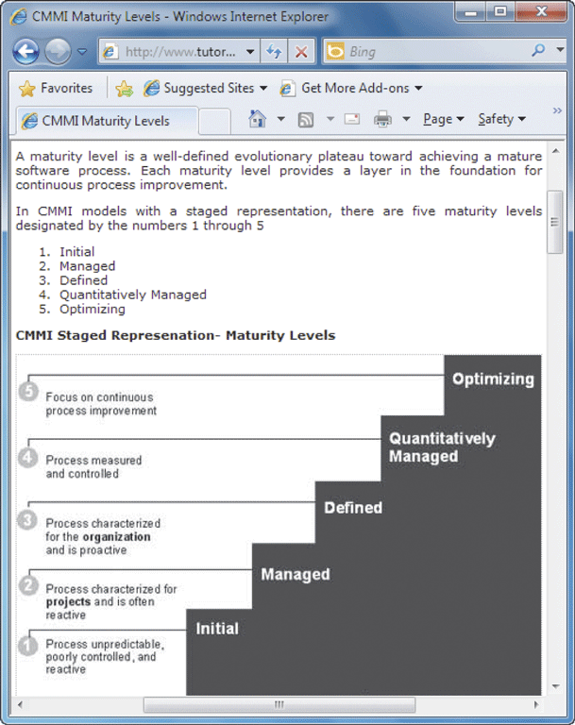
Software Quality Assurance
Software Engineering
Capability Maturity Model (CMM)
Capability Maturity Model Integration (CMMI)
Process improvement
CMMI tracks an organization's processes, using five maturity layers

Slide 8
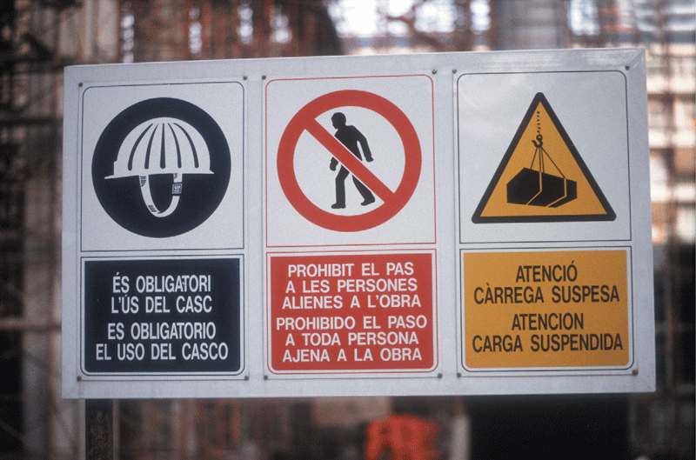
Software Quality Assurance
International Organization for Standardization (ISO)
Many firms seek assurance that software systems will meet rigid quality standards
ISO 90003:2004
ISO requires a specific development plan

Slide 9
Overview of Application Development
Application development
Objective is to translate the design into program and code modules that will function properly
Review the System Design
Tasks produced an overall design and a plan for physical implementation

Slide 10
Overview of Application Development
Application Development Tasks
Traditional methods
Start by reviewing documentation from prior SDLC phases and creating a set of program designs
At this point, coding and testing tasks begin
Agile Methods
Intense communication and collaboration will now begin between the IT team and the users or customers
Objective is to create the system through an iterative process

Slide 11
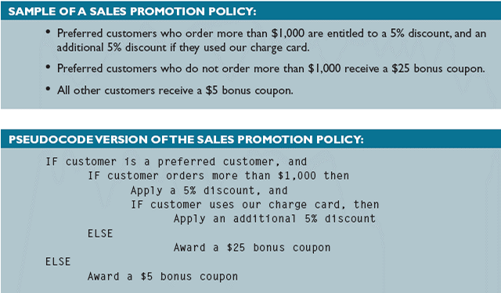
Overview of Application Development
System Development Tools
Entity-relationship diagrams
Flowcharts
Pseudocode
Decision tables and decision trees

Slide 12
Overview of Application Development
Project Management
Even a modest-sized project might have hundreds or even thousands of modules
Important to set realistic schedules, meet project deadlines, control costs, and maintain quality
Should use project management tools and techniques

Slide 13
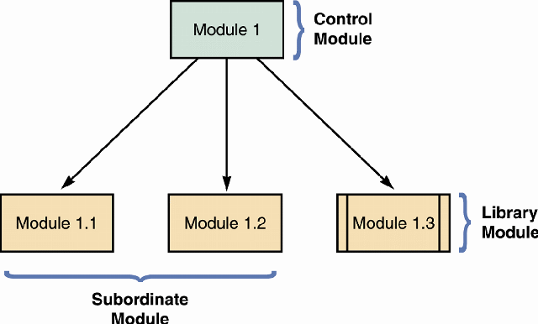
Structured Application Development
Structure Charts
Control module
Subordinate modules
Module
Data Couple
Control Couple
Condition
Loop

Slide 14
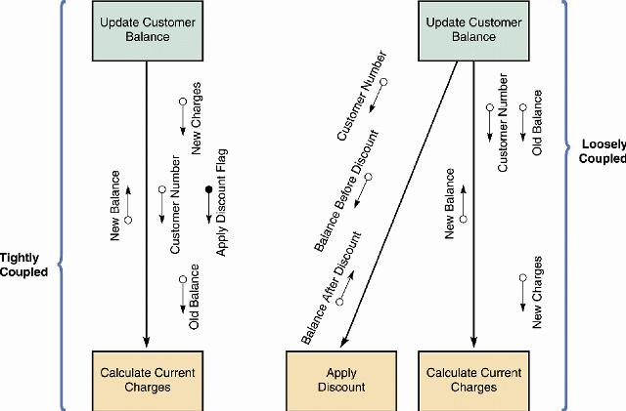
Structured Application Development
Cohesion and Coupling
If you need to make a module more cohesive, you can split it into separate units, each with a single function
Loosely coupled
Tightly coupled

Slide 15
Structured Application Development
Drawing a Structure Chart
Step 1: Review the DFDs
Review all DFDs for accuracy and completeness
Step 2: Identify Modules and Relationships
Transform functional primitives or object methods into program modules
Three-level structure charts relate to the three DFD levels

Slide 16
Structured Application Development
Steps in Drawing a Structure Chart
Step 3: Add Couples, Loops, and Conditions
Identify the data elements that pass from one module to another
Step 4: Analyze the Structure Chart and the Data Dictionary
Ensure that the chart reflects all previous documentation and that the logic is correct

Slide 17
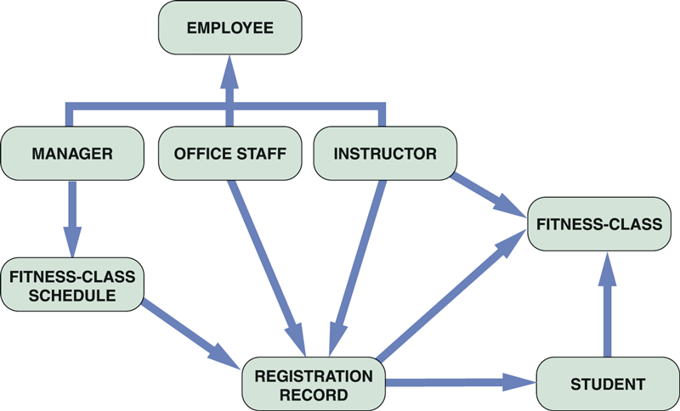
Object-Oriented Application Development
Object-oriented development (OOD)
Characteristics of Object-Oriented Application Development
The application's structure is represented by the object model itself

Slide 18
Object-Oriented Application Development
Implementation of Object-Oriented Designs
Main objective is to translate object methods into program code modules and determine what event or message will trigger the execution of each module
Object-Oriented Cohesion and Coupling
Classes – loosely coupled
Methods – loosely coupled and highly cohesive

Slide 19
Agile Application Development
Is a distinctly different systems development method
Development team is in constant communication with the customer
Focuses on small teams, intense communication, and rapid development iterations
Extreme Programming (XP) is one of the newest agile methods

Slide 20
Agile Application Development
An extreme programming (XP) Example
User story
Release plan
Iteration cycle
Iteration planning meeting
Parallel programming
Test-driven design

Slide 21
Agile Application Development
The Future of Agile Development
Critics claim it lacks discipline and produces systems of questionable quality
Before implementing agile development, the proposed system and development methods should be examined carefully
A one-size-fits-all solution does not exist

Slide 22
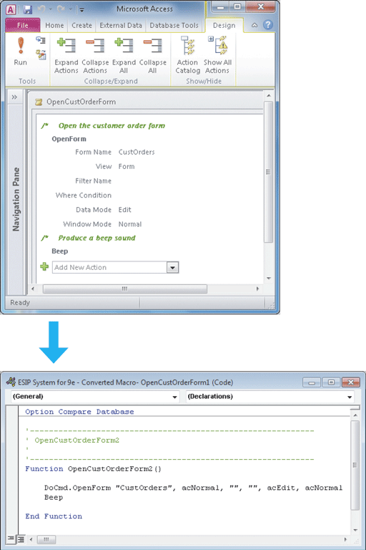
Coding
Coding
Programming Environments
Integrated development environment (IDE)
Generating Code
Can generate editable program code directly from macros, keystrokes, or mouse actions

Slide 23
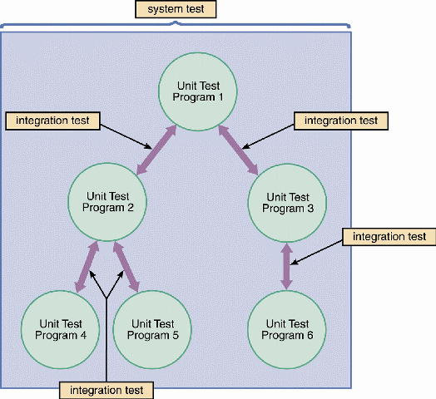
Testing the System
Unit Testing
Integration Testing
System Testing
You should regard thorough testing as a cost-effective means of providing a quality product

Slide 24
Documentation
Program Documentation
System Documentation
Operations Documentation
User Documentation
Systems analysts usually are responsible for preparing documentation to help users learn the system

Slide 25
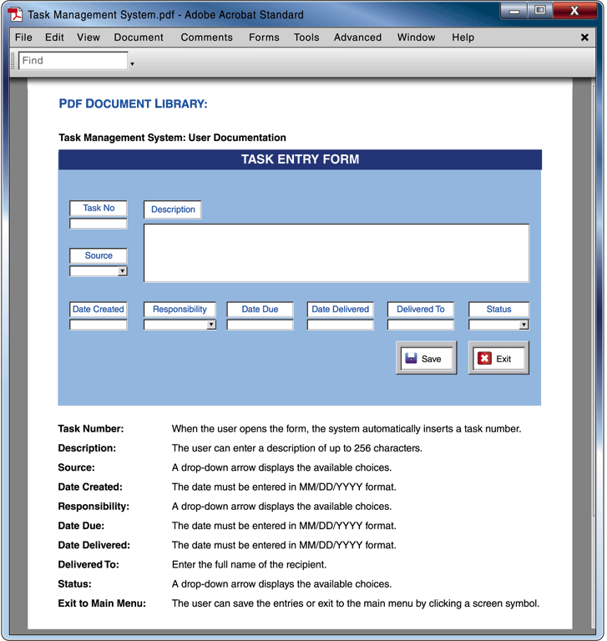
Documentation
User Documentation
Effective online documentation is an important productivity tool
Written documentation material also is valuable

Slide 26
Management Approval
After system testing is complete, you present the results to management
If system testing produced no technical, economical, or operational problems, management determines a schedule for system installation and evaluation

Slide 27
System Installation and Evaluation
Remaining steps in systems implementation:
Prepare a separate operational and test environment
Provide training for users, managers, and IT staff
Perform data conversion and system changeover
Carry out post-implementation evaluation of the system
Present a final report to management

Slide 28
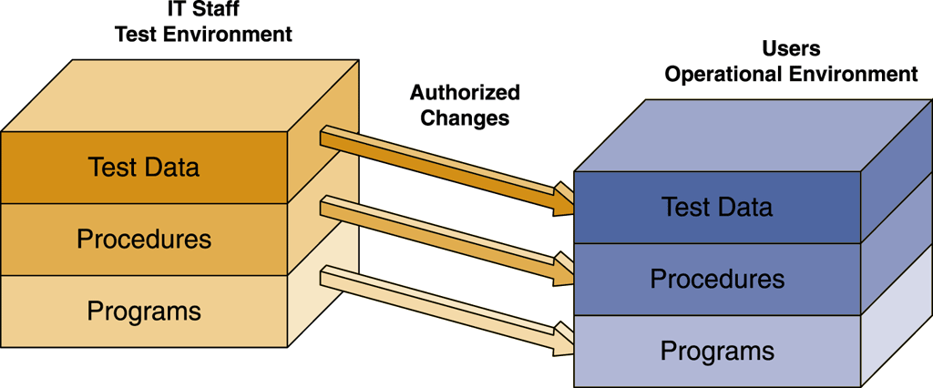
Operational and Test Environments

Slide 29
Operational and Test Environments
The operational environment includes hardware and software configurations and settings, system utilities, telecommunications resources, and any other components that might affect system performance
If you have to build or upgrade network resources to support the new system, you must test the platform rigorously before system installation begins

Slide 30
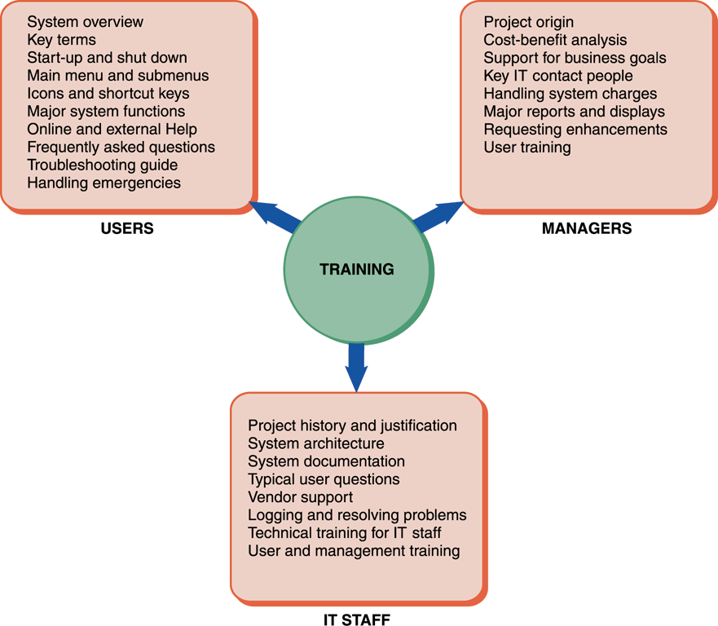
Training
Training Plan
The three main groups for training are users, managers, and IT staff
You must determine how the company will provide training
Vendor Training
Often gives the best return on your training dollars

Slide 31
Training
Vendor Training
If the system includes the purchase of software or hardware, then vendor-supplied training is one of the features you should investigate in the RFPs (requests for proposal) and RFQs (requests for quotation) that you send to potential vendors
Often gives the best return on your training dollars

Slide 32
Training
Webinars, Podcasts, and Tutorials
Webcast
Subscribers
As technology continues to advance, other wireless devices such as PDAs and cell phones will be able to receive podcasts
Tutorials can be developed by software vendors, or by a company’s IT team

Slide 33
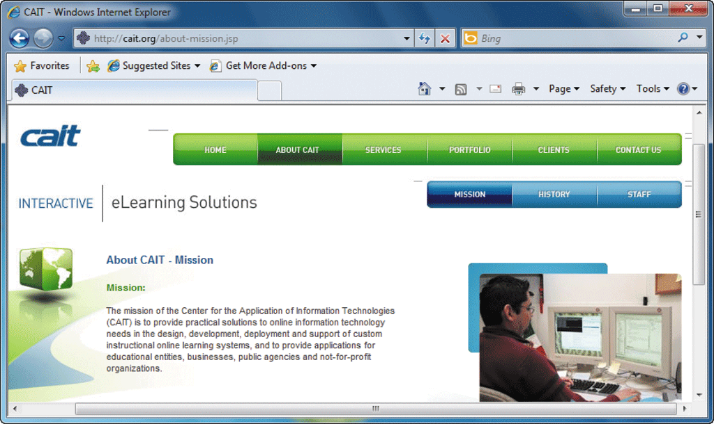
Training
Outside Training Resources
Many training consultants, institutes, and firms are available that provide either standardized or customized training packages

Slide 34
Training
Training Tips
Train people in groups, with separate training programs for distinct groups
Select the most effective place to conduct the training
Provide for learning by hearing, seeing, and doing
Prepare effective training materials, including interactive tutorials
Rely on previous trainees

Slide 35
Training
Interactive Training
Usually, a relationship exists between training methods and costs
Online training
Should include step-by-step instructions
Video tutorials
You don’t have to be a professional video developer to create effective training tutorials

Slide 36
Data Conversion
Data Conversion Strategies
The old system might be capable of exporting data in an acceptable format for the new system or in a standard format such as ASCII or ODBC
If a standard format is not available, you must develop a program to extract the data and convert it
Often requires additional data items, which might require manual entry

Slide 37
Data Conversion
Data Conversion Security and Controls
You must ensure that all system control measures are in place and operational to protect data from unauthorized access and to help prevent erroneous input
Some errors will occur
It is essential that the new system be loaded with accurate, error-free data

Slide 38
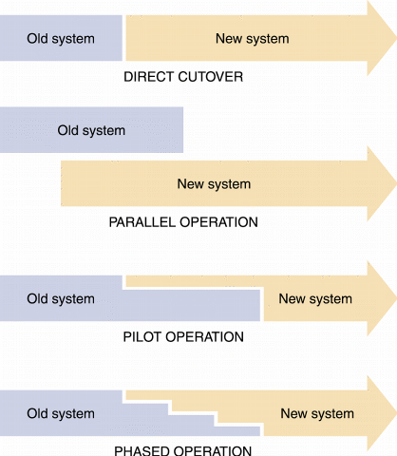
System Changeover

Slide 39
System Changeover
Direct Cutover
Involves more risk than other changeover methods
Companies often choose the direct cutover method for implementing commercial software packages
Cyclical information systems usually are converted using the direct cutover method at the beginning of a quarter, calendar year, or fiscal year

Slide 40
System Changeover
Parallel Operation
Easier to verify that the new system is working properly under parallel operation than under direct cutover
Running both systems might place a burden on the operating environment and cause processing delay
Is not practical if the old and new systems are incompatible technically
Also is inappropriate when the two systems perform different functions

Slide 41
System Changeover
Pilot Operation
The group that uses the new system first is called the pilot site
The old system continues to operate for the entire organization
After the system proves successful at the pilot site, it is implemented in the rest of the organization, usually using the direct cutover method
Is a combination of parallel operation and direct cutover methods

Slide 42
System Changeover
Phased Operation
You give a part of the system to all users
The risk of errors or failures is limited to the implemented module only
Is less expensive than full parallel operation
Is not possible, however, if the system cannot be separated easily into logical modules or segments

Slide 43
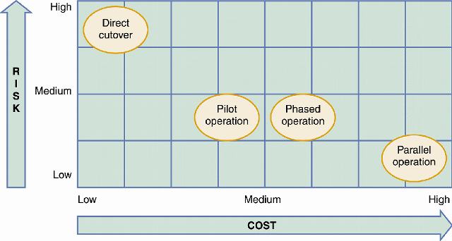
System Changeover

Slide 44
Post-Implementation Tasks
Post-Implementation Evaluation
A post-implementation evaluation should examine all aspects of the development effort and the end product — the developed information system
You can apply the same fact-finding techniques in a post-implementation evaluation that you used to determine the system requirements during the systems analysis phase

Slide 45
Post-Implementation Tasks
Final Report to Management
Your report should include the following:
Final versions of all system documentation
Planned modifications and enhancements to the system that have been identified
Recap of all systems development costs and schedules

Slide 46
Post-Implementation Tasks
Final Report to Management
Your report should include the following:
Comparison of actual costs and schedules to the original estimates
Post-implementation evaluation, if it has been performed
Marks the end of systems development work

Slide 47
Chapter Summary
The systems implementation phase consists of application development, testing, installation, and evaluation of the new system
Analysts and technical writers also prepare operations documentation and user documentation
Develop a training program
A post-implementation evaluation assesses and reports on the quality of the new system and the work done by the project team

Slide 48
Chapter Summary
The final report to management includes the final system documentation, describes any future system enhancements that already have been identified, and details the project costs
The report represents the end of the development effort and the beginning of the new system’s operational life
Chapter 11 complete

