Slide 1
Requirement Structuring
Use Case Modelling
Use case modeling helps analysts analyze the functional requirements of a system.
It also helps developers understand the functional requirements of the system without worrying about how those requirements will be implemented
What is a Use Case
A use case shows the behavior or functionality of a system. It is a descriptuin of how a system intereacts wit its environment by illustrating the activities that are performed by the users of the system and the system responses.
Essentially
A use case is what a user does(actions of the user) with the system and what the system does in return.
Goal of a Use Case
Create a set of use cases that describes all the task that users need to perform while using the system

Slide 2
Role of Use Cases
Use Cases expresses and clarify user requirement: i.e,: it defines the expected interaction between user and the system with focus on the user.
Useful tools to clarify user requirements
Conveys the user's point of view
Two types of uses case
Graphical –based uses cases
Text –based uses cases
Use cases describe how an external event triggers some response from the system
E.g,
select courses to register
drops courses
Enter sales data
Compute commission
Generate report
Notes:
NB: Uses cases are event driven

Slide 3
Creating Use Case-
Identify the major steps and its exceptions
Identify elements with each major step
Confirm use case with users

Slide 4
Tips for Creating Use Cases
Use Cases are stated as present tense verb phrase
Examples:
Register a course
Order food
Start attempt
Tips
Create use cases only when there is the need to clarify what the system must do from the users perspective.
Use gradual refinement
Concentrate on describing the user’s objective with the system completely
Keep both audiences in mind
Notes:
Use cases describe how an external event triggers some response from the system
E.g, Student Registration
select courses to register
drops courses
Enter sales data
Compute commission
Generate report

Slide 5
Definitions and Symbols
The use case diagram is a picture that shows system behavior, along with the key actors that interact with the system.
Actors: An external entity that interacts with a system. Actors are represented by stick figures.
NB: an actor is a role, not an individual. Individuals are instances of actors. One individual may play many roles simultaneously. An actor is involved with the functioning of a system at some basic level.
Use case. Each use case is represented as an ellipse. Each use case represents a single system function. The name of the use case can be listed inside the ellipse or just below it.
• System boundary. The system boundary is represented as a box that includes all the relevant use cases. Note that actors are outside the system boundary
Connections. The actors are connected to use cases with lines, and that use cases are connected to each other with arrows.
A solid line connecting an actor to a use case shows that the actor is involved in that system function. The solid line does not mean that the actor is sending data to or receiving data from the use case
Note that all of the actors in a use case diagram are not involved in all the use cases in the system

Slide 6
Extend relationship. An extend relationship extends a use case by adding new behaviors or actions. It is shown as a dotted-line arrow pointing toward the use case that has been extended and labeled with the <<extend>> symbol.
Notes: Using the diagram
Typically, a use case is initiated by an actor. For example, Bill Student is initiated by the Finance Office.
A use case can interact with actors other than the one that initiated it.
The Bill Student use case, although initiated by the Bursar’s Office, interacts with the Students by mailing them tuition invoices
Another use case, Register for Classes, is carried out by two actors, Student and Registration officers
A use case represents complete functionality. You should not represent an individual action that is part of an overall function as a use case.

Slide 7
Include relationship. Another kind of relationship between use cases is an include relationship, which arises when one use case uses another use case. An include relationship is shown diagrammatically as a dotted-line arrow pointed toward the use case that is being used. The line is labeled with the <<include>> symbol.
Notes:
Include relationship
An association between two use cases where one use case uses the functionality contained in the other.

Slide 10
Structured Analysis
Analysts use various tools to understand and describe the information system.
One of the ways is using structured analysis.

Slide 11
What is Structured Analysis?
Structured Analysis is a development method that allows the analyst to understand the system and its activities in a logical way.
It is a systematic approach, which uses graphical tools that analyze and refine the objectives of an existing system and develop a new system specification which can be easily understandable by user

Slide 12
It has following attributes:
It is graphic which specifies the presentation of application.
It divides the processes so that it gives a clear picture of system flow.
It is logical rather than physical i.e., the elements of system do not depend on vendor or hardware.
It is an approach that works from high-level overviews to lower-level details.

Slide 13
Structured Analysis Tools
During Structured Analysis, various tools and techniques are used for system development.
They are:
Data Flow Diagrams
Data Dictionary
Decision Trees
Decision Tables
Structured English
Pseudocode

Slide 14
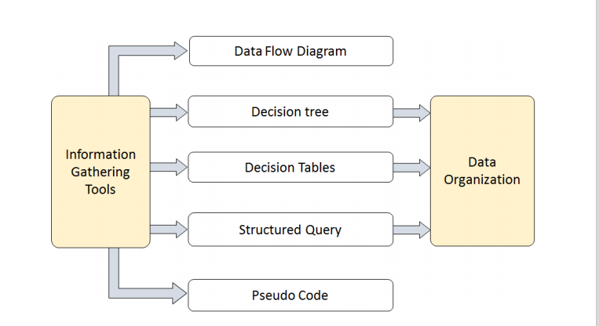

Slide 15
Data Flow Diagrams(DFD) or Bubble Chart
It is a technique developed by Larry Constantine to express the requirements of system in a graphical form.
It shows the flow of data between various functions of system and specifies how the current system is implemented.
- It is an initial stage of design phase that functionally divides the requirement specifications down to the lowest level of detail.

Slide 16
DFD
Its graphical nature makes it a good communication tool between user and analyst or analyst and system designer.
It gives an overview of what data a system processes, what transformations are performed, what data are stored, what results are produced and where they flow.

Slide 17
Basic Elements of DFD
DFD is easy to understand and quite effective when the required design is not clear and the user wants a notational language for communication. However, it requires a large number of iterations for obtaining the most accurate and complete solution.

Slide 18
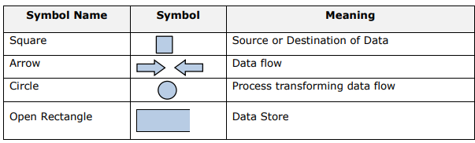

Slide 19
Types of DFD
DFDs are of two types: Physical DFD and Logical DFD.
The following table lists the points that differentiate a physical DFD from a logical DFD

Slide 20
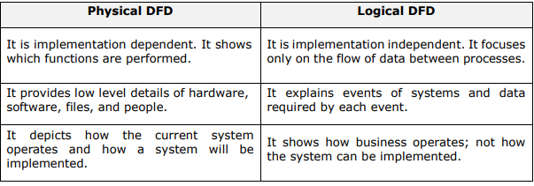

Slide 21
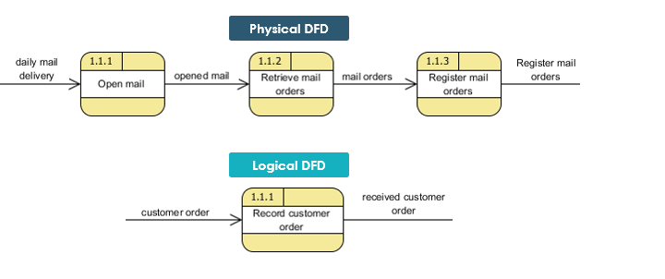
Physical and Logical DFD: Example
Physical DFD specifies actual flow of physical documentation, while logical DFD only focus on the information flow in business term

Slide 22
Context Diagram
A context diagram helps in understanding the entire system by one DFD which gives the overview of a system.
It starts with mentioning major processes with little details and then goes onto giving more details of the processes with the top-down approach. The context diagram of mess management is shown below.

Slide 23
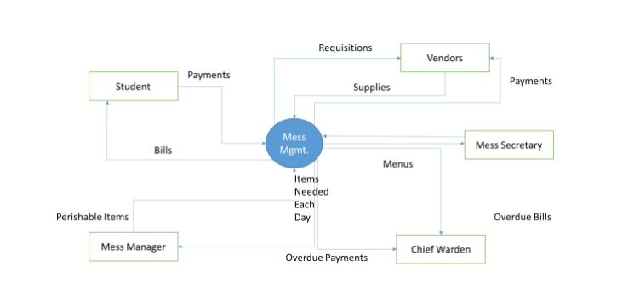

Slide 24
Data Dictionary
A data dictionary is a structured repository of data elements in the system. It stores the descriptions of all DFD data elements that is, details and definitions of data flows, data stores, data stored in data stores, and the processes.
A data dictionary improves the communication between the analyst and the user. It plays an important role in building a database.
Most DBMSs have a data dictionary as a standard feature.
For example, refer the following table:

Slide 25
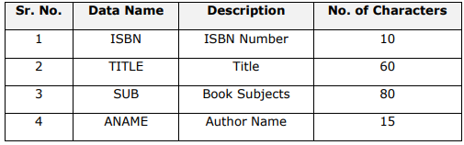

Slide 26
Decision Trees
Decision trees are a method for defining complex relationships by describing decisions and avoiding the problems in communication.
A decision tree is a diagram that shows alternative actions and conditions within horizontal tree framework.
Thus, it depicts which conditions to consider first, second, and so on

Slide 27
Decision trees depict the relationship of each condition and their permissible actions.
A square node indicates an action and a circle indicates a condition.
It forces analysts to consider the sequence of decisions and identifies the actual decision that must be made

Slide 28
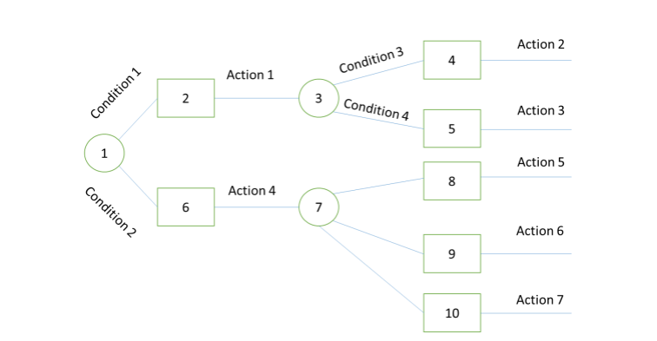

Slide 29
DECISION TREE – Generalized Structure
The major limitation of a decision tree is that it lacks information in its format to describe what other combinations of conditions you can take for testing.
It is a single representation of the relationships between conditions and actions. For example, refer the following decision tree:

Slide 30
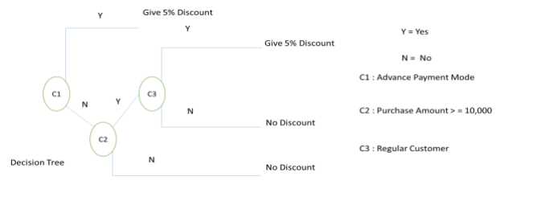

Slide 31
Decision Tables
Decision tables are a method of describing the complex logical relationship in a precise manner which is easily understandable.
It is useful in situations where the resulting actions depend on the occurrence of one or several combinations of independent conditions.
It is a matrix containing row or columns for defining a problem and the actions.

Slide 32
Components of a Decision Table
Condition Stub: It is in the upper left quadrant which lists all the condition to be checked.
Action stub: It is in the lower left quadrant which outlines all the action to be carried out to meet such condition.
Condition Entry: It is in upper right quadrant which provides answers to questions asked in condition stub quadrant.
Action Entry: It is in lower right quadrant which indicates the appropriate action resulting from the answers to the conditions in the condition entry quadrant.

Slide 33
The entries in decision table are given by Decision Rules which define the relationships between combinations of conditions and courses of action. In rules section,
Y shows the existence of a condition.
N represents the condition, which is not satisfied.
A blank - against action states it is to be ignored.
X (or a check mark will do) against action states it is to be carried out.

Slide 34
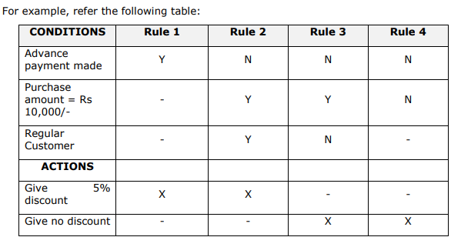

Slide 35
Structured English
Structure English is derived from structured programming language which gives more understandable and precise description of process.
It is based on procedural logic that uses construction and imperative sentences designed to perform operation for action.

Slide 36
It is best used when sequences and loops in a program must be considered and the problem needs sequences of actions with decisions.
It does not have strict syntax rule.
It expresses all logic in terms of sequential decision structures and iterations.

Slide 37
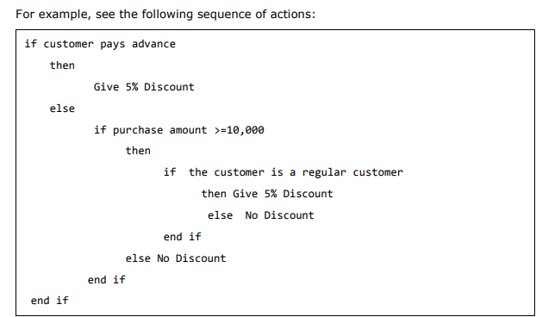

Slide 38
Pseudocode
Pseudocode is an informal way of programming description that does not require any strict programming language syntax or underlying technology considerations.
It is used for creating an outline or a rough draft of a program. Pseudocode summarizes a program’s flow, but excludes underlying details.
System designers write pseudocode to ensure that programmers understand a software project's requirements and align code accordingly.

Slide 39
Pseudocode
A pseudocode does not conform to any programming language and expresses logic in plain English.
It may specify the physical programming logic without actual coding during and after the physical design.
It is used in conjunction with structured programming.
It replaces the flowcharts of a program.

Slide 40
Guidelines for Selecting Appropriate Tools
Use the following guidelines for selecting the most appropriate tool that would suit your requirements:
Use DFD at high or low level analysis for providing good system documentations.
Use data dictionary to simplify the structure for meeting the data requirement of the system.

Slide 41
Use structured English if there are many loops and actions are complex.
Use decision tables when there are a large number of conditions to check, and logic is complex.
Use decision trees when sequencing of conditions is important and if there are few conditions to be tested.

