Slide 1

Unix Systems Administration and Security (Linux)
Week #3 – Networking
hardware, basic network
protocols

Slide 2
What is “Networking”?
The method of connecting multiple autonomous computers
Why?
  Share information
  Providing a “service” to other computers or the people using them
  Provide access to information in other locations
  Some clustering applications to increase computational power (Eg. Seti@home project)
The internet is the largest “network of networks”

Slide 3
What defines a network?
You need at least the following
  Two or more computers
  Some equipment to connect them together. Eg:
    Ethernet switch
    Ethernet cable
  Network protocol software on host. Eg
    TCP/IP, IPX, etc.
  Network application software. Eg.
    Apache, ssh, Web browser, etc.

Slide 4
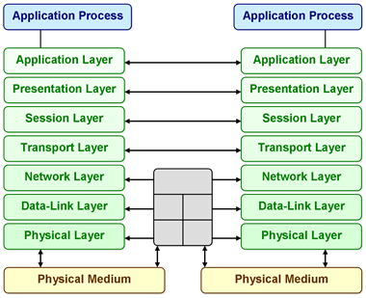
OSI Reference model

Slide 5
How does Linux fit in here?
Linux is just another computer in this network scheme
Linux can function as:
  Client – accesses data from servers
  Server – provides data to clients
  Router – connects small networks together to form larger networks
  Firewall – provides ability to filter network traffic

Slide 6
Networking Hardware
Ethernet is the most common component in current networks
  High speed (Currently up to 10 gigabits/second can be reached with correct hardware)
  Low cost (Once installed, no ongoing costs)
  Limited distance (100Mbit can only reach up to 75 meters)
  Commonly used for local networks
ATM, DSL and other WAN technologies
  Provide ability to link networks across longer distances
  Use higher level protocols like PPP, PPPoE, etc. to provide networking layer
  Generally slower than Ethernet
  Higher cost (using telecommunications company infrastructure)

Slide 7
Networking Hardware (2)
Satellite and Fibre links
  High speed
  Longer distance communication possible
  More commonly owned by telecommunications companies
  Technologies like these are primarily used for the backbone of the internet
Abilene network
  Part of Internet2 project
  Currently capable of speeds up to 10Gbit/s across long distance
  Currently only connecting a handful of American universities

Slide 8
IEEE 802.X standards
Apply to ethernet and ethernet based networking hardware
  802.3 defines the primary standard for ethernet packets
  802.11 defines wireless standards
  http://standards.ieee.org/getieee802/portfolio.html for more details
Provides data link and some of the network layer in the OSI reference model

Slide 9
RFC – Request for Comments
Documentation describing internet standards
Available from http://www.rfc.net/
Broken up into 4 parts:
  RFC’s – Request for Comments – Starting point for standards)
  STD’s – Standards – Technical specification. Can combine multiple RFC’s)
  BCP’s – Best Current Practice
  FYI’s – For Your Information
Beware RFC’s released on April 1st. They are generally humorous (Eg. RFC2324 - Hyper Text Coffee Pot Control Protocol)

Slide 10
Networking Protocols
A variety of protocols are/were available
They can generally co-exist on the same networking hardware
Examples:
  NetBEUI – Designed by IBM and Microsoft for Peer-to-peer networking (Not routable)
  IPX – Developed by Novell for older versions of Netware
  SNA – “Blue Glue” IBM protocol for linking mainframes, PC’s and terminals
  DECNet – Digital’s network protocol

Slide 11
Networking Protocols (2)
TCP/IP
  Evolved from protocols used in experimental ARPA/DARPA networks
  Originally composed of 100 protocols. Not all are used, however.
  Revision (IPv6) in progress, but is stalling
    Larger address range (128 bits vs 32 bits)
    Some provisions for security
    Advent of NAT has slowed demand for completion
Appletalk – Apple peer-to-peer protocol

Slide 12
IP
Internet Protocol
  Native protocol of the internet
  Defacto standard for most networks
  Native networking model on Unix, but also implemented on all other OS’es.
Advantages
  Easily routable
  Can shape network traffic
Disadvantages
  Quite complex

Slide 13
IP Sub-Protocols
IP is not a single protocol
  Many special purpose protocols
  STD’s exist to describe available sub protocols
Sub-Protocols include:
  IP – Low level packet protocols
  TCP – Connection based – “guaranteed” delivery
  UDP – connectionless – faster but delivery isn’t guaranteed
  ICMP – Control Messages. Flow control, etc.

Slide 14
TCP – Connection based protocol
Establishes a “path” between client and server
Guarantees that a given “stream” of data will arrive in order (assuming it arrives)
From RFC973, Transmission Control Protocol:
  Must recover from damaged, lost duplicated or out of order packets
  Uses sequence numbers
  Acknowledgement of arrival from receiving TCP layer

Slide 15
UDP – User Datagram Protocol
Does not guarantee delivery, order, etc.
Transaction oriented
  Client sends request packet to server
  Server sends response packet to client
  These packets are not necessarily related.
“Faster” than TCP
  Smaller overhead
  No sequence numbers
  No error checking or recovery

Slide 16
IP Addressing
All nodes in a network must have a unique IP address
  4 octets (8 bits) separated by periods
    “Dotted Quad” notation
    Decimal no’s are 0-255
    Each octet = 1 byte
  Theoretically 2³² available addresses.
    Actual number is significantly lower
    Network addresses
    Broadcast addresses
    Multicast addresses
  Example IP Address
    192.168.0.1

Slide 17
Reserved Addresses
Some addresses are reserved for special purposes
  “Private” networks
    10.0.0.0 – 10.255.255.255 (10.0.0.0/8)
    172.16.0.0 - 17.31.255.255 (172.16.0.0/12)
    192.168.0.0 – 192.168.255.255 (192.168.0.0/16)
  Loopback devices
    127.0.0.0 – 127.255.255.255 (127.0.0.0/8)
    127.0.0.1 is always a link to the local host
  Multicast
    224.0.0.0 – 239.255.255.255 (224.0.0.0/7)
    224.0.0.1 – All hosts on this subnet
    224.0.0.2 – All routers on this subnet

Slide 18
Binding an IP address
IP addresses are bound to network interfaces
  Linux supports binding multiple IP addresses to single network interface
  Also possible to bind a single IP address to multiple interfaces for redundancy purposes
Generally, most network interfaces will have a single IP address.

Slide 19

Using ifconfig
Setting up an interface:
  ifconfig int ip.ad.dr.es netmask ne.tm.as.k
  Ifconfig eth0 192.168.0.1 netmask 255.255.255.0
Enabling and disabling an interface:
  ifconfig eth0 up
  ifconfig eth0 down
Showing configuration:
  ifconfig int

Slide 20
Automatic configuration
Distributions have configuration information for interfaces and how they should be initialised
Could be simple and stored in a Bourne shell script (Eg. Slackware) or could be in a config file (Eg. RedHat, SuSE, etc.)
This information is used during the boot process to automatically initialise the interface
Also allows specifying gateways, etc.
Can also use DHCP for this task

Slide 21
Dynamic Host Control Protocol
(DHCP)
Used to automatically assign IP address information to an interface that asks for it.
Works by “loaning out” the IP address for a period of time
Simplifies configuration in large environments
Can set the following information:
  IP address
  Default router
  DNS information
  WINS information for windows hosts

Slide 22
DHCPCD – DHCP Client daemon
Unix service to manage DHCP information
Simplest usage:
  dhcpcd interface
    If no interface provided, assumes eth0
Stores local state information in /etc/dhcpcd
  Which interface(s)
  What is set
  Storage spot for scripts to run when the IP address changes

Slide 23
IP Aliasing
A Linux computer can have more than one IP address for a single interface. Eg.
  ifconfig eth0 192.168.11.1
  ifconfig eth0:0 192.168.11.2
Hardware bound to eth0 now responds to both IP addresses
Since the address is in each packet, it is easy to treat them separately.
  Eg. Apache can run multiple different websites based on IP address

Slide 24
Routing
Impractical to have all machines on one single network
  Load limits
  Even with switching, there are limits
  There is a theoretical limit on the number of machines on a network
Best practice is to split the network into “sub-nets” and route traffic between networks
  Requires a router
  Clients need to know where the router is

Slide 25
Routing – Static routes
Not the best solution – harder to change information around later
Most IP implementations include a method of route discovery (if routers are advertising)
Can be useful for a “default route”
  Packets go to the default router if there is no idea where to send them
  Set up default router:
    # route add –net 0.0.0.0/0 gw 192.168.0.254

Slide 26
Sub-Net Masking: An overview
Sub-net masks separate the machine address from the network address
If the network address is the same, then the machines are local
  No router required for communication
If the network is different, no direct communication possible
  Need one or more routers
Example sub-net mask:
  255.255.255.0 – Standard “Class C” subnet
  Aka. 192.168.0.12/24
More detail next lecture

Slide 27
“Ports” within TCP (and UDP)
A port in TCP and UDP protocols is similar to a plug/socket arrangement
A client process establishing an IP connection to a server will specify the IP address and the port number
The port number specifies which service is required
A port is required at both ends – so that the server can send responses back

Slide 28
“Ports” within TCP (and UDP)
Ports numbered between 0 and 65535
Ports cannot be shared between processes
A port below 1024 is “secure” – Root user must open these ports
Common internet services have associated ports
See /etc/services for the list of well known services
Also see STD2 for the official list

Slide 29
Hostnames
A hostname is a human representation of an IP address
There are multiple schemes for mapping hostnames to IP addresses:
  /etc/hosts
  DNS
  NIS, NIS+

Slide 30
The /etc/hosts file
Simple mapping between IP addresses and hostname
Flat text file with the following format:
  Ip-addr FQ-hostname alias1 alias2 …
For example:
  127.0.0.1 localhost
  192.168.1.2 smeg.company.com smeg
  192.168.1.3 lister.company.com www

Slide 31
DNS
Primary method of hostname resolution on the Internet
Uses a world-wide distributed database
Organisations are responsible for their own database
Uses TCP and UDP connections to a DNS server to resolve addresses
More detail on how this operates later

Slide 32
NIS, NIS+, etc.
NIS is a method of distributing common configuration items within a network
NIS in particular has a lot of security issues
Can distribute a hosts “file”, referred to as a “map” using the IP address as a key and the hostnames as values
Designed for other data as well (Eg. Passwd files, etc.)

Slide 33
Services: telnet
One of the default ways of connecting to a remote computer
telnet service provides a login prompt and requires login
Unencrypted, so passwords are transmitted in plain text
telnet client can set up a TCP connection to any port
  Useful for debugging TCP services

Slide 34
Useful debugging tools
Netstat
Ethereal, tcpdump, etc.
Ntop
Ngrep
Nc

Slide 35
Netstat – Network statistics
Network connections
Routing tables
Interface statistics
Masquerade connections
Netlink messages
Multicast information

Slide 36

Sample netstat

Slide 37
Ethereal
Packet capture utility
  Puts interface into “promiscuous mode”, capturing all available packets
Has GTK-based GUI interface
Has knowledge of common packet and protocol formats
Can filter packets

Slide 38
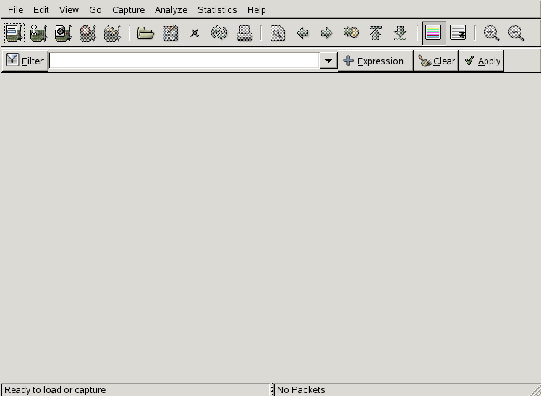
Ethereal

Slide 39

Tcpdump
Text-based packet filter
Packets stream past on terminal
Can put output to a file
  File can be interpreted by Ethereal

Slide 40
Netcat, ntop and ngrep
Netcat is designed as a debugging tool for IP based protocols
  Dummy server to output what a client sends
  Can communicate with TCP and UDP services
  Not commonly installed by default
Ntop provides graphical representation of traffic in network
Ngrep provides an interface similar to grep for network traffic

