Slide 1
Phase Description
Systems Design is the third of five phases in the systems development life cycle
Now you will work on a physical design that will meet the specifications described in the system requirements document
Tasks will include user interface design, data design, and system architecture
Deliverable is system design specification
Notes:
System inputs and outputs—forms and reports—are produced at the end of the
systems analysis phase of the SDLC. During systems analysis, however, you may
not have been concerned with the precise appearance of forms and reports.
For example, every input form is associated with a data flow entering a process on a DFD, and every output form
or report is a data flow produced by a process on a DFD.
Form

Slide 2
Chapter Objectives
Explain the concept of user interface design and human-computer interaction, including basic principles of user-centered design
List user interface design guidelines
Describe user interface components, including screen elements and controls
Discuss output design and technology issues
Notes:
3

Slide 3
Chapter Objectives
Design effective source documents
Explain input design and technology issues
Discuss guidelines for data entry screen design
Use input masks and validation rules to reduce input errors
Describe output and input controls and security
Notes:
3

Slide 4
Form: A business document that contains some predefined data
and may include some areas where additional data are to be
filled in; typically based on one database record.
Report : A business document that contains only predefined data; it
is a passive document used only for reading or viewing; typically
contains data from many unrelated records or transactions

Slide 5
Introduction
User interface design is the first task in the systems design phase of the SDLC
Designing the interface is extremely important, because everyone wants a system that is easy to learn and use
Notes:
4

Slide 6
What Is a User Interface?
User interface (UI)
Consists of all the hardware, software, screens, menus, functions, outputs, and features that affect two-way communications between the user and the computer

Slide 7
User Interface Design
Evolution of the User Interface
Process-control
As information management evolved from centralized data processing to dynamic, enterprise-wide systems, the primary focus also shifted — from the IT department to the users themselves
User-centered system
Requires an understanding of human-computer interaction and user-centered design principles

Slide 8
User Interface Design
Human-Computer Interaction
Human-computer interaction (HCI) describes the relationship between computers and people who use them to perform their jobs
Graphical user interface (GUI)
Main objective is to create a user-friendly design that is easy to learn and use

Slide 9
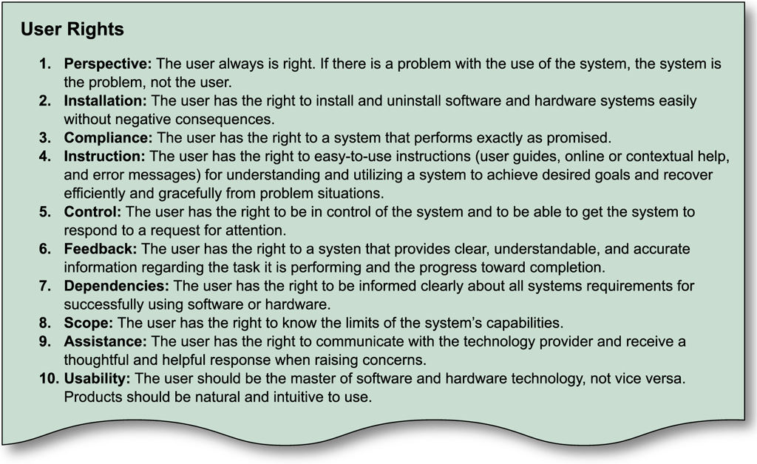
User Interface Design
Human-Computer Interaction

Slide 10
Principles of User-Centered Design
Understand the Business
Maximize Graphical Effectiveness
Think Like a User
Use Models and Prototypes
Focus on Usability
Invite Feedback
Document Everything

Slide 11
Designing the User Interface
Follow eight basic guidelines
Design a transparent interface
Create an interface that is easy to learn and use
Enhance user productivity
Make it easy for users to obtain help or correct errors
Minimize input data problems
Provide feedback to users
Create an attractive layout and design
Use familiar terms and images

Slide 12
Designing the User Interface
Good user interface design is based on a combination of ergonomics, aesthetics, and interface technology

Slide 13
Designing the User Interface
Design a Transparent Interface
Facilitate the system design objectives, rather than calling attention to the interface
Create a design that is easy to learn and remember
Design the interface to improve user efficiency and productivity
Write commands, actions, and system responses that are consistent and predictable

Slide 14
Designing the User Interface
Create an Interface that Is Easy to Learn and Use
Clearly label all controls, buttons, and icons
Select only those images that users can understand easily, and provide on-screen instructions that are logical, concise, and clear
Show all commands in a list of menu items
Make it easy to navigate

Slide 15
Designing the User Interface
Enhance User Productivity
Organize tasks, commands, and functions in groups that resemble actual business operations
Create alphabetical menu lists
Provide shortcuts so experienced users can avoid multiple menu levels
Use default values if the majority of values in a field are the same

Slide 16
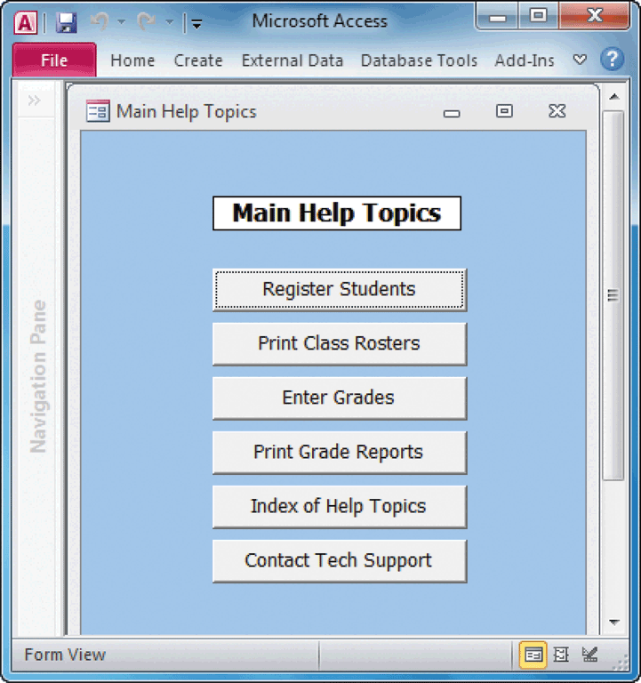
Designing the User Interface
Make It Easy for Users to Obtain Help or Correct Errors
Ensure that Help is always available
Provide user-selected Help and context-sensitive Help

Slide 17
Designing the User Interface
Minimize Input Data Problems
Create input masks
Display event-driven messages and reminders
Establish a list of predefined values that users can click to select
Build in rules that enforce data integrity

Slide 18
Designing the User Interface
Provide Feedback to Users
Display messages at a logical place on the screen
Alert users to lengthy processing times or delays
Allow messages to remain on the screen long enough for users to read them
Let the user know whether the task or operation was successful or not

Slide 19
Designing the User Interface
Create an Attractive Layout and Design
Use appropriate colors to highlight different areas of the screen
Use special effects sparingly
Use hyperlinks that allow users to jump to related topics
Group related objects and information

Slide 20
Designing the User Interface
Use Familiar Terms and Images
Remember that users are accustomed to a pattern of red=stop, yellow=caution, and green=go
Provide a keystroke alternative for each menu command
Use familiar commands if possible
Provide a Windows look and feel in your interface design if users are familiar with Windows-based applications

Slide 21
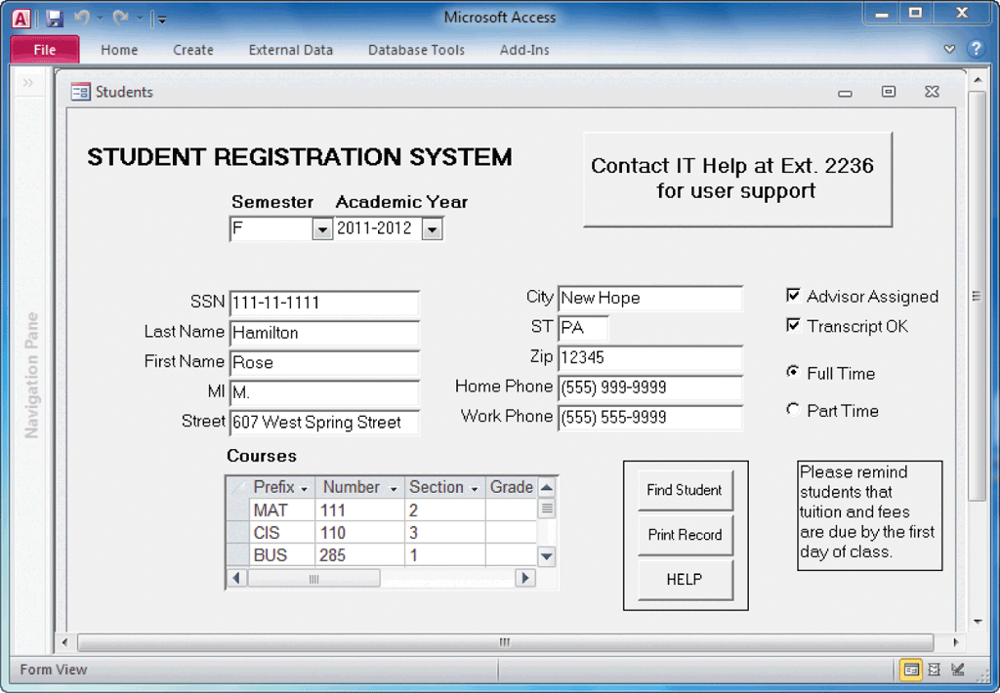
Designing the User Interface
Add Control Features
Menu bar
Toolbar
Command button
Dialog box
Text box
Toggle button

Slide 22
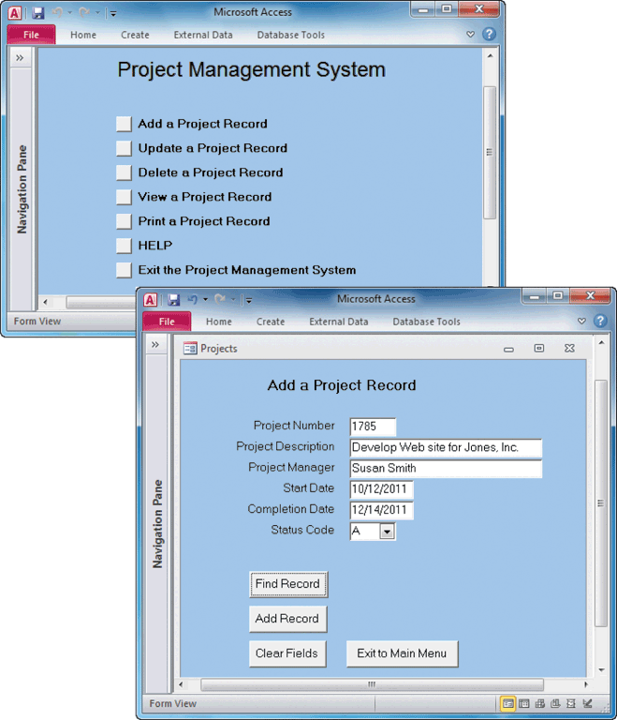
Designing the User Interface
Add Control Features
List box – scroll bar
Drop-down list box
Option button, or radio button
Check box
Calendar control
Switchboard

Slide 23
Output Design
Before designing output, ask yourself several questions:
What is the purpose of the output?
Who wants the information, why is it needed, and how will it be used?
What specific information will be included?
Will the output be printed, viewed on-screen, or both? What type of device will the output go to?

Slide 24
Output Design
Before designing output, ask yourself several questions:
When will the information be provided, and how often must it be updated?
Do security or confidentiality issues exist?
Your answers will affect your output design strategies

Slide 25
Output Design
Overview of Report Design
Few firms have been able to eliminate printed output totally
Turnaround documents
Reports must be easy to read and well organized
Database programs include a variety of report design tools
Character-based reports

Slide 26
Output Design
Types of Reports
Detail reports
Exception reports
Summary reports

Slide 27
Output Design
User Involvement in Report Design
Printed reports are an important way of delivering information, so users should approve all report designs in advance
Submit each design for approval as you complete it, rather than waiting until you finish all report designs
Mock-up
Report analysis form

Slide 28
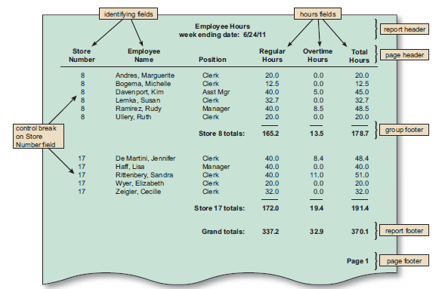
Output Design
Report Design Principles

Slide 29
Output Design
Output Technology
Internet-based information delivery
Webcast
E-mail
Blogs
Instant Messaging
Wireless Devices

Slide 30
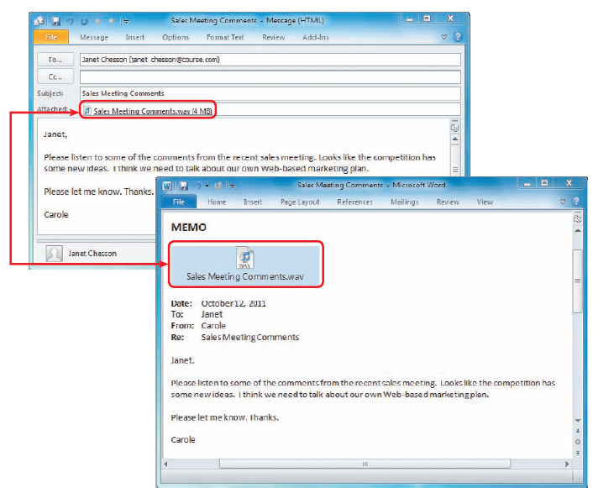
Output Design
Output Technology
Digital audio, images, and video
Podcasts
Automated facsimile systems
Faxback systems
Computer output microfilm (COM)
Computer output to digital media

Slide 31
Output Design
Output Technology
Specialized Forms of Output
An incredibly diverse marketplace requires many forms of specialized output and devices
Portable, Web-connected devices
Retail point-of-sale terminals
Automatic teller machines (ATMs)
Special-purpose printers

Slide 32
Input Design
The quality of the output is only as good as the quality of the input
Garbage in, garbage out (GIGO)
Objective of input design is to ensure the quality, accuracy, and timeliness of input data
Good input design requires attention to human factors as well as technology issues

Slide 33
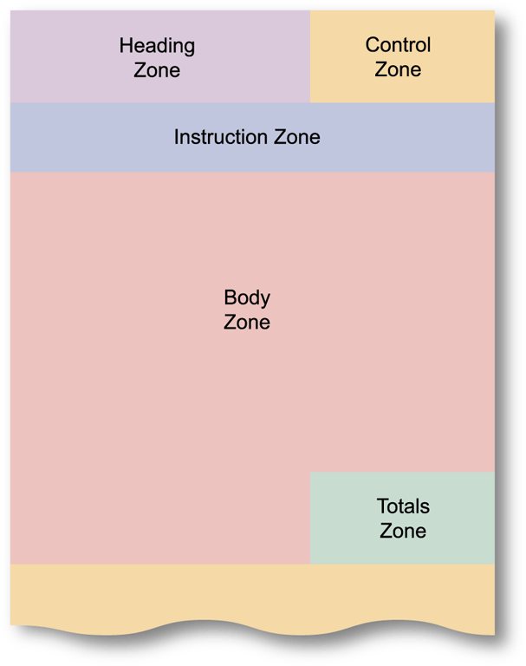
Input Design
Source Documents and Forms
Form layout
Heading zone
Control zone
Instruction zone
Body zone
Totals zone
Authorization zone

Slide 34
Input Design
Source Documents and Forms
Dr. Jakob Nielson believes that users scan a page, picking out individual words and sentences
As a result, Web designers must use scannable text to capture and hold a user’s attention

Slide 35
Input Design
Data Entry Screens
Guidelines
Restrict user access to screen locations where data is entered
Provide a descriptive caption for every field, and show the user where to enter the data and the required or maximum field size
Display a sample format if a user must enter values in a field in a specific format - separator
Require an ending keystroke for every field

Slide 36
Input Design
Data Entry Screens
Guidelines
Do not require users to type leading zeroes for numeric fields
Do not require users to type trailing zeroes for numbers that include decimals
Display default values so operators can press the ENTER key to accept the suggested value
Use a default value when a field value will be constant for successive records or throughout the data entry session
Display a list of acceptable values for fields, and provide meaningful error messages

Slide 37
Input Design
Data Entry Screens
Guidelines
Provide a way to leave the data entry screen at any time without entering the current record
Provide users with an opportunity to confirm the accuracy of input data before entering it
Provide a means for users to move among fields on the form
Design the screen form layout to match the layout of the source document
Allow users to add, change, delete, and view records
Provide a method to allow users to search for specific information

Slide 38
Input Design
Input Masks
Use input masks, which are templates or patterns that restrict data entry and prevent errors
A mask can manipulate the input data and apply a specific format

Slide 39
Input Design
Validation Rules
At least eight types of data validation rules
Sequence check
Existence check
Data type check
Range check – limit check
Reasonableness check
Validity check – referential integrity
Combination check
Batch controls – hash totals

Slide 40
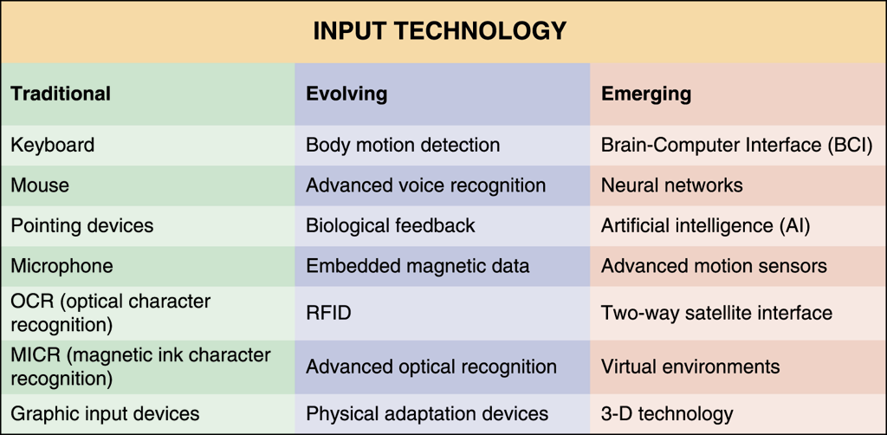
Input Design
Input Technology
Batch input
Batch
Online input
Online data entry
Source data automation
RFID tags or Magnetic data strips

Slide 41
Input Design
Input Technology
Tradeoffs
Unless source data automation is used, manual data entry is slower and more expensive than batch input because it is performed at the time the transaction occurs and often done when computer demand is at its highest
The decision to use batch or online input depends on business requirements

Slide 42
Input Design
Input Volume Reduction
Guidelines will help reduce input volume
Input necessary data only
Do not input data that the user can retrieve from system files or calculate from other data
Do not input constant data
Use codes

Slide 43
Security and Control Issues
Output Control and Security
Output security
The IT department is responsible for output control and security measures
Diskless workstation
Port protector

Slide 44
Security and Control Issues
Input Security and Control
Input Control
Every piece of information should be traceable back to the input data
Audit trail
Data security
Records retention policy
Encrypted – encryption

Slide 45
Chapter Summary
The purpose of systems design is to create a physical model of the system that satisfies the design requirements that were defined during the systems analysis phase
The chapter began with a discussion of user interface design and human-computer interaction (HCI) concepts
Various types of printed reports, including detail, exception, and summary reports
You also learned about other types of output
Notes:
49

Slide 46
Chapter Summary
Discussion of input design began with a description of source documents and the various zones in a document
The discussion of data entry screen design explained the use of input masks and validation rules to reduce data errors
You also learned about batch and online input methods, input media and procedures, and input volume
Finally, you learned about security and control
Notes:
49

