Slide 1
Today’s Lecture Outline
Where are we?
Why Process Modeling?
What is Process Modeling?
Basic Symbols for Process Modeling
System Concept vs. Process Decomposition
Decomposition Rules
Basic Concepts about a Data Flow
Rules for Data Flow

Slide 2
Where are we?
Project ID and Selection
1. Determine system requirements
2. Structure system
requirements (ch. 8-10)
3. Generate alternatives for selection
Project Initiation
& Planning
Analysis
Data Modeling
Process Modeling
Logic Modeling
Logical Design
Maintenance
Physical Design
Implementation

Slide 3
What is Process Modeling?
Process modeling – A formal way of representing how a business operates and it illustrates activities that are performed and how data move between the components
A technique to organize and document the system structure and data flow between system’s PROCESSES and their relevant procedures to be implemented by a system.
Data Flow Diagramming - The data flow diagram allow the analyst to model how data flow through an information system and show the relationships among the data flows.
It also shows the processes that change or transform the data
Another logical modeling tool to support the process modeling
the second step in the Analysis stage of SDLC

Slide 4




Basic Symbols of Process Modeling
Data Flow Diagram and Its Components
DFD: A diagram about the data flow between external agents (sources/ sinks) and the processes and data stores within a system
Key Components:
External
Agent

Slide 5
Components
A data flow is data that are in motion and moving as a unit from one place in a system to another.
  E.g. customer order, sales receipt, or paycheck, student results etc
A data store is data at rest. A data store may represent one of many different physical locations for data, including a file folder, one or more computer-based file(s), or a notebook. A data store might contain data about customers, students, customer orders, or supplier invoices
A process is the work or actions performed on data so that they are transformed, stored, or distributed.
Eg: the process to generate paychecks, calculate overtime pay, or compute GPA, calculate cost of items purchased
A source/sink is the origin and/or destination of the data. Source/sinks are sometimes referred to as external entities because they are outside the system.
E.g. customer, Student, Environmental Protection Agency (EPA) office, or Audit system

Slide 6
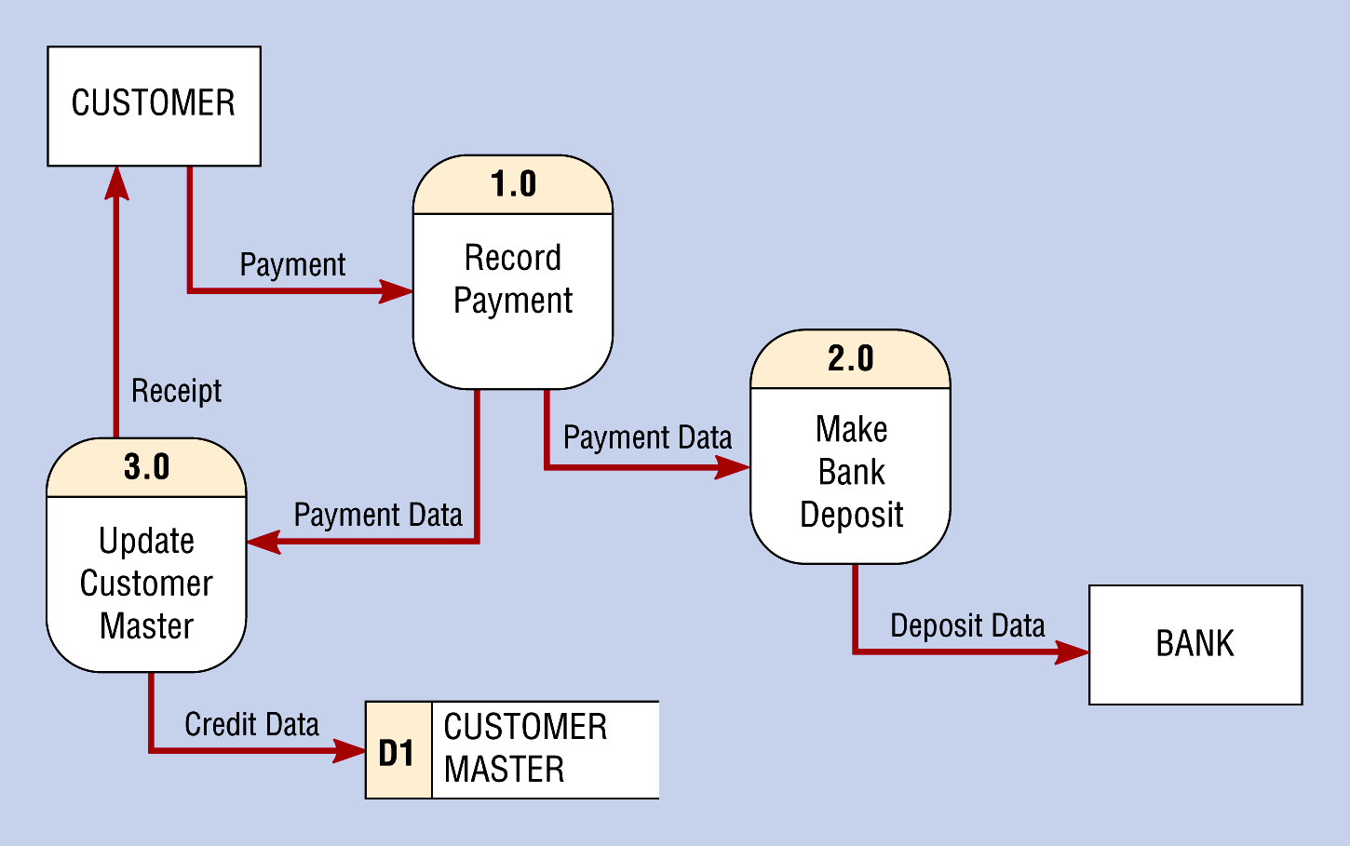
An Example -
A Data Flow Diagram for a Banking System

Slide 7
An Information System
A Generic View
In general, a system could be viewed as a single Process
0
Information
System
Trans
Data
Report
Sink
(Mgmt)
Source
(Customer)
You could have multiple sources and sinks!
This generic diagram is called “Context Diagram”

Slide 8
A Context Diagram
An overview of an organizational system that shows the system boundary, sources / sinks that interact with the system, and the major information flows between the entities and the system
A Context Diagram addresses only one process.
An example ...

Slide 9
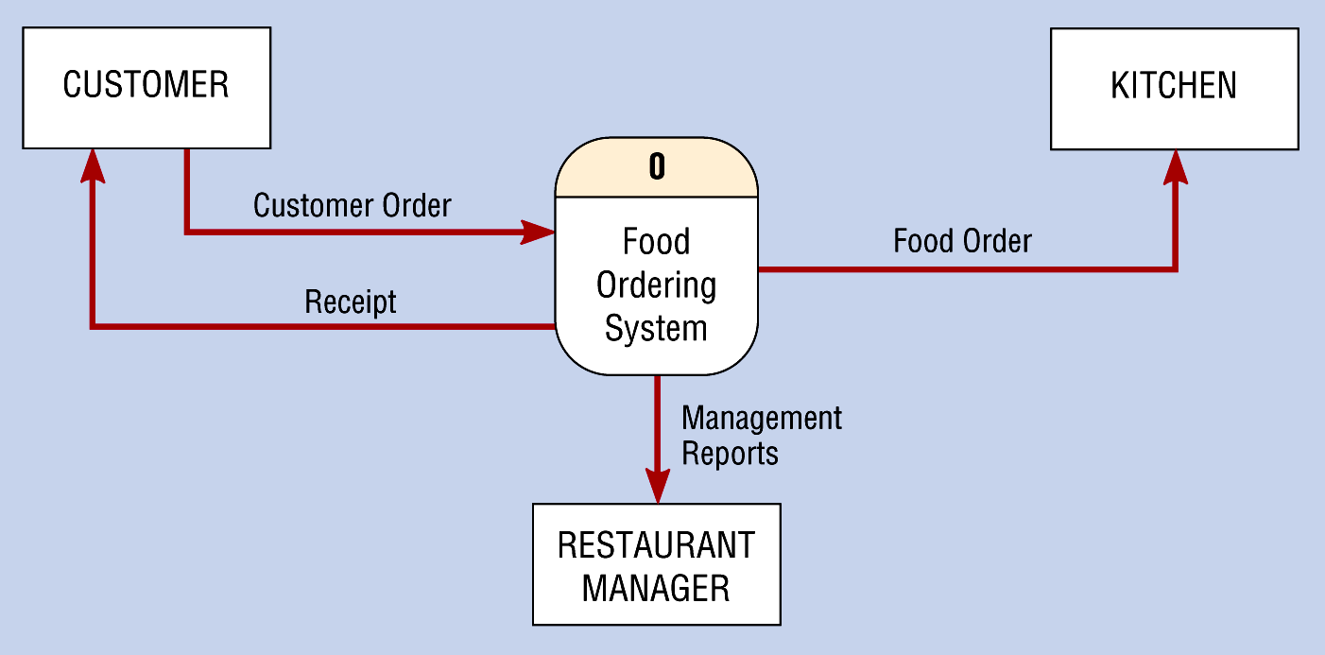
An Example -
A Context Diagram for a Fast-Food IS

Slide 10
A Systematic Way for Process Modeling
Process Decomposition
In general, a system could be too complex to understand when viewed as a single Process
We need a Process Decomposition scheme
i.e., to separate a system into its subsystems (sub-processes), which in turn could be further divided into smaller subsystems until the final subsystems become manageable units (i.e., primitive processes!)
A divide and conquer strategy!!

Slide 11
Level-0 Diagram
A DFD that represents the primary functional processes in the system at the highest possible level
An Example ...

Slide 12
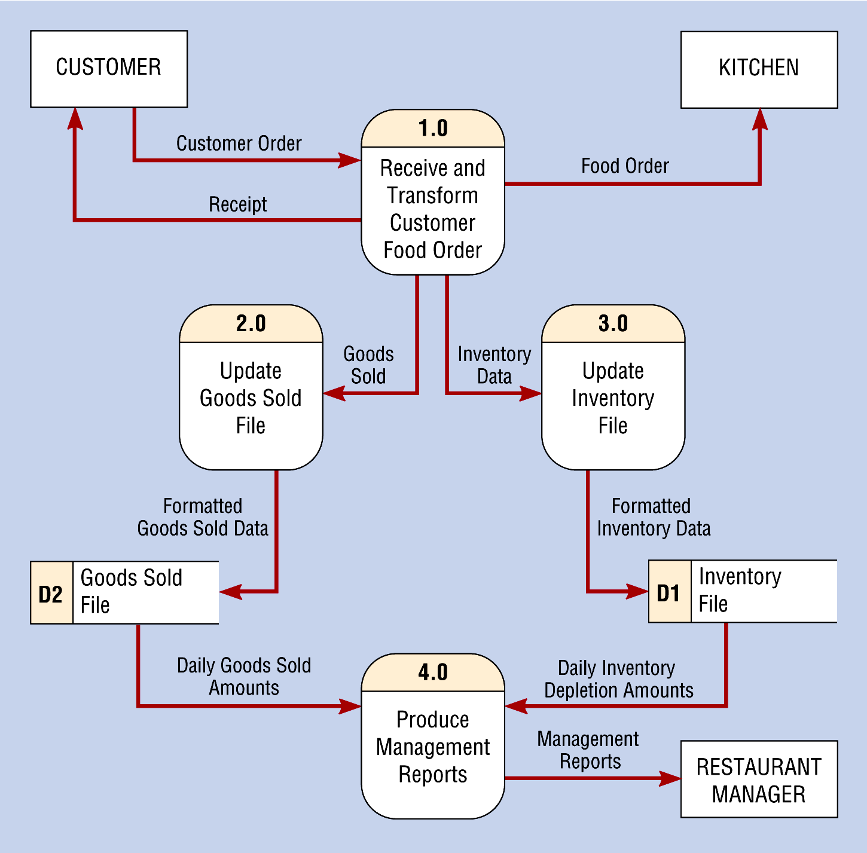
An Example - A decomposed Context Diagram - Level 0 Diagram

Slide 13
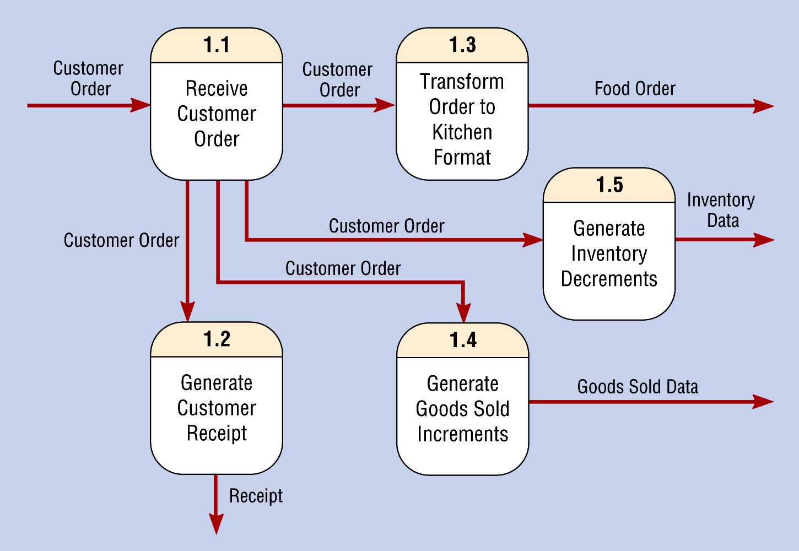
An Example - A further decomposition
A Level-1 Data Flow Diagram

Slide 14
Process Decomposition Rules
Generic Decomposition Rules:
A process in a DFD could be either a parent process or a child process, or both.
A parent process must have two or more child processes.
A child process may further be decomposed into a set of child processes.

Slide 15
Decomposition Overview
Context Diagram
Level-0
Diagram

Slide 16
Three Major Types of Process
Function Process - A function is a set of related activities of the business (e.g., Marketing, Production, etc.)
Event Process - An event process is a logical unit of work that must be completed as a whole. (e.g., Process customer credit verification)
Primitive Process - a primitive process is a discrete, lowest-level activity/task required to complete an event. (e.g., Check the credit card balance)

Slide 17
Naming Rules for Processes
Function Process - use a Noun!
Event Process - Use a general action verb
  Process Student registration.
  Respond to ...
  Generate ...
Primitive Process - use a strong action verb
  Validate Student ID
  Check ...
  Calculate ...

Slide 18
Rules for Processes
No process can have only outputs (a miracle!)
No process can have only inputs (a black hole!)
No process can produce outputs with insufficient inputs ( a gray hole!)

Slide 19
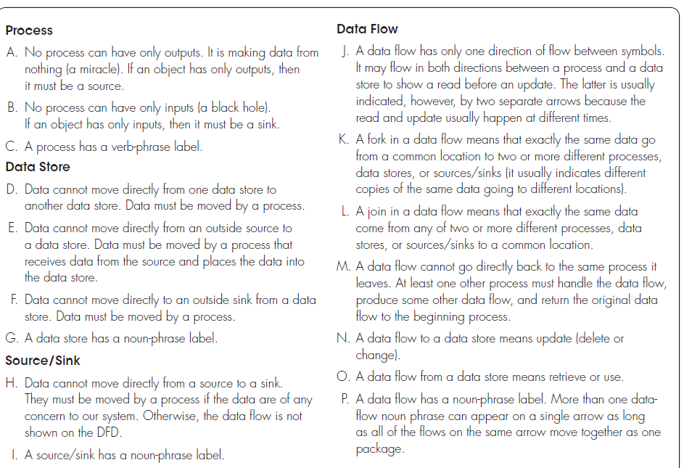
Rules Governing Data Flow Diagramming

Slide 20
Can You Identify Errors in This Diagram?
What’s wrong?
Membership
application
Employee
Gray Hole
Black Hole
Bank statement
3.1.1
Existing account
3.1.2
Generate an
Create a new
Employee bank
member account
statement
Employee
status
Employee address
Miracle
Member Accounts
Employees
New account status
3.1.3
Frozen account notification
Accounts
Freeze member
Receivable
account number
Department

Slide 21
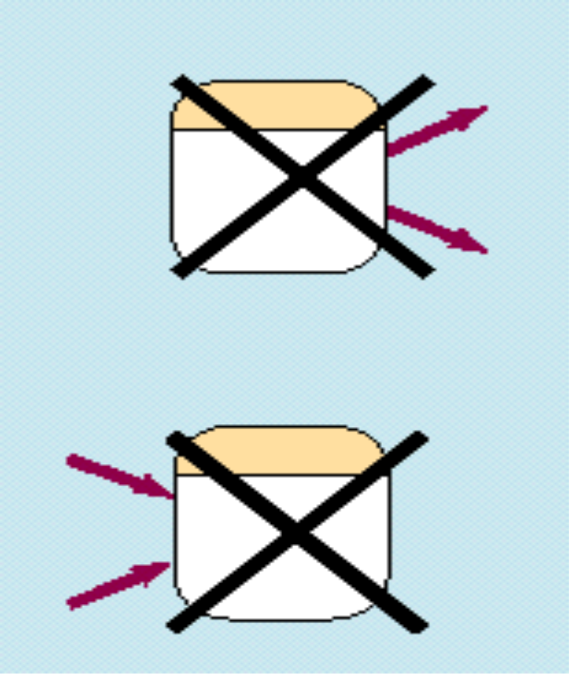
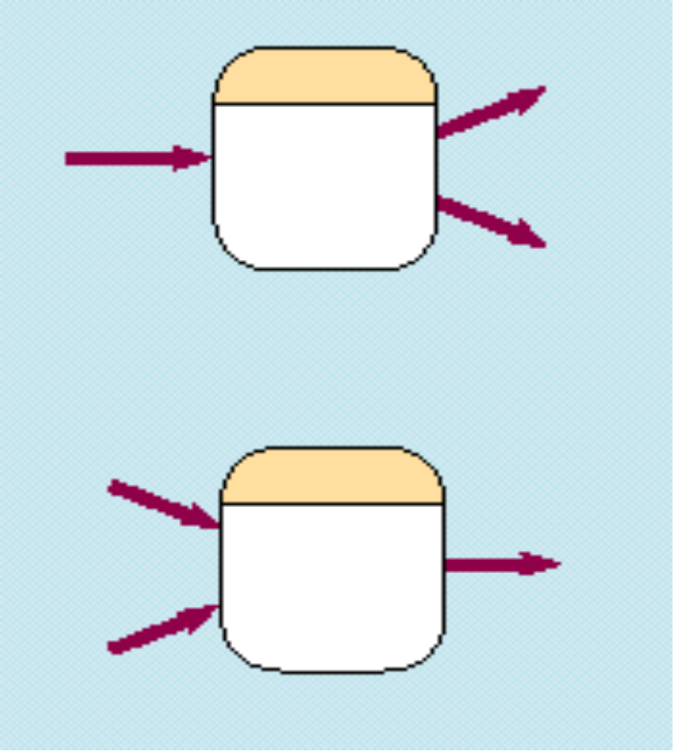
Processes in a DFD
Correct vs. Incorrect
Incorrect
Correct

Slide 22
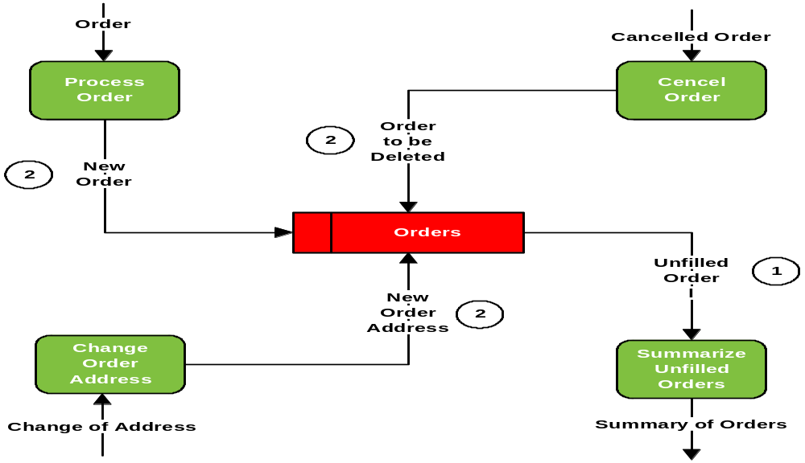
Basic Concept About Data Flows ...
It has two kinds of flow: a) Inflow to a Data Store (Create/Modify/Delete) b) Outflow from a Data Store (Read)
Delete
Read
Create
Modify

Slide 23
Rules for Data Stores
Data cannot move directly from one data store to another data store -- it must be moved by a process.
Data cannot move directly from an outside source to a data store -- it must be moved by a process.
Data cannot move directly to an outside sink from a data store -- it must be moved by a process.
You need to use a Noun phrase to label each data flow

Slide 24
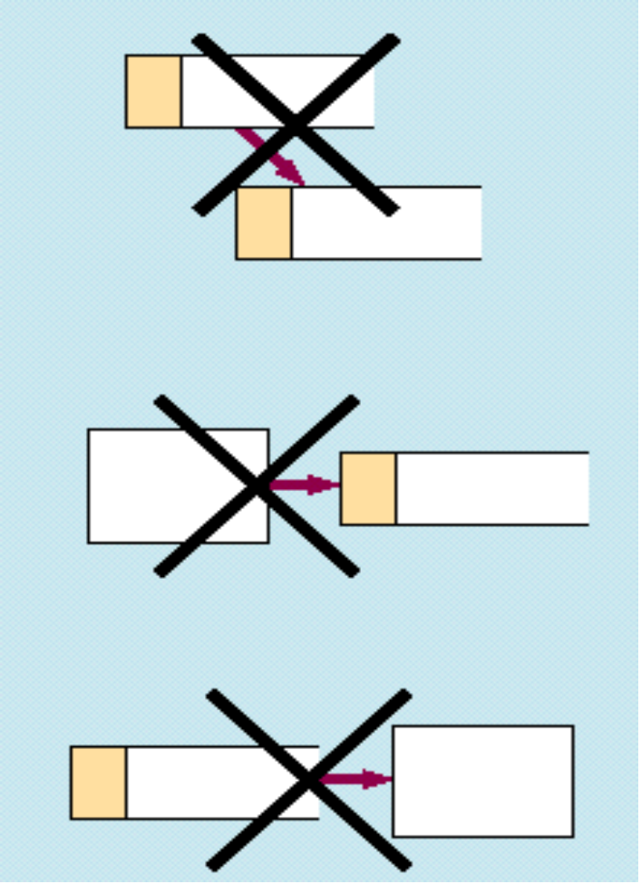
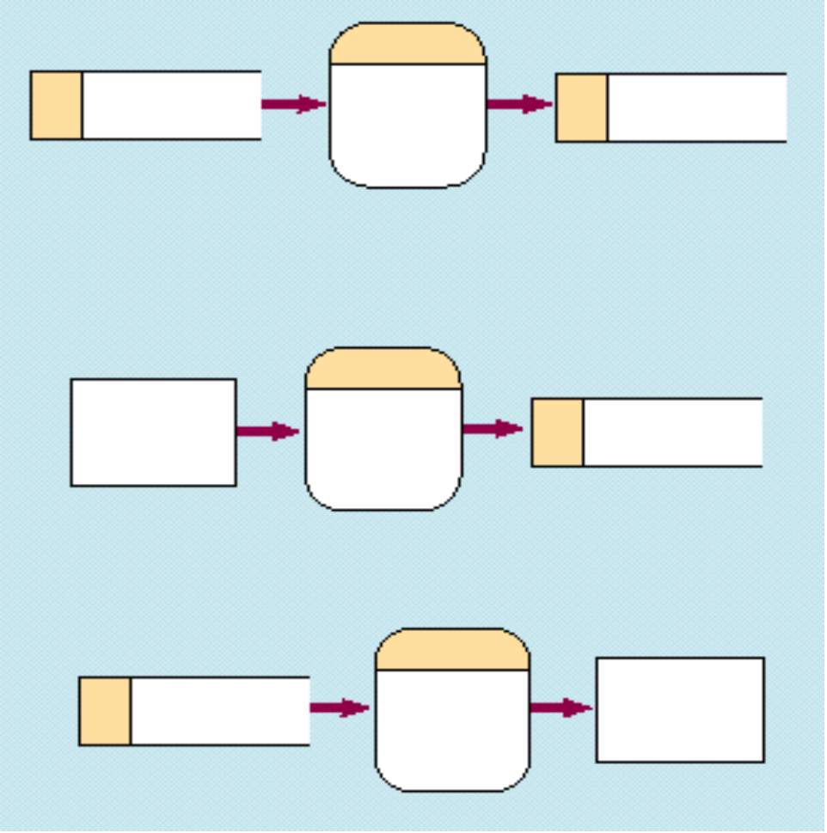
Data Flows in a DFD
Incorrect vs. Correct
Incorrect
Correct

Slide 25
Naming Rules Data Flow
Use a singular noun phrase for each data flow
  Ex: customer data, shipping report, …, etc.
Carry logical meaning only, i.e., no implication on data form or data structure
Minimum flow (no data flooding!!)
Should never be “Unnamed!!” - otherwise, there might be a modeling error.

Slide 26
Naming Scheme for Other DFD Components
Process (Event) - Use an Action Verb Phrase
  Process member order, Generate bank statement, ...
External Agent (Sink/Source) - Use a singular descriptive noun
  Ex: Student, Customer, etc.
Data Store –
  Use a plural descriptive noun (Members, Customers, etc.)
  Or use a noun + file (Inventory file, Goods sold file)

Slide 27
Basic Rule in
DFD Decomposition
Balancing Principle -- the decomposed DFD (I.e., the next lower level DFD ) should retain the same number of inputs and outputs from its previous higher level DFD (I.e., No new inputs or outputs when a DFD is decomposed)

Slide 28
Balancing Principle
Context Diagram
Level-0
Diagram

Slide 29

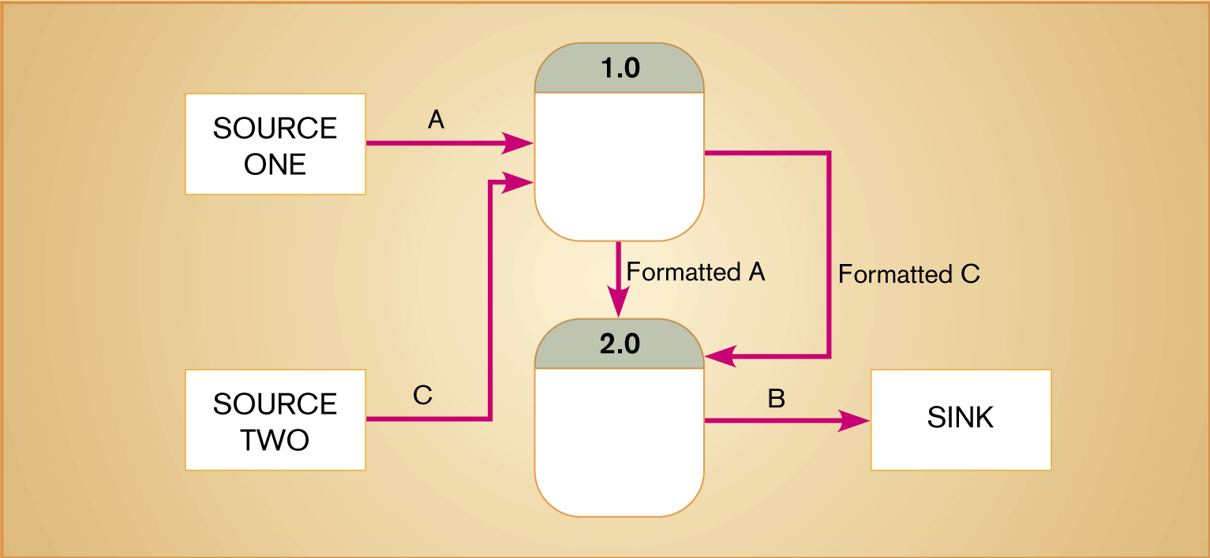
Unbalanced DFD

