Slide 1
Chapter 1
File Systems and Databases
Database Systems: Design, Implementation, and Management, Fifth Edition, Rob and Coronel

Slide 2
Database Systems: Design, Implementation, & Management, 5th Edition, Rob & Coronel

Slide 3
PROFILE
Dr. Eng. Seth Alornyo
Academic
Doctor of Philosophy (Ph.D.)- Software Engineering
Master of Philosophy (M.Phil.)- Information Technology
Bachelor of Science (BSc) Computer Science
Professional
Microsoft Certified Professional (MCP)
Cisco Certified Network Associate(CCNA)
International Computer Driving License (ICDL)
Research Area
Cyber security / Cryptography /Network Security
Further details at “Google scholar” name search
Chapter 1 Introduction

Slide 4
Disclaimer!
The lecture slides are partially collected from the Internet for educational purpose only. The lecturer does not claim any credit for them and the copyrights belong to the original authors
Chapter 1 Introduction
30/10/2014

Slide 5
In this chapter, you will learn:
What a database is, what it does, and why database design is important
How modern databases evolved from files and file systems
About flaws in file system data management
What a DBMS is, what it does, and how it fits into the database system
About types of database systems and database models
Database Systems: Design, Implementation, & Management, 5th Edition, Rob & Coronel

Slide 6
Data versus Information
  Data constitute building blocks of information
  Data is processed to produce information
  Information reveals meaning of data
  Information is a valuable resource
  Information is basis for knowledge
  Good, timely, relevant information is critical to decision making
  Good decision making is key to organizational survival
Database Systems: Design, Implementation, & Management, 5th Edition, Rob & Coronel

Slide 7
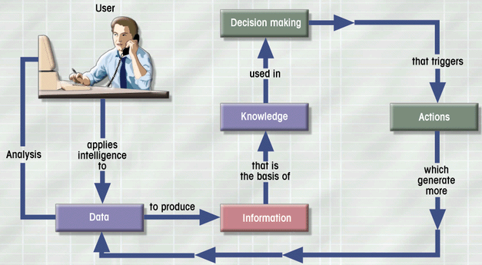
Data-Information-Decision Cycle
Figure 16.1
Database Systems: Design, Implementation, & Management, 5th Edition, Rob & Coronel

Slide 8
Database Management
A database is a shared, integrated computer structure containing:
  Application (or end user) data
  Metadata (data about data, eg. datatype, length, required/not required, validation, …)
Database Management System (DBMS)
  Manages Database structure
  Controls access to data
  Provides query language
Database Systems: Design, Implementation, & Management, 5th Edition, Rob & Coronel

Slide 9
Advantages of DBMS
  Makes data management more efficient and effective
  Query language allows quick answers to ad hoc (one time) queries
  Provides easier access to better-managed data
  Promotes integrated view of organization’s operations
  Reduces the probability of inconsistent data (same data stored in different places with possibility of different values)
Database Systems: Design, Implementation, & Management, 5th Edition, Rob & Coronel

Slide 10
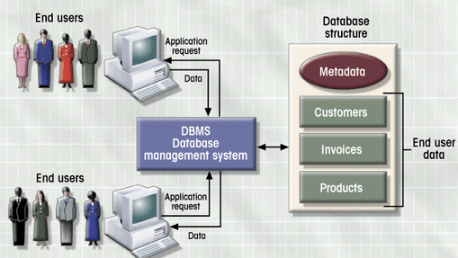
DBMS Manages Interaction
Figure 1.2
Database Systems: Design, Implementation, & Management, 5th Edition, Rob & Coronel

Slide 11
Database Design
Importance of Good Design
  Poor design results in unwanted data redundancy (unnecessary duplication of data)
  Poor design generates errors leading to decisions based on incorrect data
Practical Approach
  Focus on principles and concepts of database design
  Importance of logical design
Database Systems: Design, Implementation, & Management, 5th Edition, Rob & Coronel

Slide 12
Historical Roots of Database
First computer applications focused on clerical tasks (eg preparing bills)
Requests for information (eg how many bills were not paid this month) quickly followed
File systems developed to address needs
  Data organized according to expected use
  Data Processing (DP) specialists computerized manual file systems
Database Systems: Design, Implementation, & Management, 5th Edition, Rob & Coronel

Slide 13
File Terminology
Data
  Raw Facts
Field
  Group of characters with specific meaning
Record
  Logically connected fields that describe a person, place, or thing
File
  Collection of related records
Database Systems: Design, Implementation, & Management, 5th Edition, Rob & Coronel

Slide 14
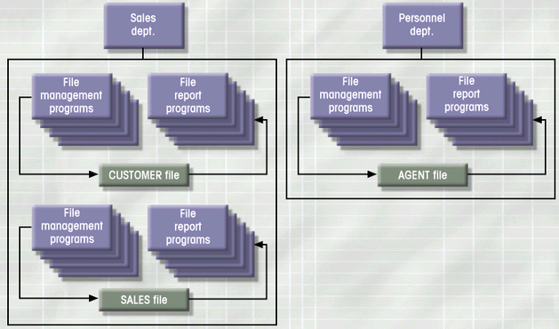
Simple File System
Figure 1.5
Database Systems: Design, Implementation, & Management, 5th Edition, Rob & Coronel

Slide 15
File System Disadvantages
File System Data Management
  Requires extensive programming in third-generation language (3GL)
  Time consuming
  Makes ad hoc queries impossible
  Leads to islands of information
Database Systems: Design, Implementation, & Management, 5th Edition, Rob & Coronel

Slide 16
File System Critique (con’t.)
Data Dependence
  Change in file’s data characteristics requires modification of data access programs
  Must tell program what to do and how
  Makes file systems cumbersome from programming and data management views
Structural Dependence
  Change in file structure requires modification of related programs
Database Systems: Design, Implementation, & Management, 5th Edition, Rob & Coronel

Slide 17
File System Critique (con’t.)
Field Definitions and Naming Conventions
  Flexible record definition anticipates reporting requirements
  Selection of proper field names important
  Attention to length of field names
  Use of unique record identifiers
Database Systems: Design, Implementation, & Management, 5th Edition, Rob & Coronel

Slide 18
File System Critique (con’t.)
Data Redundancy
  Different and conflicting versions of same data
  Results of uncontrolled data redundancy
    Data anomalies
      Modification
      Insertion
      Deletion
    Data inconsistency
      Lack of data integrity
Database Systems: Design, Implementation, & Management, 5th Edition, Rob & Coronel

Slide 19
Database Systems
Database consists of logically related data stored in a single repository
Provides advantages over file system management approach
  Eliminates inconsistency, data anomalies, data dependency, and structural dependency problems
  Stores data structures, relationships, and access paths in addition to application data
Database Systems: Design, Implementation, & Management, 5th Edition, Rob & Coronel

Slide 20
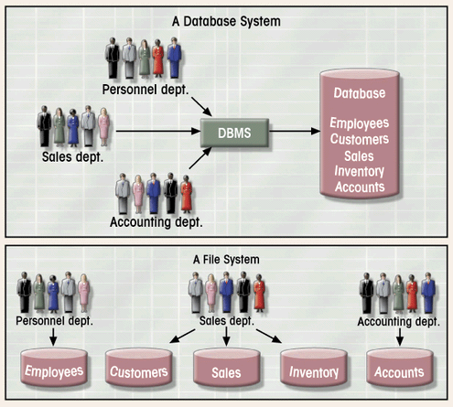
Database vs. File Systems
Figure 1.6
Database Systems: Design, Implementation, & Management, 5th Edition, Rob & Coronel

Slide 21
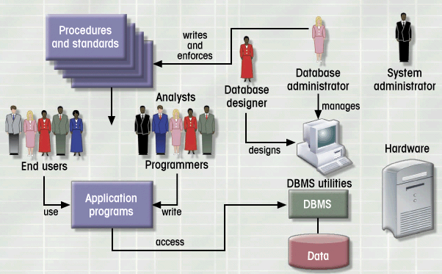
Database System Environment
Figure 1.7
Database Systems: Design, Implementation, & Management, 5th Edition, Rob & Coronel

Slide 22
Database System Types
Databases can be differentiated by different factors including:
Single-user vs. Multiuser Database
  Desktop
  Workgroup
  Enterprise
Centralized vs. Distributed
Use
  Production or transactional
  Decision support or data warehouse
Database Systems: Design, Implementation, & Management, 5th Edition, Rob & Coronel

Slide 23
DBMS Functions
Data dictionary management
Data storage management
Data transformation and presentation
Security management
Multiuser access control
Backup and recovery management
Data integrity management
Database language and application programming interfaces
Database communication interfaces
Database Systems: Design, Implementation, & Management, 5th Edition, Rob & Coronel

Slide 24
Database Models
Collection of logical constructs used to represent data structure and relationships within the database
  Conceptual models: logical nature of data representation
  Implementation models: emphasis on how the data are represented in the database
Database Systems: Design, Implementation, & Management, 5th Edition, Rob & Coronel

Slide 25
Implementation Database Models
  Hierarchical (first), example: IMS
  Network (next), example: IDMS
  Relational (next), examples: Oracle, DB2
  Object Oriented (latest)
Database Systems: Design, Implementation, & Management, 5th Edition, Rob & Coronel
Notes:
31

Slide 26
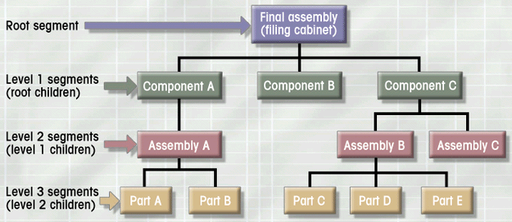
Hierarchical Database Model
Logically represented by an upside down tree
  Each parent can have many children
  Each child has only one parent
Figure 1.8
Database Systems: Design, Implementation, & Management, 5th Edition, Rob & Coronel

Slide 27
Hierarchical Database Model
Advantages
  Conceptual simplicity
  Database security and integrity
  Data independence
  Efficiency
Disadvantages
  Complex implementation
  Difficult to manage and lack of standards
  Lacks structural independence
  Applications programming and use complexity
  Implementation limitations
Database Systems: Design, Implementation, & Management, 5th Edition, Rob & Coronel

Slide 28
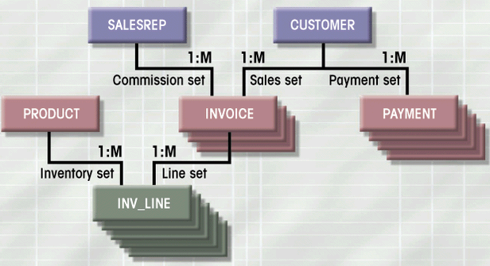
Network Database Model
Each record can have multiple parents
  Composed of sets
  Each set has owner record and member record
  Member may have several owners
Figure 1.10
Database Systems: Design, Implementation, & Management, 5th Edition, Rob & Coronel

Slide 29
Network Database Model
Advantages
  Conceptual simplicity
  Handles more relationship types
  Data access flexibility
  Promotes database integrity
  Data independence
  Conformance to standards
Disadvantages
  System complexity
  Lack of structural independence
Database Systems: Design, Implementation, & Management, 5th Edition, Rob & Coronel

Slide 30
Relational Database Model
Most widely used model today
Perceived by user as a collection of tables for data storage
Tables are a series of row/column intersections
Tables related by sharing common entity characteristic(s)
Database Systems: Design, Implementation, & Management, 5th Edition, Rob & Coronel

Slide 31
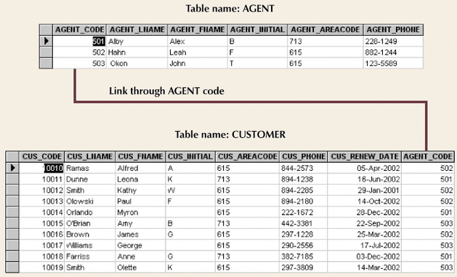
Relational Database Model (con’t.)
Figure 1.11
Database Systems: Design, Implementation, & Management, 5th Edition, Rob & Coronel

Slide 32
Relational Database Model
Advantages
  Structural independence
  Improved conceptual simplicity
  Easier database design, implementation, management, and use
  Ad hoc query capability with SQL
  Powerful database management system
Database Systems: Design, Implementation, & Management, 5th Edition, Rob & Coronel

Slide 33
Relational Database Model
Disadvantages
  Substantial hardware and system software overhead
  Poor design and implementation is made easy
  May promote “islands of information” problems
Database Systems: Design, Implementation, & Management, 5th Edition, Rob & Coronel

Slide 34
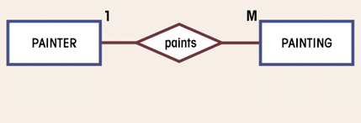
Entity Relationship Database Model
Complements the relational data model concepts
Represented in an entity relationship diagram (ERD)
Based on entities, attributes, and relationships
Figure 1.13
Database Systems: Design, Implementation, & Management, 5th Edition, Rob & Coronel

Slide 35
Entity Relationship Database Model
Advantages
  Exceptional conceptual simplicity
  Visual representation
  Effective communication tool
  Integrated with the relational database model
Disadvantages
  Limited constraint representation
  Limited relationship representation
  No data manipulation language
  Loss of information content
Database Systems: Design, Implementation, & Management, 5th Edition, Rob & Coronel

Slide 36
Object-Oriented Database Model
Objects or abstractions of real-world entities are stored
  Attributes describe properties
  Collection of similar objects is a class
    Methods represent real world actions of classes
    Classes are organized in a class hierarchy
  Inheritance is ability of object to inherit attributes and methods of classes above it
Database Systems: Design, Implementation, & Management, 5th Edition, Rob & Coronel

Slide 37
OO Data Model
Advantages
  Adds semantic content
  Visual presentation includes semantic content
  Database integrity
  Both structural and data independence
Disadvantages
  Lack of OODM
  Complex navigational data access
  Steep learning curve
  High system overhead slows transactions
Database Systems: Design, Implementation, & Management, 5th Edition, Rob & Coronel

Slide 38
Database Models and the Internet
Characteristics of “Internet age” databases
  Flexible, efficient, and secure Internet access
  Easily used, developed, and supported
  Supports complex data types and relationships
  Seamless interfaces with multiple data sources and structures
  Simplicity of conceptual database model
  Many database design, implementation, and application development tools
  Powerful DBMS GUI make DBA job easier
Database Systems: Design, Implementation, & Management, 5th Edition, Rob & Coronel

