Slide 1
CIS 421 Web Based Java Programming
Building GUIs (Graphical User Interfaces) with Java
Part 1

Slide 2
AWT vs. Swing
Early Java development used graphic classes defined in the Abstract Windowing Toolkit (AWT)
With Java 2, Swing classes were introduced
Many AWT components have improved Swing counterparts
For example, the AWT Button class corresponds to a more versatile Swing class called JButton
However, Swing does not generally replace the AWT; we still use AWT events and the underlying AWT event processing model

Slide 3
java.awt - The Abstract Windowing Toolkit
Introduced with Java 1.0
Classes are divided into 3 main categories:
  graphics (colours, fonts, shapes, etc.)
  components (GUI components: windows, buttons, menus, etc.)
  layout managers (control the positioning of components on the screen)
Each component corresponds to a “peer” component provided by the native GUI toolkit on the target platform (Windows, Sun Solaris, etc.)
Here is a (small) subset of the AWT class hierarchy:

Slide 4
Object
Component
Container
Window
Panel
Frame
Applet

Slide 5
java.awt - The Abstract Windowing Toolkit
Component
  an abstract class
  superclass of all GUI components except menu components and class CheckboxGroup
Container
  the superclass for all components that contain other components
  defines add(), for adding components to a container

Slide 6
java.awt - The Abstract Windowing Toolkit
Window
  a top-level window with no border or menu bar
  rarely instantiated (its subclasses are more useful)
Frame
  a window with a title bar
  can have a menu bar
  top-level window for Java AWT-based applications
    typically, main() creates an instance of an object that is a Frame as its top-level application window, then adds GUI components to it

Slide 7
java.awt - The Abstract Windowing Toolkit
Panel
  a container that must be contained within another container
  does not have its own window
Applet
  a subclass of Panel
  actually part of the java.applet package, not the AWT

Slide 8
AWT Limitations
“look and feel” of AWT-based programs differs slightly across platforms, because of differences in the underlying native GUI elements
AWT components limited to those that are available on all platforms (lowest common denominator)

Slide 9
javax.swing - The Swing Toolkit
In response, Netscape developed the Internet Foundation Classes, which evolved into the Swing toolkit that is part of Sun’s Java Foundation Classes (JFC)
Swing components do not require native peer components
Each Swing UI component is painted onto a blank window
Only peer functionality required is the ability to display windows and paint on them

Slide 10
Relationship of Swing and AWT
Object
Component
Window
Container
JComponent
Frame
Panel
JPanel
JFrame
Applet
JApplet

Slide 11
Relationship of Swing and AWT (con’t)
Container
add(Component)
remove(Component)
setLayoutManager()
...
Window
addWindowListener()
pack()
show()
...
MenuContainer
Frame
Dialog
JWindow
AWT
setIconImage()
setMenuBar()
setTitle()
...
setModal()
setTitle()
...
Swing
JFrame
JDialog
contentPane
contentPane
getContentPane()
setJMenuBar()
...
getContentPane()
...

Slide 12
Inherited Functions
Component
addMouseListener()
addKeyListener()
...
getBounds()
getComponentAt()
...
void paint(Graphics)
AWT
Swing
Container
Button
add(Component)
remove(Component)
setLayoutManager()
...
JComponent
Canvas
setBorder()
setUI()
...
...
Label
Panel
Box
...
Window
Swing Components

Slide 13
Swing Components
There are various Swing GUI components that we can incorporate into our software:
  labels (including images)
  text fields and text areas
  buttons
  check boxes
  radio buttons
  menus
  combo boxes
  and many more…
Using the proper components for the situation is an important part of GUI design

Slide 14
Labels and Image Icons
A label is used to provide information to the user or to add decoration to the GUI
A Swing label is defined by the JLabel class
It can incorporate an image defined by the ImageIcon class (later)
The alignment and relative positioning of the text and image of a label can be explicitly set

Slide 15
Buttons
GUI buttons fall into various categories:
  push button – a generic button that initiates some action
  check box – a button that can be toggled on or off
  radio buttons – a set of buttons that provide a set of mutually exclusive options
Radio buttons must work as a group; only one can be toggled on at a time
Radio buttons are grouped using the ButtonGroup class

Slide 16
Buttons
Push buttons and radio buttons generate action events when pushed or toggled
Check boxes generate item state changed events when toggled

Slide 17
Radio Buttons
Declaration and initialization:
JRadioButton radioButtonSmall, radioButtonLarge ;
radioButtonSmall = new JRadioButton (“small”, false);
radioButtonLarge = new JRadioButton (“large”, false);
this.add (radioButtonSmall);
this.add (radioButtonLarge);
radioButtonSmall.addActionListener (this);
radioButtonLarge.addActionListener (this);
Action Listener may be assigned to each button

Slide 18
Radio Buttons
Action performed method use is same as regular buttons
But one needs to put them in a group so they become mutually exclusive
ButtonGroup buttonGroup = new ButtonGroup();
buttonGroup.add(small);
buttonGroup.add(large);

Slide 19
Combo Boxes
A combo box displays a particular option with a pull down menu from which the user can choose a different option
The currently selected option is shown in the combo box
A combo box can be editable, so that the user can type their option directly into the box
itemStateChanged() fires on a mouse click in a ComboBox

Slide 20
Combo Box
What goes in the constructor:
// Combo Box
comboBoxItem = new JComboBox();
this.add (comboBoxItem );
comboBoxItem.addItemListener (this);
comboBoxItem.addItem ("10 Computer");
comboBoxItem. addItem ("20 Monitor ");
comboBoxItem. addItem ("30 Printer ");

Slide 21
Combo Box
A Combo Box can be changed dynamically:
// Combo Box
comboBoxItem.addItem ("10 Computer");
comboBoxItem.removeAllItems ();
A Combo Box can not be emptied unless it has something in it

Slide 22

JTextField
Constructor: new JTextField(20) // 20 columns
Get text out: field.getText()
Put text in: field.setText(“whatever”);
Get an ActionEvent when the user presses return or enter:
field.addActionListener(myActionListener);
Select the text in the field: field.selectAll();
Put the curson back in the field: field.requestFocus();
JLabel
JTextField(20)

Slide 23
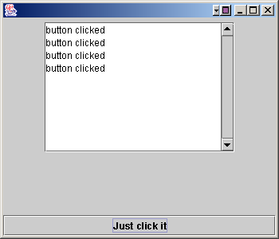
JTextArea
JFrame jf = new JFrame();
JPanel jp = new JPanel();
JButton jb = new JButton("Just click it");
jb.addActionListener(this);
text = new JTextArea(10,20);
text.setLineWrap(true);
JScrollPane scroller = new JScrollPane(text);
scroller.setVerticalScrollBarPolicy(
ScrollPaneConstants.VERTICAL_SCROLLBAR_ALWAYS);
scroller.setHorizontalScrollBarPolicy(
ScrollPaneConstants.HORIZONTAL_SCROLLBAR_NEVER);
jp.add(scroller);
jf.getContentPane().add(BorderLayout.CENTER,jp);
jf.getContentPane().add(BorderLayout.SOUTH,jb);
Create a JScrollPane and give it the text area that it is going to scroll for

Slide 24
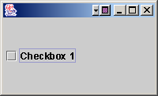
JCheckBox
Constructor: new JCheckBox(“checkbox 1”);
Listen for an item event (when it is selected or deselected):
  check.addItemListener(this);
Handle the event:
  public void itemStateChanged(ItemEvent e) {
  String onOff = “off”;
  if (check.isSelected() ) onOff = “on”;
  }
Select or deselect it in code:
  check.setSelected(true);
  check.setSelected(false);

Slide 25
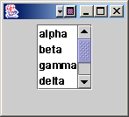
JList
String[] entries = {“alpha”, “beta”, “gamma”, “delta”,
“zeta”, “eta” };
JPanel jp = new JPanel();
JList list = new JList(entries);
JScrollPane scroller = new JScrollPane(list);
scroller.setVerticalScrollBarPolicy(
ScrollPaneConstants.VERTICAL_SCROLLBAR_ALWAYS);
scroller.setHorizontalScrollBarPolicy(
ScrollPaneConstants.HORIZONTAL_SCROLLBAR_NEVER);
jp.add(scroller);
list.setVisibleRowCount(4);
list.setSelectionMode(ListSelectionModel.SINGLE_SELECTION);
jf.getContentPane().add(jp);

Slide 26
Example - Creating a Frame
import javax.swing.*;
public class FrameExample1
{
public static void main(String args[])
{
JFrame f =
new JFrame("Frame Example 1");
f.setSize(400, 300);
f.show();
}
}

Slide 27
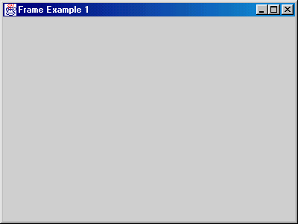
Example - Creating a Frame

Slide 28
Example - Creating a Frame
By default, a frame is sized at at 0x0 pixels, so setSize() is sent to the frame to change it size to 400 pixels wide x 300 pixels high
If the setSize() message is not sent, only the title bar is displayed
setSize() inherited from Component
The show() message is sent to the frame to make it visible and bring it to the front (if it is behind another window)
show() inherited from Window

Slide 29
Example - A Closeable Frame
This frame has a deficiency that limits its usefulness as a basis for developing applications
  clicking on the Close button or selecting Close from the left-most drop-down menu hides the frame but does not close the application
  if the Java interpreter was run from a command line, to stop the program we must close the console window (NT) or issue a kill command(Unix).
This is because nobody is listening to the closing of the window…

Slide 30
GUI Input via the Interface
InputStreams are employed to get input from the user via the keyboard
  it waits for the user to input data and press enter
In a GUI-based program, there can be several sources of input; e.g., clicking a button, moving a slider, typing characters in a text field, etc.
Invoking methods to wait for user input via a specific component won’t work, if multiple input source points
  the interface can have multiple input points
    e.g. Microsoft Word can get input from multiple sources
      Menu, Toolbar, Text input, Alt-keystroke
  we can’t predict where the next input will come from

Slide 31
Event-Driven GUI
GUI-based Java programs use the Java Event Model
The Java Virtual Machine watches for the user’s actions on components; e.g.,
  mouse movement/dragging, clicks on components
  key presses
The JVM creates event objects that correspond to these actions, and sends these event objects to listeners which are provided by the program to handle the events

Slide 32
Event-Driven GUI
java.awt.AWTEvent extends EventObject and is the superclass of all Java 1.1 AWT events
Each AWT event is represented by its own subclass; e.g.,
  java.awt.event.WindowEvent
  java.awt.event.MouseEvent
Swing adds additional event classes, but uses the Java 1.1 event model
Listening is done via Listener Interfaces, whose functions fire when events occur, dispatching an event object to the functions, which must be implemented

Slide 33

Mouse Event and Listener with Other Listeners
Component
EventListener
listenerList
addMouseListener(listener)
removeMouseListener(listener)
processMouseEvent(mouseEvent)
...
MouseListener
MouseMotionListener
mouseClicked(mouseEvent)
mousePressed(mouseEvent)
mouseReleased(mouseEvent)
mouseEntered(mouseEvent)
mouseExited(mouseEvent)
KeyListener
ActionListener
mouseEvent(
MOUSE_PRESSED,
123, 456)
Functions of the interface
all must be
explicitly implemented
(Note: Some will be empty)
MouseEvent
getX()
getY()
getClickCount()

Slide 34
Events
EventObject
AWTEvent
getSource()
getID()
ComponentEvent
ActionEvent
other AWT events
many notification event types
getComponent()
InputEvent
FocusEvent
WindowEvent
getModifiers()
getWhen()
ContainerEvent
PaintEvent
MouseEvent
KeyEvent
getX()
getY()
getClickCount()

Slide 35
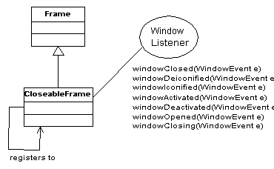
Class diagram for ClosableFrame
We can now design a subclass of JFrame called CloseableFrame
that behaves as expected when the Close button is clicked
Java Multiple Inheritance: One class + Interface(s)

Slide 36
Example - A Closeable Frame
import javax.swing.*;
import java.awt.event.*;
public class CloseableFrame
extends JFrame
implements WindowListener
{

Slide 37
Example - A Closeable Frame
public CloseableFrame()
{
super();
addWindowListener(this);
}
public CloseableFrame(String str)
{
super(str);
addWindowListener(this);
}

Slide 38
Example - A Closeable Frame
public void
windowClosed(WindowEvent event)
{} // Do nothing!
public void
windowDeiconified(WindowEvent event)
{}
public void
windowIconified(WindowEvent event)
{}

Slide 39
Example - A Closeable Frame
public void
windowActivated(WindowEvent event)
{} // Do nothing!
public void
windowDeactivated(WindowEvent event)
{}
public void
windowOpened(WindowEvent event)
{}

Slide 40
Example - A Closeable Frame
public void
windowClosing(WindowEvent event)
{
// dispose of the JFrame object
dispose();
// terminate the program
System.exit(0);
}

Slide 41
Example - A Closeable Frame
public static void main(String args[])
{
JFrame f = new CloseableFrame
("Closeable Frame");
f.setSize(400, 300);
f.show();
}
}

Slide 42
CloseableFrame Constructors
JFrame has two useful constructors:
  JFrame() creates an untitled JFrame object
  JFrame(String title) creates a JFrame object with the specified title
Our CloseableFrame class provides similar constructors

Slide 43
CloseableFrame
When a window is opened, closing, closed, activated, deactivated, iconified, or deiconified, it sends a WindowEvent object to its WindowListener object
CloseableFrame is-a JFrame is-a Frame is-a Window, so a CloseableFrame object will send WindowEvents
When the Close button is clicked, it notifies the listener object by invoking the object’s windowClosing() method

Slide 44
Closing the Window
We could create a separate class for the listener object; but instead, the CloseableFrame object serves as its own listener for WindowEvent events
  CloseableFrame implements the WindowListener interface
  the frame registers itself as its own listener by sending itself the addWindowListener(this) message (addWindowListener() inherited from Window)

Slide 45
CloseableFrame
We want to terminate the application when the CloseableFrame object is closing, so we are interested in the windowClosing() method
  CloseableFrame must implement the other 6 methods listed in the WindowListener interface, but they can have empty bodies
When the window’s Close button is pushed, it invokes the windowClosing() method of its listener; i.e., the windowClosing() method in class CloseableFrame

Slide 46
Structure of a JFrame object
Title
JFrame
JRootPane
JLayeredPane
optional menu bar
content pane
glass pane
Adapted from Core Java 1.2,
Volume 1 - Fundamentals,
Horstmann & Cornell

Slide 47
JFrame
Methods for manipulating these parts
  public Container getContentPane()
  public Component getGlassPane()
  public JMenuBar getJMenuBar()
  public JLayeredPane getLayeredPane()
  public JRootPane getRootPane()
  public void setContentPane(…)
  public void setGlassPane(…)
  public void setJMenuBar(…)
  public void setLayeredPane(…)
  public void setRootPane(…)

Slide 48
Example : Adding a menu to a JFrame
Title
JMenuBar
File Edit Search View
Undo
Redo
Cut
Copy
Paste
JMenu
JMenuItem

Slide 49
What components make up a Menu Bar ?
Container
JComponent
AbstractButton
JMenuBar
+add(m:JMenu):JMenu
JMenuItem
getComponent():Component
JMenu
+add(i:JMenuItem)JMenuItem

Slide 50
What inputs come from a menu bar ?
In response to a user clicking on a JMenuItem object, the Java runtime will generate a java.awt.event.ActionEvent object
In order to respond to the ActionEvent, an object must implement java.awt.event.ActionListener that has a single method :
public void actionPerformed(ActionEvent e);
EventObject
+getSource():Object
AWTEvent
ActionEvent
+getActionCommand():String

Slide 51
Adding a menu to a JFrame
public class MenuFrame extends JFrame
implements ActionListener
{
public MenuFrame() {
// Set up frame itself – title,size,location
JMenuBar menuBar = new JMenuBar( );
setJMenuBar( menuBar );
JMenu fileMenu = new JMenu( "File" );
menuBar.add( fileMenu );
JMenu editMenu = new JMenu( "Edit" );
menuBar.add( editMenu );
JMenu searchMenu = new JMenu( "Search" );
menuBar.add( searchMenu );
JMenu viewMenu = new JMenu( "View" );
menuBar.add( viewMenu );

Slide 52
Adding a menu to a JFrame
JMenuItem item;
item = new JMenuItem ( "Undo" );
item.addActionListener( this );
editMenu.add( item );
item = new JMenuItem ( "Redo" );
item.addActionListener( this );
editMenu.add( item );
… // etc for Cut, Copy, Paste

Slide 53
Adding a menu to a JFrame
public void actionPerformed( ActionEvent e )
{
System.out.println ( e.getSource() );
System.out.println ( e.getActionCommand() );
}
If you select Edit->Undo :
javax.swing.JMenuItem[…]
Undo

Slide 54
Layout Manager
A layout manager is a Java object associated with a particular component (usually with a background component)
The layout manager controls the components contained within the component the layer manager is associated with
E.g. if a frame holds a panel, and the panel holds a button, the panel’s layout manager control s the size and placement of the button, and the frame’s layout manager controls the size and placement of the panel, and the button does not need a layout manager
A panel holds 5 things (north, east, south, west, center): even if the 5 things each have their own layout managers, the size and location of the 5 things in the panel are controlled by the panel’s layout manager
Different background components have different types of layout managers, different layout managers have different layout policies
Commonly used layout managers:
  BorderLayout: default for a frame
  FlowLayout: default for a panel
  BoxLayout

Slide 55
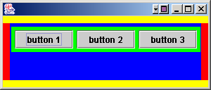
Nested Layouts
import javax.swing.*;
import java.awt.event.*;
public class SimpleGUI1 implements ActionListener {
…
JPanel panelA = new JPanel();
JPanel panelB = new JPanel();
panelB.add(new JButton(“button 1”));
panelB.add(new JButton(“button 2”));
panelB.add(new JButton(“button 3”));
panelA.add(panelB);
panelA.setColor(Color.blue);
panelB.setColor(Color.green);
…
}
Both panelA and panelB have their own layout managers.

Slide 56
BorderLayout
A BorderLayout manager divides a background component into 5 regions
You can only add one component per region
Components layed out by this manager usually don’t get to have their preferred size
BorderLayout is the default layout manager for a frame
north
west
center
east
south

Slide 57
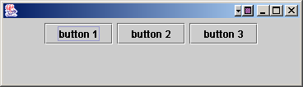
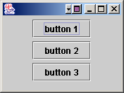
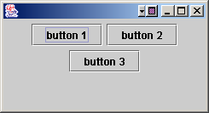
FlowLayout
A FlowLayout manager acts kind of like a word processor, except with components instead of words
Each component is the size it wants to be, and they are laid out left to right in the order that they are added, with “word-wrap” turned on
When a component won’t fit horizontally, it drops to the next “line” in the layout
Default layout manager for a panel

Slide 58
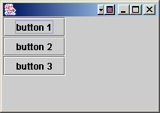
BoxLayout
A BoxLayout manager is like FlowLayout in that each component gets to have its own size, and the components are placed in the order they are added
A BoxLayout can stack the components vertically or horizontally (instead of automatic ‘component wrapping’)

Slide 59
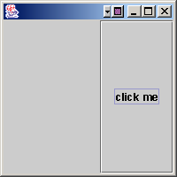
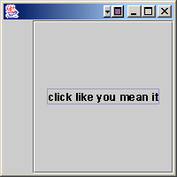
How is a BorderLayout laid out?
…
JButton jb = new JButton(“click me”);
jf.getContentPane().add(BorderLayout.EAST,jb);
jf.setSize(200,200);
…
…
JButton jb = new JButton(“click like you mean it”);
jf.getContentPane().add(BorderLayout.EAST,jb);
jf.setSize(200,200);
…
Since it is the east region or a border layout, the preferred width is respected, but the height will be as tall as the frame.

Slide 60
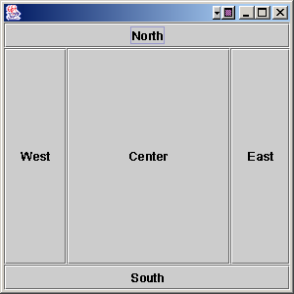
How BorderLayout layout?
When something is put in the north or south, it goes all the way across the frame, so the things in the east and west will not be as tall as the frame
Components in the east and west get their preferred width
Components in the north and south get their preferred height
Components in the center get whatever space is left over, based on the frame dimensions

Slide 61
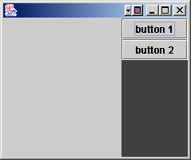
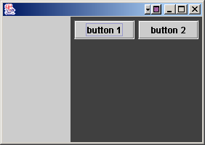
BorderLayout and FlowLayout together
  JFrame jf = new JFrame();
  JPanel jp = new JPanel();
  jp.setBackground(Color.darkGray);
  JButton jb1 = new JButton(“button 1”);
  JButton jb2 = new JButton(“button 2”);
  jp.add(jb1);
  jp.add(jb2);
  jf.getContentPane().add(BorderLayout.EAST,jp);
  jf.setSize(250,200);
  jf.setVisible(true);
  Which layout on the left corresponds to the above code?
  How to get the other one?

Slide 62
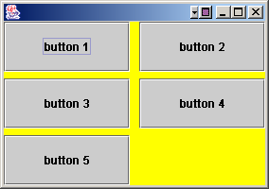
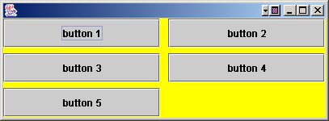
GridLayout
GridLayout
Sets up a grid (each cell is the same size)
(m x n) layout
frame.getContentPane().setLayout(new GridLayout(3,2,10,7));
(Row, Col,
Horizontal Gap,
Vertical Gap)

Slide 63
Layout Managers
Predefined layout managers defined in the Java standard class libraries:
Flow Layout
Border Layout
Card Layout
Grid Layout
GridBag Layout
Defined in the AWT
Box Layout
Overlay Layout
Defined in Swing

Slide 64
Layout Managers
Every container has a default layout manager, but we can also explicitly set the layout manager for a container
Each layout manager has its own particular rules governing how the components will be arranged
Some layout managers pay attention to a component's preferred size or alignment, and others do not
The layout managers attempt to adjust the layout as components are added and as containers are resized

Slide 65
Special Features
Swing components offer a variety of other features
Tool tips provide a short pop-up description when the mouse cursor rests momentarily on a component
Borders around each component can be stylized in various ways
Keyboard shortcuts called mnemonics can be added to graphical objects such as buttons
Check the Sun Tutorial for more info

Slide 66
The Graphics Class
paintComponent() is passed a reference to a Graphics object
A Graphics object is a device-independent interface to the computer's graphics display
Most of its methods are concerned with drawing shapes (filled and unfilled), and managing fonts and colours
paintComponent() sends the Graphics object
  the drawOval() message, to draw each point
  the drawLine() message, to draw the straight line

Slide 67
Some Graphics Methods
drawString()
drawOval(), fillOval()
drawRect(), fillRect(), clearRect()
drawRoundRect(), fillRoundRect()
draw3DRect(), fill3DRect()
drawArc(), fillArc()
drawPolygon(), fillPolygon()
drawPolyline()

Slide 68
Graphics Usage
Put your own graphics on the screen:
  Create your own paintable widget
  Put the widget on the frame
  Display it
  import java.awt.*;
  import javax.swing.*;
  class MyDrawPanel extends JPanel {
  public void paintComponent(Graphics g) {
  g.setColor(Color.orange);
  g.fillRect(20,50,100,100);
  }
  }
Make a subclass of JPanel, a widget that can be added to a frame, and override the paintComponent() method
paintComponent() is called by the system when it is time to paint the widget
g is a Graphic object that is the actual drawing surface that mapped to the real display, and is handed to you by the system
Draw a rectangle with orange color

