Slide 1
Selecting the Appropriate Development Methodology
Notes:
Choosing a methodology is not simple, because
no one methodology is always best (if it were, we’d simply use it everywhere!).
Many organizations have standards and policies to guide the choice of methodology.
You will find that organizations range from having one “approved” methodology
to having several methodology options to having no formal policies at all.

Slide 3
Notes:
Many of the RAD methodologies require the use of new tools and techniques
that have a significant learning curve. Often these tools and techniques
increase the complexity of the project and require extra time for learning. Once they
are adopted and the team becomes experienced, the tools and techniques can significantly
increase the speed in which the methodology can deliver a final system.
Users normally need to interact with technology
to really understand what the new system can do and how to best apply it
to their needs.
The RAD methodologies of prototyping and throwaway prototyping
are usually more appropriate when user requirements are unclear because they provide prototypes for users to interact with early in the SDLC. Agile development
may also be appropriate if on-site user input is available.

Slide 4
Notes:
When the system will use new technology with
which the analysts and programmers are not familiar (e.g., the first Web development
project with Java), applying the new technology early in the methodology
will improve the chance of success. If the system is designed without some familiarity
with the base technology, risks increase because the tools may not be capable
of doing what is needed. Throwaway prototyping-based methodologies are
particularly appropriate for a lack of familiarity with technology because they
explicitly encourage the developers to create design prototypes for areas with
high risks. Phased development-based methodologies are good as well because
they create opportunities to investigate the technology in some depth before the
design is complete. While one might think prototyping-based methodologies
would also be appropriate, they are much less so, because the early prototypes
that are built usually only scratch the surface of the new technology. Usually, it is
only after several prototypes and several months that the developers discover
weaknesses or problems in the new technology.

Slide 5
System Complexity
Complex systems require careful and detailed analysis and design.
Throwaway prototyping-based methodologies are particularly well suited to such detailed analysis and design, but prototyping-based methodologies are not.
Notes:
The throwaway prototyping-based methodologies have a relatively thorough
analysis phase that is used to gather information and to develop ideas for the system
concept. Many of the features suggested by the users may not be well understood,
however, and there may be challenging technical issues to be solved.

Slide 6
System Reliability
System reliability is usually an important factor in system development.
For some applications reliability is truly critical(e.g., medical equipment, missile control systems), while not important for others (e.g., games, Internet video).
Throwaway prototyping-based methodologies are most appropriate when system reliability is a high priority, because they combine detailed analysis and design phases with the ability for the project team to test many different approaches through design prototypes before completing the design.
Notes:
After all, who wants an unreliable system? However, reliability is
just one factor among several

Slide 7
Prototyping-based methodologies are generally not a good choice when reliability is critical because they lack the careful analysis and design phases that are essential for dependable systems.

Slide 8
Short Time Schedules
Projects that have short time schedules are well suited for RAD-based methodologies because those methodologies are designed to increase the speed of development.
Prototyping and phased development-based methodologies are excellent choices when timelines are short because they best enable the project team to adjust the functionality in the system on the basis of a specific delivery date.
Notes:
If the project schedule starts to slip, it can be readjusted by removing
functionality from the version or prototype under development. Waterfallbased
methodologies are the worst choice when time is at a premium because
they do not allow for easy schedule changes

Slide 9
Notes:
Project members are change agents who
identify ways to improve an organization, build an information system to support
them, and train and motivate others to use the system. Leading a successful organizational
change effort is one of the most difficult jobs that someone can do. Understanding
what to change, how to change it, and convincing others of the need for
change requires a wide range of skills
Analysts must have the technical skills to understand the organization’s existing
technical environment, the new system’s technology foundation, and the way in
which both can be fit into an integrated technical solution. Business skills are
required to understand how IT can be applied to business situations and to ensure
that the IT delivers real business value. Analysts are continuous problem solvers at
both the project and the organizational level, and they put their analytical skills to
the test regularly.

Slide 10
Skills and Roles
Technical Skills: Analysts must have the technical skills to understand the organization’s existing technical environment, the new system’s technology foundation, and the way in which both can be fit into an integrated technical solution.
Business skills : These are required to understand how IT can be applied to business situations and to ensure that the IT delivers real business value.
Analytical skills: Analysts are continuous problem solvers at both the project and the organizational level, and they put their analytical skills to the test regularly.
Interpersonal Skills: Often, analysts need to communicate effectively one-on-one with users and business managers (who often have little experience with technology) and with programmers (who often have more technical expertise than the analyst).
Management: Analyst need to manage people with whom they work and they must manage the pressure and risks associated with unclear situations.
Ethical: analysts must deal fairly, honestly, and ethically with other project team members, managers, and system users. Analysts deal with confidential information (e.g.,dissent among employees); it is important to maintain confidence and trust with all people.

Slide 11
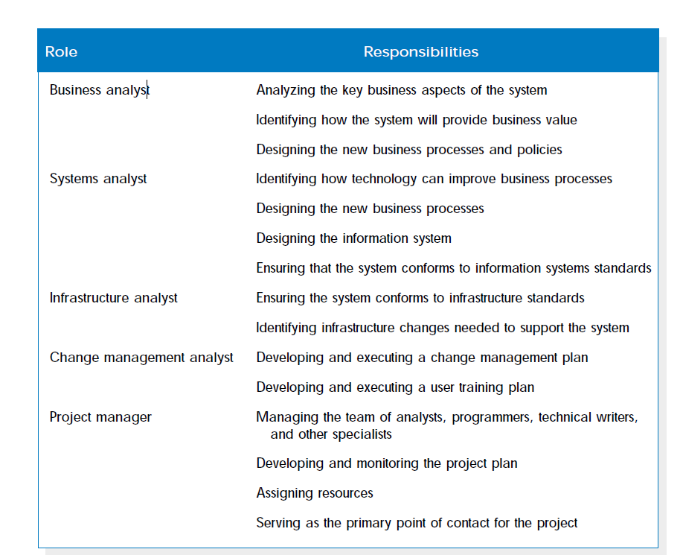

Slide 13
Guidelines for Developing a Prototype
Work in manageable modules
Build the prototype rapidly
Modify the prototype in successive iterations
Stress the user interface

Slide 14
Disadvantages of Prototyping
•It can be difficult to manage prototyping as a project in the larger systems effort
•Users and analysts may adopt a prototype as a completed system
Advantages of Prototyping
•Possibility for changing the system early in its development
•Opportunity to stop development on a system that is not working
•Possibility of developing a system that more closely addresses users’ needs and expectations

Slide 15
Users’ Role in Prototyping
•Honest involvement
•Experimenting with the prototype
•Giving open reactions to the prototype
•Suggesting additions to or deletions from the prototype

Slide 16
RAD (Rapid Application Development
An object-oriented approach to systems development that includes a method of development as well as software tools.
RAD Phases
Requirements planning
RAD design workshop
Implementation
Software Tools for RAD
Microsoft Access, Microsoft Visual Basic, Visual C++, and Microsoft .NET
Differ from one another in their:
Capabilities to support client/server applications
Ease of use and the amount of programming skills that is required

Slide 17
Comparing RAD to the SDLC
•RAD software tools are used to generate screensand exhibit the overall flow of the running of the application
•RAD users are signing off on a visual model representation
•RAD implementation is less stressfulbecause users have helped to design the business aspects of the system

Slide 18
The RAD design workshop and the SDLC approach compared

Slide 19
When to Use RAD
•When the team includes programmers and analysts who are experienced
•When there are pressing reasons for speeding up application development
•The project involves a novel ecommerce application and needs quick results
•Users are sophisticated and highly engaged with the goals of the company

Slide 20
Disadvantages of RAD
•Project is rushed
•Inadequate documentation

Slide 21
Agile Modeling
•Agile methods are a collection of innovative, user-centered approaches to systems development
•This approach tries to define an overall system plan quickly, develop and release software quickly, and then continuously revise the software to add additional features

Slide 22
Values and Principles of Agile Modeling
Communication
Users may critique, and sometimes complain
Simplicity
Feedback
Courage

Slide 23
The Basic Principlesof Agile Modeling
Providing rapid feedback
Assuming simplicity
over 90 percent of problems can be solved with utter simplicity
•Changing incrementally
making the smallest change possible that still results in a difference
•Embracing change
be able to simultaneously solve whatever presents the biggest obstacle
•Encouraging quality work
all participants want to do quality work

Slide 24
Activities, Resources, and Practices of Agile Modeling
Coding -the most valuable thing that we receive from code is “learning.”
Testing -the agile approach views automated tests as critical.
Listening -in the agile approach, listening is done in the extreme.
Designing -a way of creating a structure to organize all of the logic in the system.

Slide 25
User stories can be recorded on cards. The user story should be brief enough for an analyst to determine what systems features are needed

Slide 26
Lessons Learned from Agile Modeling
Short releases allow the system to evolve
Pair programming enhances overall quality
Onsite customers are mutually beneficial to the business and the agile development team
Balanced resources and activities support project goals
Agile values are crucial to success
communication, simplicity, feedback, and courage

