Slide 1
Sorting Algorithms

Slide 2
Sorting
Sorting is a process that organizes a collection of data into either ascending or descending order.
Formally
  Input: A sequence of n numbers <a1,a2,…,an>
  Output: A reordering <a’1,a’2,…,a’n> of the sequence such that a’1 ≤ a’2 ≤ … ≤ a’n
  Given the input <6, 3, 1, 7>, the algorithm should produce
  <1, 3, 6, 7>
    Called an instance of the problem

Slide 3
Sorting
Sorting is a process that organizes a collection of data into either ascending or descending order.
We encounter sorting almost everywhere:
  Sorting prices from lowest to highest
  Sorting flights from earliest to latest
  Sorting grades from highest to lowest
  Sorting songs based on artist, album, playlist, etc.

Slide 4
Sorting Algorithms
There are many sorting algorithms (as of 27.10.2014 there are 44 Wikipedia entries)
In this class we will learn:
  Selection Sort
  Insertion Sort
  Bubble Sort
  Merge Sort
  Quick Sort
    Bogo sort and Sleep sort are some bad/slow algorithms
These are among the most fundamental sorting algorithms

Slide 5
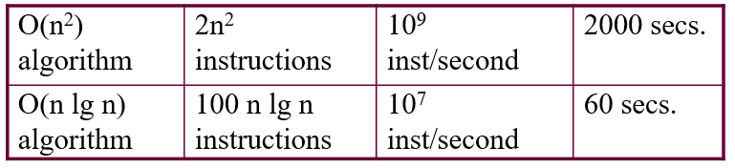
Sorting Algorithms
As we learnt in the Analysis lecture (time complexity), a stupid approach uses up computing power faster than you might think.
Sorting a million numbers:
Interactive graphics: Algorithms must terminate in 1/30 of a sec.

Slide 6
Sorting Algorithms
As we learnt in the Analysis lecture (time complexity), a stupid approach uses up computing power faster than you might think.
Sorting a million numbers:
https://youtu.be/kPRA0W1kECg

Slide 7
Selection Sort
Partition the input list into a sorted and unsorted part (initially sorted part is empty)
Select the smallest element and put it to the end of the sorted part
Increase the size of the sorted part by one
Repeat this n-1 times to sort a list of n elements

Slide 8
Sorted
Unsorted
23 | 78 | 45 | 8 | 32 | 56
8 | 78 | 45 | 23 | 32 | 56
8 | 23 | 45 | 78 | 32 | 56
8 | 23 | 32 | 78 | 45 | 56
8 | 23 | 32 | 45 | 78 | 56
8 | 23 | 32 | 45 | 56 | 78
Original List
After pass 1
After pass 2
After pass 3
After pass 4
After pass 5

Slide 9
Selection Sort (cont.)
template <class Item>
void selectionSort(Item a[], int n) {
for (int i = 0; i < n-1; i++) {
int min = i;
for (int j = i+1; j < n; j++)
if (a[j] < a[min]) min = j;
swap(a[i], a[min]);
}
}
template < class Object>
void swap( Object &lhs, Object &rhs )
{
Object tmp = lhs;
lhs = rhs;
rhs = tmp;
}

Slide 10
Selection Sort -- Analysis
What is the complexity of selection sort?
Does it have different best, average, and worst case complexities?

Slide 11
Selection Sort – Analysis (cont.)
Selection sort is O(n²) for all three cases (prove this)
Therefore it is not very efficient

Slide 12
Insertion Sort
Insertion sort is a simple sorting algorithm that is appropriate for small inputs.
  Most common sorting technique used by card players.
Again, the list is divided into two parts: sorted and unsorted.
In each pass, the first element of the unsorted part is picked up, transferred to the sorted sublist, and inserted at the appropriate place.
A list of n elements will take at most n-1 passes to sort the data.

Slide 13
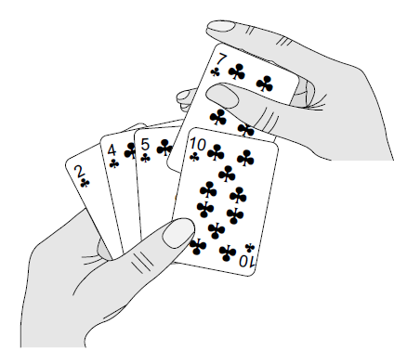
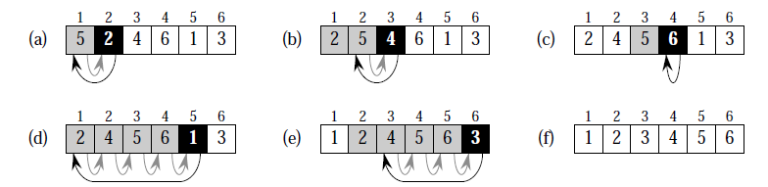
Insertion Sort

Slide 14
Sorted
Unsorted
23 | 78 | 45 | 8 | 32 | 56
23 | 78 | 45 | 8 | 32 | 56
23 | 45 | 78 | 8 | 32 | 56
8 | 23 | 45 | 78 | 32 | 56
8 | 23 | 32 | 45 | 78 | 56
8 | 23 | 32 | 45 | 56 | 78
Original List
After pass 1
After pass 2
After pass 3
After pass 4
After pass 5

Slide 15
Insertion Sort Algorithm
template <class Item>
void insertionSort(Item a[], int n)
{
for (int i = 1; i < n; i++)
{
Item tmp = a[i]; // the element to be inserted
int j;
for (j=i; j>0 && tmp < a[j-1]; j--)
a[j] = a[j-1]; // shift elements
a[j] = tmp; // insert
}
}

Slide 16
Insertion Sort – Analysis
Running time depends on not only the size of the array but also the contents of the array.
Best-case: ➔ O(n)
  Array is already sorted in ascending order.
Worst-case: ➔ O(n²)
  Array is in reverse order:
Average-case: ➔ O(n²)
  We have to look at all possible initial data organizations.

Slide 17
Analysis of insertion sort
Which running time will be used to characterize this algorithm?
  Best, worst or average?
Worst:
  Longest running time (this is the upper limit for the algorithm)
  It is guaranteed that the algorithm will not be worse than this.
Sometimes we are interested in average case. But there are some problems with the average case.
  It is difficult to figure out the average case. i.e. what is average input?
  Are we going to assume all possible inputs are equally likely?
  In fact for most algorithms average case is same as the worst case.

Slide 18
Bubble Sort
Repeatedly swap adjacent elements that are out of order.
https://youtu.be/vxENKlcs2Tw
Sort pairs of elements far apart from each other, then progressively reduce the gap between elements to be compared. Starting with far apart elements, it can move some out-of-place elements into position faster than a simple nearest neighbor exchange. This generalization is called Shell Sort.

Slide 19
Bubble Sort
23 | 78 | 45 | 8 | 32 | 56
23 | 45 | 78 | 8 | 32 | 56
23 | 45 | 8 | 78 | 32 | 56
23 | 45 | 8 | 32 | 78 | 56
23 | 45 | 8 | 32 | 56 | 78
23 | 8 | 45 | 32 | 56 | 78
8 | 23 | 45 | 32 | 56 | 78
8 | 23 | 32 | 45 | 56 | 78

Slide 20
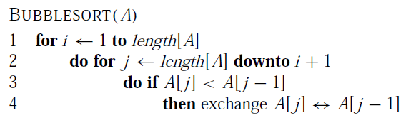
Bubble Sort Algorithm
template <class Item>
void bubleSort(Item a[], int n)
{
bool sorted = false;
int last = n-1;
for (int i = 0; (i < last) && !sorted; i++){
sorted = true;
for (int j=last; j > i; j--)
if (a[j-1] > a[j]{
swap(a[j],a[j-1]);
sorted = false; // signal exchange
}
}
}

Slide 21
Bubble Sort – Analysis
Best-case: ➔ O(n)
  Array is already sorted in ascending order.
Worst-case: ➔ O(n²)
  Array is in reverse order:
Average-case: ➔ O(n²)
  We have to look at all possible initial data organizations.
In fact, any sorting algorithm which sorts elements by swapping adjacent elements can be proved to have an O(n²) average case complexity

Slide 22
Theorem
Any sorting algorithm which sorts elements by swapping adjacent elements can be proved to have an O(n²) average case complexity
To understand this, consider the following array:
  [3, 2, 1]
Here, we have three inversions: (3, 2), (3, 1), (2, 1)
An inversion is defined as a pair (a, b) where a > b and index(a) < index(b)
Note that a single swap of adjacent elements can only remove one inversion. Thus, for the above example we need 3 swaps to make the array sorted

Slide 23
Theorem
Generalizing this, for an array of n elements, there can be C(n,2) total pairs (where C represents combination)
C(n,2) = n(n-1) / 2
We can assume that, on average, half of these pairs are inversions.
Average number of inversions = n(n-1) / 4
As each swap of adjacent elements can remove a single inversion, we need n(n-1) / 4 swaps to remove all inversions (that is to make the array sorted)
The complexity of n(n-1) / 4 swaps is equal to O(n²)
This is the lower bound on the average case complexity of sorting algorithms that sort by swapping adjacent elements

Slide 24
Recursive Insertion Sort
To sort A[1..n], we recursively sort A[1..n-1] and then insert A[n] into the sorted array A[1..n-1]
A good practice of recursion
  Code?

Slide 25
Recursive Insertion Sort
To sort A[1..n], we recursively sort A[1..n-1] and then insert A[n] into the sorted array A[1..n-1]
insertionSortRec(A, n)
{
if (n>1)
insertionSortRec(A, n-1)
insertKeyIntoSubarray(A[n], A[1..n-1]) //trivial; can //be done in //O(n)
}

Slide 26
Recursive Insertion Sort
To sort A[1..n], we recursively sort A[1..n-1] and then insert A[n] into the sorted array A[1..n-1]
A = 5 2 4 6 1 3
insertKeyIntoSubarray
1 2 4 5 6 3
2 4 5 6 1
2 4 5 6
2 5 4
5 2

Slide 27
Recursive Insertion Sort
To sort A[1..n], we recursively sort A[1..n-1] and then insert A[n] into the sorted array A[1..n-1]
T(n) = T(n-1) + O(n) is the time complexity of this sorting

Slide 28
Recursive Insertion Sort
To sort A[1..n], we recursively sort A[1..n-1] and then insert A[n] into the sorted array A[1..n-1]
T(n) = T(n-1) + O(n)
  Reduce the problem size to n-1 w/ O(n) extra work
  Seems to be doing O(n) work n-1 times; so O(n²) guess?
  T(n) ≤ cn² //assume holds
  T(n) ≤ c(n-1)² + dn
  = cn² -2cn + c + dn
  = cn² –c(2n -1) + dn
  ≤ cn² //because large values of c dominates d

Slide 29
Recurrences
How about the complexity of T(n) = T(n/2) + O(1)
  Reduce the problem size to half w/ O(1) extra work
  Seems to be doing O(1) work logn times; so O(logn) guess?
  T(n) ≤ clogn //assume holds
  T(n) ≤ c(log(n/2)) + d
  = clogn – clog2 + d
  = clogn – e //c can always selected to be > constant d
  ≤ clogn

Slide 30
Recurrences
How about the complexity of T(n) = 2T(n/2) + O(n)
  Reduce the problem to 2 half-sized problems w/ n extra work
  Seems to be doing O(n) work logn times; so O(nlogn) guess?
  T(n) ≤ cnlogn //assume holds
  T(n) ≤ 2c(n/2 log(n/2)) + dn
  = cnlogn – cnlog2 + dn
  = cnlogn – n(c’ + d) //c’ = clog2
  ≤ cnlogn

Slide 31
Recurrences
How about the complexity of T(n) = T(n-1) + T(n-2)
  Reduce? the problem to a twice bigger one w/ no extra work
  T(n-1) + T(n-2) > 2T(n-2) ➔ n replaced by 2n-4 (doubled)
  Or, n-size problem replaced with 2n-3 size problem (doubled)
  Seems to be doubling the problem size; so O(2^{n}) is good guess

Slide 32
Fast Algorithm
Describe an algorithm that, given a set S of n integers and another integer x, determines whether or not there exists 2 elements in S whose sum is exactly x
  O(n²) //brute force

Slide 33
Fast Algorithm
Describe an algorithm that, given a set S of n integers and another integer x, determines whether or not there exists 2 elements in S whose sum is exactly x
  O(nlogn) //sort followed by binary search

Slide 34
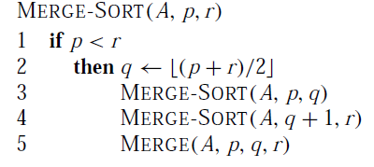
Mergesort
Mergesort algorithm is one of two important divide-and-conquer sorting algorithms (the other one is quicksort).
It is a recursive algorithm.
  Divides the list into halves,
  Sort each halve separately (recursively), and
  Then merge the sorted halves into one sorted array.
https://youtu.be/es2T6KY45cA

Slide 35
Mergesort - Example
6 | 3 | 9 | 1 | 5 | 4 | 7 | 2
divide
6 | 3 | 9 | 1
5 | 4 | 7 | 2
divide
divide
6 | 3
9 | 1
5 | 4
7 | 2
divide
divide
divide
divide
6
3
9
1
5
4
7
2
merge
merge
merge
merge
3 | 6
1 | 9
4 | 5
2 | 7
merge
merge
1 | 3 | 6 | 9
2 | 4 | 5 | 7
merge
1 | 2 | 3 | 4 | 5 | 6 | 7 | 9

Slide 36
Merge
const int MAX_SIZE = maximum-number-of-items-in-array;
void merge(DataType theArray[], int first, int mid, int last)
{
DataType tempArray[MAX_SIZE]; // temporary array
int first1 = first; // beginning of first subarray
int last1 = mid; // end of first subarray
int first2 = mid + 1; // beginning of second subarray
int last2 = last; // end of second subarray
int index = first1; // next available location in tempArray
for ( ; (first1 <= last1) && (first2 <= last2); ++index)
if (theArray[first1] < theArray[first2])
tempArray[index] = theArray[first1++];
else
tempArray[index] = theArray[first2++];

Slide 37
Merge (cont.)
// finish off the first subarray, if necessary
for (; first1 <= last1; ++first1, ++index)
tempArray[index] = theArray[first1];
// finish off the second subarray, if necessary
for (; first2 <= last2; ++first2, ++index)
tempArray[index] = theArray[first2];
// copy the result back into the original array
for (index = first; index <= last; ++index)
theArray[index] = tempArray[index];
}

Slide 38
Mergesort
void mergesort(DataType theArray[], int first, int last) {
if (first < last) { // more than one item
int mid = (first + last)/2; // index of midpoint
mergesort(theArray, first, mid);
mergesort(theArray, mid+1, last);
// merge the two halves
merge(theArray, first, mid, last);
}
} // end mergesort

Slide 39
Analysis of Mergesort
What is the complexity of the merge operation for merging two lists of size n/2?
It is O(n) as we need to copy all elements
Then the complexity of mergesort can be defined using the following recurrence relation:
T(n) = 2T(n/2) + n
Solving this relation gives us O(nlogn) complexity //Slide 30
The complexity is the same for the best, worst, and average cases
The disadvantage of mergesort is that we need to use an extra array for the merge operation (not memory efficient)

Slide 40
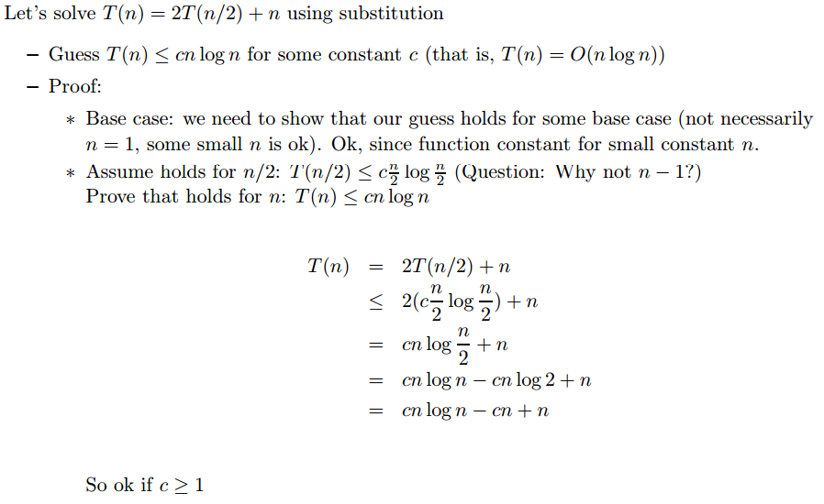
Analysis of Mergesort
Solving T(n) = 2T(n/2) + n gives us O(nlogn) complexity

Slide 41
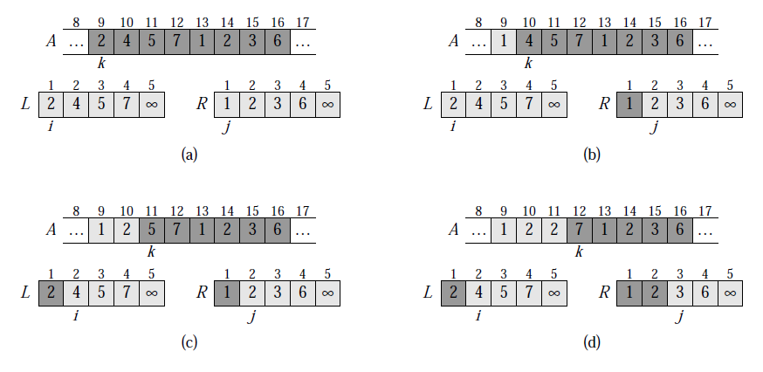
Merging Step (Linear time)
Extra array for merge operation

Slide 42
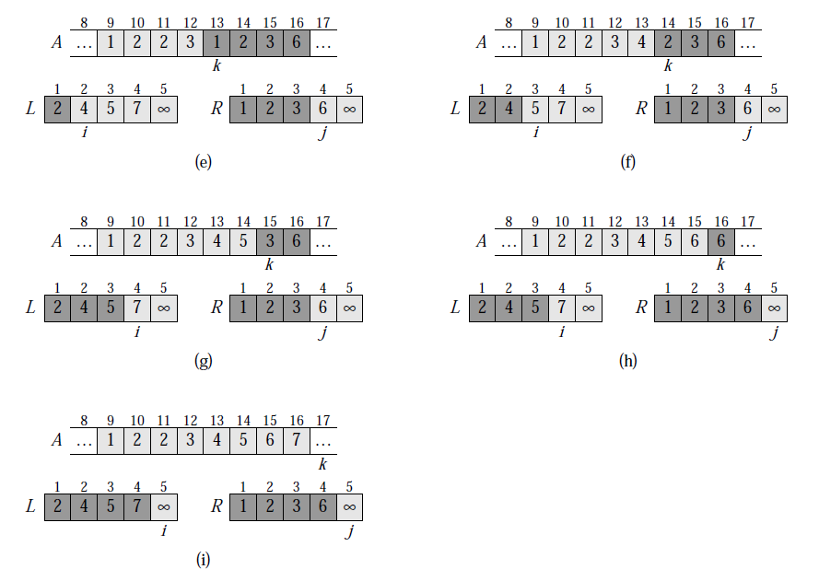
Merging Step (Linear time)

Slide 43
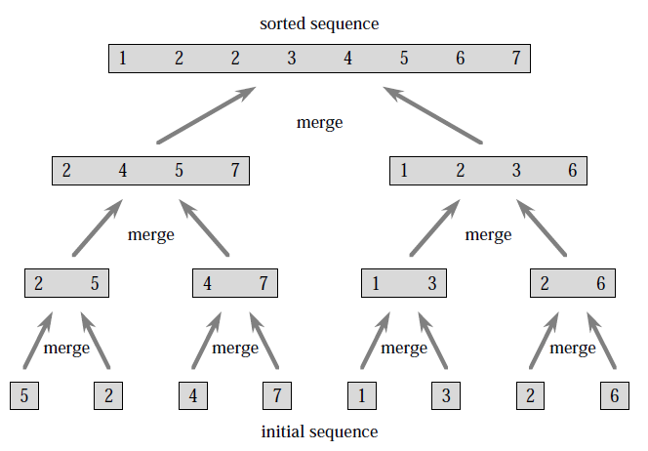
Demo
On array = {5, 2, 4, 7, 1, 3, 2, 6}

Slide 44
Quicksort
Like mergesort, quicksort is also based on
the divide-and-conquer paradigm.
But it uses this technique in a somewhat opposite manner,
as all the hard work is done before the recursive calls.
It works as follows:
  First selects a pivot element,
  Then it partitions an array into two parts (elements smaller than and greater than or equal to the pivot)
  Then, it sorts the parts independently (recursively),
  Finally, it combines the sorted subsequences by
  a simple concatenation.
https://youtu.be/vxENKlcs2Tw

Slide 45
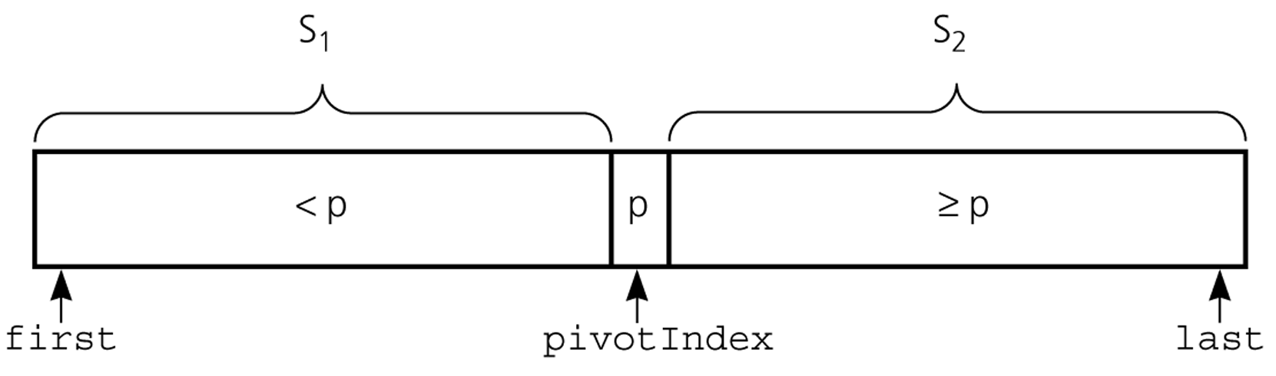
Partition
Partitioning places the pivot in its correct place position within the array.
Arranging the array elements around the pivot p generates two smaller sorting problems.
  sort the left section of the array, and sort the right section of the array.
  when these two smaller sorting problems are solved recursively, our bigger sorting problem is solved.

Slide 46
Pivot Selection
Which array item should be selected as pivot?
  Somehow we have to select a pivot, and we hope that we will get a good partitioning.
  If the items in the array arranged randomly, we choose a pivot randomly.
  We can choose the first or last element as the pivot (it may not give a good partitioning).
  We can choose the middle element as the pivot
  We can use a combination of the above to select the pivot (in each recursive call a different technique can be used)

Slide 47
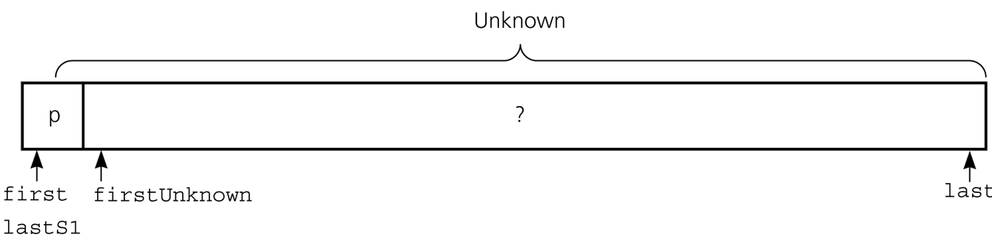
Partitioning
Initial state of the array

Slide 48
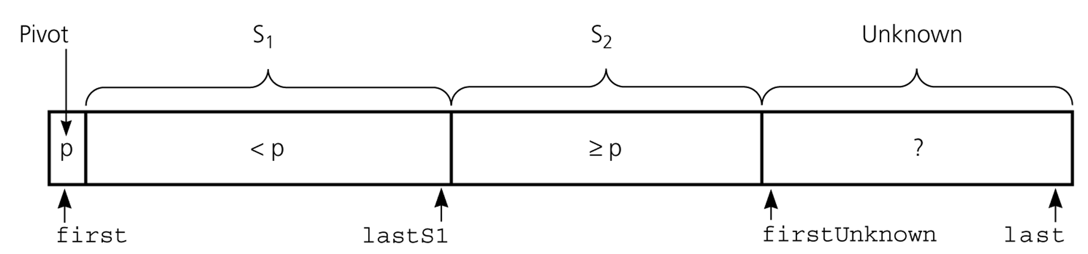
Partitioning

Slide 49
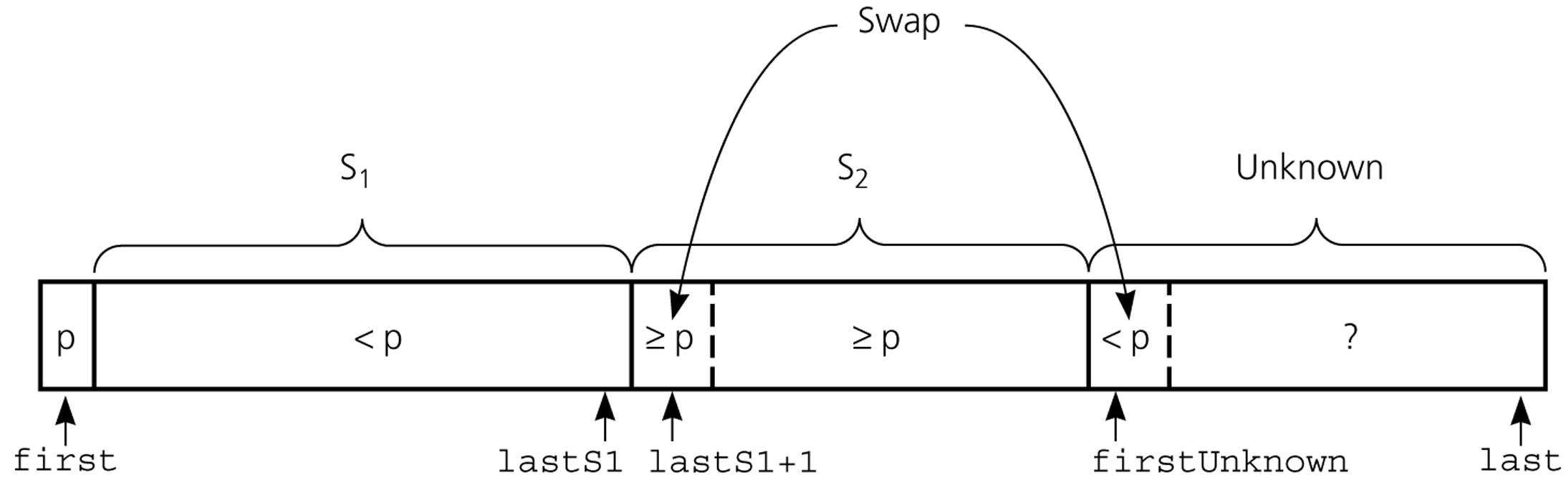
Partitioning
Moving theArray[firstUnknown] into S₁ by swapping it with
theArray[lastS1+1] and by incrementing both lastS1 and firstUnknown.

Slide 50
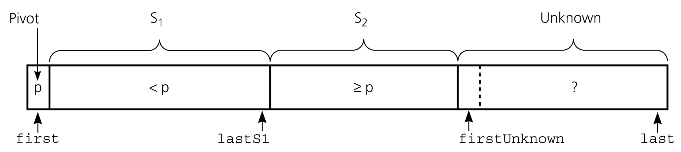
Partitioning
Moving theArray[firstUnknown] into S₂ by incrementing firstUnknown.

Slide 51
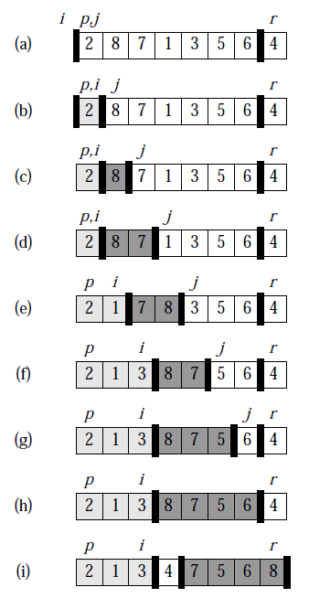
Partitioning – An Example

Slide 52
Partition Function
template <class DataType>
void partition(DataType theArray[], int first, int last,
int &pivotIndex) {
int pIndex = choosePivot(theArray, first, last);
// put pivot at position first
swap(theArray[pIndex], theArray[first]);
DataType pivot = theArray[first]; // copy pivot

Slide 53
Partition Function (cont.)
int lastS1 = first; // index of last item in S1
int firstUnknown = first + 1; //index of 1st item in unknown
// move one item at a time until unknown region is empty
for (; firstUnknown <= last; ++firstUnknown) {
if (theArray[firstUnknown] < pivot)
++lastS1;
swap(theArray[firstUnknown], theArray[lastS1]);
}
// place pivot in proper position and mark its location
swap(theArray[first], theArray[lastS1]);
pivotIndex = lastS1;
}

Slide 54
Quicksort Function
void quicksort(DataType theArray[], int first, int last) {
int pivotIndex;
if (first < last) {
partition(theArray, first, last, pivotIndex);
// sort regions S1 and S2
quicksort(theArray, first, pivotIndex-1);
quicksort(theArray, pivotIndex+1, last);
}
}

Slide 55
Quicksort – Analysis
If we always select the smallest or largest element as the pivot, we’ll not be able to divide the array into similar sized partitions
In that case, the complexity of the quicksort can be defined by:
T(n) = n + T(1) + T(n-1)
This gives O(n²) complexity (worst case) //Slide 28
If our partitions are equal sized we have:
  T(n) = n + 2T(n/2) (same as mergesort)
This gives O(nlogn) complexity (best case)
On average, quicksort has been proven to have O(nlogn) complexity as well (based on alternation b/w good/bad partitions)
It also does not need an extra array like mergesort
Therefore, it is the most popular sorting algorithm

Slide 56
C/C++ Language Support
We can implement sorting algorithms ourselves
We can also use existing implementations
In C, the function qsort (part of stdlib.h header) implements the quicksort algorithm
In C++ std::sort (part of algorithm header) implements a mixture of quicksort, heapsort, and insertion sort
Many sorting algorithms in comparison: https://youtu.be/ZZuD6iUe3Pc

Slide 57
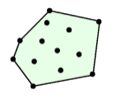
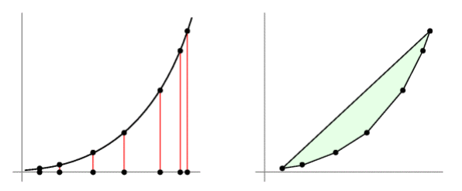
Sorting vs. Geometry
A cool reduction of Convex Hull problem into Sorting problem
This is the convex hull of the point set P:
  Release a large rubber band around points/nails
Given unsorted a0, a1, a2, .., an, construct set of points in the plane via ai=ai² parabola as shown at left
Every point must be on the convex hull ‘cos parabolas are convex
Convex hull of this parabola = Ordered hull vertices = Sorting

