Slide 1

Unix Systems Administration (Linux)
Essential Task Of System
Adninistrator

Slide 2
SA Task
Adding and Removing users
  Adds account
  Remove accounts that are no longer active
  Can automate process
  Makes administrative decisions
Adding and Removing Hardware
  Add and configure new hardware (eg printer or hard drive)
  Remove hardware devices
Notes:
Linux itself is actually only the kernel, which we can refer to as the core of the operating system. The kernels duty is to manage the interface to the hardware, including memory, CPU, storage and other peripherals.
The kernel is also responsible for maintaining user processes, and to schedule their access to the resources they require.

Slide 3
SA Task Continues …
Performing Backups
  Make sure backups are properly executed and on schedule
  Manual or automate
  Usually ignore by SA’s
Installing New Software
  Install and test new software
  Inform users of availability of software
  Upgrade software ( Application and OS)
Notes:
Whilst the kernel is important, it is by no means everything necessary to run a unix computer. Additional applications are necessary to provide actual purpose to the system.
A linux installation is made up of 3 main items; installation and configuration files, software packages and the linux kernel itself. A “Distribution” is simply a collection of these items into a single operating system.

Slide 4
SA Task continues ….
Monitoring the Systems
  Large installation requires vigilant supervision
  Watch log files
  Availability of system resources
  Availability of services eg mail, web , DNS etc
TroubleShooting
  Machine breakdown occasionally
  Play mechanic by diagnosing problems
  Call expert if needed
  Finding problem is harder than fixing
Notes:
There are a large number of distributions in existance. Linux.org reports over 100 English based distributions alone. The distributions that are listed on this slide are the most common distributions in existence.

Slide 5
SA Task Continues …
Maintaining Documentation
  Document software that are installed
  Document cable connections
  Record of backup’s and all hardware
  Procedures and policies
Auditing Security
  Implement security policies
  Check to make sure security is not breached
Notes:
Fedora is the “community” edition of RedHat. Whilst RedHat doesn’t provide any official support for Fedora, there is a level of support offered by community users.
Fedora is the place where RedHat tests out new features of Linux before putting them into the Enterprise edition of RedHat Linux. As such, Fedora could be referred to as a “bleeding edge”.

Slide 6
SA Task continues …
Helping Users
  Time consuming ( be smart)
  Range of problems to be solved

Slide 7
Important Users
SuperUser or root
Daemon
Bin
Nobody
sys

Slide 8
Superuser powers
Super user has all privileges
  Has UID of 0
  Perform and valid operation on files and processes
  System calls can be executed only by superuser
  Ability to change its UID and GID
Choose root password
Becoming root

Slide 9
Su and sudo
Su: substitute user identity
  Allows one to become a superuser
  Also used to change identity to another user ( su username)
  Create habit of using /bin/su
Sudo
  Limited su access
  Consults the /etc/sudoers file
  Prompts for users own password
  Keeps logs of command line that were executed

Slide 10
Advantages of sudo
Accountablity because of command logging
Operators can chores without unlimited root privileges
Root password can be known by just an individual
Faster to use than to run su
Privileges can be revoked without the need to change the root password
Canonical list of users with root privileges is maintained
Less chance of root shell being left unattened
Single file used to control access of entire network

Slide 11
Examples of Restricted operations
Chaning the root directory of a process with chroot
Creating device files
Setting the system clock
Raising resource usage limits and process priorities
Setting the system’s hostname
Configuring privileleged network ports < 1024
Shutting down the system

Slide 12
Other Pseudo-users
Bin
  Legacy owner of system commands
Daemon
  Owner of unprivileged system software
Nobody
  Generic NFS user
  Use to represent root account on other systems

Slide 13
The /etc/sudoers file
# Aliases for machines
Host_Alias MAIL = austin, mantse, smtp1, smtp0
Host_Alias WEB = ashanti, sikadwa, nii
#Collection of Commands
Cmnd_Alias DUMP = /sbin/dump, /sbin/restore
Cmnd_Alias Printing = /usr/sbin/lpc, /usr/bin/lprm
Cmnd_Alias SHELLS = /bin/sh, /bin/tcsh, /bin/csh, /bin/bash, /bin/bsh
# Permissions
Noble, adubia MAIL = ALL
richard WEB = /usr/local/bin/tcpdump : MAIL = (operator) DUMP
Tracy ALL = (ALL) ALL, !SHELLS
%wheels ALL, !MAIL = NOPASSWORD: PRINTING

Slide 14
Unix Systems Administration & Network Security(Linux)
Processes

Slide 15
What is a Process?
An idea used to represent an instance of a running program
  Can initiate a sub process usually referred to a child process, child dies when parent dies
  Processes can exchange information or synchronize their operation through several methods of interprocess communication

Slide 16
Components of a process
Consist of Address space and set of data structures
Kernels internal data structure records information about each process
  The process’s address space
  The current status of the process (sleep, stopped, runnable, zombie)
  The execution priority of the process
  Information about the resources the process has used
  The process’s signal mask
  The owner of the process

Slide 17
…. cont
PID: process ID number
  Kernel assigns a unique ID to each process
  PID assigned in order as process are created
  Restart again from 1, skipping any that is still in use
PPID: Parent PID
  Existing process clones itself and create a new process
  The original is referred to as parent whiles the copy is referred to as a child.

Slide 18
… cont
UID
  A process’s UID is the user identification number of the person who created it
GID
  GID is group identification number of a process
EUID and EGID
  Are the effective UID and GID
  Used to determine what resources and files a process has permission to access. Setuid or setgid use to upgrade or downgrade permissions

Slide 19
Niceness
A numeric hint to kernel of how a process should be treated in relation to others for CPU time
A high nice value means a low priority for your process ( ranges between -20 to +19)
A child process inherits the nice value of its parent
The owner of a process can increase its nice value but can not lower it.
        nice –n value command (process)
        Renice -5 8828
        Renice 5 –u ruby

Slide 20
Signals
Process level interrupt request
  Used to send communicate between processes
  Can be used by terminal driver to kill, interrupt, or suspend process with special keys
  Can be used by Administrator to achieve various results
  Used by kernels when process commits a violation eg division by zero

Slide 21
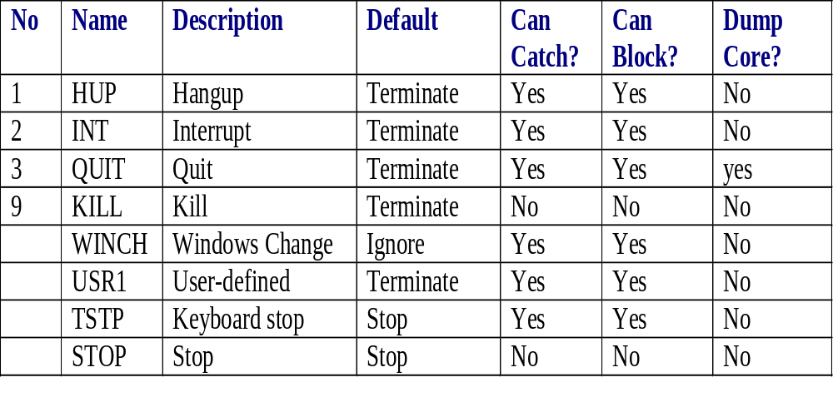
Signals cont …

Slide 22
Kill and Killall
Usually used to terminate a process but in general used to send a signal to a process
Can be used with the signal numbers in previous table
  Kill [-signal] pid
Killall is used to kill a process that you don’t know the PID
  Killall –USR1 xinetd

Slide 23
Process States
Runnable
  The process can be executed, whenever CPU time is available
  All resources has been acquired
Sleeping
  Waiting for some resources
  When runnable process makes a system call that can not be executed they are put to sleep
Zombie
  Trying to die
  Finished execution but status not yet collected
Stopped
  Suspended ( not allowed to execute)

Slide 24
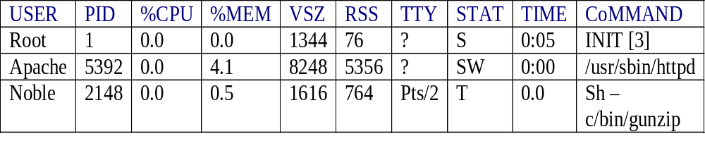
Monitor Process
Ps is used for monitoring process
  Ps –ef
  Ps –aux
  Ps –lax

Slide 25
COSC2222
Unix Systems Administration and Network Security(Linux)
Week #2 – Boot Process,
Resource Management,
Administrative tools
Godfred Ofori-Som

Slide 26
Overview of boot process
x86 Boot process
  POST (Power On Self Test)
  Boot MBR (Master Boot Record)
  MBR loads boot sector of the “bootable” partition.
  Initial Linux kernel is loaded and configured
Other hardware will follow a similar process
Godfred Ofori-Som

Slide 27
The POST
Initial check to ensure that expected hardware is available and working.
Common steps in POST:
  Check memory
  Check hard drives and other low level devices (ie. Keyboards, etc)
On most x86 computers, faults messages are beeps through the speaker.
  Check motherboard manual to identify what the beeps mean
  Common problems include RAM or video card not properly connected, though they could also be faulty.
POST is responsible for loading the MBR
Godfred Ofori-Som

Slide 28
The MBR
There are 2 parts to the MBR
  Partition table
  Code to read partition table and read boot sector of bootable parition.
    About 450 bytes of space available.
Linux installs GRUB or LILO into MBR to allow boot
Both LILO and GRUB use this to load a second stage boot loader
Godfred Ofori-Som

Slide 29
Boot Loaders (LILO, GRUB)
LILO
  Original boot loader for Linux
  Configured through /etc/lilo.conf
  Primary issue is that reconfiguration requires rebuilding MBR code
GRUB
  Configured (usually) through /boot/grub/menu.lst
  Configuration file is read on boot, so changes are easily accomodated
Godfred Ofori-Som

Slide 30
Kernel Loading
LILO or GRUB will load and execute the Linux kernel
  Devices initialised
  Initrd can be used here
Linux kernel has a specific size limit
  May require more devices compiled into kernel than can actually fit
  Initrd fixes this by providing additional space for kernel modules to be included at boot stage.
  Not the same as dynamically loading modules
Godfred Ofori-Som

Slide 31
Modular Kernels
The Linux kernel has a modular approach
Advantages
  Generally smaller kernel
  Greater flexibility
  Not generally necessary to build custom kernel
Disadvantages
  Boot process is more complex
  Required modules that are missing will cause kernel to panic
  Small performance hit
Godfred Ofori-Som

Slide 32
Process 1 – init
Init is the first process started by the kernel
Always has PID 1
Reads and deals with /etc/inittab to start up other processes
Is the parent process of all user processes
Starts other processes to manage low level tasks (eg. Swapping)
Godfred Ofori-Som

Slide 33
Starting up other processes
Two main methods used for starting up processes
  BSD – Set of large scripts that start everything up
  SysV – Set of small scripts that start individual services
Most Linux distros use the SysV approach
  More modular, more “package friendly”
In both cases, scripts are written in Bourne Shell
Godfred Ofori-Som

Slide 34
…finally the login prompt.
Login process is actally called ‘getty’ or something similar (eg. Mingetty)
  Verifies username and password
  Initialises login shell
Alternatives include xdm for X-based logins
  Kdm and gdm also exist for this purpose
Text mode is by far the simpler method to get working
Godfred Ofori-Som

Slide 35
Resource Management
No computer has infinate resources for users to use
Resources that commonly cause problems
  Diskspace
  RAM
  CPU time
  Network bandwidth
Need to manage these resources to make sure that system performance does not suffer
How this is done depends on what system is used for
Godfred Ofori-Som

Slide 36

Disk space
/suse filesystem full
  System usually allocates 5% of filesystem to overflow by root user
  Some older systems will allocate 10%
  This value is configurable when the filesystem is created
Godfred Ofori-Som

Slide 37


Checking usage by directories
The du command
is used for this:
For summaries, use
du –sk:
Godfred Ofori-Som

Slide 38
What to do when you run out
Buy more
  May not always be the best solution.
Clean out the old garbage
  May require users to clean out stuff they no longer require
Clean out logfiles, temporary files, etc.
Relocate data onto other disks
Godfred Ofori-Som

Slide 39
Memory Management
In /proc, there is a file called meminfo that contains memory usage information
Vmstat reports on a number of memory related statistics
SAR (System Activity Reporter) can also be set up to provide longer term memory usage data.
Godfred Ofori-Som

Slide 40

/proc/meminfo
This is the contents of meminfo on a host with 1Gb RAM and 512Mb of swap memory
Only 13 Mb RAM free, but 700Mb RAM taken up by file system cache
Godfred Ofori-Som

Slide 41
Memory and Performance
When memory runs out, system moves unused sections out to swap
Swap is normally a disk partition, and disk is slower to read than memory
If a system uses swap too much, it is called “thrashing”.
When no more swap space free, memory allocations will fail
Ideally, a system should never use swap.
Godfred Ofori-Som

Slide 42
CPU Management
The CPU resource is the amount of time a process spends on the CPU
Processes must wait their turn for use of the CPU (scheduling)
CPU usage is shown via ‘uptime’ or ‘top’ in the form of load averages
  > uptime
  7:36pm up 5 days 11:09, 2 users, load average: 0.10, 0.09, 0.03
Load average is the average number of processes waiting for the CPU over 1, 5 and 15 minutes
Most systems can handle load averages up to 2x the number of CPU’s before it is a problem. This depends on the application, however
Godfred Ofori-Som

Slide 43

CPU usage and processes
The ps command lists running processes
Example:
-e means all
processes
-f means extended format
Godfred Ofori-Som

Slide 44
Admin Tools
Unix/Linux has a large variety of tools available
  Command line tools like ps, uptime, etc.
  GUI tools
Systems becoming more complex, so need ways of simplifying management
Godfred Ofori-Som

Slide 45
GUI vs. Text management
GUI
  Easier to learn/use
  Generally requires high bandwidth connection to use
  When well designed can be used for system monitoring
Text
  Can be incorporated into scripts to add functionality
  Generally faster if you know what you are doing
  Often harder for someone unfamiliar with the system to learn
Godfred Ofori-Som

Slide 46

System Configuration
Most configuration files will be stored in /etc. Eg:
  /etc/hosts
  /etc/inittab
  /etc/resolv.conf
  /etc/samba.conf
Mostly, you can
edit these with a
text editor like vi.
Godfred Ofori-Som

Slide 47
RC Boot files
Modifying the boot process in SysV
  Adding/Removing symlinks in /etc/rcn.d
    Eg: # ln –s /etc/init.d/ssh /etc/rc2.d/S90ssh
    Will be executed by system with ‘start’ command line option
  Individual services need their own script
Modifying boot process in BSD
  Boot scripts longer, but everything is defined in sections
  Often simply a matter of uncommenting the right section
  To remove, use comments, don’t delete!
Godfred Ofori-Som

