Slide 1
DATA COMMUNICATION AND NETWORK
Data communications are the exchange of data between two devices via some form of transmission medium such as a wire cable.
For data communications to occur, the communicating devices must be part of a communication system made up of a combination of hardware (physical equipment) and software (programs).

Slide 2
The effectiveness of a data communications system depends on
four fundamental characteristics:
-Delivery
Accuracy,
Timeliness
and jitter.
1. Delivery. The system must deliver data to the correct destination. Data must be received by the intended device or user and only by that device or user.
2. Accuracy. The system must deliver the data accurately. Data that have been altered in transmission and left uncorrected are unusable.
3. Timeliness. The system must deliver data in a timely manner. Data delivered late are useless. In the case of video and audio, timely delivery means delivering data as they are produced, in the same order that they are produced, and without significant delay. This kind of delivery is called real-time transmission.
4. Jitter. Jitter refers to the variation in the packet arrival time. It is the uneven delay in the delivery of audio or video packets.

Slide 3
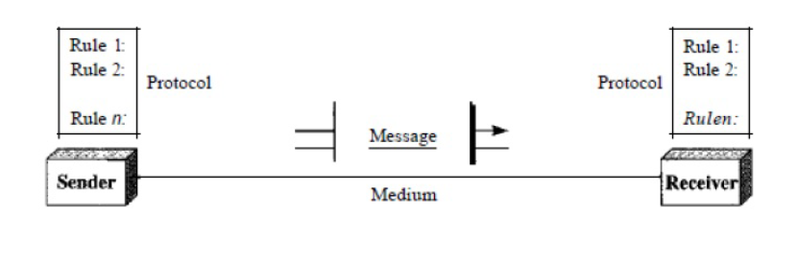
COMPONENTS DATA COMMUNICATION
A data communications system has five

Slide 4
1. Message. The message is the information (data) to be communicated. Popular forms of information include text, numbers, pictures, audio, and video.
2. Sender. The sender is the device that sends the data message. It can be a computer, workstation, telephone handset, video camera, and so on.
3. Receiver. The receiver is the device that receives the message. It can be a computer, workstation, telephone handset, television, and so on.
4. Transmission medium. The transmission medium is the physical path by which a message travels from sender to receiver. Some examples of transmission media include twisted-pair wire, coaxial cable, fiber-optic cable, and radio waves
5. Protocol. A protocol is a set of rules that govern data communications. It represents an agreement between the communicating devices.

Slide 5
DATA TRANSMISSION MODES
Communication between two devices can be simplex, half-duplex, or full-duplex.
Simplex:
In simplex mode, the communication is unidirectional, as on a one-way street. Only one of the two devices on a link can transmit; the other can only receive. Keyboards and traditional monitors are examples of simplex devices. The keyboard can only introduce input; the monitor can only accept output. The simplex mode can use the entire capacity of the channel to send data in one direction.
Half-Duplex:
In half-duplex mode, each station can both transmit and receive, but not at the same time. When one device is sending, the other can only receive, and vice versa. In a half-duplex transmission, the entire capacity of a channel is taken over by whichever of the two devices is transmitting at the time. Walkie-talkies and CB (citizens band) radios are both half-duplex systems. The half-duplex mode is used in cases where there is no need for communication in both directions at the same time; the entire capacity of the channel can be utilized for each direction.

Slide 6
Full-Duplex:
In full-duplex both stations can transmit and receive simultaneously. The full-duplex mode is like a two way street with traffic flowing in both directions at the same time. In full-duplex mode, signals going in one direction share the capacity of the link: with signals going in the other direction. One common example of full-duplex communication is the telephone network. When two people are communicating by a telephone line, both can talk and listen at the same time. The full-duplex mode is used when communication in both directions is required all the time. The capacity of the channel, however, must be divided between the two directions.

Slide 7
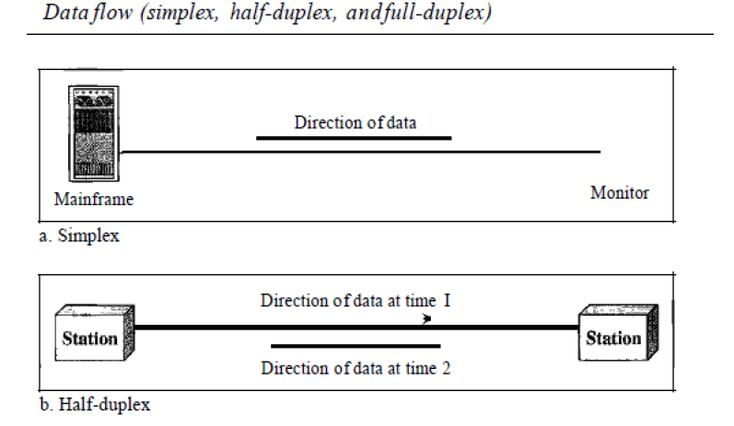

Slide 8
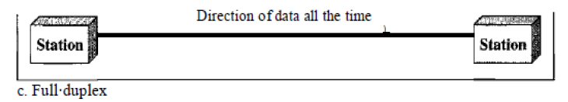
FULL DUPLEX

Slide 9
Network Criteria
A network must be able to meet a certain number of criteria. The most important of these are performance, reliability, and security.
Performance:
Performance can be measured in many ways, including transit time and response time. Transit time is the amount of time required for a message to travel from one device to another. Response time is the elapsed time between an inquiry and a response. The performance of a network depends on a number of factors, including the number of users, the type of transmission medium, the capabilities of the connected hardware, and the efficiency of the software.
Reliability:
Network reliability is measured by the frequency of failure, the time it takes a link to recover from a failure, and the network's robustness in a catastrophe.
Security:
Network security issues include protecting data from unauthorized access, protecting data from damage and development, and implementing policies and procedures for recovery from breaches and data losses.

Slide 10
COMPUTER NETWORKS
A system of interconnected computers and computerized peripherals such as printers is called computer network. This interconnection among computers facilitates information sharing among them. Computers may connect to each other by either wired or wireless media.

Slide 11
Classification of Computer Networks
Computer networks are classified based on various factors.
They includes:
Geographical span
Inter-connectivity
Administration
Architecture

Slide 12
Geographical Span
Geographically a network can be seen in one of the following categories:
It may be spanned across your table, among Bluetooth enabled devices,. Ranging not more than few meters.
It may be spanned across a whole building, including intermediate devices to connect all floors.
It may be spanned across a whole city.
It may be spanned across multiple cities or provinces.
It may be one network covering whole world.

Slide 13
Inter-Connectivity
Components of a network can be connected to each other differently in some fashion. By connectedness we mean either logically, physically, or both ways.
Every single device can be connected to every other device on network, making the network mesh.
All devices can be connected to a single medium but geographically disconnected, created bus like structure.
Each device is connected to its left and right peers only, creating linear structure.
All devices connected together with a single device, creating star like structure
All devices connected arbitrarily using all previous ways to connect each other, resulting in a hybrid structure.

Slide 14
Administration
From an administrator’s point of view, a network can be private network which belongs a single autonomous system and cannot be accessed outside its physical or logical domain. A network can be public which is accessed by all.

Slide 15
Network Architecture
Computer networks can be discriminated into various types such as Client-Server, peer-to-peer or hybrid, depending upon its architecture.
There can be one or more systems acting as Server. Other being Client, requests the Server to serve requests. Server takes and processes request on behalf of Clients.
Two systems can be connected Point-to-Point, or in back-to-back fashion. They both reside at the same level and called peers.
There can be hybrid network which involves network architecture of both the above types.

Slide 16
Network Applications
Computer systems and peripherals are connected to form a network. They provide numerous advantages:
Resource sharing such as printers and storage devices
Exchange of information by means of e-Mails and FTP
Information sharing by using Web or Internet
Interaction with other users using dynamic web pages
IP phones
Video conferences
Parallel computing
Instant messaging

Slide 17
Generally, networks are distinguished based on their geographical span. A network can be as small as distance between your mobile phone and its Bluetooth headphone and as large as the internet itself, covering the whole geographical world.

Slide 18
Personal Area Network
A Personal Area Network (PAN) is smallest network which is very personal to a user. This may include Bluetooth enabled devices or infra-red enabled devices. PAN has connectivity range up to 10 meters. PAN may include wireless computer keyboard and mouse, Bluetooth enabled headphones, wireless printers and TV remotes.

Slide 19
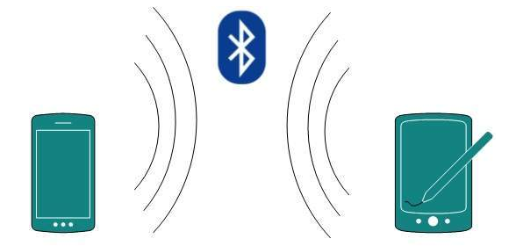
For example, Piconet is Bluetooth-enabled Personal Area Network which may contain up to 8 devices connected together in a master-slave fashion.

Slide 20
Local Area Network
A computer network spanned inside a building and operated under single administrative system is generally termed as Local Area Network (LAN). Usually, LAN covers an organization’ offices, schools, colleges or universities. Number of systems connected in LAN may vary from as least as two to as much as 16 million.
LAN provides a useful way of sharing the resources between end users. The resources such as printers, file servers, scanners, and internet are easily sharable among computer

Slide 21
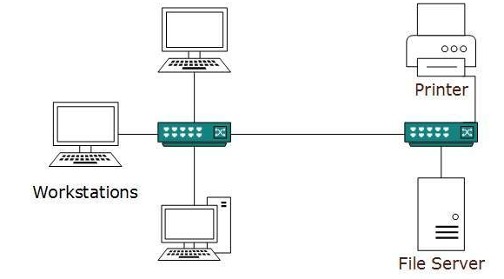

Slide 22
LANs are composed of inexpensive networking and routing equipment. It may contains local servers serving file storage and other locally shared applications. It mostly operates on private IP addresses and does not involve heavy routing. LAN works under its own local domain and controlled centrally.
LAN uses either Ethernet or Token-ring technology. Ethernet is most widely employed LAN technology and uses Star topology, while Token-ring is rarely seen.
LAN can be wired, wireless, or in both forms at once.

Slide 23
Metropolitan Area Network
The Metropolitan Area Network (MAN) generally expands throughout a city such as cable TV network. It can be in the form of Ethernet, Token-ring, ATM, or Fiber Distributed Data Interface (FDDI).
Metro Ethernet is a service which is provided by ISPs. This service enables its users to expand their Local Area Networks. For example, MAN can help an organization to connect all of its offices in a city.

Slide 24
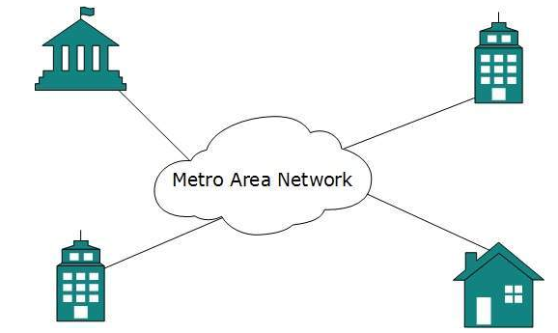
Backbone of MAN is high-capacity and high-speed fiber optics. MAN works in between Local Area Network and Wide Area Network. MAN provides uplink for LANs to WANs or internet.

Slide 25
Wide Area Network
As the name suggests, the Wide Area Network (WAN) covers a wide area which may span across provinces and even a whole country. Generally, telecommunication networks are Wide Area Network. These networks provide connectivity to MANs and LANs. Since they are equipped with very high speed backbone, WANs use very expensive network equipment.

Slide 26
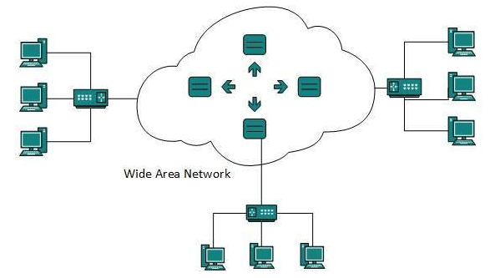
WAN may use advanced technologies such as Asynchronous Transfer Mode (ATM), Frame Relay, and Synchronous Optical Network (SONET). WAN may be managed by multiple administration.

Slide 27
Internetwork
A network of networks is called an internetwork, or simply the internet. It is the largest network in existence on this planet. The internet hugely connects all WANs and it can have connection to LANs and Home networks. Internet uses TCP/IP protocol suite and uses IP as its addressing protocol. Present day, Internet is widely implemented using IPv4. Because of shortage of address spaces, it is gradually migrating from IPv4 to IPv6.
Internet enables its users to share and access enormous amount of information worldwide. It uses WWW, FTP, email services, audio and video streaming etc. At huge level, internet works on Client-Server model.

Slide 28
Internet uses very high speed backbone of fibre optics. To inter-connect various continents, fibres are laid under sea known to us as submarine communication cable.
Internet is widely deployed on World Wide Web services using HTML linked pages and is accessible by client software known as Web Browsers. When a user requests a page using some web browser located on some Web Server anywhere in the world, the Web Server responds with the proper HTML page. The communication delay is very low.
Internet is serving many proposes and is involved in many aspects of life. Some of them are:

Slide 29
Web sites
E-mail
Instant Messaging
Blogging
Social Media
Marketing
Networking
Resource Sharing
Audio and Video Streaming

Slide 30
PHYSICAL STRUCTURES
TYPES OF CONNECTIONS: A network is two or more devices connected through links. A link is a communications pathway that transfers data from one device to another.
There are two possible types of connections:
point-to-point
and multipoint.

Slide 31
Point-to-Point
A point-to-point connection provides a dedicated link between two devices. The entire capacity of the link is reserved for transmission between those two devices. Most point-to-point connections use an actual length of wire or cable to connect the two ends, but other options, such as microwave or satellite links, are also possible. When you change television channels by infrared remote control, you are establishing a point-to-point connection between the remote control and the television's control system.

Slide 32
Multipoint
A multipoint (also called multidrop) connection is one in which more than two specific devices share a single link. In a multipoint environment, the capacity of the channel is shared, either spatially or temporally. If several devices can use the link simultaneously, it is a spatially shared connection. If users must take turns, it is a timeshared connection.

Slide 33
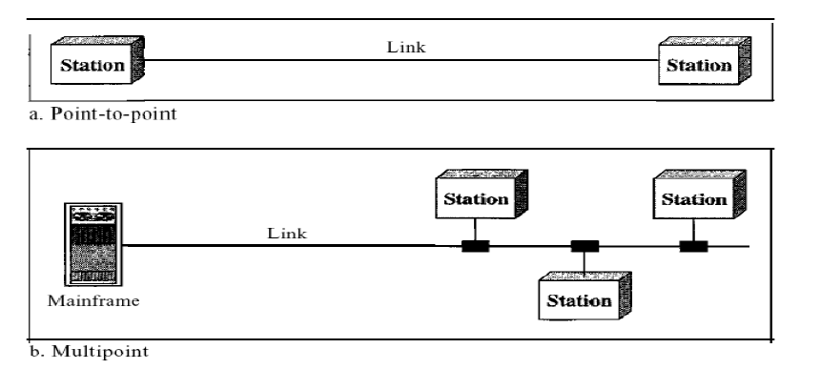

Slide 34
Network Topologies
A Network Topology is the arrangement with which computer systems or network devices are connected to each other. Topologies may define both physical and logical aspect of the network. Both logical and physical topologies could be same or different in a same network

Slide 35
Bus Topology
In case of Bus topology, all devices share single communication line or cable. Bus topology may have problem while multiple hosts sending data at the same time. Therefore, Bus topology either uses CSMA/CD technology or recognizes one host as Bus Master to solve the issue. It is one of the simple forms of networking where a failure of a device does not affect the other devices. But failure of the shared communication line can make all other devices stop functioning.

Slide 36
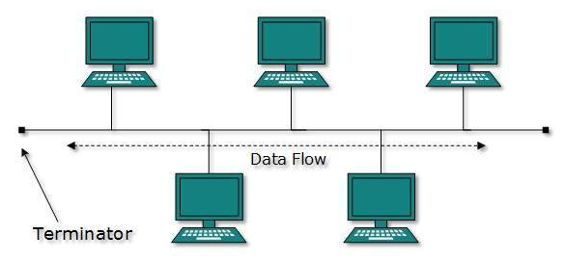
Bus Topology
Both ends of the shared channel have line terminator. The data is sent in only one direction and as soon as it reaches the extreme end, the terminator removes the data from the line.

Slide 37
Star Topology
All hosts in Star topology are connected to a central device, known as hub device, using a point-to-point connection. That is, there exists a point to point connection between hosts and hub. The hub device can be any of the following:
Layer-1 device such as hub or repeater
Layer-2 device such as switch or bridge
Layer-3 device such as router or gateway

Slide 38
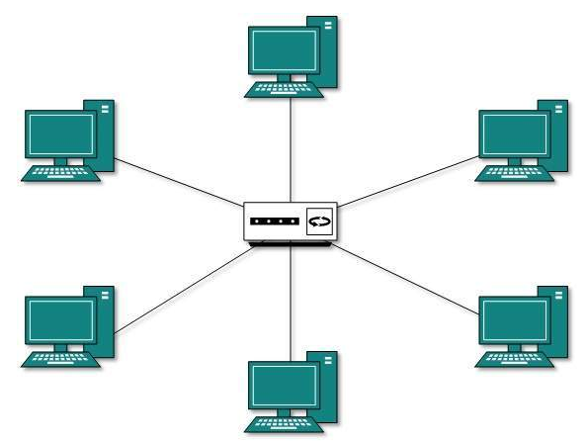
Star Topology

Slide 39
As in Bus topology, hub acts as single point of failure. If hub fails, connectivity of all hosts to all other hosts fails. Every communication between hosts, takes place through only the hub. Star topology is not expensive as to connect one more host, only one cable is required and configuration is simple.

Slide 40
Ring Topology
In ring topology, each host machine connects to exactly two other machines, creating a circular network structure. When one host tries to communicate or send message to a host which is not adjacent to it, the data travels through all intermediate hosts. To connect one more host in the existing structure, the administrator may need only one more extra cable.

Slide 41
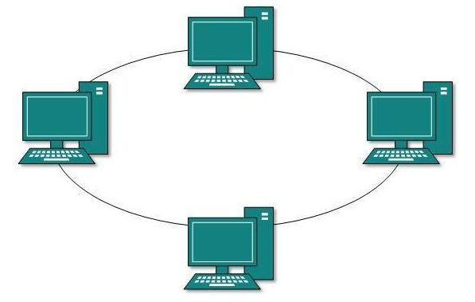
Ring Topology
Failure of any host results in failure of the whole ring. Thus, every connection in the ring is a point of failure. There are methods which employ one more backup ring.

Slide 42
Mesh Topology
In this type of topology, a host is connected to one or multiple hosts. This topology has hosts in point-to-point connection with every other host or may also have hosts which are in point-to-point connection to few hosts only.

Slide 43
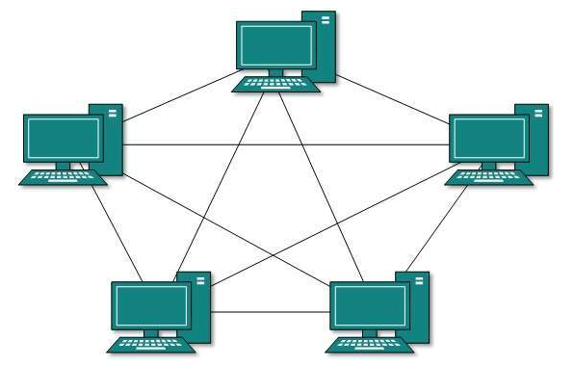

Slide 44
Hosts in Mesh topology also work as relay for other hosts which do not have direct point-to-point links. Mesh technology comes into two types
Full Mesh: All hosts have a point-to-point connection to every other host in the network. Thus for every new host n(n-1)/2 connections are required. It provides the most reliable network structure among all network topologies.
Partially Mesh: Not all hosts have point-to-point connection to every other host. Hosts connect to each other in some arbitrarily fashion. This topology exists where we need to provide reliability to some hosts out of all.

Slide 45
Tree Topology
Also known as Hierarchical Topology, this is the most common form of network topology in use presently. This topology imitates as extended Star topology and inherits properties of bus topology.
This topology divides the network in to multiple levels/layers of network. Mainly in LANs, a network is bifurcated into three types of network devices. The lowermost is access-layer where computers are attached. The middle layer is known as distribution layer, which works as mediator between upper layer and lower layer. The highest layer is known as core layer, and is central point of the network, i.e. root of the tree from which all nodes fork.

Slide 46
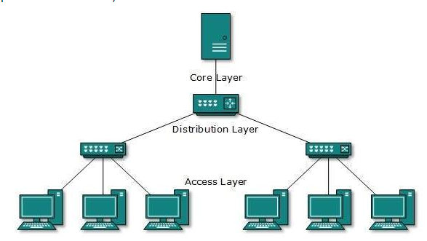

Slide 47
Daisy Chain
This topology connects all the hosts in a linear fashion. Similar to Ring topology, all hosts are connected to two hosts only, except the end hosts. Means, if the end hosts in daisy chain are connected then it represents Ring topology.

Slide 48

Each link in daisy chain topology represents single point of failure. Every link failure splits the network into two segments. Every intermediate host works as relay for its immediate hosts

Slide 49
Hybrid Topology
A network structure whose design contains more than one topology is said to be hybrid topology. Hybrid topology inherits merits and demerits of all the incorporating topologies.

Slide 50
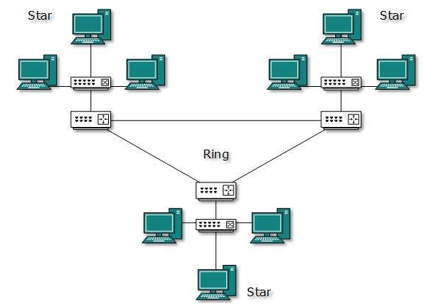
The above picture represents an arbitrarily hybrid topology. The combining topologies may contain attributes of Star, Ring, Bus, and Daisy-chain topologies. Most WANs are connected by means of Dual-Ring topology and networks connected to them are mostly Star topology networks. Internet is the best example of largest Hybrid topology

Slide 51
Computer Network Models
Networking engineering is a complicated task, which involves software, firmware, chip level engineering, hardware, and electric pulses. To ease network engineering, the whole networking concept is divided into multiple layers. Each layer is involved in some particular task and is independent of all other layers. But as a whole, almost all networking tasks depend on all of these layers. Layers share data between them and they depend on each other only to take input and send output.

Slide 52
Layered Tasks
In layered architecture of Network Model, one whole network process is divided into small tasks. Each small task is then assigned to a particular layer which works dedicatedly to process the task only. Every
layer does only specific work.
In layered communication system, one layer of a host deals with the task done by or to be done by its peer layer at the same level on the remote host

Slide 53
The task is either initiated by layer at the lowest level or at the top most level. If the task is initiated by the-top most layer, it is passed on to the layer below it for further processing. The lower layer does the same thing, it processes the task and passes on to lower layer. If the task is initiated by lower most layer, then the reverse path is taken.

Slide 54
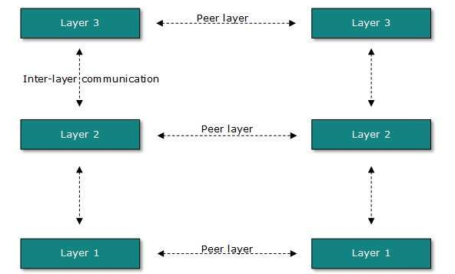
Every layer clubs together all procedures, protocols, and methods which it requires to execute its piece of task. All layers identify their counterparts by means of encapsulation header and tail.

Slide 55
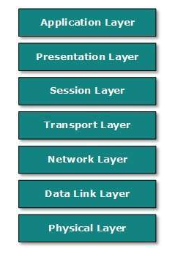
OSI Model
Open System Interconnect is an open standard for all communication systems. OSI model is established by International Standard Organization (ISO). This model has seven layers.

Slide 56
Application Layer: This layer is responsible for providing interface to the application user. This layer encompasses protocols which directly interact with the user.
Presentation Layer: This layer defines how data in the native format of remote host should be presented in the native format of host.
Session Layer: This layer maintains sessions between remote hosts. For example, once user/password authentication is done, the remote host maintains this session for a while and does not ask for authentication again in that time span.

Slide 57
Transport Layer: This layer is responsible for end-to-end delivery between hosts.
Network Layer: This layer is responsible for address assignment and uniquely addressing hosts in a network.
Data Link Layer: This layer is responsible for reading and writing data from and onto the line. Link errors are detected at this layer.
Physical Layer: This layer defines the hardware, cabling wiring, power output, pulse rate etc.

Slide 58
Internet Model
Internet uses TCP/IP protocol suite, also known as Internet suite. This defines Internet Model which contains four layered architecture. OSI Model is general communication model but Internet Model is what the internet uses for all its communication. The internet is independent of its underlying network architecture so is its Model. This model has the following layers

Slide 59
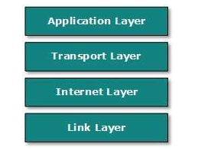
INTERNET MODEL

Slide 60
Application Layer: This layer defines the protocol which enables user to interact with the network. For example, FTP, HTTP etc.
Transport Layer: This layer defines how data should flow between hosts. Major protocol at this layer is Transmission Control Protocol (TCP). This layer ensures data delivered between hosts is in-order and is responsible for end-to-end delivery.

Slide 61
Internet Layer: Internet Protocol (IP) works on this layer. This layer facilitates host addressing and recognition. This layer defines routing.
Link Layer: This layer provides mechanism of sending and receiving actual data. Unlike its OSI Model counterpart, this layer is independent of underlying network architecture and hardware.

Slide 62
Computer Network Security
During initial days of internet, its use was limited to military and universities for research and development purpose. Later when all networks merged together and formed internet, the data used to travel through public transit network. Common people may send the data that can be highly sensitive such as their bank credentials, username and passwords, personal documents, online shopping details, or confidential documents.

Slide 63
All security threats are intentional i.e. they occur only if intentionally triggered. Security threats can be divided into the following categories:
Interruption
Interruption is a security threat in which availability of resources is attacked. For example, a user is unable to access its web-server or the web-server is hijacked.
Privacy-Breach
In this threat, the privacy of a user is compromised. Someone, who is not the authorized person is accessing or intercepting data sent or received by the original authenticated user.

Slide 64
Integrity
This type of threat includes any alteration or modification in the original context of communication. The attacker intercepts and receives the data sent by the sender and the attacker then either modifies or generates false data and sends to the receiver. The receiver receives the data assuming that it is being sent by the original Sender.
Authenticity
This threat occurs when an attacker or a security violator, poses as a genuine person and accesses the resources or communicates with other genuine users.

Slide 65
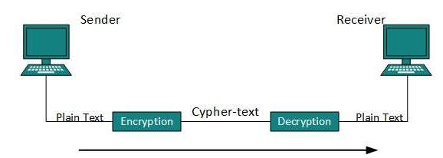
No technique in the present world can provide 100% security. But steps can be taken to secure data while it travels in unsecured network or internet. The most widely used technique is Cryptography

Slide 66
Cryptography is a technique to encrypt the plain-text data which makes it difficult to understand and interpret. There are several cryptographic algorithms available present day as described below:
Secret Key
Public Key
Message Digest
Secret Key Encryption
Both sender and receiver have one secret key. This secret key is used to encrypt the data at sender’s end. After the data is encrypted, it is sent on the public domain to the receiver. Because the receiver knows and has the Secret Key, the encrypted data packets can easily be decrypted.

Slide 67
Public Key Encryption
In this encryption system, every user has its own Secret Key and it is not in the shared domain. The secret key is never revealed on public domain. Along with secret key, every user has its own but public key. Public key is always made public and is used by Senders to encrypt the data. When the user receives the encrypted data, he can easily decrypt it by using its own Secret Key.
Example of public key encryption is Rivest-Shamir-Adleman (RSA).

Slide 68
Message Digest
In this method, actual data is not sent, instead a hash value is calculated and sent. The other end user, computes its own hash value and compares with the one just received. If both hash values are matched, then it is accepted otherwise rejected.
Example of Message Digest is MD5 hashing. It is mostly used in authentication where user password is cross checked with the one saved on the server

Slide 69
DCN - Physical Layer Introduction
Physical layer in the OSI model plays the role of interacting with actual hardware and signalling mechanism. Physical layer is the only layer of OSI network model which actually deals with the physical connectivity of two different stations. This layer defines the hardware equipment, cabling, wiring, frequencies, pulses used to represent binary signals etc

Slide 70
Physical layer provides its services to Data-link layer. Data-link layer hands over frames to physical layer. Physical layer converts them to electrical pulses, which represent binary data. The binary data is then sent over the wired or wireless media.
Signals
When data is sent over physical medium, it needs to be first converted into electromagnetic signals. Data itself can be analogue such as human voice, or digital such as file on the disk. Both analogue and digital data can be represented in digital or analogue signals.

Slide 71
Digital Signals
Digital signals are discrete in nature and represent sequence of voltage pulses. Digital signals are used within the circuitry of a computer system.
Analog Signals
Analog signals are in continuous wave form in nature and represented by continuous electromagnetic waves

Slide 72
Transmission Impairment
When signals travel through the medium they tend to deteriorate. This may have many reasons as given:
Attenuation
For the receiver to interpret the data accurately, the signal must be sufficiently strong. When the signal passes through the medium, it tends to get weaker. As it covers distance, it loses strength

Slide 73
Dispersion
As signal travels through the media, it tends to spread and overlaps. The amount of dispersion depends upon the frequency used.
Delay distortion
Signals are sent over media with pre-defined speed and frequency. If the signal speed and frequency do not match, there are possibilities that signal reaches destination in arbitrary fashion. In digital media, this is very critical that some bits reach earlier than the previously sent ones.

Slide 74
Noise
Random disturbance or fluctuation in analogue or digital signal is said to be Noise in signal, which may distort the actual information being carried. Noise can be characterized in one of the following class:
Thermal Noise
Heat agitates the electronic conductors of a medium which may introduce noise in the media. Up to a certain level, thermal noise is unavoidable.

Slide 75
Intermodulation
When multiple frequencies share a medium, their interference can cause noise in the medium. Intermodulation noise occurs if two different frequencies are sharing a medium and one of them has excessive strength or the component itself is not functioning properly, then the resultant frequency may not be delivered as expected.

Slide 76
Crosstalk
This sort of noise happens when a foreign signal enters into the media. This is because signal in one medium affects the signal of second medium.
Impulse
This noise is introduced because of irregular disturbances such as lightening, electricity, short-circuit, or faulty components. Digital data is mostly affected by this sort of noise

Slide 77
Transmission Media
The media over which the information between two computer systems is sent, called transmission media. Transmission media comes in two forms.
- Guided Media
- Unguided Media

Slide 78
Guided Media
All communication wires/cables are guided media, such as UTP, coaxial cables, and fibre Optics. In this media, the sender and receiver are directly connected and the information is send (guided) through it.

Slide 79
Unguided Media
Wireless or open air space is said to be unguided media, because there is no connectivity between the sender and receiver. Information is spread over the air, and anyone including the actual recipient may collect the information.

Slide 80
Channel Capacity
The speed of transmission of information is said to be the channel capacity. We count it as data rate in digital world. It depends on numerous factors such as:
Bandwidth: The physical limitation of underlying media.
Error-rate: Incorrect reception of information because of noise.
Encoding: The number of levels used for signalling.

Slide 81
Multiplexing
Multiplexing is a technique to mix and send multiple data streams over a single medium. This technique requires system hardware called multiplexer (MUX) for multiplexing the streams and sending them on a medium, and de-multiplexer (DMUX) which takes information from the medium and distributes to different destinations.

Slide 82
Switching

