Slide 1
Data Modeling Using the Entity-Relationship (ER) Model

Slide 2
Outline
Overview of Database Design Process
Example Database Application (COMPANY)
ER Model Concepts
  Entities and Attributes
  Entity Types, Value Sets, and Key Attributes
  Relationships and Relationship Types
  Weak Entity Types
  Roles and Attributes in Relationship Types
ER Diagrams - Notation
ER Diagram for COMPANY Schema
Alternative Notations – UML class diagrams, others

Slide 3
Overview of Database Design Process
Two main activities:
  Database design
  Applications design
Focus in this unit on database design
  To design the conceptual schema for a database application
Applications design focuses on the programs and interfaces that access the database
  Generally considered part of software engineering

Slide 4

Overview of Database Design Process

Slide 5
Example COMPANY Database
We need to create a database schema design based on the following (simplified) requirements of the COMPANY Database:
  The company is organized into DEPARTMENTs. Each department has a name, number and an employee who manages the department. We keep track of the start date of the department manager. A department may have several locations.
  Each department controls a number of PROJECTs. Each project has a unique name, and is located at a single location.

Slide 6
Example COMPANY Database (Contd.)
  We store each EMPLOYEE’s social security number, address, salary, sex, and birthdate.
    Each employee works for one department but may work on several projects.
    We keep track of the number of hours per week that an employee currently works on each project.
    We also keep track of the direct supervisor of each employee.
  Each employee may have a number of DEPENDENTs.
    For each dependent, we keep track of their name, sex, birthdate, and relationship to the employee.

Slide 7
ER Model Concepts
Entities and Attributes
  Entities are specific objects or things in the mini-world that are represented in the database.
    For example the EMPLOYEE John Smith, the Research DEPARTMENT, the ProductX PROJECT
  Attributes are properties used to describe an entity.
    For example an EMPLOYEE entity may have the attributes Name, SSN, Address, Sex, BirthDate
  A specific entity will have a value for each of its attributes.
    For example a specific employee entity may have Name='John Smith', SSN='123456789', Address ='731, Fondren, Houston, TX', Sex='M', BirthDate='09-JAN-55‘
  Each attribute has a value set (or data type) associated with it – e.g. integer, string, subrange, enumerated type, …

Slide 8
Types of Attributes (1)
Simple
  Each entity has a single atomic value for the attribute. For example, SSN or Sex.
Composite
  The attribute may be composed of several components. For example:
    Address(Apt#, House#, Street, City, State, ZipCode, Country), or
    Name(FirstName, MiddleName, LastName).
    Composition may form a hierarchy where some components are themselves composite.
Multi-valued
  An entity may have multiple values for that attribute. For example, Color of a CAR or PreviousDegrees of a STUDENT.
    Denoted as {Color} or {PreviousDegrees}.

Slide 9
Types of Attributes (2)
In general, composite and multi-valued attributes may be nested arbitrarily to any number of levels, although this is rare.
  For example, PreviousDegrees of a STUDENT is a composite multi-valued attribute denoted by {PreviousDegrees (College, Year, Degree, Field)}
  Multiple PreviousDegrees values can exist
  Each has four subcomponent attributes:
    College, Year, Degree, Field

Slide 10

Example of a composite attribute

Slide 11
Entity Types and Key Attributes (1)
Entities with the same basic attributes are grouped or typed into an entity type.
  For example, the entity type EMPLOYEE and PROJECT.
An attribute of an entity type for which each entity must have a unique value is called a key attribute of the entity type.
  For example, SSN of EMPLOYEE.

Slide 12
Entity Types and Key Attributes (2)
A key attribute may be composite.
  VehicleTagNumber is a key of the CAR entity type with components (Number, State).
An entity type may have more than one key.
  The CAR entity type may have two keys:
    VehicleIdentificationNumber (popularly called VIN)
    VehicleTagNumber (Number, State), aka license plate number.
Each key is underlined

Slide 13
Displaying an Entity type
In ER diagrams, an entity type is displayed in a rectangular box
Attributes are displayed in ovals
  Each attribute is connected to its entity type
  Components of a composite attribute are connected to the oval representing the composite attribute
  Each key attribute is underlined
  Multivalued attributes displayed in double ovals
See CAR example on next slide

Slide 14

Entity Type CAR with two keys and a corresponding Entity Set

Slide 15
Entity Set
Each entity type will have a collection of entities stored in the database
  Called the entity set
Previous slide shows three CAR entity instances in the entity set for CAR
Same name (CAR) used to refer to both the entity type and the entity set
Entity set is the current state of the entities of that type that are stored in the database

Slide 16
Initial Design of Entity Types for the COMPANY Database Schema
Based on the requirements, we can identify four initial entity types in the COMPANY database:
  DEPARTMENT
  PROJECT
  EMPLOYEE
  DEPENDENT
Their initial design is shown on the following slide
The initial attributes shown are derived from the requirements description

Slide 17

Initial Design of Entity Types:
EMPLOYEE, DEPARTMENT, PROJECT, DEPENDENT

Slide 18
Refining the initial design by introducing relationships
The initial design is typically not complete
Some aspects in the requirements will be represented as relationships
ER model has three main concepts:
  Entities (and their entity types and entity sets)
  Attributes (simple, composite, multivalued)
  Relationships (and their relationship types and relationship sets)
We introduce relationship concepts next

Slide 19
Relationships and Relationship Types (1)
A relationship relates two or more distinct entities with a specific meaning.
  For example, EMPLOYEE John Smith works on the ProductX PROJECT, or EMPLOYEE Franklin Wong manages the Research DEPARTMENT.
Relationships of the same type are grouped or typed into a relationship type.
  For example, the WORKS_ON relationship type in which EMPLOYEEs and PROJECTs participate, or the MANAGES relationship type in which EMPLOYEEs and DEPARTMENTs participate.
The degree of a relationship type is the number of participating entity types.
  Both MANAGES and WORKS_ON are binary relationships.

Slide 20
Relationship type vs. relationship set (1)
Relationship Type:
  Is the schema description of a relationship
  Identifies the relationship name and the participating entity types
  Also identifies certain relationship constraints
Relationship Set:
  The current set of relationship instances represented in the database
  The current state of a relationship type

Slide 21
Relationship type vs. relationship set (2)
Previous figures displayed the relationship sets
Each instance in the set relates individual participating entities – one from each participating entity type
In ER diagrams, we represent the relationship type as follows:
  Diamond-shaped box is used to display a relationship type
  Connected to the participating entity types via straight lines

Slide 22
Constraints on Relationships
Constraints on Relationship Types
  (Also known as ratio constraints)
  Cardinality Ratio (specifies maximum participation)
    One-to-one (1:1)
    One-to-many (1:N) or Many-to-one (N:1)
    Many-to-many (M:N)
  Existence Dependency Constraint (specifies minimum participation) (also called participation constraint)
    zero (optional participation, not existence-dependent)
    one or more (mandatory participation, existence-dependent)

Slide 23

Relationship instances of the WORKS_FOR N:1 relationship between EMPLOYEE and DEPARTMENT

Slide 24

Relationship instances of the M:N WORKS_ON relationship between EMPLOYEE and PROJECT

Slide 25
Refining the COMPANY database schema by introducing relationships
By examining the requirements, six relationship types are identified
All are binary relationships( degree 2)
Listed below with their participating entity types:
  WORKS_FOR (between EMPLOYEE, DEPARTMENT)
  MANAGES (also between EMPLOYEE, DEPARTMENT)
  CONTROLS (between DEPARTMENT, PROJECT)
  WORKS_ON (between EMPLOYEE, PROJECT)
  SUPERVISION (between EMPLOYEE (as subordinate), EMPLOYEE (as supervisor))
  DEPENDENTS_OF (between EMPLOYEE, DEPENDENT)

Slide 26

ER DIAGRAM – Relationship Types are:
WORKS_FOR, MANAGES, WORKS_ON, CONTROLS, SUPERVISION, DEPENDENTS_OF

Slide 27
Weak Entity Types
An entity that does not have a key attribute
A weak entity must participate in an identifying relationship type with an owner or identifying entity type
Entities are identified by the combination of:
  A partial key of the weak entity type
  The particular entity they are related to in the identifying entity type
Example:
  A DEPENDENT entity is identified by the dependent’s first name, and the specific EMPLOYEE with whom the dependent is related
  Name of DEPENDENT is the partial key
  DEPENDENT is a weak entity type
  EMPLOYEE is its identifying entity type via the identifying relationship type DEPENDENT_OF

Slide 28

Summary of notation for ER diagrams

Slide 29
UML Notations for the ER Methodology
Represent classes (similar to entity types) as large rounded boxes with three sections:
  Top section includes entity type (class) name
  Second section includes attributes
  Third section includes class operations (operations are not in basic ER model)
Relationships (called associations) represented as lines connecting the classes
  Other UML terminology also differs from ER terminology
Used in database design and object-oriented software design
UML has many other types of diagrams for software design (will be covered in Software Engineering)

Slide 30
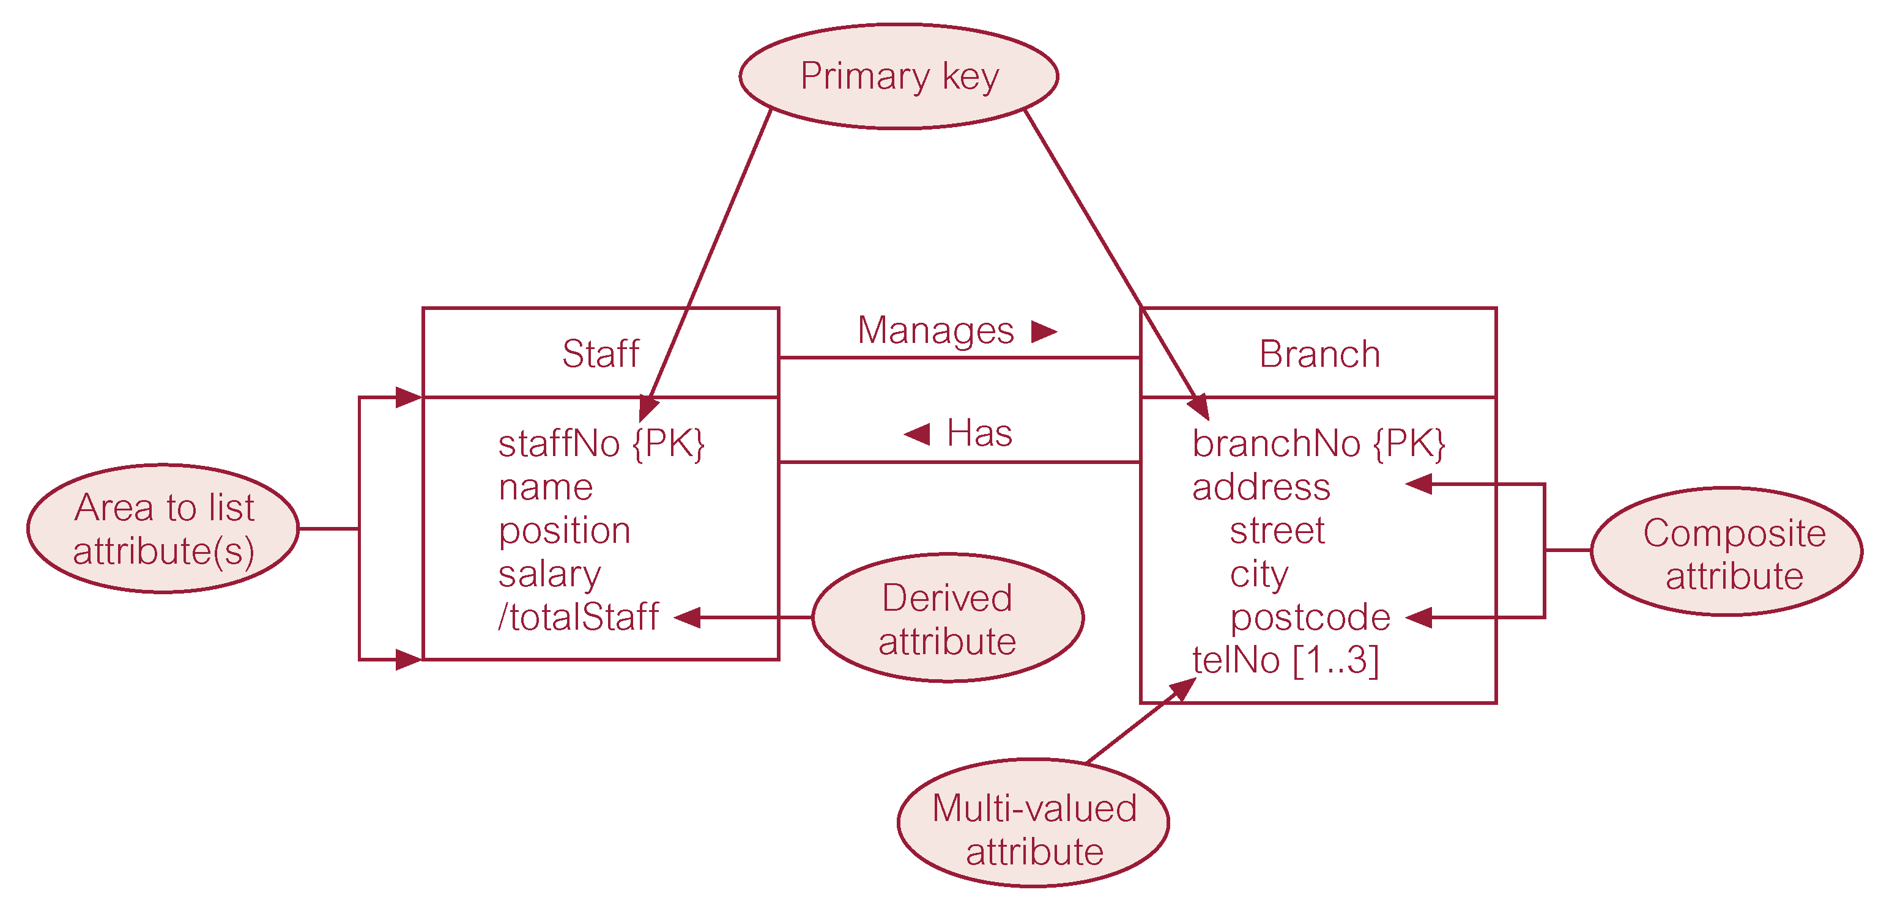
UML Example

Slide 31
End

