Slide 1
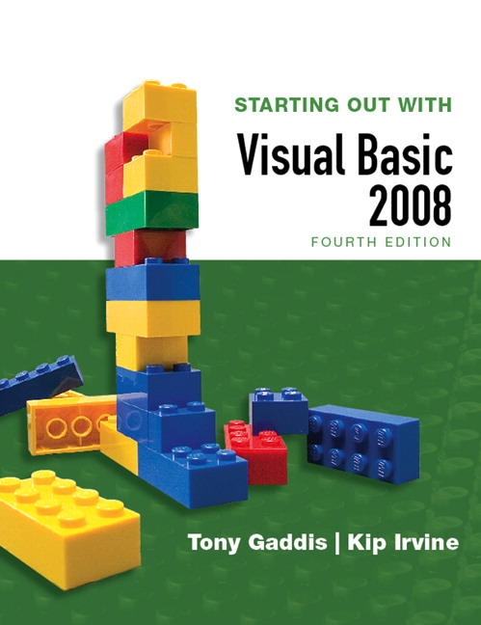
STARTING OUT WITH
Visual Basic 2008
FOURTH EDITION
Tony Gaddis
Haywood Community College
Kip Irvine
Florida International University
Slide 1- <number>

Slide 2
Chapter
1
Introduction to Programming and Visual Basic 2005
Copyright © 2007 Pearson Education, Inc. Publishing as Pearson Addison-Wesley

Slide 3
1.1
Computer Systems:
Hardware and Software
Computer Systems Consist of Similar Hardware Devices and Components
Copyright © 2007 Pearson Education, Inc. Publishing as Pearson Addison-Wesley

Slide 4
Computer Hardware
Refers to the physical components
Not one device but a system of many devices
Major types of components include:
  Central Processing Unit
  Main memory
  Secondary storage devices
  Input devices
  Output devices
Slide 1- <number>

Slide 5
Organization of a Computer System
Central
Processing
Unit
Input
Device
Output
Device
Main
Memory
Secondary
Storage
Slide 1- <number>

Slide 6
The CPU
Fetches instructions from main memory
Carries out the operations commanded by the instructions
Each instruction produces some outcome
CPU gets instructions from a program
A program is an entire sequence of instructions
Instructions are stored as binary numbers
Binary number - a sequence of 1’s and 0’s
Slide 1- <number>

Slide 7
Main Memory
Commonly known as random access memory, or just RAM
Holds instructions and data needed for programs that are currently running
RAM is usually a volatile type of memory
  Contents are lost when power is turned off
Used as temporary storage
Slide 1- <number>

Slide 8
Secondary Storage
A nonvolatile storage medium
  Contents retained while power is off
Hard disk drives are most common
  Records data magnetically on a circular disk
  Provides fast access to large amounts of data
Optical devices store data on CD’s as pits
USB flash memory devices
  High capacity device plugs into USB port
  Portable, reliable, and fits easily in a pocket
Slide 1- <number>

Slide 9
Input Devices
Any type of device that provides data to a computer from the outside world
For example:
  Keyboard
  Mouse
  Scanner
Slide 1- <number>

Slide 10
Output Devices
Any type of device that provides data from a computer to the outside world
Examples of output data:
  A printed report
  An image such as a picture
  A sound
Common output devices include:
  Monitor (display screen)
  Printer
Slide 1- <number>

Slide 11
Questions
Identify the five major hardware components
Explain why computers have both main memory and secondary memory

Slide 12
Software
The programs that run on a computer
Two major categories
  Operating systems
    Controls the processes within the computer
    Manages the computer's hardware devices
  Application Software
    Solve problems or perform tasks needed by users
    Examples include word processing, spreadsheets, games, Internet browsers, playing music, etc)
    Each program is referred to as an application
    This book develops applications in Visual Basic
Slide 1- <number>

Slide 13
1.2
Programs and Programming Languages
A Program Is a Set of Instructions a Computer Follows in Order to Perform a Task
A Programming Language Is a Special Language Used to Write Computer Programs
Copyright © 2007 Pearson Education, Inc. Publishing as Pearson Addison-Wesley

Slide 14
What Is a Program?
Computers can only follow instructions
A computer program is a set of instructions on how to solve a problem or perform a task
In order for a computer to compute someone’s gross pay, we must tell it to perform the steps on the following slide
Slide 1- <number>

Slide 15
Computing Gross Pay
Display message: "How many hours did you work?"
Allow user to enter number of hours worked
Store the number the user enters in memory
Display message: "How much are you paid per hour?"
Allow the user to enter an hourly pay rate
Store the number the user enters in memory
Multiply hours worked by pay rate and store the result in memory
Display a message with the result of the previous step
This well-defined, ordered set of steps for solving a problem is called an algorithm
Slide 1- <number>

Slide 16
States and Transitions
Program Starting State
hours worked
hourly pay rate
amount earned
Memory snapshots show
states of the program
Store hours worked in memory
Store hourly pay rate in memory
Multiply hours worked by pay rate
and store amount earned in memory
??
??
??
Snapshot after Step 3
hours worked
hourly pay rate
amount earned
20
??
??
Snapshot after Step 6
hours worked
hourly pay rate
amount earned
20
25
??
Snapshot after Step 7
hours worked
hourly pay rate
amount earned
20
25
500
Slide 1- <number>

Slide 17
Programming Languages
The steps in our algorithm must be stated in a form the computer understands
The CPU processes instructions as a series of 1’s and 0’s called machine language
This is a tedious and difficult format for people
Instead, programming languages allow us to use words instead of numbers
Software converts the programming language statements to machine language
Slide 1- <number>

Slide 18
Common Programming Languages
Visual Basic
Python
Javascript
Java
C#
C
C++
PHP
Visual Basic is not just a programming language
It’s a programming environment with tools to:
  Create screen elements
  Write programming language statements
Slide 1- <number>

Slide 19
Methods of Programming
Procedural
  Constructed as a set of procedures
  (operational, functional units)
  Each procedure is a set of instructions
  The Gross Pay computation is a procedure
Object-Oriented
  Uses real-world objects such as students, transcripts, and courses
  Objects have data elements called attributes
  Objects also perform actions
Slide 1- <number>

Slide 20
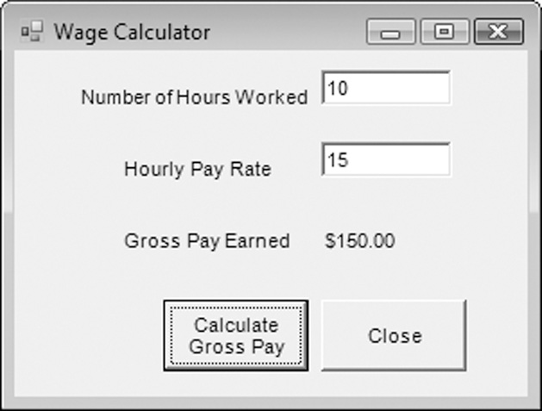
Example of an Object
This is a Visual Basic
GUI object called a form
Contains data and actions
Data, such as Hourly Pay
Rate, is a text property
that determines the
appearance of form objects
Actions, such as Calculate Gross Pay, is a method that determines how the form reacts
A form is an object that contains other objects such as buttons, text boxes, and labels
Slide 1- <number>

Slide 21
Example of an Object
Form elements are
objects called controls
This form has:
  Two TextBox controls
  Four Label controls
  Two Button controls
The value displayed by
a control is held in the text property of the control
Left button text property is Calculate Gross Pay
Buttons have methods attached to click events
Slide 1- <number>

Slide 22
Event Driven Programming: Events
The GUI environment is event-driven
An event is an action that takes place within a program
  Clicking a button (a Click event)
  Keying in a TextBox (a TextChanged event)
Visual Basic controls are capable of detecting many, many events
A program can respond to an event if the programmer writes an event procedure
Slide 1- <number>

Slide 23
1.3
More About Controls and Programming
As a Visual Basic Programmer, You Must Design and Create the Two Major Components of an Application: the GUI Elements (Forms and Other Controls) and the Programming Statements That Respond to And/or Perform Actions (Event Procedures)
Copyright © 2007 Pearson Education, Inc. Publishing as Pearson Addison-Wesley

Slide 24
Visual Basic Controls
As a Windows user you’re already familiar with many Visual Basic controls:
    Label - displays text the user cannot change
    TextBox - allows the user to enter text
    Button – performs an action when clicked
    RadioButton - A round button that is selected or deselected with a mouse click
    CheckBox – A box that is checked or unchecked with a mouse click
    Form - A window that contains these controls
Tutorial 1-3 demonstrates these controls
Slide 1- <number>

Slide 25
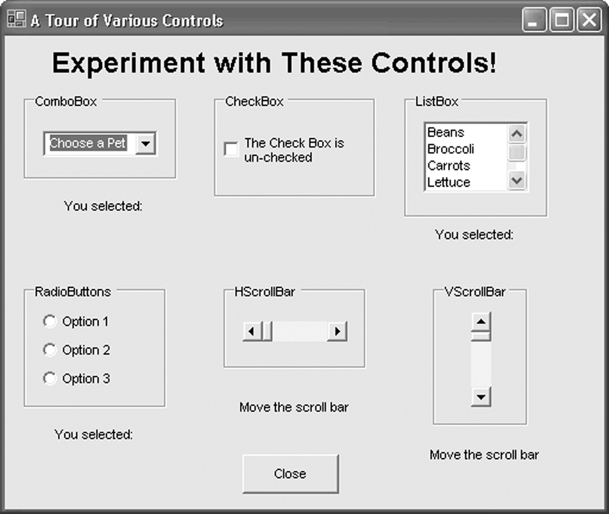
Tutorial 1-3, Visual Basic Controls
Slide 1- <number>

Slide 26
Name Property
All controls have properties
Each property has a value (or values)
Not all properties deal with appearance
The name property establishes a means for the program to refer to that control
Controls are assigned relatively meaningless names when created (e.g., Label1, Label2, etc.)
Programmers usually change these names to something more meaningful to make the program easier to read by human beings!
Slide 1- <number>

Slide 27
Examples of Names
The label controls use the default names (Label1, etc.)
Text boxes, buttons, and the Gross Pay label play an
active role in the program and have been changed
Label1
txtHoursWorked
Label2
txtPayRate
Label3
lblGrossPay
btnCalcGrossPay
btnClose
Slide 1- <number>

Slide 28
Naming Conventions
Control names must start with a letter
Remaining characters may be letters, digits, or underscore
1st 3 lowercase letters indicate the type of control
  txt… for Text Boxes
  lbl… for Labels
  btn… for Buttons
After that, capitalize the first letter of each word
txtHoursWorked is clearer than txthoursworked
Slide 1- <number>

Slide 29
Event Handler – Compute Gross Pay
Private Sub btnCalcGrossPay_Click(ByVal sender As System.Object, _
ByVal e As System.EventArgs) Handles btnCalcGrossPay.Click
‘Define a variable to hold the gross pay.
Dim sngGrossPay As Single
‘Convert the values in the text boxes to numbers,
‘and calculate the gross pay.
sngGrossPay = CSng(txtHoursWorked.Text) * CSng(txtPayRate.Text)
‘Format the gross pay for currency display and
‘assign it to the Text property of a label.
lblGrossPay.Text = FormatCurrency(sngGrossPay)
End Sub
Slide 1- <number>

Slide 30
Event Handler - Close
Private Sub btnClose_Click(ByVal sender As System.Object, _
ByVal e As System.EventArgs) Handles btnClose.Click
‘End the program by closing its window.
Me.Close()
End Sub
Slide 1- <number>

Slide 31
Language Elements
Keywords: Words with special meaning to Visual Basic (e.g., Private, Sub)
Programmer-defined-names: Names created by the programmer (e.g., sngGrossPay, btnClose)
Operators: Special symbols to perform common operations (e.g., +, -, *, and /)
Remarks: Comments inserted by the programmer – these are ignored when the program runs (e.g., any text preceded by a single quote)
Slide 1- <number>

Slide 32
Language Elements: Syntax
Syntax defines the correct use of key words, operators, & programmer-defined names
Similar to the syntax (rules) of English that defines correct use of nouns, verbs, etc.
A program that violates the rules of syntax will not run until corrected
Slide 1- <number>

Slide 33
1.4
The Programming Process
The Programming Process Consists of Several Steps, Which Include Design, Creation, Testing, and Debugging Activities
Copyright © 2007 Pearson Education, Inc. Publishing as Pearson Addison-Wesley

Slide 34
Step 1 of Developing an Application
Clearly define what the program is to do
For example, the Wage Calculator program:
  Purpose: To calculate the user’s gross pay
  Input: Number of hours worked, hourly pay rate
  Process: Multiply number of hours worked by hourly pay rate (result is the user’s gross pay)
  Output: Display a message indicating the user’s gross pay
Slide 1- <number>

Slide 35
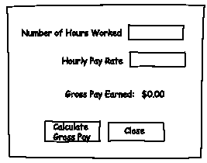
Step 2 of Developing an Application
Visualize the application running on the computer and design its user interface
Slide 1- <number>

Slide 36
Step 3 of Developing an Application
Make a list of the controls needed
Type Name Description
TextBox txtHoursWorked Allows the user to enter the number of hours worked.
TextBox txtPayRate Allows the user to enter the hourly pay rate
Label lblGrossPay Displays the gross pay, after the btnCalcGrossPay
button has been clicked
Button btnCalcGrossPay When clicked, multiplies the number of hours worked
by the hourly pay rate
Button btnClose When clicked, terminates the application
Label (default) Description for Number of Hours Worked TextBox
Label (default) Description for Hourly Pay Rate TextBox
Label (default) Description for Gross Pay Earned Label
Form (default) A form to hold these controls
Slide 1- <number>

Slide 37
Step 4 of Developing an Application
Define values for each control's relevant properties:
Control Type Control Name Text
Form (Default) "Wage Calculator"
Label (Default) "Number of Hours Worked"
Label (Default) "Hourly Pay Rate"
Label (Default) "Gross Pay Earned"
Label lblGrossPay "$0.00"
TextBox txtHoursWorked ""
TextBox txtPayRate ""
Button btnCalcGrossPay "Calculate Gross Pay"
Button btnClose "Close"
Slide 1- <number>

Slide 38
Step 5 of Developing an Application
List the methods needed for each control:
Method Description
btnCalcGrossPay_Click Multiplies hours worked by hourly pay rate
These values are entered into the txtHoursWorked and txtPayRate TextBoxes
Result is stored in lblGrossPay Text property
btnClose_Click Terminates the application
Slide 1- <number>

Slide 39
Step 6 of Developing an Application
Create pseudocode or a flowchart of each method:
  Pseudocode is an English-like description in programming language terms
  A flowchart is a diagram that uses boxes and other symbols to represent each step
Store Hours Worked x Hourly Pay Rate in sngGrossPay.
Store the value of sngGrossPay in lblGrossPay.Text.
Multiply hours worked by hourly payrate. Store result in sngGrossPay.
Copy value in sngGrossPay to lblGrossPay text property
Start
End
Slide 1- <number>

Slide 40
Step 7 of Developing an Application
Check the code for errors:
  Read the flowchart and/or pseudocode
  Step through each operation as though you are the computer
  Use a piece of paper to jot down the values of variables and properties as they change
  Verify that the expected results are achieved
Slide 1- <number>

Slide 41
Step 8 of Developing an Application
Use Visual Basic to create the forms and other controls identified in step 3
  This is the first use of Visual Basic, all of the previous steps have just been on paper
  In this step you develop the portion of the application the user will see
Slide 1- <number>

Slide 42
Step 9 of Developing an Application
Use Visual Basic to write the code for the event procedures and other methods created in step 6
  This is the second step on the computer
  In this step you develop the methods behind the click event for each button
  Unlike the form developed on step 8, this portion of the application is invisible to the user
Slide 1- <number>

Slide 43
Step 10 of Developing an Application
Attempt to run the application - find syntax errors
  Correct any syntax errors found
  Syntax errors are the incorrect use of an element of the programming language
  Repeat this step as many times as needed
  All syntax errors must be removed before Visual Basic will create a program that actually runs
Slide 1- <number>

Slide 44
Step 11 of Developing an Application
Run the application using test data as input
  Run the program with a variety of test data
  Check the results to be sure that they are correct
  Incorrect results are referred to as a runtime error
  Correct any runtime errors found
  Repeat this step as many times as necessary
Slide 1- <number>

Slide 45
1.5
Visual Studio and the
Visual Basic Environment
Visual Studio Consists of Tools That You Use to Build Visual Basic Applications
Copyright © 2007 Pearson Education, Inc. Publishing as Pearson Addison-Wesley

Slide 46
The Visual Studio IDE
Visual Studio is an integrated development environment, often abbreviated as IDE
Provides everything needed to create, test, and debug software including:
  The Visual Basic language
  Form design tools to create the user interface
  Debugging tools to help find and correct programming errors
Visual Studio supports other languages beside Visual Basic such as C++ and C#
Slide 1- <number>

Slide 47
The Visual Basic Environment
Tutorial 1-4 introduces elements of the IDE:
  Customizing the IDE
  Design window – a place to design and create a form
  Solution Explorer window – shows files in the solution
  Properties window – modify properties of an object
  Dynamic Help window – a handy reference tool
  Toolbar – contains icons for frequently used functions
  Toolbox window – objects used in form design
  Tooltips – a short description of button’s purpose
Slide 1- <number>

