Slide 1
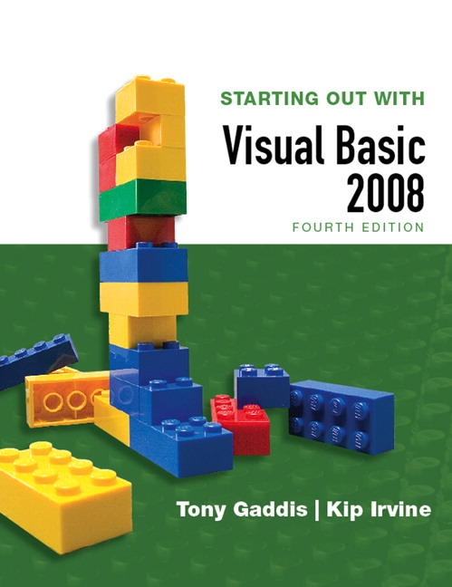
STARTING OUT WITH
Visual Basic 2008
FOURTH EDITION
Tony Gaddis
Haywood Community College
Kip Irvine
Florida International University
Slide 3- <number>

Slide 2
Chapter
3
Input, Variables, Exceptions,
And Calculations
Copyright © 2007 Pearson Education, Inc. Publishing as Pearson Addison-Wesley

Slide 3
Introduction
This chapter covers the use of text boxes to gather input from users
It also discusses the use of
  variables
  named constants
  Type conversion functions
  mathematical calculations
  Format menu commands
  the Load procedure of a form
Slide 3- <number>

Slide 4
3.1
Gathering Text Input
In This Section, We Use the Textbox Control to Gather Input That the User Has Typed on the Keyboard
Copyright © 2007 Pearson Education, Inc. Publishing as Pearson Addison-Wesley

Slide 5
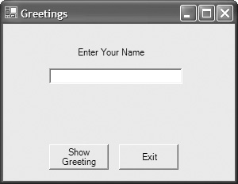
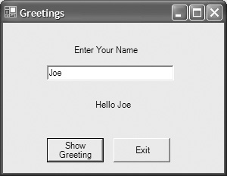
The TextBox Control
A text box is a rectangular area on a form that accepts input from a keyboard
Tutorial 3-1 provides an example in the use of a text box
txtUserName
lblGreeting
btnClose
btnShowGreeting
Slide 3- <number>

Slide 6
The Text Property of a TextBox
A user can change the text property of a text box simply by typing in the text box
A programmer can change the text property of a text box with an assignment statement
  Uses the form Object.Property similar to working with the text property of a label
  The following code assigns the text to the right of the equal sign to the text property of a TextBox box txtInput left of the equal sign
  txtInput.Text = “Type your name”
Slide 3- <number>

Slide 7
The Text Property of a TextBox
We can also use the text property of a text box to retrieve something the user has typed
  The following code assigns the text in txtInput to the text property of the label lblSet
  lblSet.Text = txtInput.Text
  Once again we use the form Object.Property
  This is the standard format to refer to any property of any object
Slide 3- <number>

Slide 8
Clearing a TextBox
Can be done with an assignment statement:
  txtInput.Text = ""
  Two adjacent quote marks yields a null string
  So this replaces whatever text was in txtInput with "nothing" -- a string with no characters
Can also be done with a method:
  txtInput.Clear()
  Clear is a Method, not a Property
  Methods are actions – as in clearing the text
  Uses the form Object.Method
Slide 3- <number>

Slide 9
String Concatenation
We often need to combine two or more strings into a longer one
This operation is called Concatenation
Concatenation is signaled by the '&' operator in the same way addition is signaled by a '+'
Slide 3- <number>

Slide 10
String Concatenation
Assume the user has entered their name into the TextBox txtName
Label lblGreeting can say, “Hello” to any name found in the TextBox
  lblGreeting.Text = "Hello " & txtName.Text
  Appends user name in txtName.Text to “Hello ” and stores result in text property of lblGreeting
Slide 3- <number>

Slide 11
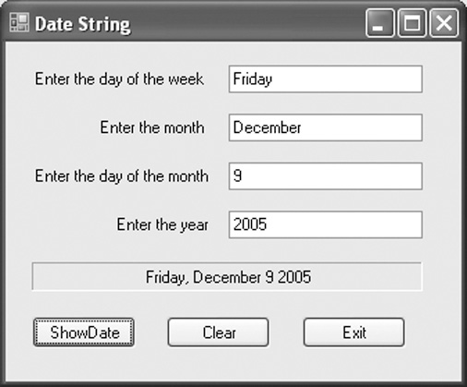
String Concatenation
Tutorial 3-2 provides another example of how to concatenate strings from text boxes
txtDayOfWeek
txtMonth
txtDayOfMonth
txtYear
lblDateString
btnExit
btnClear
btnShowDate
Slide 3- <number>

Slide 12
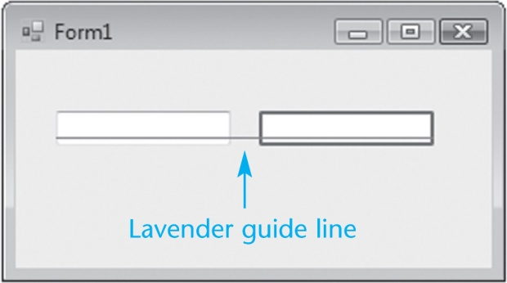
Aligning Controls in Design Mode
When dragging a control to a form, it can be aligned with a control already on the form
Guide lines automatically appear
  Blue guide lines appear for vertical alignment
  Lavender guide lines for horizontal alignment
Horizontal alignment example
Slide 3- <number>

Slide 13
The Focus Method
For a control to have the focus means that it is ready to receive the user's input
In a running form, one and only one of the controls on the form may have the focus
Only a control capable of receiving some sort of input may have the focus
The focus can be set to a control in code using the Focus method:
txtUserName.Focus()
Slide 3- <number>

Slide 14
The Focus Method
You can tell which control has focus by its characteristics:
  When a TextBox has focus, it will have a blinking cursor or its text will be highlighted
  When a button, radio button, or a check box has focus, you’ll see a thin dotted line around the control
Tutorial 3-3 shows an example of the Focus method
Slide 3- <number>

Slide 15
Controlling Form Tab Order with the TabIndex Property
Tab key steps focus from one control to the next
This order is set by the TabIndex property
The Tab key causes the focus to jump to the control with the next highest TabIndex value
The TabIndex property is best changed with the Tab Order option from the View menu
  Displays the form in tab order selection mode
  Set a new tab order by clicking the controls in the order you want
  This sets the numeric TabIndex value
Slide 3- <number>

Slide 16
Keyboard Access Keys in Buttons
Say your form had a button with the text "Save" on it
You can allow the user to activate the button using Alt-S instead of a mouse click
Just change the button text property to "&Save"
The character following the '&' (S in this case) is designated as an access key
Be careful not to use the same access key for two different buttons
Slide 3- <number>

Slide 17
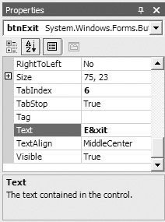
'&' Has Special Meaning in a Button
Note that the '&' in "&Save" does not display in the button control on the form
It simply establishes the Alt Key access
In order to actually display an '&' on a button, it must be entered as "&&“
  Button text Save & Exit is entered as Save && Exit
Slide 3- <number>

Slide 18
Setting the Accept Button
The accept button is a button that is implicitly activated if the user hits the Enter Key
The AcceptButton Property designates which button on the form will behave in this manner
The button clicked most frequently on a form is usually assigned as the accept button
Slide 3- <number>

Slide 19
Setting the Cancel Button
The cancel button is a button that is implicitly activated if the user hits the Escape Key
The CancelButton Property designates which button on the form will behave in this manner
Any exit or cancel button on a form is a candidate to become the cancel button
Tutorial 3-5 provides examples of setting access keys, accept, and cancel buttons
Slide 3- <number>

Slide 20
3.2
Variables and Data Types
Variables Hold Information That May Be Manipulated, Used to Manipulate Other Information, or Remembered for Later Use
Copyright © 2007 Pearson Education, Inc. Publishing as Pearson Addison-Wesley

Slide 21
Why Have Variables?
A variable is a storage location in the computer’s memory, used for holding information while the program is running
The information that is stored in a variable may change, hence the name “variable”
Slide 3- <number>

Slide 22
What Can You Do With Variables?
Copy and store values entered by the user, so they may be manipulated
Perform arithmetic on values
Test values to determine that they meet some criterion
Temporarily hold and manipulate the value of a control property
Remember information for later use in the program
Slide 3- <number>

Slide 23
How to Think About Variables
You the programmer make up a name for the variable
Visual Basic associates that name with a location in the computer's RAM
The value currently associated with the variable is stored in that memory location
Slide 3- <number>

Slide 24
Declaring Variables
A variable declaration is a statement that creates a variable in memory
The syntax is
Dim VariableName As DataType
  Dim (short for Dimension) is a keyword
  VariableName is the programmer designated name
  As is a keyword
  DataType is one of many possible keywords for the type of value the variable will contain
Example: Dim intLength as Integer
Slide 3- <number>

Slide 25
Declaring Multiple Variables
Several variables may be declared in one statement if they all hold the same type of value
Dim intLength, intWidth, intHeight as Integer
Or this can be done in 3 separate statements
  Dim intLength as Integer
  Dim intWidth as Integer
  Dim intHeight as Integer
Slide 3- <number>

Slide 26
Setting the Value of a Variable
An assignment statement is used to set the value of a variable, as in:
  Assign the value 112 to the variable length
    length = 112
  Assign the string literal “Good Morning “ followed by the contents of the text box txtName to the variable greeting
    greeting = "Good Morning " & txtName.Text
An assignment changes only the left operand
The right operand remains unchanged
Slide 3- <number>

Slide 27
Visual Basic Data Types
Integer types
  Byte
  Short
  Integer
  Long
Floating-Point types
  Single
  Double
  Decimal
Other data types
  Boolean
  Char
  String
  Date
Slide 3- <number>

Slide 28
Integer Data Types
For values that will always be a whole number
Usually name a variable starting with a 3 or 4 letter prefix indicating the variable’s type
Data Type | Naming Prefix | Description
Byte | byt | Unsigned integer from 0 to 255
Short | shrt | Signed integer from -32,768 to 32,767
Integer | int | Signed integer from -2,147,483,648 to 2,147,483,647
Long | lng | Signed integer from -9,223,372,036,854,775,808 to 9,223,372,036,854,775,807
Slide 3- <number>

Slide 29
Floating-Point Data Types
For values that may have fractional parts
Single used most frequently
Double sometimes used in scientific calculations
Decimal often used in financial calculations
Data Type | Naming Prefix | Description
Single | sng | As large as 10³⁸ plus or minus, 7 decimal positions
Double | dbl | As large as 10³⁰⁸ plus or minus,15 decimal positions
Decimal | dec | As large as 10²⁹ plus or minus, 29 decimal positions
Slide 3- <number>

Slide 30
Other Common Data Types
Boolean – variable naming prefix is bln
  Holds 2 possible values, True or False
Char – variable naming prefix is chr
  Holds a single character
  Allows for characters from other languages
String – variable naming prefix is str
  Holds a sequence of up to 2 billion characters
Date – variable naming prefix is dat
  Can hold date and/or time information
Slide 3- <number>

Slide 31
Working with the String Data Type
A string literal is enclosed in quotation marks
The following code assigns the name Jose Gonzales to the variable strName
Dim strName as string
strName = "Jose Gonzales"
An empty string literal can be coded as:
  Two consecutive quotation marks
  strName = ""
  Or by the special identifier String.Empty
  strName = String.Empty
Slide 3- <number>

Slide 32
Working with the Date Data Type
Date data type variables can hold the date and time
A date literal is enclosed within # symbols
startDate = #10/20/2005 6:30:00 AM#
or startDate = #12/10/2005#
or startTime = #21:15:02#
Or can use a function to convert a string to a date
startDate = System.Convert.ToDateTime("12/3/2002")
System.Convert.ToDateTime function is used to store a date from a text box in a date variable
userDate = System.Convert.ToDateTime(txtDate.text)
Slide 3- <number>

Slide 33
Assigning Text to a Variable
Tutorial 3-6 provides an example of how the contents of text boxes are assigned to a string variable
  ' Declare a string variable to hold the full name.
  Dim strFullName As String
  ' Combine the first and last names
  ' and copy the result to lblFullName
  strFullName = txtFirstName.Text & " " & txtLastName.Text
  lblFullName.Text = strFullName
Slide 3- <number>

Slide 34
Variable Naming Rules
The first character of a variable name must be a letter or an underscore
Subsequent characters may be a letter, underscore, or digit
  Thus variable names cannot contain spaces or periods (or many other kinds of characters)
Visual Basic keywords cannot be used as variable names
Slide 3- <number>

Slide 35
Variable Naming Conventions
Naming conventions are a guideline to help improve readability but not required syntax
A variable name should describe its use
Each data type has a recommended prefix, in lower case, that begins the variable name
The 1st letter of each subsequent word in the variable name should be capitalized
  intHoursWorked - an integer variable
  strLastName - a string (or text) variable
Slide 3- <number>

Slide 36
Declaring Variables with IntelliSense
As you enter your program, VB often aids you by offering a list of choices that could be used at that point
After typing "As" in a variable declaration, VB will offer an alphabetical list of all possible data types
  Type the first few letters of the data type name
  Intellisense box will highlight the matching type
  Press the Tab key to select highlighted choice
Or just complete typing the entire data type name
Slide 3- <number>

Slide 37
Default Values and Initialization
When a variable is first created in memory, it is assigned a default value
  numeric types are given a value of zero
  Boolean types are given a value of False
  strings are given a value of Nothing
  dates default to 12:00:00 AM January 1,1
Good practice to initialize string variables
  Dim strName as String = String.Empty
  String with value Nothing causes error if used
Slide 3- <number>

Slide 38
Initialization of Variables
Can provide a starting or initialization value for any type of variable in a Dim statement
Usually want to set an initial value unless assigning a value prior to using the variable
Just append = value to the Dim statement where value is the literal to be assigned to the variable
Dim intMonthsPerYear As Integer = 12
Slide 3- <number>

Slide 39
3.3
Performing Calculations
Visual Basic Has Powerful Arithmetic Operators That Perform Calculations With Numeric Variables and Literals
Copyright © 2007 Pearson Education, Inc. Publishing as Pearson Addison-Wesley

Slide 40
Common Arithmetic Operators
Visual Basic provides operators for the common arithmetic operations:
  + Addition
  - Subtraction
  * Multiplication
  / Division
  ^ Exponentiation
Slide 3- <number>

Slide 41
Common Arithmetic Operators
Addition
  decTotal = decPrice + decTax
Subtraction
  decNetPrice = decPrice – decDiscount
Multiplication
  dblArea = dblLength * dblWidth
Division
  sngAverage = sngTotal / intItems
Exponentiation
  dblCube = dblSide ^ 3
Slide 3- <number>

Slide 42
Special Integer Division Operator
The backslash (\) is used as an integer division operator
Divides one integer by another
The result is always an integer, created by discarding any remainder from the division
If calculating the number of hours in a given number of minutes
  intHours = intMinutes \ 60
  With intMinutes equal to 190, this calculation will result in the value 3 assigned to intHours
Slide 3- <number>

Slide 43
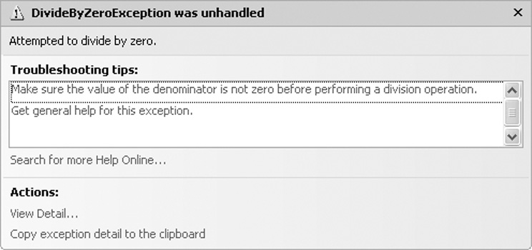
Modulus (MOD) Operator
This operator can be used in place of the backslash operator to give the remainder of a division operation
  intRemainder = 17 MOD 3 ‘result is 2
  dblRemainder = 17.5 MOD 3 ‘result is 2.5
Use of the \ or MOD
operator to perform integer
division by zero causes a
DivideByZeroException
runtime error
Slide 3- <number>

Slide 44
Retrieving the Current Date/Time
A series of keywords yields the current date, current time, or both
  Description Keyword Example
  Date & Time Now datCurrent=Now
  Time only TimeOfDay datCurrTime=TimeOfDay
  Date only Today datCurrDate=Today
Variables datCurrent, datCurrTime, and datCurrDate must be declared as Date data types
Slide 3- <number>

Slide 45
Scope and Local Variables
Scope refers to the part of the program where:
  A variable is visible and
  May be accessed by program code
Variables declared within a procedure are called local variables and observe these characteristics
  Scope begins where variable is declared
  Extends to end of procedure where declared
  Variable is not visible outside the procedure
A variable cannot be declared twice in the same procedure
Slide 3- <number>

Slide 46
Class-Level and Global Scope
A variable declared inside a class but outside any procedure is a class-level variable
  Scope is throughout all procedures of the class
A variable declared outside any class or procedure is a global variable
  Scope is throughout all forms, classes, and procedures of the project
Class-level and global scope will be discussed further in future chapters
Values in a variable are destroyed when it goes out of scope
Slide 3- <number>

Slide 47
Combined Assignment Operators
Often need to change the value in a variable and assign the result back to that variable
  For example: var = var – 5
  Subtracts 5 from the value stored in var
Other examples:
  x = x + 4 Adds 4 to x
  x = x – 3 Subtracts 3 from x
  x = x * 10 Multiplies x by 10
VB provides for this common need with combined assignment operators
Slide 3- <number>

Slide 48
Combined Assignment Operators
These special assignment operators provide an easy means to perform these common operations:
Operator Usage Equivalent to Effect
+= x += 2 x = x + 2 Add to
-= x -= 5 x = x – 5 Subtract from
*= x *= 10 x = x * 10 Multiply by
/= x /= y x = x / y Divide by
\= x \= y x = x \ y Int Divide by
&= name &= last name = name & last Concatenate
Slide 3- <number>

Slide 49
Arithmetic Operator Precedence
Operator precedence tells us the order in which operations are performed
From highest to lowest precedence:
  Exponentiation (^)
  Multiplicative (* and /)
  Integer Division (\)
  Modulus (MOD)
  Additive (+ and -)
Where precedence is the same, operations occur from left to right
Slide 3- <number>

Slide 50
Operator Precedence Examples
The result is very different when the divide by 2 operation is moved from the end of the calculation to the middle.
  6 * 2^3 + 4 / 2
  6 * 8 + 4 / 2
  48 + 4 / 2
  48 + 2
  50
  6 / 2 * 2^3 + 4
  6 / 2 * 8 + 4
  3 * 8 + 4
  24 + 4
  28
Slide 3- <number>

Slide 51
Grouping with Parentheses
Parentheses () can be used to force selected parts of an expression to be evaluated before others
Assume we’re computing the average of 3 numbers
  dblAvg = int1 + int2 + int3 / 3 ‘incorrect
  int3 / 3 is evaluated first
  That result is added to int1 and int2
Use parentheses to control order of operations
  dblAvg = (int1 + int2 + int3) / 3 ‘correct
  int1 + int2 + int3 is evaulated first
  That result is divided by 3
When in doubt, use parentheses!
Slide 3- <number>

Slide 52
3.4
Mixing Different Data Types
Copyright © 2007 Pearson Education, Inc. Publishing as Pearson Addison-Wesley

Slide 53
Implicit Type Conversions
A value of one data type can be assigned to a variable of a different type
  An implicit type conversion is an attempt to convert to the receiving variable’s data type
A widening conversion suffers no loss of data
  Converting an integer to a single
  Dim sngNumber as Single = 5
A narrowing conversion may lose data
  Converting a decimal to an integer
  Dim intCount = 12.2 ‘intCount becomes 12
Slide 3- <number>

Slide 54
Option Strict
Option Strict is a VB configuration setting
Only widening conversions are allowed when Option Strict is set to On
  An integer can be assigned to a decimal
  A decimal cannot be assigned to an integer
  A single can be assigned to a double
  A double cannot be assigned to a single
Option Strict On is recommended to help catch errors
Slide 3- <number>

Slide 55
Type Conversion Runtime Errors
Consider the statement
Dim intCount as Integer = “abc123”
This is a narrowing conversion
With Option Strict On, statement will not compile
With Option Strict Off, statement compiles but
  String “abc123” will not convert to an integer
  A runtime error called a type mismatch occurs when this statement is executed
Slide 3- <number>

Slide 56
Named Constants
Programs often need to use given values
  For example: decTotal *= 1.06
  Adds 6% sales tax to an order total
Two problems with this approach
  The reason for multiplying decTotal by 1.06 isn’t always obvious
  If sales tax rate changes, must find and change every occurrence of .06 or 1.06
Use of named constants resolves both these issues
Slide 3- <number>

Slide 57
Named Constants
Can declare a variable whose value is set at declaration and cannot be changed later:
  Const sngSALES_TAX_RATE As Single = 1.06
Looks like a normal declaration except:
  Const used instead of Dim
  An initialization value is required
  By convention, entire name capitalized with underscore characters to separate words
The objective of our code is now clearer
  Const sngSALES_TAX_RATE As Single = 1.06
  decTotal *= sngSALES_TAX_RATE
Slide 3- <number>

Slide 58

Explicit Type Conversions
A function performs some predetermined operation and provides a single output
VB provides a set of functions that permit narrowing conversions with Option Strict On
These functions will accept a constant, variable name, or arithmetic expression
The function returns the converted value
Slide 3- <number>

Slide 59
Explicit Type Conversions
The following narrowing conversions require an explicit type conversion
  Double to Single
  Single to Integer
  Long to Integer
Boolean, Date, Object, String, and numeric types represent different sorts of values and require conversion functions as well
Slide 3- <number>

Slide 60
Explicit Type Conversion Examples
Rounding can be done with the CInt function
  intCount = CInt(12.4) ‘intCount value is 12
  intCount = CInt(12.5) ‘intCount value is 13
CStr converts an integer value to a string
  Dim strText as String = CStr(26)
CDec converts a string to a decimal value
  Dim decPay as Decimal = CDec(“$1,500”)
CDate converts a string to a date
  Dim datHired as Date = CDate(“05/10/2005”)
Slide 3- <number>

Slide 61
A Full List of Conversion Functions
There are conversion functions for each data type
CBool ( expr )
CByte ( expr )
CChar ( expr )
CDate ( expr )
CDbl ( expr )
CDec ( expr )
CInt ( expr )
CLng ( expr )
CObj ( expr )
CShort ( expr )
CSng ( expr )
CStr ( expr )
Slide 3- <number>

Slide 62
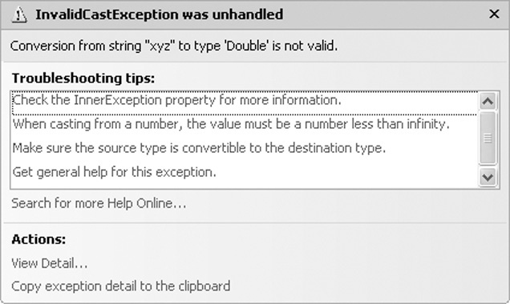
Invalid Conversions
Conversion functions can fail
  Dim dblSalary as Double = CDbl(“xyz”)
  Dim datHired as Date = CDate(“05/35/2005”)
String “xyz” can’t be converted to a number
There’s no day 35 in the month of May
These failed conversions
cause a runtime error called
an invalid cast exception
Slide 3- <number>

Slide 63
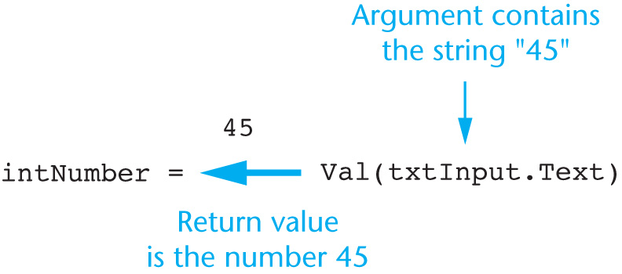
The Val Function
The Val function is a more forgiving means of performing string to numeric conversions
Uses the form
Val(string) as
shown here
If the initial characters form a numeric value, the Val function will return that
Otherwise, it will return a value of zero
Slide 3- <number>

Slide 64
The Val Function
Val Function Value Returned
  Val("34.90“) 34.9
  Val("86abc“) 86
  Val("$24.95“) 0
  Val("3,789“) 3
  Val("“) 0
  Val("x29“) 0
  Val("47%“) 47
  Val("Geraldine“) 0
Slide 3- <number>

Slide 65
3.5
Formatting Numbers and Dates
Copyright © 2007 Pearson Education, Inc. Publishing as Pearson Addison-Wesley

Slide 66
The ToString Method
Converts the contents of a variable as a string
Every VB data type has a ToString method
Uses the form VariableName.ToString
  Value in VariableName is converted to a string
For example
Dim number as Integer = 123
lblNumber.text = number.ToString
  Converts integer 123 to string “123”
  Then assigns the string to the text property of the lblNumber control
Slide 3- <number>

Slide 67
ToString Method with Format String
Can pass a format string to the ToString method
  Indicates how you want to format the string
For example
Dim dblSample as Double
Dim strResult as String
dblSample = 1234.5
strResult = dblSample.ToString(“c”)
  The value “c” is a format string
  Converts 1234.5 to currency format $1,234.50
Slide 3- <number>

Slide 68
Types of Format Strings
N or n – number format includes commas and displays 2 digits to the right of the decimal
F or f – fixed point format 2 digits to the right of the decimal but no commas
C or c – currency format includes dollar sign, commas, and 2 digits to the right of the decimal
P or p – percent format multiplies number by 100 and displays with a trailing space and percent sign
The computer’s regional settings determine some format items such as currency symbol
Slide 3- <number>

Slide 69
Specifying Decimal Positions
Can add an integer to the format string to indicate number of digits to display after the decimal point
Rounding occurs when displaying fewer decimal positions than the number contains as in the 2nd line
Number Value | Format String | ToString() Value
12.3 | n3 | 12.300
12.348 | n2 | 12.35
1234567.1 | n | 1,234,567.10
123456.0 | f2 | 123456.00
.234 | p | 23.40 %
-1234567.8 | c | ($1,234,567.80)
Slide 3- <number>

Slide 70
Specifying Integer Leading Zeros
Can specify a minimum width when displaying an integer value
Leading zeros are inserted to meet the minimum width if needed
Integer Value | Format String | ToString() Value
23 | d | 23
23 | d4 | 0023
1 | d2 | 01
Slide 3- <number>

Slide 71
Formatting Dates and Times
The ToString method can format a Date or DateTime value in a variety of ways
If the date is 4/7/2008 and the time is 3:22:18 PM
Tutorial 3-8 provides an opportunity to work with number formatting concepts
Format String | Description | ToString() Value
d | Short Date | 4/7/2008
D | Long Date | Monday, April 7, 2008
t | Short Time | 3:22 PM
T | Long Time | 3:22:18 PM
F | Full Date/Time | Monday, April 7, 2008 3:22:18 PM
Slide 3- <number>

Slide 72
3.6
Exception Handling
A Well-Engineered Program Should Report Errors and Try To Continue Or Explain Why It Can’t Continue and Then Shut Down.
Use Exception Handling to Recover Gracefully from Errors
Copyright © 2007 Pearson Education, Inc. Publishing as Pearson Addison-Wesley

Slide 73
Runtime Errors
We’ve shown two possible runtime errors
  DivideByZeroException
  InvalidCastException
  There are many others
Runtime errors occur for may reasons
A runtime error results when:
  Visual Basic throws an exception
  And it is an unhandled exception
Exception handling allows a program to fail gracefully and recover if possible
Slide 3- <number>

Slide 74
Message Boxes
A message box is an easy way to notify the user when an error occurs
MessageBox.Show displays a pop-up window with a message and an OK button
There are two basic formats
  MessageBox.Show( message )
  MessageBox.Show( message , caption )
message appears in the body of the window
caption appears in the title bar of the window
Slide 3- <number>

Slide 75
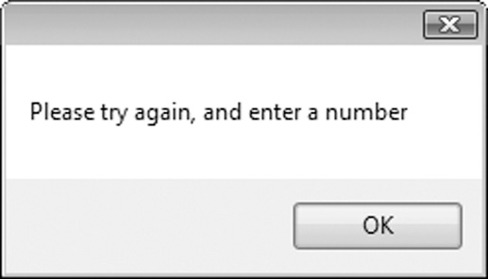
Message Box Example
The following code displays the message box shown below
MessageBox.Show(“Please try again, and enter a number”)
The capabilities of the MessageBox will be presented in more detail in Chapter 4
Slide 3- <number>

Slide 76
Handling Exceptions
Visual Basic provides an exception handler
A simple form that ignores some options is:
    Try
    try-block
    Catch [exception-type]
    catch-block
    End Try
The try-block contains program statements that might throw an exception
The catch-block contains statements to execute if an exception is thrown
Slide 3- <number>

Slide 77
Exception Handling Example
Consider the following exception handling code
    Try
    Dim decSalary as Decimal
    decSalary = CDec(txtSalary.Text)
    MessageBox.Show(“Your salary is “ _
    & decSalary & “ dollars”)
    Catch
    MessageBox.Show(“ Please try again,” _
    & “and enter a number”, “Entry Error”)
    End Try
If CDec throws a cast exception, the try block catches it, jumps to and executes the catch block which displays the error message
Slide 3- <number>

Slide 78
More Exception Handling Features
Can catch specific types of messages
Can capture and show the exception message issued by Visual Basic
    Try
    Dim decAnnualSalary as Decimal
    Dim intPayPeriods as Integer
    Dim decSalary as Decimal
    decAnnualSalary = CDec(txtAnnualSalary.Text)
    intPayPeriods = CInt(txtPayPeriods.Text)
    decSalary.Text = decAnnualSalary / intPayPeriods
    lblSalary.Text = decSalary.ToString()
    Catch ex as InvalidCastException
    MessageBox.Show(ex.Message, “Entry Error”)
    Catch ex as DivideByZeroException
    MessageBox.Show(“Zero Value Not Allowed “ _ & “ for Pay Periods”)
    End Try
Slide 3- <number>

Slide 79
Exception Handling Exercise
Tutorial 3-9 provides an opportunity to work with exception handling concepts
Slide 3- <number>

Slide 80
3.7
Group Boxes and the Load Event Procedure
The GroupBox Control Is Used to Group Other Controls.
The Load Event Procedure Is Executed When a Form Loads Into Memory
Copyright © 2007 Pearson Education, Inc. Publishing as Pearson Addison-Wesley

Slide 81
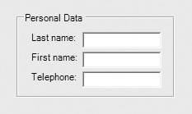
The GroupBox Control
A GroupBox creates a grouping of controls
  Controls are enclosed in
  a box with a title
  It’s apparent the controls
  within the GroupBox are related in some way
  Controls in a GroupBox have their own tab order
  Moving a GroupBox moves its controls with it
  Removing a GroupBox also removes all controls within it
Slide 3- <number>

Slide 82
Placing Controls within a Group Box
Must create the GroupBox first
Then select the GroupBox control and
  Double-click the tool from the ToolBox to place the control in the group
  or
  Click and drag the control from the ToolBox to the GroupBox
To move an existing control to a GroupBox
  Select the control and cut it from the form
  Select the group and paste the control into it
Slide 3- <number>

Slide 83
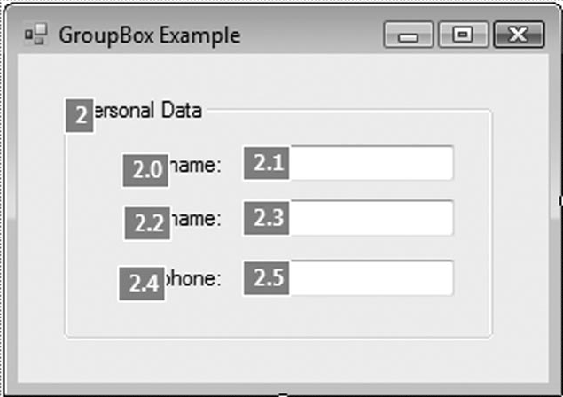
GroupBox Tab Order
A GroupBox has it’s own place in form tab order
Once the tab order reaches the GroupBox
  Must tab through all controls in the GroupBox
  before tabbing to controls outside GroupBox
  Tab order of controls inside the GroupBox
  can be assigned in any order
The GroupBox to the right
is 2nd in the form tab order
Tab order of controls in the
GroupBox is 2.1, 2.3, & 2.5
Slide 3- <number>

Slide 84
Selecting Multiple Controls
Multiple controls can be selected and then acted upon as a group
  Click and drag over the desired controls
  Any control partially or completely within the selection box will be selected
  Or hold the Ctrl key while clicking the controls
Once selected, a group of controls may
  Be moved together as a group
  Be deleted in a single step
  Have their properties set in a single step
Slide 3- <number>

Slide 85
Load Event Procedure
Every form has a Load event procedure
Automatically executed when the form is displayed
Double-click in any empty space on the form
The code window will appear
Place the code to be executed between the Private Sub and End Sub lines
Private Sub Form1_Load(ByVal sender As System.Object, _
ByVal e As System.EventArgs) Handles MyBase.Load
' Code to be executed when the Form loads
End Sub
Slide 3- <number>

Slide 86
3.8
Building the Room Charge Calculator Application
An Opportunity to Apply the Various Concepts Discussed in this Chapter
Copyright © 2007 Pearson Education, Inc. Publishing as Pearson Addison-Wesley

Slide 87
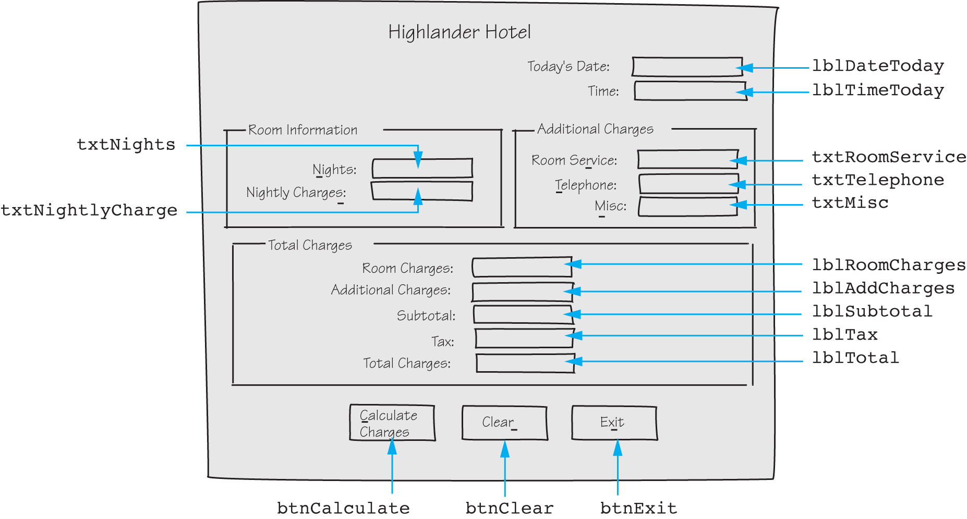
The Room Charge Calculator
Slide 3- <number>

Slide 88
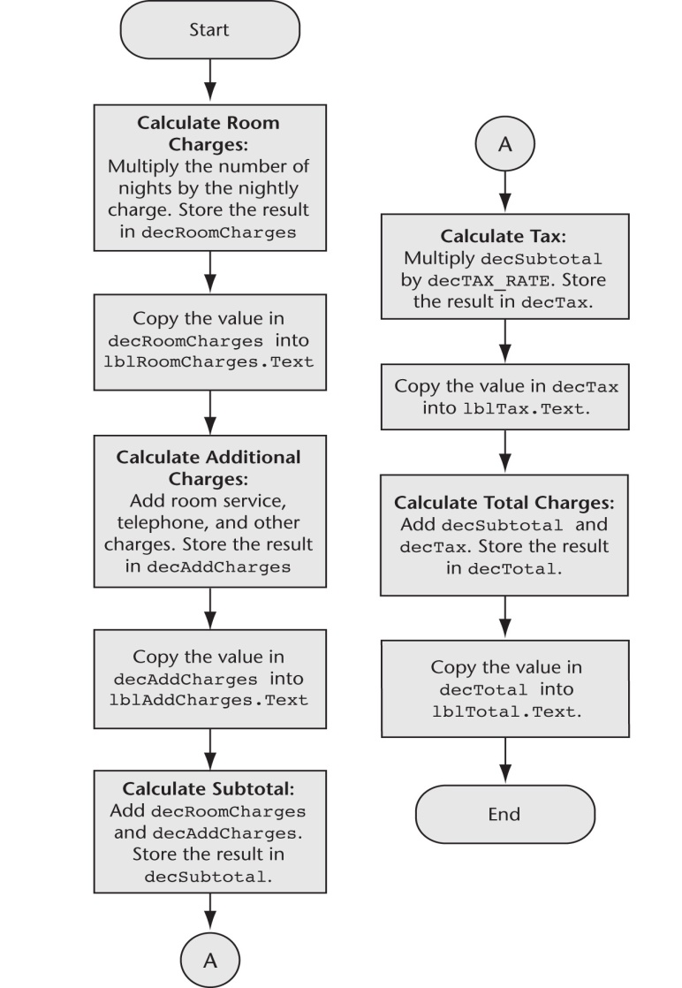
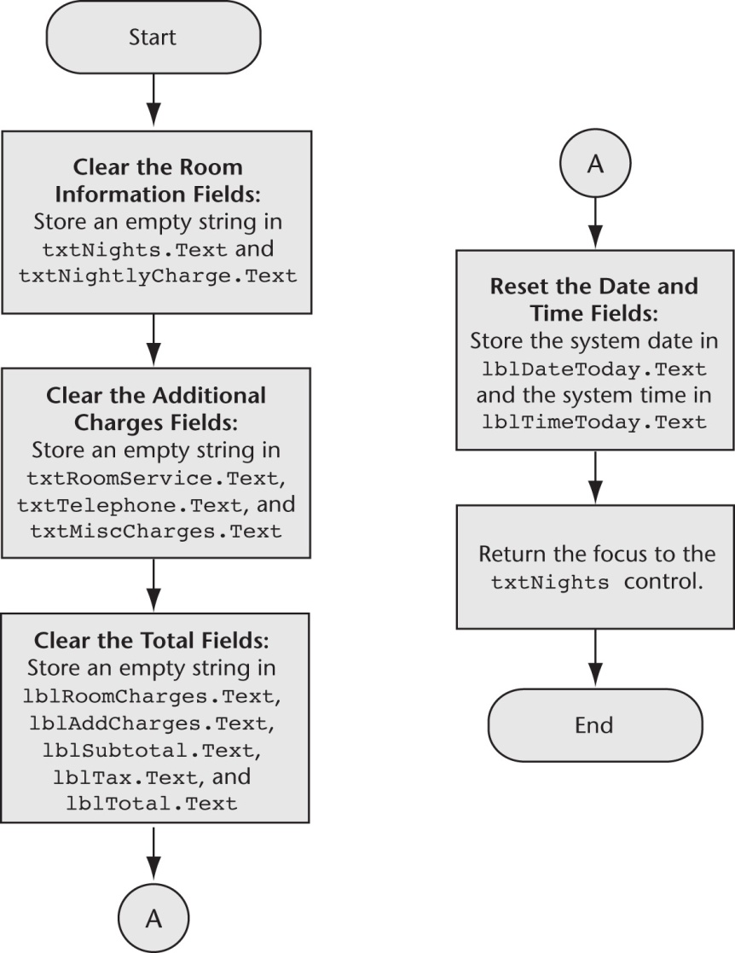
Button Click Event Flowcharts
Calculate Button
C l e a r B u t t o n
Slide 3- <number>

Slide 89
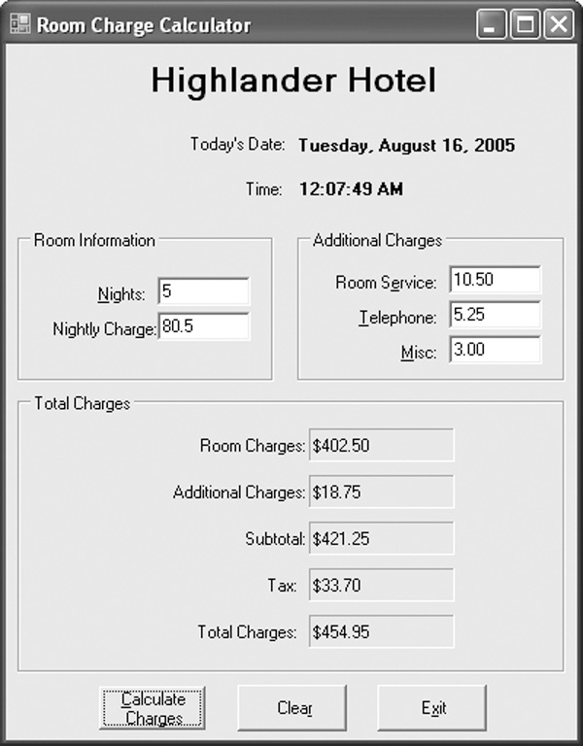
Completed Form
Slide 3- <number>

Slide 90
3.9
More About Debugging:
Locating Logic Errors
Visual Basic Allows You to Pause a Program, Then Execute Its Statements One at a Time
After Each Statement Executes, You May Examine Variable Contents and Property Values
Copyright © 2007 Pearson Education, Inc. Publishing as Pearson Addison-Wesley

Slide 91
Debugging Problem
The program runs but does not work correctly (has one or more logic errors)
Running the program with various inputs has not isolated where those logic errors lie
What can be done?
Slide 3- <number>

Slide 92
Visual Basic Debugging Aids
You can set breakpoints
  A line or lines you select in your source code
  When execution reaches this line, it pauses
  You may then examine the values in variables and certain control properties
  You may also single step through the program which executes one statement at a time
This allows you to see and examine:
  What is happening one statement at a time
  Where it is happening
  What the various data values are (Watches)
Slide 3- <number>

Slide 93
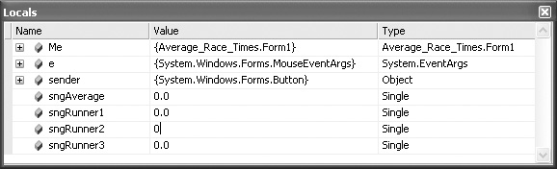
Visual Basic Debugging Aids
Tutorial 3-12 demonstrates how to
  Set breakpoints
  Examine the values of variables and control properties
  Use the Autos,
  Locals, and
  Watch windows
  Use the Debug Toolbar
Step Into
Start Debugging
Step Out
Break All
Stop Debugging
Step Over
Slide 3- <number>

