Slide 1
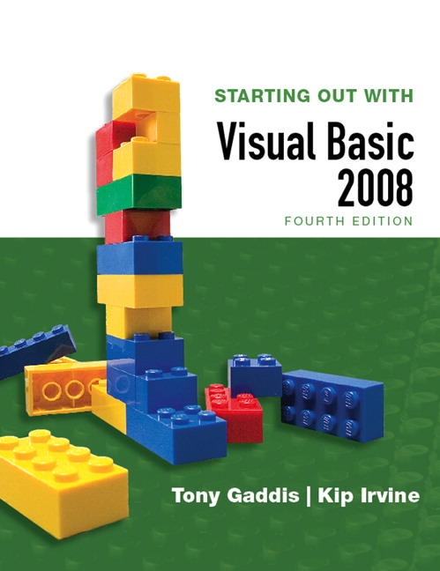
STARTING OUT WITH
Visual Basic 2008
FOURTH EDITION
Tony Gaddis
Haywood Community College
Kip Irvine
Florida International University
Slide 4- <number>

Slide 2
Chapter
4
Making Decisions and
Working With Strings
Copyright © 2007 Pearson Education, Inc. Publishing as Pearson Addison-Wesley

Slide 3
Introduction
This chapter covers the Visual Basic decision statements
  If…Then
  If…Then…Else
  If…Then…ElseIf
  Select Case
It also discusses the use of
  Radio Buttons
  Message Boxes
Slide 4- <number>

Slide 4
4.1
The Decision Structure
The Decision Structure Allows a Program to Have More Than One Path of Execution
Copyright © 2007 Pearson Education, Inc. Publishing as Pearson Addison-Wesley

Slide 5
Order of Statement Execution
Thus far, our code has been executed sequentially in a sequence structure
To write meaningful programs we need multiple paths of execution
  Some statements should be executed under certain circumstances in a decision structure
  This chapter presents the means to execute statements conditionally
  Next chapter presents the means to execute the same statements repeatedly
Slide 4- <number>

Slide 6
The Decision Structure
Flowchart of a
typical decision
structure
Evaluate the
condition
  Is it cold outside?
Execute or skip
over some code
  If yes, wear a coat
Condition
True
False
Conditional
Code
Slide 4- <number>

Slide 7
4.2
The If…Then Statement
The If…Then Statement Causes Other Statements to Execute Only Under a Certain Condition
Copyright © 2007 Pearson Education, Inc. Publishing as Pearson Addison-Wesley

Slide 8
If…Then Statement Syntax
If condition Then
statement
(more statements as needed)
End If
New keywords used above:
  If
  Then
  End
Slide 4- <number>

Slide 9
Relational Operators Test Conditions
Usually a condition is formed using a relational operator
A relational operator determines if a specific relationship exists between two values
  > Greater than
  < Less than
  = Equal to
  <> Not equal to
  >= Greater than or equal to
  <= Less than or equal to
Slide 4- <number>

Slide 10
Binary Operators
Relational operators are binary – meaning they use two operands, for example:
  length > width Is length greater than width?
  size <= 10 Is size less than or equal 10?
Relational operators yield a True or False result
Slide 4- <number>

Slide 11
If…Then Examples
‘Bonus awarded if sales greater than 50000
If sales > 50000 Then
getsBonus = True
End If
‘Bonus, 12% commission rate, and a day off
‘awarded if sales greater than 50000
If sales > 50000 Then
getsBonus = True
commissionRate = 0.12
daysOff = daysOff + 1
End If
Slide 4- <number>

Slide 12
If…Then Rules
The If and the Then must be on the same line
Only a remark may follow the Then
The End If must be on a separate line
Only a remark may follow the End If
Tutorial 4-1 presents an application that uses the If…Then statement
Slide 4- <number>

Slide 13
If…Then Programming Style
The code between the If…Then and the End If is indented
Visual Basic does not require this
It is a convention among programmers to aid in the readability of programs
By default, the Visual Basic editor will automatically do this indentation as you enter your program
Slide 4- <number>

Slide 14
Relational Operators with Math Operators
Either or both relational operator operands may be mathematical expressions
Math operators are evaluated before relational operators
x+y and a-b are evaluated first
Each result is then compared using the > operator
If x + y > a - b Then
lblMessage.Text = "It is true!"
End If
Slide 4- <number>

Slide 15
Relational Operators
With Function Calls
Either or both relational operator operands may be function calls
If CInt(txtInput.Text) < 100 Then
lblMessage.Text = "It is true!"
End If
Slide 4- <number>

Slide 16
Boolean Variables as Flags
A flag is a Boolean variable that signals when some condition exists in the program
Since a Boolean variable is either True or False, it can be used as the condition of an If
  Since a Boolean variable already evaluates to True or False, an operator is not required
If blnQuotaMet Then
lblMessage.Text = "You have met your sales quota"
End If
Slide 4- <number>

Slide 17
4.3
The If…Then…Else Statement
The If...Then...Else Statement Executes One Group of Statements If the Condition Is True and Another Group of Statements If the Condition Is False
Copyright © 2007 Pearson Education, Inc. Publishing as Pearson Addison-Wesley

Slide 18
If…Then vs. If…Then…Else
The If…Then construct will execute or ignore a group of statements
(do something or do nothing)
The If…Then…Else construct will execute one group of statements or another group (do this or do that)
Tutorial 4-2 contains an example of the If…Then…Else construct
Slide 4- <number>

Slide 19
If…Then…Else Example
Condition
False
True
Statement(s)
If False
Statement(s)
If True
If temperature < 40 Then
lblMesage.Text = “A little cold, isn’t it?”
Else
lblMesage.Text = “Nice weather we’re having!”
End If
Slide 4- <number>

Slide 20
4.4
The If…Then…ElseIf Statement
The If...Then…Elseif Statement Is Like a Chain of If...Then...Else Statements
They Perform Their Tests, One After the Other, Until One of Them Is Found to Be True
Copyright © 2007 Pearson Education, Inc. Publishing as Pearson Addison-Wesley

Slide 21
Two Mutually Exclusive Choices
The If…Then…Else has two choices
  The condition will either be True or False
  So either the Then clause or Else clause will be executed
  These are two mutually exclusive choices
Slide 4- <number>

Slide 22
Multiple Possible Choices
The If…Then…ElseIf statement allows for an entire series of possible choices
In pseudo code:
If it is very cold Then
Wear a coat
Elseif it is chilly
Wear a light jacket
Elseif it is windy
Wear a windbreaker
Elseif it is hot
Wear no jacket
Slide 4- <number>

Slide 23
Multiple Possible Choices
Each of the series of conditions in an If…Then…ElseIf is tested in sequence
When a condition is true, the remaining conditions are ignored
The order of the conditions is vital
  Wrong order can result in wrong decision
  What if it’s chilly and windy?
  If windy is tested before chilly, you’d go out with a windbreaker when you need a jacket
Slide 4- <number>

Slide 24
In Visual Basic Syntax
If condition₁ Then
Statement(s)₁
Elseif condition₂ Then
Statements(s)₂
Elseif condition₃ Then
Statements₃
…
End If
Slide 4- <number>

Slide 25
In Flowchart Form
C₁
True
Statement(s)₁
False
C₂
True
Statement(s)₂
False
C₃
True
Statement(s)₃
False
Slide 4- <number>

Slide 26
Example of ElseIf Usage
If sngAverage < 60 Then
lblGrade.Text = "F"
ElseIf sngAverage < 70 Then
lblGrade.Text = "D"
ElseIf sngAverage < 80 Then
lblGrade.Text = "C"
ElseIf sngAverage < 90 Then
lblGrade.Text = "B"
ElseIf sngAverage <= 100 Then
lblGrade.Text = "A"
End If
Does the order of these conditions matter?
What happens if we reverse the order?
Slide 4- <number>

Slide 27
The Same Code Without ElseIf
If sngAverage < 60 Then
lblGrade.Text = "F"
End If
If sngAverage < 70 Then
lblGrade.Text = "D"
End If
If sngAverage < 80 Then
lblGrade.Text = "C"
End If
If sngAverage < 90 Then
lblGrade.Text = "B"
End If
If sngAverage <= 100 Then
lblGrade.Text = "A"
End If
Does this code function correctly? What is assigned to lblGrade for a 65 average? 75?
Slide 4- <number>

Slide 28
The (Optional) Trailing Else
A sequence of ElseIf’s may end with a plain Else, called a trailing Else
If none of the conditions are True, the trailing Else statement(s) will be executed
Slide 4- <number>

Slide 29
Use of a Trailing Else
If average is greater than 100, lblGrade is assigned the text “Invalid”
If sngAverage < 60 Then
lblGrade.Text = "F"
ElseIf sngAverage < 70 Then
lblGrade.Text = "D"
ElseIf sngAverage < 80 Then
lblGrade.Text = "C"
ElseIf sngAverage < 90 Then
lblGrade.Text = "B"
ElseIf sngAverage <= 100 Then
lblGrade.Text = "A"
Else
lblGrade.Text = "Invalid"
End If
Slide 4- <number>

Slide 30
4.5
Nested If Statements
A Nested If Statement Is an If Statement in the Conditionally Executed Code of Another If Statement
Copyright © 2007 Pearson Education, Inc. Publishing as Pearson Addison-Wesley

Slide 31
If Statements Within If Statements
Any type of statement may be used inside a set of Then, Else, or ElseIf statements of an If
This includes other If statements
If statements within If statements create a more complex decision structure called a Nested If
Slide 4- <number>

Slide 32
Nested If Example
A bank customer qualifies for a special loan if:
  Earns over 30000 & on the job more than 2 years
  Or been on the job more than 5 years
If sngSalary > 30000 Then
If intYearsOnJob > 2 Then
lblMessage.Text = “Applicant qualifies."
Else
lblMessage.Text = “Applicant does not qualify."
End If
Else
If intYearsOnJob > 5 Then
lblMessage.Text = “Applicant qualifies."
Else
lblMessage.Text = “Applicant does not qualify."
End If
End If
Note how the convention of indentations
emphasizes the structure of nested Ifs.
Slide 4- <number>

Slide 33
Flowchart Version
sngSalary > 30000
False
True
intYearsOnJob > 5
intYearsOnJob > 2
False
True
False
True
lblMessage.Text =
“Applicant does
not qualify."
lblMessage.Text =
“Applicant
qualifies."
lblMessage.Text =
“Applicant does
not qualify."
lblMessage.Text =
“Applicant
qualifies."
Slide 4- <number>

Slide 34
4.6
Logical Operators
Logical Operators Combine Two or More Relational Expressions Into a Single Expression
Copyright © 2007 Pearson Education, Inc. Publishing as Pearson Addison-Wesley

Slide 35
Visual Basic Logical Operators
Operator Effect
And Both operands must be true for the overall
expression to be true, otherwise it is false
Or One or both operands must be true for the overall
expression to be true, otherwise it is false
Xor One operand (but not both) must be true for the
overall expression to be true, otherwise it is false
Not Reverses the logical value of an expression
Slide 4- <number>

Slide 36
The And Operator
The truth table for the And Operator
Expression 1 Expression 2 Expression 1 And Expression 2
True False False
False True False
False False False
True True True
If temperature < 20 And minutes > 12 Then
lblMessage.Text = “Temperature is in the danger zone."
End If
AndAlso operator works identically but does not test minutes>12 if temperature<20 is false
Slide 4- <number>

Slide 37
The Or Operator
The truth table for the Or Operator
Expression 1 Expression 2 Expression 1 Or Expression 2
True False True
False True True
False False False
True True True
If temperature < 20 Or temperature > 100 Then
lblMessage.Text = “Temperature is in the danger zone."
End If
OrElse operator works identically but does not test minutes>12 if temperature<20 is true
Slide 4- <number>

Slide 38
The Xor Operator
The truth table for the Xor Operator
Expression 1 Expression 2 Expression 1 Or Expression 2
True False True
False True True
False False False
True True False
If total > 1000 Xor average > 120 Then
lblMessage.Text = “You may try again."
End If
Slide 4- <number>

Slide 39
The Not Operator
The truth table for the Not Operator
Expression 1 Not Expression 1
True False
False True
If Not temperature > 100 Then
lblMessage.Text = "You are below the maximum temperature."
End If
Slide 4- <number>

Slide 40
Checking Numerical Ranges
Checking for a value inside a range uses And
Checking for a value outside a range uses Or
If x >= 20 And x <= 40 Then
lblMessage.Text = “Value is in the acceptable range."
End If
If x < 20 Or x > 40 Then
lblMessage.Text = “Value is outside the acceptable range."
End If
Slide 4- <number>

Slide 41
Precedence of Logical Operators
Logical operators have an order of precedence just as arithmetic operators do
From highest to lowest precedence
  Not
  And
  Or
  Xor
As with arithmetic operations, parentheses are often used to clarify order of operations
Slide 4- <number>

Slide 42
Precedence of Logical Operators
For example, in the statement
  If x < 0 And y > 100 Or z = 50
  x < 0 And y > 100 is evaluated first
  If the And condition is true, we then evaluate
  True Or z = 50
  If the And condition is false, we then evaluate
  False Or z = 50
If the Or condition is to be evaluated first parentheses must be used
  If x < 0 And (y > 100 Or z = 50)
Slide 4- <number>

Slide 43
Math, Relational, &
Logical Operators
Evaluate the following if a=5, b=7, x=100, y=30
  If x > a * 10 And y < b + 20
  Evaluating the math operators leaves us with
  If x > 50 And y < 27
  Evaluating the relational operators leaves
  If True And False
  Evaluating the logical operators leaves
  False
Parentheses make order of operations clear
  If (x > (a * 10)) And (y < (b + 20))
Slide 4- <number>

Slide 44
4.7
Comparing, Testing,
and Working With Strings
This Section Shows You How to Use Relational Operators to Compare Strings, and Discusses Several Intrinsic Functions That Perform Tests and Manipulations on Strings
Copyright © 2007 Pearson Education, Inc. Publishing as Pearson Addison-Wesley

Slide 45
Strings Can Be Compared
Relational operators can be used to compare strings and string literals as well as numbers
strName1 = "Mary"
strName2 = "Mark"
If strName1 = strName2 Then
lblMessage.Text = “Names are the same"
Else
lblMessage.Text = “Names are NOT the same"
End If
If strMonth <> "October" Then
' statement
End If
Slide 4- <number>

Slide 46
How Are Strings Compared?
Each character is encoded as a numerical value using the Unicode standard
Letters are arranged in alphabetic order
  The Unicode numeric code for A is less than the Unicode numeric code for B
Characters of each string are compared one by one until a difference is found
  M a r y
  M a r k
Mary is greater than Mark
because “y” has a Unicode
value greater than “k”
Slide 4- <number>

Slide 47
How Are Strings Compared?
Upper case letters do not have the same value as their lower case equivalents
  Upper case letters are less than lower case
The >, <, >=, and <= operators can be used with strings as well
If one string is shorter than another, spaces are substituted for the missing characters
Spaces have a lower value than letters
  “Hi” has 2 spaces added if compared to “High”
  “Hi ” is less than “High”
Slide 4- <number>

Slide 48
The Empty String
A space (or blank) is considered a character
An empty string is a string with no characters
  A string with just spaces has characters in it
The empty string is written as "", as in the following code that tests for no input:
If txtInput.Text = "" Then
lblMessage.Text = "Please enter a value"
End If
Slide 4- <number>

Slide 49
ToUpper Method
ToUpper method can be applied to a string
Results in a string with lowercase letters converted to uppercase
The original string is not changed
littleWord = "Hello"
bigWord = littleWord.ToUpper()
' littleWord retains the value "Hello"
' bigWord is assigned the value "HELLO"
Slide 4- <number>

Slide 50
ToLower Method
The ToLower method performs a similar but opposite purpose
Can be applied to a string
Results in a string with the lowercase letters converted to uppercase
The original string is not changed
bigTown = “New York"
littleTown = bigTown.ToLower()
' bigTown retains the value “New York"
' littleTown is assigned the value “new york"
Slide 4- <number>

Slide 51
A Handy Use for ToUpper or ToLower
ToUpper or ToLower can be used to perform case insensitive comparisons of strings
1st comparison below is false “Hello”<>“hello”
2nd comparison is true
  ToLower converts both strings to lower case
  Causes “hello” to be compared to “hello”
Tutorial 4-6 demonstrates how this is used
word1 = "Hello“
Word2 = “hello”
If word1 = word2 ‘false, not equal
If word1.ToLower() = word2.ToLower() ‘true, equal
Slide 4- <number>

Slide 52
IsNumeric Function
This function accepts a string as an argument and returns True if the string contains a number
  Dim strNumber as String
  strNumber = “576”
  If IsNumeric(strNumber) ‘returns true
  strNumber = “123abc”
  If IsNumeric(strNumber) ‘returns false
Use IsNumeric function to determine if a given string contains numeric data
Slide 4- <number>

Slide 53
Determining the Length of a String
The Length method determines the length of a string, e.g.:
If txtInput.Text.Length > 20 Then
lblMessage.Text = “Enter fewer than 20 characters."
End If
Note: txtInput.Text.Length means to apply
the Length Method to the value of the Text property
of the Object txtInput
Slide 4- <number>

Slide 54
Trimming Spaces from Strings
There are three Methods that remove spaces from strings:
  TrimStart – removes leading spaces
  TrimEnd – removes trailing spaces
  Trim – removes leading and trailing spaces
greeting = " Hello "
lblMessage1.Text = greeting.TrimStart()
' Returns the value "Hello "
lblMessage1.Text = greeting.Trim()
‘ Returns the value "Hello"
Slide 4- <number>

Slide 55
The Substring Method
The Substring method returns a portion of a string or a “string within a string” (a substring)
Each character position is numbered sequentially with the 1st character referred to as position zero
StringExpression.Substring(Start)
  returns the characters from the Start position to the end
StringExpression.Substring(Start, Length)
  returns the number of characters specified by Length beginning with the Start position
Slide 4- <number>

Slide 56
Substring Method Examples
Position 0
Position 7
Dim firstName As String
Dim fullName As String = "George Washington"
firstName = fullName.Substring(0, 6)
' firstName assigned the value "George"
' fullName is unchanged
lastName = fullName.Substring(7)
‘ lastName assigned the value “Washington”
‘ fullName unchanged
Slide 4- <number>

Slide 57
Search for a String Within a String
Use the IndexOf method
StringExpression.IndexOf(Searchstring)
  Searches the entire string for Searchstring
StringExpression.IndexOf(SearchString, Start)
  Starts at the character position Start and searches for Searchstring from that point
StringExpr.IndexOf(SearchString, Start, Count)
  Starts at the character position Start and searches Count characters for SearchString
Slide 4- <number>

Slide 58
IndexOf Method Examples
IndexOf will return the starting position of the SearchString in the string being searched
Positions are numbered from 0 (for the first)
If SearchString is not found, a -1 is returned
Tutorial 4-7 provides an opportunity to work with several of the string methods
Position 0
Position 9
Dim name As String = "Angelina Adams"
Dim position As Integer
position = name.IndexOf("A", 1)
' position has the value 9
Slide 4- <number>

Slide 59
4.8
The Message Box
Sometimes You Need a Convenient Way to Display a Message to the User
This Section Discusses the Messagebox.Show Method, Which Allows You to Display a Message in a Dialog Box
Copyright © 2007 Pearson Education, Inc. Publishing as Pearson Addison-Wesley

Slide 60
Message Box Arguments
A message box is a dialog box with a user message in a pop-up window
The following can be specified
  Message - text to display within the box
  Caption - title for the top bar of the box
  Buttons - indicates which buttons to display
  Icon - indicates icon to display
  DefaultButton - indicates which button corresponds to the Return Key
  All arguments but the Message are optional
  Use of an argument requires those before it
Slide 4- <number>

Slide 61
MessageBox Buttons Argument
MessageBoxButtons.AbortRetryIgnore
Displays Abort, Retry, and Ignore buttons
MessageBoxButtons.OK
Displays only an OK button
MessageBoxButtons.OKCancel
Displays OK and Cancel buttons
MessageBoxButtons.RetryCancel
Display Retry and Cancel buttons
MessageBoxButtons.YesNo
Displays Yes and No buttons
MessageBoxButtons.YesNoCancel
Displays Yes, No, and Cancel buttons
Slide 4- <number>

Slide 62
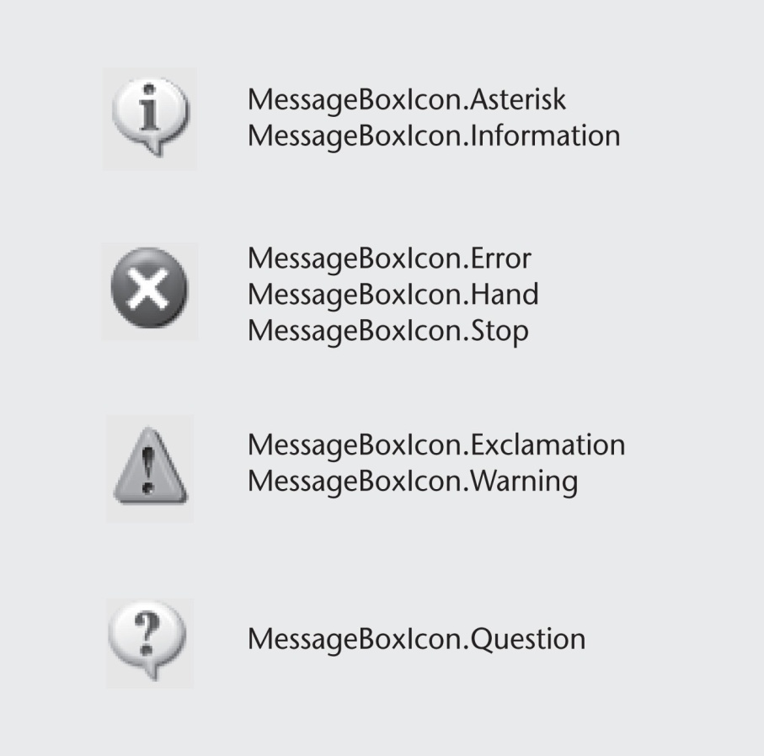
MessageBox Icon Argument
The Icon argument specifies a particular type of icon to appear in the message box
There are 4 possible icons shown to the left
Note that some values show the same icon
Slide 4- <number>

Slide 63
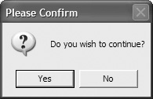
Example Message Box
MessageBox.Show("Do you wish to continue?", _
"Please Confirm", _
MessageBoxButtons.YesNo, _
MessageBoxIcon.Question)
Slide 4- <number>

Slide 64
Which Button Was Clicked
MessageBox returns a value indicating which button the user clicked:
  DialogResult.Abort
  DialogResult.Cancel
  DialogResult.Ignore
  DialogResult.No
  DialogResult.OK
  DialogResult.Retry
  DialogResult.Yes
Slide 4- <number>

Slide 65
Which Button Was Clicked Example
Dim result As Integer
result = MessageBox.Show("Do you wish to continue?", _
"Please Confirm", MessageBoxButtons.YesNo)
If result = DialogResult.Yes Then
' Perform an action here
ElseIf result = DialogResult.No Then
' Perform another action here
End If
Slide 4- <number>

Slide 66
4.9
The Select Case Statement
In a Select Case Statement, One of Several Possible Actions Is Taken, Depending on the Value of an Expression
Copyright © 2007 Pearson Education, Inc. Publishing as Pearson Addison-Wesley

Slide 67
Select Case Statement
Similar to If…Then…ElseIf
  Performs a series of tests
  Conditionally executes the first true condition
Select Case is different in that:
  A single test expression may be evaluated
  The test expression is listed once
  The possible values of the expression are then listed with their conditional statements
Case Else may be included and executed if none of the values match the expression
Slide 4- <number>

Slide 68
Find Day of Week With Select Case
Select Case CInt(txtInput.Text)
Case 1
MessageBox.Show("Day 1 is Monday.")
Case 2
MessageBox.Show("Day 2 is Tuesday.")
Case 3
MessageBox.Show("Day 3 is Wednesday.")
Case 4
MessageBox.Show("Day 4 is Thursday.")
Case 5
MessageBox.Show("Day 5 is Friday.")
Case 6
MessageBox.Show("Day 6 is Saturday.")
Case 7
MessageBox.Show("Day 7 is Sunday.")
Case Else
MessageBox.Show("That value is invalid.")
End Select
Slide 4- <number>

Slide 69
Select Case With Multiple Values
Select Case strAnimal
Case "Dogs", "Cats"
MessageBox.Show ("House Pets")
Case "Cows", "Pigs", "Goats"
MessageBox.Show ("Farm Animals")
Case "Lions", "Tigers", "Bears"
MessageBox.Show ("Oh My!")
End Select
Slide 4- <number>

Slide 70
Select Case with Operators
Select Case intScore
Case Is >= 90
strGrade = “A”
Case 80 to 89
strGrade = “B”
Case 70 to 79
strGrade = “C”
Case 60 to 69
strGrade = “D”
Case 0 to 59
strGrade = “F”
Case Else
MessageBox.Show(“Invalid Score”)
End Select
Tutorial 4-8 demonstrates the Select Case
Slide 4- <number>

Slide 71
4.10
Introduction to Input Validation
Input Validation Is the Process of Inspecting Input Values and Determining Whether They Are Valid
Copyright © 2007 Pearson Education, Inc. Publishing as Pearson Addison-Wesley

Slide 72
Validation Example
Output is only as good as the input
  “Garbage in, garbage out”
Input validation is the process of inspecting user input to see that it meets certain rules
The TryParse method verifies that an input value is in a valid numeric or date format
Decision structures are often used to validate input
Slide 4- <number>

Slide 73
The TryParse Method
Converts an input value to another format
  Verifies that input of integers, decimals, dates, etc., are entered in an acceptable format
  Returns Boolean value indicating True if conversion successful
  Returns False if unsuccessful
Each numeric variable type has a TryParse method
Date & Boolean types include the TryParse method as well
Slide 4- <number>

Slide 74
Verify Integer Entry With TryParse
Use Integer.TryParse method to convert value
  txtInput.Text contains numeric string to convert
  intResult receives converted value
  TryParse returns True if input is an integer
  TryParse returns False if input is not an integer
Dim intResult As Integer
If Integer.TryParse(txtInput.Text, intResult) Then
lblMessage.Text = "Success!"
Else
lblMessage.Text = "Error: an integer was not found"
End If
Slide 4- <number>

Slide 75
Verify Date Entry With TryParse
Use Date.TryParse method to convert value
  txtInput.Text contains date string to convert
  datBirth receives converted value
  TryParse returns True if input in date format
  TryParse returns False if input not a valid date
  Not used so Then clause indicates invalid date
Dim datBirth As Date
If Not Date.TryParse(txtInput.Text, datBirth) Then
lblMessage.Text = “Not a valid date!“
End If
Slide 4- <number>

Slide 76
Using If To Check Range of Values
Decision structures often used to validate input
Example verifies that entries for both decSales and decAdvance are positive numbers
' Validate the input to ensure that
' no negative numbers were entered.
If decSales < 0 Or decAdvance < 0 Then
MessageBox.Show("Please enter positive numbers" & _
" for sales and/or advance pay.“, “Error”)
EndIf
Slide 4- <number>

Slide 77
4.11
Radio Buttons and
Check Boxes
Radio Buttons Appear in Groups of Two or More and Allow the User to Select One of Several Possible Options
Check Boxes Allow an Item to Be Selected or Deselected by Checking or Unchecking a Box
Copyright © 2007 Pearson Education, Inc. Publishing as Pearson Addison-Wesley

Slide 78
Radio Buttons
Used when only one of several possible options may be selected at one time
  Car radio buttons select one station at a time
May be placed in a group box
  Group box defines a set of radio buttons
  Can select only one button within a group box
  Those on a form but not inside a group box are considered members of the same group
Radio buttons have a boolean Checked property and a CheckChanged event
Slide 4- <number>

Slide 79
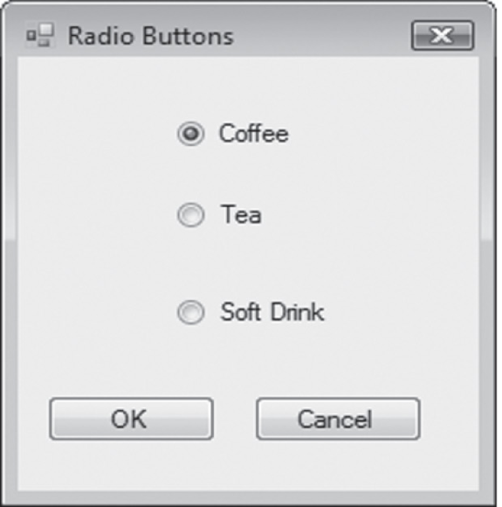
Checking Radio Buttons in Code
If radCoffee.Checked = True Then
MessageBox.Show("You selected Coffee")
ElseIf radTea.Checked = True Then
MessageBox.Show("You selected Tea")
ElseIf radSoftDrink.Checked = True Then
MessageBox.Show("You selected a Soft Drink")
End If
Slide 4- <number>

Slide 80
Check Boxes
Unlike radio buttons, can select many check boxes at one time
May also be placed in a group box
  Not limited to one selection within a group box
  Can select as many check boxes as you like within the same group box
Check boxes also have a boolean Checked property and a CheckChanged event
Tutorial 4-9 provides radio button and check box examples
Slide 4- <number>

Slide 81

Checking Check Boxes in Code
If chkChoice4.Checked = True Then
MessageBox.Show("You selected Choice 4")
End If
Slide 4- <number>

Slide 82
4.12
Class-Level Variables
Class-level Variables Are Not Local to Any Procedure
In a Form They Are Declared Outside of Any Procedure, and May Be Accessed by Statements in Any Procedure in the Same Form
Copyright © 2007 Pearson Education, Inc. Publishing as Pearson Addison-Wesley

Slide 83
Advantages of Class-level Variables
Variable scope refers to the portion of a program in which that variable is visible
Variables declared inside a procedure or method have local scope
  Only visible inside that procedure or method
Sometimes a variable needs to be visible to many procedures or methods within a form
Variables declared outside a procedure but within a form have class scope
  These are visible throughout the form
  Makes communication between procedures easy
Slide 4- <number>

Slide 84
Declaring a Class-Level Variable
decTotalSalary - class-level variable
  Declared before first procedure in form class
decWeeklyPay - local variable inside a procedure
Public Class Form1
Dim decTotalSalary As Decimal ‘Class-level variable
Private Sub btnAddWeekly_Click(ByVal sender As System.Object,
ByVal e As System.EventArgs) Handles btnAddWeekly.Click
Dim decWeeklyPay As Decimal 'Local variable
decWeeklyPay = CDec(txtPay.Text)
decTotalSalary += decWeeklyPay
End Sub
Slide 4- <number>

Slide 85
Class-level Variables Disadvantages
Class-level variables should be used sparingly - only when really needed
Why?
As programs grow larger, use of variables becomes more difficult to keep track of
  The smaller the scope the better
  Smaller scope easier to keep track of
Slide 4- <number>

Slide 86
4.13
The Health Club Membership Fee Calculator Application
The Health Club Membership Fee Calculator uses features discussed in this chapter, including If statements, a Select Case statement, radio buttons, and check boxes
Copyright © 2007 Pearson Education, Inc. Publishing as Pearson Addison-Wesley

Slide 87
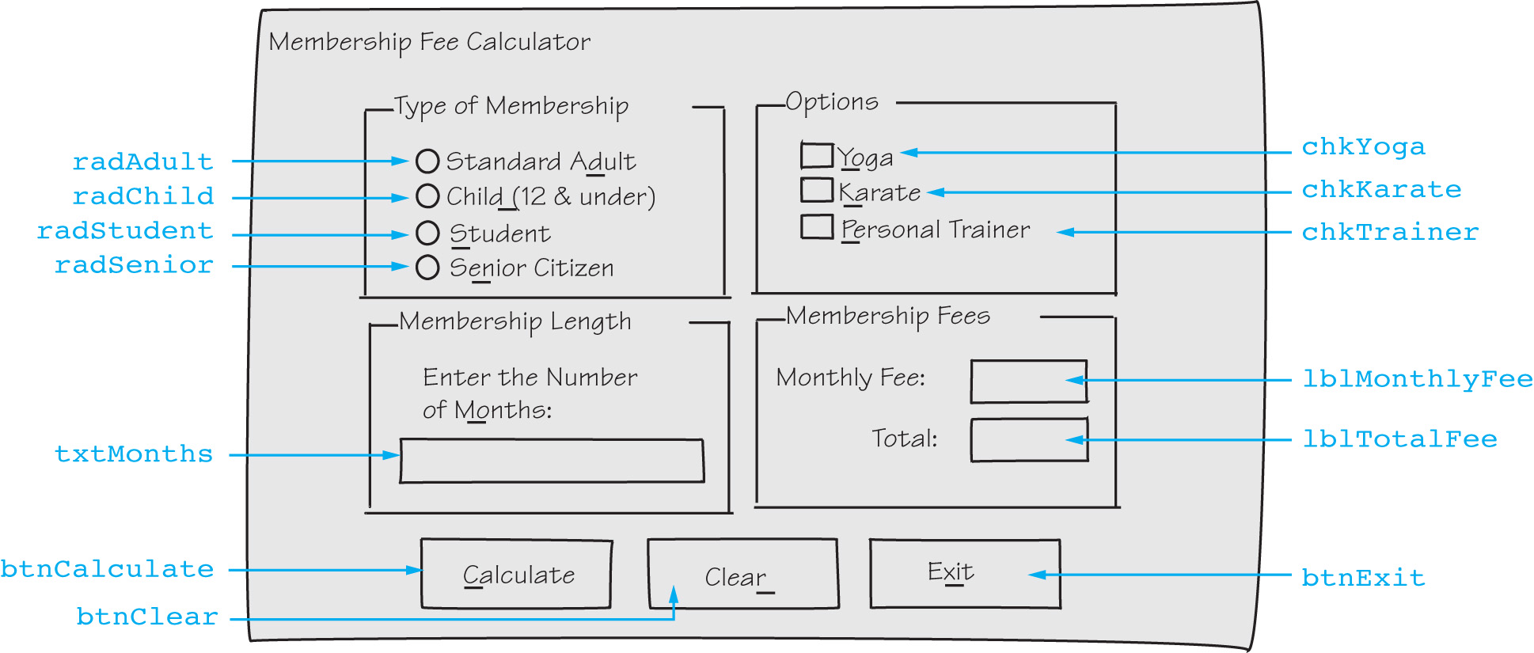
Health Club Fee Calculator Form
Slide 4- <number>

Slide 88
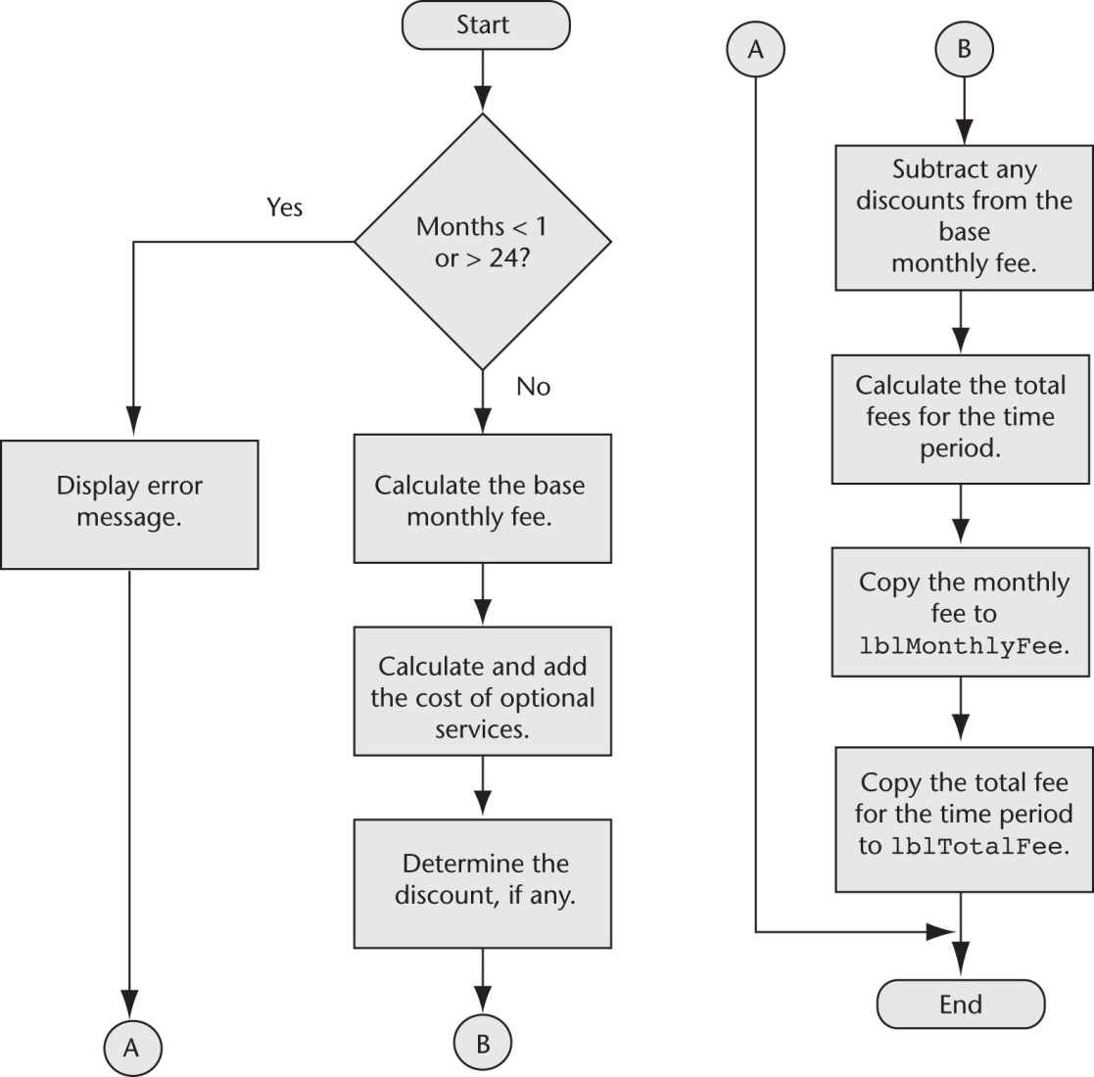
Calculate Button Click Event Flowchart
Slide 4- <number>

Slide 89
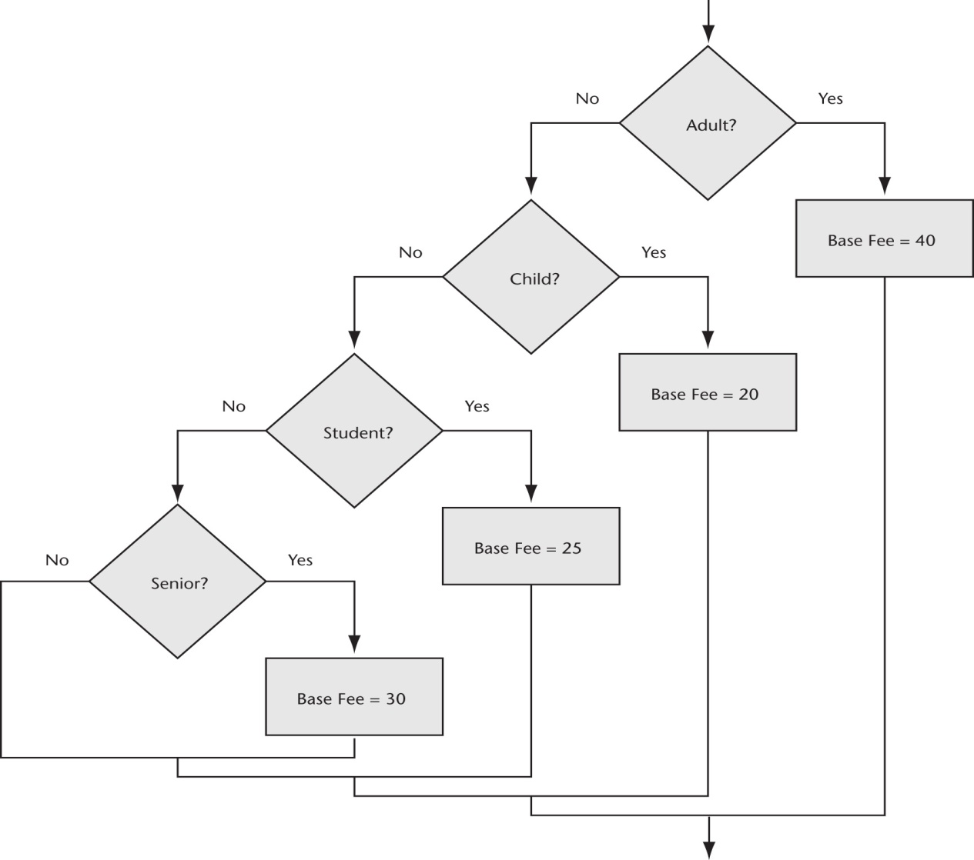
Base Monthly Fee Calculation Flowchart
Uses a series of ElseIf statements
Slide 4- <number>

Slide 90
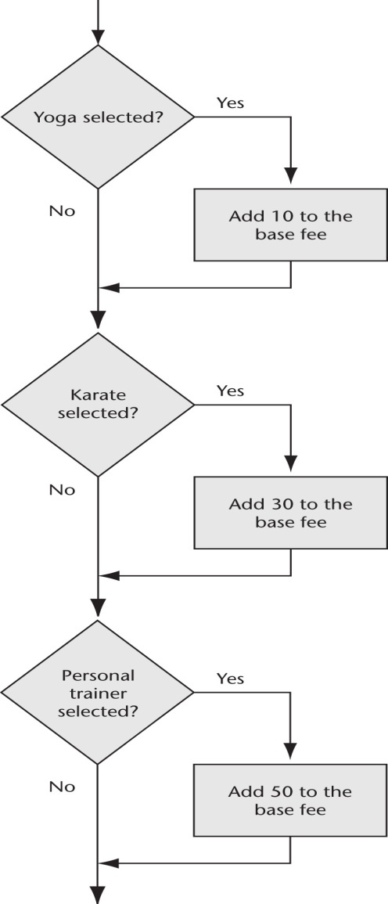
Calculate Optional Services Flowchart
Uses several If...Then statements
Slide 4- <number>

Slide 91
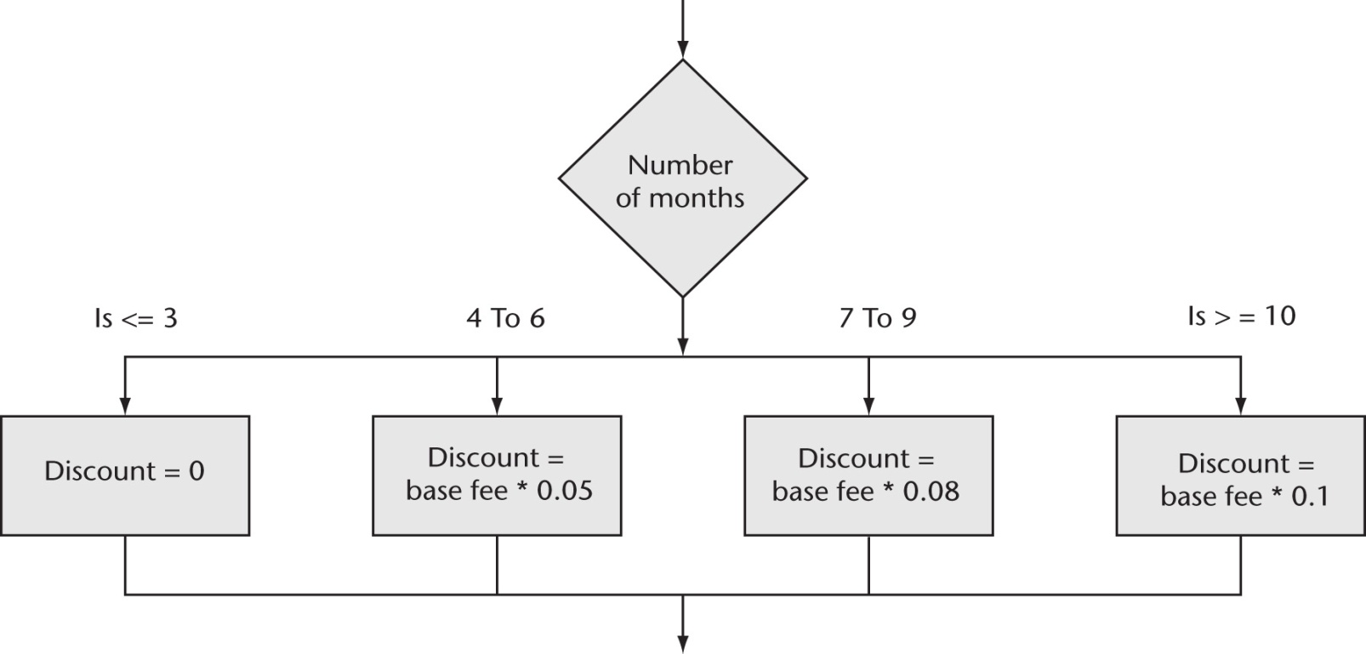
Compute Discount Flowchart
Uses a Select Case statement
Slide 4- <number>

