Slide 1
Searching in Binary Search Tree (BST)

Slide 2
For searching a value in BST, consider it as a sorted array. Now we can easily perform search operation in BST using Binary Search Algorithm.

Slide 3
Algorithm to search for a key in a given Binary Search Tree
Let’s say we want to search for the number X, We start at the root. Then:
We compare the value to be searched with the value of the root.
If it’s equal we are done with the search if it’s smaller we know that we need to go to the left subtree because in a binary search tree all the elements in the left subtree are smaller and all the elements in the right subtree are larger.
Repeat the above step till no more traversal is possible
If at any iteration, key is found, return True. Else False.

Slide 4
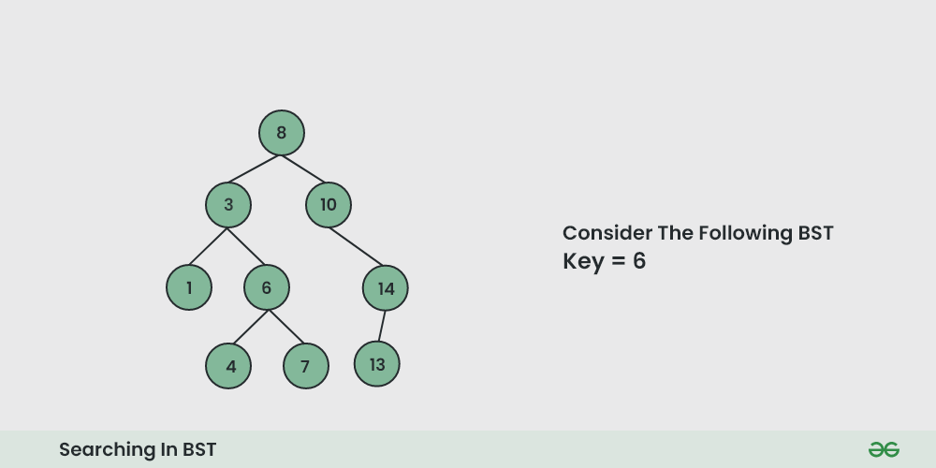
Illustration of searching in a BST

Slide 5
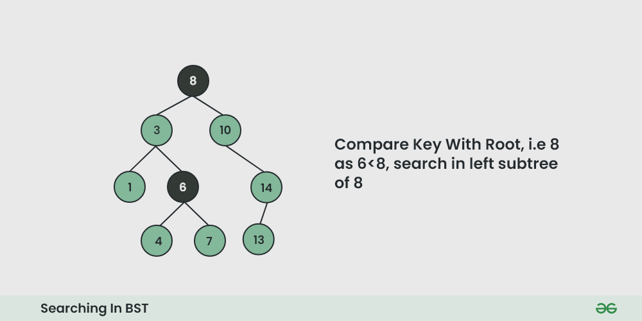

Slide 6
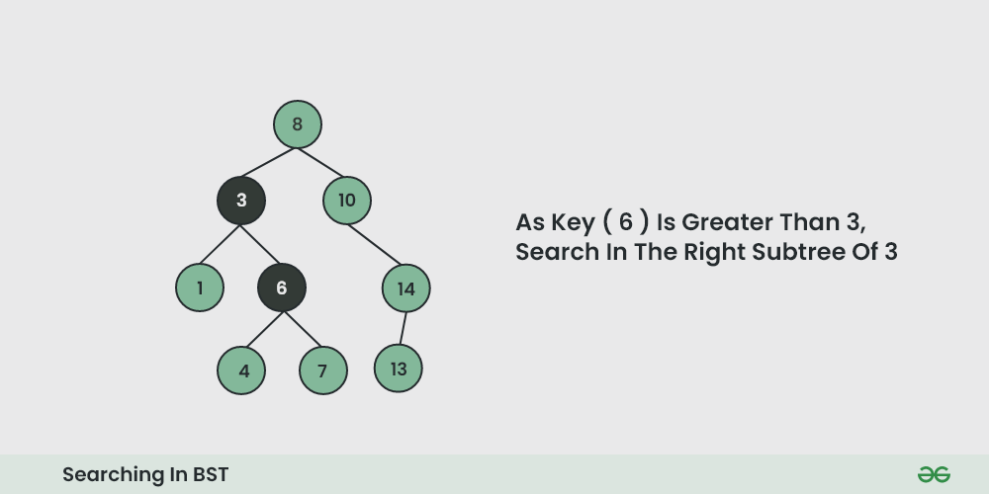

Slide 7
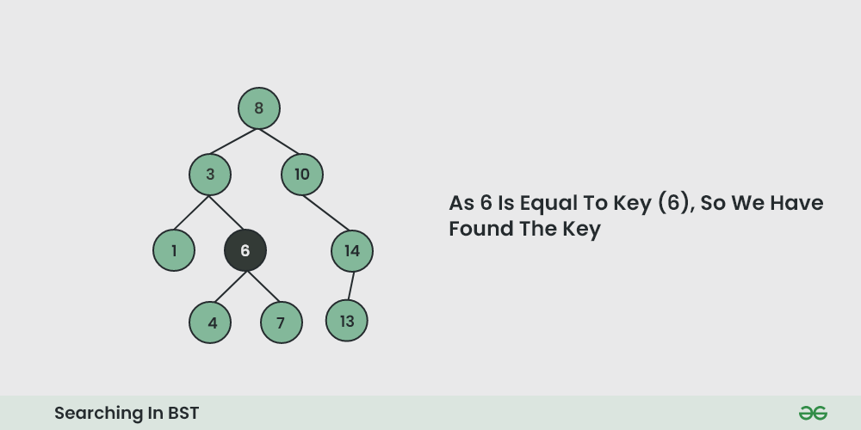

Slide 8
Searching
Binary search trees are called “search trees” because they make searching for a certain value more efficient than in an unordered tree. In an ideal binary search tree, we do not have to visit every node when searching for a particular value.
Here is how we search in a binary search tree:
Begin at the tree’s root node
If the value is smaller than the current node, move left
If the value is larger than the current node, move right

Slide 9
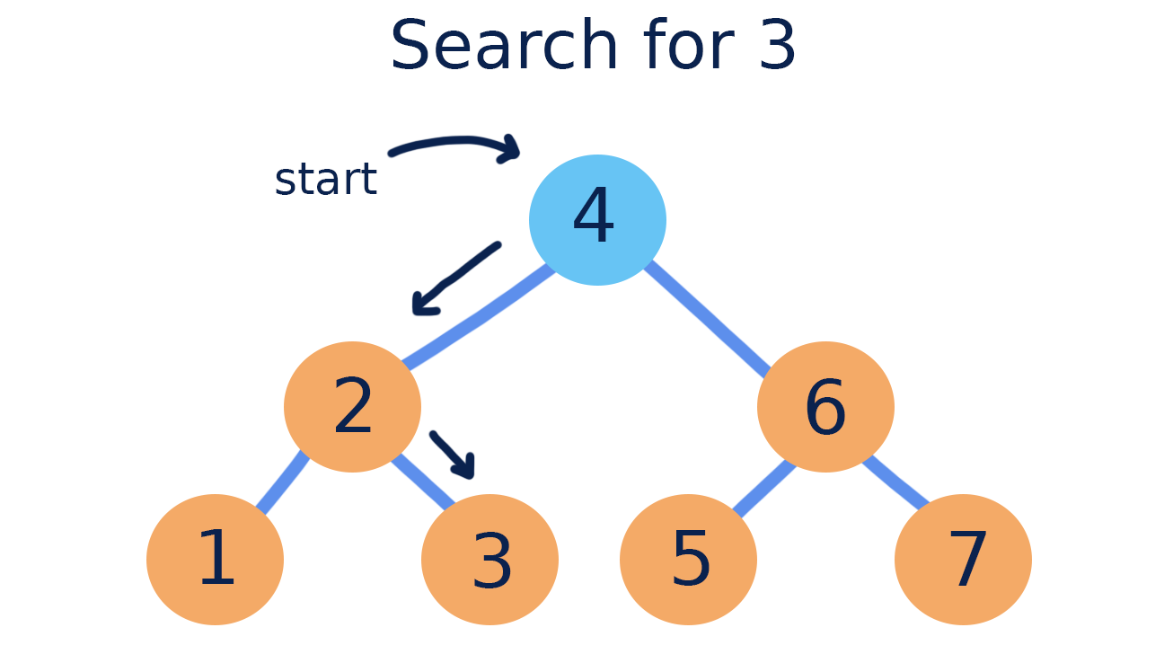

Slide 10
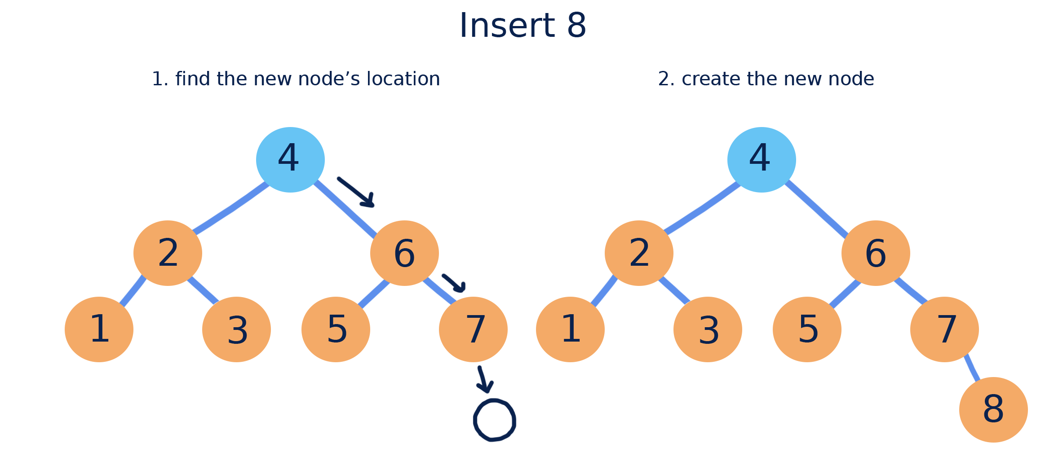
Inserting
New nodes in a binary search tree are always added at a leaf position. Performing a search can easily find the position for a new node.

Slide 11
Removing
When removing from a binary search tree, we are concerned with keeping the rest of the tree in the correct order. This means removing is different depending on whether the node we are removing has children. There are three cases:

Slide 12
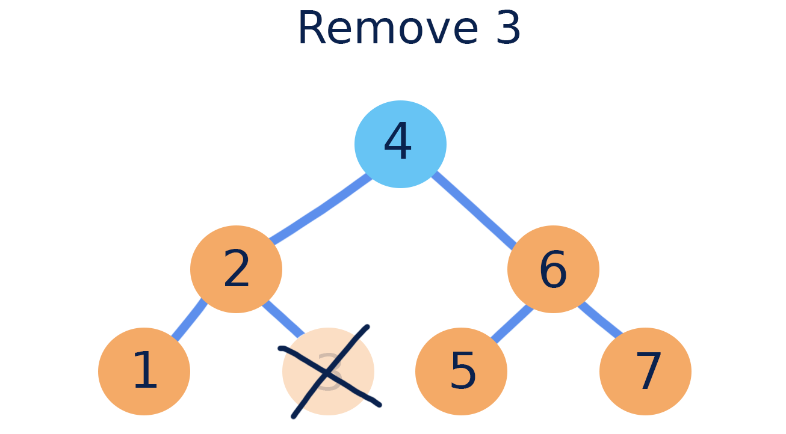
If the node has a single child, (left or right) we must move the child into the position of the node when deleting it.

Slide 13
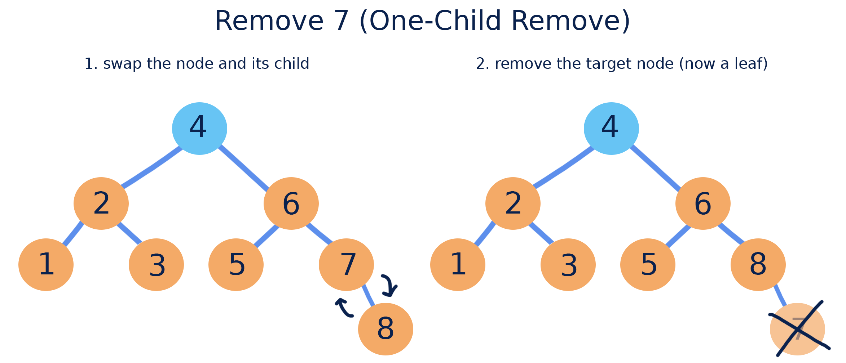
If the node has two children, we must first find the In-Order Predecessor (IOP): the largest node in our node’s left subtree. The IOP is always a zero or one child node, and can be found by starting at the left subtree’s root and moving right. We can then swap the node being removed with its IOP and delete it using the zero or one child remove.

Slide 14
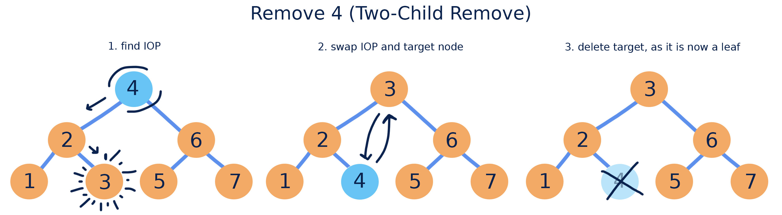

Slide 15
Runtime and BSTs
Depending on the values contained in a binary search tree, and the order in which they are added, the performance of a BST’s operations can vary. This performance depends on the shape of the tree and the number of nodes it contains.
In an ideal case, a binary search tree has a similar number of nodes in its right and left subtrees. Since you have to visit less nodes when searching in an ideal BST, this case has a run time of O(lg(n)) for all operations that utilize find, including search, insert, and remove.

Slide 16
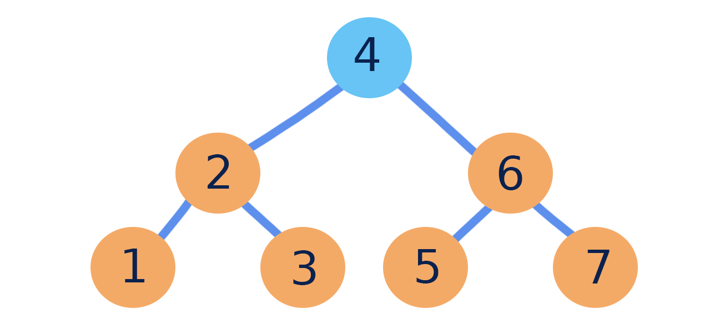
The worst case of a binary search tree is one that has its values added in numerical order. This structure then doesn’t resemble a tree - it looks like a linked list! As potentially every node has to be visited when searching, the worst case BST has a run time of O(n) for all operations utilizing find.

Slide 17
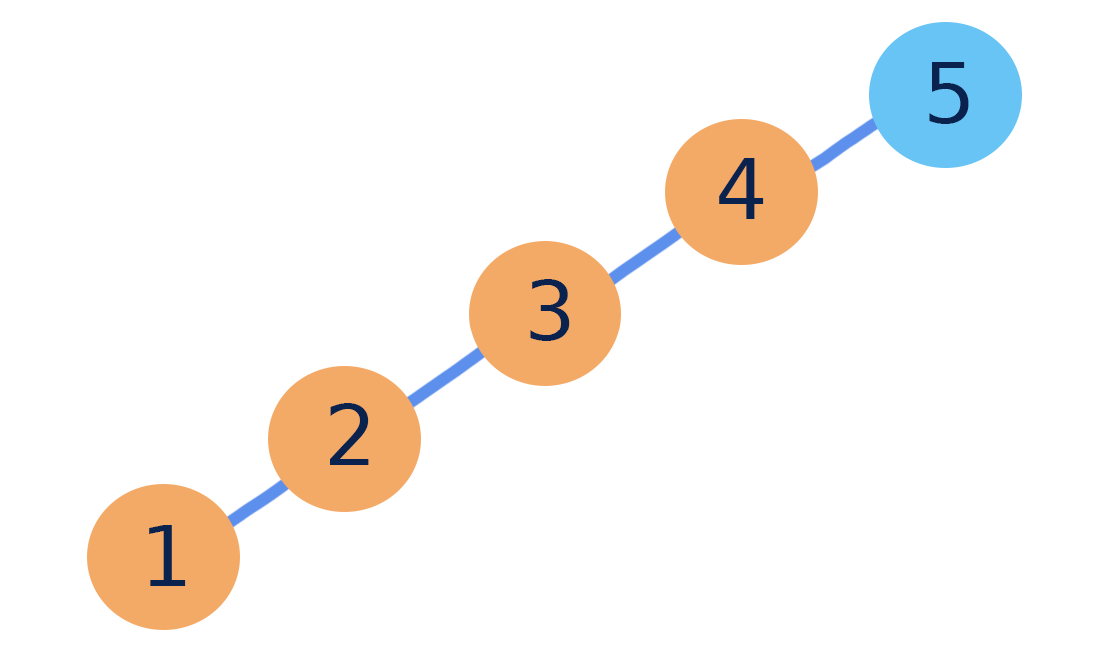

Slide 18
Binary Search Working
Binary Search Algorithm can be implemented in two ways which are discussed below.
Iterative Method
Recursive Method
The recursive method follows the divide and conquer approach.

Slide 19
Try
Suppose we are using binary search on an array with approximately 1,000,000 elements. How many visits should we expect to make in the worst case?

Slide 20
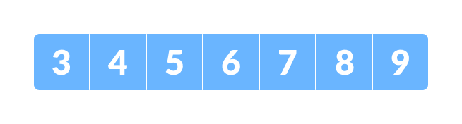
The array in which searching is to be performed

Slide 21
Let x = 4 be the element to be searched.

Slide 22
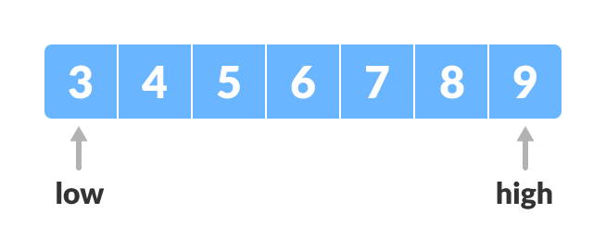
2. Set two pointers low and high at the lowest and the highest positions respectively.

Slide 23
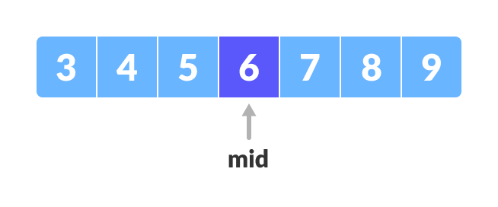
Find the middle element mid of the array ie. arr[(low + high)/2] = 6

Slide 24
4. If x == mid, then return mid. Else, compare the element to be searched with m.
5. If x > mid, compare x with the middle element of the elements on the right side of mid. This is done by setting low to low = mid + 1.
6. Else, compare x with the middle element of the elements on the left side of mid. This is done by setting high to high = mid - 1.

Slide 25
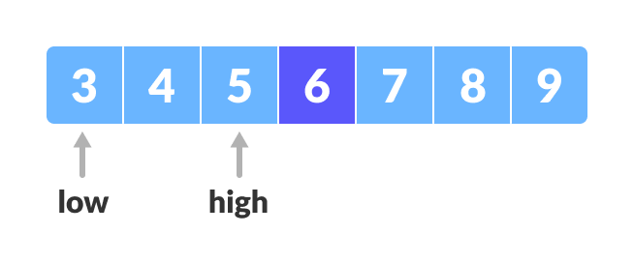

Slide 26
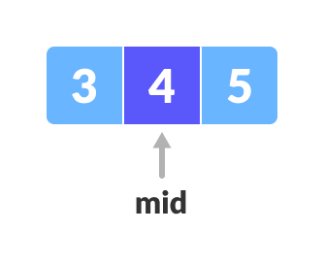
7. Repeat steps 3 to 6 until low meets high.

Slide 27
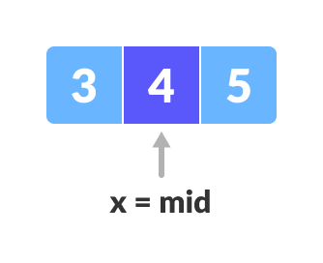
x = 4 is found.

Slide 28
Binary Search Algorithm
Iteration Method
do until the pointers low and high meet each other.
mid = (low + high)/2
if (x == arr[mid])
return mid
else if (x > arr[mid]) // x is on the right side
low = mid + 1
else // x is on the left side
high = mid - 1

Slide 29
Recursive Method
binarySearch(arr, x, low, high)
if low > high
return False
else
mid = (low + high) / 2
if x == arr[mid]
return mid
else if x > arr[mid] // x is on the right side
return binarySearch(arr, x, mid + 1, high)
else // x is on the left side
return binarySearch(arr, x, low, mid - 1)

