Slide 1
Understanding Time Complexity

Slide 2
Q. Imagine a classroom of 100 students in which you gave your pen to one person. You have to find that pen without knowing to whom you gave it.

Slide 3
Here are some ways to find the pen and what the O order is.
O(n²): You go and ask the first person in the class if he has the pen. Also, you ask this person about the other 99 people in the classroom if they have that pen, and so on, This is what we call O(n²).
O(n): Going and asking each student individually is O(N).
O(log n): Now I divide the class into two groups, then ask: “Is it on the left side or the right side of the classroom?” Then I take that group and divide it into two and ask again, and so on. Repeat the process till you are left with one student who has your pen. This is what you mean by O(log n).

Slide 4
The O(n²) searches if only one student knows on which student the pen is hidden.
The O(n) if one student had the pen and only they knew it.
The O(log n) search if all the students knew, but would only tell me if I guessed the right side.
The above O -> is called Big – Oh which is an asymptotic notation. There are other asymptotic notations like theta and Omega.

Slide 5
Is the Time Complexity of an Algorithm/Code the same as the Running/Execution Time of Code?
The Time Complexity of an algorithm/code is not equal to the actual time required to execute a particular code, but the number of times a statement executes. We can prove this by using the time command.
For example: Write code in C/C++ or any other language to find the maximum between N numbers, where N varies from 10, 100, 1000, and 10000. For Linux based operating system (Fedora or Ubuntu)

Slide 6
For N = 10: you may get 0.5 ms time,
For N = 10,000: you may get 0.2 ms time.
Also, you will get different timings on different machines. Even if you will not get the same timings on the same machine for the same code, the reason behind that is the current network load.
So, we can say that the actual time required to execute code is machine-dependent (whether you are using Pentium 1 or Pentium 5) and also it considers network load if your machine is in LAN/WAN.

Slide 7
What is meant by the Time Complexity of an Algorithm?
Instead of measuring actual time required in executing each statement in the code, Time Complexity considers how many times each statement executes.
Example 1
class Timec {
public static void main(String[] args)
{
System.out.print("Hello World");
}
}

Slide 8
Output
Hello World
Time Complexity: In the above code “Hello World” is printed only once on the screen.
So, the time complexity is constant: O(1) i.e. every time a constant amount of time is required to execute code, no matter which operating system or which machine configurations you are using.
Auxiliary Space: O(1)

Slide 9
Example 2:
class TimeC {
public static void main(String[] args)
{
int i, n = 8;
for (i = 1; i <= n; i++) {
System.out.printf("Hello World !!!\n");
}
}
}

Slide 10
Output
Hello World !!!
Hello World !!!
Hello World !!!
Hello World !!!
Hello World !!!
Hello World !!!
Hello World !!!
Hello World !!!
Time Complexity: In the above code “Hello World !!!” is printed only n times on the screen, as the value of n can change. So, the time complexity is linear: O(n) i.e. every time, a linear amount of time is required to execute code. Auxiliary Space: O(1)

Slide 11
Time Complexity
Time complexity is a measure of the time required to run an algorithm as the input size increases.
It is one of the high level measures of Scalability i.e how the algorithm performs in terms of execution time.
The time complexity of algorithms is most commonly expressed using the big O notation.

Slide 12
Big O Notation
Big O Notation is a way to measure an algorithm’s efficiency. It measures the time it takes to run your function as the input grows. Or in other words, how well does the function scale.
There are two parts to measuring efficiency — time complexity and space complexity.
Time complexity is a measure of how long the function takes to run in terms of its computational steps. Space complexity has to do with the amount of memory used by the function.

Slide 13
Why Do You Need To Calculate Time Complexity?
The time complexity of an algorithm is a metric that may be used to quantify the amount of time required for an algorithm to run as just a function of the length of the input.
The space complexity of the algorithm is the measurement of how much memory or storage space it requires to run, and it is expressed as binary search functions of the amount of such data that is being processed.

Slide 14
Binary search algorithm
Finding an object in a sorted list of objects can be done quickly and effectively with the use of an algorithm called binary search. It works by continually dividing the area of the list in half that might contain the object until you have reduced the possible places to just one. This process continues until the list has only one viable location.

Slide 15
The Time Complexity Algorithm Cases
Best case: This is the time limit at which an algorithm can be run. We must be familiar with the scenario that results in the fewest amount of procedures being carried out.
In the illustration, our array is [1, 2, 3, 4, 5], and the question we are attempting to answer is whether or not the number "1" is contained within the array. Now that you've made only one comparison, you should be able to deduce that the element in question is indeed contained within the array. Therefore, this represents the best possible outcome of your program.

Slide 16
Average case: We first determine the amount of time required to complete the task based on each of the many inputs that could be used, then we add up all of the results, and finally, we divide the total by the total number of inputs. We must be aware of (or can forecast) the distribution of cases.

Slide 17
Worst case: This is the upper bound on the amount of time it takes for an algorithm to complete its task. We must identify the scenario that results in the highest possible number of arithmetic operations being carried out. In the context of this discussion, the worst possible scenario would be if the array that was provided to us was [1, 2, 3, 4, 5], and we tried to determine whether or not the element "6" was included in the array.
Following the completion of the if-condition of our loop's iteration five times, the algorithm will provide the value "0" as the final result.

Slide 18
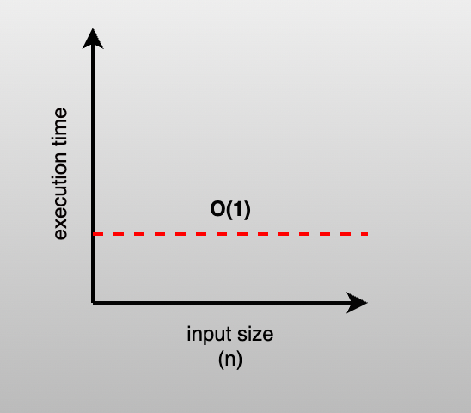
Different Types Notations
Constant Time Complexity
An algorithm that requires the same amount of time to execute regardless of the size of the input.
The Big O notation for constant time is O(1).

Slide 19
public class EvenOddExample { public static void main(String[] args) { int number = 10; if (isEven(number)) {
System.out.println(number + " is even"); } else {
System.out.println(number + " is odd"); } } public static
boolean isEven(int number) { // Using the "or" operator to
check if the number is even return (number % 2 == 0) || (number == 0); } }

Slide 20
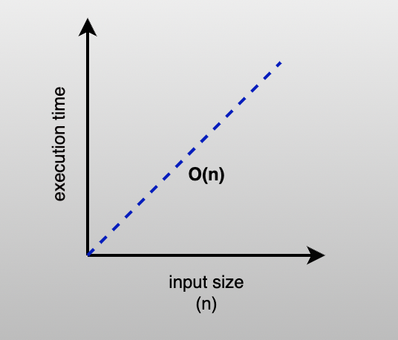
Linear Time Complexity
An algorithm whose performance grows linearly and in direct proportion to the input size.

Slide 21
Big O notation for linear complexity is O(n).
There’s a 1–1 correlation between input size and execution time.

Slide 22
public class EvenOddArrayExample { public static void main(String[] args) { int[] numbers = {23, 54, 51, 98, 54, 23, 32};
System.out.println("Even and Odd numbers in the array:"); for (int number : numbers) { if (isEven(number)) {
System.out.println(number + " is even"); } else {
System.out.println(number + " is odd"); } } } public static Boolean
isEven(int number) { // Using the modulo operator to check if the number is even return number % 2 == 0; } }

Slide 23
The above function checks each item to find whether it is even or odd. Computation time is directly related to the size of the array. So time complexity of the above function is O(n).

Slide 24
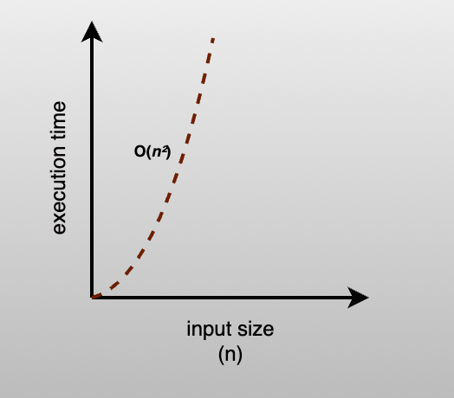
Quadratic Time Complexity
An algorithm that takes time proportional to the square of its input size.
Runtime increases sharply, faster than input sizes.

Slide 25
Big O notation for quadratic time complexity is O(n²).

Slide 26
Logarithmic Time Complexity
An algorithm that takes a subset of input data leading to faster runtime.
Execution time goes up linearly while the input data size grows exponentially.

Slide 27
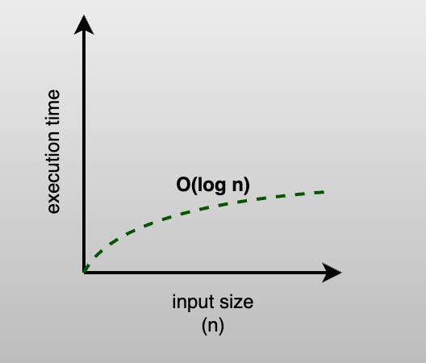

Slide 28
Big O notation for logarithmic time complexity is O(log n).
Binary Search, Quick Sort are examples of logarithmic time complexity.

