Slide 1
Simulation and Modelling

Slide 2
The lecture slides are partially collected from the Internet for educational purpose only. The lecturer does not claim any credit for them and the copyrights belong to the original authors

Slide 3
These notes are provided free of charge and may not be sold in any shape or form
These notes are NOT a substitute for material covered during course lectures. If you miss a lecture, you should definitely obtain both these notes and notes written by a student who attended the lecture.
Material from these notes is obtained from various sources, including, but not limited to, the following:
  Discrete-Event System Simulation, Fifth Edition by Banks, Carson, Nelson and Nicol (Prentice Hall)
    Also (same title and authors) Third and Fourth Editions
  Object-Oriented Discrete-Event Simulation with Java by Garrido (Kluwer Academic/Plenum Publishers)
  Simulation Modeling and Analysis, Third Edition by Law and Kelton (McGraw Hill)
  A First Course in Monte Carlo by George S. Fishman (Thomson & Brooks/ Cole

Slide 4
Goals of Course
To understand the basics of computer simulation, including:
  Simulation concepts and terminology
  When it is useful
  Why it is useful
  How to approach a simulation
  How to develop / run a simulation
  How to interpret / analyze the results

Slide 5
Goals of Course
To understand and utilize some of the mathematics required in simulations
  Statistical models and probability distributions
    How various models are defined
    Which models are correct for which situations
  Simple queuing theory
    Characteristics
    Performance measures
    Markovian models

Slide 6
Goals of Course
  Random number theory
    Generating and testing pseudo-random numbers
    Generating pseudo-random values within various distributions
  Analysis / generation of input data
    How is input data generated?
    Is the data correct and appropriate for the simulation?
  Analysis / measurement of output data
    What does the output data mean and what can be derived from it?
    How confident are we in our results?

Slide 7
Goals of Course
To implement some simulation tools and some simulation projects
  What enhancements do typical programming languages need to facilitate simulation?
  Programming will be done in Java
    Review if you are rusty
    Find / keep a good Java reference
    There are special-purpose simulation languages, but we will probably not be using them

Slide 8
Introduction to Simulation
What is simulation?
  Banks, et al:
    "A simulation is the imitation of the operation of a real-world process or system over time". It "involves the generation of an artificial history of a system, and the observation of that artificial history to draw inferences … "
  Law & Kelton:
    "In a simulation we use a computer to evaluate a model (of a system) numerically, and data are gathered in order to estimate the desired true characteristics of the model"

Slide 9
Introduction to Simulation
  More specifically (but still superficially)
    We develop a model of some real-world system that (we hope) represents the essential characteristics of that system
      Does not need to exactly represent the system – just the relevant parts
    We use a program (usually) to test / analyze that model
      Carefully choosing input and output
    We use the results of the program to make some deductions about the real-world system
  http://en.wikipedia.org/wiki/Computer_simulation
    Some interesting info here

Slide 10
Introduction to Simulation
Why (or when) do we use simulation?
    This is fairly intuitive
  Consider arbitrary large system X
    Could be a computer system, a highway, a factory, a space probe, etc.
  We'd like to evaluate X under different conditions
    Option 1: Build system X and generate the conditions, then examine the results
      This is not always feasible for many reasons:
        X may be difficult to build
        X may be expensive to build

Slide 11
Introduction to Simulation
        We may not want to build X unless it is "worthwhile"
        The conditions that we are testing may be difficult or expensive to generate for the real system
    For example:
      A company needs to increase its production and needs to decide whether it should build a new plant or it should try to increase production in the plants it already has
        Which option is more cost-effective for the company?
      Clearly, building the new plant would be very expensive and would not be desirable to do unless it is the more cost-effective solution
      But how can we know this unless we have built the new plant?

Slide 12
Introduction to Simulation
    Another (ongoing) example:
      NASA wants to know if damage on the Space Shuttle will threaten it upon re-entry
      If they wait until re-entry to make a judgment, it is already too late
      In this case it is not feasible to do the real-world test

Slide 13
Introduction to Simulation
    Option 2: Model system X, simulate the conditions and use the simulation results to decide
      Continuing with the same first example:
      Model both possibilities for increasing production and simulate them both
        We then choose the solution that is most economically feasible
      Continuing with the Space Shuttle example
      Model the damage and the stress that re-entry imparts on the shuttle
        Determine via a simulation if the damage will threaten the shuttle or not
        Note the importance of being correct here

Slide 14
Introduction to Simulation
    Clearly, this is itself not a trivial task
      Simulations are often large, complex and difficult to develop
      Just developing the correct system model can be a daunting task
        There are many variables that must be taken into account
      However, if a new plant costs hundreds of millions or even billions of dollars, spending on the order of thousands (or even hundreds of thousands) of dollars on a simulation could be a bargain
      Note that with the Shuttle example, most of the work for this must be done in advance
        Don't have time to design & implement this during the duration of a flight

Slide 15
Introduction to Simulation
  When is simulation NOT a good idea?
      See Section 1.2 of Banks text
      We will look at some of the guidelines now
    Don't use a simulation when the problem can be solved in a "simpler" or more exact way
      Some things that we think may have to be simulated can be solved analytically
      Ex: Given N rolls of a fair pair of dice, what are the relative expected frequencies of each of the possible values {2, 3, 4, … 12} ?
        We could certainly simulate this, "rolling" the dice N times and counting
        However, based on the probability of each possible result, we can derive a more exact answer analytically

Slide 16
Introduction to Simulation
        How many ways do we have of obtaining each outcome?
        2:1, 3:2, 4:3, 5:4, 6:5, 7:6, 8:5, 9:4, 10:3, 11:2, 12:1
        Total of 36 possible outcomes
        For N "rolls", the expected frequency of value i is
        N * (P_{i}) = N * (outcomes yielding i / total outcomes)
        For example, for 900 rolls, the expected number of 9s generated would be 900 * (4 / 36) = 100
        Note that the expected value may not be a whole number (nor should it necessarily be)
        Given 500 rolls, the expected number of 9s is
        500 * (4 / 36) ≈ 55.55
      Note: You should be familiar with the general approach above from CS 0441
        We will be looking at some more complex analytical models later on

Slide 17
Introduction to Simulation
    Don't use a simulation if it is easier or cheaper to experiment directly on a real system
      Ex: A 24 hour supermarket manager wants to know how to best handle the cash register during the "midnight shift":
        Have one cashier at all times
        Have two cashiers at all times
        Have one cashier at all times, and a second cashier available (but only working as cashier if the line gets too long)
      Each of these can be done during operating hours
        An extra employee can be used to keep track of queue data (and would not be too expensive)
        Differences are (likely) not that drastic so that customers will be alienated

Slide 18
Introduction to Simulation
    Don't use a simulation if the system is too complex to model correctly / accurately
      This is often not obvious
      Can depend on cost and alternatives as well
        However, a bad model may not be helpful and could actually be harmful
        Ex: With the Space Shuttle, lives were at risk – if the model predicts incorrectly the results are catastrophic

Slide 19
Some Definitions
System
  "A group of objects that are joined together in some regular interaction or interdependence toward the accomplishment of some purpose" (Banks et al)
    Note that this is a very general definition
    We will represent this system in our simulation using variables (objects) and operations
  The state of a system is the variables (and their values) at one instance in time

Slide 20
Some Definitions
Discrete vs. Continuous Systems
  Discrete System
    State variables change at discrete points in time
      Ex: Number of students in CS 1538
        When a registration or add is completed, number of students increases, and when a drop is completed, number of students decreases
  Continuous System
    State variables change continuously over time
      Ex: Volume of CO₂ in the atmosphere
        CO₂ is being generated via people (breathing), industries and natural events and is being consumed by plants

Slide 21
Some Definitions
      Models of continuous systems typically use differential equations to indicate rate of change of state variables
      Note that if we make the time increment and the unit of measurement small enough, we may be able to convert a continuous system into a discrete one
        However, this may not be feasible to do
        Why?
      Also note that systems are not necessarily exclusively discrete or exclusively continuous
    We will be primarily concerned with Discrete Systems in this course

Slide 22
Some Definitions
System Components
  Entities
    Objects of interest within a system
      Typically "active" in some way
      Ex: Customers, Employees, Devices, Machines, etc
    Contain attributes to store information about them
      Ex: For Customer: items purchased, total bill
    May perform activities while in the system
      Ex: For Customer: shopping, paying bill
      In many cases it is really just the period of time required to perform the activity
    Note how nicely this meshes with object-oriented programming

Slide 23
Some Definitions
  Events
    Instantaneous occurrences that may change the state of a system
      Note that the event itself does not take any time
      Ex: A customer arrives at a store
      Note that they "may" change the state of the system
        Example of when they would not?
    Endogenous event
      Events occurring within the system
      Ex: Customer moves from shopping to the check-out
    Exogenous event
      Events relating / connecting the system to the outside
      Ex: Customer enters or leaves the store
Notes:
Event that does not change state of system: Customer arrives but does not stay (ex: queue is too long)

Slide 24
Some Definitions
System Model
  A representation of the system to be used / studied in place of the actual system
    Allows us to study a system without actually building it (which, as we discussed previously, could be very expensive and time-consuming to do)
  Physical Model
    A physical representation of the system (often scaled down) that is actually constructed
      Tests are then run on the model and the results used to make decisions about the system
      Ex: Development of the "bouncing bomb" in WWII
        http://www.sirbarneswallis.com/Bombs.htm
      Ex: Most things done on Mythbusters

Slide 25
Some Definitions
  Mathematical Model
    Representing the system using logical and mathematical relationships
    Simple ex: d = v_{o}t + ½ at²
      This equation can be used to predict the distance traveled by an object at time t
      However, will acceleration always be the same?
    Often this model is fairly complex and defined by the entities and events
    This is the model we will be using
    However, in order to be useful, the model must be evaluated in some way
      i.e. The behavior based on the model must be determined

Slide 26
Some Definitions
    Analytical evaluation
      If the model is not too complex we can sometimes solve it in a closed form using analytical methods
      One type of analytical evaluation is the Markov process (or Markov chain)
      Nice simple example at:
      http://en.wikipedia.org/wiki/Examples_of_Markov_chains
      We will see this more in Section 6.4
      Often problems that are too complex, even if they can be modeled analytically, are too computation intensive to be practical
    Simulation evaluation
      More often we need to simulate the behavior of the model

Slide 27
Some Definitions
  Deterministic Model
    Inputs to the simulation are known values
      No random variables are used
      Ex: Customer arrivals to a store are monitored over a period of days and the arrival times are used as input to the simulation
  Stochastic Model
    One or more random variables are used in the simulation
      Results can only be interpreted as estimates (or educated guesses) of the true behavior of the system
      Quality of the simulation depends heavily on the correctness of the random data distribution
        Different situations may require different distributions

Slide 28
Some Definitions
      Ex: Customers arrive at a store with exponentially distributed interarrival times having a mean of 5 minutes
    In most cases we do not know all of the input data in advance, and at least some random data is required
      Thus, our simulations will typically use the stochastic model

Slide 29
Some Definitions
  Static Model
    Models a system at a single point in time, rather than over a period of time
    Sometimes called Monte Carlo simulations
      We'll briefly discuss these later (they are interesting and very useful)
  Dynamic Model
    Models a system over time
    Our simulations will typically use this model
In summary our models will typically be: discrete, mathematical, stochastic and dynamic

Slide 30
The Clock
Since we are using the dynamic model, we need to represent the passage of time
  We need to use a clock
  Three fundamental approaches to time progression
    Next-event time advance
      Clock initialized to zero
      As the times of future events are determined, they are put into the future event list (FEL)
      Clock is advanced to the time of the next most imminent event, the event is executed and removed from the list
      See example in Section 3.1.1

Slide 31
The Clock
  Ex: People (P) using a MAC machine
    Event A == arrival of a customer at MAC machine
    Event C == completion of a transaction by a customer
Clock | FEL | Event | Action
0 | (A₂,t₁), (C₁,t₂) | A₁ | P₁ arrives, is served; Events A₂ and C₁ generated, placed in FEL
t₁ | (C₁,t₂), (A₃,t₃) | A₂ | P₂ arrives, waits; Event A₃ generated, placed in FEL
t₂ | (A₃,t₃), (C₂,t₄) | C₁ | P₁ completes; P₂ is served; Event C₂ generated, placed in FEL
t₃ | (A₄,t₅), (C₂,t₄) | A₃ | P₃ arrives, waits; Event A₄ generated, placed in FEL (note: t₅<t₄)
t₅ | (C₂,t₄), (A₅,t₆) | A₄ | P₄ arrives, waits; Event A₅ generated, placed in FEL
t₄ | (A₅,t₆), (C₃,t₇) | C₂ | P₂ completes; P₃ is served; Event C₃ generated, place in FEL

Slide 32
The Clock
    Fixed-increment time advance (activity scanning)
      Clock initialized to zero
      Clock is incremented by a fixed amount (ex. 1)
      With each increment, list of events is checked to see which should occur (could be none)
      Clock is typically easier to implement in this way
      However, execution is less efficient, esp. if time between events is large
        Potentially many scans for each event

Slide 33
The Clock
    Process-interaction approach
      Entities are associated with processes
      Processes interact as entities progress through system
      Could delay while waiting for a resource, or during an interaction with another process
        Can be implemented with multithreading or multiprocessing

Slide 34
Simple Example
Let's consider a very simple example:
  Single-Channel Queue (Example 2.5 in text)
    Small grocery store with a single checkout counter
    Customers arrive at the checkout at random between 1 and 8 minutes apart (uniform)
    Service times at the counter vary from 1 to 6 minutes
      P(1) = 0.1, P(2) = 0.2, P(3) = 0.3, P(4) = 0.25
      P(5) = 0.1, P(6) = 0.05
    Start with first customer arriving at time 0
    Run for a given number of customers (text uses 100)
    Calculate some results that may be useful

Slide 35
Simple Example
  The entities are the customers
  The system is discrete since states are changed at specific points in time
    ex: a customer arrives or leaves
  The model is mathematical (since we don't have real customers)
  The model is stochastic since we are generating random arrivals and random service times
  The model is dynamic since we are progressing in time

Slide 36
Simple Example
  What results are we interested in?
    In this simple case we may want to know
      What fraction of customers have to wait in line
      What is the average amount of time that they wait
      What is the fraction of time the cashier is idle (or busy)
    We probably want to do several runs and get cumulative results over the runs (ex: averages)
    There are more complex statistics that may be relevant
      We will discuss some of these later

Slide 37
Simple Example
  We can program this example, but in this simple case we could also use a table or spreadsheet to obtain our results
    Let's first look at an "Excel novice" approach to this
      See sim1.xls
    Although some of the spreadsheet formulas require some thought, this is fairly simple to do
    Note that each row in the spreadsheet depends only on some local data (generated in that row) and the data in the previous row
      We do not need a "memory" of all rows
    Authors have a much nicer spreadsheet with macros
      See http://www.bcnn.net

Slide 38
Programming a Simple Example
If we do program it, how would we do it?
  Using Java, it is logical to do it in an object-oriented way
  Let's think about what is involved
    We need to represent our entities
      As text indicates, for this simple example we do not have to explicitly represent them
      However, we can do it if we want to – and have our Customers and CheckOut as simple Java objects
    We need to represent our events
      We need to store events in our Future Event List (FEL) and we have two different kinds of events (arrival of a customer, finish of a checkout)

Slide 39
Programming a Simple Example
        We need to distinguish between the different event types (since different actions are taken for different events)
        We need to order our events based on the simulation clock time that they will occur
      Thus we probably need to explicitly represent the events in some way
        Use classes and inheritance to represent the different events
        This enables events to share characteristics but also to be distinguished from each other
        So we need a event time instance variable and a method to compare event times
        Look at SimEvent.java, ArrivalEvent.java, CompletionEvent.java

Slide 40
Priority Queue to Represent the FEL
    We need to represent the FEL itself
      Since we are inserting items and then removing them based on priority (earliest next time of an event is removed first), we should use a priority queue (PQ) with the following operations:
        add (Object e) – add a new Object to the PQ
        remove() – remove and return the Object with the min (best) priority value
        peek() – return the Object with the min (best) priority value without removing it
      It's also a good idea to have some helper methods
        size() – how many items are in the PQ
        isEmpty() – is the PQ empty
      There are variations of these ops depending on the implementation, but the idea is the same

Slide 41
Priority Queue to Represent the FEL
      How to efficiently implement a Priority Queue?
        How about an unsorted array or linked list?
        add is easy but remove is hard – why? – discuss
        How about a sorted array or linked list?
        removeMin is easy but add is hard – why? – discuss
      Neither implementation is adequate in terms of efficiency
        Note that the premise of a PQ is that everything that is inserted is eventually removed
        Thus, with N adds you have N removes
        Discuss / show on board overall time required for both implementations
        You may have seen this already in CS 1501
      Thus we need a better approach
        Implementation of choice is the Heap

Slide 42
Heap Implementation of a Priority Queue
      Idea of a Heap:
        Store data in a partially ordered complete binary tree such that the following rule holds for EACH node, V:
        Priority(V) betterthan Priority(LChild(V))
        Priority(V) betterthan Priority(RChild(V))
        This is called the HEAP PROPERTY
        Note that betterthan here often means smaller
        Note also that there is no ordering of siblings – this is why the overall ordering is only a partial ordering
      ex:
10
30
20
40
70
85
35
90
45
80

Slide 43
Heap Implementation of a Priority Queue
      How to do our operations?
        peek() is easy – return the root
        add() and remove() are not so obvious
        Let's look at them separately
      add(Object e)
        We want to maintain the heap property
        However, we don't know where in advance the new object will end up
        We also don't want a lot of rearranging or searching if we can avoid it – remember time is key
        Solution: Add new object at the next open leaf in the last level of the tree, then push the node UP the tree until it is in the proper location
        This operation is called upHeap
        See example on board

Slide 44
Heap Implementation of a Priority Queue
      remove()
        Clearly, the min node is the root
        However, removing it will disrupt the tree greatly
        How can we solve this problem?
Remember BST delete?
  Did not actually delete the root, but rather the _______________ (fill in blank)
We will do a similar thing with our Heap
  Copy the last leaf to the root and delete (easily) the leaf node
  Then re-establish the heap property by a downHeap
  See example on board

Slide 45
Heap Implementation of a Priority Queue
      Run-Time?
        Since our tree is complete, it is balanced and thus for N nodes has a height of ~ lgN
        Thus upHeapand downHeap require no more than ~lgN time to complete
        Thus, if we have N adds and N removeMins, our total run-time will be NlgN
        This is a SIGNIFICANT improvement of the simpler implementations, especially for a long simulation
        Ex: Compare N² with NlgN for N = 1M (= 2²⁰)
      Note:
        For our simple example, a heap is probably not necessary, since we have few items in our FEL at any given time
        However, for more complex simulations, with many different event types, a heap is definitely preferable

Slide 46
Implementing a Heap
      How to Implement a Heap?
        We could use a linked binary tree, similar to that used for BST
        Will work, but we have overhead associated with dynamic memory allocation and access
        But note that we are maintaining a complete binary tree for our heap
        It turns out that we can easily represent a complete binary tree using an array
        We simply must map the tree locations onto the array indexes in a reasonable / consistent way
      Idea:
        Number nodes row-wise starting at 0 (some implementations start at 1)
        Use these numbers as index values in the array

Slide 47
Implementing a Heap
        Now, for node at index i
        See example on board
      Now we have the benefit of a tree structure with the speed of an array implementation
    So now should we write the code?
      No! Luckily, in JDK 1.5 a heap-based PriorityQueue class has been provided!
      It's still a good idea to understand the implementation, however
      Look at API
  Parent(i) = floor((i-1)/2)
  LChild(i) = 2i+1
  RChild(i) = 2i+2

Slide 48
Queue for Waiting Customers
    We need to represent the queue (or line) of customers waiting at the checkout
      This is a FIFO queue and can simply be implemented in various ways
        We can use a circular array
        We can use a linked-list
      You should be already familiar with queue implementations from CS 0445
      In JDK 1.5 Queue is an interface which is implemented by the LinkedList class
        See API
        Q: Would a similar approach using an ArrayList also be good?

Slide 49
Programming a Simple Example
    We need to represent the clock
      This is fairly easy – we can do it with an integer
        In some cases it might be better to use a double
    We need to implement some activities
      These are actually better defined as the time required for activities to execute
      Typically interarrival times or service times, either specified exactly (with deterministic model) or by probability distributions (with stochastic model)
        In our case, we have the interarrival times of customers and the time required for checkout, specified by the distributions shown on pp. 45-46 of the text
        We will discuss various distributions in more detail later

Slide 50
Programming a Simple Example
  Let's put this all together: GrocerySim.java
    This is a fairly object-oriented implementation, using newer JDK 1.5 features
  Note that there is also a Java version from authors in Chapter 4
    Look over this one as well
    Does not utilize JDK 1.5 and not quite as object-oriented
    The author also switches distributions in this implementation
      Uses an exponential distribution for arrivals
      Uses a normal distribution for service times
        We will look at these later

Slide 51
One More Example
News Dealer's Problem
  Example 2.7 in text
  Simple inventory problem
    Each day new inventory is produced and used, but is not carried over to successive days
    Thus, time is more or less removed from this problem
  Used where goods are only useful for a short time
    Ex: newspaper, fresh food
  In this case, our goal is to try to optimize our profit

Slide 52
News Dealer's Problem
  Specifics of the News Dealer's Problem
    Seller buys N newspapers per day for 0.33 each
    Seller sells newspapers for 0.50 each
    Unused papers are "scrapped' for 0.05 each
    If seller runs out, lost revenue is 0.17 for each not sold paper
      Text says this is controversial, which is true
      How to predict how many would have been sold?
        Perhaps seller goes home when he/she runs out
        May be a goal to run out every day – easier than returning the papers for scrap
    See sim2.xls

Slide 53
News Dealer's Problem
  In fact we do we really need to simulate this problem at all?
    The data is simple and highly mathematical
    Time is not involved
  Let's try to come up with an analytical solution to this problem
    We have two distributions, the second of which utilizes the result of the first
    Let's calculate the expected values for random variables using these distributions
      For a given discrete random variable X, the expected value,
        E(X) = Sum [x_{i} p(x_{i})] (more soon in Chapter 5)
        ^{all i}

Slide 54
News Dealer's Problem
    Let our random variable, X, be the number of newspapers sold
      Let's first consider the expected value for each of the demands of good, fair and poor
Demand Probability Distribution
Demand | Good | Fair | Poor
40 | 0.03 | 0.10 | 0.44
50 | 0.05 | 0.18 | 0.22
60 | 0.15 | 0.40 | 0.16
70 | 0.20 | 0.20 | 0.12
80 | 0.35 | 0.08 | 0.06
90 | 0.15 | 0.04 | 0.00
100 | 0.07 | 0.00 | 0.00

Slide 55
News Dealer's Problem
    E_{good}(X) = (40)(0.03) + (50)(0.05) + (60)(0.15) +
    (70)(0.20) + (80)(0.35) + (90)(0.15) +
    (100)(0.07) = 75.2
    E_{fair}(X) = (40)(0.10) + (50)(0.18) + (60)(0.40) +
    (70)(0.20) + (80)(0.08) + (90)(0.04) +
    (100)(0.00) = 61
    E_{poor}(X) = (40)(0.44) + (50)(0.22) + (60)(0.16) +
    (70)(0.12) + (80)(0.06) + (90)(0.00) +
    (100)(0.00) = 51.4
  Now we need to use the second distribution (of good, fair and poor days) to determine the overall expected value

Slide 56
News Dealer's Problem
    E(X) = (E_{good}(X))(0.35) + (E_{fair}(X))(0.45) +
    (E_{poor}(X))(0.20) = 64.05
  Now we utilize the expected number of newspapers sold to find results for each of the potential number that we stock
    Let sales = expected value calculated above
    Let stock = number vendor purchases
    Let left = stock – sales (only if stock > sales, else 0)
    Let lost = sales – stock (only if sales > stock, else 0)
    Profit = (Min(sales,stock))(0.5) – (stock)(0.33) +
    (left)(0.05) – (lost)(0.17)

Slide 57
News Dealer's Problem
Stock | Profit
40 | 2.71
50 | 6.11
60 | 9.51
70 | 9.2
80 | 6.4
90 | 3.6
100 | 0.82
Expected profit values for given stock amounts
Note that this table shows that 60 is the best choice (more or less agreeing with the simulation results)

Slide 58
News Dealer's Problem
  Is this analytical solution correct?
    Not entirely
    We are using an expected value to derive another expected value – oversimplifying the actual analysis
    The variance from the expected value will cause our actual results to differ
    Note that the simulation results are almost identical to the analytical for small and large inventories
    In the middle there is more variation and this is where using the expected value is inadequate
    However, as a basis for choosing the best number of papers to stock, it still works

Slide 59
Other Simulation Examples
  There are other examples in Chapters 2 and 3
    Read over them carefully
    We may look at some of these types of simulations later on in the term

Slide 60
Simulation Software
Simulations can be written in any good programming language
However, many things that need to be done in simulations can be built into languages to make them easier
  Random values from various probability distributions
  Tools for modeling
  Tools for generating and analyzing output
  Graphical tools for displaying results

Slide 61
Simulation Software
  Look at the various described languages
  Our simple queueing example (Example 2.5) is shown using many of the languages
    Even if you don't completely understand all of the code, look it over to note some differences
  We may look at one of these packages later in the term if we have time

Slide 62
Probability and Statistics in Simulation
Why do we need probability and statistics in simulation?
  Needed to validate the simulation model
  Needed to determine / choose the input probability distributions
    Needed to generate random samples / values from these distributions
  Needed to analyze the output data / results
  Needed to design correct / efficient simulation experiments

Slide 63
Experiments and Sample Space
Experiment
  A process which could result in several different outcomes
Sample Space
  The set of possible outcomes of a given experiment
Example:
  Experiment: Rolling a single die
  Sample Space: {1, 2, 3, 4, 5, 6}
Another example?

Slide 64
Random Variables
Random Variable
  A function that assigns a real number to each point in a sample space
  Example 5.2:
    Let X be the value that results when a single die is rolled
    Possible values of X are 1, 2, 3, 4, 5, 6
Discrete Random Variable
  A random variable for which the number of possible values is finite or countably infinite
    Example 5.2 above is discrete – 6 possible values

Slide 65
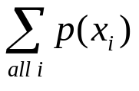
Random Variables and Probability Distribution
    Countably infinite means the values can be mapped to the set of integers
      Ex: Flip a coin an arbitrary number of times. Let X be the number of times the coin comes up heads
Probability Distribution
  For each possible value, x_{i}, for discrete random variable X, there is a probability of occurrence, P(X = x_{i}) = p(x_{i})
  p(x_{i}) is the probability mass function (pmf) of X, and obeys the following rules:
      p(x_{i}) >= 0 for all i
      = 1

Slide 66
Random Variables and Probability Distribution
  The set of pairs (x_{i}, p(x_{i})) is the probability distribution of X
  Examples:
    For Example 5.2 (assuming a fair die):
      Probability Distribution:
        {(1, 1/6), (2, 1/6), (3, 1/6), (4, 1/6), (5, 1/6), (6, 1/6)}
    From Example 2.5 for Service Times
      Probability Distribution:
        {(1, 0.1), (2, 0.2), (3, 0.3), (4, 0.25), (5, 0.1), (6, 0.05)}
    From Example 2.7 for Type of Newsday
      Probability Distribution:
        {(0, 0.35), (1, 0.45), (2, 0.20)}
        Note in this case we are assigning the values 0, 1, 2 to the outcomes somewhat arbitrarily

Slide 67
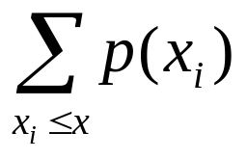
Cumulative Distribution
Cumulative Distribution Function
  The pmf gives probabilities for individual values x_{i} of random variable X
  The cumulative distribution function (cdf), F(x), gives the probability that the value of random variable X is <= x, or
    F(x) = P(X <= x)
  For a discrete random variable, this can be calculated simply by addition:
    F(x) =

Slide 68
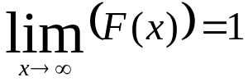
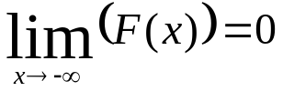
Cumulative Distribution
  Properties of cdf, F:
    F is non-decreasing
  and
    P(a < X ≤ b) = F(b) – F(a) for all a < b
  Ex: Probability that a roll of two dice will result in a value > 7?
    Discuss
  Ex: Probability that 10 flips of a fair coin will yield between 6 and 8 (inclusive) heads?
    Discuss
Notes:
Rolling two dice: Let Random Variable X be the value resulting from a roll of the dice.
Thus, F(x) = [sum i = 2 to x] of p(i). From slides 12 and 13 we can obtain the p(i) values.
Using formula (5.5) our answer is F(12) – F(7) = 1 – [1/36 + 2/36 + 3/36 + 4/36 + 5/36 + 6/36] =
1 – 21/36 = 15/36
Coin flips: Let Random Variable X be the number of flips that are heads
If the coin is fair the probability of each flip being a heads is ½
This is in fact a binomial distribution (see Section 5.3). We will discuss it more shortly

Slide 69
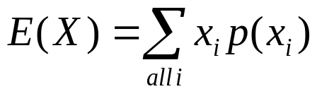
Expected Value
Expected Value (for discrete random variables)
  Also called the mean
  Ex: Expected value for roll of 2 fair dice?
    E(X) = (2)(1/36) + (3)(2/36) + (4)(3/36) + (5)(4/36) + (6)(5/36) + (7)(6/36) + (8)(5/36) + (9)(4/36) + (10)(3/36) + (11)(2/36) + (12)(1/36)
    = 7
    Note that in this case the expected value is an actual value, but not necessarily
Notes:
We discussed this a bit already with the Newspaper Seller's problem

Slide 70
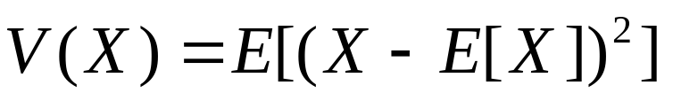
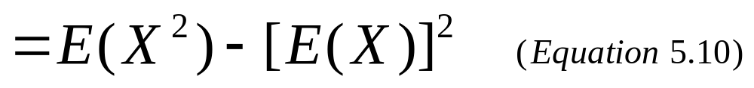
Expected Value and Variance
  If each value has the same "probability", we often add the values together and divide by the number of values to get the mean (average)
    Ex: Average score on an exam
Variance
  We won't prove the identity, but it is useful

Slide 71
Expected Value and Variance
    In the original definition, we need to subtract the mean from each of the X values before squaring
      So we need each X value to calculate the mean AND AFTER the mean has been calculated
        Must look at them twice
    In the right side of the equation (Equation 5.10 in the text), we need to calculate the mean of X and the mean of the squares of X
      We can do this as we process the individual X values and need to look at them only one time
    Ex: What is the variance of the following group of exam scores: { 75, 90, 40, 95, 80 }
      Since each value occurs once, we can consider this to have a uniform distribution

Slide 72
Expected Value and Variance
    V(X) using original definition:
      E(X) = (75+90+40+95+80)/5 = 76
      V(X) = E[(X – E[X])²] = [(75-76)² + (90-76)² + (40-76)²
      + (95-76)² + (80-76)²]/5
      = (1 + 196 + 1296 + 361 + 16)/5 = 374
    V(X) using Equation 5.10
      E(X) = (75+90+40+95+80)/5 = 76
      E(X²) = (5625+8100+1600+9025+6400)/5 = 6150
      V(X) = 6150 – (76)² = 374
      Note that in this case we can add each number to one sum and its square to another, so we can calculate our overall answer with one a single "look" at each number

Slide 73
Discrete Distributions
Discrete Distributions of interest:
  Bernoulli Trials and the Bernoulli Distribution
    Consider an experiment with the following properties
      n independent trials are performed
      each trial has two possible results – success or failure
      the probability of success, p and failure, q (= 1 – p) is constant from trial to trial
      for random variable X, X = 1 for a success and X = 0 for a failure
    Probability Distribution:
      P(X = 1) = p
      P(X = 0) = 1 – p = q
      or 0 for all other values of X

Slide 74
Bernoulli Distribution
    Expected Value
      E(X) = (0)(q) + (1)(p) = p
    Variance
      V(X) = [0²q + 1²p] – p² = p(1 – p)
  A single Bernoulli trial is not that interesting
    Typically, multiple trials are performed, from which we can derive other distributions:
      Binomial Distribution
      Geometric Distribution

Slide 75
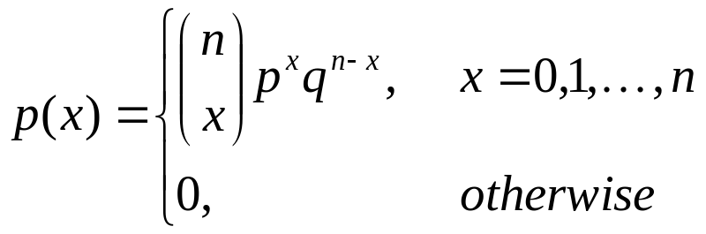
Binomial Distribution
  Binomial Distribution
    Given n Bernoulli trials, let random variable X denote the number of successes in those trials
    Note that the order of the successes is not important, just the number of successes
      Thus, we can achieve the same number of successes in various different ways
      Since the trials are independent, we can multiply the probabilities for each trial to get the overall probability for the sequence

Slide 76
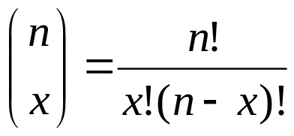
Binomial Distribution
    Recall that the number of combinations of n items taken x at a time is
    E(X) = np
      Discuss
    V(X) = npq
    Consider an example:
      Exercise 5.1
      Read
      Do solution on board
Notes:
p(x) = (100 c x) (0.01)^{x}(0.99)^{100-x}, x = 0, 1, …
P(X > 2) = 1 – P(X <= 2) = 1 – P(0) – P(1) – P(2)
= 1 – (100 C 0)(0.01)⁰(0.99)¹⁰⁰ – (100 C 1)(0.01)¹(0.99)⁹⁹ – (100 C 2)(0.01)²(0.99)⁹⁸
= 1 – (1)(1)(0.366) – (100)(0.01)(0.370) – (4950)(0.0001)(0.373)
= 1 – (0.366) – (.370) – (0.185) = 0.079
Coin flip: We want the probability that 10 flips of a fair coin will result in between 6 and 8 heads
We could do this using the cumulative probability function (cdf) for the binomial distribution. However, this is not trivial to calculate, so for a given problem we may be better calculating the values directly. In this case, we need to calculate P(6) + P(7) + P(8) = (10 C 6)(0.5)⁶(0.5)⁴ + (10 C 7)(0.5)⁷(0.5)³ + (10 C 8)(0.5)⁸(0.5)² =
= (210)(0.001) + (120)(0.001) + (45)(0.001) = 0.375

Slide 77
Binomial Distribution
    Consider again coin-flip ex. on slide 67
    Generally speaking binomial distributions can be used to determine the probability of a given number of defective items in a batch, or the probability of a given number of people having a certain characteristic
      Ex: The trait of having a klinkled flooje occurs on average in 10% of Kreptoplomians (krep-tō-plō'-mē-əns). Given a group of 20 Kreptoplomians, what is the probability that 3 of them have klinkled floojes?
        P(3) = (20 C 3)(0.1)³(0.9)¹⁷ = (1140)(0.001)(0.1668)
        = 0.1902
        Note that if we wanted "at least 3" the answer would be different – how to calculate?

Slide 78
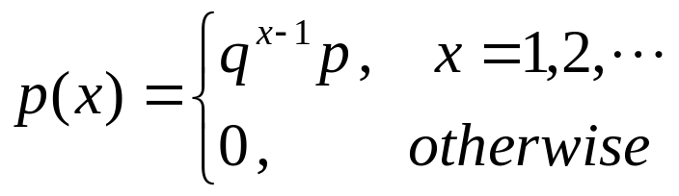
Geometric Distribution
  Geometric Distribution
    Given a sequence of Bernoulli trials, let X represent the number of trials required until the first success
      i.e. we have x – 1 failures, followed by a success
      Note that the maximum probability for this is at X = 1, regardless of p and q
    E(X) = 1/p
    V(X) = q/p²
      We will omit the proofs of the above, since they are fairly complex (involving series solutions)

Slide 79
Geometric Distribution
    Ex: What is the probability that the first Kreptoplomian found to have a klinkled flooje will be the 5th Kreptoplomian overall?
      (0.9)⁴(0.1) = 0.0656
    Ex: The probability that a certain computer will fail during any 1-hour period is 0.001
      What is the probability that the computer will survive at least 3 hours?
        Here p = 0.001 and q = (1 – p) = 0.999
      Using a geometric distribution, we want to solve
      P(X >= 4) = 1 – P(1) – P(2) – P(3)
      = 1 – (0.001) – (0.999)(0.001)
      – (0.999)²(0.001)
      = 0.997

Slide 80
Geometric Distribution
    The Geometric Distribution is memoryless
      Consider the following two scenarios where p = probability that a component will fail in the next hour. Assume the current hour is hour 0.
        What is the probability that the component will fail by the end of hour 3?
        What is the probability that the component will fail by the end of hour 6, given that it has not failed by the end of hour 3 ?
        For 1) the solution is P(1) + P(2) + P(3)
        For 2), since the component did NOT fail by the end of hour 3, and since the probability is for the next hour (whatever that hour may be), the solution is the same
      We can prove this property with fairly simple algebra
        First we need one additional definition

Slide 81
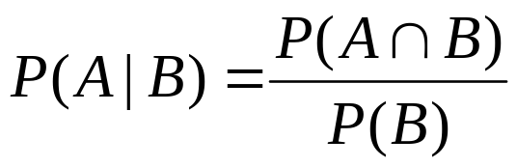
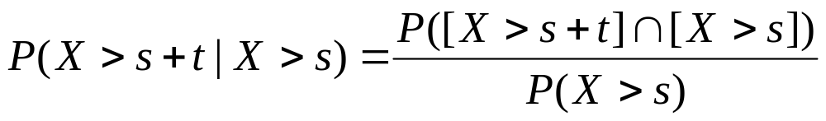
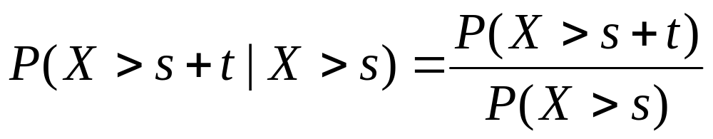
Geometric Distribution
    The conditional probability of an event, A, given that another event, B, has occurred is defined to be:
    Applying this to the geometric distribution we get
      Clearly, if X > s+t, then X > s (since t cannot be negative), so we get

Slide 82
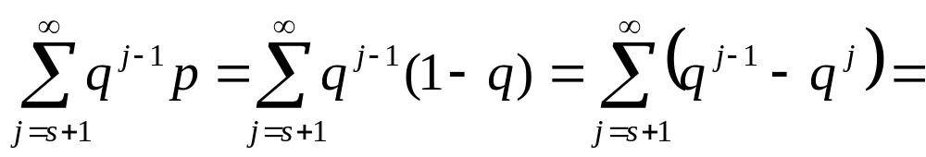
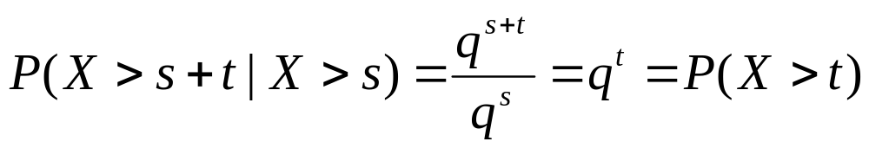
Geometric Distribution
      Consider that P(X > s) =
      We can use similar logic to determine that
      P(X > s + t) = q^{s+t}
      Now our conditional probability becomes
      and thus we have shown that the geometric distribution is memoryless
        We will see shortly that the exponential distribution is also memoryless

Slide 83
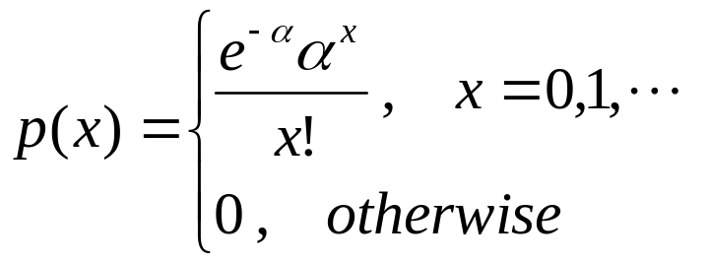
Poisson Distribution
  Poisson Distribution
    Often used to model arrival processes with constant arrival rates
    Gives (probability of) the number of events that occur in a given period
    Formula looks quite complicated (and NOT discrete), but it is discrete and using it is not that difficult
    Where α is the mean arrival rate. Note that α must be positive
    E(X) = V(X) = α

Slide 84
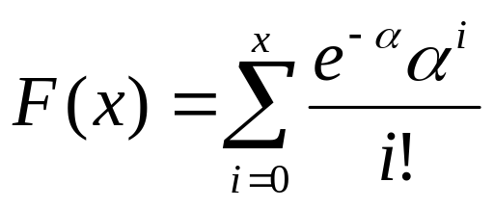
Poisson Distribution
    Note: The Poisson Distribution is actually the convergence of the Binomial Distribution as the number of trials, n, approaches infinity
      If we think of n as the number of subintervals of a given unit of time
      As n → ∞, the subintervals get smaller and smaller
      We will skip the detailed math here
      One nice feature of this is that we can use a Poisson Distribution to approximate a Binomial Distribution when n is large

Slide 85
Poisson Distribution
    Example
      Number of people logging onto a computer per minute is Poisson Distributed with mean 0.7
      What is the probability that 5 or more people will log onto the computer in the next 10 minutes?
      Solution?
        Must first convert the mean to the 10 minute period – if mean is 0.7 in 1 minute, it will be (0.7)(10) = 7 in a ten minute period
        Now we can plug in the formula
        P(X >= 5) = 1 – P(0) – P(1) – P(2) – P(3) – P(4)
        = 1 – F(4) (where F is the cdf)
        = 1 – 0.173 (from Table A.4 in the text)
        = 0.827
Notes:
If we calculate it using the formula, we get
1 – (e⁻⁷)(7⁰)/0! – (e⁻⁷)(7¹)/1! – (e⁻⁷)(7²)/2! – (e⁻⁷)(7³)/3! – (e⁻⁷)(7⁴)/4!
= 1 – (0.000912) – (0.006832) – (0.022341) – (0.052129) – (0.091226)
= 0.827

Slide 86
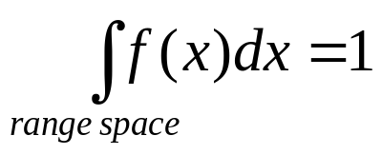
Continuous Random Variables
Continuous Random Variable
  Random variable X is continuous if its sample space is a range or collection of ranges of real values
  More formally, there exists non-negative function f(x), called the probability density function, such that for any set of real numbers, S
      f(x) >= 0 for all x in the range space
      – the total area under f(x) is 1
      f(x) = 0 for all x not in the range space
    Note that f(x) does NOT give the probability that X = x
      Unlike the pmf for discrete random variables

Slide 87
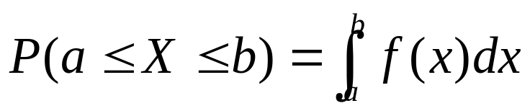
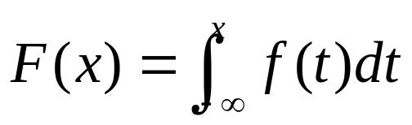
Continuous Random Variables
    The probability that X lies in a given interval [a,b] is
      We see this visually as the "area under the curve"
      Note that for continuous random variables,
      P(X = x) = 0 for any x (see from formula above)
      Rather we always look at the probability of x within a given range (although the range could be very small)
    The cumulative density function (cdf), F(x) is simply the integral from -∞ to x or
      This gives us the probability up to x

Slide 88
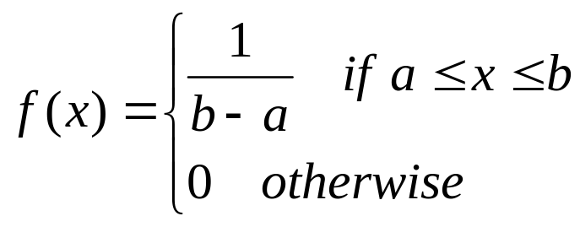
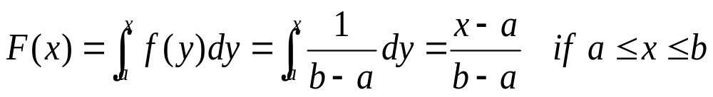
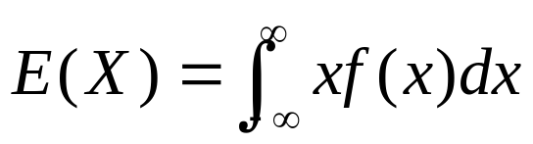
Continuous Random Variables
    Ex: Consider the uniform distribution on the range [a,b] (see text p. 189)
      Look at plots on board for example range [0,1]
        What about F(x) when x < a or x > b?
  Expected Value for a continuous random variable
      Compare to the discrete expected value

Slide 89
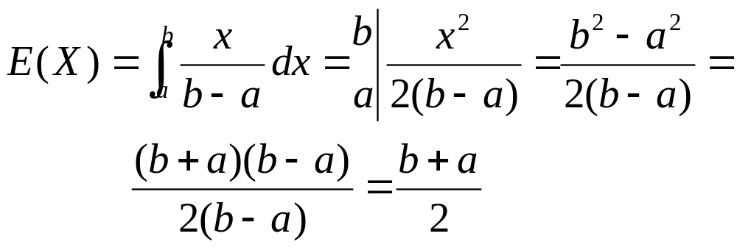
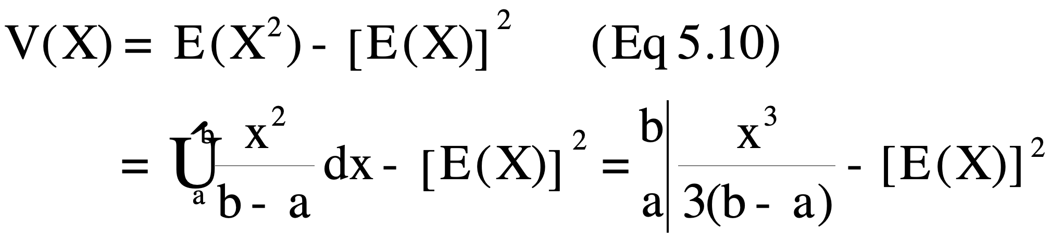
Continuous Random Variables
  Variance for continuous random variables
    Defined in same way as for discrete variables
      Calculating it will clearly be different, however
  Ex: Uniform Distribution

Slide 90
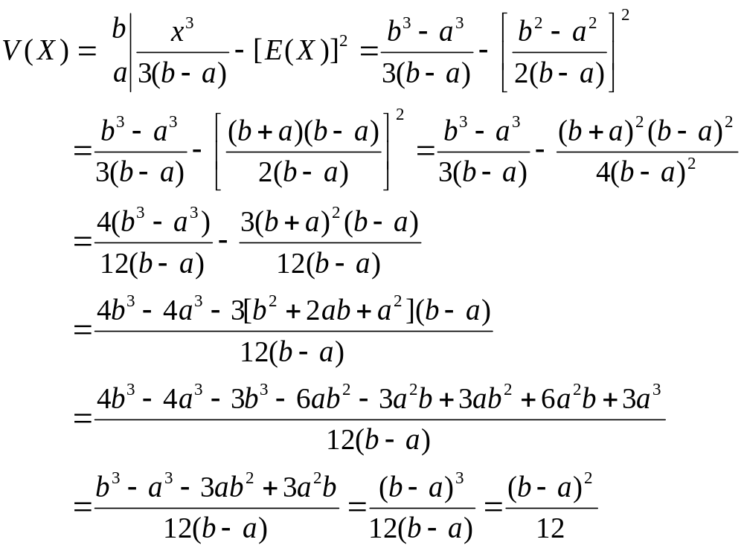
Continuous Random Variables

Slide 91
Uniform Distribution
    Generally speaking we will not be calculating these values from scratch (good news, in all likelihood!)
      However, it is good (and fun!) to see how it can be done for at least one (simple) distribution
  The Uniform Distribution will be useful primarily in the generation of other distributions
    Ex: Most random number generators on computers minimally will provide a uniform value from [0,1)
      We will later see how that can be used to generate other random variates (See Chapter 8)

Slide 92
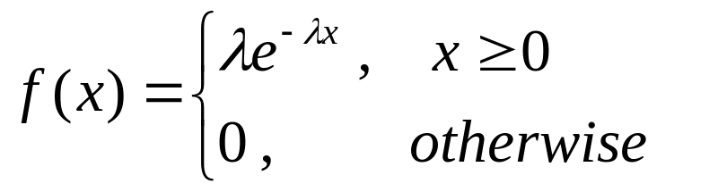
Exponential Distribution
  Given a value λ > 0, the pdf of the Exponential Distribution is
    Since the exponent is negative, the pdf will decrease as x increases – see shape on board and p. 191
    λ is the rate: number of occurrences per time unit
      Ex: arrivals per hour; failures per day
    Note that 1/λ can thus be considered to be the time between events or the duration of events
      Ex: 10 arrivals per hour → 1/10 hr (6min) average between arrivals
      Ex: 20 customers served per hour → 1/20 hr (3min) average service time

Slide 93
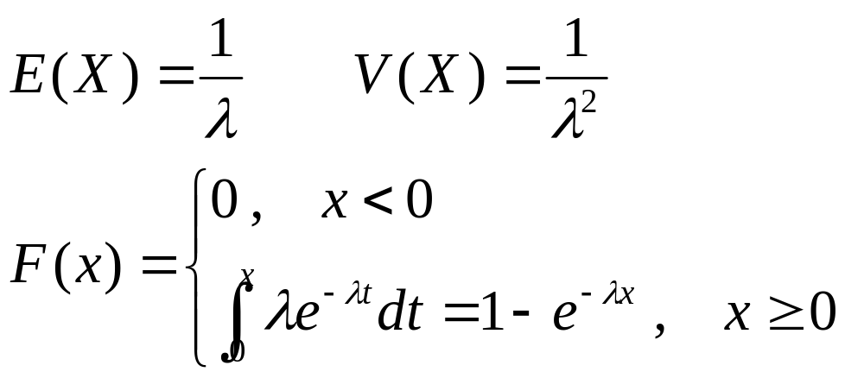
Exponential Distribution
    Some more definitions
      See shape of cdf on board and p. 191
    Ex: Assume the hard drives manufactured by Herb's Hard Drives have a mean lifetime of 4 years, exponentially distributed
      What is the probability that one of Herb's Hard Drives will fail within the first two years?
      What is the probability that one of Herb's Hard Drives will last at least 8 years (or twice the mean)?
Notes:
First we need to be careful to formulate the problem correctly. Since the mean lifetime is 4 years, then λ will be ¼ or 1 failure per 4 years. We want to calculate P(X <= 2) = F(2) = 1 – e^{-(1/4)(2)} = 1 – e^{-1/2} = 1 – 0.6065 = 0.3934
We take the same approach, but now want P(X > 8) = 1 – P(X <= 8) = 1 – (1 – e^{-(1/4)(8)}) = 1 – (1 – 0.1353) = 0.1353

Slide 94
Exponential Distribution
    Like the geometric distribution, the exponential distribution is memoryless
      Implies that P(X > s+t | X > s) = P(X > t)
      The proof of this is similar in nature to that for the geometric distribution
        See pp. 193 in text
    Ex: Exercise 5.19 in the text
      Component has exponential time-to-failure with mean 10,000 hrs
        Component has already been in operation for its mean life. What is the prob. that it will fail by 15,000 hrs?
        Component is still ok at 15,000 hrs. What is the prob. that it will operate for another 5,000 hrs
        The first thing we need to do here is be sure we understand the problem correctly

Slide 95
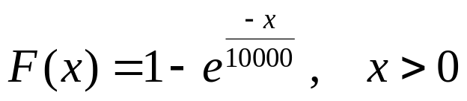
Exponential Distribution
      First, let's determine our distribution
        X is the time to failure, and is exponentially distributed with mean 10,000 hours
        This gives us a cumulative distribution
        Here the failure rate = λ = 1/10000
      a) is pretty clear – we want the probability that it lasts at most 15,000 given that it has lasted 10,000
        We want P(X <= 15000 | X > 10000)
        Due to the memoryless property of the exponential distribution, this reduces to P(X <= 5000) which is
        1 – e^{-1/2} = 0.3935

Slide 96
Exponential Distribution
      b) is trickier (and actually not phrased well)
        Do they mean the prob. that it will last exactly 5000 more hours?
        If so, the probability is 0, since continuous distributions have 0 prob. for a specific value
        Do they mean it will last at most 5000 more hours?
        If so, the answer is the same as a) due to the memoryless property
        Do they mean it will last at least 5000 more hours?
        If so, we want 1 – F(5000) = 0.6065

Slide 97
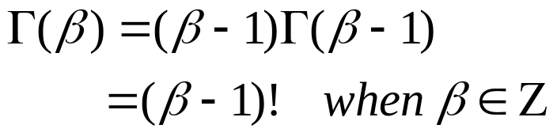
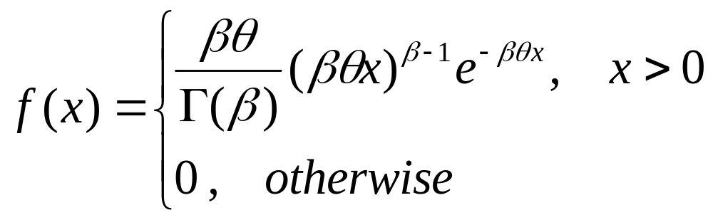
Gamma Distribution
  Gamma Distribution
    More general than exponential
    Based on the gamma function, which is a continuous generalization of the the factorial function
        base case Γ(1) = 1
      β is called the shape parameter
      The gamma function also has θ, the scale parameter
      This leads the the following pdf:

Slide 98
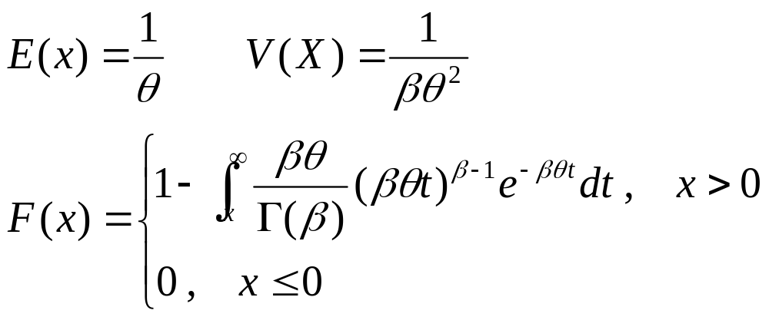
Gamma Distribution
      These formulas look complicated (and they are)
      However, they allow for more flexibility in the distributions
        Allow more different curves (See Fig. 5.11)
        See also: http://en.wikipedia.org/wiki/Gamma_distribution
      Note that if β=1, the equations simplify to the exponential distribution with rate θ
        Look at the formulas to see this

Slide 99
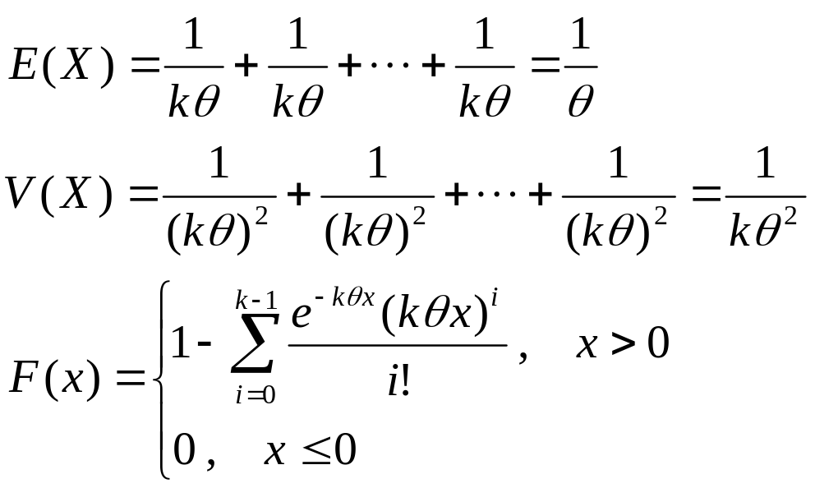
Erlang Distribution
  When β is an arbitrary positive integer, k, the Gamma Distribution is also called the Erlang Distribution of order k
    In general terms, it represents the sum of k independent, exponentially distributed variables, each with rate kθ (= λ)
      X = X₁ + X₂ + … + X_{k} leading to

Slide 100
Erlang Distribution
    This allows us to determine probabilities for sequences of exponentially distributed events
      Note that the rates for all events in the sequence must be the same
    Ex: Exercise 5.21 in text
      Time to serve a customer at a bank is exponentially distributed with mean 50 sec
        Probability that two customers in a row will each require less than 1 minute for their transaction
        Probability that the two customers together will require less than 2 minutes for their transactions
        It is important to recognize the difference between these two problems

Slide 101
Erlang Distribution
      For a) we are looking at the probability that each of two independent events will be < 1 minute
        In this case, the probability overall is the product of the two probabilities, each of which is exponential
        λ = rate = 1/mean = 1/50
        We want P(X < 60) = F(60) = 1 – e^{-(1/50)(60)} = 0.6988
        Thus the total probability is (0.6988)² = 0.4883
      For b) we are looking at the probability that two events together will be < 2 minutes
        In this case the probability overall is an Erlang distribution with k = 2 and kθ = 1/50, and we want to determine P(X < 120) = F(120)
        Substituting into our equation for F, we get

