Slide 1
COMP 315: MODELLING AND SIMULATION
Group 1

Slide 2
Content
Automated Teller Machine(ATM)
Context model
Interaction model
Structural model
Behavioral model

Slide 3

AUTOMATED TELLER MACHINE(ATM)
An electronic device that allows individuals to perform basic banking transactions without the need for a human teller.
Cash Withdrawals
Deposits
Balance Inquiries etc.

Slide 4
CONTEXT MODEL
Context model shows how the system being modeled is placed in the environment with other systems.
Context model depict the relationships between a system and its external entities or stakeholders
Context model show what lies outside the boundaries

Slide 5
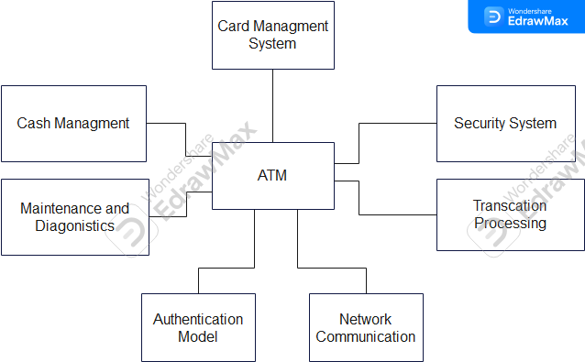
CONTEXT MODEL OF AN ATM

Slide 6
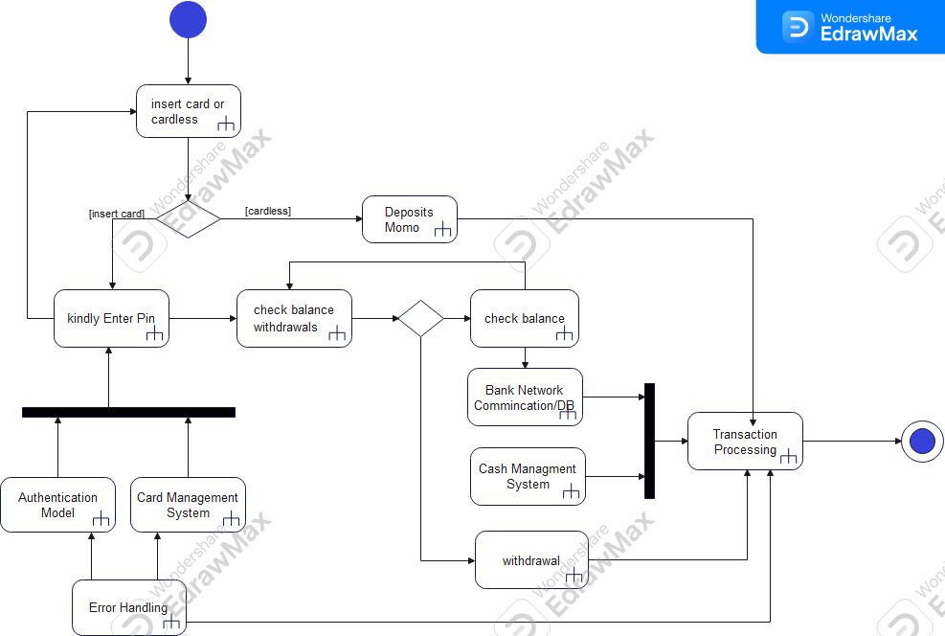
PROCESS MODEL OF AN ATM

Slide 7
INTERACTION MODEL
Modeling user interaction is important as it helps to identify user requirements.
These models are essential for understanding the dynamic aspects of a system, focusing on the flow of information, control, and data between different parts of the system
Use case diagrams and sequence diagrams may be used for interaction modeling.

Slide 8
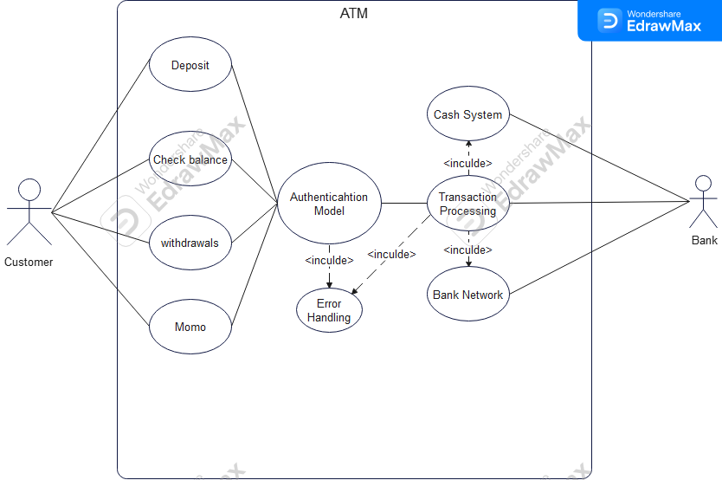
USE CASE OF AN ATM

Slide 9
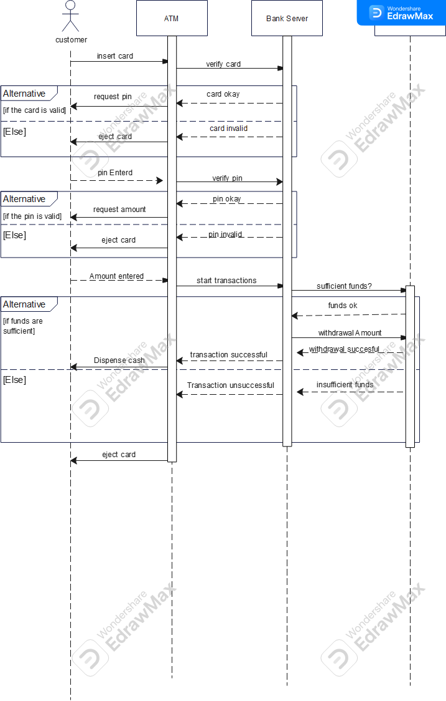
SEQUENCE DIAGRAMS OF AN ATM

Slide 10
STRUCTURAL MODELS
Structural modeling captures the static features of a system.
The purpose is to reduce the semantic gap between the real word and the world of Software engineering/development
Represents things, ideas and concepts of importance o the application system

Slide 11
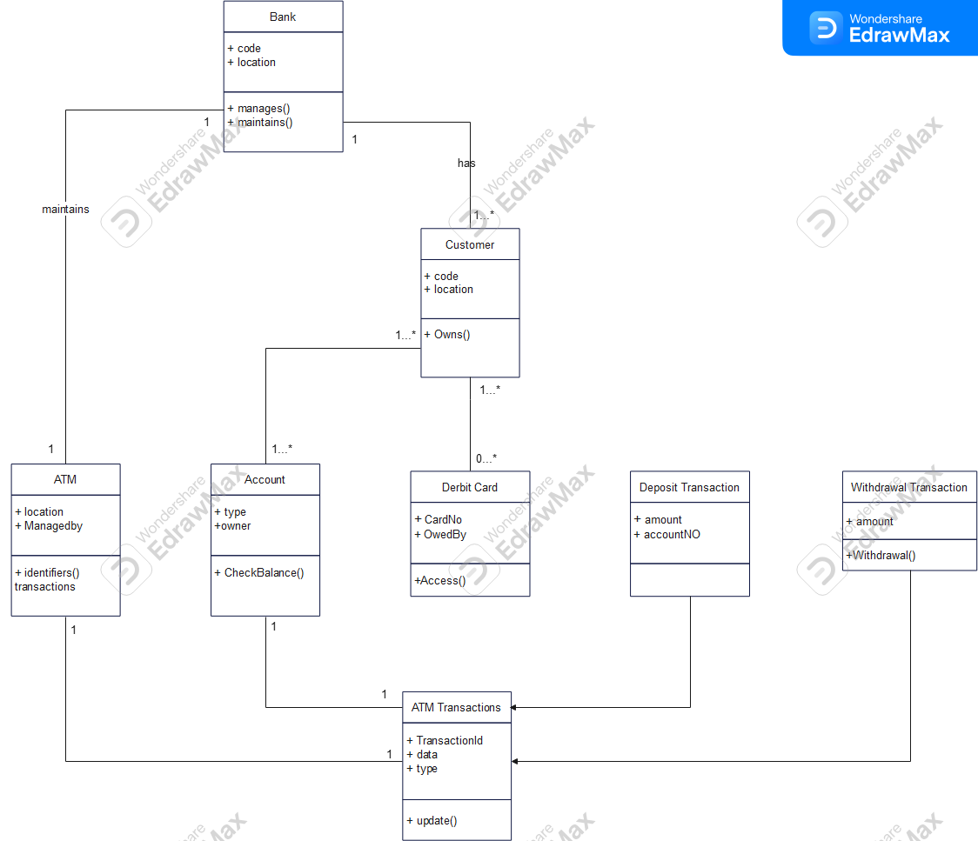
STRUCTURAL MODELS OF AN ATM

Slide 12
BEHAVIORAL MODELS
Behavioral model are models of the dynamic behavior of system as it is executing.
A system responds to stimulus from it’s environment
Data-driven models shows sequences of the actions involved in the processing input data and the generating and associated output.
Event-driven modeling shows how a system responds to external and internal events

Slide 13

BEHAVIORAL MODELS (DATA-DRIVEN)

Slide 14
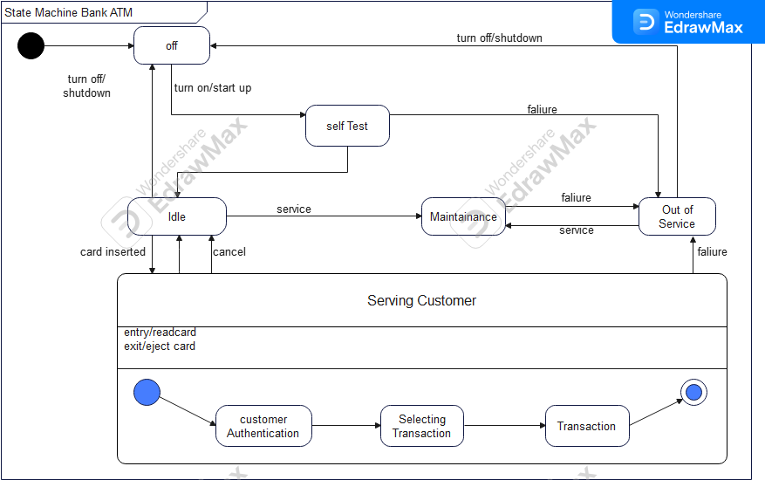
BEHAVIORAL MODELS (EVENT-DRIVEN)

