Slide 1
CS 143A - Principles of Operating Systems
Lecture 3 - CPU Scheduling
Prof. Nalini Venkatasubramanian
nalini@ics.uci.edu
Principles of Operating Systems - CPU Scheduling
‹#›
Notes:
‹#›

Slide 2
Outline
Basic Concepts
Scheduling Objectives
Levels of Scheduling
Scheduling Criteria
Scheduling Algorithms
FCFS, Shortest Job First, Priority, Round Robin, Multilevel
Multiple Processor Scheduling
Real-time Scheduling
Algorithm Evaluation
Principles of Operating Systems - CPU Scheduling
‹#›
Notes:
‹#›

Slide 3
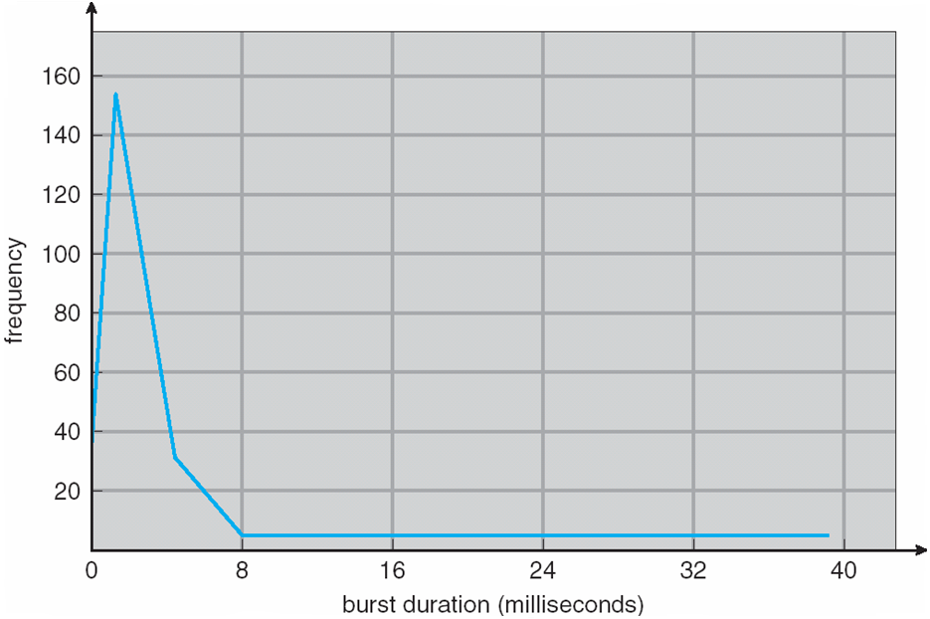
CPU Burst Distribution
Principles of Operating Systems - CPU Scheduling
‹#›
Notes:
‹#›

Slide 4
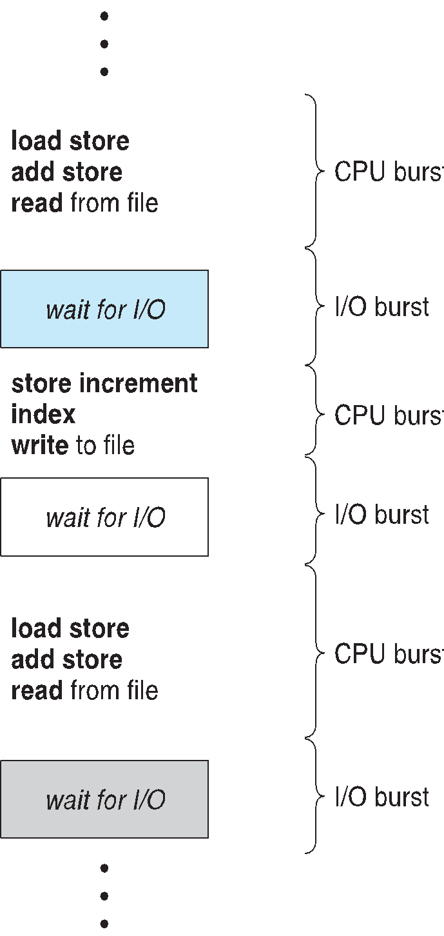
Basic Concepts
Maximum CPU utilization obtained with multiprogramming.
CPU-I/O Burst Cycle
Process execution consists of a cycle of CPU execution and I/O wait.
Principles of Operating Systems - CPU Scheduling
‹#›
Notes:
‹#›

Slide 5
Scheduling Objectives
Enforcement of fairness
in allocating resources to processes
Enforcement of priorities
Make best use of available system resources
Give preference to processes holding key resources.
Give preference to processes exhibiting good behavior.
Degrade gracefully under heavy loads.
Principles of Operating Systems - CPU Scheduling
‹#›
Notes:
‹#›

Slide 6
Program Behavior Issues
I/O boundedness
short burst of CPU before blocking for I/O
CPU boundedness
extensive use of CPU before blocking for I/O
Urgency and Priorities
Frequency of preemption
Process execution time
Time sharing
amount of execution time process has already received.
Principles of Operating Systems - CPU Scheduling
‹#›
Notes:
‹#›

Slide 7
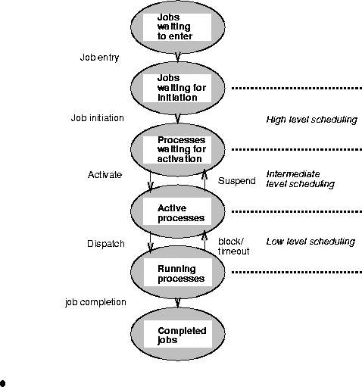

Levels of Scheduling
High Level / Job Scheduling
Selects jobs allowed to compete for CPU and other system resources.
Intermediate Level / Medium Term Scheduling
Selects which jobs to temporarily suspend/resume to smooth fluctuations in system load.
Low Level (CPU) Scheduling or Dispatching
Selects the ready process that will be assigned the CPU.
Ready Queue contains PCBs of processes.
Principles of Operating Systems - CPU Scheduling
‹#›
Notes:
‹#›

Slide 8
CPU Scheduler
Selects from among the processes in memory that are ready to execute, and allocates the CPU to one of them.
Non-preemptive Scheduling
Once CPU has been allocated to a process, the process keeps the CPU until
Process exits OR
Process switches to waiting state
Preemptive Scheduling
Process can be interrupted and must release the CPU.
Need to coordinate access to shared data
Principles of Operating Systems - CPU Scheduling
‹#›
Notes:
‹#›

Slide 9
CPU Scheduling Decisions
CPU scheduling decisions may take place when a process:
switches from running state to waiting state
switches from running state to ready state
switches from waiting to ready
terminates
Scheduling under 1 and 4 is non-preemptive.
All other scheduling is preemptive.
Principles of Operating Systems - CPU Scheduling
‹#›
Notes:
‹#›

Slide 10
CPU scheduling decisions
new
admitted
exit
terminated
interrupt
ready
running
I/O or
event
completion
Scheduler
dispatch
I/O or
event wait
waiting
Principles of Operating Systems - CPU Scheduling
‹#›
Notes:
‹#›

Slide 11
Dispatcher
OS dispatcher module gives control of the CPU to the process selected by the short-term scheduler. This involves:
switching context
switching to user mode
jumping to the proper location in the user program to restart (continue) that program
Dispatch Latency:
time it takes for the dispatcher to stop one process and start another running.
Dispatcher must be fast.
Principles of Operating Systems - CPU Scheduling
‹#›
Notes:
‹#›

Slide 12
Scheduling Criteria
CPU Utilization
Keep the CPU and other resources as busy as possible
Throughput
# of processes that complete their execution per time unit.
Turnaround time
amount of time to execute a particular process from its entry time.
Principles of Operating Systems - CPU Scheduling
‹#›
Notes:
‹#›

Slide 13
Scheduling Criteria (cont.)
Waiting time
amount of time a process has been waiting in the ready queue.
Response Time (in a time-sharing environment)
amount of time it takes from when a request was submitted until the first response is produced, NOT output.
Principles of Operating Systems - CPU Scheduling
‹#›
Notes:
‹#›

Slide 14
Optimization Criteria
Optimize overall system
Max CPU Utilization
Max Throughput
Optimize individual processes’ performance
Min Turnaround time
Min Waiting time
Min Response time
Principles of Operating Systems - CPU Scheduling
‹#›
Notes:
‹#›

Slide 15
First Come First Serve (FCFS) Scheduling
Policy: Process that requests the CPU FIRST is allocated the CPU FIRST.
FCFS is a non-preemptive scheduling algorithm.
Implementation - using FIFO queues
incoming process is added to the tail of the queue.
Process selected for execution is taken from head of queue.
Performance metric - Average waiting time in queue.
Gantt Charts are used to visualize schedules.
Principles of Operating Systems - CPU Scheduling
‹#›
Notes:
‹#›

Slide 16
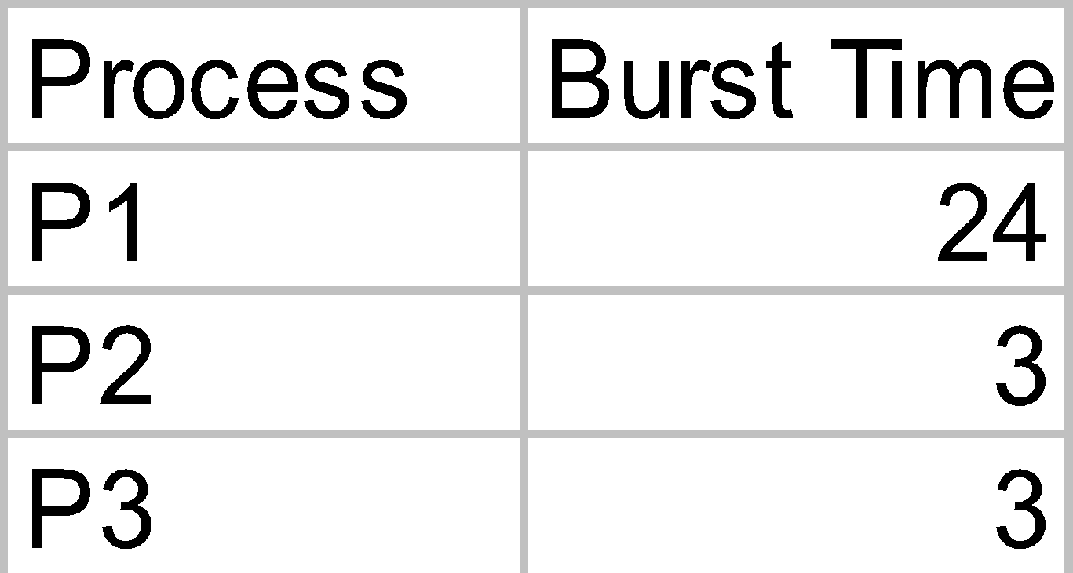
First-Come, First-Served(FCFS) Scheduling
Example
Suppose the arrival order for the processes is
P1, P2, P3
Waiting time
P1 = 0;
P2 = 24;
P3 = 27;
Average waiting time
(0+24+27)/3 = 17
Gantt Chart for Schedule
P1
P2
P3
0
24
27
30
Principles of Operating Systems - CPU Scheduling
‹#›
Notes:
‹#›

Slide 17
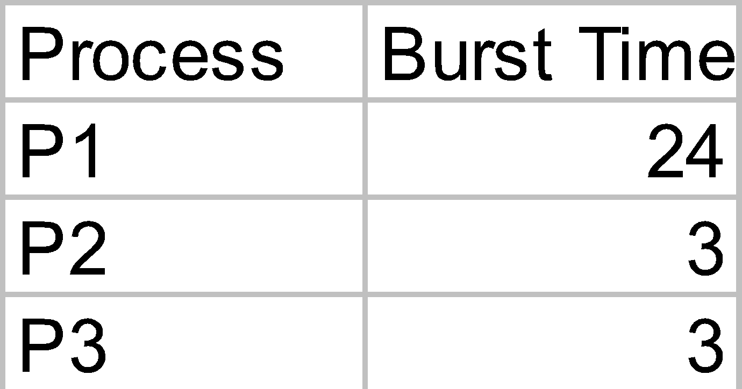
FCFS Scheduling (cont.)
Suppose the arrival order for the processes is
P2, P3, P1
Waiting time
P1 = 6; P2 = 0; P3 = 3;
Average waiting time
(6+0+3)/3 = 3 , better..
Convoy Effect:
short process behind long process, e.g. 1 CPU bound process, many I/O bound processes.
Example
Gantt Chart for Schedule
P2
P3
P1
0
3
6
30
Principles of Operating Systems - CPU Scheduling
‹#›
Notes:
‹#›

Slide 18
Shortest-Job-First (SJF) Scheduling
Associate with each process the length of its next CPU burst. Use these lengths to schedule the process with the shortest time.
Two Schemes:
Scheme 1: Non-preemptive
Once CPU is given to the process it cannot be preempted until it completes its CPU burst.
Scheme 2: Preemptive
If a new CPU process arrives with CPU burst length less than remaining time of current executing process, preempt. Also called Shortest-Remaining-Time-First (SRTF).
SJF is optimal - gives minimum average waiting time for a given set of processes.
Principles of Operating Systems - CPU Scheduling
‹#›
Notes:
‹#›

Slide 19
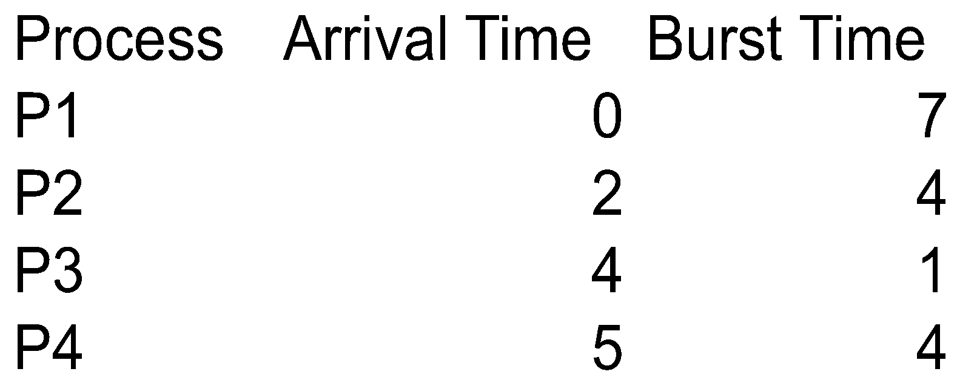
Non-Preemptive SJF Scheduling
Example
Gantt Chart for Schedule
P1
P3
P2
P4
Average waiting time =
(0+6+3+7)/4 = 4
0
7
8
12
16
Principles of Operating Systems - CPU Scheduling
‹#›
Notes:
‹#›

Slide 20
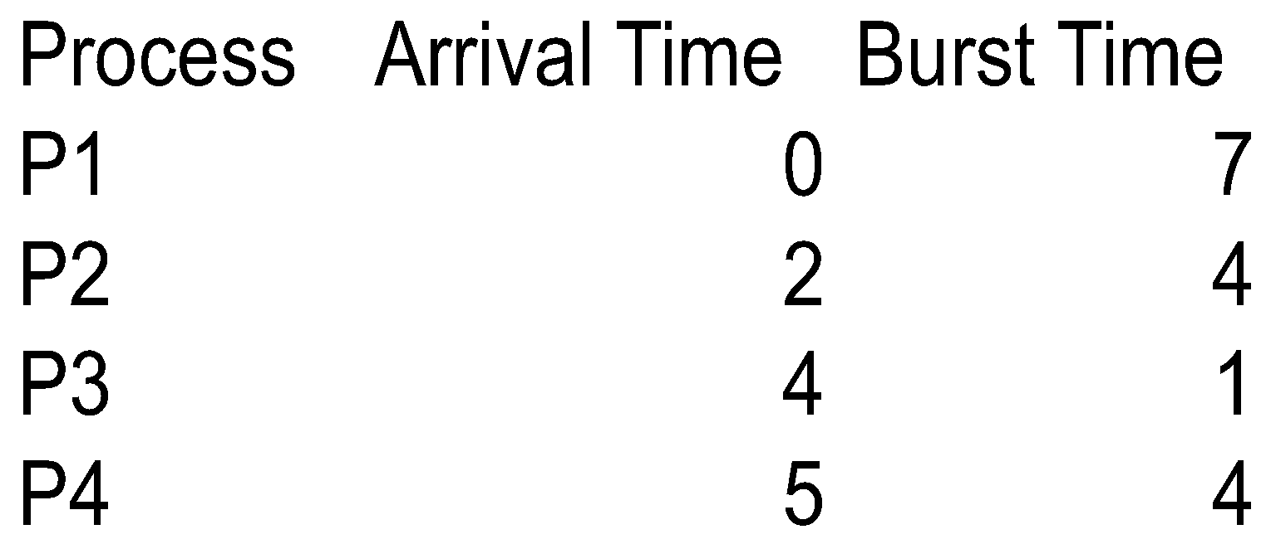
Preemptive SJF Scheduling (SRTF)
Example
Gantt Chart for Schedule
P1
P2
P3
P2
P4
P1
Average waiting time =
(9+1+0+2)/4 = 3
0
2
4
5
7
11
16
Principles of Operating Systems - CPU Scheduling
‹#›
Notes:
‹#›

Slide 21
Determining Length of Next CPU Burst
One can only estimate the length of burst.
Halting problem: cannot (in general) determine if a program will run forever on some input or complete in finite time
Estimate next CPU burst by an exponentially-weighted moving average over previous ones:
tn = actual length of n^{th} burst
τn+1 = predicted value for the next CPU burst
α = weight, 0 ≤ α ≤ 1
Define
τn+1 = α tn + (1 - α) τn
Principles of Operating Systems - CPU Scheduling
‹#›
Notes:
‹#›

Slide 22
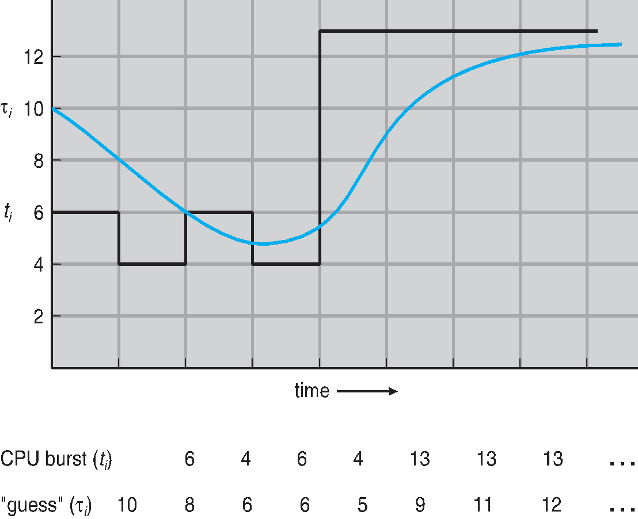
Prediction of the length of the next CPU burst
‹#›
Notes:
‹#›

Slide 23
Exponential Averaging(cont.)
α = 0
τn+1 = τn; Recent history does not count
α= 1
τn+1 = tn; Only the actual last CPU burst counts.
Similarly, expanding the formula:
τn+1 = αtn + (1-α) αtn-1 + …+ (1-α)^j αtn-j + … (1-α)^(n+1) τ0
Each successive term has less weight than its predecessor.
Principles of Operating Systems - CPU Scheduling
‹#›
Notes:
‹#›

Slide 24
Priority Scheduling
A priority value (integer) is associated with each process. Can be based on
Cost to user
Importance to user
Aging
%CPU time used in last X hours.
CPU is allocated to process with the highest priority.
Preemptive
Non-preemptive
Principles of Operating Systems - CPU Scheduling
‹#›
Notes:
‹#›

Slide 25
Priority Scheduling (cont.)
SJF is a priority scheme where the priority is the predicted next CPU burst time.
Higher priority number 🡪 lower priority
E.g. priority 0 is higher priority than priority 1
Problem
Starvation!! - Low priority processes may never execute.
Solution
Aging - as time progresses increase the priority of the process.
Principles of Operating Systems - CPU Scheduling
‹#›
Notes:
‹#›

Slide 26
Round Robin (RR)
Each process gets a small unit of CPU time
Time quantum usually 10-100 milliseconds.
After this time has elapsed, the process is preempted, moved to the end of the ready queue, and the process at the head of the ready queue is allocated the CPU.
n processes, time quantum = q
Each process gets 1/n CPU time in chunks of at most q at a time.
No process waits more than (n-1)q time units.
Performance considerations:
Time slice q too large – FIFO (FCFS) behavior
Time slice q too small - Overhead of context switch is too expensive.
Heuristic - 70-80% of jobs block within time slice
Principles of Operating Systems - CPU Scheduling
‹#›
Notes:
‹#›

Slide 27
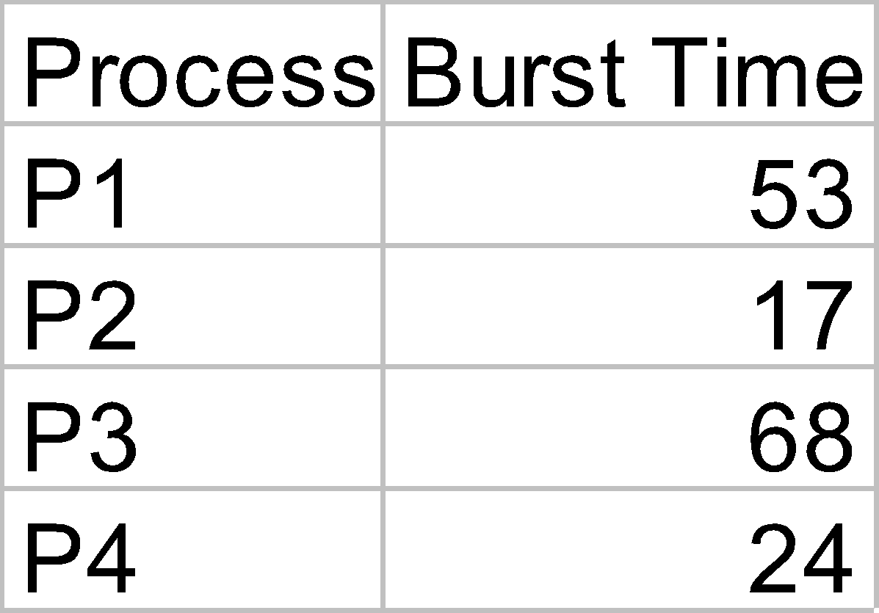
Round Robin Example
Time Quantum = 20
Gantt Chart for Schedule
P1
P2
P3
P4
P1
P3
P4
P1
P3
P3
0
20
37
57
77
97
117
121
134
154
162
Typically, higher average turnaround time than SRTF, but better response time
Principles of Operating Systems - CPU Scheduling
‹#›
Notes:
‹#›

Slide 28
Multilevel Queue
Ready Queue partitioned into separate queues
Example: system processes, foreground (interactive), background (batch), student grades
Each queue has its own scheduling algorithm
Example: foreground (RR), background (FCFS)
Processes assigned to one queue permanently.
Scheduling must be done between the queues
Fixed priority - serve all from foreground, then from background. Possibility of starvation.
Time slice - Each queue gets some CPU time that it schedules - e.g. 80% foreground (RR), 20% background (FCFS)
Principles of Operating Systems - CPU Scheduling
‹#›
Notes:
‹#›

Slide 29
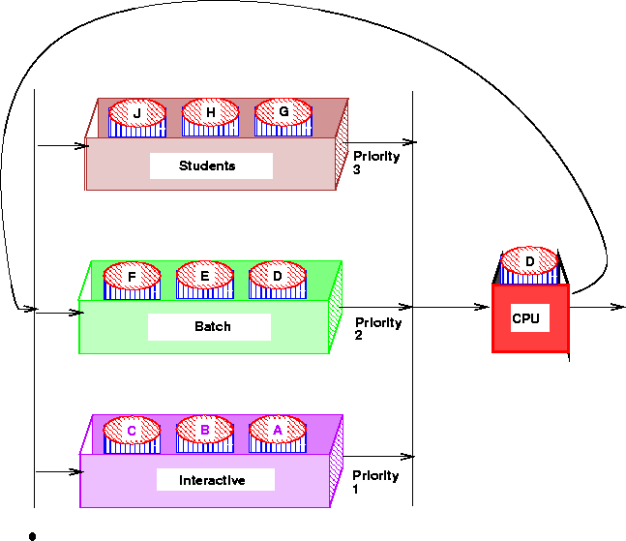
Multilevel Queues
Principles of Operating Systems - CPU Scheduling
‹#›
Notes:
‹#›

Slide 30
Multilevel Feedback Queue
Multilevel Queue with priorities
A process can move between the queues.
Aging can be implemented this way.
Parameters for a multilevel feedback queue scheduler:
number of queues.
scheduling algorithm for each queue.
method used to determine when to upgrade a process.
method used to determine when to demote a process.
method used to determine which queue a process will enter when that process needs service.
Principles of Operating Systems - CPU Scheduling
‹#›
Notes:
‹#›

Slide 31
Multilevel Feedback Queues
Example: Three Queues -
Q0 - time quantum 8 milliseconds (FCFS)
Q1 - time quantum 16 milliseconds (FCFS)
Q2 - FCFS
Scheduling
New job enters Q0 - When it gains CPU, it receives 8 milliseconds. If job does not finish, move it to Q1.
At Q1, when job gains CPU, it receives 16 more milliseconds. If job does not complete, it is preempted and moved to Q2.
Principles of Operating Systems - CPU Scheduling
‹#›
Notes:
‹#›

Slide 32
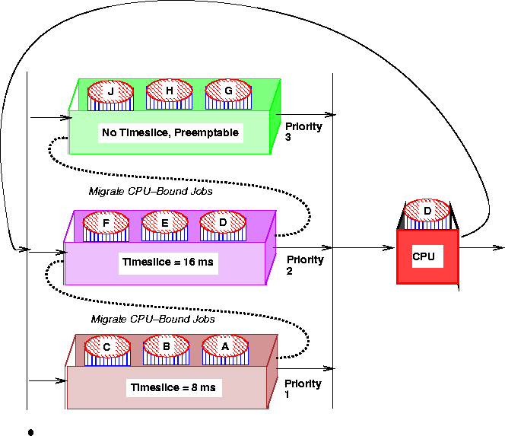
Multilevel Feedback Queues
Principles of Operating Systems - CPU Scheduling
‹#›
Notes:
‹#›

Slide 33
Multiple-Processor Scheduling
CPU scheduling becomes more complex when multiple CPUs are available.
Have one ready queue accessed by each CPU.
Self scheduled - each CPU dispatches a job from ready Q
Manager-worker - one CPU schedules the other CPUs
Homogeneous processors within multiprocessor.
Permits Load Sharing
Asymmetric multiprocessing
only 1 CPU runs kernel, others run user programs
Principles of Operating Systems - CPU Scheduling
‹#›
Notes:
‹#›

Slide 34
Real-Time Scheduling
Hard Real-time Computing -
required to complete a critical task within a guaranteed amount of time.
Soft Real-time Computing -
requires that critical processes receive priority over less important ones.
Types of real-time Schedulers
Periodic Schedulers - Fixed Arrival Rate
Demand-Driven Schedulers - Variable Arrival Rate
Deadline Schedulers - Priority determined by deadline
…
Principles of Operating Systems - CPU Scheduling
‹#›
Notes:
‹#›

Slide 35
Issues in Real-time Scheduling
Dispatch Latency
Problem - Need to keep dispatch latency small, OS may enforce process to wait for system call or I/O to complete.
Solution - Make system calls preemptible, determine safe criteria such that kernel can be interrupted.
Priority Inversion and Inheritance
Problem: Priority Inversion
Higher Priority Process P0 needs kernel resource currently being used by another lower priority process P1.
P0 must wait for P1, but P1 isn’t getting scheduled in CPU!
Solution: Priority Inheritance
Low priority process now inherits high priority until it has completed use of the resource in question.
Principles of Operating Systems - CPU Scheduling
‹#›
Notes:
‹#›

Slide 36
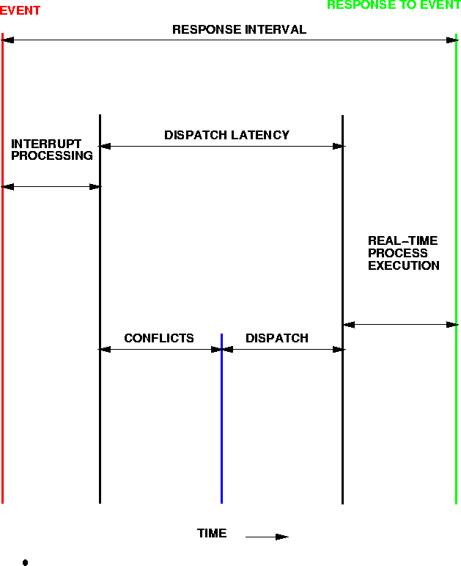
Real-time Scheduling - Dispatch Latency
Principles of Operating Systems - CPU Scheduling
‹#›
Notes:
‹#›

Slide 37
Scheduling Algorithm Evaluation
Deterministic Modeling
Takes a particular predetermined workload and defines the performance of each algorithm for that workload.
Too specific, requires exact knowledge to be useful.
Queuing Models and Queuing Theory
Use distributions of CPU and I/O bursts. Knowing arrival and service rates - can compute utilization, average queue length, average wait time, etc…
Little’s formula: n = λ×W
n is the average queue length, λ is the avg. arrival rate and W is the avg. waiting time in queue.
Other techniques: Simulations, Implementation
Principles of Operating Systems - CPU Scheduling
‹#›
Notes:
‹#›

