Slide 1
Types of data structures - Operations on data structures

Slide 2
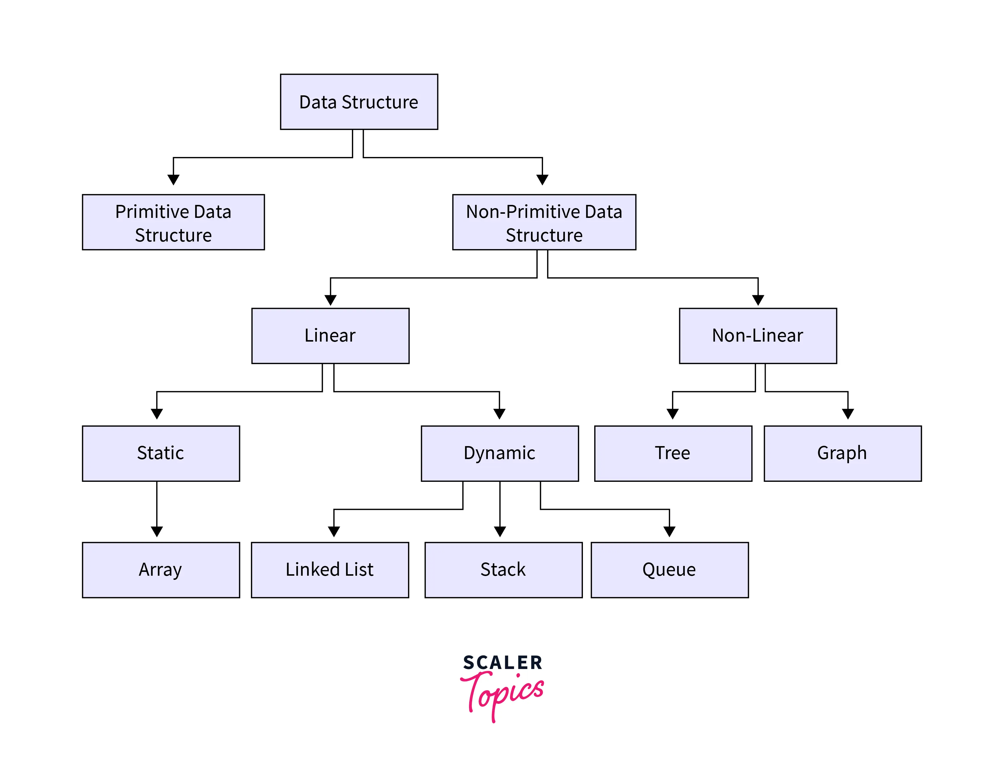
Types of data structures

Slide 3
Types of data structures
Data structures can be broadly categorized into two main types:
Primitive data structures.
Non-primitive data structures.

Slide 4
Primitive data structures
Primitive data structures are the fundamental or basic data types provided by a programming language. They are not composed of other data types and are used to represent simple values. Common examples of primitive data structures include:
a. Integer (int): Represents whole numbers, both positive and negative.
b. Floating-Point (float and double): Represents real numbers with decimal points.
c. Character (char): Represents individual characters.

Slide 5
d. Boolean (bool): Represents true or false values.
e. Enumerations (enum): Represents a set of named constant values.
f. Pointers: Represents memory addresses, often used for referencing other data structures.
Primitive data structures have a fixed size and memory representation, and their values are usually atomic and cannot be further decomposed into smaller data structures.

Slide 6
Non Primitive Data structure
Non-Primitive data structure is a data structure that allows you to store multiple data type values.
The non-primitive data structure is further classified into two parts i.e. linear data structure and non-linear data structure.
Linear data structures are considered sequential data structures and sequential data structures store elements in a sequence in the memory.
Some of the Examples: Linked List, Array, and Stack

Slide 7
The non-linear data structure is considered as a random type of data structure. Graphs and trees are examples of non-linear data structures.

Slide 8
Array
Array:- Array is a linear data structure that stores the elements of similar data types at a contiguous memory location.
Example: Refer to the below image for the example of the array data structure

Slide 9
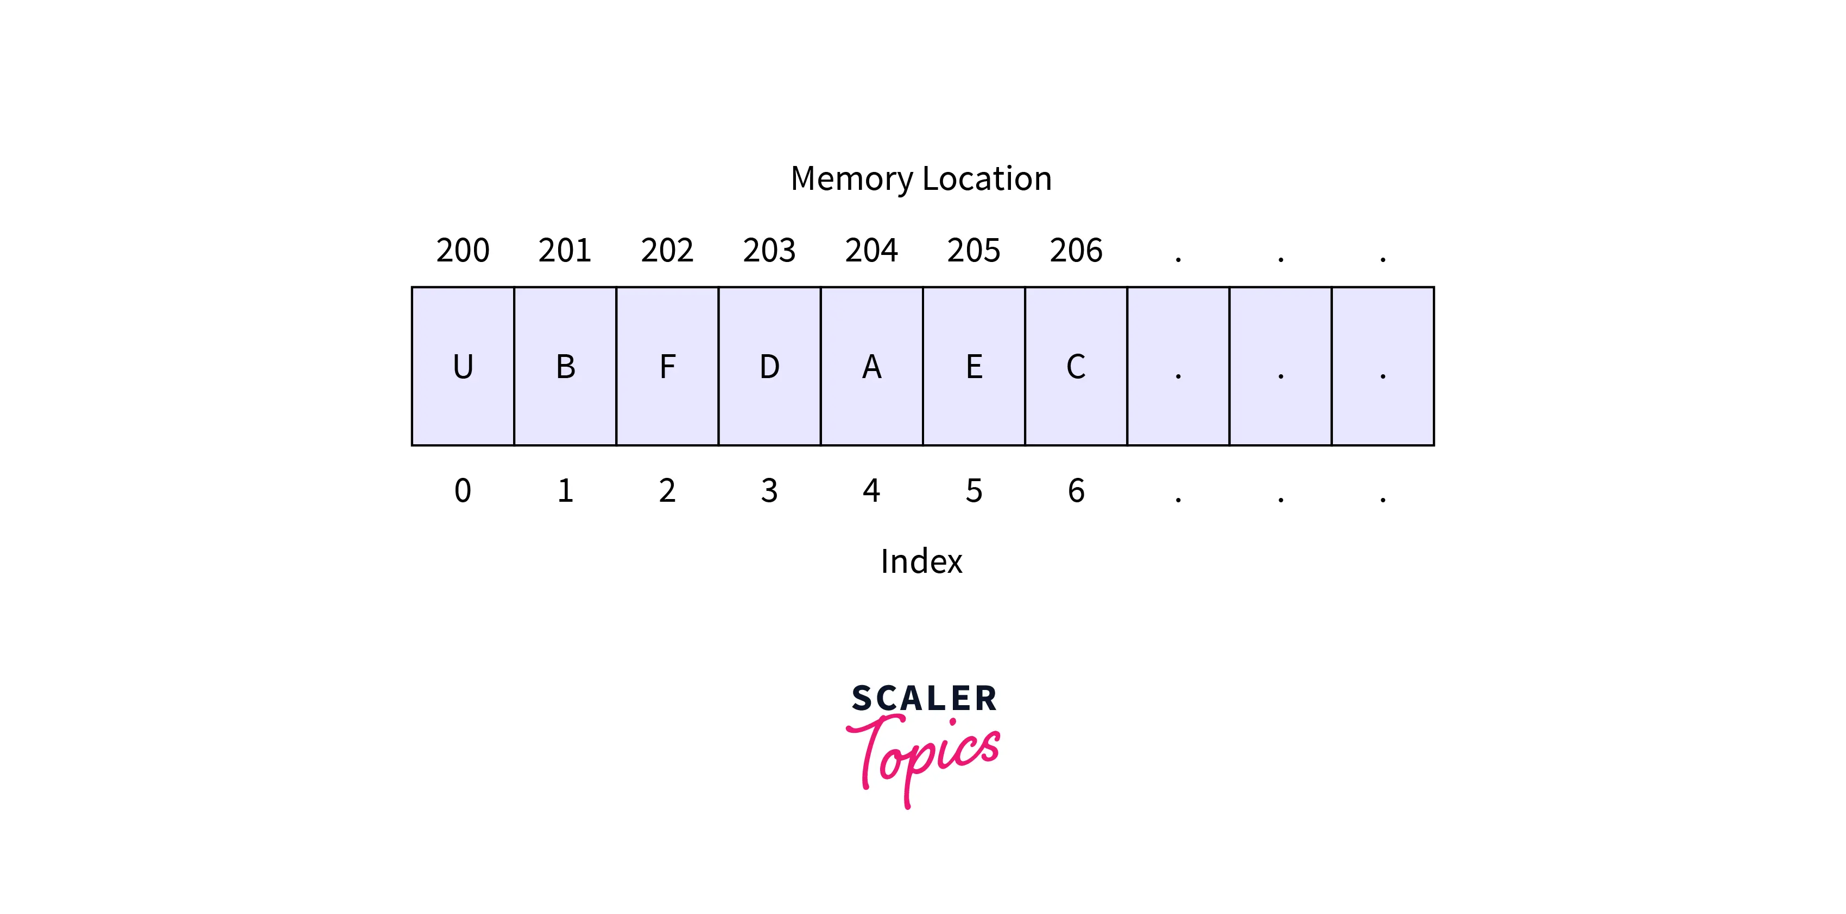

Slide 10
Arrays can be classified as one-dimensional array, two- dimensional array or multidimensional array.
One-dimensional Array: It has only one row of elements. It is stored in ascending storage location.
Two-dimensional Array: It consists of multiple rows and columns of data elements. It is also called as a matrix.
Multidimensional Array: Multidimensional arrays can be defined as array of arrays.
Multidimensional arrays are not bounded to two indices or two dimensions. They can include as many indices as required.

Slide 11
Limitations
Arrays are of fixed size.
Data elements are stored in contiguous memory locations which may not be always available.
Insertion and deletion of elements can be problematic because of shifting of elements from their positions. However, these limitations can be solved by using linked lists.

Slide 12
Storing list of data elements belonging to same data type.
Lack of Dynamic Behavior: Arrays are not dynamic data structures. Once their size is defined, it cannot be changed. To work with varying data sizes, you would need to create a new array and copy elements, which can be inefficient.
Contiguous Memory: Arrays store elements in contiguous memory locations, which means that all elements must be adjacent to one another. This limits their ability to efficiently insert or delete elements, as it often requires shifting elements to accommodate changes.

Slide 13
Operation on Array in data structure
Traverse − Print each element in the array one by one.
Insertion − At the specified index, adds an element.
Deletion − The element at the specified index is deleted.
Search − Uses the provided index or the value to search for an element.
Update − The element at the specified index is updated.

Slide 14
Display
int[] balance = { 300, 200, 100 }
Explain the statement above and write the code to display 200 only

Slide 15
In this Java code:
We define a class named Main.
The main method is the entry point of the Java program.
We declare an integer array balance with the specified values.
Instead of cout for output, we use System.out.println() to print the value at index 1 of the balance array.
Remember that Java uses different syntax and libraries compared to C++, so the code provided is a Java equivalent of your C++ code.

Slide 16
Code in Java
public class Main {
public static void main(String[] args) {
int[] Bal = { 300, 200, 100 };
System.out.println(Bal[1]);
}
}

Slide 17
Print out all the elements in this Array
int[] balance = { 300, 200, 100 };

Slide 18
public class DisplayArray {
public static void main(String[] args) {
int[] Bal = { 300, 200, 100 };
// Iterate through the array and print each element
for (int i = 0; i < Bal.length; i++) {
System.out.println(Bal[i]);
}
}
}

Slide 19
Write the algorithm of this
public class DisplayArray {
public static void main(String[] args) {
int[] Bal = { 300, 200, 100 };
// Iterate through the array and print each element
for (int i = 0; i < Bal.length; i++) {
System.out.println(Bal[i]);
}

Slide 20
public class DisplayArray {
Start
Initialize an integer array named Bal with values {300, 200, 100}.
Iterate through the elements of the Bal array using a "for" loop:
a. Initialize a loop control variable i to 0.
b. Check if i is less than the length of the Bal array using the condition i < Bal.length.
c. If the condition is true, execute the following steps:
i. Print the value of Bal[i] to the console using System.out.println(Bal[i]).
ii. Increment the loop control variable i by 1 using i++.

Slide 21
d. Repeat steps 3b and 3c until the condition i < Bal.length becomes false.
End
This algorithm initializes an array, iterates through its elements using a "for" loop, and prints each element to the console. The loop control variable i is used to access each element in the array, and the loop continues until all elements have been processed. The result is that the values of the array elements are displayed on separate lines in the console.

Slide 22
Traversing
Traversing is performed to display every element of data structure or to perform any operation on its element. Traversing is also known as iterating over the data structure.
Traversing operation is used to access elements of data structure or to perform some operation on elements.

Slide 23
Some common traversal techniques used in various data structures:
Linear Search: Linear search is used to traverse arrays or lists to find a specific element. It involves iterating through each element one by one until the target element is found or until the end of the data structure is reached.
For Loop: A for loop is commonly used for array or list traversal. It provides a structured way to iterate through elements by specifying the start, end, and step values. For example, for (int i = 0; i < N; i++) can be used to traverse an array of length N.
While Loop: While loops are used for traversing when the exact number of iterations is not known in advance. You iterate as long as a certain condition is met.

Slide 24
For-Each Loop: Many modern programming languages provide a for-each loop (e.g., for item in collection) that simplifies the traversal of collections by abstracting the index or iterator.
Recursion: Recursion can be used to traverse hierarchical data structures like trees and graphs. A function calls itself to traverse subtrees or subgraphs.

Slide 25
Two-Dimensional Array
A two-dimensional array, also known as a 2D array, is a collection of data elements arranged in a grid-like structure with rows and columns. Each element in the array is referred to as a cell and can be accessed by its row and column indices/indexes.
Int arr[4][5];
Size of this array:

Slide 26
Visualizing of the array
Int arr[4][5];
Rows=4
Cols= 5
This has form a matrix

Slide 27
How to Initialize Two Dimensional Array
Method
Int a [2][3]={{1,2,3,},{4,5,6}};
0
1
2
0
1 | 2 | 3
4 | 5 | 6
1

Slide 28
1D array elements can be printed array Elements?
1D array elements can be printed array using single for loop.
Int a [5] = {1,2,3,4};
for(i=0; i<5; i++)
{
System.out.println(a[5]);
}

Slide 29
2D array elements can be printed array using two nested for loops.
Int a [2][3]={{1,2,3,},
{4,5,6}};

Slide 30
public class Print2DArray {
public static void main(String[] args) {
int[][] a = {
{1, 2, 3},
{4, 5, 6}
};
// Loop through the rows
for (int i = 0; i < a.length; i++) {
// Loop through the columns within each row
for (int j = 0; j < a[i].length; j++) {
System.out.print(a[i][j] + " ");
}
System.out.println(); // Move to the next line after each row
}
}

Slide 31
Linked Lists
A linked list is a linear data structure, in which the elements are not stored at contiguous memory locations.
A Linked List is a linear data structure which looks like a chain of nodes, where each node is a different element. Unlike Arrays, Linked List elements are not stored at a contiguous location.

Slide 32
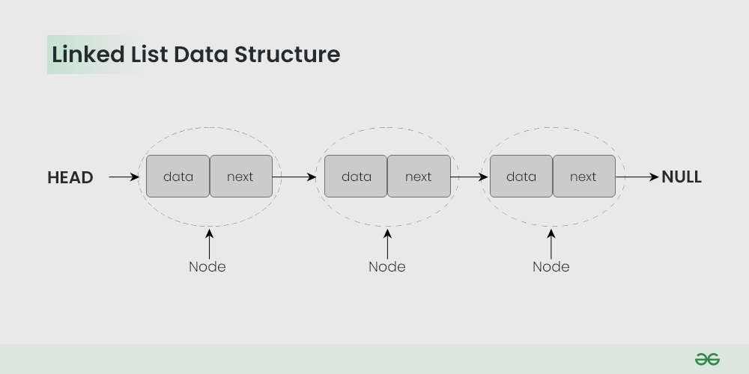

Slide 33
Why linked list data structure needed?
Dynamic Data structure: The size of memory can be allocated or de-allocated at run time based on the operation insertion or deletion.
Ease of Insertion/Deletion: The insertion and deletion of elements are simpler than arrays since no elements need to be shifted after insertion and deletion, Just the address needed to be updated.

Slide 34
Efficient Memory Utilization: As we know Linked List is a dynamic data structure the size increases or decreases as per the requirement so this avoids the wastage of memory.
Implementation: Various advanced data structures can be implemented using a linked list like a stack, queue, graph, hash maps, etc.

Slide 35
Disadvantages of Linked Lists

Slide 36
Disadvantages of Linked Lists
Memory usage: The use of pointers is more in linked lists hence, complex and requires more memory.
Accessing a node: Random access is not possible due to dynamic memory allocation.
Search operation costly: Searching for an element is costly and requires O(n) time complexity.
Traversing in reverse order: Traversing is more time-consuming and reverse traversing is not possible in singly linked lists.

Slide 37
Types of linked lists
There are mainly three types of linked lists:
Single-linked list
Double linked list
Circular linked list

Slide 38
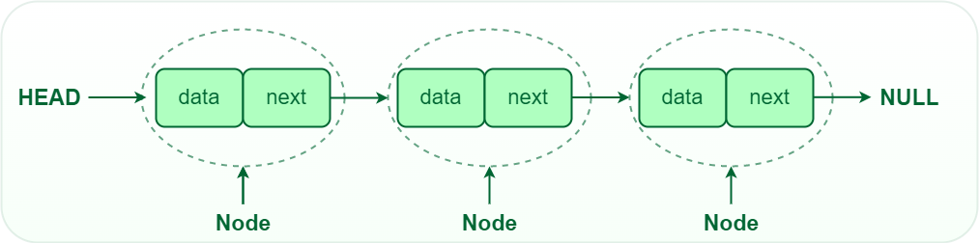
Single-linked list
In a singly linked list, each node contains a reference to the next node in the sequence. Traversing a singly linked list is done in a forward direction.

Slide 39
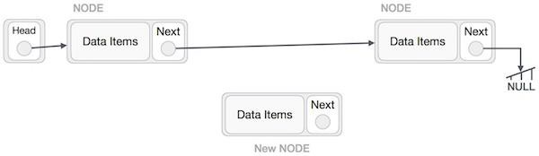
Insertion Operation
inserting a node B (NewNode), between A (LeftNode) and C (RightNode). Then point B.next to C −

Slide 40
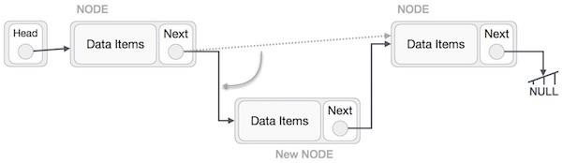
NewNode.next −> RightNode;

Slide 41
Create Single-linked list
To create a linked list, you need to define a node class and a linked list class to manage the list.

Slide 42
STEP 1 Define the Node Class
class Node {
int data;
Node next;
public Node(int data) {
this.data = data;
this.next = null;

Slide 43
Step 2: create a link to access the data and the next pointer of the node
public class Main {
public static void main(String[] args) {
// Create a single node
Node singleNode = new Node(42);
// Access the data and next pointer of the single node
System.out.println("Data: " + singleNode.data);
System.out.println("Next: " + singleNode.next);
}
}

Slide 44
// Method to add a new node at the beginning
public void push(int data) {
Node newNode = new Node(data);
newNode.next = head;
head = newNode;

Slide 45
}
// Method to print the linked list
public void printList() {
Node temp = head;
while (temp != null) {
System.out.print(temp.data + " ");
temp = temp.next;
}
}
}

Slide 46
Insertion at the Beginning:
To add a new node at the beginning of the linked list:
public void insertAtBeginning(int data) {
Node newNode = new Node(data);
newNode.next = head;
head = newNode;
}

Slide 47
Algorithm
1. START
2. Create a node to store the data
3. Check if the list is empty
4. If the list is empty, add the data to the node and assign the head pointer to it.
5 If the list is not empty, add the data to a node and link to the current head. Assign the head to the newly added node.
6. END

Slide 48
Insertion at the End
public void insertAtEnd(int data) {
// Create a new node with the given data
Node newNode = new Node(data);
// Check if the list is empty (head is null)
if (head == null) {
// If the list is empty, make the new node the head
head = newNode;
} else {
}
}

Slide 49
Node current = head;
while (current.next != null) {
current = current.next;
}
current.next = newNode;
}
}

Slide 50
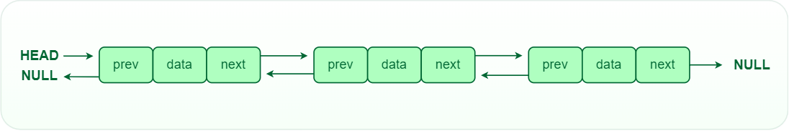
Double-linked list
In a doubly linked list, each node contains references to both the next and previous nodes. This allows for traversal in both forward and backward directions, but it requires additional memory for the backward reference.

Slide 51
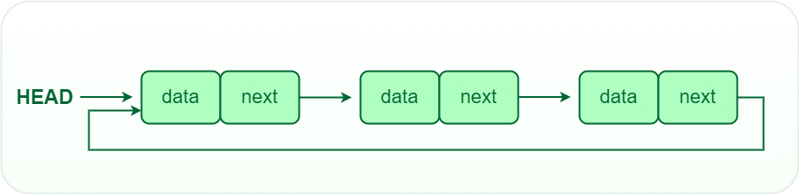
Circular linked list
In a circular linked list, the last node points back to the head node, creating a circular structure. It can be either singly or doubly linked.

Slide 52
Operations on Linked Lists
Insertion: Adding a new node to a linked list involves adjusting the pointers of the existing nodes to maintain the proper sequence. Insertion can be performed at the beginning, end, or any position within the list
Deletion: Removing a node from a linked list requires adjusting the pointers of the neighboring nodes to bridge the gap left by the deleted node. Deletion can be performed at the beginning, end, or any position within the list.
Searching: Searching for a specific value in a linked list involves traversing the list from the head node until the value is found or the end of the list is reached.

Slide 53
Stack
Stack is a linear data structure that follows a particular order in which the operations are performed. The order may be LIFO(Last In First Out) or FILO(First In Last Out).
LIFO implies that the element that is inserted last, comes out first and FILO implies that the element that is inserted first, comes out last.

Slide 54
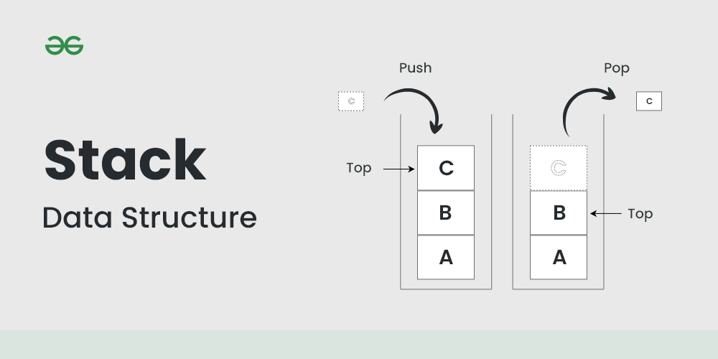

Slide 55
Advantages of Stack
Easy implementation: Stack data structure is easy to implement using arrays or linked lists, and its operations are simple to understand and implement.
Efficient memory utilization: Stack uses a contiguous block of memory, making it more efficient in memory utilization as compared to other data structures.
Fast access time: Stack data structure provides fast access time for adding and removing elements as the elements are added and removed from the top of the stack.

Slide 56
Helps in function calls: Stack data structure is used to store function calls and their states, which helps in the efficient implementation of recursive function calls.
Supports backtracking: Stack data structure supports backtracking algorithms, which are used in problem-solving to explore all possible solutions by storing the previous states.
Used in Compiler Design: Stack data structure is used in compiler design for parsing and syntax analysis of programming languages.
Enables undo/redo operations: Stack data structure is used to enable undo and redo operations in various applications like text editors, graphic design tools, and software development environments.

Slide 57
Disadvantages of Stack
Limited capacity: Stack data structure has a limited capacity as it can only hold a fixed number of elements. If the stack becomes full, adding new elements may result in stack overflow, leading to the loss of data.
No random access: Stack data structure does not allow for random access to its elements, and it only allows for adding and removing elements from the top of the stack. To access an element in the middle of the stack, all the elements above it must be removed.

Slide 58
Memory management: Stack data structure uses a contiguous block of memory, which can result in memory fragmentation if elements are added and removed frequently.
Not suitable for certain applications: Stack data structure is not suitable for applications that require accessing elements in the middle of the stack, like searching or sorting algorithms.
Stack overflow and underflow: Stack data structure can result in stack overflow if too many elements are pushed onto the stack, and it can result in stack underflow if too many elements are popped from the stack.

Slide 59
Recursive function calls limitations: While stack data structure supports recursive function calls, too many recursive function calls can lead to stack overflow, resulting in the termination of the program.

Slide 60
Basic operation on Push and Pop
Push:
Description: The "push" operation is used to add an element to the top of the stack.
How it works: When you "push" an element onto the stack, it becomes the new top element, and the stack size increases by one.
Key points:
The new element is added at the top of the stack.
It is the most recently added element.
Any element previously at the top of the stack is now below the new element.

Slide 61
Pop:
Description: The "pop" operation is used to remove the top element from the stack.
How it works: When you "pop" an element from the stack, the top element is removed, and the stack size decreases by one.
Key points:
The top element, which was added most recently, is removed.
The element below it (the one added before)becomes the new top element.
The removed element is typically returned or used in some way, depending on the application.

Slide 62
Creating a simple stack in Java
import the java.util.Stack class, which provides a basic stack implementation for integers.
Create a Stack object called stack to store integer values.
use the push method to add elements to the stack.

Slide 63
use the pop method to remove and return elements from the stack.
use the peek method to look at the top element without removing it.
Use the is Empty method to check if the stack is empty.

Slide 64
import java.util.Stack;
public class SimpleStackExample {
public static void main(String[] args) {
Stack<Integer> stack = new Stack<>();
// Push elements onto the stack
stack.push(1);
stack.push(2);
stack.push(3);

Slide 65
// Pop elements from the stack
int poppedElement = stack.pop();
System.out.println("Popped element: " + poppedElement);
// Peek at the top element without removing it
int topElement = stack.peek();
System.out.println("Top element: " + topElement);

Slide 66
// Check if the stack is empty
boolean isEmpty = stack.isEmpty();
System.out.println("Is the stack empty? " + isEmpty);
}
}

Slide 67
Application of stack in real life
1.Undo/Redo Functionality in Software: Many software applications, such as word processors, image editors, and web browsers, use stacks to implement undo and redo functionality. Each action is pushed onto the stack, allowing users to undo and redo their actions in reverse order.
2.Document or Paper Trays in Printers: Many printers have atrays that stack printed pages. The last page printed is the first to be removed from the tray.

Slide 68
CREATE A STACK TO ADD 1 2 3 IN JAVA AND DISPLAY THE OUTPUT

Slide 69
import java.util.Stack;
public class SimpleStackExample {
public static void main(String[] args) {
// Creating a stack
Stack<Integer> stack = new Stack<>();

Slide 70
// Pushing elements onto the stack
stack.push(1);
stack.push(2);
stack.push(3);
// Displaying the output
System.out.println("Stack elements:");
// Using enhanced for loop to iterate over the stack and print each element
for (Integer element : stack) {
System.out.println(element);
}
}
}

Slide 71
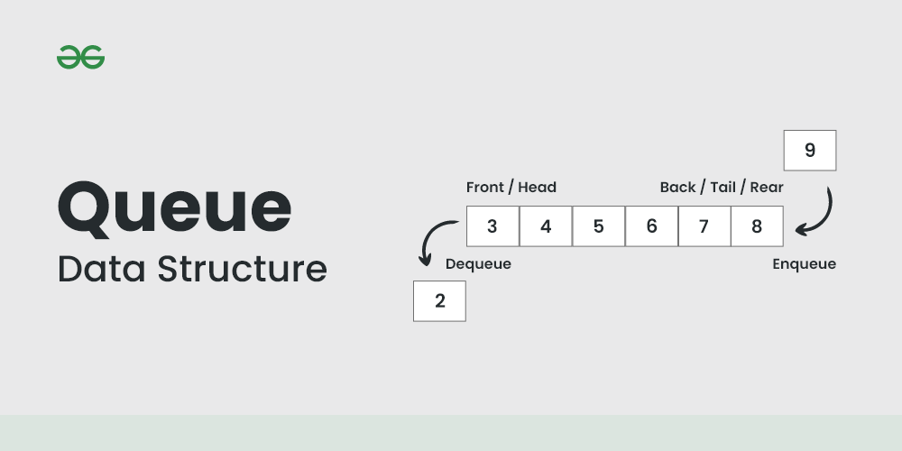
Queue
A Queue is defined as a linear data structure that is open at both ends and the operations are performed in First In First Out (FIFO) order.

Slide 72
Characteristics of Queue
Queue can handle multiple data.
We can access both ends.
They are fast and flexible.

Slide 73
Advantages of Queue
A large amount of data can be managed efficiently with ease.
Operations such as insertion and deletion can be performed with ease as it follows the first in first out rule.
Queues are useful when a particular service is used by multiple consumers.
Queues are fast in speed for data inter-process communication.
Queues can be used in the implementation of other data structures.

Slide 74
Real-time application of Queue
ATM Booth Line
Ticket Counter Line
Key press sequence on the keyboard
CPU task scheduling
Waiting time of each customer at call centers.

Slide 75
Disadvantages of Queue
The operations such as insertion and deletion of elements from the middle are time consuming.
Limited Space.
In a classical queue, a new element can only be inserted when the existing elements are deleted from the queue.
Searching an element takes O(N) time.
Maximum size of a queue must be defined prior.

Slide 76
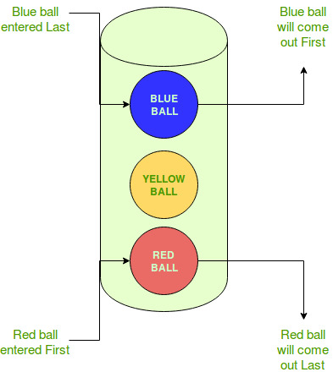
LIFO (Last-In-First-Out) approach in Programming
LIFO is an abbreviation for last in, first out. It is a method for handling data structures where the first element is processed last and the last element is processed first.

Slide 77
Where is LIFO used
Data Structures:
Certain data structures like Stacks and other variants of Stacks use LIFO approach for processing data.
Extracting latest information:
Sometimes computers use LIFO when data is extracted from an array or data buffer. When it is required to get the most recent information entered, the LIFO approach is used.

Slide 78
Types of Queue
Simple Queue or Linear Queue
Circular Queue
Priority Queue
Double Ended Queue (or Deque)

Slide 79
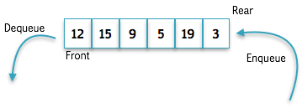
Simple Queue or Linear Queue
In Linear Queue, an insertion takes place from one end while the deletion occurs from another end. The end at which the insertion takes place is known as the rear end, and the end at which the deletion takes place is known as front end.

Slide 80
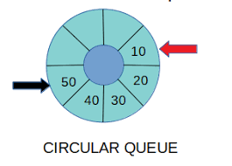
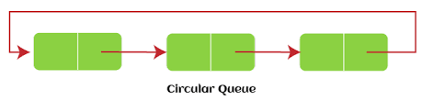
Circular Queue
In Circular Queue, all the nodes are represented as circular. It is similar to the linear Queue except that the last element of the queue is connected to the first element. It is also known as Ring Buffer, as all the ends are connected to another end.

Slide 81
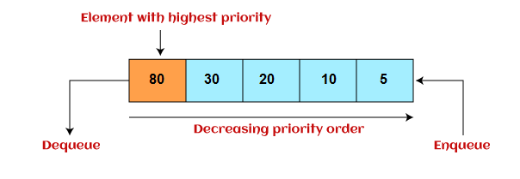
Priority Queue
It is a special type of queue in which the elements are arranged based on the priority. It is a special type of queue data structure in which every element has a priority associated with it.
Suppose some elements occur with the same priority, they will be arranged according to the FIFO principle.

Slide 82
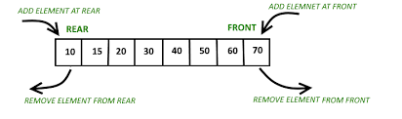
Deque or Double Ended
Deque or Double Ended Queue is a type of queue in which insertion and removal of elements can either be performed from the front or the rear. Thus, it does not follow FIFO rule (First In First Out).

Slide 83
Creates a queue, adds elements 1, 2, and 3 to it, and then displays the elements in the queue

Slide 84
import java.util.LinkedList;
import java.util.Queue;
public class SimpleQueueExample {
public static void main(String[] args) {
// Creating a queue
Queue<Integer> queue = new LinkedList<>();

Slide 85
// Adding elements to the queue
queue.offer(1);
queue.offer(2);
queue.offer(3);
// Displaying the elements in the queue
System.out.println("Queue elements: " + queue);
}
}
When you run this program, the output will be:
Queue elements: [1, 2, 3]

Slide 86
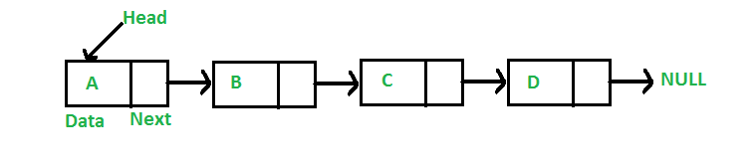
Given a singly linked list. The task is to find the sum of nodes of the given linked list and write the Algorithm
Input: 7->6->8->4->1

