Slide 1
COURSE Format
ABDM3314 Entrepreneurship
COURSEWORK = 60%
Final Exam = 40%
  Total = 100%
EXAM STRUCTURE
3 HOURS DURATION
Section A - Case study = 25 marks
Section B - Answer 3 out of 4 Q’s
= 25 marks each
1-<number>

Slide 2
REFERENCE/TEXT:
ABDM3314 Entrepreneurship
Barringer, R. Bruce & R. Duane Ireland 2012, Entrepreneurship,
4th edn, New Jersey: Pearson International Edition.
Schaper, M, Volery, T, Weber, P & Lewis, K 2011, Entrepreneurship and Small Business,
3rd Asia-Pacific edn, Wiley.
1-<number>

Slide 3

ABDM3314 Entrepreneurship
Lecture #1 & 2
Chapter 1
Introduction to Entrepreneurship
Bruce R. Barringer
R. Duane Ireland
1-<number>

Slide 4
Chapter Objectives
1 of 2
Explain entrepreneurship and discuss its importance.
Describe corporate entrepreneurship and its use in established firms.
Discuss three main reasons people decide to become entrepreneurs.
Identify four main characteristics of successful entrepreneurs.
Explain five common myths regarding entrepreneurship.
2-<number>

Slide 5
Chapter Objectives
2 of 2
Explain how entrepreneurial firms differ from salary-substitute and lifestyle firms.
Discuss the changing demographics of entrepreneurs in the United States.
Discuss the impact of entrepreneurial firms on economies and societies.
Identify ways in which large firms benefit from the presence of smaller entrepreneurial firms.
Explain the entrepreneurial process.
2-<number>

Slide 6
Introduction to Entrepreneurship
According to the 2007 GEM
study, 9.6% of Americans
are actively engaged in
starting a business or are
the owner/manager of a
business that is less than
three years old.
There is tremendous interest in entrepreneurship in the U.S. and around the world.
1-<number>

Slide 7
Indications of Increased Interest in Entrepreneurship
Books
  Amazon.com lists over 45,000 books dealing with entrepreneurship and 118,000 focused on small business.
College Courses
  In 1985, there were about 250 entrepreneurship courses offered across all colleges in the United States.
  Today, more than 5,000 entrepreneurship courses are offered in two-year and four-year colleges and universities in the United States.
1-<number>

Slide 8
What is Entrepreneurship?
Academic Definition (Stevenson & Jarillo)
  Entrepreneurship is the process by which individuals pursue opportunities without regard to resources they currently control.
Venture Capitalist (Fred Wilson)
  Entrepreneurship is the art of turning an idea into a business.
Explanation of What Entrepreneurs Do
  Entrepreneurs assemble and then integrate all the resources needed –the money, the people, the business model, the strategy—needed to transform an invention or an idea into a viable business.
1-<number>

Slide 9
Towards a definition of entrepreneurship
Entrepreneurship:
  The process brought about by individuals of identifying new opportunities and converting them into marketable products or services
        Schaper 2011

Slide 10
Corporate Entrepreneurship
1 of 2
Corporate Entrepreneurship
  Is the conceptualization of entrepreneurship at the firm level.
  All firms fall along a conceptual continuum that ranges from highly conservative to highly entrepreneurial.
  The position of a firm on this continuum is referred to as its entrepreneurial intensity.
1-<number>

Slide 11
Corporate Entrepreneurship
2 of 2
Entrepreneurial Firms
Conservative Firms
Proactive
Innovative
Risk taking
Take a more “wait and see”
posture
Less innovative
Risk adverse
1-<number>

Slide 12

Why Become an Entrepreneur?
The three primary reasons that people become entrepreneurs and start their own firms
Desire to be their own boss
Desire to pursue their
own ideas
Financial rewards
1-<number>

Slide 13
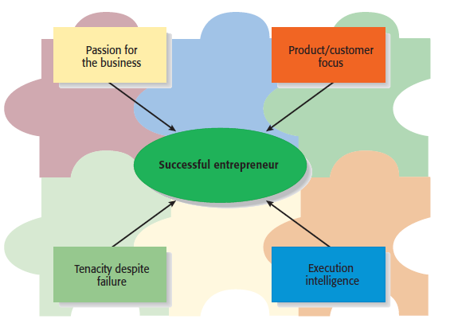
Characteristics of Successful Entrepreneurs
1 of 3
Four Primary Characteristics
1-<number>

Slide 14
Characteristics of Successful Entrepreneurs
2 of 3
Passion for the Business
  The number one characteristic shared by successful entrepreneurs is a passion for the business.
  This passion typically stems from the entrepreneur’s belief that the business will positively influence people’s lives.
Product/Customer Focus
  A second defining characteristic of successful entrepreneurs is a product/customer focus.
  An entrepreneur’s keen focus on products and customers typically stems from the fact that most entrepreneurs are, at heart, craftspeople.
1-<number>

Slide 15
Characteristics of Successful Entrepreneurs
3 of 3
Tenacity Despite Failure
  Because entrepreneurs are typically trying something new, the failure rate is naturally high.
  A defining characteristic for successful entrepreneurs’ is their ability to persevere through setbacks and failures.
Execution Intelligence
  The ability to fashion a solid business idea into a viable business is a key characteristic of successful entrepreneurs.
1-<number>

Slide 16
Common Myths About Entrepreneurs
1 of 6
Myth 1: Entrepreneurs Are Born Not Made
  This myth is based on the mistaken belief that some people are genetically predisposed to be entrepreneurs.
  The consensus of many studies is that no one is “born” to be an entrepreneur; everyone has the potential to become one.
  Whether someone does or doesn’t become an entrepreneur, is a function of the environment, life experiences, and personal choices.
1-<number>

Slide 17
Common Myths About Entrepreneurs
2 of 6
Although no one is “born” to be an entrepreneur, there are common traits and characteristics of successful entrepreneurs
Achievement motivated
Alert to opportunities
Creative
Decisive
Energetic
Has a strong work ethic
Is a moderate risk taker
Is a networker
Lengthy attention span
Optimistic disposition
Persuasive
Promoter
Resource assembler/leverager
Self-confident
Self-starter
Tenacious
Tolerant of ambiguity
Visionary
1-<number>

Slide 18
Common Myths About Entrepreneurs
3 of 6
Myth 2: Entrepreneurs Are Gamblers
  Most entrepreneurs are moderate risk takers.
  The idea that entrepreneurs are gamblers originates from two sources:
    Entrepreneurs typically have jobs that are less structured, and so they face a more uncertain set of possibilities than people in traditional jobs.
    Many entrepreneurs have a strong need to achieve and set challenging goals, a behavior that is often equated with risk taking.
1-<number>

Slide 19
Common Myths About Entrepreneurs
4 of 6
Myth 3: Entrepreneurs Are Motivated Primarily by Money.
  While it is naïve to think that entrepreneurs don’t seek financial rewards, money is rarely the reason entrepreneurs start new firms.
  In fact, some entrepreneurs warn that the pursuit of money can be distracting.
1-<number>

Slide 20
Common Myths About Entrepreneurs
5 of 6
Myth 4: Entrepreneurs Should Be Young and Energetic.
  The most active age for business ownership is 35 to 45 years old.
  While it is important to be energetic, investors often cite the strength of the entrepreneur as their most important criteria in making investment decisions.
    What makes an entrepreneur “strong” in the eyes of an investor is experience, maturity, a solid reputation, and a track record of success.
    These criteria favor older rather than younger entrepreneurs.
1-<number>

Slide 21
Common Myths About Entrepreneurs
Myth 5: Entrepreneurs love the spotlight
-the vast majority of them do not attract public attention
-they are working on proprietary products and services, avoid public notice.
1-<number>

Slide 22
The key elements of entrepreneurship
There are five generally agreed conditions that are necessary for entrepreneurship to occur:
  an individual (the entrepreneur)
  a market opportunity
  adequate resources
  a business organisation
  a favourable environment

Slide 23
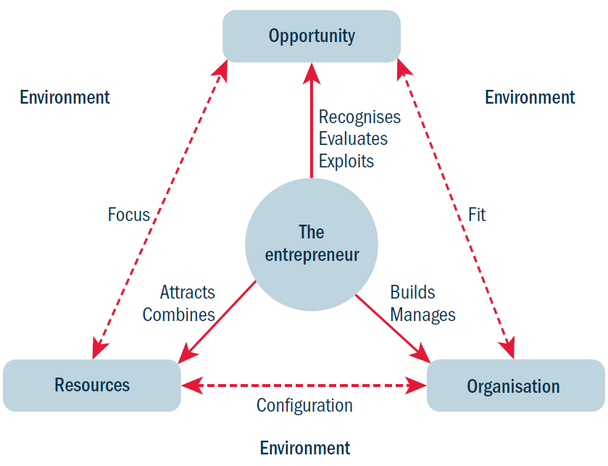
The key elements
of entrepreneurship
Figure 1.1: The key elements of entrepreneurship

Slide 24
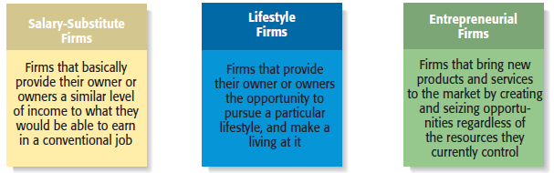
Types of Start-Up Firms
1-<number>

Slide 25
Triggers and barriers to start-ups
Triggers
Material rewards:
  make more money; keep the proceeds of the business; reward according to effort
Creativity:
  use my own talents; a desire to create something; control from begin to end; passion about what I am doing
Desire for autonomy:
  be my own boss; work my own hours; work with people I like, at a location of my choice

Slide 26
Triggers and barriers to start-ups
Barriers
Lack of resources:
  weak management and marketing skills; lack of information on start-ups; lack of finance
Compliance costs:
  high taxes and costs associated with compliance to government legislation
Hard reality:
  setting up a venture is harder than initially expected; uncertainty; fear of failure

Slide 27
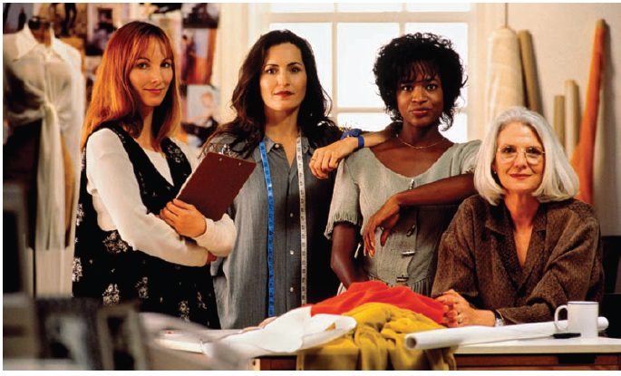
Changing Demographics of Entrepreneurs
1 of 3
Women Entrepreneurs
There were 6.2 million women-
owned businesses in 2002 (the
most recent statistics available)
This number was up 20% from
1997.
1-<number>

Slide 28
Changing Demographics of Entrepreneurs
2 of 3
Minority Entrepreneurs
Senior Entrepreneurs
Minorities owned roughly 18%
of U.S. businesses in 2002.
This number was up 10% from
1997.
Although statistics are not kept
on senior entrepreneurs, there is
strong evidence that the number
of older people choosing
entrepreneurial careers is rapidly
increasing.
1-<number>

Slide 29
Changing Demographics of Entrepreneurs
3 of 3
Young Entrepreneurs
Interest among young people in entrepreneurial careers is
growing.
According to a Gallop study, 7 out of 10 high school students
want to start their own business.
Over 2,000 two-year and four-year colleges and universities
offer entrepreneurship courses.
3-<number>

Slide 30
The risks of a career in entrepreneurship
There are 4 types of risks to consider before embracing a career in entrepreneurship:
  financial risks
  career risks
  social risks
  health risks

Slide 31
Financial risks
Large amounts of own money have to be invested
Borrowing funds from bankers, venture capitalists, or partners can reduce financial risks
Legal structures can help to minimise financial risks

Slide 32
Career risks
Questions about (re-)employment after an eventual failure must be considered
This risk is particularly acute for well-paid specialists and people close to retirement
Risks can be minimised by launching a business on a part-time basis

Slide 33
Social risks
Starting a business venture requires much of the entrepreneur’s energy and time
The decision to set up a venture should therefore involve the family to reduce conflict potential
Another risk is linked to the (negative) image of failed entrepreneurs like in Singapore — hence the kia siu attitude — ‘afraid to lose’

Slide 34
Health risks
There is evidence that entrepreneurs experience higher job stress and psychosomatic health problems than other people
Would-be entrepreneurs should make sure that their health can cope with the demands and challenges of starting and running a business

Slide 35
Economic Impact of Entrepreneurial Firms
Innovation
  Is the process of creating something new, which is central to the entrepreneurial process.
  Small firms are twice as innovative per employee as large firms.
Job Creation
  In the past two decades, economic activity has moved in the direction of smaller entrepreneurial firms, which may be due to their unique ability to innovate and focus on specialized tasks.
1-<number>

Slide 36
Entrepreneurial Firms’ Impact on Society and Larger Firms
Impact on Society
  The innovations of entrepreneurial firms have a dramatic impact on society.
  Think of all the new products and services that make our lives easier, enhance our productivity at work, improve our health, and entertain us in new ways.
Impact on Larger Firms
  Many entrepreneurial firms have built their entire business models around producing products and services that help larger firms become more efficient and effective.
1-<number>

Slide 37
The Entrepreneurial Process
The Entrepreneurial Process Consists of Four Steps
Step 1: Deciding to become an entrepreneur.
Step 2: Developing successful business ideas.
Step 3: Moving from an idea to an entrepreneurial firm.
Step 4: Managing and growing the entrepreneurial firm.
1-<number>

Slide 38
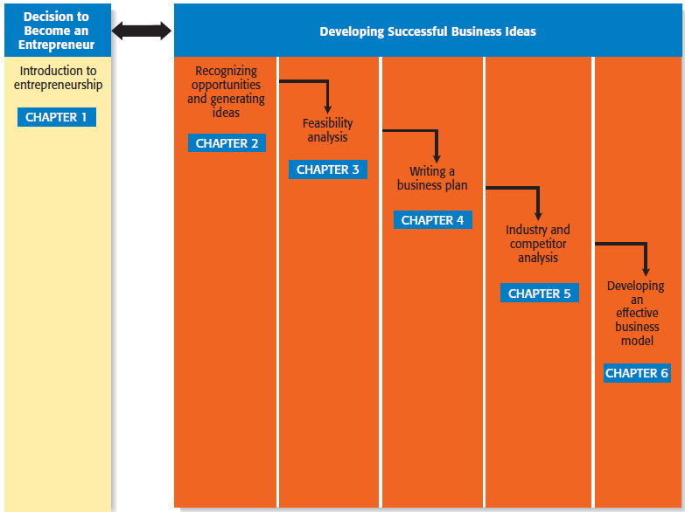
Steps in the Entrepreneurial Process
1 of 2
Step 1
Step 2
Developing Successful Business Ideas
1-<number>

Slide 39
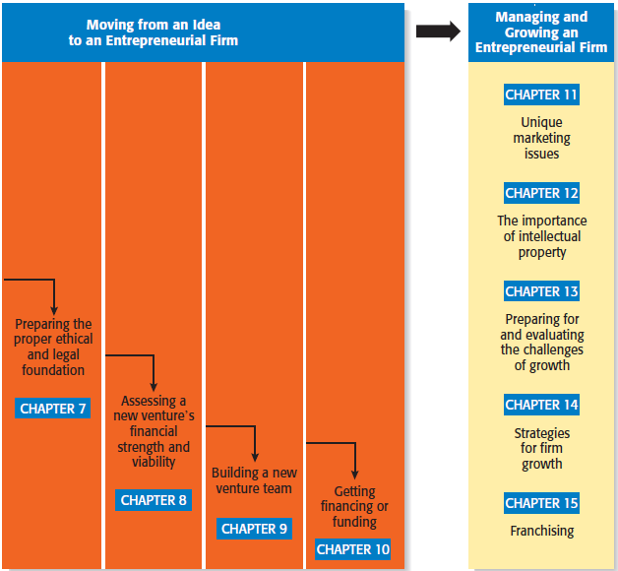
Steps in the Entrepreneurial Process
2 of 2
Step 3
Step 4
1-<number>

