Slide 1
Entrepreneurship : Find and Test your business ideas
Learning Outcomes:
- Discover you strength :How to understand yourself (who you are would lead you the best possible business).
How to assess the ideas you have ( great opportunities or just ideas) or eliminate ideas that do not have heart or head)
Create a micro plan to test your opportunity. (test using social media allows you to be very targeted –
Figuring out how to increase the odds of making a winning business model by testing different headlines

Slide 2
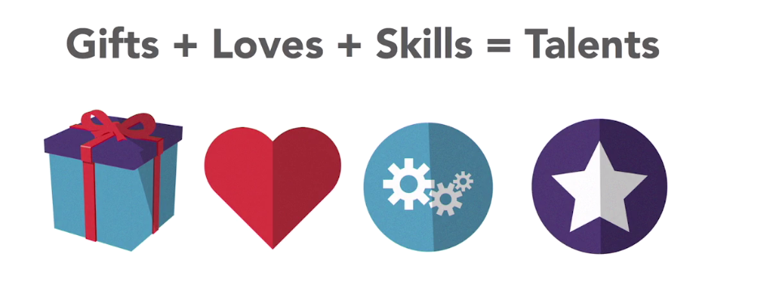
Model to discover oneself

Slide 3
Gifts : are things you were born to do
Things you love: What are thinks you like to do for fun ?
Skills : Knowledge you have acquired over time either through learning or apprenticeship .

Slide 4
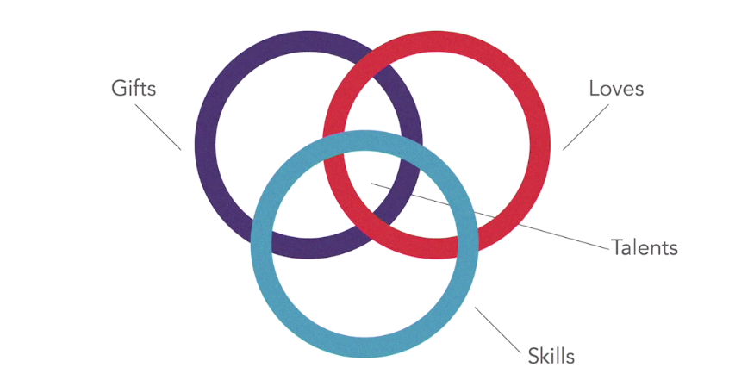
How do them came together ?

Slide 5
When there is something that is mention multiple times in all the three categories that is an excellent sign that you have a talent in that area.
NB: you must focus your business idea generation around that talent.
( that is a best start point)
Conclusion : Talents are about you and needs are what other people want.
The best entrepreneurs cultivate an awareness of the world around them and the needs other people have.

Slide 6
Eg : moving to a new area and realizing that there not dry cleaning services around ….. Thus is a need that can exist in a market place. ( this could be a good business idea).
NB: The main idea is to discover the pains (needs) other people have.
…… use worksheet ………………..

Slide 7
Series of questions to explore
What is missing in your day ?
What is too difficult for you ?
What are things other people are asking to do or give ?
What are the business annoyances ? (things that happen on regular basis that drive you crazy)
What are the things you do that the market buys on regular basis ? ( the kind of businesses that revolve around your talent)

Slide 8
Use Fill the brainstorm worksheet ………………( Get 10 new ideas)
Let select the top best 5 ideas out of the 10 using the head, heart worksheet.
Let us start with the head column (check the box on any idea that makes sense or logical
Let us check on the heart ( how to you feel about it ? Idea that is exciting , interesting or the ones you are passionate about.
Eliminate any idea that does not have heart or head.
Ranking the ideas left.

Slide 9
Evaluation of ideas
Opportunity factors : these are the principles that combine together lead to an actually successful business (they signal a good business opportunity):
1- Demand (how much does the market actually wants this products or services ?)
2- Expertise (the know how in the industry )
3- Resources ( things that are necessary to create a product or a service : money, equipment, materials )

Slide 10
Cont…….
4- Profitability ( How can we make money in the business ? Looking the price and the cost differential and make sure there is enough money to be made)
5- Distribution ( How to get the product into people hands ? You infrastructure and connection to achieve that)
6- Proprietary Advantage ( what make the entrepreneur unique in terns of a patent, a trademark or a process)

Slide 11
Discussion on the opportunity factors
Demand : ( how many people can buy the product or service – the market size-----
DEMAND CONSIDERATION:
1- Who are they ? ( Are we selling to People or business ? Women ? Men , Children , their age group, taste)
2- Where are they– customers---- ? ( Geography--- what city or region please do not sell to the entire world rather focus on your geography)
3- How many of these people or business exist (use tool on the social media to check this : LinkedIn to run a test add

Slide 12
Exploration of expertise
Do you have the necessary expertise ? Let us gauge (measure) your expertise.
1- Identification of technical abilities or skills required for the business
( eg : sales skill, web design , legal etc… )
2- Assess yourself on these skills from 0 to 10 on each of the required skills) 0= no clue to do it and 10= a master at it.--- be honest about the assessment -----
3- Highlight the skills below 7 ( signs that you that have the capability to do the business ---- problem). This does not stop the idea (hire someone, outsource your idea or team up with some with the skill)

Slide 13
Cont…
Nb: look for a skill required in the person you are teaming up with.
It is advisable to hire people instead of partnering with them (giving up equity).

Slide 14
Resources
Do you have enough money to start the business – how much do you need ? Do you best guess and multiply that guess by two ( everything is more expensive than you think I would be )
- Where is the money coming from ( loan , from a friend ?
How much money do you to ran the business for the first 6 months ? Assuming no profit is coming in --- ( most businesses need about 6 months ramp-up time)
Assignment – resource worksheet --

Slide 15
Do you have the material you to start the business ? Do you have access to them ? If not where are you going to get them ?
Do you have the equipment you need ?
Is there any other resources we need and we have thought about yet ?

