Slide 1
Mobile app development with flutter
Flutter is an open-source UI toolkit developed by Google that is used to build, network, and integrate apps from a single code base. Following are the steps that would take you through the process of developing, testing and deploying a mobile application.

Slide 2
steps
Set Up the Development Environment
Create a New Flutter Project
Build your app's interface by defining Widgets
Implement application logic
Add functionality and features
Test your application
Debug and Optimize
Build and Deploy

Slide 3
Installing flutter in windows
Step 1 − Go to URL, https://flutter.dev/docs/get-started/install/windows and download the latest Flutter SDK.
Step 2 − Unzip the zip archive in a folder, say C:\flutter\
Step 3 − Update the system path to include flutter bin directory.
Step 4 − Flutter provides a tool, flutter doctor to check that all the requirement of flutter development is met.
Step 6 − Install the latest Android SDK, if reported by flutter doctor
Step 7 − Install the latest Android Studio, if reported by flutter doctor
Step 8 − Start an android emulator or connect a real android device to the system.
Step 9 − Install Flutter and Dart plugin for Android Studio. It provides startup template to create new Flutter application, an option to run and debug Flutter application in the Android studio itself, etc.

Slide 4
Creating app in android studio
Step 1 − Open Android Studio
Step 2 − Create Flutter Project. For this, click File → New → New Flutter Project.
Step 3 − Select Flutter Application. For this, select Flutter Application and click Next
Step 4 − Configure the application as below and click Next.
Project name: hello_app
Flutter SDK Path: <path_to_flutter_sdk>
Project Location: <path_to_project_folder>
Description: Flutter based hello world application
Step 5 − Configure Project.
Set the company domain as flutterapp.tutorialspoint.com and click Finish.
Step 6 − Enter Company domain.

Slide 5
Components of the structure
android − Auto generated source code to create android application
ios − Auto generated source code to create ios application
lib − Main folder containing Dart code written using flutter framework
ib/main.dart − Entry point of the Flutter application
test − Folder containing Dart code to test the flutter application
test/widget_test.dart − Sample code
.gitignore − Git version control file
.metadata − auto generated by the flutter tools
.packages − auto generated to track the flutter packages
.iml − project file used by Android studio
pubspec.yaml − Used by Pub, Flutter package manager
pubspec.lock − Auto generated by the Flutter package manager, Pub
README.md − Project description file written in Markdown format

Slide 6
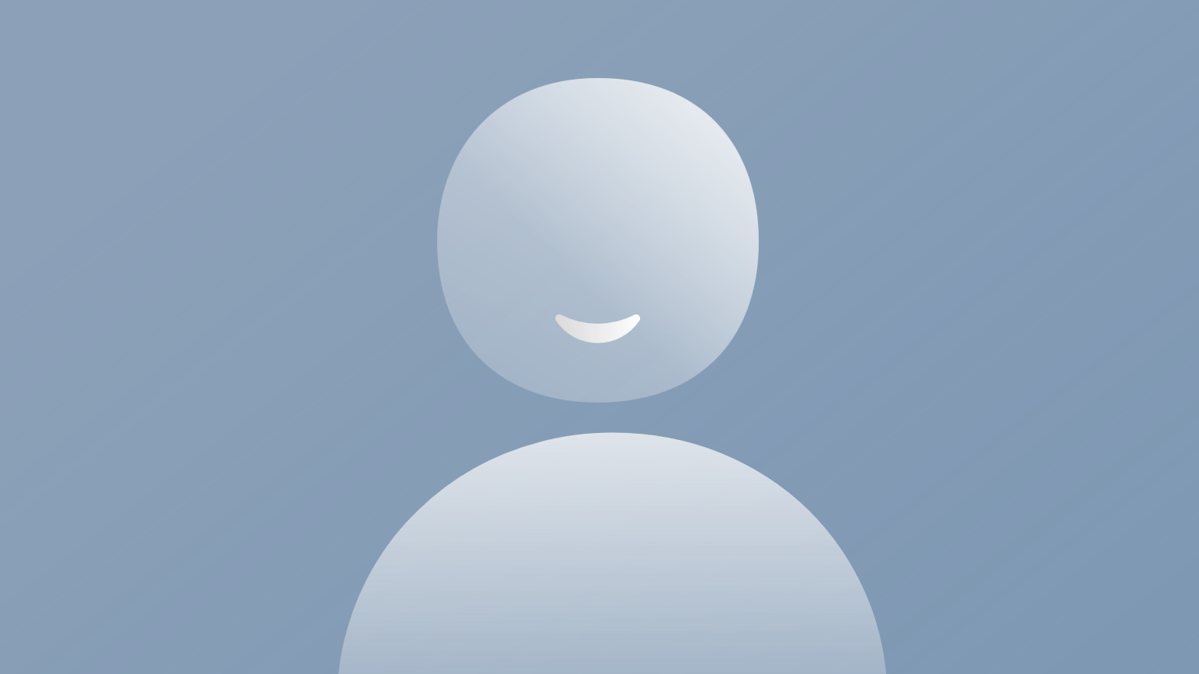
Flutter architecture app
Widgets
Gestures
Concept of State
Layers

Slide 7
widgets
The core concept of the Flutter framework is In Flutter, Everything is a widget.
Widgets are basically user interface components used to create the user interface of the application.
Widgets are the primary component of any flutter application.
It acts as a UI for the user to interact with the application.
Any flutter application is itself a widget that is made up of a combination of widgets
In Flutter, the application is itself a widget.
The application is the top- level widget and its UI is build using one or more children (widgets), which again build using its children widgets.
This composability feature helps us to create a user interface of any complexity.

Slide 8
In a standard application, the root defines the structure of the application followed by a Material App widget which basically holds its internal components in place.
This is where the properties of the UI and the application itself is set.
The Material App has a Scaffold widget that consists of the visible components (widgets) of the application.
The Scaffold has two primary properties namely the body and appbar.
It holds all the child widgets and this is where all its properties are defined

Slide 9
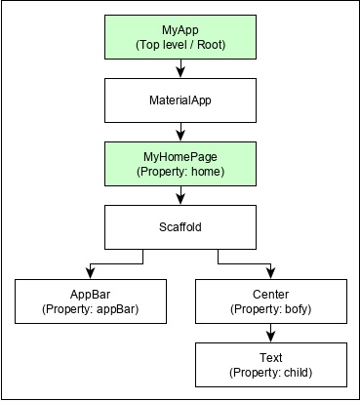

Slide 10
Important points
MyApp is the user created widget and it is build using the Flutter native widget, MaterialApp.
MaterialApp has a home property to specify the user interface of the home page, which is again a user created widget, MyHomePage.
MyHomePage is build using another flutter native widget, Scaffold
Scaffold has two properties – body and appBar
body is used to specify its main user interface and appBar is used to specify its header user interface
Header UI is build using flutter native widget, AppBar and Body UI is build using Center widget.
The Center widget has a property, Child, which refers the actual content and it is build using Text widget.

Slide 11
Description of the widgets used are as follows
Scaffold – Implements the basic material design visual layout structure.
App-Bar – To create a bar at the top of the screen.
Text To write anything on the screen.
Container – To contain any widget.
Center – To provide center alignment to other widgets.

Slide 12
gestures
Flutter widgets support interaction through a special widget, GestureDetector.
GestureDetector is an invisible widget having the ability to capture user interactions such as tapping, dragging, etc., of its child widget.
Many native widgets of Flutter support interaction through the use of GestureDetector.
We can also incorporate interactive feature into the existing widget by composing it with the GestureDetector widget.
We will learn the gestures separately in the upcoming chapters.

Slide 13
Concept of state
Flutter widgets support State maintenance by providing a special widget, StatefulWidget. Widget needs to be derived from StatefulWidget widget to support state maintenance and all other widget should be derived from StatefulWidget.
The states are nothing but data objects.
Flutter widgets are reactive in native.
This is similar to reactjs and StatefulWidget will be auto re- rendered whenever its internal state is changed.
The re-rendering is optimized by finding the difference between old and new widget UI and rendering only the necessary changes

Slide 14
layers
The most important concept of Flutter framework is that the framework is grouped into multiple category in terms of complexity and clearly arranged in layers of decreasing complexity.
A layer is build using its immediate next level layer.
The top most layer is widget specific to Android and iOS.
The next layer has all flutter native widgets.
The next layer is Rendering layer, which is low level renderer component and renders everything in the flutter app.
Layers goes down to core platform specific code

Slide 15
