Slide 1
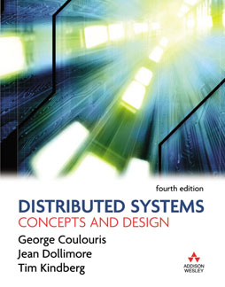

Distributed Systems:
Introduction

Slide 2
Overview of chapters
Introduction
  Ch 1: Characterization of distributed systems
  Ch 2: System models
Coordination models and languages
General services
Distributed algorithms
Shared data
Building distributed services

Slide 3
Introduction: Overview
Definitions
Examples
Resource sharing and the Web
Types of concurrency
Challenges
Architectural models
Fundamental Models
Summary

Slide 4
Definitions
Distributed system =
  Hardware or software components,
  Network
  Communication, coordination by message passing.
Consequences:
  Concurrency
  No global clock
  Independent failures
Motivation
  Resource sharing
Notes:
Kan veel korter

Slide 5
Definitions (cont.)
Distributed algorithm =
  collection of cooperating algorithms
  using message passing
  examples:
    mutual exclusion: to prevent different processes to use the same resource simultaneously

Slide 6
Overview
Definitions
Examples
Resource sharing and the Web
Types of concurrency
Challenges
Architectural models
Fundamental Models
Summary

Slide 7
Examples
Examples of distributed systems:
  Internet & intranets
  Distributed UNIX
  Mobile & ubiquitous computing
  Commercial applications
History

Slide 8
Example 1: Internet
intranet

ISP



backbone
satellite link
desktop computer:
server:
network link:

Slide 9
Example 1: Internet (cont.)
= A vast interconnected collection of computer networks
  collection of intranets connected by backbones
ISPs: connectivity + services
Services: WWW, Email, file transfer

Slide 10
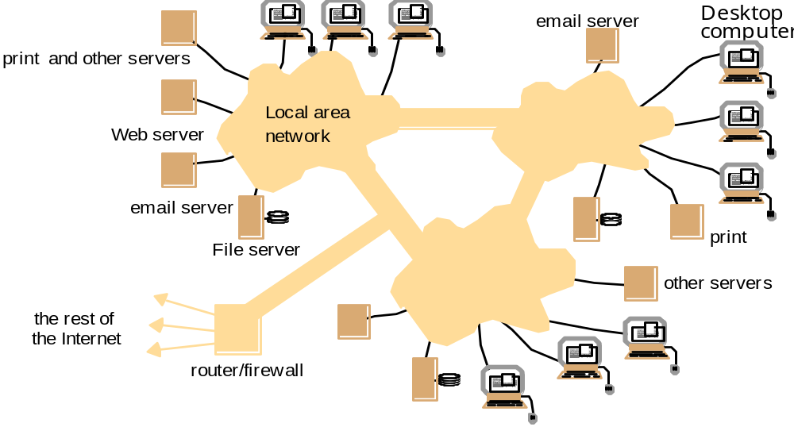
Example 1: Intranets
LAN
LAN
LAN

Slide 11
Example 1: Intranets (cont.)
= portion of internet
  A collection of LAN’s connected through backbones
  Connected to internet through routers
  Separate administration
  Local security policies
Motivation
  Internet applications: WWW, Email, file transfer
  More resource sharing
    Sharing files, printers, databases,
    Avoiding the installation of software through services over the intranet (using “thin clients”)
Firewall: filtering messages at router

Slide 12
Example 2: Distributed Unix
Origin: Bell labs, 1975
Interprocess communication: BSD UNIX
Distributed operating system =
Operating system of
  a collection of autonomous computers
  linked by computer network
  equipped with distributed software
  to …..
A technical
achievement !
create for the users a single integrated computing facility

Slide 13
Example 2: Distributed Unix (cont)
wide spread components (SUN license)
  Remote Procedure Calling (RPC)
  Network File System (NFS)
  Network Information Service (NIS)

Slide 14
Example 2: Distributed Unix (cont)
*
Applied research
  remove limitations of original UNIX
  improve scaling
Result ..
  new generation of distributed systems
  Examples: Mach, Amoeba, Andrew (file system), Kerberos (security)
open
modular
extensible

Slide 15
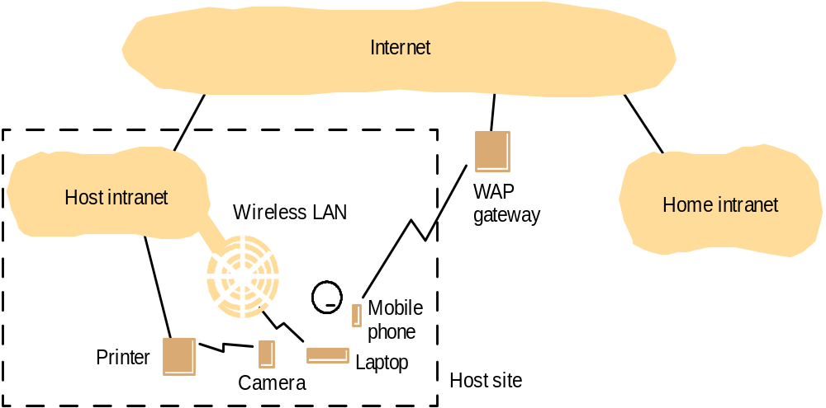
Example 3:
Mobile & ubiquitous computing

Slide 16
Example 3:
Mobile & ubiquitous computing
Miniaturization & wireless networking
  Laptops
  Handheld devices: Personal Data Assistent, mobile phones, video/digital camera’s,…
  Wearable computers: smart watches, smart cards, …
  Embedded devices: washing machines, cars, hi-fi systems,…
=> Mobile computing:
=> Ubiquitous computing

Slide 17
Example 3:
Mobile & ubiquitous computing
Mobile computing: moving computing devices in and out intranets
  Transparent access to home intranet
  Access to local resources at remote site
  Location-aware computing
Ubiquitous computing
  Small computing devices everywhere
  Communication between devices

Slide 18
Example 3:
Mobile & ubiquitous computing
Challenges
  Discovery of resources
  Automated reconfiguration of host intranet and mobile device when entering or leaving
  Cope with limited connectivity
  Privacy and security to
    Users
    Visited environment

Slide 19
Example 4:
Commercial applications
E-commerce
  On-line retail, home banking
Airline reservation systems
Telecommunication
  Audio and video: real-time traffic
Healthcare
  Global access to patient information
Manufacturing
  Resource planning and control
…

Slide 20
Examples (cont)
History
  1950s: programmers reserve computers
  1960s: batch processing on mainframes
  1970s: time sharing on mainframes and minicomputers
  1980s: personal computers
    first: in isolation
    later: integrated in networks ➔ distributed file systems
  1990s: distributed systems
    increased integration;
    middleware
  2000s: ??? ➔ ubiquitous computing

Slide 21
Overview
Definitions
Examples
Resource sharing and the Web
Types of Concurrency
Challenges
Architectural models
Fundamental Models
Summary

Slide 22
Types of Concurrency
Interleaved computation (single processor)
  Job = execution of one program
  Concurrent job = cooperating subtasks/threads
  interleaved execution
  threads communicate via shared memory
  a single clock
    => events can be ordered

Slide 23
Types of Concurrency
Parallel computing (Multiprocessor)
  job = execution of one program
  job = cooperating subtasks/threads
  real concurrency
  threads communicate via shared memory
  a single clock
    events can be ordered
E.g. SIMD: Single Instruction/Multiple Data

Slide 24
Types of Concurrency
Distributed computing:
  job = execution of many procedures
  Job = many cooperating tasks
  a single process can have subtasks/threads
  real concurrency
  processes communicate via message passing
  multiple clocks
    => only partial order for events

Slide 25
Types of Concurrency
Parallel versus Distributed
“parallel” hardware:
  identical processors,
  regular interconnection structure
small granularity of tasks
frequent communication between tasks
homogeneity: tasks perform similar functions
Clock synchronised
“distributed” hardware:
  different types of processors and
  networks
large granularity of tasks
less frequent communication between tasks
inhomogeneity: tasks perform different functions
synchronized execution of tasks

Slide 26
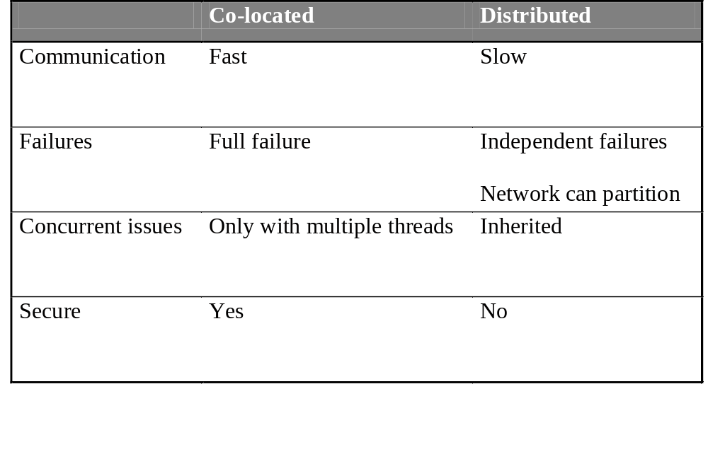
Comparison (cont.)
Local concurrency versus Distributed
*
Fundamental realities:

Slide 27
Overview
Definitions
Examples
Resource sharing and the Web
Types of Concurrency
Challenges
Architectural models
Fundamental Models
Summary

Slide 28
Challenges
Heterogeneity
Openness
Security
Scalability
Failure handling
Concurrency
Transparency

Slide 29
Challenges: Heterogeneity
Heterogeneity at many levels
  Networks (ethernet, token ring, .. )
  Computer hardware
  Operating systems (different API to internet)
  Programming languages
  Implementations by different developer (data structures)
Solutions … middleware
  Java RMI
  CORBA
  Implement uniform high level API
Remote procedures
Remote method invocation
Remote event notification
Distributed transactions

Slide 30
Challenges: Openness
Open systems
  enables adding system extensions without disruption or duplication of existing services
How?
  Uniform communication mechanism
    to enable distributed programming
  Published and standard interfaces
    to access shared resources
Result
  open distributed systems
  heterogeneous hardware possible

Slide 31
Challenges: Security
Attacks against
  Confidentiality/privacy
  Integrity of messages
  Authentication of user: simulating false identity
  Availability : unauthorized use of resources
    Accessing files, printers, …
    Denial of service: blocking server by overwhelming it with requests
    Mobile code performing unauthorized operations

Slide 32
Challenges: Scalability
  allow scaling up the system
  while keeping the same software
major challenge!
  Control cost of physical resources ( cost < O(n), n number of users)
  Control performance loss ( loss < O(log n), n size of data)
  Prevent software resources running out (e.g. IP addresses)
  Avoid performance bottlenecks
general techniques:
  Replication & partitioning of data,
  Caching of data
  multiple servers

Slide 33
Challenges: Scalability
Computers vs. Web servers in the Internet
Date
Computers
Web servers
Percentage
1993, July
1,776,000
130
0.008
1995, July
6,642,000
23,500
0.4
1997, July
19,540,000
1,203,096
6
1999, July
56,218,000
6,598,697
12
2001, July
125,888,197
31,299,592
25
2003, July
42,298,371

Slide 34
Challenges: Failure handling
Partial failures
  Difficult to handle
Techniques used:
  Detecting failures (e.g. checksums)
  Masking failures (e.g. message retransmission)
  Tolerating failures (e.g. browser announces server not available)
  Recovery from failures (e.g. save & restore state)
  Redundancy: replicating services

Slide 35
Challenges: Concurrency
The problem:
  different clients simultaneous accessing a shared resource
Solutions
  limit the number of users to 1
    (inefficient and restrictive)
  allow concurrent executions
    non-trivial
    Synchronization tools are needed
      Known techniques e.g. semaphores

Slide 36
Challenges: Transparency
A system is transparent for a feature if the feature is unobservable for the user
Examples:
  rlogin : local versus remote computer
  Java RMI: local versus remote object
    Message to local or remote object is the same
  GSM: location is transparent
Increase of uniformity!

Slide 37
Challenges: Transparency
Access: identical access to local and remote resources
Location: access to resources without knowledge of their physical/network location
Concurrency
Replication
Failure
Mobility: allows movement of resources
Performance
Scaling

Slide 38
Overview
Definitions
Examples
Resource sharing and the Web
Types of Concurrency
Challenges
Architectural models
Fundamental Models
Summary

Slide 39
Architectural Models
A model of a system
  = certain aspect of a system
  = abstract view on a system making abstraction
  of all properties not related to the selected aspect

Slide 40
Architectural models
Focus on organization and interaction of the distributed system:
  Different component objects/processes
  their way of communication
Architecture has major impact on quality of system
  Architecture determines to great deal whether the system will meet present and expected future demands.

Slide 41
Architectural models
Architecture: structure in terms of separately specified components
Overall goal: structure will meet present and
likely future demands
Major concerns: make system
  Reliable
  Manageable
  Adaptable
  Cost-effective

Slide 42
Architectural models
Architectural model
  Simplifies & abstracts functions of components
  Placement of components
  Interrelationships between components
Overview
  Software layers
  System architectures
  Design requirements

Slide 43
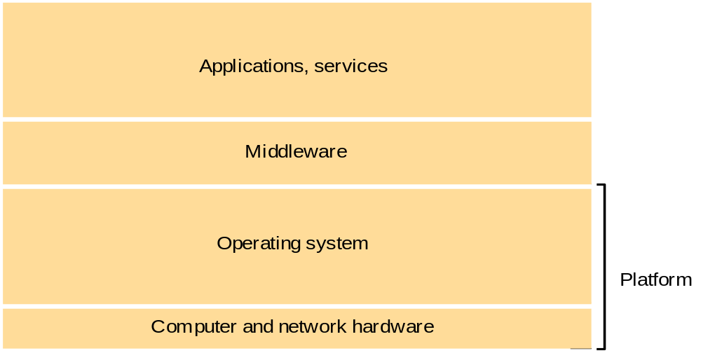
Architectural models:
Software layers

Slide 44
Architectural models:
Software layers
Platform
  Various implementations
  Provides communication & cooperation between processes
Middleware

Slide 45
Architectural models:
Software layers
Middleware
  Purpose
    Mask heterogeneity
    Provide convenient programming model
  Raises level of communication activities
    Remote method invocation: RMI, CORBA, DCOM
    Group communication
    Notification of events
    Partitioning, replication of shared data
  Provides infrastructural services
    Naming, transactions, persistent storage

Slide 46
Architectural models:
Software layers
Middleware: limitations
end-to-end argument
  Some aspects require support at application level

Slide 47
Architectural models
Architectural model
  Simplifies & abstracts functions of components
  Placement of components
  Interrelationships between components
Overview
  Software layers
  System architectures
  Design requirements

Slide 48
Architectural models:
System architectures
Overview
  Client-server: different roles
    n-Tier Architectures
    Multiple servers
    Proxy servers and caches
    Mobile code
  Peer-to-peer: cooperation as peers

Slide 49
Architectural models:
System architectures
Client-server model
  defines roles for 2 interacting entities
  client:
    needs a particular service
    sends request to server
    gets (after some time) reply
  server:
    awaits requests from clients
    performs requested function
  server can be client of another server

Slide 50
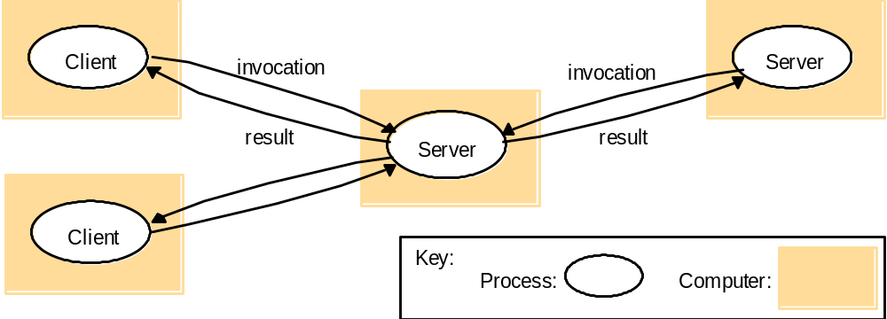
Architectural models:
System architectures
Client-server model

Slide 51
Architectural models:
System architectures
One-tier application architecture:
Presentation
Processing
Terminals, or
PC + terminal emulation
Data
Network
mainframe

Slide 52
Architectural models:
System architectures
Two-Tier Architecture
  2 entities used in the distributed application:
    at the user desktop:
    user interface + %(application)
    at the database server:
    %(application) + database
  thin <> fat client
    thin: ➔ no application code at desktop, only GUI
    fat: ➔ all application code at desktop

Slide 53
Architectural models:
System architectures
Two-Tier Architecture: thin client
Presentation
Processing
Data
Network
PC
mainframe

Slide 54
Architectural models:
System architectures
Two-Tier Architecture: fat client
Presentation
Processing
Data
Network
PC
mainframe

Slide 55
Architectural models:
System architectures
Two-Tier Architecture: issues
  update of code at clients: hard (many different systems)
  ➔ thin clients
  application code executed at mainframe: performance bottleneck
  ➔ fat clients

Slide 56
Architectural models:
System architectures
Multi-Tier Architecture
  3 entities used in the distributed application:
    at the user desktop:
    user interface
    at the application server
    application logic
    at the database server:
    data

Slide 57
Architectural models:
System architectures
Multi-Tier Architecture:
Data
Presentation
Network
mainframe
PC
Processing
Application server

Slide 58
Architectural models:
System architectures
Multi-Tier Architecture: issues
  opportunities for
    better performance
    more flexibility
  interactions between 3 parties
    more cooperation overhead
    need for transactions?

Slide 59
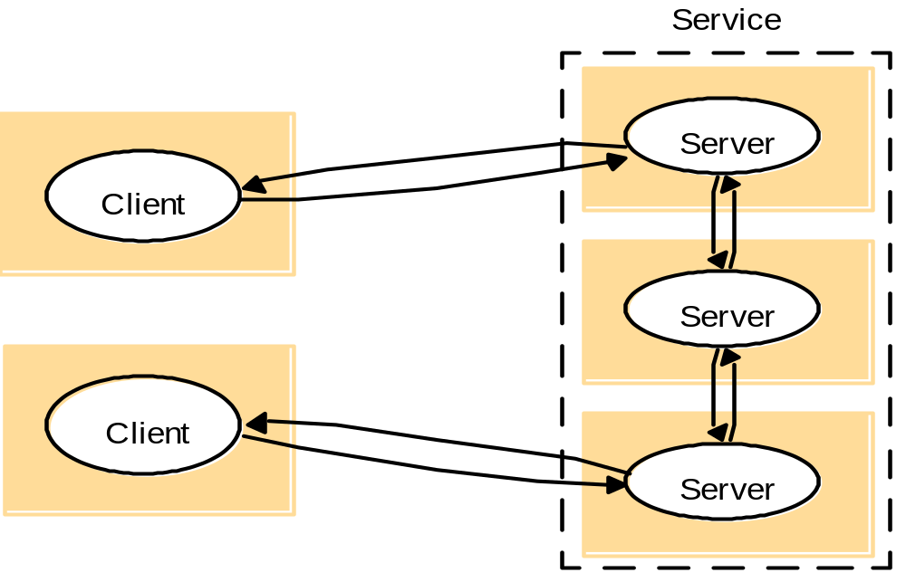
Architectural models:
System architectures
Services provided by multiple servers

Slide 60
Architectural models:
System architectures
Services provided by multiple servers
  Partition objects
    Examples: DNS, WWW
  Replicated copies of objects
    Examples: Sun NIS
    Increases performance & availability
    Improves fault tolerance

Slide 61
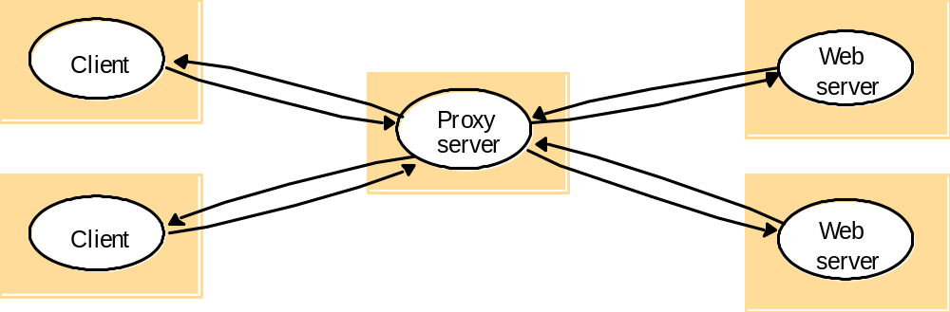
Architectural models:
System architectures
Proxy servers and caches
+ Reduce load on network & web servers
- Consistency!

Slide 62
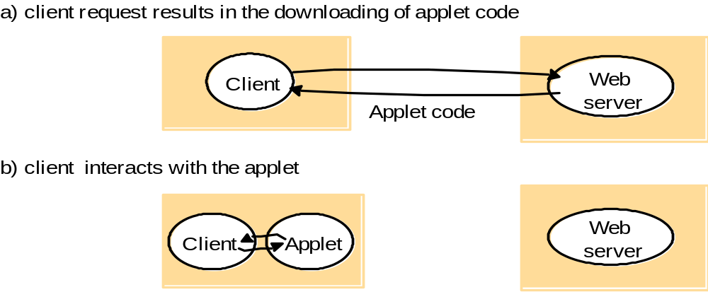
Architectural models:
System architectures
Mobile code
  Good interactive response
  Potential security threat

Slide 63
Architectural models:
System architectures
Mobile agents
  Running program (code + data)
  Travels from computer to computer
  Local access to data
  Potential security threat

Slide 64
Architectural models:
System architectures
Client-server model + variations
  Simple approach to sharing
  Centralization of service provision & management
  Poor scaling
Observations
  Functionality
  today’s desktop >> yesterday’s servers
  Always-on broadband connections
  Peer-to-peer

Slide 65
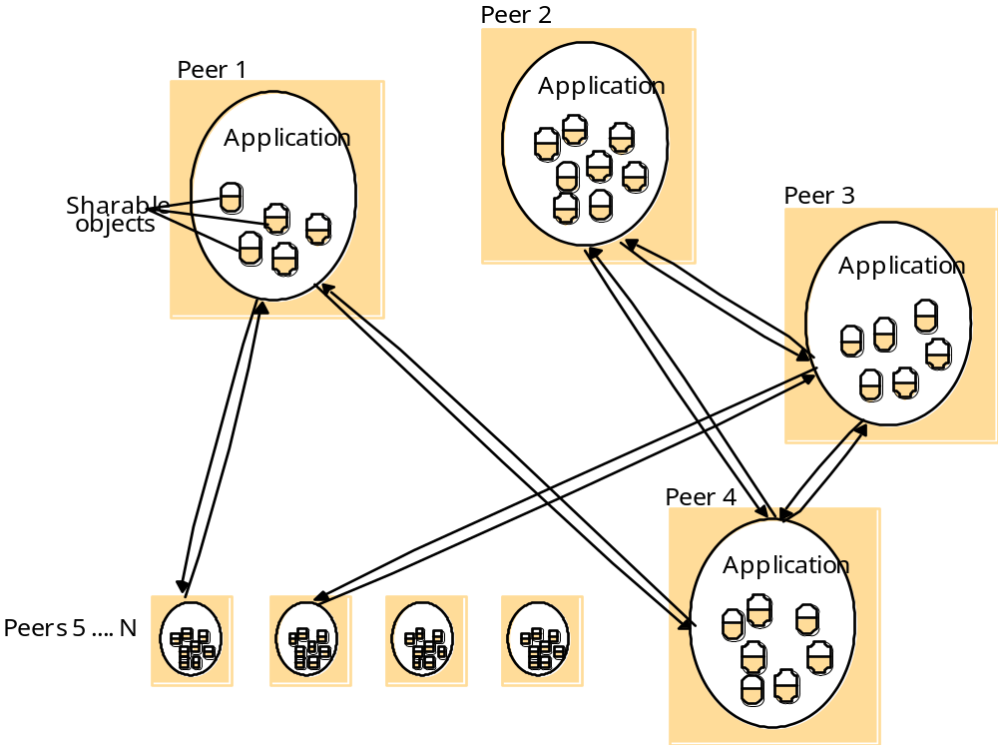
Architectural models:
System architectures
Peer processes

Slide 66
Architectural models:
System architectures
Peer-to-peer
  Exploit resources in a large number of participating computers
  Shared objects distributed over participants
  Replication to distribute load & to provide resilience
  More complex architecture
  Examples:
    Antecedents: DNS, Netnews/Usenet, Grapevine name registration
    Napster, Ivy file system

Slide 67
Architectural models
Architectural model
  Simplifies & abstracts functions of components
  Placement of components
  Interrelationships between components
Overview
  Software layers
  System architectures
  Design requirements

Slide 68
Architectural models:
Design requirements
Minimal requirement:
  maintain functionality of a non-distributed system
added value:
  extended resource access
  extended application interface for explicit sharing, fault tolerance, etc.
  advanced end user applications: CSCW (computer supported cooperative work)
QoS …
  Reliability
  Security
  Performance
  Adaptability

Slide 69
User Requirements
Quality of service
Reliability and availability
  reliability = measure of the likelihood of the system to deviate from the designed behaviour
  increased by enabling failure detection and recovery
  highly reliable services ➔ often worse response
  fault tolerant system: detects failures and either
    fails gracefully (predictably)
    masks the fault

Slide 70
User Requirements
Quality of service
Security: new problems
  privacy and integrity of users data in network packets
    by tampering the network cable
    by connecting a machine to read and/or inject data packets
  openness to interface with system software
    not all machines are physically secure
    e.g. a bogus file server could be created

Slide 71
User Requirements
Quality of service
Performance
  Responsiveness
  Throughput
    Processing speed at clients & servers + data transfer rate
  Balancing computational load

Slide 72
Overview
Definitions
Examples
Resource sharing and the Web
Comparison: distributed versus ...
Challenges
Architectural models
Fundamental Models
Summary

Slide 73
Fundamental models
System model gives answers to
  What are the main entities in the system?
  How do they interact?
  What are characteristics that affect individual & collective behavior?
Purpose of model:
  Make explicit all relevant assumptions
  Make generalizations concerning what is possible or impossible

Slide 74
Fundamental models
Aspects captured in our models:
  Interaction: time aspects
  Failure
  Security

Slide 75
Fundamental models:
Interaction model
Time is important
  E.g. multimedia application requires timeliness
  E.g. Event ordering problem in email Inbox
Item | From | Subject
23 | Z | Re:Meeting
24 | X | Meeting
25 | Y | Re:Meeting

Slide 76
Fundamental models:
Interaction model
How to avoid the email ordering problem?
  No problem if clock synchronization
  Clock synchronization is sometimes impossible

Slide 77
Fundamental models:
Interaction model
No global notion of time
Synchronisation of time impossible due to:
  Performance variations:
    Latency (time between start of sending and end of receiving)
    Bandwidth
    Processing time for messages
  Computers have different clock drift rates
Synchronous model
Asynchronous model

Slide 78
Fundamental models:
Interaction model
Synchronous distributed systems
  Upper & lower bounds for
    Time to execute processing step
    Message transmission
    Clock drift rate
  Allow
    Use of timeouts to detect process failure
    Guarantee of timeliness (multimedia)
    Partial clock synchronisation

Slide 79
Fundamental models:
Interaction model
Asynchronous distributed systems
  No time bounds
  Many systems are asynchronous
    E.g. Internet
    Due to sharing of processors & communication channels
    Often offer the best performance (because no resources are wasted)
  Consequences:
    Clock synchronization impossible
    No guarantee of timeliness possible

Slide 80
Fundamental models:
Interaction model
Solution to ordering problem
  With (perfect) clock synchronization
    no problem
  In asynchronous model
    Facts:
      Ordering possible within a single process
      Send m before receive m
    Event ordering possible
    Implementation: logical clocks

Slide 81
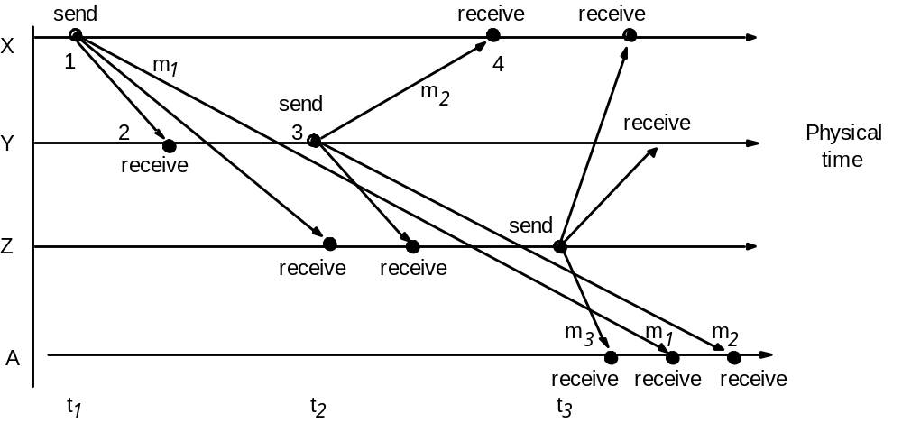
Fundamental models:
Interaction model
Event ordering

Slide 82
Fundamental models
Aspects captured in models:
  Interaction
  Failure
  Security

Slide 83
Fundamental models:
Failure model
How can distributed systems fail?
  Partial failures
  of • processes
        communication channels
Taxonomy
  Process <> communication channels
  Kind of failure: • Omission
        • Arbitrary
        • Timing

Slide 84
Fundamental models:
Failure model
Omission failure
  Failure to perform an action
  Processes:
    Subclasses:
      Crash no further execution
      Fail-stop crash + detection possible
    Consequences for asynchronous systems
      Failure not detectable
      Reaching agreement impossible
  Communication:

Slide 85
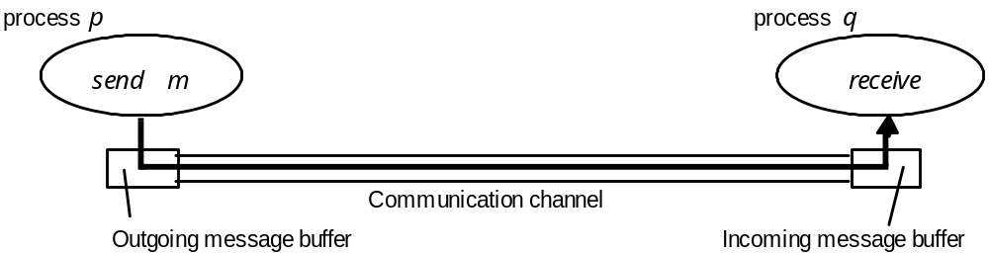
Fundamental models:
Failure model
Omission failure
  Communication:
    Send-omission
    Receive-omission
    Channel-omission

Slide 86
Fundamental models:
Failure model
Arbitrary or Byzantine failures:
  Worst possible failure semantics
    Any behavior possible
  Processes:
    Omit processing steps
    Perform unintended steps
  Communication
    Message contents corrupted
    Non-existing message delivered
    Messages delivered twice
    Rare: checksums, sequence numbers

Slide 87
Fundamental models:
Failure model
Class of failure
Affects
Description
Fail-stop
Process
Process halts and remains halted. Other processes may
detect this state.
Crash
Process
Process halts and remains halted. Other processes may
not be able to detect this state.
Omission
Channel
A message inserted in an outgoing message buffer never
arrives at the other end’s incoming message buffer.
Send-omission
Process
A process completes a
send,
but the message is not put
in its outgoing message buffer.
Receive-omission
Process
A message is put in a process’s incoming message
buffer, but that process does not receive it.
Arbitrary
Process or
Process/channel exhibits arbitrary behaviour: it may
(Byzantine)
channel
send/transmit arbitrary messages at arbitrary times,
commit omissions; a process may stop or take an
incorrect step.

Slide 88
Fundamental models:
Failure model
Timing failures
  Applicable in synchronous systems
Class of Failure
Affects
Description
Clock
Process
Process’s local clock exceeds the bounds on its
rate of drift from real time.
Performance
Process
Process exceeds the bounds on the interval
between two steps.
Performance
Channel
A message’s transmission takes longer than the
stated bound.

Slide 89
Fundamental models:
Failure model
Masking failures
  Approach:
    Hide
    Convert to a more acceptable failure
  Examples:
    Checksums: corrupted message ➔ omission failure
    Retransmission of message: hide omission failure

Slide 90
Fundamental models
Aspects captured in models:
  Interaction
  Failure
  Security

Slide 91
Fundamental models:
Security model
Avoid unauthorized use of resources
Secure processes and interactions
Copy of
m
The enemy
m’
Process
p
m
Process
q
Communication channel

Slide 92
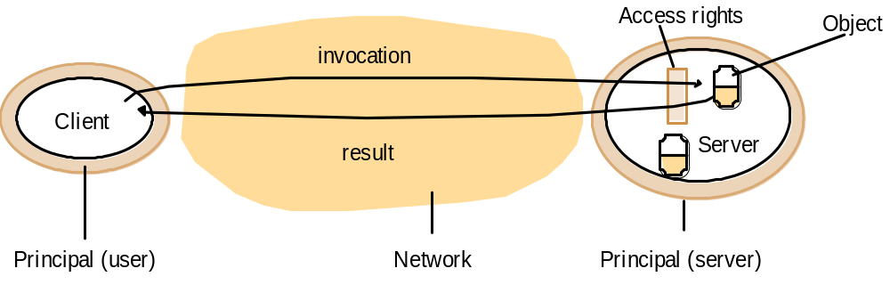
Fundamental models:
Security model
Based on architectural model with
  Clients
  Servers: manage objects

Slide 93
Protecting objects
Protecting objects/resources by
  giving access rights to users
  associating with each invocation an authority (a user with access rights) who allows for the use of the object or asked for it
    e.g. user asks a remote process to print something on his printer
    the authority here is the user
authority = PRINCIPAL
principal is user or process
server checks identity of authority and checks its access rights
Works only if communication is secure

Slide 94
Fundamental models:
Security model
Securing processes and interactions
  Threats to processes
    False identification of sender of message
  Threats to communication channels
    Copy, alter, inject messages
  Denial of service
    Overload resource (channel, processor)

Slide 95
Fundamental models:
Security model
Defeating security threats
  Cryptography
  Shared secrets
  Authentication
  Secure channels
Principal
A
Principal
B
Process
p
Secure channel
Process
q

Slide 96
Fundamental models:
Security model
Uses of model
  Security straightforward? NO
    Processing cost
    Management cost
    Inconvenience for users
  Approach:
    Analysis of all threats
    Acceptable cost

Slide 97
Overview
Definitions
Examples
Comparison: distributed versus ...
Resource sharing and the Web
Challenges
Architectural models
Fundamental Models
Summary

Slide 98
Summary
Distributed systems:
  Computers
  Processes
  Messages
  No common clock
  Partial failures

Slide 99
Summary
Challenges
  Heterogeneity
  Openness
  Security
  Scalability
  Failure handling
  Concurrency
  Transparency

Slide 100
Summary
Architectural models:
  Variations on client-server
  Large scale resource sharing
  Management of concurrent updates
  QOS
    Reliability
    Security
    Performance
    adaptability

Slide 101
Summary
Fundamental models:
  Interaction
  Failure
  security

Slide 102
Distributed Systems:
Introduction

