Slide 1
OOP in dart
Dart is an object-oriented language, which means it uses classes and objects to structure code.
Dart uses classes and objects to implement OOP principles such as encapsulation, inheritance, and polymorphism.

Slide 2
Key Features of Dart OOP
Key Features of Dart OOP
Encapsulation: Hide data with private fields and expose through getters/setters.
Inheritance: Share properties/methods between parent and child classes.
Polymorphism: Override and use parent class references for child objects.
Abstract Classes: Define blueprints for other classes.
Mixins: Reuse functionality without class inheritance.

Slide 3
Class: A blueprint for creating objects, defining properties and methods. A class acts as a template to define the properties (variables) and behaviors (methods) of an object
Object: An instance of a class.
Constructor: A special function used to initialize an object.
Methods: Functions defined inside a class.
Properties: Variables or fields defined inside a class.

Slide 4
Step 1: Define a Class
A class acts as a template to define the properties (variables) and behaviors (methods) of an object.
class Car {
// Properties
String brand;
int speed;
// Constructor
Car(this.brand, this.speed);
// Method
void displayInfo() {
print("Brand: $brand, Speed: $speed km/h");
}
}
brand and speed are properties.
Car(this.brand, this.speed) is a constructor and displayInfo is a method.

Slide 5
Step 2 : Create an Object An object is an instance of a class created using the new keyword or directly.
void main() {
// Create an object of the Car class
Car myCar = Car('Toyota', 120);
// Access properties and methods
myCar.displayInfo();
}

Slide 6
Step 3: Add Custom Behavior Add methods to define custom behavior for the objects.
class Car {
String brand;
int speed;
Car(this.brand, this.speed);
void accelerate(int increment) {
speed += increment;
print("$brand accelerated to $speed km/h");
}
}
void main() {
Car myCar = Car('Toyota', 120);
myCar.accelerate(20); // Output: Toyota accelerated to 140 km/h
}

Slide 7
Step 4: Encapsulation
Encapsulation hides the internal details of an object and exposes only what is necessary. Use private fields (prefix with _) and public getters/setters.
class BankAccount {
String _accountHolder;
double _balance;
BankAccount(this._accountHolder, this._balance);
// Getter
double get balance => _balance;
// Setter
void deposit(double amount) {
if (amount > 0) {
_balance += amount;
print("Deposited: \$${amount}"); } }}

Slide 8
void main() {
BankAccount account = BankAccount('Alice', 500);
account.deposit(100);
print("Balance: ${account.balance}"); // Output: Balance: 600
}

Slide 9
Step 5: Inheritance
Inheritance allows a class (child) to inherit properties and methods from another
class (parent).
class Vehicle {
void start() {
print("Vehicle started");
} }
class Car extends Vehicle {
void honk() {
print("Car honks");
}}

Slide 10
void main() {
Car myCar = Car();
myCar.start(); // Output: Vehicle started
myCar.honk(); // Output: Car honks
}

Slide 11
Step 6: Polymorphism
Polymorphism allows objects to be treated as instances of their parent class.
Override methods to provide specific implementations.
class Vehicle {
void start() {
print("Vehicle started");
}}
class Car extends Vehicle {
@override
void start() {
print("Car started");
}
}

Slide 12
void main() {
Vehicle myVehicle = Car();
myVehicle.start(); // Output: Car started
}

Slide 13
Step 7: Abstract Classes
Abstract classes define a blueprint and cannot be instantiated directly.
Subclasses must override abstract methods.
abstract class Animal {
void sound(); // Abstract method
}
class Dog extends Animal {
@override
void sound() {
print("Dog barks");
}
}

Slide 14
void main() {
Animal myDog = Dog();
myDog.sound(); // Output: Dog barks
}

Slide 15
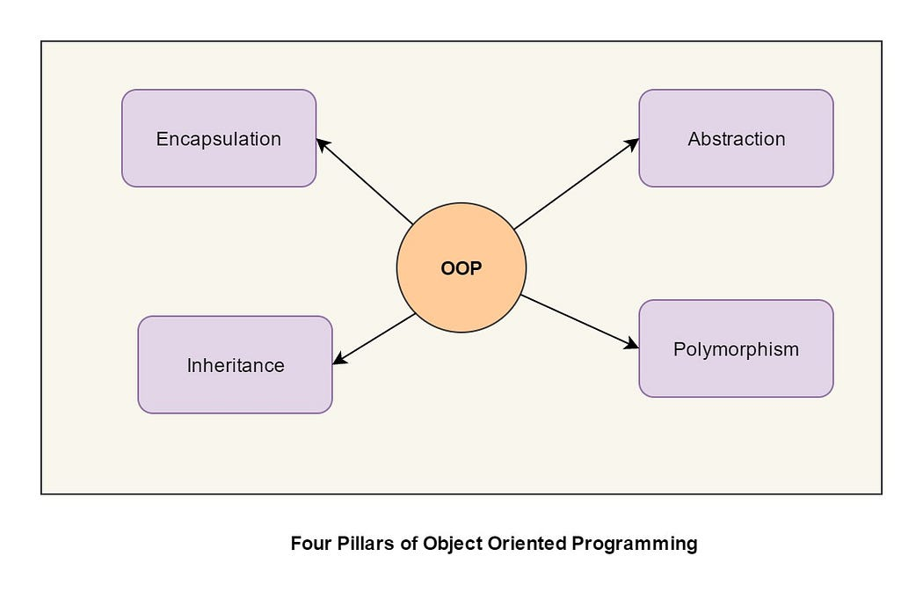

Slide 16
Classes and Objects
A class is a blueprint for creating objects. An object is an instance of a class.
class Dog {
String name;
int age;
Dog(this.name, this.age);
void bark() {
print('$name says Woof!’); } }
void main() {
Dog myDog = Dog('Buddy', 3);
myDog.bark(); }

Slide 17
Inheritance
Inheritance allows a class to inherit properties and methods from another class.
Inheritance is an important pillar of OOP.
The capability of a class to derive properties and characteristics from another class is called Inheritance.
When we write a class, we inherit properties from other classes.
When we create a class, we do not need to write all the properties and functions again and again, as these can be inherited from another class that possesses it.
Inheritance allows the user to reuse the code whenever possible and reduce its redundancy.

Slide 18
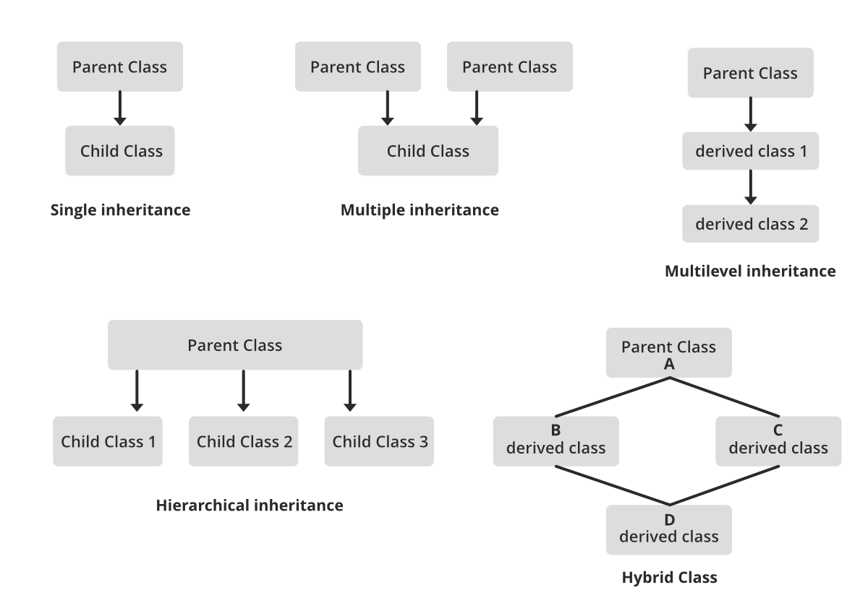

Slide 19
Inheritance
class Animal {
void eat() {
print('Eating...’); } }
class Cat extends Animal {
void meow() {
print('Meow!'); } }
void main() {
Cat myCat = Cat();
myCat.eat(); // Output: Eating...
myCat.meow(); // Output: Meow!
}

Slide 20
Encapsulation
Encapsulation
Encapsulation is the bundling of data and methods that operate on that data within one unit (class). You can use private variables and methods by prefixing them with an underscore.

Slide 21
class BankAccount {
double _balance = 0; // Private variable
void deposit(double amount) {
if (amount > 0) {
_balance += amount; }}
double get balance => _balance; // Getter
}
void main() {
BankAccount account = BankAccount();
account.deposit(100);
print('Balance: ${account.balance}'); // Output: Balance: 100.0
}

Slide 22
Polymorphism
Polymorphism allows methods to do different things based on the object that it is acting upon.
This can be achieved through method overriding.
The word polymorphism means having many forms.
In simple words, we can define polymorphism as the ability of a message to be displayed in more than one form.
For example, A person at the same time can have different characteristics. Like a man at the same time is a father, a husband, an employee.
So the same person posses different behavior in different situations.
This is called polymorphism.

Slide 23
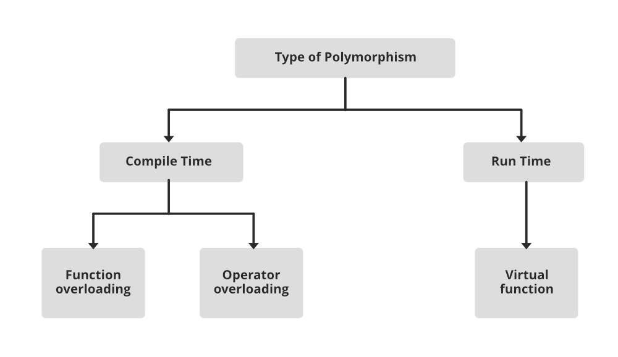

Slide 24
void main() {
Shape shape1 = Circle();
Shape shape2 = Square();
shape1.draw(); // Output: Drawing a circle
shape2.draw(); // Output: Drawing a square
}
class Shape {
void draw() {
print('Drawing a shape');}}
class Circle extends Shape {
@override
void draw() {
print('Drawing a circle’); }}
class Square extends Shape {
@override
void draw() {
print('Drawing a square');}}

