Slide 1
CENTRAL UNIVERSITY
Department of Computer Science and Information Technology
Bachelor of Science
Computer Science

Slide 2
Course Introduction
Course Title: Computer Security
Course Code: COMP404
Credit Hours: 3 Credit Hours
Level: 400
Program: BSc Computer Science
Name of Lecturer: James Anani Kofi Amezi
Contact of Lecturer: 0244544355
Email of Lecturer: aamezi@central.edu.gh
Office Hours: Mondays to Fridays (8am to 5pm)

Slide 3
Course Introduction
Course description/overview
The course aims to provide students with a broad understanding of computer security including security risks, attacks, prevention and defence methods; security protocols and access control models.

Slide 4
Course Introduction
Course Objective
By the end of this course students should be able to:
describe the essence of computer security
list some types of computer malware
define the methods and processes for ensuring computer security

Slide 5
Course Requirements
Main Course Books
Principles of Information Security-Cengage (2022)
Computer Security: Principles and Practice (2018)
Computer Network Security and Cyber Ethics (2014)
Discipline and Diligence

Slide 6
Course Outline
Week 1: Introduction to Computer Security
Week 2: The Need for Information Security
Week 3: Information Security Management
Week 4: Risk Management
Week 5: Incident Response and Contingency Planning
Week 6: Legal, Ethical, and Professional Issues in Information Security
Week 7: Security and Personnel
Week 8: Security Technology: Access Controls, Firewalls, and VPNs Week 9: Security Technology: Intrusion Detection and Prevention Systems, and Other Security Tools
Week 10: Cryptography
Week 11: Implementing Information Security
Week 12: Information Security Maintenance

Slide 7
Introduction to Computer Security
Introduction To Computer Security
What Is Security?
Components Of An Information System
Security And The Organization
Information Security: Is It An Art Or A Science?
Lesson Summary
Review Questions
Notes:
Introduction to Information
Security 1
Introduction To Information Security 2
The 1960s 3
The 1970s and ’80s 4
The 1990s 7
2000 to Present 7
What Is Security? 8
Key Information Security Concepts 9
Critical Characteristics of Information 11
CNSS Security Model 14
Components Of An Information System 15
Software 15
Hardware 15
Data 16
People 16
Procedures 16
Networks 17
Security And The Organization 17
Balancing Information Security and Access 17
Approaches to Information Security
Implementation 18
Security Professionals 19
Data Responsibilities 20
Communities of Interest 20
Information Security: Is It An Art Or
A Science?
21
Security as Art 21
Security as Science 21
Security as a Social Science 22
Module Summary

Slide 8
Introduction to Computer Security
Lesson 1 Objectives
At the end of this lecture, you should be able to:
Define information security
Discuss the history of computer security and explain how it evolved into information security
Define key terms and critical concepts of information security
Describe the information security roles of professionals within an organization
Notes:
Introduction to Information
Security 1
Introduction To Information Security 2
The 1960s 3
The 1970s and ’80s 4
The 1990s 7
2000 to Present 7
What Is Security? 8
Key Information Security Concepts 9
Critical Characteristics of Information 11
CNSS Security Model 14
Components Of An Information System 15
Software 15
Hardware 15
Data 16
People 16
Procedures 16
Networks 17
Security And The Organization 17
Balancing Information Security and Access 17
Approaches to Information Security
Implementation 18
Security Professionals 19
Data Responsibilities 20
Communities of Interest 20
Information Security: Is It An Art Or
A Science?
21
Security as Art 21
Security as Science 21
Security as a Social Science 22
Module Summary

Slide 9
Introduction to Computer Security
Introduction To Computer Security
Information security is the protection of information assets that use, store, or transmit information through the application of policy, education, and technology. Information security evolved from the early field of computer security. Security is protection from danger. A successful organization should have multiple layers of security in place.

Slide 10
Introduction to Computer Security
2. What Is Security?
Security is “the quality or state of being secure—to be free from danger.” Security is protection against adversaries—from those who would do harm, inten-tionally or otherwise—is the objective. It is a multi-layered system that protects the sovereignty of an organisation, its assets, its resources, and its people.
Notes:
Introduction to Information
Security 1
Introduction To Information Security 2
The 1960s 3
The 1970s and ’80s 4
The 1990s 7
2000 to Present 7
What Is Security? 8
Key Information Security Concepts 9
Critical Characteristics of Information 11
CNSS Security Model 14
Components Of An Information System 15
Software 15
Hardware 15
Data 16
People 16
Procedures 16
Networks 17
Security And The Organization 17
Balancing Information Security and Access 17
Approaches to Information Security
Implementation 18
Security Professionals 19
Data Responsibilities 20
Communities of Interest 20
Information Security: Is It An Art Or
A Science?
21
Security as Art 21
Security as Science 21
Security as a Social Science 22
Module Summary

Slide 11
Introduction to Computer Security
2. What Is Security?
The Committee on National Security Systems (CNSS) defines information security as the protection of information and its critical elements, including the systems and hardware that use, store, and transmit that information. The CNSS model of information security evolved from a concept developed by the computer security industry called the C.I.A. triangle. The C.I.A. triangle has been the industry standard for computer security since the development of the mainframe. It is based on the three characteristics of information that give it value to organizations: Confidentiality, Integrity, and Availability.

Slide 12
Introduction to Computer Security
2. What Is Security?
A successful organization should have the following multiple layers of security in place to protect its operations:
Physical Security, to protect physical items, objects, or areas from unauthorized access and misuse
Personnel Security, to protect the individual or group of individuals who are authorized to access the organization and its operations
Operations Security, to protect the details of a particular operation or series of activities
Communications Security, to protect communications media, technology, and content
Network Security, to protect networking components, connections, and contents
Information Security, to protect the confidentiality, integrity and availability of information assets, whether in storage, processing, or transmission. It is achieved via the application of policy, education, training and awareness, and technology.
Notes:
A successful organization should have the following multiple layers of security in place to protect
its operations:
Physical security, to protect physical items, objects, or areas from unauthorized access
and misuse
Personnel security, to protect the individual or group of individuals who are authorized
to access the organization and its operations
Operations security, to protect the details of a particular operation or series of
activities
Communications security, to protect communications media, technology, and content
Network security, to protect networking components, connections, and contents
Information security, to protect the confidentiality, integrity and availability of information
assets, whether in storage, processing, or transmission. It is achieved via the
application of policy, education, training and awareness, and technology.

Slide 13
Introduction to Computer Security
2. What Is Security?
Key Information Security Concepts
Access: A subject or object’s ability to use, manipulate, modify, or affect another subject or object. Authorized users have legal access to a system, whereas hackers have illegal access to a system. Access controls regulate this ability.
Asset: The organizational resource that is being protected. An asset can be logical, such as a Web site, information, or data; or an asset can be physical, such as a person, computer system, or other tangible object. Assets, and particularly information assets, are the focus of security efforts; they are what those efforts are attempting to protect.
Notes:
Key Information Security Concepts
This book uses a number of terms and concepts that are essential to any discussion of information
security. Some of these terms are illustrated in Figure 1-4; all are covered in greater
detail in subsequent chapters.
Access: A subject or object’s ability to use, manipulate, modify, or affect another subject
or object. Authorized users have legal access to a system, whereas hackers have
illegal access to a system. Access controls regulate this ability.
Asset: The organizational resource that is being protected. An asset can be logical,
such as a Web site, information, or data; or an asset can be physical, such as a person,
computer system, or other tangible object. Assets, and particularly information assets,
are the focus of security efforts; they are what those efforts are attempting to protect.
Attack: An intentional or unintentional act that can cause damage to or otherwise compromise
information and/or the systems that support it. Attacks can be active or passive,
intentional or unintentional, and direct or indirect. Someone casually reading sensitive
information not intended for his or her use is a passive attack. A hacker attempting to
break into an information system is an intentional attack. A lightning strike that causes a
fire in a building is an unintentional attack. A direct attack is a hacker using a personal
computer to break into a system. An indirect attack is a hacker compromising a system
and using it to attack other systems, for example, as part of a botnet (slang for robot network).
This group of compromised computers, running software of the attacker’s choosing,
can operate autonomously or under the attacker’s direct control to attack systems and
steal user information or conduct distributed denial-of-service attacks. Direct attacks originate
from the threat itself. Indirect attacks originate from a compromised sy

Slide 14
Introduction to Computer Security
2. What Is Security?
Key Information Security Concepts
Attack: An intentional or unintentional act that can cause damage to or otherwise compromise information and/or the systems that support it. Attacks can be active or passive, intentional or unintentional, and direct or indirect. Someone casually reading sensitive information not intended for his or her use is a passive attack. A hacker attempting to break into an information system is an intentional attack. A lightning strike that causes a fire in a building is an unintentional attack. A direct attack is a hacker using a personal computer to break into a system. An indirect attack is a hacker compromising a system and using it to attack other systems, for example, as part of a botnet (slang for robot network).
Notes:
Key Information Security Concepts
Attack: An intentional or unintentional act that can cause damage to or otherwise compromise
information and/or the systems that support it. Attacks can be active or passive,
intentional or unintentional, and direct or indirect. Someone casually reading sensitive
information not intended for his or her use is a passive attack. A hacker attempting to
break into an information system is an intentional attack. A lightning strike that causes a
fire in a building is an unintentional attack. A direct attack is a hacker using a personal
computer to break into a system. An indirect attack is a hacker compromising a system
and using it to attack other systems, for example, as part of a botnet (slang for robot network).
This group of compromised computers, running software of the attacker’s choosing,
can operate autonomously or under the attacker’s direct control to attack systems and
steal user information or conduct distributed denial-of-service attacks. Direct attacks originate
from the threat itself. Indirect attacks originate from a compromised sy

Slide 15
Introduction to Computer Security
2. What Is Security?
Key Information Security Concepts
Control, Safeguard, or Countermeasure: Security mechanisms, policies, or procedures that can successfully counter attacks, reduce risk, resolve vulnerabilities, and other-wise improve the security within an organization. The various levels and types of controls are discussed more fully in the following chapters.
Exploit: A technique used to compromise a system. This term can be a verb or a noun. Threat agents may attempt to exploit a system or other information asset by using it illegally for their personal gain. Or, an exploit can be a documented process to take advantage of a vulnerability or exposure, usually in soft-ware, that is either inherent in the software or is created by the attacker. Exploits make use of existing software tools or custom-made software components.
Notes:
Exposure: A condition or state of being exposed. In information security, exposure
exists when a vulnerability known to an attacker is present.
Loss: A single instance of an information asset suffering damage or unintended or
unauthorized modification or disclosure. When an organization’s information is stolen,
it has suffered a loss.

Slide 16
Introduction to Computer Security
2. What Is Security?
Key Information Security Concepts
Exposure: A condition or state of being exposed. In information security, exposure exists when a vulnerability known to an attacker is present.
Loss: A single instance of an information asset suffering damage or unintended or unauthorized modification or disclosure. When an orga-nization’s information is stolen, it has suffered a loss.
Protection Profile or Security Posture: The entire set of controls and safeguards, including policy, education, training and awareness, and technology, that the organization implements (or fails to implement) to protect the asset. The terms are sometimes used interchangeably with the term security program, although the security program often com-prises managerial aspects of security, including planning, person-nel, and subordinate programs.

Slide 17
Introduction to Computer Security
2. What Is Security?
Key Information Security Concepts
Risk: The probability that something unwanted will happen. Organizations must minimize risk to match their risk appetite—the quantity and nature of risk the organization is willing to accept.
Subjects and Objects: A computer can be either the subject of an attack—an agent entity used to conduct the attack—or the object of an attack—the target entity. A computer can be both the subject and object of an attack, when, for example, it is compromised by an attack (object), and is then used to attack other systems (subject).
Notes:
Risk: The probability that something unwanted will happen. Organizations must minimize
risk to match their risk appetite—the quantity and nature of risk the organization
is willing to accept.
Subjects and objects: A computer can be either the subject of an attack—an agent
entity used to conduct the attack—or the object of an attack—the target entity, as
shown in Figure 1-5. A computer can be both the subject and object of an attack,
when, for example, it is compromised by an attack (object), and is then used to attack
other systems (subject).
Threat: A category of objects, persons, or other entities that presents a danger to an
asset. Threats are always present and can be purposeful or undirected. For example,
hackers purposefully threaten unprotected information systems, while severe storms
incidentally threaten buildings and their contents.
Threat agent: The specific instance or a component of a threat. For example, all hackers
in the world present a collective threat, while Kevin Mitnick, who was convicted
for hacking into phone systems, is a specific threat agent. Likewise, a lightning strike,
hailstorm, or tornado is a threat agent that is part of the threat of severe storms.
Vulnerability: A weaknesses or fault in a system or protection mechanism that opens it
to attack or damage. Some examples of vulnerabilities are a flaw in a software package,
an unprotected system port, and an unlocked door. Some well-known vulnerabilities
have been examined, documented, and published; others remain latent (or
undiscovered).

Slide 18
Introduction to Computer Security
2. What Is Security?
Key Information Security Concepts
Threat: A category of objects, persons, or other entities that presents a danger to an asset. Threats are always present and can be purposeful or undirected. For example, hackers purposefully threaten unprotected information systems, while severe storms incidentally threaten buildings and their contents.
Threat Agent: The specific instance or a component of a threat. For example, all hackers in the world present a collective threat, while Kevin Mitnick, who was convicted for hacking into phone systems, is a specific threat agent. Likewise, a lightning strike, hailstorm, or tornado is a threat agent that is part of the threat of severe storms.
Vulnerability: A weaknesses or fault in a system or protection mechanism that opens it to attack or damage. Some examples of vulnerabilities are a flaw in a software package, an unprotected system port, and an unlocked door. Some well-known vulnerabilities have been examined, documented, and published; others remain latent (or undiscovered).
Notes:
Threat: A category of objects, persons, or other entities that presents a danger to an
asset. Threats are always present and can be purposeful or undirected. For example,
hackers purposefully threaten unprotected information systems, while severe storms
incidentally threaten buildings and their contents.
Threat agent: The specific instance or a component of a threat. For example, all hackers
in the world present a collective threat, while Kevin Mitnick, who was convicted
for hacking into phone systems, is a specific threat agent. Likewise, a lightning strike,
hailstorm, or tornado is a threat agent that is part of the threat of severe storms.
Vulnerability: A weaknesses or fault in a system or protection mechanism that opens it
to attack or damage. Some examples of vulnerabilities are a flaw in a software package,
an unprotected system port, and an unlocked door. Some well-known vulnerabilities
have been examined, documented, and published; others remain latent (or
undiscovered).

Slide 19
Introduction to Computer Security
2. What Is Security?
Critical Characteristics of Information
The value of information comes from the char-acteristics it possesses. When a characteristic of information changes, the value of that information either increases, or, more commonly, decreases. Some characteristics affect information’s value to users more than others do. This can depend on circum-stances; for example, timeliness of information can be a critical factor, because information loses much or all of its value when it is delivered too late.

Slide 20
Introduction to Computer Security
2. What Is Security?
Critical Characteristics of Information
Availability: enables authorized users—persons or computer systems—to access information without interference or obstruction and to receive it in the required format.
Accuracy: Information has accuracy when it is free from mis-takes or errors and it has the value that the end user expects. If information has been intentionally or unintentionally modified, it is no longer accurate.
Authenticity of information is the quality or state of being genuine or original, rather than a reproduction or fabrication. Information is authentic when it is in the same state in which it was created, placed, stored, or transferred.
Notes:
Availability Availability enables authorized users—persons or computer systems—to
access information without interference or obstruction and to receive it in the required format.
Consider, for example, research libraries that require identification before entrance.
Librarians protect the contents of the library so that they are available only to authorized
patrons. The librarian must accept a patron’s identification before that patron has free
access to the book stacks. Once authorized patrons have access to the contents of the stacks,
they expect to find the information they need available in a useable format and familiar language,
which in this case typically means bound in a book and written in English.
Accuracy Information has accuracy when it is free from mistakes or errors and it has the
value that the end user expects. If information has been intentionally or unintentionally
modified, it is no longer accurate. Consider, for example, a checking account. You assume
that the information contained in your checking account is an accurate representation of
your finances. Incorrect information in your checking account can result from external or
internal errors. If a bank teller, for instance, mistakenly adds or subtracts too much from
your account, the value of the information is changed. Or, you may accidentally enter an
incorrect amount into your account register. Either way, an inaccurate bank balance could
cause you to make mistakes, such as bouncing a check.

Slide 21
Introduction to Computer Security
2. What Is Security?
Critical Characteristics of Information
Confidentiality: Information has confidentiality when it is protected from disclosure or exposure to unauthorized individuals or systems. Confidentiality ensures that only those with the rights and privileges to access information are able to do so. When unauthorized individuals or systems can view information, confidentiality is breached. To protect the confidentiality of information, you can use a number of measures, including the following:
Information classification
Secure document storage
Application of general security policies
Education of information custodians and end users
Notes:
Confidentiality Information has confidentiality when it is protected from disclosure or
exposure to unauthorized individuals or systems. Confidentiality ensures that only those
with the rights and privileges to access information are able to do so. When unauthorized
individuals or systems can view information, confidentiality is breached. To protect the confidentiality
of information, you can use a number of measures, including the following:
Information classification
Secure document storage
Application of general security policies
Education of information custodians and end users
Confidentiality, like most of the characteristics of information, is interdependent with other
characteristics and is most closely related to the characteristic known as privacy. The relationship
between these two characteristics is covered in more detail in Chapter 3, “Legal
and Ethical Issues in Security.”
The value of confidentiality of information is especially high when it is personal information
about employees, customers, or patients. Individuals who transact with an organization
expect that their personal information will remain confidential, whether the organization is
a federal agency, such as the Internal Revenue Service, or a business. Problems arise when
companies disclose confidential information. Sometimes this disclosure is intentional, but
there are times when disclosure of confidential information happens by mistake—for example,
when confidential information is mistakenly e-mailed to someone outside the organization
rather than to someone inside the organization. Several cases of privacy violation are
outlined in Offline: Unintentional Disclosures.
Other examples of confidentiality breaches are an employee throwing away a document
containing critical information without shredding it, or a hacker who successfully breaks
into an internal database of a Web-based organization and steals sensitive information
about the clients, such as names, addresses, and credit card numbers.
As a consumer, you give up pieces of confidential information in exchange for convenience
or value almost daily. By using a “members only” card at a grocery store, you disclose
some of your spending habits. When you fill out an online survey, you exchange pieces of
your personal history for access to online privileges. The bits and pieces of your information
that you disclose are copied, sold, replicated, distributed, and eventually coalesced into profiles
and even complete dossiers of yourself and your life. A similar technique is used in a
criminal enterprise called salami theft. A deli worker knows he or she cannot steal an entire
salami, but a few slices here or there can be taken home without notice. Eventually the deli
worker has stolen a whole salami. In information security, salami theft occurs when an
employee steals a few pieces of information at a time, knowing that taking more would be
noticed—but eventually the employee gets something complete or useable.

Slide 22
Introduction to Computer Security
2. What Is Security?
Critical Characteristics of Information
Integrity Information has integrity when it is whole, complete, and uncorrupted. The integrity of information is threatened when the information is exposed to cor-ruption, damage, destruction, or other disruption of its authentic state. Corruption can occur while information is being stored or transmitted. Many computer viruses and worms are designed with the explicit purpose of corrupting data.
Availability: Information Availability enables authorized users to access information without interference or obstruction and to receive it in the required format.
Notes:
Integrity
Information has integrity when it is in its expected state and can be trusted. The
integrity of information is threatened when it is exposed to corruption, damage,
destruction, or other disruption of its authentic state. Corruption can occur while information is being stored or
transmitted. Many computer viruses and worms are designed with the explicit purpose of corrupting data. For this
reason, a key method for detecting a virus or worm is to look for changes in file integrity, as shown by the file size.
Another key method of assuring information integrity is file hashing, in which a file is read by a special algorithm that
uses the bit values in the file to compute a single large number called a hash value. The hash value for any combination
of bits is unique.
If a computer system performs the same hashing algorithm on a file and obtains a different number than the file’s
recorded hash value, the file has been compromised and the integrity of the information is lost. Information integrity
is the cornerstone of information systems because information is of no value or use if users cannot verify its integrity.
File hashing and hash values are examined in detail in Module 10.
File corruption is not necessarily the result of external forces, such as hackers. Noise in the transmission media,
for instance, can also cause data to lose its integrity. Transmitting data on a circuit with a low voltage level can alter
and corrupt the data. Redundancy bits and check bits can compensate for internal and external threats to the integrity
of information. During each transmission, algorithms, hash values, and error-correcting codes ensure the integrity of
the information. Data whose integrity has been compromised is retransmitted.
Unfortunately, even the routine use of computers can result in unintended changes to files as the equipment
degrades, software malfunctions, or other “natural causes” occur.
Availability
Availability enables authorized users—people or computer systems—to access information without interference or
obstruction and to receive it in the required format. Consider, for example, research libraries that require identification
before entrance. Librarians protect the contents of the library so that they are available only to authorized patrons.
The librarian must accept a patron’s identification before the patron has free access to the book stacks. Once authorized
patrons have access to the stacks, they expect to find the information they need in a usable format and familiar
language. In this case, the information is bound in a book that is written in English.

Slide 23
Introduction to Computer Security
2. What Is Security?
Critical Characteristics of Information
Accuracy: Information has accuracy when it is free from mistakes or errors and has the value that the end user expects. If information has been intentionally or unintentionally modified, it is no longer accurate.
Authenticity: Information is authentic when it is in the same state in which it was created, placed, stored, or transferred.
Utility: The utility of information is its usefulness. In other words, information has value when it can serve a purpose. If information is available but is not in a meaningful format to the end user, it is not useful.
Possession: The possession of information is the quality or state of ownership or control.
Notes:
Accuracy
Information has accuracy when it is free from mistakes or errors and has the value that the end user expects. If information
has been intentionally or unintentionally modified, it is no longer accurate. Consider a checking account, for
example. You assume that the information in your account is an accurate representation of your finances. Incorrect
information in the account can result from external or internal errors. If a bank teller, for instance, mistakenly adds
or subtracts too much money from your account, the value of the information is
changed. Or, you may accidentally enter an incorrect amount into your account register.
Either way, an inaccurate bank balance could cause you to make other mistakes,
such as bouncing a check that overdraws your account.
Authenticity
Information is authentic when it is in the same state in which it was created, placed,
stored, or transferred. Consider for a moment some common assumptions about e-mail.
When you receive e-mail, you assume that a specific individual or group created and
transmitted the e-mail—you assume you know its origin. This is not always the case.
E-mail spoofing, the act of sending an e-mail message with a modified field, is a problem
for many people today because the modified field often is the address of the originator.
Spoofing the sender’s address can fool e-mail recipients into thinking that the messages
are legitimate traffic, thus inducing them to open e-mail they otherwise might not have.
Utility
The utility of information is its usefulness. In other words, information has value
when it can serve a purpose. If information is available but is not in a meaningful
format to the end user, it is not useful. For example, U.S. Census data can quickly
become overwhelming and difficult for a private citizen to interpret; however, for a
politician, the same data reveals information about residents in a district—such as
their race, gender, and age. This information can help form a politician’s campaign
strategy or shape their policies and opinions on key issues.
Possession
The possession of information is the quality or state of ownership or control. Information
is said to be in one’s possession if one obtains it, independent of format or
other characteristics. While a breach of confidentiality always results in a breach

Slide 24
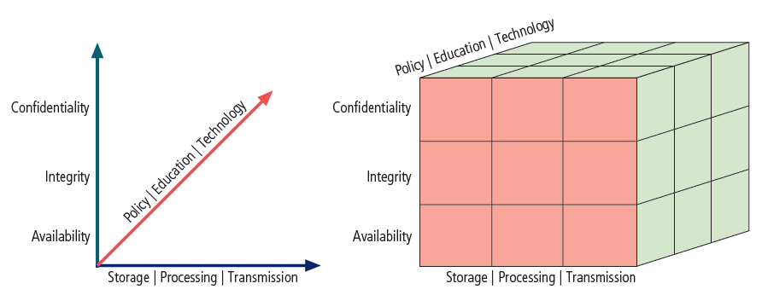
Introduction to Computer Security
CNSS Security Model (The McCumber Cube)

Slide 25
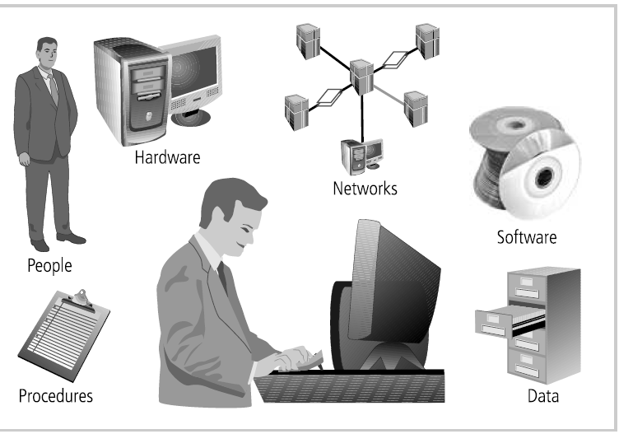
Introduction to Computer Security
3. Components of an Information System
Notes:
Introduction to Information
Security 1
Introduction To Information Security 2
The 1960s 3
The 1970s and ’80s 4
The 1990s 7
2000 to Present 7
What Is Security? 8
Key Information Security Concepts 9
Critical Characteristics of Information 11
CNSS Security Model 14
Components Of An Information System 15
nd The Organization 17
Balancing Information Security and Access 17
Approaches to Information Security
Implementation 18
Security Professionals 19
Data Responsibilities 20
Communities of Interest 20
Information Security: Is It An Art Or
A Science?
21
Security as Art 21
Security as Science 21
Security as a Social Science 22
Module Summary

Slide 26
Introduction to Computer Security
3. Components Of An Information System
Software
Hardware
Data
People
Procedures
Networks

Slide 27
Introduction to Computer Security
3. Components Of An Information System
Software: The software component of the IS comprises applications, operating systems, and assorted command utilities. Software is perhaps the most difficult IS component to secure.
Hardware: Hardware is the physical technology that houses and executes the software, stores and transports the data, and provides interfaces for the entry and removal of information from the system. Physical security policies deal with hardware as a physical asset and with the protection of physical assets from harm or theft.
Data: Data stored, processed, and transmitted by a computer system must be protected. Data is often the most valuable asset of an organi-zation and therefore is the main target of intentional attacks. Systems developed in recent years are likely to make use of database manage-ment systems.

Slide 28
Introduction to Computer Security
3. Components of an Information System
People: people can be the weakest link in an organization’s information security program. Unless policy, education and training, awareness, and technology are properly employed to prevent people from accidentally or intentionally damaging or losing information, they will remain the weakest link. Social engineering can prey on the tendency to cut corners and the commonplace nature of human error. It can be used to manipulate people to obtain access information about a system.
Procedures: Procedures are written instructions for accomplishing a specific task.
Networks: Networking is the IS component that moves data and information between the components of the information system and has created much of the need for increased computer and information security. When information systems are connected to each other to form LANs, and these LANs are connected to other networks such as the Internet, new security challenges rapidly emerge.
Notes:
Introduction to Information
Security 1
Introduction To Information Security 2
The 1960s 3
The 1970s and ’80s 4
The 1990s 7
2000 to Present 7
What Is Security? 8
Key Information Security Concepts 9
Critical Characteristics of Information 11
CNSS Security Model 14
Components Of An Information System 15
Software 15
Hardware 15
Data 16
People 16
Procedures 16
Networks 17
Security And The Organization 17
Balancing Information Security and Access 17
Approaches to Information Security
Implementation 18
Security Professionals 19
Data Responsibilities 20
Communities of Interest 20
Information Security: Is It An Art Or
A Science?
21
Security as Art 21
Security as Science 21
Security as a Social Science 22
Module Summary

Slide 29
Introduction to Computer Security
4. Security And The Organization
Balancing Information Security and Access
Approaches to Information Security Implementation
Security Professionals
Data Responsibilities
Communities of Interest

Slide 30
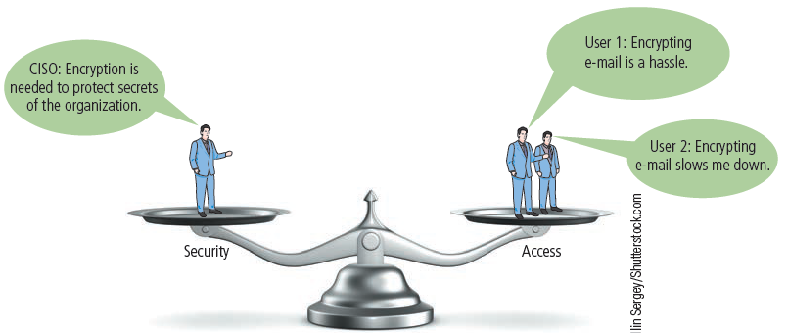
Introduction to Computer Security
4. Security And The Organization
Balancing Information Security and Access

Slide 31
Introduction to Computer Security
4. Security And The Organization
Balancing Information Security and Access
Even with the best planning and implementation, it is impossible to obtain perfect information security. To achieve balance—that is, to operate an information system that satisfies users and security professionals equally—the security level must allow reasonable access yet protect against threats. An imbalance can occur when the needs of the end user are undermined by obsessive focus on protecting and administering the information systems.

Slide 32
Introduction to Computer Security
4. Security And The Organization
2. Approaches to Information Security Implementation
Bottom-Up Approach: Securing information assets is an incremental process that requires coordination, time, and patience. Information security can begin as an attempt by systems administrators to improve the security of their systems by working together. The key advantage of the bottom-up approach is the technical expertise of individual administra-tors.
Top-Down Approach: With this approach, the project is formally designed and supported by upper-level managers who issue policies, procedures, and processes, dictate the goals and expected outcomes, and determine accountability for each required action. This approach has strong upper management support, a dedicated champion, usually dedi-cated funding, a clear planning and implementation process, and the means of influencing organizational culture. The most successful kind of top-down approach also involves a formal development strategy known as a systems development life cycle.

Slide 33
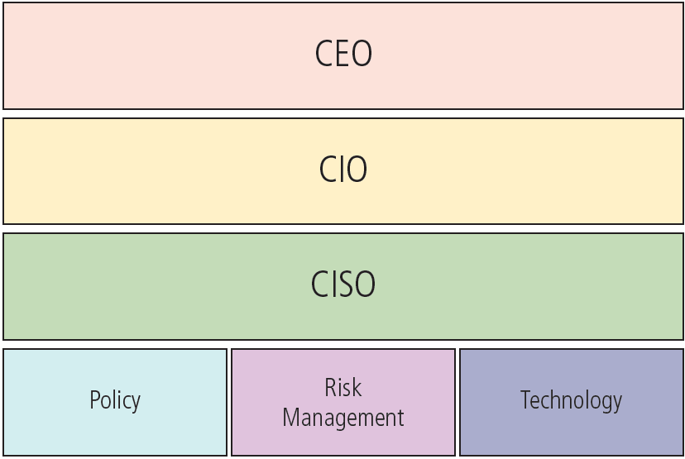
Introduction to Computer Security
4. Security And The Organization
3. Security Professionals

Slide 34
Introduction to Computer Security
4. Security And The Organization
4. Data Responsibilities
Data Owners: Individuals who control, and are responsible for, the security and use of a particular set of information.
Data Custodians: (also known as data stewards) are responsible for the information and the systems that process, transmit, and store it. The duties of a data custodian often include overseeing data storage and backups, implementing the specific procedures and policies laid out in the security policies and plans, and reporting to the data owner.
Data Trustees: are individuals appointed by data owners to oversee the management of a particular set of information and to coordinate with data custodians for its storage, protection, and use.
Data Users: all individuals or end users with access to the information
Notes:
Data Responsibilities
The four types of data ownership and their respective responsibilities are outlined
here:
• Data owners—Data owners usually determine the level of data classification
as well as the changes to that classification required by organizational
change. The data owners work with subordinate managers to oversee the
day-to-day administration of the data.
• Data custodians—Working directly with data owners, data custodians (also
known as data stewards) are responsible for the information and the systems
that process, transmit, and store it. Depending on the size of the organization,
this may be a dedicated position, such as the CISO, or it may be
an additional responsibility of a systems administrator or other technology
manager. The duties of a data custodian often include overseeing data storage
and backups, implementing the specific procedures and policies laid out
in the security policies and plans, and reporting to the data owner.
• Data trustees—Data trustees are individuals appointed by data owners to
oversee the management of a particular set of information and to coordinate
with data custodians for its storage, protection, and use. Because data owners
are typically top-level executives and managers too busy to oversee the
management of their data, they will typically appoint a senior subordinate
as a data trustee to handle those responsibilities.
• Data users—Everyone in the organization is responsible for the security of
data, so data users are included here as all individuals or end users with
access to information and thus an information security role.

Slide 35
Introduction to Computer Security
4. Security And The Organization
5. Communities of Interest
Information Security Management and Professionals
Information Technology Management and Professionals
Organizational Management and Professionals
National Communication Authority
Data Protection Agency
Internet Society of Ghana
Information Technology Association of Ghana
Notes:
Information Security Management and Professionals
The roles of information security professionals are aligned with the goals and mission of the information security community
of interest. These job functions and organizational roles focus on protecting the organization’s information
systems and stored information from attacks.
Information Technology Management and Professionals
The community of interest made up of IT managers and skilled professionals in systems design, programming,
networks, and other related disciplines has many of the same objectives as the information security community.
However, its members focus more on costs of system creation and operation, ease of use for system users, and
timeliness of system creation, as well as transaction response time. The goals of the IT community and the information
security community are not always in complete alignment, and depending on the organizational structure,
this may cause conflict.
Organizational Management and Professionals
The organization’s general management team and the rest of the personnel in the organization make up the other major
community of interest. This large group is almost always made up of subsets of other interests as well, including executive
management, production management, human resources, accounting, and legal staff, to name just a few. The IT
community often categorizes these groups as users of information technology systems, while the information security
community categorizes them as security subjects. In fact, this community serves as the greatest reminder that all IT
systems and information security objectives exist to further the objectives of the broad organizational community. The
most efficient IT systems operated in the most secure fashion ever devised have no value if they are not useful to the
organization as a whole.

Slide 36
Introduction to Computer Security
5. Information Security: Is It An Art Or A Science?
Security as Art
Security as Science
Security as a Social Science

Slide 37
Introduction to Computer Security
6. Lesson Summary (1/4)
Information security evolved from the early field of computer security.
Security is protection from danger. A successful organization should have multiple layers of security in place to protect its people, operations, physical infrastructure, functions, communications, and information.
Information security is the protection of information assets that use, store, or transmit information through the application of policy, education, and technology.
Notes:
• Information security evolved from the early field of computer security.
• Security is protection from danger. A successful organization should have multiple layers of security in place
to protect its people, operations, physical infrastructure, functions, communications, and information.
• Information security is the protection of information assets that use, store, or transmit information through
the application of policy, education, and technology.
• The critical characteristics of information, including confidentiality, integrity, and availability (the C.I.A. triad),
must be protected at all times. This protection is implemented by multiple measures that include policies,
education, training and awareness, and technology.
• Information systems are made up of the major components of hardware, software, data, people, procedures,
and networks.
• Upper management drives the top-down approach to security implementation, in contrast with the bottom-up
approach or grassroots effort, in which individuals choose security implementation strategies.
• The control and use of data in the organization is accomplished by the following parties:
❍❍ Data owners, who are responsible for the security and use of a particular set of information
❍❍ Data custodians, who are responsible for the storage, maintenance, and protection of the information
❍❍ Data trustees, who are appointed by data owners to oversee the management of a particular set of information
and to coordinate with data custodians for its storage, protection, and use
❍❍ Data users, who work with the information to perform their daily jobs and support the mission of the
organization
• Each organization has a culture in which communities of interest are united by similar values and share common
objectives. The three communities in information security are general management, IT management, and
information security management.
• Information security has been described as both an art and a science, and it comprises many aspects of social
science as well.

Slide 38
Introduction to Computer Security
6. Lesson Summary (2/4)
The critical characteristics of information, including confidentiality, integrity, and availability (the C.I.A. triad), must be protected at all times. This protection is implemented by multiple measures that include policies, education, training and awareness, and technology.
Information systems are made up of the major components of hardware, software, data, people, procedures, and networks.
Upper management drives the top-down approach to security implementation, in contrast with the bottom-up approach or grassroots effort, in which individuals choose security implementation strategies.
Notes:
• Information security evolved from the early field of computer security.
• Security is protection from danger. A successful organization should have multiple layers of security in place
to protect its people, operations, physical infrastructure, functions, communications, and information.
• Information security is the protection of information assets that use, store, or transmit information through
the application of policy, education, and technology.
• The critical characteristics of information, including confidentiality, integrity, and availability (the C.I.A. triad),
must be protected at all times. This protection is implemented by multiple measures that include policies,
education, training and awareness, and technology.
• Information systems are made up of the major components of hardware, software, data, people, procedures,
and networks.
• Upper management drives the top-down approach to security implementation, in contrast with the bottom-up
approach or grassroots effort, in which individuals choose security implementation strategies.
• The control and use of data in the organization is accomplished by the following parties:
❍❍ Data owners, who are responsible for the security and use of a particular set of information
❍❍ Data custodians, who are responsible for the storage, maintenance, and protection of the information
❍❍ Data trustees, who are appointed by data owners to oversee the management of a particular set of information
and to coordinate with data custodians for its storage, protection, and use
❍❍ Data users, who work with the information to perform their daily jobs and support the mission of the
organization
• Each organization has a culture in which communities of interest are united by similar values and share common
objectives. The three communities in information security are general management, IT management, and
information security management.
• Information security has been described as both an art and a science, and it comprises many aspects of social
science as well.

Slide 39
Introduction to Computer Security
6. Lesson Summary (3/4)
The control and use of data in the organization is accomplished by the following parties:
Data owners, who are responsible for the security and use of a particular set of information
Data custodians, who are responsible for the storage, maintenance, and protection of the information
Data trustees, who are appointed by data owners to oversee the management of a particular set of information and to coordinate with data custodians for its storage, protection, and use
Data users, who work with the information to perform their daily jobs and support the mission of the organization
Notes:
• Information security evolved from the early field of computer security.
• Security is protection from danger. A successful organization should have multiple layers of security in place
to protect its people, operations, physical infrastructure, functions, communications, and information.
• Information security is the protection of information assets that use, store, or transmit information through
the application of policy, education, and technology.
• The critical characteristics of information, including confidentiality, integrity, and availability (the C.I.A. triad),
must be protected at all times. This protection is implemented by multiple measures that include policies,
education, training and awareness, and technology.
• Information systems are made up of the major components of hardware, software, data, people, procedures,
and networks.
• Upper management drives the top-down approach to security implementation, in contrast with the bottom-up
approach or grassroots effort, in which individuals choose security implementation strategies.
• The control and use of data in the organization is accomplished by the following parties:
❍❍ Data owners, who are responsible for the security and use of a particular set of information
❍❍ Data custodians, who are responsible for the storage, maintenance, and protection of the information
❍❍ Data trustees, who are appointed by data owners to oversee the management of a particular set of information
and to coordinate with data custodians for its storage, protection, and use
❍❍ Data users, who work with the information to perform their daily jobs and support the mission of the
organization
• Each organization has a culture in which communities of interest are united by similar values and share common
objectives. The three communities in information security are general management, IT management, and
information security management.
• Information security has been described as both an art and a science, and it comprises many aspects of social
science as well.

Slide 40
Introduction to Computer Security
6. Lesson Summary (4/4)
Each organization has a culture in which communities of interest are united by similar values and share common objectives. The three communities in information security are general management, IT management, and informa-tion security management.
Information security has been described as both an art and a science, and it comprises many aspects of social science as well.

Slide 41
Introduction to Computer Security
7. Review Questions
What are the three components of the C.I.A. triad?
What are they used for?
Describe the critical characteristics of information. How are they used in the study of computer security?
Identify the six components of an information system. Which are most directly affected by the study of compu-ter security?
Why is the top-down approach to information security superior to the bottom-up approach?
Notes:
Introduction to Information
Security 1
Introduction To Information Security 2
The 1960s 3
The 1970s and ’80s 4
The 1990s 7
2000 to Present 7
What Is Security? 8
Key Information Security Concepts 9
Critical Characteristics of Information 11
CNSS Security Model 14
Components Of An Information System 15
Software 15
Hardware 15
Data 16
People 16
Procedures 16
Networks 17
Security And The Organization 17
Balancing Information Security and Access 17
Approaches to Information Security
Implementation 18
Security Professionals 19
Data Responsibilities 20
Communities of Interest 20
Information Security: Is It An Art Or
A Science?
21
Security as Art 21
Security as Science 21
Security as a Social Science 22
Module Summary

Slide 42
Introduction to Computer Security
Questions
???????????
?????????
???????
?????
???
?
Notes:
Introduction to Information
Security 1
Introduction To Information Security 2
The 1960s 3
The 1970s and ’80s 4
The 1990s 7
2000 to Present 7
What Is Security? 8
Key Information Security Concepts 9
Critical Characteristics of Information 11
CNSS Security Model 14
Components Of An Information System 15
Software 15
Hardware 15
Data 16
People 16
Procedures 16
Networks 17
Security And The Organization 17
Balancing Information Security and Access 17
Approaches to Information Security
Implementation 18
Security Professionals 19
Data Responsibilities 20
Communities of Interest 20
Information Security: Is It An Art Or
A Science?
21
Security as Art 21
Security as Science 21
Security as a Social Science 22
Module Summary

Slide 43
The Need for Information Security
Lesson 2 Objectives
At the end of this lecture, you should be able to:
Discuss the need for information security
Explain why a successful information security program is the shared responsibility of the entire organization
List and describe the threats posed to information security and common attacks associated with those threats
List the common information security issues that result from poor software development efforts

Slide 44
The Need for Information Security
Introduction to the Need for Information Security
Information Security Threats and Attacks
The 12 Categories of Threats
Lesson Summary
Review Questions

Slide 45
The Need for Information Security
Introduction to the Need for Information Security
The primary mission of an information security program is to ensure that information assets—information and the systems that house them—are protected and thus remain safe and useful. Information security performs four important functions for an organization:
Protecting the organization’s ability to function
Protecting the data and information the organization collects and uses, whether physical or electronic
Enabling the safe operation of applications running on the organization’s IT systems
Safeguarding the organization’s technology assets

Slide 46
The Need for Information Security
Information Security Threats and Attacks
To protect your organization’s information, you must:
know yourself—that is, be familiar with the information to be protected and the systems that store, transport, and process it
know your enemy; in other words, the threats you face.
To make sound decisions about information security, Management must be informed about the various threats to an organization’s people, applica-tions, data, and information systems. A threat represents a potential risk to an information asset, whereas an attack represents an ongoing act against the asset that could result in a loss. Threat agents damage or steal an organization’s information or physical assets by using exploits to take advantage of vulnerabilities where controls are not present or no longer effective. Unlike threats, which are always present, attacks exist only when a specific act may cause a loss.
Notes:
Around 500 B.C., the Chinese general Sun Tzu Wu wrote The Art of War, a military treatise that emphasizes the importance
of knowing yourself as well as the threats you face.2 To protect your organization’s information, you must
(1) know yourself—that is, be familiar with the information to be protected and the systems that store, transport,
and process it—and (2) know your enemy; in other words, the threats you face. To make sound decisions about information
security, management must be informed about the various threats to an organization’s people, applications,
data, and information systems. As discussed in Module 1, a threat represents a potential risk to an information asset,
whereas an attack represents an ongoing act against the asset that could result in a loss. Threat agents damage or steal
an organization’s information or physical assets by using exploits to take advantage of vulnerabilities where controls
are not present or no longer effective. Unlike threats, which are always present, attacks exist only when a specific act
may cause a loss. For example, the threat of damage from a thunderstorm is present throughout the summer in many
places, but an attack and its associated risk of loss exist only for the duration of an actual thunderstorm. The following
sections discuss each of the major types of threats and corresponding attacks facing modern information assets.

Slide 47
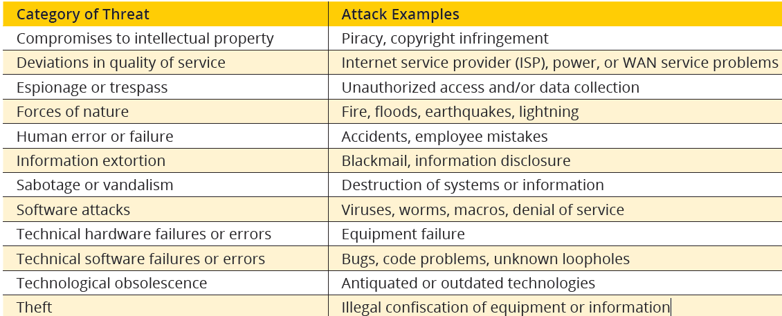
The 12 Categories Of Threats
The 12 Categories of Threats

Slide 48
The 12 Categories Of Threats
1. Compromises to Intellectual Property
Software Piracy: use of software without paying for it
Copyright Protection and User Registration: paying for a single instance but installing multiple copies

Slide 49
The 12 Categories Of Threats
2. Deviations in Quality of Service
Internet Service Issues
Communications and Other Service Provider Issues
Power Irregularities

Slide 50
The 12 Categories Of Threats
3. Espionage or Trespass
Shoulder Surfing
Hackers:
• Expert • Novice • PenTester • Black • White • Grey
Escalation of Privileges:
• Jailbreaking • Rooting
Hacker Variants: cracker, phreaker
Password Attacks:
• Brute force • Dictionary • Rainbow tables • Social Engineering
Notes:
Forces of Nature
Human Error or Failure
Information Extortion
Sabotage or Vandalism
Software Attacks
Technical Hardware Failures or Errors
Technical Software Failures or Errors
Technological Obsolescence
Theft

Slide 51
The 12 Categories Of Threats
4. Forces of Nature
Also known as Acts of God, (or force majeure), these may include but not limited to
Fires
Floods
Earthquakes
Landslides
Mudslides
Windstorms
Sandstorms
Solar Flares
Lightning
Volcanic Eruptions
Pandemics
Civil Disorder
Wars
Insect Infestations.

Slide 52
The 12 Categories Of Threats
5. Human Error or Failure
Social Engineering
Business E-Mail Compromise (BEC)
Advance-Fee Fraud
Phishing
Pretexting

Slide 53
The 12 Categories Of Threats
6. Information Extortion
Ransomware:
Lockscreen
Encryption

Slide 54
The 12 Categories Of Threats
7. Sabotage or Vandalism
Online Activism (Hacktivist or Cyberactivist)
Cyberterrorism and Cyberwarfare
Doxing (Releasing Secret Documents)
Positive Online Activism

Slide 55
The 12 Categories Of Threats
8. Software Attacks
Malware (Malicious Code or Malicious Software)
Viruses
Back Doors
Denial-of-Service (DoS) and Distributed Denial-of-Service (DDoS)
Pharming
Man-in-the-Middle (MITM)
TCP hijacking (Session Hijacking)
Password Crack
Brute Force
Dictionary Attack
Hoaxes
Adware
Spam
Sniffers

Slide 56
The 12 Categories Of Threats
9. Technical Hardware Failures or Errors
Mean Time Between Failure (MTBF)
Mean Time To Failure (MTTF)
Mean Time To Diagnose (MTTD)
Mean Time To Repair (MTTR)
Annualized Failure Rate (AFR)

Slide 57
The 12 Categories Of Threats
10. Technical Software Failures or Errors
1. Injection
2. Broken Authentication
3. Sensitive Data Exposure
4. XML External Entities (XXE)
5. Broken Access Control
6. Security Misconfiguration
7. Cross-Site Scripting (XSS)
8. Insecure Deserialization
9. Insufficient Logging & Monitoring
10. Insecure Direct Object References

Slide 58
The 12 Categories Of Threats
11. Technological Obsolescence
Antiquated or outdated infrastructure can lead to unreliable and untrustworthy systems. when technology becomes outdated, there is a risk of losing data integrity from attacks.

Slide 59
The 12 Categories Of Threats
12. Theft
The threat of theft is a constant. The value of information is diminished when it is copied without the owner’s knowledge.
Physical theft can be controlled easily using a wide variety of measures, from locked doors to trained security personnel and the installation of alarm systems. Electronic theft, however, is a more complex problem to manage and control.

Slide 60
The 12 Categories Of Threats
Lesson Summary
Information security performs four important functions to ensure that information assets remain safe and useful:
protecting the organization’s ability to function
enabling the safe operation of applications implemented on the organization’s IT systems
protecting the data an organization collects and uses
safeguarding the organization’s technology assets.
To make sound decisions about information security, management must be informed about threats to its people, applications, data, and information systems, and the attacks they face.
Threats are any events or circumstances that have the potential to adversely affect operations and assets. An attack is an intentional or unintentional act that can damage or otherwise compromise information and the systems that support it. A vulnerability is a potential weakness in an asset or its defensive controls.

Slide 61
The 12 Categories Of Threats
Lesson Summary
• Threats or dangers facing an organization’s people, information, and systems fall into the following categories:
❍Compromises to intellectual property—Intellectual property, such as trade secrets, copyrights, trademarks, or patents, are intangible assets that may be attacked via software piracy or the exploitation of asset protection controls.
❍ Deviations in quality of service—Organizations rely on services provided by others. Losses can come from interruptions to those services.
❍ Espionage or trespass—Asset losses may result when electronic and human activities breach the confidentiality of information.
❍ Forces of nature—A wide range of natural events can overwhelm control systems and preparations to cause losses to data and availability.
❍ Human error or failure—Losses to assets may come from intentional or accidental actions by people inside and outside the organization.

Slide 62
The 12 Categories Of Threats
Lesson Summary
❍ Information extortion—Stolen or inactivated assets may be held hostage to extract payment of ransom.
❍ Sabotage or vandalism—Losses may result from the deliberate sabotage of a computer system or business, or from acts of vandalism. These acts can either destroy an asset or damage the image of an organization.
❍ Software attacks—Losses may result when attackers use software to gain unauthorized access to systems or cause disruptions in systems availability.
❍ Technical hardware failures or errors—Technical defects in hardware systems can cause unexpected results, including unreliable service or lack of availability.
❍ Technical software failures or errors—Software used by systems may have purposeful or unintentional errors that result in failures, which can lead to loss of availability or unauthorized access to information.
❍ Technological obsolescence—Antiquated or outdated infrastructure can lead to unreliable and untrustworthy systems that may result in loss of availability or unauthorized access to information.
❍ Theft—Theft of information can result from a wide variety of attacks.

Slide 63
The 12 Categories Of Threats
Review Questions
What is the most common violation of intellectual property?
How does an organization protect against it?
What are the various types of malware?
How do worms differ from viruses?
What are the various forces of nature?
How can you protect against shoulder surfing?
Why are employees among the greatest threats to information security?
What is information extortion? Describe how such an attack can cause losses, using an example not found in the text.

Slide 64
The 12 Categories Of Threats
Review Questions
For a sniffer attack to succeed, what must the attacker do?
How can an attacker gain access to a network to use the sniffer system?
What are the types of password attacks?
What can a systems administrator do to protect against them?
Consider that an individual threat agent, like a hacker, can be a factor in more than one threat category. If a hacker breaks into a network, copies a few files, defaces a Web page, and steals credit card numbers, how many different threat categories does the attack fall into?

Slide 65
The Need for Information Security
Questions
???????????
?????????
???????
?????
???
?

Slide 66
Information Security Management
Upon completion of this lesson, you should be able to:
Describe the different management functions with respect to information security
Define information security governance and list the expectations of the organization’s senior management with respect to it
Describe management’s role in the development, maintenance, and enforcement of information security policy, standards, practices, procedures, and guidelines
List the elements in an effective security education, training, and awareness program and describe a methodology for effectively implementing security policy in the organization
Explain what an information security blueprint is, identify its major components, and explain how it supports the information security program
Notes:
Week 1: Introduction to Information Security
Week 2: The Need for Information Security
Week 3: Information Security Management
Week 4: Risk Management
Week 5: Incident Response and Contingency Planning
Week 6: Legal, Ethical, and Professional Issues in Information Security
Week 7: Security and Personnel
Week 8: Security Technology: Access Controls, Firewalls, and VPNs
Week 9: Security Technology: Intrusion Detection and Prevention Systems, and Other Security Tools
Week 10: Cryptography
Week 11: Implementing Information Security
Week 12: Information Security Maintenance

Slide 67
Information Security Management
Introduction to the Management of Information Security
Information Security Planning and Governance
Information Security Policy, Standards, and Practices
Security Education, Training, and Awareness Program
Information Security Blueprint, Models, and Frameworks
Lesson Summary
Review Questions
Exercises

Slide 68
Information Security Management
Introduction to the Management of Information Security
An organization’s information security effort succeeds only when it operates in conjunction with the organization’s information security policy. An information security program begins with policy, standards, and practices, which are the foundation for the information security program and its blueprint. InfoSec activities in an organisation revolves around the “Six P’s”:
Planning
Policy
Programs
Protection
People
Projects

Slide 69
Information Security Management
Introduction to the Management of Information Security
1. Planning
Planning in InfoSec management are activities necessary to support the design, creation, and implementation of InfoSec strategies within the planning environments of all organiza-tional units, including IT. Because the InfoSec strategic plans must support not only the IT department’s use and protec-tion of information assets but those of the entire organiza-tion, it is imperative that the CISO work closely with all senior managers in developing InfoSec strategy. The business strategy is translated into the IT strategy.

Slide 70
Information Security Management
Introduction to the Management of Information Security
2. Policy
In InfoSec, there are three general policy categories, which are:
Enterprise Information Security Policy (EISP)—Developed within the context of the strategic IT plan, this sets the tone for the InfoSec department and the InfoSec climate across the organization.
Issue-Specific Security Policies (ISSPs)—These are sets of rules that define acceptable behavior within a specific organizational resource, such as e-mail or Internet usage.
Systems-Specific Policies (SysSPs)—A merger of technical and managerial intent, SysSPs include both the managerial guidance for the implementation of a technology as well as the technical specifications for its configuration.

Slide 71
Information Security Management
Introduction to the Management of Information Security
3. Programs
InfoSec operations that are specifically managed as separate entities are called “programs.” An example would be a security education, training, and awareness (SETA) program or a risk management program. SETA programs provide critical information to employees to maintain or improve their current levels of security knowledge. Risk management programs include the identification, assessment, and control of risks to information assets. Other programs that may
emerge include a physical security program, complete with fire protection, physical access, gates, and guards.

Slide 72
Information Security Management
Introduction to the Management of Information Security
4. Protection
The protection function is executed via a set of risk management activities, as well as protection mechanisms, technologies, and tools. Each of these mechanisms or safeguards represents some aspect of the management of specific controls in the overall InfoSec plan.
5. People
People are the most critical link in the InfoSec program. This area encompasses security personnel (the professional information security employees), the security of personnel (the protection of employees and their information), and aspects of the SETA program mentioned earlier.

Slide 73
Information Security Management
Introduction to the Management of Information Security
6. Projects
Whether an InfoSec manager is asked to roll out a new security training program or select and implement a new firewall, it is important that the process be managed as a project. The final element for InfoSec management is the application of a project management discipline to all elements of the InfoSec program. Project management involves identifying and controlling the resources applied to the project, as well as measuring progress and adjusting the process as progress is made toward the goal.

Slide 74
Information Security Management
2. Information Security Planning and Governance
InfoSec Planning and Governance is a core factor in the strategic planning of any serious organisation that employs an information system. Strategic planning is the process of defining and specifying the long-term direction (strategy) to be taken by an organization, and the allocation and acquisition of resources needed to pursue this effort.

Slide 75
Information Security Management
2. Information Security Planning and Governance
InfoSec Planning and Governance involves:
Information Security Leadership
Information Security Governance Outcomes
Planning Levels
Planning and the CISO

Slide 76
Information Security Management
2. Information Security Planning and Governance
1. Information Security Leadership
The leadership of the information security function that delivers strategic planning and corporate responsibility is best accomplished using an approach refered to as Governance, Risk Management, and Compliance (GRC). When security programs are designed and managed as a technical specialty in the IT department, they are less likely to be effective. A broader view of InfoSec encompasses all of an organization’s information assets, including IT assets. These valuable commodities must be protected regardless of how the information is processed, stored, or transmitted, and with a thorough understanding of the risks and benefits.

Slide 77
Information Security Management
2. Information Security Planning and Governance
1. Information Security Leadership
The standard recommendations for the assessment of an information security governance program specifies six high-level “action-oriented” information security governance principles:
1. Establish organization-wide information security.
2. Adopt a risk-based approach.
3. Set the direction of investment decisions.
4. Ensure conformance with internal and external requirements.
5. Foster a security-positive environment.
6. Review performance in relation to business outcomes.

Slide 78
Information Security Management
2. Information Security Planning and Governance
1. Information Security Leadership
The standard promotes five governance processes, which should be adopted by the organization’s executive management and its governing board.
• Evaluate—Review the status of current and projected progress toward organizational information security objectives and make a determination whether modifications of the program or its strategy are needed to keep on track with strategic goals.
• Direct—The board of directors provides instruction for developing or implementing changes to the security program. This could include modification of available resources, structure of priorities of effort, adoption of policy, recommendations for the risk management program, or alteration to the organization’s risk tolerance.

Slide 79
Information Security Management
2. Information Security Planning and Governance
1. Information Security Leadership
• Monitor—The review and assessment of organizational information security performance toward goals and objectives by the governing body. Monitoring is enabled by ongoing performance measurement.
• Communicate—The interaction between the governing body and external stakeholders, where information on organizational efforts and recommendations for change are exchanged.
• Assure—The assessment of organizational efforts by external entities like certification or accreditation groups, regulatory agencies, auditors, and other oversight entities, in an effort to validate organizational security governance, security programs, and strategies.

Slide 80
Information Security Management
2. Information Security Planning and Governance
1. Information Security Leadership
InfoSec governance includes all of the accountabilities and methods undertaken by the board of directors and executive management to provide the following:
• Strategic direction
• Establishment of objectives
• Measurement of progress toward those objectives
• Verification that risk management practices are appropriate
• Validation that the organization’s assets are used properly

Slide 81
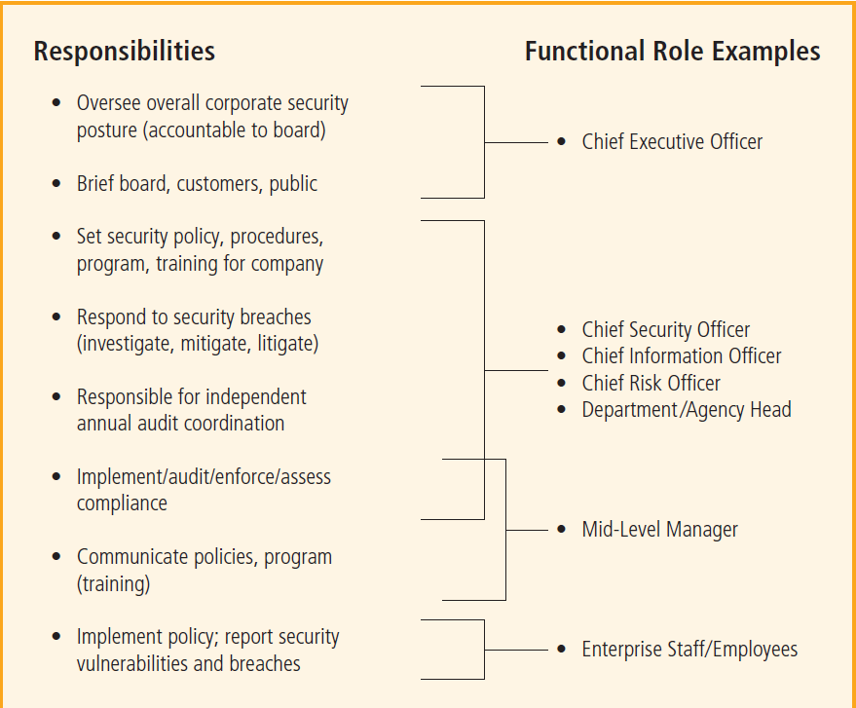
Information Security Management

Slide 82
Information Security Management
2. Information Security Planning and Governance
2. Information Security Governance Outcomes
The five goals of information security governance are as follows:
Strategic alignment of information security with business strategy to support organizational objectives
Risk management by executing appropriate measures to manage and mitigate threats to information resources
Resource management by using information security knowledge and infrastructure efficiently and effectively
Performance measurement by measuring, monitoring, and reporting information security governance metrics to ensure that organizational objectives are achieved
Value delivery by optimizing information security investments in support of organizational objectives

Slide 83
Information Security Management
2. Information Security Planning and Governance
3. Planning Levels
Strategic plans are used to create tactical plans, which in turn are used to develop operational plans. Tactical planning focuses on undertakings that will be completed within one or two years. Managers and employees use operational planning derived from tactical planning to organize the ongoing, day-to-day performance of tasks. Frequent communication and feedback from the teams to the project managers and/or team leaders, and then up to the various management levels, will make the planning process more manageable and successful.

Slide 84
Information Security Management
2. Information Security Planning and Governance
4. Planning and the CISO
The first priority of the CISO and the information security management team is the creation of a strategic plan to accomplish the organization’s information security objectives. The plan is an evolving statement of how the CISO and various elements of the organization will implement the objectives of the enterprise information security policy (EISP), Information security, like information technology, must support more than its own functions. All organizational units will use information, not just IT-based information, so the information security group must understand and support the strategic plans of all business units.

Slide 85
Information Security Management
3. Information Security Policy, Standards, and Practices
Policies function like laws in an organization because they dictate acceptable and unacceptable behavior there, as well as the penalties for failure to comply. Like laws, policies define what is right and wrong, the penalties for violating policy, and the appeal process. Standards, on the other hand, are more detailed statements of what must be done to comply with policy. They have the same requirements for compliance as policies. Standards may be informal or part of an organizational culture, as in de facto standards. Or, standards may be published, scrutinized, and ratified by a group, as in formal or de jure standards. Practices, procedures, and guidelines effectively explain how to comply with policy.

Slide 86
Information Security Management
3. Information Security Policy, Standards, and Practices
Policy: Instructions that dictate acceptable and/or unacceptable behavior within an organization.
Standard: A detailed statement of what must be done to comply with policy, sometimes viewed as the rules governing policy compliance.
De facto Standard: A standard that has been widely adopted or accepted by a public group rather than a formal standards organization.

Slide 87
Information Security Management
3. Information Security Policy, Standards, and Practices
De jure Standard: A standard that has been formally evaluated, approved, and ratified by a formal standards organization.
Guidelines: Non-mandatory recommendations that employees may use as a reference in complying with a policy.
Procedures: Step-by-step instructions designed to assist employees in following policies, standards, and guidelines.
Practices: Examples of actions that illustrate compliance with policies.

Slide 88
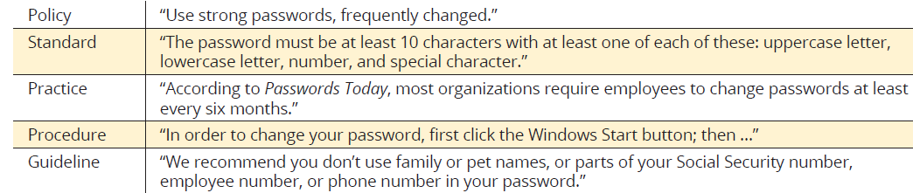
Information Security Management
3. Information Security Policy, Standards, and Practices
Relationship between Policies, Standards, Practices, Procedures, and Guidelines

Slide 89
Information Security Management
3. Information Security Policy, Standards, and Practices
Issue-Specific Security Policy
An organization’s ISSP must:
address specific areas of technology
require frequent updates
contain a statement about the organization’s position on a specific issue.
Notes:
Statement of Policy
The policy should begin with a clear statement of purpose—in other words, what exactly is this policy supposed to
accomplish? Consider a policy that covers the issue of fair and responsible Internet use. The introductory section of
this policy should address the following questions: What is the scope of this policy? Who does this policy apply to?
Who is responsible and accountable for policy implementation? What technologies and issues does it address?
Authorized Access and Usage of Equipment
This section of the policy statement addresses who can use the technology governed by the policy and what it can be
used for. Remember that an organization’s information systems are its exclusive property, and users have no rights of
use. Each technology and process is provided for business operations. Use for any other purpose constitutes misuse
of equipment. This section defines “fair and responsible use” of equipment and other organizational assets and should
address key legal issues, such as protection of personal information and privacy.
Prohibited Use of Equipment
Unless a particular use is clearly prohibited, the organization cannot penalize its employees for misuse. For example,
the following can be prohibited: personal use, disruptive use or misuse, criminal use, offensive or harassing materials,
and infringement of copyrighted, licensed, or other intellectual property. As an alternative approach, sections 2 and 3
of Table 3-3 can be collapsed into a single category called “Appropriate Use.” Many organizations use such an ISSP
section to cover both categories.
Systems Management
The systems management section of the ISSP policy statement focuses on the users’ relationship to systems management.
Specific rules from management include regulating the use of e-mail, the storage of materials, the authorized
monitoring of employees, and the physical and electronic scrutiny of e-mail and other electronic documents. It is
important that all such responsibilities are assigned either to the systems administrator or the users; otherwise, both
parties may infer that the responsibility belongs to the other.
Violations of Policy
The people to whom the policy applies must understand the penalties and repercussions of violating it. Violations of
policy should carry penalties that are appropriate—neither draconian nor overly lenient. This section of the policy
statement should contain not only specific penalties for each category of violation, but instructions for how people
in the organization can report observed or suspected violations. Many people think that powerful employees in an
organization can retaliate against someone who reports violations. Allowing anonymous submissions is often the only
way to convince users to report the unauthorized activities of more influential employees.
Policy Review and Modification
Because any document is only useful if it is up to date, each policy should contain procedures and a timetable for
periodic review. As the organization’s needs and technologies change, so must the policies that govern their use.
This section should specify a methodology for reviewing and modifying the policy to ensure that users do not begin
circumventing it as it grows obsolete.
Limitations of Liability
If an employee is caught conducting illegal activities with the organization’s equipment or assets, management does
not want the organization held liable. The policy should state that if employees violate a company policy or any law
using company technologies, the company will not protect them, and the company is not liable for their actions. In
fact, many organizations assist in the prosecution of employees who violate laws when their actions violate policies.
It is assumed that such violations occur without knowledge or authorization by the organization.
Copyright

Slide 90
Information Security Management
3. Information Security Policy, Standards, and Practices
Issue-Specific Security Policy
An organization’s ISSP may cover the following topics:
Statement of Policy
Authorized Access and Usage of Equipment
Prohibited Use of Equipment
Systems Management
Violations of Policy
Policy Review and Modification
Limitations of Liability
Notes:
Statement of Policy
The policy should begin with a clear statement of purpose—in other words, what exactly is this policy supposed to
accomplish? Consider a policy that covers the issue of fair and responsible Internet use. The introductory section of
this policy should address the following questions: What is the scope of this policy? Who does this policy apply to?
Who is responsible and accountable for policy implementation? What technologies and issues does it address?
Authorized Access and Usage of Equipment
This section of the policy statement addresses who can use the technology governed by the policy and what it can be
used for. Remember that an organization’s information systems are its exclusive property, and users have no rights of
use. Each technology and process is provided for business operations. Use for any other purpose constitutes misuse
of equipment. This section defines “fair and responsible use” of equipment and other organizational assets and should
address key legal issues, such as protection of personal information and privacy.
Prohibited Use of Equipment
Unless a particular use is clearly prohibited, the organization cannot penalize its employees for misuse. For example,
the following can be prohibited: personal use, disruptive use or misuse, criminal use, offensive or harassing materials,
and infringement of copyrighted, licensed, or other intellectual property. As an alternative approach, sections 2 and 3
of Table 3-3 can be collapsed into a single category called “Appropriate Use.” Many organizations use such an ISSP
section to cover both categories.
Systems Management
The systems management section of the ISSP policy statement focuses on the users’ relationship to systems management.
Specific rules from management include regulating the use of e-mail, the storage of materials, the authorized
monitoring of employees, and the physical and electronic scrutiny of e-mail and other electronic documents. It is
important that all such responsibilities are assigned either to the systems administrator or the users; otherwise, both
parties may infer that the responsibility belongs to the other.
Violations of Policy
The people to whom the policy applies must understand the penalties and repercussions of violating it. Violations of
policy should carry penalties that are appropriate—neither draconian nor overly lenient. This section of the policy
statement should contain not only specific penalties for each category of violation, but instructions for how people
in the organization can report observed or suspected violations. Many people think that powerful employees in an
organization can retaliate against someone who reports violations. Allowing anonymous submissions is often the only
way to convince users to report the unauthorized activities of more influential employees.
Policy Review and Modification
Because any document is only useful if it is up to date, each policy should contain procedures and a timetable for
periodic review. As the organization’s needs and technologies change, so must the policies that govern their use.
This section should specify a methodology for reviewing and modifying the policy to ensure that users do not begin
circumventing it as it grows obsolete.
Limitations of Liability
If an employee is caught conducting illegal activities with the organization’s equipment or assets, management does
not want the organization held liable. The policy should state that if employees violate a company policy or any law
using company technologies, the company will not protect them, and the company is not liable for their actions. In
fact, many organizations assist in the prosecution of employees who violate laws when their actions violate policies.
It is assumed that such violations occur without knowledge or authorization by the organization.
Copyright

Slide 91
Information Security Management
3. Information Security Policy, Standards, and Practices
Systems-Specific Security Policy (SysSP)
These are organizational policies that often function as standards or procedures to be used when configuring or maintaining systems. SysSPs can be separated into two general groups:
Managerial Guidance
Technical Specifications
However, these may be written as a single unified SysSP document.

Slide 92
Information Security Management
3. Information Security Policy, Standards, and Practices
Systems-Specific Security Policy (SysSP)
Managerial Guidance
A policy that expresses management’s intent for the acquisition, implementation, configuration, and management of a particular technology, written from a business perspective.
Technical Specifications
A policy that expresses technical details for the acquisition, implementation, configuration, and management of a particular technology, written from a technical perspective; usually includes details on configuration rules, systems policies, and access control.

Slide 93
Information Security Management
3. Information Security Policy, Standards, and Practices
Systems-Specific Security Policy (SysSP)
Technical Specifications usually employ two main methods:
Access Control Lists
Specifications of authorization that govern the rights and privileges of users to a particular information asset; includes user access lists, matrices, and capabilities tables.
Configuration Rules
The instructions a system administrator codes into a server, networking device, or security device to specify how it operates.

Slide 94
Information Security Management
3. Information Security Policy, Standards, and Practices
For policies to be effective and legally defensible, the following must be done properly:
Development—Policies must be written using industry-accepted practices and formally approved by management.
Dissemination—Policies must be distributed using all appropriate methods.
Review—Policies must be readable and read by all employees.
Comprehension—Policies must be understood by all employees.
Compliance—Policies must be formally agreed to by act or affirmation.
Enforcement—Policies must be uniformly applied to all employees.

Slide 95
Information Security Management
4. Security Education, Training, and Awareness Program
A managerial program designed to improve the security of information assets by providing targeted knowledge, skills, and guidance for an organization’s employees.
SETA programs are designed to supplement the general education and training programs that many organizations use to educate staff about information security.
The SETA program consists of three distinct elements:
Security Education
Security Training
Security Awareness.

Slide 96
Information Security Management
4. Security Education, Training, and Awareness Program
The purpose of SETA is to enhance security by doing the following:
Improving awareness of the need to protect system resources
Developing skills and knowledge so computer users can perform their jobs more securely
Building in-depth knowledge as needed to design, implement, or operate security programs for organizations and systems

Slide 97
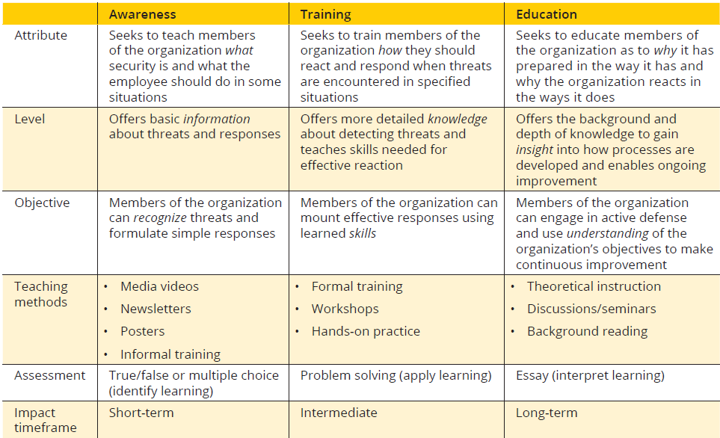
Information Security Management
4. Security Education, Training, and Awareness Program

Slide 98
Information Security Management
5. Information Security Blueprint, Models, and Frameworks
The information security blueprint (ISB) is the plan and basis for the design, selection, and implementation of all security program elements, including policies, risk management programs, education and training programs, technological controls, and program maintenance. The blueprint is the organization’s detailed implementation of an information security framework. The blueprint specifies tasks and the order in which they are to be accomplished, just as an architect’s blueprint serves as the design template for the construction of a building. The framework is the philosophical foundation from which the blueprint is designed, like the style or methodology in which an architect was trained.

Slide 99
Information Security Management
5. Information Security Blueprint, Models, and Frameworks
Information Security Model
A well-recognized information security framework, usually promoted by a government agency, standards organization, or industry group. (eg ISO 27000 Series, NIST Security Models, etc)
Information Security Framework
In information security, a specification of a model to be followed during the design, selection, and initial and ongoing implementation of all subsequent security controls, including information security policies, security education and training programs, and technological controls.

Slide 100
Information Security Management
5. Information Security Blueprint, Models, and Frameworks
Design of the Security Architecture
The security architecture of an organization can be organized along key components such as:
Spheres of Security
Levels of Controls
Defense in Depth
Security Perimeter

Slide 101
Information Security Management
5. Information Security Blueprint, Models, and Frameworks
Spheres of Security
Policies
People
Technology

Slide 102
Information Security Management
5. Information Security Blueprint, Models, and Frameworks
Defence in Depth
A strategy for the protection of information assets that uses multiple layers and different types of controls to provide optimal protection; typically, implementation of many different types of controls. A basic tenet of security architectures is the layered implementation of security. To achieve defense in depth, an organization must establish multiple layers of security controls and safeguards, which can be organized into policy, training and education, and technologies. Redundancy can be implemented at several points throughout the security architecture, such as in firewalls, proxy ervers, and access controls.

Slide 103
Information Security Management
5. Information Security Blueprint, Models, and Frameworks
Security Perimeter
A security perimeter is the border of security that protects all internal systems from outside threats. Security perimeters can effectively be implemented as multiple technologies that segregate the protected information from potential attackers. Within security perimeters, the organization can establish security domains, each with differing levels of security, between which traffic must be screened. The assumption is that if people have access to one system within a security domain, they have authorized access to all systems within that domain.

Slide 104
Information Security Management
5. Information Security Blueprint, Models, and Frameworks
Levels of Controls
Information security safeguards provide three levels of control: Managerial, Operational, and Technical.
Managerial focuses on administrative planning, organizing, leading, and controlling, and that are designed by strategic planners and implemented by the organization’s security administration; they include governance and risk management.
Operational focuses on lower-level planning that deals with the functionality of the organization’s security; they include disaster recovery planning, incident response planning, and SETA programs.
Technical focuses on the application of modern technologies, systems, and processes to protect information assets; they include firewalls, virtual private networks, etc.

Slide 105
Information Security Management
6. Lesson Summary
• Information security governance is the application of the principles of corporate governance to the information
security function. These principles include executive management’s responsibility to provide strategic
direction, ensure the accomplishment of objectives, oversee that risks are appropriately managed, and validate
responsible resource use.
• Management must use policies as the basis for all information security planning, design, and deployment.
Policies direct how issues should be addressed and technologies should be used.
• Standards are more detailed than policies and describe the steps that must be taken to conform to policies.
• Management must define three types of security policies: general or security program policies, issue-specific
security policies, and systems-specific security policies.
• The enterprise information security policy (EISP) should be a driving force in the planning and governance
activities of the organization as a whole.
• Information security policy is best disseminated in a comprehensive security education, training, and awareness
(SETA) program. A security awareness program is one of the least frequently implemented but most
beneficial programs in an organization. A security awareness program is designed to keep information security
at the forefront of users’ minds.
• Several published information security frameworks by government organizations, private organizations, and
professional societies supply information on best practices for their members.
• One of the foundations of security architectures is the layered implementation of security. This layered
approach is referred to as defense in depth.

Slide 106
Information Security Management
7. Review Questions
Briefly describe management, operational, and technical controls, and explain when each would be applied as part of a security framework.
What is the purpose of the SETA program?
What are the differences between a policy, a standard, and a practice?
How can a security framework assist in the designand implementation of a security infrastructure?

Slide 107
Information Security Management
8. Exercises
Search the Web for examples of issue-specific security policies (ISSP). What types of policies can you find? Using the format provided in this lesson, draft a simple issue-specific policy that outlines fair and responsible use of computers at your college, based on the rules and regulations of your institution. Does your school have a similar policy? Does it contain all the elements listed in the text?

Slide 108
The Need for Information Security
Questions
???????????
?????????
???????
?????
???
?

Slide 109
Risk Management
Introduction To Risk Management
The Risk Management Framework
The Risk Management Process
Risk Treatment/Risk Response
Managing Risk
Alternative Risk Management Methodologies
Summary
Review Questions

Slide 110
Risk Management
Upon completion of this session, you should be able to:
Define risk management and describe its importance
Explain the risk management framework and process model, including major components
Define risk appetite and explain how it relates to residual risk
Describe how risk is identified and documented
Discuss how risk is assessed based on likelihood and impact
Describe various options for a risk treatment strategy
Discuss conceptual frameworks for evaluating risk controls and formulating a cost-benefit analysis
Compare and contrast the dominant risk management methodologies

Slide 111
Risk Management
Introduction To Risk Management
If you know the enemy and know yourself, you need not fear the result of a hundred battles. If you know yourself but not the enemy, for every victory gained you will also suffer a defeat. If you know neither the enemy nor yourself, you will succumb in every battle. – Sun Tsu
Know Yourself
Know Your Enemy

Slide 112
Risk Management
Introduction To Risk Management
Know Yourself
To protect the organization's information assets, you must know:
What those assets are,
Where they are,
How they add value to the organization,
The vulnerabilities to which they are susceptible.
Frequently, organizations implement control mechanisms but then neglect the necessary periodic review, revision, and maintenance. The policies, education and training programs, and technologies that protect information must be carefully maintained and administered to ensure that they remain effective.

Slide 113
Risk Management
Introduction To Risk Management
Know Your Enemy
This means identifying, examining, and understanding the threats facing the organization. You must determine which threat aspects most directly affect the security of the organization and its information assets, and then use this information to create a list of threats, each one ranked according to the importance of the information assets that it threatens.

Slide 114
Risk Management
2. The Risk Management Framework
Risk management involves discovering and understanding the risks associated with an organization’s information assets:
1. Where and what is the risk (Risk Identification)?
2. How severe is the current level of risk (Risk Analysis)?
3. Is the current level of risk acceptable (Risk Evaluation)?
4. What do I need to do to bring the risk to an acceptable level (Risk Treatment)?

Slide 115
Risk Management
2. The Risk Management Framework
Some RM terms: (1/6)
Risk Assessment: The identification, analysis, and evaluation of risk as initial parts of risk management.
Risk Treatment (Risk Control): The application of safeguards or controls to reduce the risks to an organization’s information assets to an acceptable level.

Slide 116
Risk Management
2. The Risk Management Framework
Some RM terms: (2/6)
RM Framework: The overall structure of the strategic planning and design for the entirety of the organization’s RM efforts.
RM Process: The identification, analysis, evaluation, and treatment of risk to information assets, as specified in the RM framework.

Slide 117
Risk Management
2. The Risk Management Framework
Some RM terms: (3/6)
RM Plan: A document that contains specifications for the implementation and conduct of RM efforts.
Residual Risk: The risk to information assets that remains even after current controls have been applied.
Risk Appetite: The quantity and nature of risk that organi-zations are willing to accept as they evaluate the trade-offs between perfect security and unlimited accessibility.

Slide 118
Risk Management
2. The Risk Management Framework
Some RM terms: (4/6)
Risk Tolerance (Risk Threshold): The assessment of the amount of risk an organization is willing to accept for a particular information asset, typically synthesized into the organization’s overall risk appetite.
Zero-Tolerance Risk Exposure: An extreme level of risk tolerance whereby the organization is unwilling to allow any successful attacks or suffer any loss to an information asset.
Risk Appetite Statement: A formal document developed by the organization that specifies its overall willingness to accept risk to its information assets, based on a synthesis of individual risk tolerances.

Slide 119
Risk Management
2. The Risk Management Framework
Some RM terms: (5/6)
Risk Identification: The recognition, enumeration, and documentation of risks to an organization’s information assets.
Risk Uncertainty: The state of having limited or imperfect knowledge of a situation, making it less likely that organizations can successfully anticipate future events or outcomes.
Risk Impact: An understanding of the potential consequences of a successful attack on an information asset by a threat.
Risk Analysis: A determination of the extent to which an organization’s information assets are exposed to risk.
Threat Assessment: An evaluation of the threats to information assets, including a determination of their likelihood of occurrence and potential impact of an attack.

Slide 120
Risk Management
2. The Risk Management Framework
Some RM terms: (6/6)
Data Classification Scheme: A formal access control methodology used to assign a level of confidentiality to an information asset and thus restrict the number of people who can access it.
Risk Identification: The recognition, enumeration, and document-tation of risks to an organization’s information assets.
Risk Evaluation: The process of comparing an information asset’s risk rating to the numerical representation of the organization’s risk appetite or risk threshold to determine if risk treatment is required.

Slide 121
Risk Management
3. The Risk Management Process
Establishing the context
Identifying the risk
Analyzing the risk
Evaluating the risk
Treating the unacceptable risk
Summarizing the findings

Slide 122
Risk Management

Slide 123
Risk Management
4. Risk Treatment/Risk Response
Mitigation—Applying controls and safeguards that eliminate or reduce the remaining uncontrolled risk
Transference—Shifting risks to other areas or to outside entities
Acceptance—Understanding the consequences of choosing to leave an information asset’s vulnerability facing the current level of risk, but only after a formal evaluation and intentional acknowledgment of this decision
Termination—Removing or discontinuing the information asset from the organization’s operating environment

Slide 124
Risk Management
5. Managing Risk
When vulnerabilities have been controlled to the greatest degree possible, there is often remaining risk that has not
been completely removed, shifted, or planned for, known as Residual Risk. Although it might seem counterintuitive, the goal of InfoSec is not to bring residual risk to zero; rather, it is to bring residual risk in line with an organization’s risk appetite.

Slide 125
Risk Management
6. Alternative Risk Management Methodologies
NB: Reading Assignment
The OCTAVE Methods (Operationally Critical Threat, Asset, and Vulnerability Evaluation)
FAIR (Factor Analysis of Information Risk)
ISO Standards for InfoSec Risk Management
NIST Risk Management Framework (RMF)

Slide 126
Risk Management
Summary (1/2)
Risk management examines and documents an organization’s information assets.
Management is responsible for identifying and controlling the risks that an organization encounters. In the modern organization, the InfoSec group often plays a leadership role in risk management.
Risk appetite defines the quantity and nature of risk that organizations are willing to accept as they evaluate the trade-offs between perfect security and unlimited accessibility.
Residual risk is the amount of risk unaccounted for after the application of controls.

Slide 127
Risk Management
Summary
A key component of a risk management strategy is the identification, classification, and prioritization of the organization’s information assets.
Assessment is the identification of assets, including all the elements of an organization’s system: people, procedures, data, software, hardware, and networking elements.
The human resources, documentation, and data information assets of an organization are not as easily identified and documented as tangible assets, such as hardware and software. Less tangible assets should be identified and described using knowledge, experience, and judgment.

Slide 128
Risk Management
Review Questions
What is risk appetite? Explain why risk appetite varies from organization to organization.
In risk management strategies, why must periodic reviews be a part of the process?
According to Sun Tzu, what two things must be achieved to secure information assets successfully?
What is risk management?
Describe residual risk.

Slide 129
The Need for Information Security
Questions
???????????
?????????
???????
?????
???
?

