Slide 1


Tim Cadenbach
Microsoft MVP Developer Technologies
Developer Evangelist @ Deepl.com
Instant APIs with .NET
Tim.cadenbach@deepl.com / @timcadenbach

Slide 2
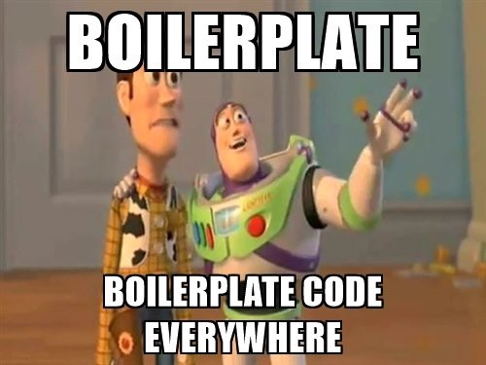
Why?

Slide 3
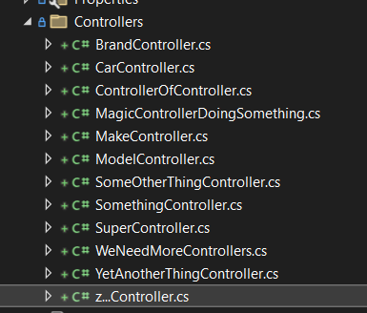
Why?

Slide 4
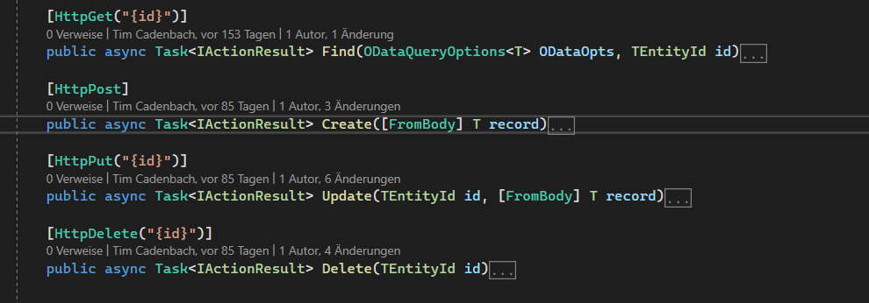
Why?

Slide 5
Why?
Anything
NOT
specific
to
Use case / model / application

Slide 6
Why?
public class DataContext : DbContext
{
public DbSet<Something> {get;set;}
public DbSet<SomeOtherThing> {get;set;
}
Something
SomeOtherThing

Slide 7


{}
Boilerplate
Model
Logic
70%
10%
20%

Slide 8

https://github.com/csharpfritz/InstantAPIs

Slide 9
No slides….just Action! ☺

Slide 10
Questions?!

Slide 11

Resources
TCDev API Generator https://www.github.com/deejaytc/net-dynamic-api
Presentation content https://github.com/DeeJayTC/netdeveloperdays
DeepL https://www.deepl.com
DeepL@Github https://www.github.com/deeplcom
@TimCadenbach
Tim.Cadenbach@deepl.com

Slide 13


