Slide 1
Presentation of HTML website
Presented by Danyal Ahmed

Slide 2
Idea of Website
Consist of HTML and CSS.
Clan Website for Game.
Consists of names of players.
Receive the Request directly through Website.
Will inform the audience about the latest updates in the clan.

Slide 3
Features of website
Master Page
Images
Video
Gifs
Contact-Form
Slideshow
Header Bar
Hovering Effects
Graphical Links
Favicon

Slide 4
Implementations :
For Form - Form tag and input tags.
For Slideshow - Keyframes to change the images in the Slideshow.
In hovering effects, I added Translate function and Menu bar Slide.
In Graphical Links used Anchor tag with Hyper Reference.

Slide 5
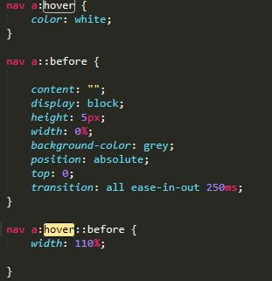
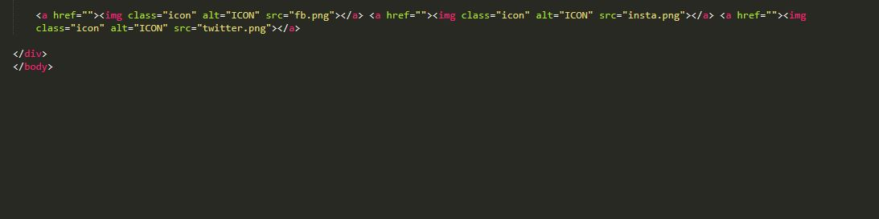
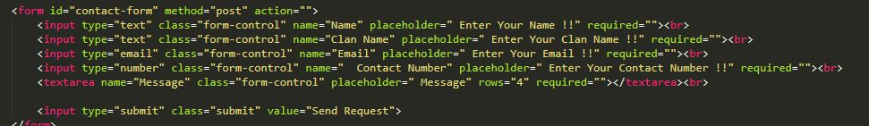
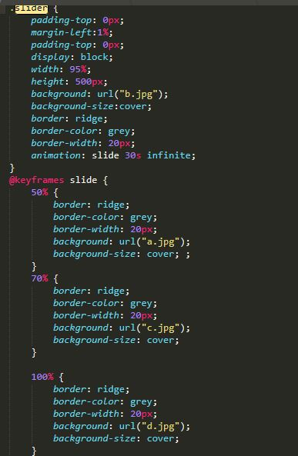
Implementations:

Slide 6
Improvements :
PHP for Form enquiries Recieving.
Javascript for further Animations.
Bootstrap or other frameworks for the better presentations of the Website.

Slide 7
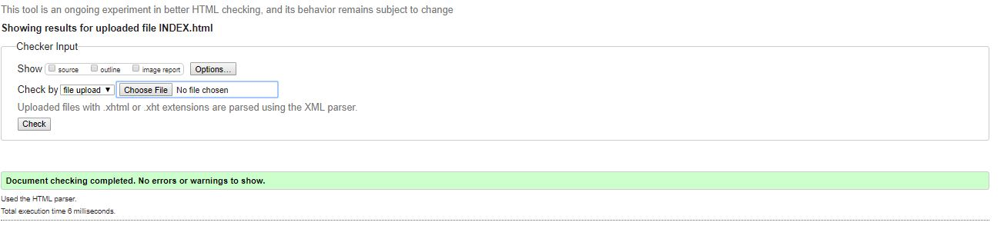
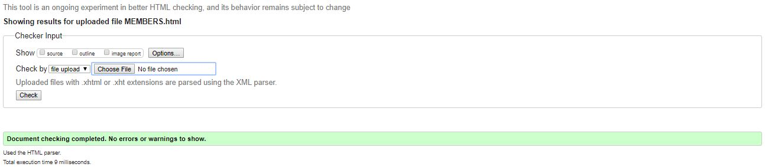
Validations :

Slide 8
Now the Demonstration of my Website !!!

