Slide 1


Analyzing COVID-19 Data Trends
Deborah Mark Itonyo

Slide 2


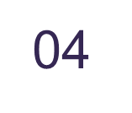
TABLE OF CONTENTS
01
02
03
INTRODUCTION
REPORTS
TRENDS
04
RECOMENDATIONS
Explanation of the task and data set
Results of the operations
Reports of Trends noticed
CONCLUSIONS
Conclusions from data insight
Recommendations from data insight

Slide 3
01
INTRODUCTION
Explanation of the task and data set

Slide 4
Introduction
This presentation gives insight to the covid-19 dataset that shows how many people were affected across the world over a span of 18 months.
This further highlights the trends and gives us a better understanding of the impact of covid-19 in its early stages.
Objectives: To analyze the data and extract meaningful insights using SQL queries.

Slide 5
02
REPORTS
Results of the operations

Slide 6
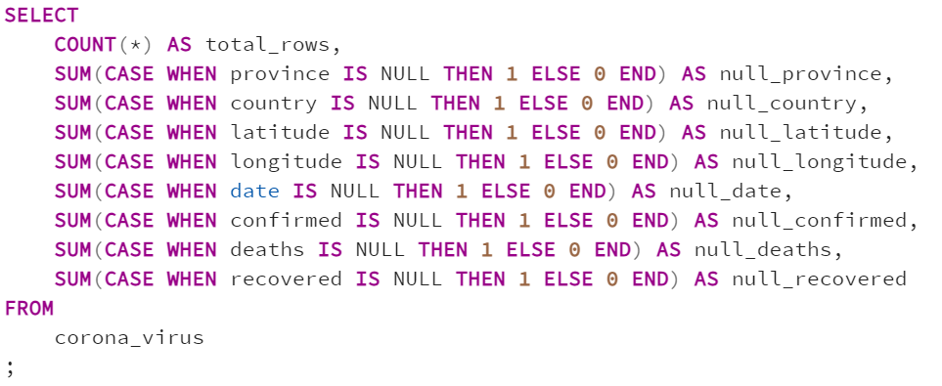
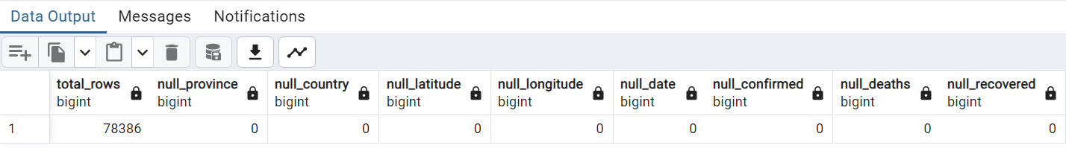
TASK 1
Write a code to check for NULL values
This code is used to check if there is any null value in the data set as a null value would affect the result of our queries

Slide 7
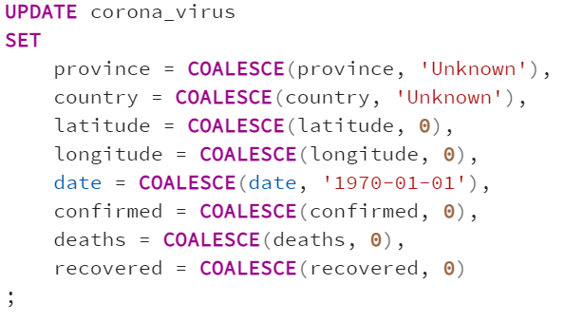
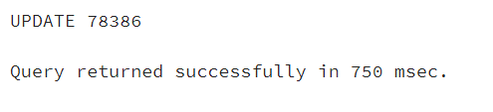
TASK 2
If NULL values are present, update them with zeros for all columns
This code is used to replace any null value in the data to zero(0) as a null value would affect the result of our queries.

Slide 8
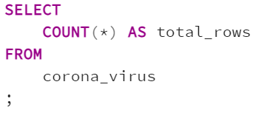
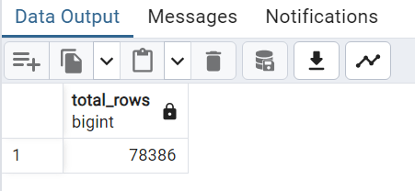
TASK 3
Check total number of rows
This code is used to check the total number of rows in the data table. The result is 78,366 rows in the table.

Slide 9
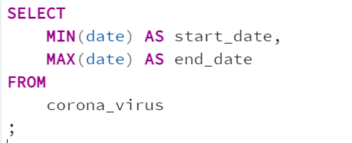
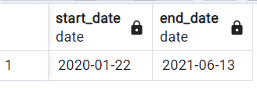
TASK 4
Check what the start date and end date is
This code is used to check the earliest data and the last date in the data table.

Slide 10
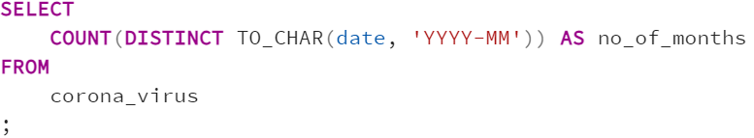
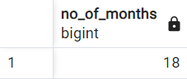
TASK 5
Number of months present in dataset
This code is used to check the number of months in the data table.

Slide 11
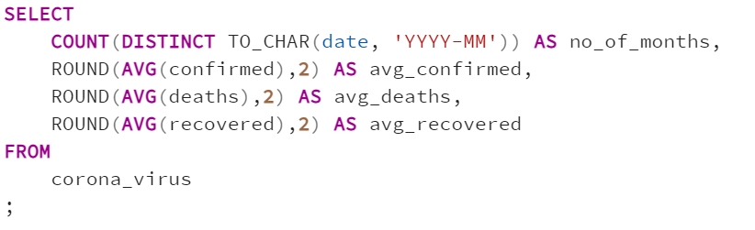
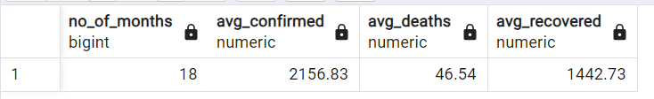
TASK 6
Find monthly average for confirmed, deaths, recovered
This code is used to check average number of confirmed cases, number of deaths, and the number of people who has recovered from the covid-19 throughout the duration in the data table.

Slide 12
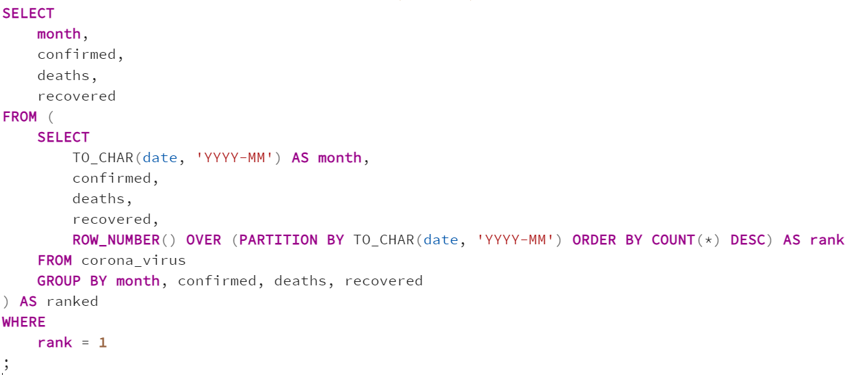
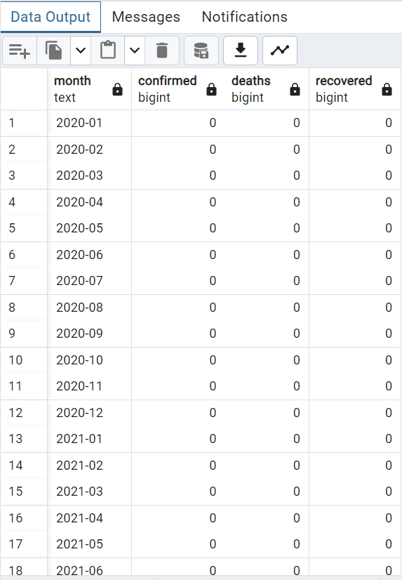
TASK 7
Find most frequent value for confirmed, deaths, recovered each month
This code is used to check the most frequent value each month for confirmed cases, deaths and recoveries in the data table.

Slide 13
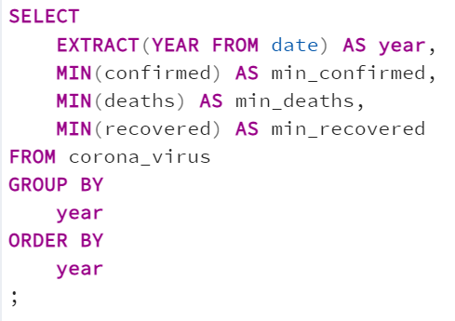
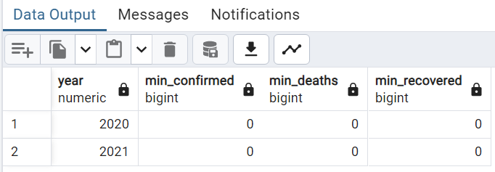
TASK 8
Find minimum values for confirmed, deaths, recovered per year
This code is used to check the most minimum yearly value for confirmed cases, deaths and recoveries in the data table.

Slide 14
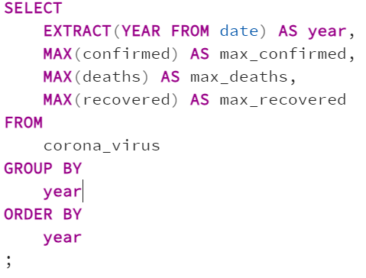
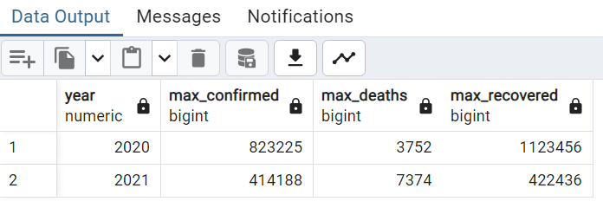
TASK 9
Find maximum values of confirmed, deaths, recovered per year
This code is used to check the most maximum yearly value for confirmed cases, deaths and recoveries in the data table.

Slide 15
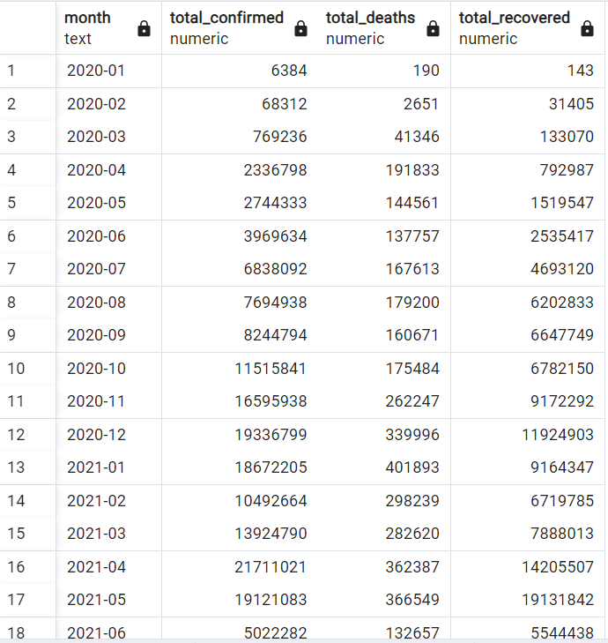
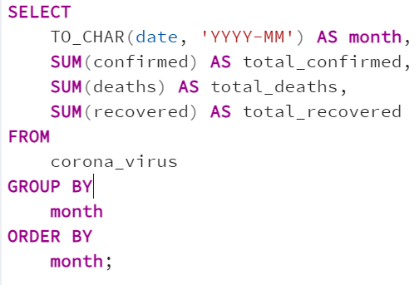
TASK 10
The total number of case of confirmed, deaths, recovered each month
This code is used to check the total number of confirmed cases, deaths and recoveries for each month in the data table.

Slide 16
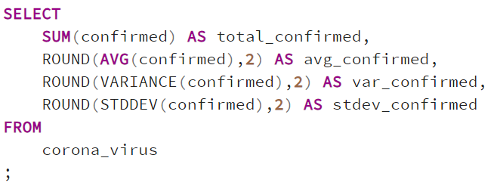

TASK 11
Check how corona virus spread out with respect to confirmed case (Eg.: total confirmed cases, their average, variance & STDEV )
This code is used to check the total spread of corona virus with respect to the confirmed cases only throughout the entire duration in our dataset.

Slide 17
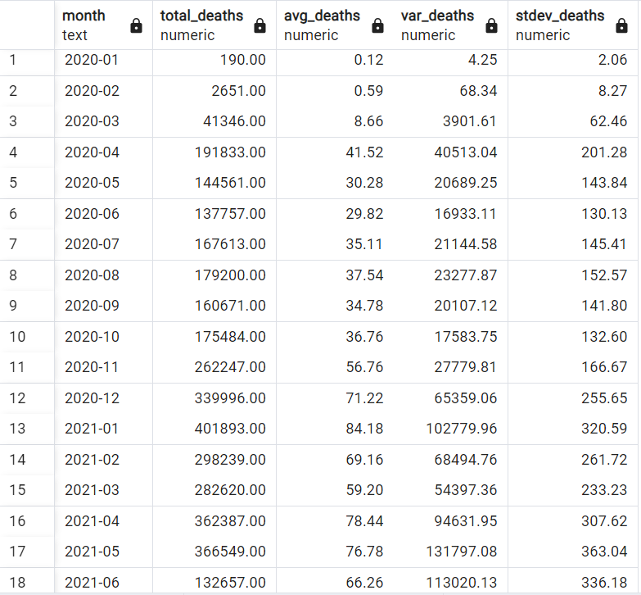
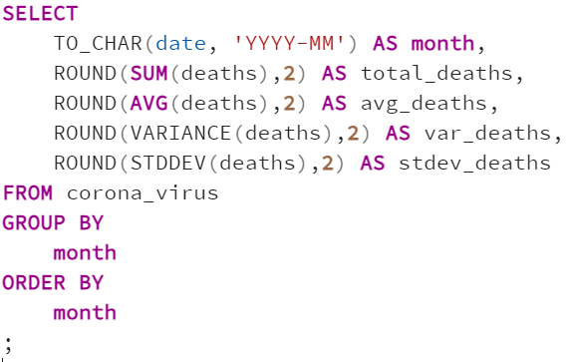
TASK 12
Check how corona virus spread out with respect to death case per month (Eg.: total confirmed cases, their average, variance & STDEV )
This code is used to check the total spread of corona virus with respect to the confirmed deaths only on a monthly basis in our dataset.

Slide 18
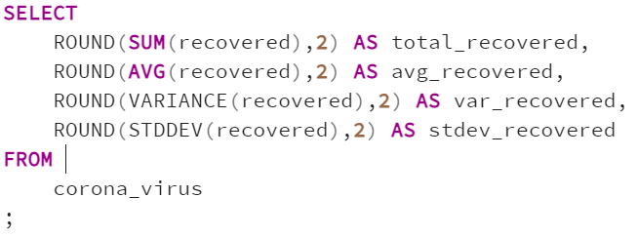
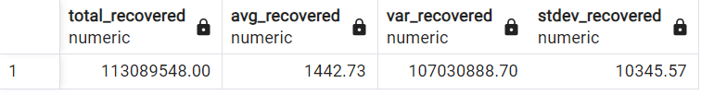
TASK 13
Check how corona virus spread out with respect to recovered case
(Eg.: total confirmed cases, their average, variance & STDEV )
This code is used to check the total spread of corona virus with respect to the recovered cases only throughout the entire duration in our dataset.

Slide 19
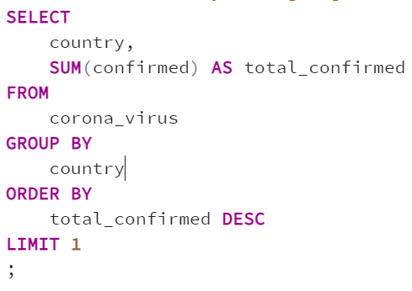
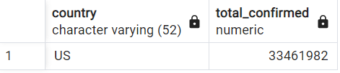
TASK 14
Find Country having highest number of the Confirmed case
This code is used to check the country that has the highest number of confirmed cases in the data table throughout the duration of the data table. It also returns the total number of confirmed cases in the country

Slide 20
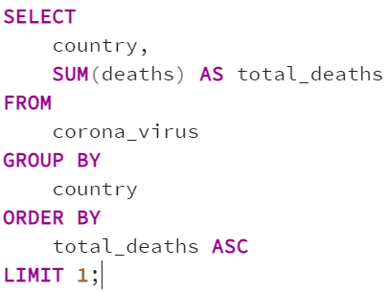
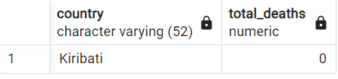

TASK 15
Find Country having lowest number of the death case
This code is used to check the country that has the lowest number of death cases in the data table throughout the duration of the data table. It also returns the total number of death cases in the country

Slide 21
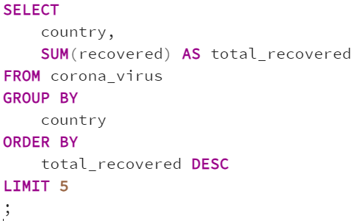
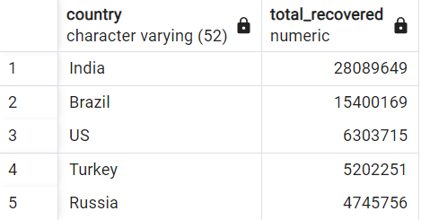

TASK 16
Find top 5 countries having highest recovered case
This code is used to check the top five countries that has the highest number of recovered cases in the data table throughout the duration of the data table. It also returns the total number of recovered cases in the countries.

Slide 22
03
TRENDS
Reports of Trends noticed

Slide 23
169,065,144
113,089,548
3,647,894
Confirmed cases
Recoveries
Deaths

Slide 24
04
CONCLUSIONS
Conclusions from data insight

Slide 25

CONCLUSION
COVID-19 Impact Over Time: The pandemic has shown considerable variability over months and years, with certain periods experiencing higher or lower impacts. The analysis of minimum and maximum values, as well as monthly totals, underscores these fluctuations.
Statistical Analysis: The statistical measures (average, variance, standard deviation) of confirmed cases, deaths, and recoveries highlight the spread and variability of COVID-19. These statistics are crucial for planning and response strategies.
Geographical Disparities: The impact of COVID-19 varies significantly across different countries. Some countries have higher confirmed cases, while others have better recovery rates or lower death rates. This information can guide international aid and resource allocation.
Data Completeness and Quality: Initial data quality issues, such as NULL values, need to be addressed for accurate analysis. Cleaning and preprocessing the data is a crucial step before performing any detailed analysis.

Slide 26
05
RECOMENDATIONS
Recommendations from data insight

Slide 27
RECOMENDATIONS
Enhanced Data Collection: Improve data collection methods to minimize missing values and ensure more comprehensive data reporting.
Targeted Interventions: Use geographical insights to focus interventions on the most affected regions and share best practices from countries with high recovery rates.
Continuous Monitoring: Regularly update and analyse the data to monitor the pandemic's progression and adjust strategies accordingly.
Further Research: Conduct more detailed studies to understand the factors contributing to high recovery rates and lower death rates in certain countries.

Slide 28

THANKS!
IF YOU HAVE ANY QUESTIONS FEEL FREE TO REACH OUT TO ME ON MY LINKEDLN
www.linkedin.com/in/deborah-itonyo
Please keep this slide as attribution

