Slide 1
Algorithms & Python
Deirdre O’Connor || deirdreoconnor1@gmail.com

Slide 2
Main topics of this course:
Writing + Running Python Code
Data Analysis + Data Management with Python
Code Optimization and Writing Efficient Programs
Coding Theory
Test-Driven Development

Slide 3
Skills acquired
To be able to write efficient and succinct, powerful programs using Python.
To analyze and create unit tests to ensure a high standard of coding.
To understand how to run Python code in a number of different environments.
To create medium-length programs to solve coding challenges.
To understand the process in designing programming solutions
To write efficient and optimised solutions to solve problems.

Slide 4
First, a recap

Slide 5
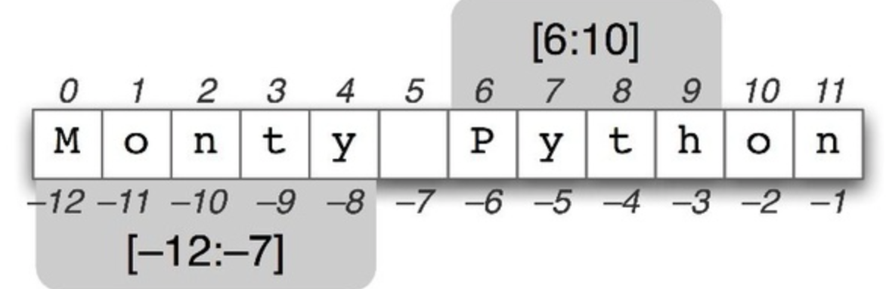
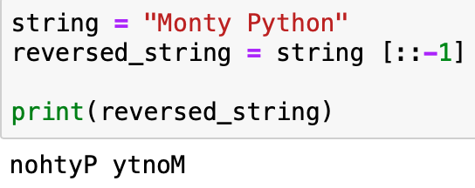
Reversing strings
Position ->
<- Negative Index

Slide 6
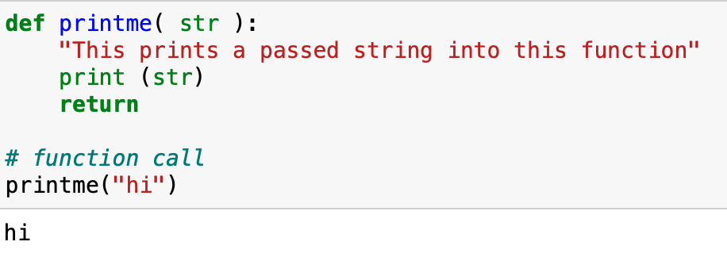
Functions
We use functions to re-use code in a program.
They are made defined with a name, parameters, and the code block below is indented.
Generally, they perform some operation on the arguments passed to them and return a result.
A function can be called anywhere in a program after being declared.
Notes:
https://www.tutorialspoint.com/python3/python_functions.htm <- these are good!

Slide 7
Functions
Sequence of statements which you can execute anywhere in your code after declaring.
Eliminates repetition in code. Functions can also reference other functions.
Make it easier to debug and find issues. Makes code easier to understand.
In short, functions allow us to split a large application into smaller chunks.
Notes:
https://www.tutorialspoint.com/python3/python_functions.htm <- these are good!

Slide 8
Functions
After a function is declared, we call it anywhere we want to use it in the program.
Functions generally will receive some input, known as arguments, perform some operation, and then return a result.
We can pass values to a function as arguments when we call it, such as in the last line of the code snippet below. This allows us to use functions in a general way, specifying the context with the arguments we pass in to it.
Notes:
https://www.tutorialspoint.com/python3/python_functions.htm <- these are good!

Slide 9
Functions
There are a lot of functions that can be used immediately because they are part of the base language of Python.
Examples: len() function, range() function.
Imagine having to code all of these from scratch without the Python Standard Library..
Challenge: create your own len() function that will work with a string or list.
Notes:
https://www.tutorialspoint.com/python3/python_functions.htm <- these are good!

Slide 10
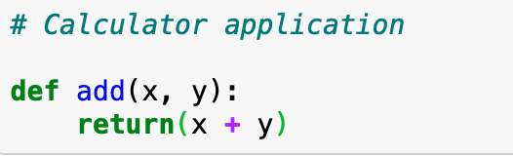
Functions
Challenge: Make a calculator application with functions for each operation:
add, subtract, multiply, divide.
It doesn’t need to be complicated. Here is the first part:

Slide 11
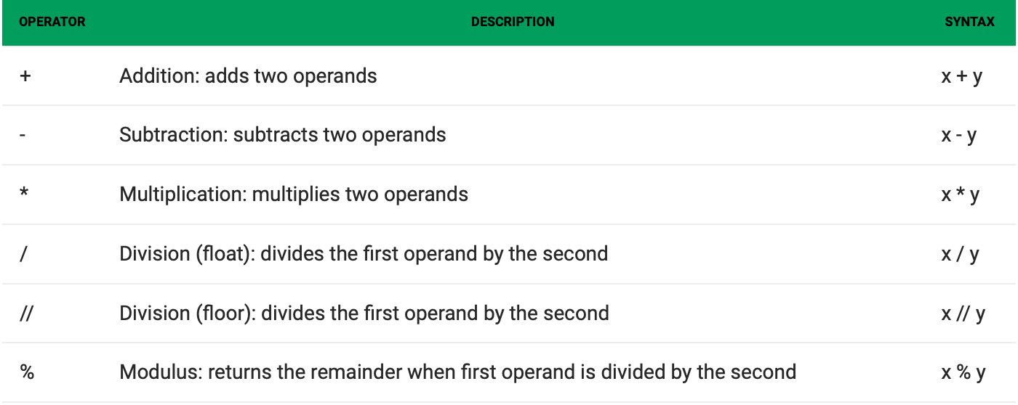
Operators
Operators compare values, for example to see if two strings are equal or which of two numbers are smaller.
There are many operators that can be used in Python. We will encounter them as we go...
Notes:
https://www.w3schools.com/python/python_conditions.asp
Need to quiz on the operators
https://www.geeksforgeeks.org/basic-operators-python/
Conditionals. Booleans. Count the number of the’s in a paragraph
More on input and the types of split
https://www.geeksforgeeks.org/taking-multiple-inputs-from-user-in-python/

Slide 12
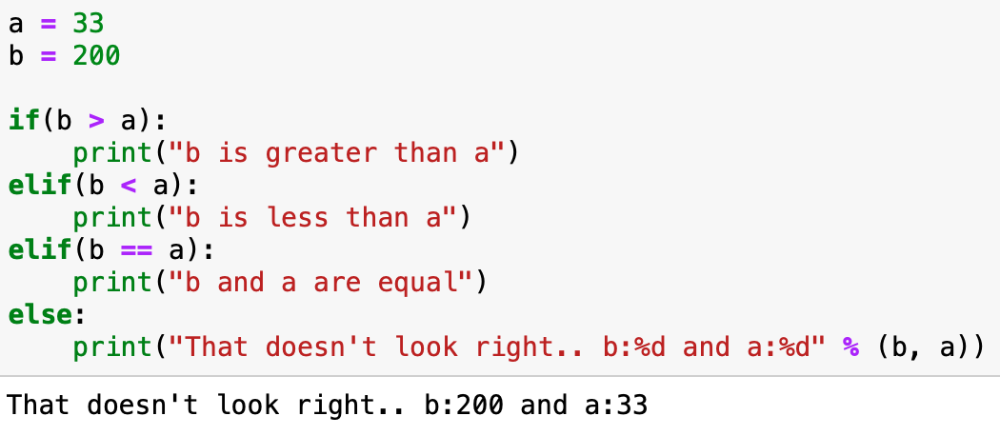
Operators
There are many operators that can be used in Python. We will encounter them as we go...
More can be read with a complete list here: https://www.w3schools.com/python/python_conditions.asp
Notes:
https://www.w3schools.com/python/python_conditions.asp
Need to quiz on the operators
https://www.geeksforgeeks.org/basic-operators-python/
Conditionals. Booleans. Count the number of the’s in a paragraph
More on input and the types of split
https://www.geeksforgeeks.org/taking-multiple-inputs-from-user-in-python/

Slide 13

If you have questions...
Now is a good time to ask them!

Slide 14
Data analysis & data management

Slide 15
Chapter outline
Libraries for Data Analysis
Getting quick insights from large datasets
Handling JSON, TXT, and CSV files
Reading / Writing to Files

Slide 16
Stop me at any point if you have questions

Slide 17
Data analysis libraries
Following are a list of libraries, you will need for any scientific computations and data analysis:
NumPy stands for Numerical Python. We will use it for handling n-dimensional arrays and basic linear algebra functions.
SciPy stands for Scientific Python, it’s built on NumPy and used a lot for handling Linear Algebra, Optimization and Sparse matrices.
Matplotlib for plotting vast variety of graphs, starting from histograms to line plots to heat plots, all directly in your notebook.
Notes:
You can use Pylab feature in ipython notebook (ipython notebook –pylab = inline) to use these plotting features inline. If you ignore the inline option, then pylab converts ipython environment to an environment, very similar to Matlab. You can also use Latex commands to add math to your plot.

Slide 18
Data analysis libraries
Following are a list of libraries, you will need for any scientific computations and data analysis:
Pandas for structured data operations and manipulations. All Python Data Scientists use this.
Scikit Learn for machine learning. Built on NumPy, SciPy and matplotlib, this library contains a lot of efficient tools for machine learning and statistical modeling including classification, regression, and clustering.
Classification: what is this? Regression: predict a value? Clustering: What is it most like?
Networkx for graphical models

Slide 19
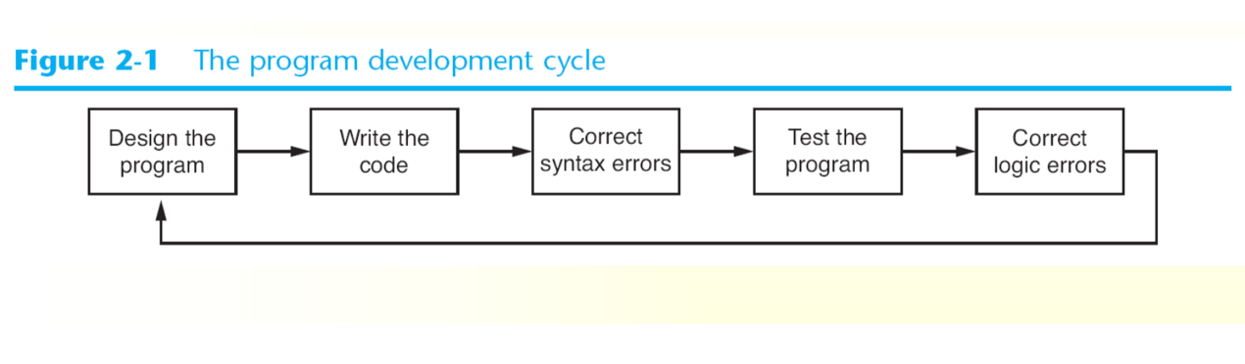
Don’t just write code, think and design code
Use pseudocode, flowcharts, user stories and use-cases

Slide 20
Reading a file
Challenge: open example1.txt in read ‘r’ mode
Print number of lines
Delimit (split) on every semicolon
Beware of errors and exceptions
We use the with keyword to automatically take care of closing the file!
Notes:
The with statement automatically takes care of closing the file once it leaves the with block, even in cases of error.

Slide 21
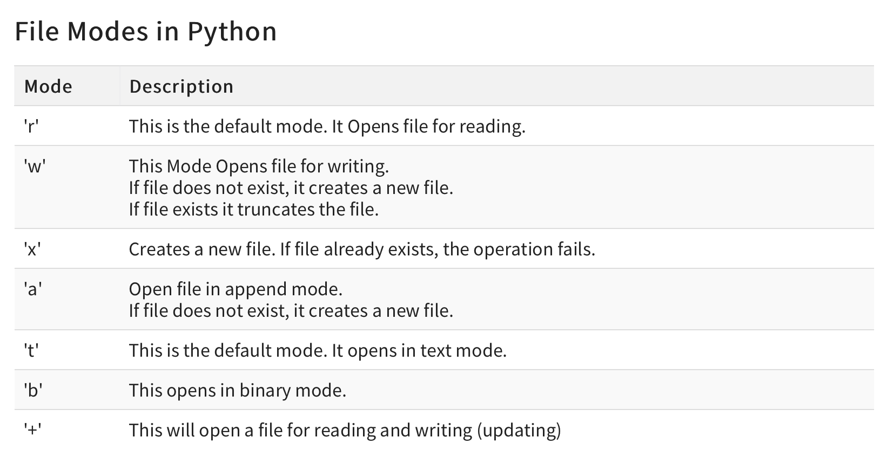

Slide 22
Reading a file
Challenge: open example1.txt in read ‘r’ mode
We use the with keyword to automatically take care of closing the file!
with open(file path, 'r') as my_file: for line in my_file
# Later, file is closed due to with/as
Notes:
The with statement automatically takes care of closing the file once it leaves the with block, even in cases of error.
with open(file path) as my_file, open(another path) as second_file: for (line number, (line1, line2)) in enumerate(zip(my_file, second_file):

Slide 23
writing to a file
Challenge: create a new file output.txt
Write out the name of all females (verify df first)
Print average age of all people
Beware of errors and exceptions

Slide 24
Code optimization & efficient programming

Slide 25
Chapter outline
Programming Efficiently
Big O Notation
Comparing Data Structures
Timing

Slide 26
Stop me at any point if you have questions

Slide 27
Programming efficiently
As you progress as a developer, it becomes increasingly important to write programs as efficiently as possible
Efficiency in the following areas:
Memory
CPU load
Execution time
Conciseness/Lines of code
Efficiency is measured using Big O Notation

Slide 28
big o notation
Big O: a mathematical notation that describes the limiting behavior of a function when the argument tends towards a particular value or infinity.
Used in Computer Science to describe the performance or complexity of an algorithm. Big O specifically describes the worst-case scenario, and can be used to describe the execution time required or the space used (e.g. in memory or on disk) by an algorithm.

Slide 29
o(1)
O(1) describes an algorithm that will always execute in the same time (or space) regardless of the size of the input data set.
bool IsFirstElementNull(IList<string> elements)
{
return elements[0] == null;
}

Slide 30
o(N)
O(N) describes an algorithm whose performance will grow linearly and in direct proportion to the size of the input data set. The example below also demonstrates how Big O favours the worst-case performance scenario; a matching string could be found during any iteration of the for loop and the function would return early, but Big O notation will always assume the upper limit where the algorithm will perform the maximum number of iterations.
bool ContainsValue(IList<string> elements, string value)
{
foreach (var element in elements)
{
if (element == value) return true;
}
return false;
}

Slide 31
o(N²)
O(N²) represents an algorithm whose performance is directly proportional to the square of the size of the input data set. This is common with algorithms that involve nested iterations over the data set. Deeper nested iterations will result in O(N³), O(N⁴) etc.
bool ContainsDuplicates(IList<string> elements)
{
for (var outer = 0; outer < elements.Count; outer++)
{
for (var inner = 0; inner < elements.Count; inner++)
{
// Don't compare with self
if (outer == inner) continue;
if (elements[outer] == elements[inner])
return true;
}
}
return false;
}

Slide 32
o(2^{N})
O(2^{N}) denotes an algorithm whose growth doubles with each addition to the input data set. The growth curve of an O(2^{N}) function is exponential - starting off very shallow, then rising meteorically. An example of an O(2^{N}) function is the recursive calculation of Fibonacci numbers:
int Fibonacci(int number)
{
if (number <= 1) return number;
return Fibonacci(number - 2) + Fibonacci(number - 1);
}

Slide 33
Logarithms
Logarithms are slightly trickier to explain so I'll use a common example:
Binary search is a technique used to search sorted data sets. It works by selecting the middle element of the data set, essentially the median, and compares it against a target value. If the values match it will return success. If the target value is higher than the value of the probe element it will take the upper half of the data set and perform the same operation against it. Likewise, if the target value is lower than the value of the probe element it will perform the operation against the lower half. It will continue to halve the data set with each iteration until the value has been found or until it can no longer split the data set.
This type of algorithm is described as O(log N)

Slide 34
Data structures for efficient programming
Linked Lists
A linked list consists of nodes.
Each node consists of a value and a pointer to another node.
The starting node of a linked list is referred to as the header.
Essentially, linked list is a chain of values connected with pointers.
They can be thought of similar to arrays in other languages but in Python they are more memory-efficient
Notes:
Linked lists
Data structures
For vs while loops
Writing concise code
List comprehensions
Loops & conditional statements in list comprehensions
Read more here if you want to explore more

Slide 35
efficient data structures: linked lists
Advantages
A linked list saves memory. It only allocates the memory required for values to be stored. In arrays, you have to set an array size before filling it with values, which can potentially waste memory.
Linked list nodes can live anywhere in the memory. Whereas an array requires a sequence of memory to be initiated, as long as the references are updated, each linked list node can be flexibly moved to a different address.
Disadvantages
Linear look up time. When looking for a value in a linked list, you have to start from the beginning of chain, and check one element at a time for a value you’re looking for. If the linked list is n elements long, this can take up to n time. On the contrary many languages allow constant lookups in arrays.
Notes:
For vs while loops
Writing concise code
List comprehensions
Loops & conditional statements in list comprehensions
Read more here if you want to explore more

Slide 36
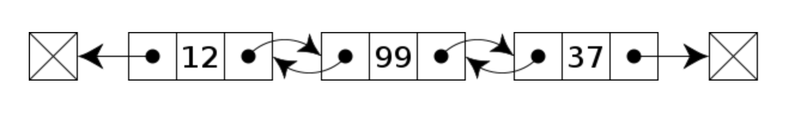
efficient data structures: linked lists
Doubly-Linked Lists also exist. As you might imagine, each node can point to the one before and after it.
Advantages over singly linked list
Can be traversed in both forward and backward direction.
Disadvantages over singly linked list
Every node requires extra space for a previous pointer.
All operations require an extra pointer to be maintained.

Slide 37
efficient data structures:
Other efficient data structures that can be used in mid-scale Python projects are
STACKS (last in, first-out (LIFO)), queues (first in, first-out (FIFO))
TREES (binary tree: every node has at most two children)
We don’t have time to cover them in this course. Instead we will look at other ways to code efficiently.

Slide 38
Looping efficiently
Sometimes it is necessary to time our programs or certain functions
For example, we can create two loops doing the exact same thing.
The first is a for loop using range, looping for 0-1000
The second loop with use while and counter to loop until count == 1000
Can you guess how timing might differ between these two?
Notes:
Writing concise code
List comprehension vs function doubler(x, y)

Slide 39
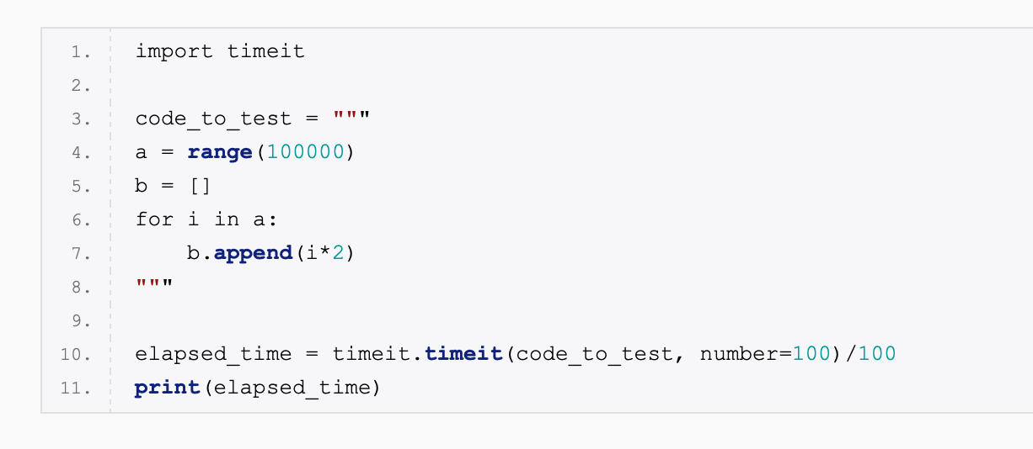
Looping efficiently: timeit()
Notes:
Writing concise code
List comprehension vs function doubler(x, y)

Slide 40
Looping efficiently: timeit()
Line 1: import timeit module.
Line 3: Create a string variable containing all of our code function spanning multiple lines. The test code is provided as a string.
Line 10: Call time.timeit() function taking the test code as an argument, executing it 100 times to find the average execution time. Timeit() decides what is the best timing method for your code based on your OS so it is highly reliable.
Line 11: Print the execution time. The result is the execution time in seconds.
Notes:
Writing concise code
List comprehension vs function doubler(x, y)

Slide 41
Try challenge 4 now
Taking the code from previous challenges, now compare the timing of each of your solutions vs another way of finding the same result

Slide 42
Test driven development

Slide 43
Chapter outline
What is TDD?
Non-trivial tests
Edge test-cases
Running tests

Slide 44
Stop me at any point if you have questions

Slide 45
Test-driven development (TDD)
Best practice among engineering teams
Before writing any code, write a test that is designed to fail until the code functions correctly
Must be robust
Must have a unit test for every unique functionality

Slide 46
Test-Driven Development (TDD)
Trivial tests: important, but easy to come up with, not exactly taxing on a program
Edge-case tests: get very creative, prove you know the user well
No input tests: trivial, and should always be included and handled

Slide 47
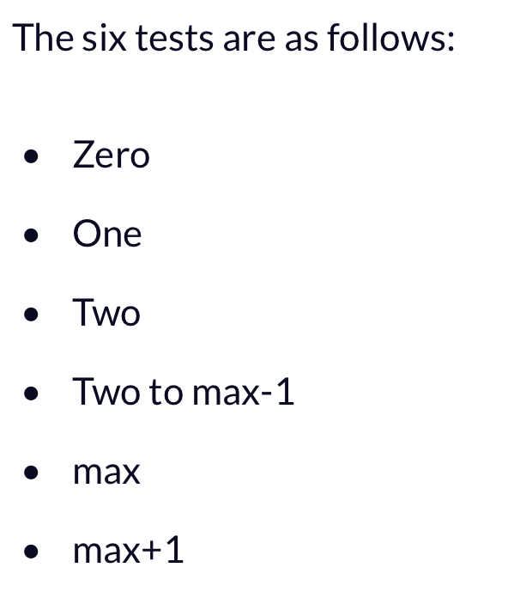
Test-Driven Development (TDD)

Slide 48
Trivial tests
Zero
Zero is used to signify any form of null input, whether that’s undefined, null, an empty array, or simply the actual number 0. Arguably the most common and simple form of bug is referencing a Zero value, and it always bears testing. Simply test a function, endpoint, or upload with a Zero input, and verify that it behaves as expected.

Slide 49
Trivial tests
One
One, like Zero, is the most basic form of the genericized single test. The function gets tested with the first valid, normal input. This is most useful for regression testing. In future iterations of the code, this test will quickly indicate if the program (or process) is operating as expected.
One testing gives you a baseline for success, whether that’s a successful authentication on an admin endpoint, a valid file upload, or a correct array modification.

Slide 50
Trivial tests
Two
Two is not simply about testing array index 2, or whether your algorithm works with 2 inputs. It also encompasses what happens when you run the same code twice.
If someone were to make a DELETE HTTP request twice in a row to the same resource, what happens? If the sort function with a custom comparator gets called twice in a row, does it behave as expected?
Two is an interesting number, because it’s the first time in which valid code that works when called once can show side effects on repeated executions. Take a small change to the functions we’ve tested above. It comes down to understanding the behavior of a function.

Slide 51
Trivial tests
Two to max-1
Two to max-1 is the sanity check. It’s very similar to the One test, but there’s a subtle difference. This should be an average use case — not the simplest or most straightforward, or the easiest to read. Just an average use case that perhaps isn’t particularly simple, but that’s fairly common.

Slide 52
Trivial tests
What about for max?
You must stress-test your application
What about for max + 1?
This is where the out of bounds errors come in
Notes:
Max might seem like an impossible test, but you must stress-test your application

Slide 53
Try challenge 5 now
Write proper unit tests for every function you have created in the previous challenges

Slide 54
Test-driven development (tdd)
Challenge: Take the following example located at: /unit_test.py and write a functional unit test that will not pass
Test 1: what if the program is expanded?
Test 2: what if a function is removed?
Ask your neighbour to test the robustness of your tests
Points to whoever writes the most robust tests
Points to whoever breaks a test

Slide 55
Unit testing
def my_function(input): return(input – 1)
import unittest
class TestClass(unittest.TestCase): def my_test(self): self.assertEqual(my_function(1), 0)) #checking 1 becomes 0

Slide 56
Coding in big projects

Slide 57
Chapter outline
Agile Development
Continuous Integration
Version Control
Best Practices for personal projects
Free Softwares

Slide 58
Stop me at any point if you have questions

Slide 59
Extra thoughts
What is continuous integration?
What is Agile Development?
Why do we need them?
Why do we as candidates need to be fluent in them?
Are they useful in personal projects?
How does Python link in with other softwares, projects, languages?

Slide 60
Time for a break
Any questions?

Slide 61
frameworks and packages
PyUnit (unit testing), PyDoc (documentation), SciPy (algebera and numerical), Pandas (data management), Sci-Kit learn (ML and data science), Tensorflow (AI), Numpy (array and numerical), BeautifulSoap (web pages scrapping), Flask (microframework), Pyramid (enterprise applications), Django (UI MVVM), urllib (web pages scraping), Tkinter (GUI), mock (mocking library), PyChecker(bug detector), Pylint (module code analysis)
Notes:
https://medium.com/fintechexplained/everything-about-python-from-beginner-to-advance-level-227d52ef32d2

Slide 62
Object Oriented Design
Sign up for HackerRank
class MyClass: def MyClassFunction(self): #self = reference to the object return 5
#Create new instance of MyClass and then call the function m = MyClass() returned_value = m.MyClassFunction()

Slide 63
Object Oriented Design
class MyClass: def __init__(self, first_property): self.first_property = first_property
def MyClassFunction(self): return self.first_property
#Create an instance m = MyClass(123) r = m.MyClassFunction()
r will be 123
m = MyClass(123) print m #Calls __str__

Slide 64
assessment
Submitted to GitHub
Uses unit tests (min. 3 including 2 functional, non-trivial test). Including more tests is a good idea!
Has a continuous while loop with proper exit statements
Reads and Writes to a text file
Include references to websites that helped you

