Slide 1
CIA-2
LOGISTIC REGRESSION
Submitted By: Deepthipriya R Pillai
Reg No: 1827034

Slide 2
Business Perspective
Problem Statement | Building a predictive model that helps in improving the accuracy, objectivity and reproducibility of breast cancer diagnosis.
Business Case | As a chronic disease, breast cancer can take many years to develop without any clinical symptoms. By diagnosing breast cancer among women in early stages along with screening exams, the chances of survival can be improved.
Business Objective | Objective of performing Logistic regression is to do diagnosis of breast cancer in order to check if it is a benign or malignant one.

Slide 3
Data Dictionary
Attributes | Types of Variables | Measure | Description
Mean Radius | Independent | Scale | Mean of distances from center to points on the perimeter
Mean Texture | Independent | Scale | Standard deviation of gray-scale values
Mean Perimeter | Independent | Scale | Mean size of the core tumor
Mean Area | Independent | Scale | Mean of area of tumor
Mean Smoothness | Independent | Scale | Mean of local variation in radius lengths
Diagnosis | Dependent | Nominal | The diagnosis of breast tissues (0 = malignant, 1 = benign)

Slide 4
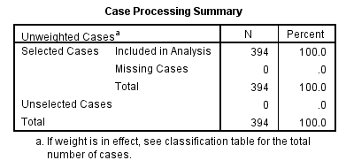
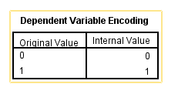
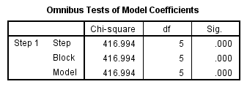
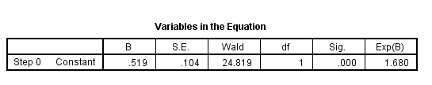
Data Preparation and Model Building
Dependent Variable Encoding:
The table shows how an outcome variable is encoded – ‘0’ (No presence of breast cancer- benign) and ‘1’ (Presence of cancer- malignant).
From 569 cases, 70% data has been used in the analysis, it can be seen that 394 cases is used. There was no Missing cases in the dataset.
Omnibus Tests of Model Coefficients: is used to check if the new model has an improvement. The value given in the Sig. column is the probability of obtaining the chi-square statistic when null hypothesis is true. The Chi Square value is significant with 416.99(df=5 and p<0.00), which means our new model is significantly better. In this case, the model is statistically significant because the p-value is less than .000.
The significance level is 0.000. According to this table the model with just the constant is a statistically significant predictor of the outcome (p <.001).But this is accurate only 62.7% of the times(as seen from classification table). Wald chi-square test that tests the null hypothesis that the constant equals 0.This hypothesis is rejected as p value is smaller than critical p value(0.05)

Slide 5
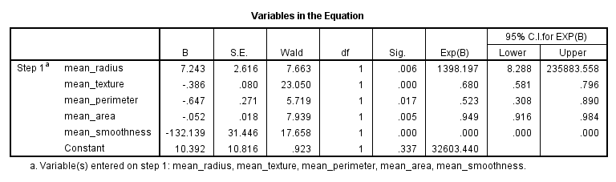
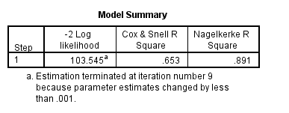
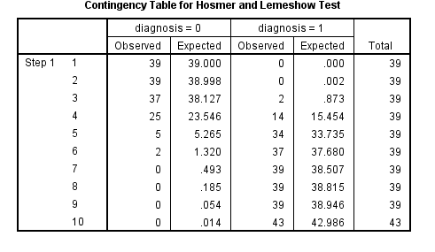

Data Analysis
logit(p) = log(p/(1-p))= β₀ + β₁*mean_radius + β₂*mean_texture + β₃*mean_perimeter + β₄*mean_area + β₅*mean_smoothness
Model Summary: The Cox & Snell R Square in Logistic Regression is R square value. This value is less because there is non- linearity. It is 65.3 % which means there is relation between the dependent and independent variables. The -2 log likelihood for the final model is 103.54, this is compared with Chi Square. variable
logit(p) = log(p/(1-p))=10.392 + 7.24*mean_radius -0.386*mean_texture -0.647*mean_perimeter –0.052*mean_area -132.139*mean_smoothness
Hosmer and Lemeshow Test: This shows overall adequacy of the model. In this case P value is greater than α that is 0.944, which means the test is not significant and hence the model is a good fit. The significance means that 94% times observed and expected are matching.

Slide 6
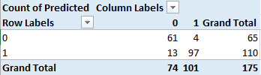
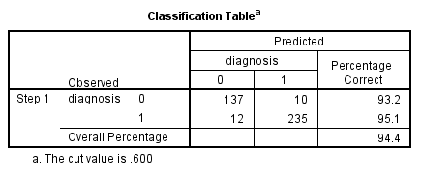
Model Diagnostics
Confusion Matrix for test data:
(0-0)61→ True Negative
(0-1)4→ False Positive
(1-0) 13→ False Negative
(1-1) 97→ True Positive
Accuracy:158 /175 – 90.2%
Misclassification Rate: 9.7%
True Positive Rate : 88%
False Positive: 6.15%
Specificity: 93.8%
Precision: 96%
Confusion Matrix:
(0-0)137→ True Negative(137 cases observed and predicted was same)
(0-1)10→ False Positive
(1-0) 12→ False Negative
(1-1) 235 → True Positive ( 235 cases Observed was same as predicted)
Accuracy:372 /394 – 94%
Misclassification Rate: 5.5%
True Positive Rate : 95%
False Positive: 6.8%
Specificity:93.1
Precision: 95.9%
Confusion matrix: The model has predicted that cancer is benign for 137 cases, and that the cancer is malignant for 235 cases. In 12 cases when the cancer was malignant it has predicted to be benign, by reducing this the model can be made a good fit.

Slide 7
Inference
The data analysis suggests that the given parameters(mean radius, mean area, mean perimeter, mean smoothness, mean texture) are all relevant to the test. More parameters can be used to increase the fitness of the model.
Research can be undertaken in this field, as more the accuracy in the prediction, better will be the rate of survival of patients.
By improving the model the difference between observed and predicted can be reduced which will be good for business.
Reference:
Breast Cancer Prediction - https://www.kaggle.com/merishnasuwal/breast-cancer-prediction-dataset

