Slide 1
Drawing Insight from COVID-19 Data,
Informing Resource Allocation Decisions

Slide 2

Problem Statement
COVID-19 has been with us for 2 years now, with most people fully vaccinated and boosted in most states, but less so in others.
Insights from data on covid-19 vaccination, surveillance, and death rates
Identify states more susceptible to new cases
Attempt time series model
Inform resource allocation decisions
https://hub.jhu.edu/2021/01/15/sars-cov-2-covid-19-variants-new-strains/

Slide 3
Key Questions
1. To which states should we distribute additional covid anti-viral therapeutics and focus outreach campaigns?
2. Can time series and classification models offer more granular insight?
https://www.centennialco.gov/Residents/Health-Environment/Coronavirus

Slide 4
The Data
COVID-19 Cases and Deaths by State
Confirmed and probable cases and deaths
Vaccination Trends by State
Breakdown by percentage of people vaccinated
Surveillance Information by state
Demographic data related to hospitalization rates
Travel Data
Trips greater than 500 miles

Slide 5
Approach
Criteria to identify states that might need additional resources:
Monthly new cases in each state
The percentage of people in a state with both a primary series and booster

Slide 6
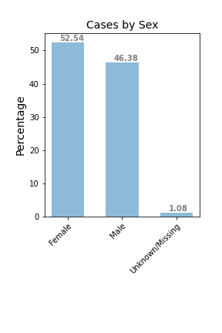
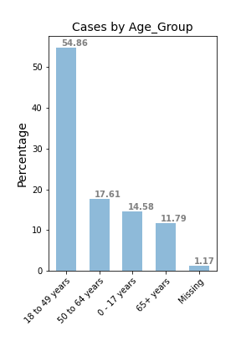
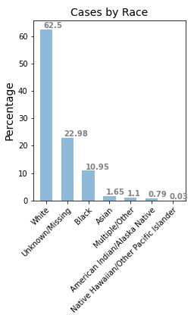
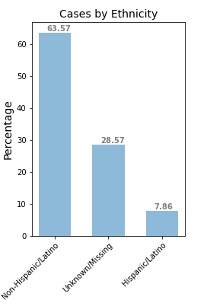
Demographic EDA- COVID

Slide 7
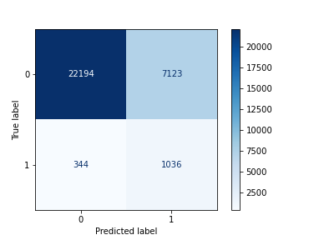
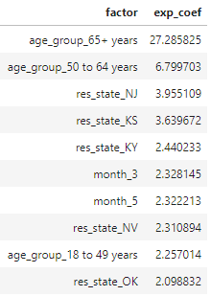
Classification model- Hosp prediction and inference
-Logistic Regression with Under Sampling
-Balanced Accuracy: 0.75
-Recall: 0.75
-Misclassification rate=0.24

Slide 8
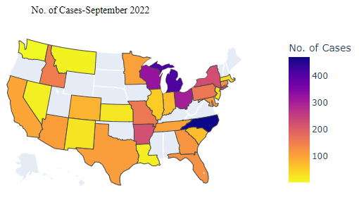
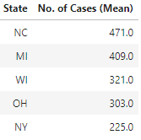
No. of Cases - September 2022
States with highest no. of cases

Slide 9
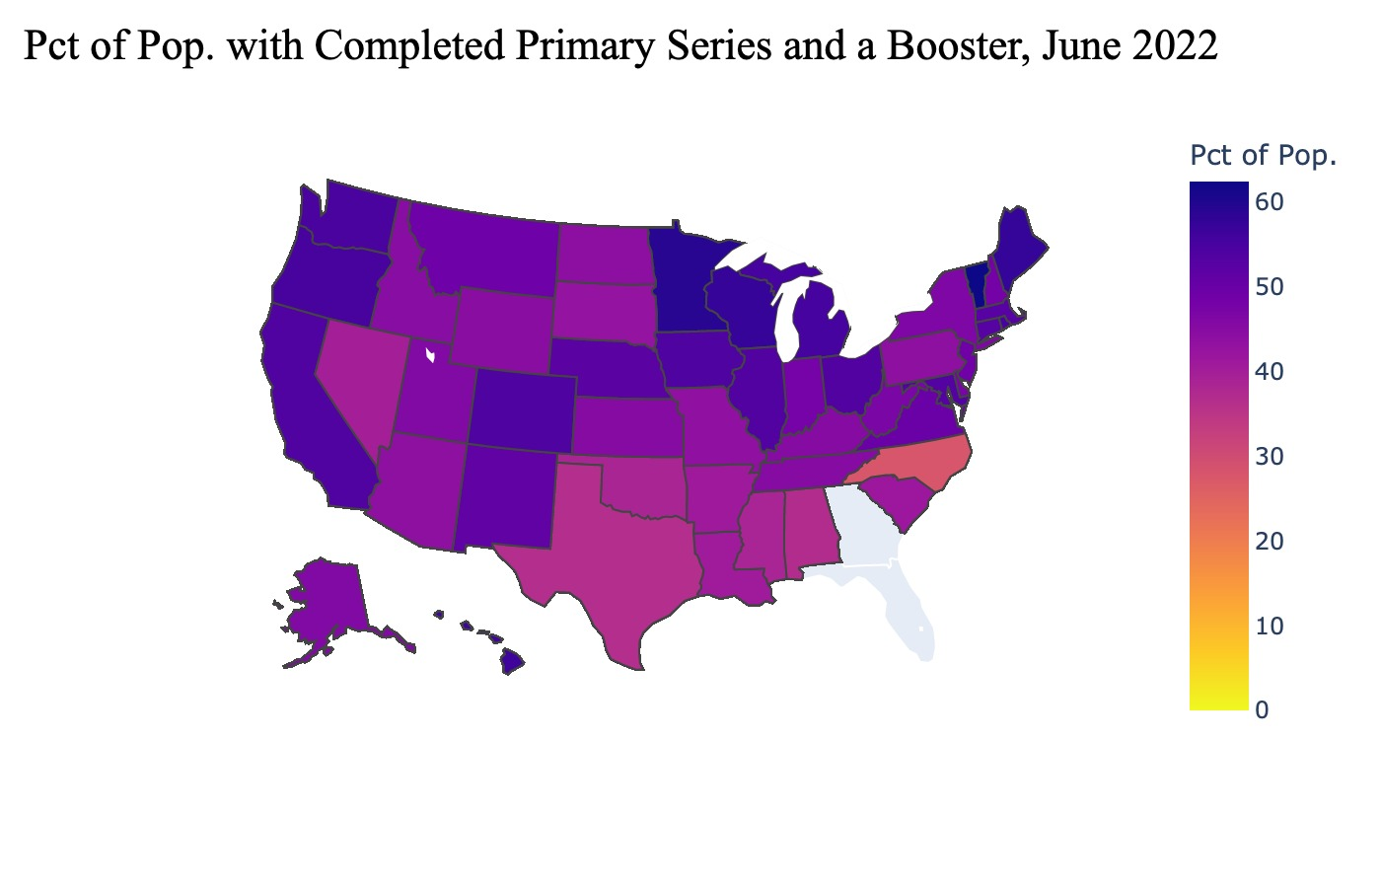
States with Lowest Pct. w/ Primary Series and Booster:
North Carolina - 28%
Alabama, 37%
Oklahoma, 38.6%
Mississippi, 38.8%
Texas, 39.2%

Slide 10
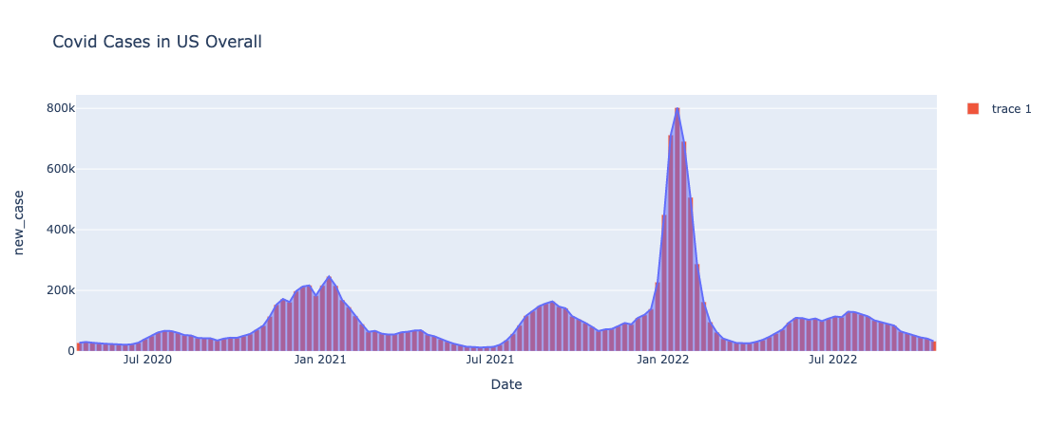
Covid Cases Evolution in US
Notes:
Now I'm going to talk about the evolution of covid cases during this time.
This is a plot of the behavior of covid cases from its beginning in March 2020 to the beginning of October 2022.
We can see that the periods in which there are a large number of cases matches with the summer (summer vacations) and the end of the year (festivity).
This can be interpreted as a certain pattern of behavior, but it is not necessarily a personality. (That's what I thought initially)

Slide 11
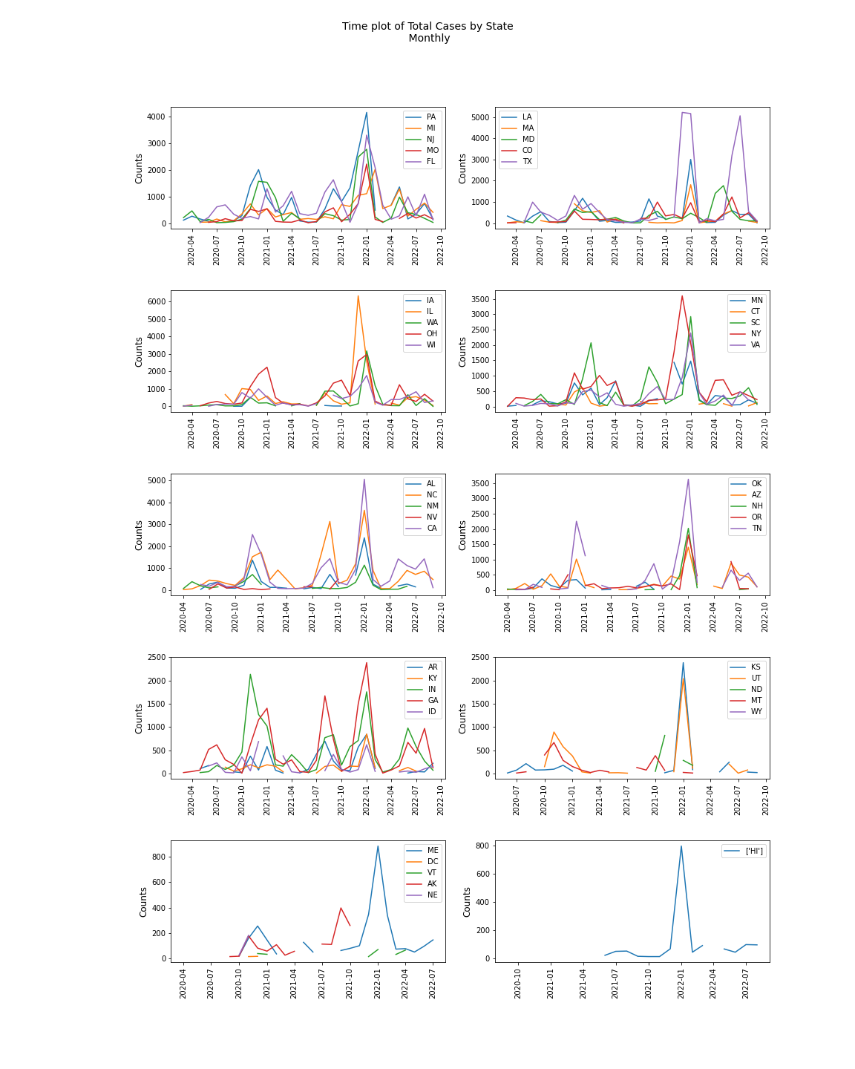
Covid Cases Evolution by State
Major peaks during winter 2020 and 2021 each state
Consistent peak across states in summer 2022 (April-August)
Some of the states show higher number of cases until September
Notes:
We can see that this pattern is also repeated for the states.
Major peaks during winter 2020 and 2021 each state
Consistent peak across states in summer 2022 (April-August)
Some of the states show higher number of cases until September

Slide 12

Covid Cases Data
Notes:
Then, I made this interactive plot to try to better visualize the behavior of covid cases during this time.
In it you can view the situation of new covid cases in each state on a specific date.

Slide 13
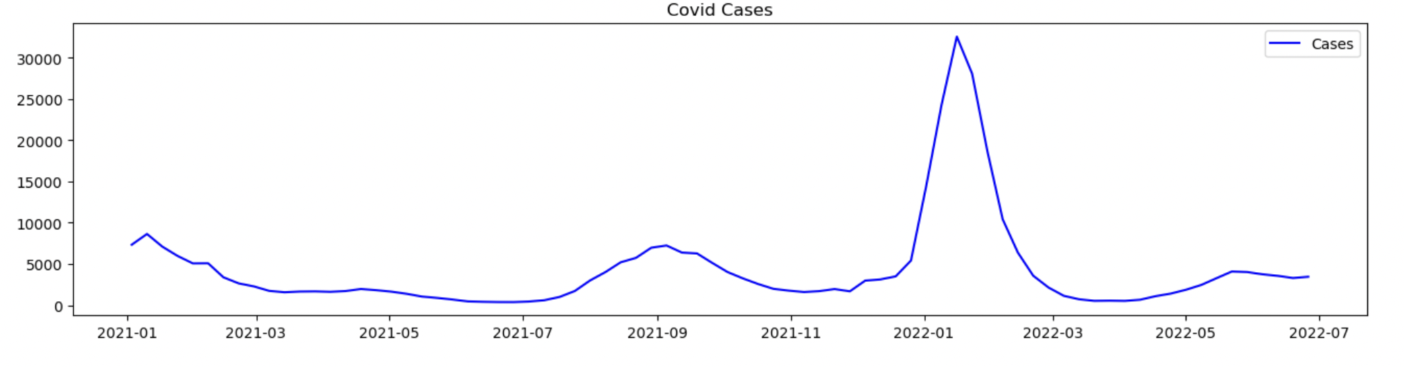
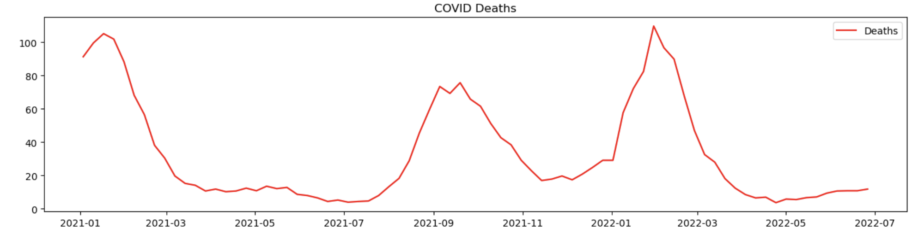
Covid Cases and Deaths Data Insights
Notes:
Making an analysis of these cases of covid and deaths, we can observe that they faithfully follow the same behavior but on a very different scale. While the cases of covid are in millions (millions) the deaths are in thousands. (thousands).
And both have peaks in the summer breaks and vacation (festivities).

Slide 14
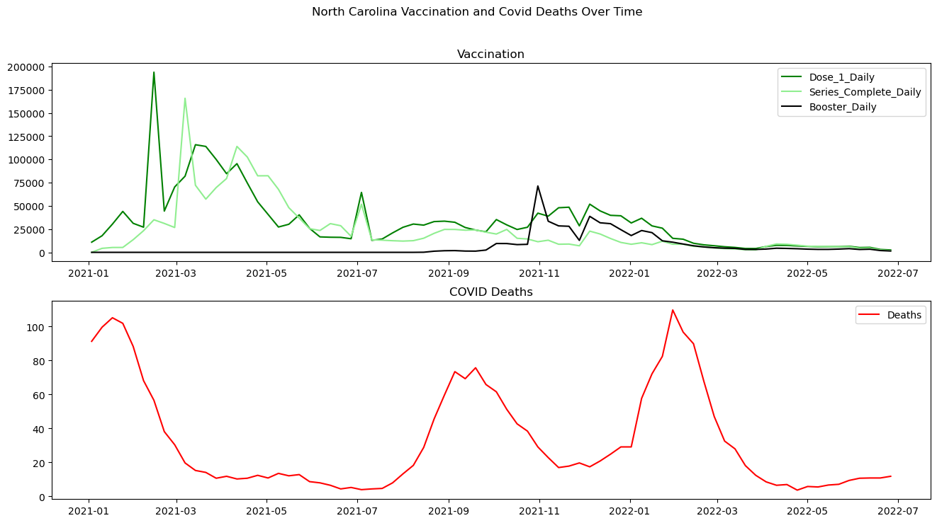
Vaccination and Deaths Data Insights
Notes:
By analyzing the behavior between vaccination and covid deaths, we can observe that vaccination does not necessarily prevent covid deaths. We can see that after the primary series was applied, there were two strong expressions of deaths (which directly accompany the cases of covid)
It is important to emphasize that the changes that occur in these graphs do not happen at the same time, as the vaccination only takes effect at least one month later.

Slide 15
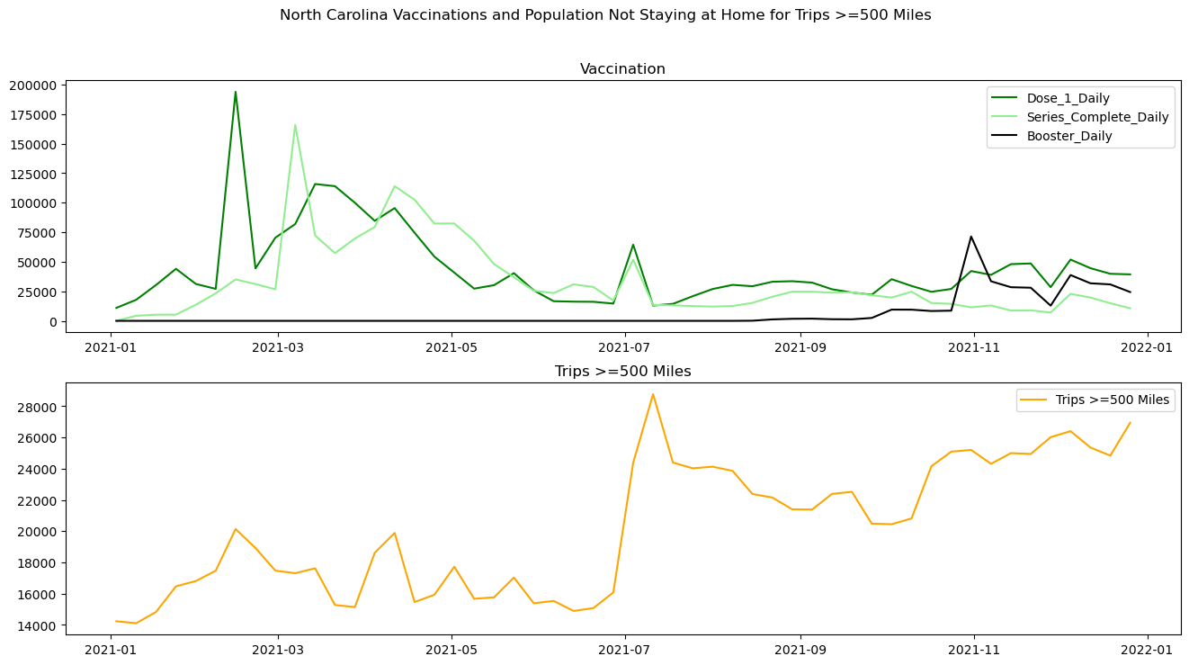
Vaccination and Travel Data
Streamlit? / Talk about the features that went into the classification (logistic regression) model
Notes:
Here we can see the relationship between vaccine and travel (displacement greater than 500 miles).
We can see that after the application of the primary series, people started to travel (leave home) and that after that we can observe that there is a growing trend in this, which means that people are returning to a normal life.
This travel information was collected and placed as the exogenous variable in the time series model

Slide 16
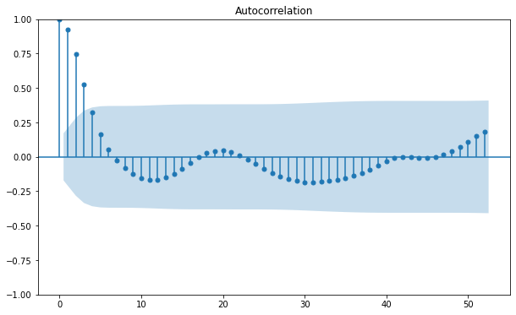
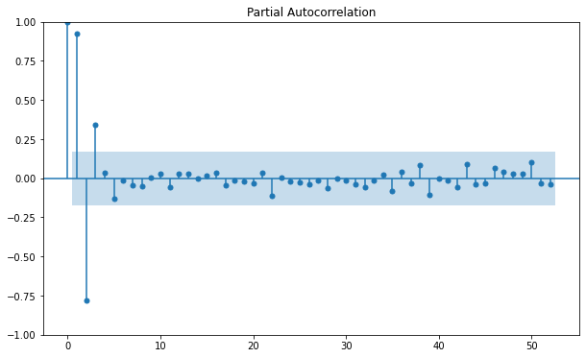
Time Series Model for Cases in US
High autocorrelation on the 3 first legs
No trends/seasonality was found at the data
Notes:
After analyzing these time series data, we start to get ready to build a time series model.
We check the autocorrelation and partial autocorrelation plot but we couldn't find any kind of trend, neither seasonality.
We could just see that the first 3 legs were highly correlated.

Slide 17
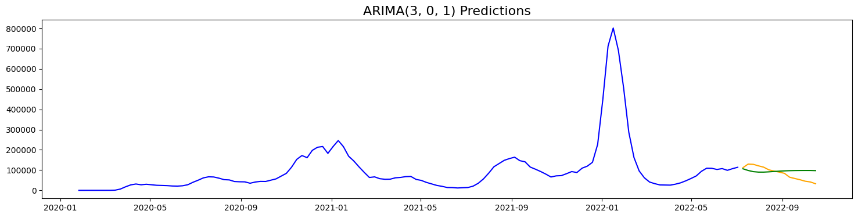
Time Series Model for Cases in US
ARIMA | (0,1,0) | 4237225928.63
ARIMA | (3,0,1) | 2791954341.41
SARIMA | (3,0,1) x (1,1,1,22) | 3638844274.47
VAR (North Carolina) | covid_deaths, covid_cases, trips | 20630275.43
Notes:
Even so, we built some models to see how it performs.
We built more than 7 models using different parameters, gridsearching and even applying TimeSeriesGenerator and neural networks
These are the parameters of some of these models. Here I used 22 (weeks) to try to get the summer/winter pattern
In the plot we can see that after a brief moment, the model can only predict the mean.
So maybe it can be used to predict small legs like 1 week or 2 weeks
If we think of resources as a vaccine, perhaps this time is not enough, because the vaccine needs at least a month to take effect, but if we think of ICU as a resource, two weeks is enough time to allocate them.
so , why I decide to build these models even though I knew the requirements were not met?

Slide 18
Findings/Recommendations
Focus on North Carolina:
Highest number of new covid cases over the past month
Lowest percent of people w/ primary series and booster (28%)
Time series modeling is difficult:
Tried multiple models: ARIMA, VAR, SARIMAX
Lack of domain knowledge
Imbalanced classes affected classification model performance:
Able to identify factors that contributed to hospitalization
Collect more data to balance

Slide 19
Thank you!!

Slide 20
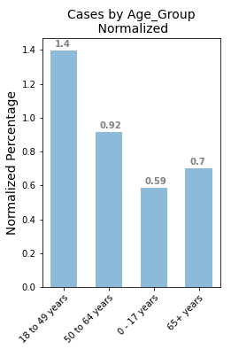
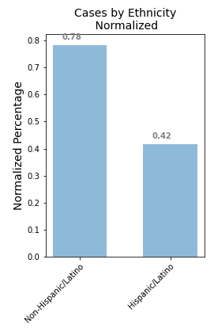
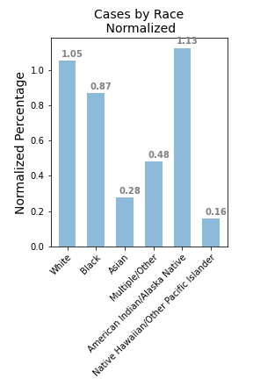

Demographic EDA- COVID

