Slide 1
BOTTRAINER — NLU MODEL TRAINER AND EVALUATOR FOR CHATBOTS

Slide 2
INTRODUCTION
BotTrainer is designed as an end-to-end Natural Language Understanding (NLU) system for chatbots using modern Large Language Models (LLMs).
Natural Language Understanding (NLU) is a core component of modern conversational AI systems such as chatbots, virtual assistants, and customer support bots. It enables machines to interpret user input, understand user intent, and extract meaningful information from natural language text. NLU plays a critical role in ensuring smooth and accurate human–computer interaction.

Slide 3
PROBLEM STATEMENT
Understand user input in natural language
Predict the correct intent of the user
Extract relevant entities from the text
Evaluate the system performance objectively
Provide an interactive interface for real-time testing

Slide 4
Tools Used in the Project
Python – Core programming language for backend logic
Large Language Models (LLMs) – Used for intent classification and entity extraction
Ollama – To run LLMs locally for inference
Gemma-3 Model – Local LLM used for structured NLU tasks
Streamlit – For building an interactive web-based user interface
JSON – For dataset design, prompts, and structured output
Scikit-learn – For evaluation metrics such as accuracy, precision, recall, and F1-score
Git & GitHub – Version control and project hosting

Slide 5
IMPLEMENTATION
Designed a JSON-based NLU dataset containing intents, example utterances, and entity schema.
Created prompt templates that guide the LLM to select one intent and extract only valid entities.
Integrated a local LLM using Ollama to process user queries.
Implemented a validation layer to ensure LLM outputs valid JSON responses.
Built a Streamlit application to accept user input and display predictions.
Developed an evaluation module to compare predictions with labeled evaluation data.
Stored the complete project with documentation in a public GitHub repository.

Slide 6
SOLUTION
The problem was solved by replacing traditional training-based models with prompt-engineered LLM inference. Instead of training a classifier, the system sends structured prompts to the LLM, which:
Selects the most appropriate intent from predefined options
Extracts relevant entities based on schema constraints
Returns results in a strict JSON format

Slide 7
CHALLENGES
Several challenges were encountered during development:
Ensuring the LLM always returned valid JSON output
Reducing hallucinations in intent and entity predictions
Designing prompts that worked consistently across different inputs
Evaluating LLM output in a deterministic manner
Managing multiple intents with overlapping meanings

Slide 8
IMPACT
The BotTrainer project demonstrates the effectiveness of LLM-based NLU systems without traditional model training. The impact of the project includes:
Faster development of NLU systems
Easy scalability by adding new intents
Reduced dependency on large labeled datasets
Improved flexibility for chatbot applications
Practical exposure to modern LLM-based NLP techniques

Slide 9
CONCLUSION
BotTrainer demonstrates that prompt-engineered Large Language Models can effectively replace traditional intent classification systems. The project highlights a modern, scalable, and training-free approach to Natural Language Understanding.
By combining prompt engineering, local LLM inference, evaluation metrics, and an interactive user interface, the project provides a complete end-to-end NLU solution suitable for academic research and real-world chatbot applications.

Slide 10
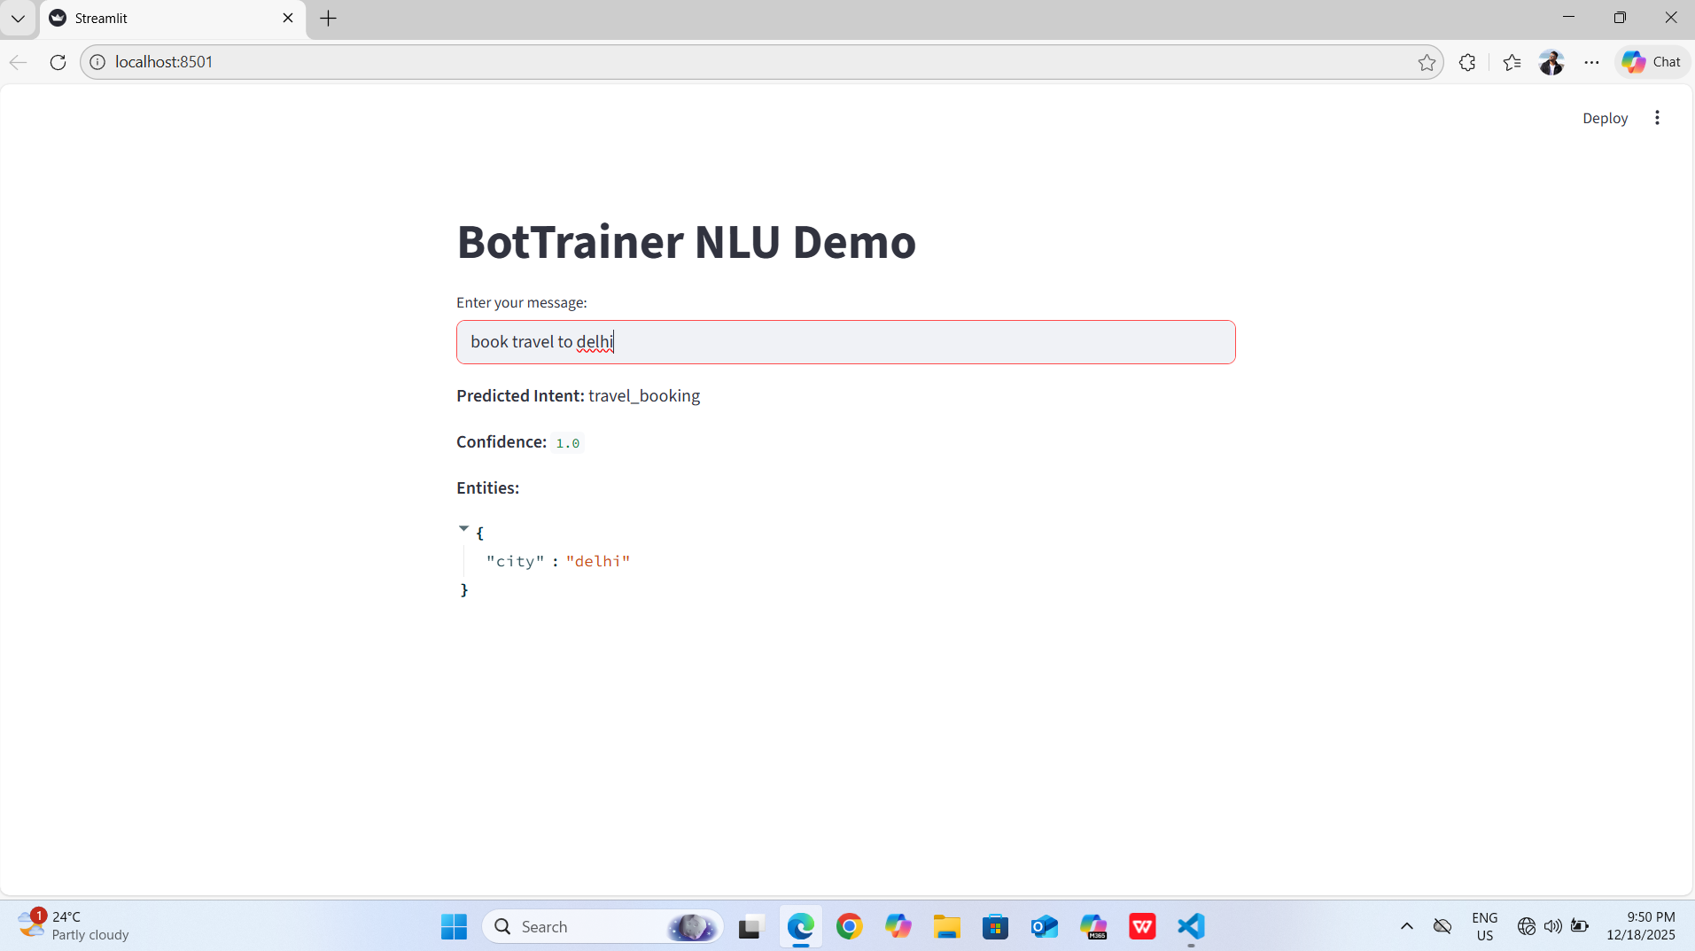
OUTPUT

Slide 11


