Slide 1
CAS AML 2025 Notebook Summary: M2D1
Project of Module 1&2 of CAS AML 2025
Presented by
Derk, Marco, Linda

Slide 2
Data
Graphisch
Menge (GB)
Idea? LSTM, RandomForest; CCF, Linear Regression

Slide 3
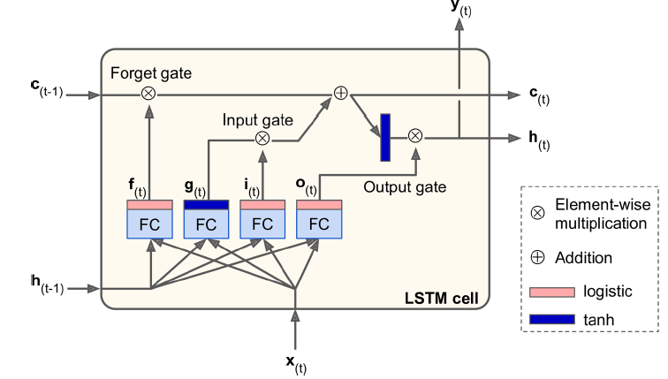
LSTM (Long Short-Term Memory)
is a type of recurrent neural network (RNN) designed to handle sequences of data and solve the issue of learning long-term dependencies in a sequence

Slide 4
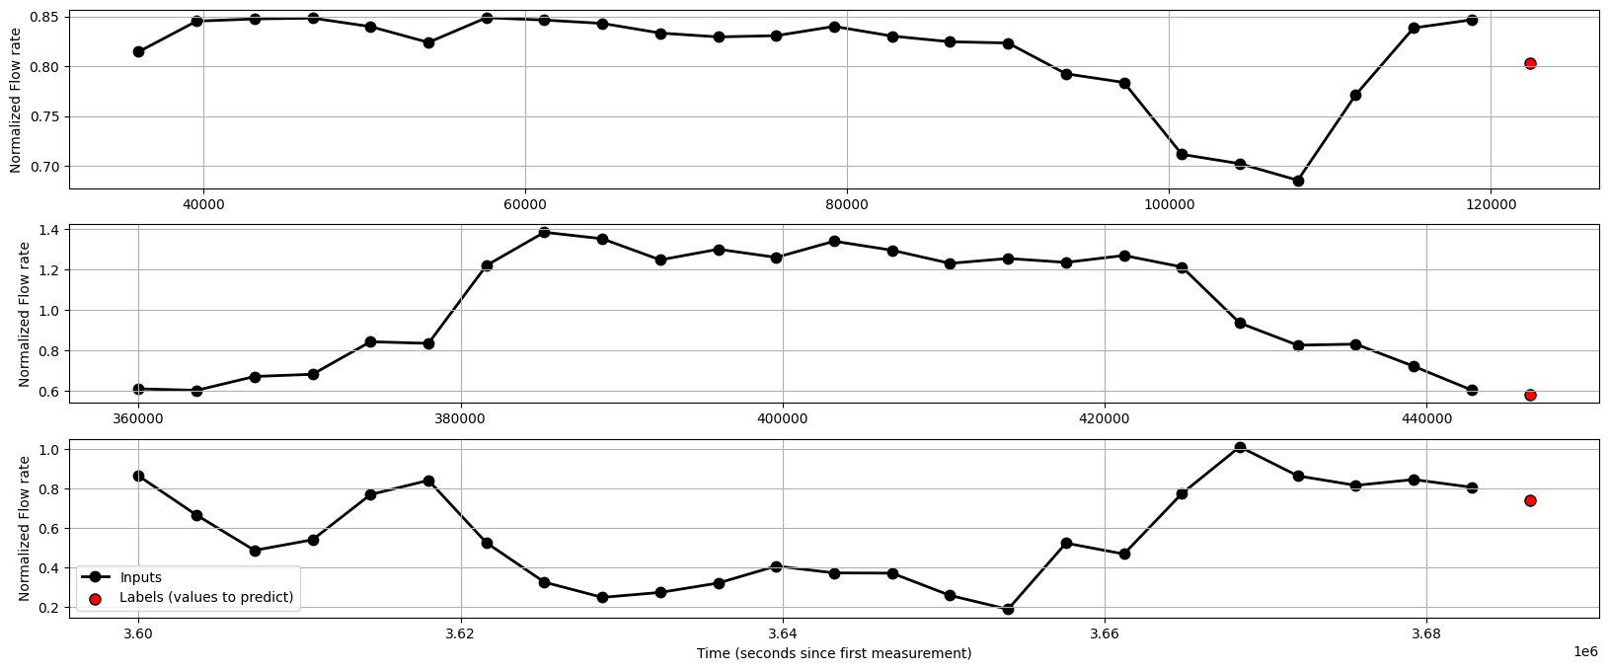
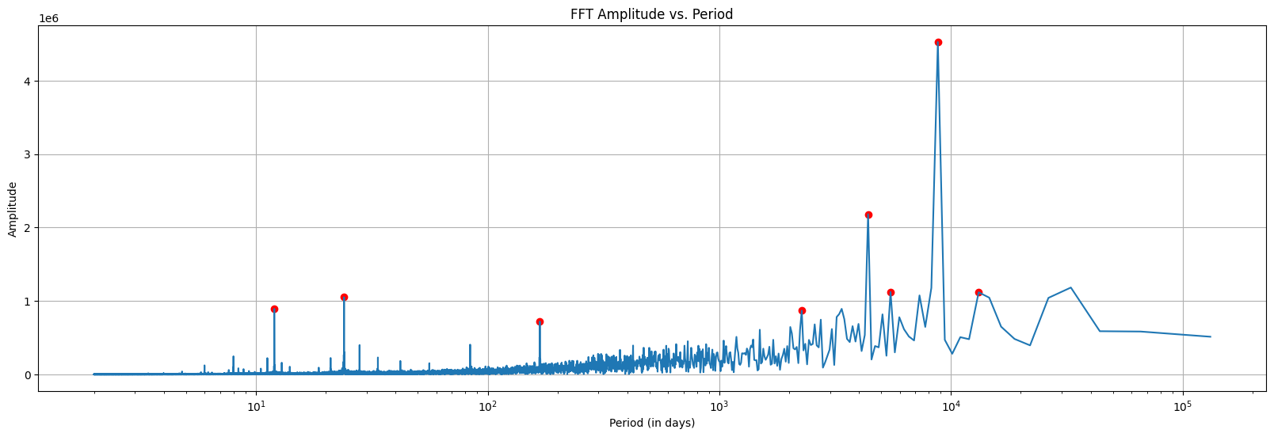
Defined LSTM-Models
Simple LSTM-Model (to Predict 1 Value in Future)
lstm_model = tf.keras.models.Sequential([
tf.keras.layers.LSTM(32, return_sequences=False),
tf.keras.layers.Dense(units=1)])
Refined LSTM-Model
lstm_model_refined = tf.keras.models.Sequential([
tf.keras.layers.LSTM(64, return_sequences=True),
tf.keras.layers.Dropout(0.2),
tf.keras.layers.LSTM(32, return_sequences=False),
tf.keras.layers.Dropout(0.2),
tf.keras.layers.Dense(units=1)])
Input-Layer (32/64 neurons)
Hidden-Layer (32 neurons)
Dropouts (to avoid over-fitting)
Output-Layer (1/6 units)
Simple Multi-Feature LSTM-Model
lstm_model = tf.keras.models.Sequential([
tf.keras.layers.LSTM(32, return_sequences=False, input_shape=(24, num_features)),
tf.keras.layers.Dense(units=1)])
Simple LSTM-Model to Predict 6 Values
lstm_model = tf.keras.models.Sequential([
tf.keras.layers.LSTM(32, return_sequences=False),
tf.keras.layers.Dense(units=6)])

