Slide 1
LendingClub Loan Analysis
Jay Ko and Richard Petrie

Slide 2
Contents
The core question: Who repays their loans?
How can we find out?
Machine Learning & our suggestion

Slide 3

Why do we care?
Many financial organizations fail to receive money back from their borrowers and it hurts not only organization's financial performance but also their existence and economy.
Notes:
Most recent example is Subprime Mortgage Crisis which borrowers could not make their payment and it caused worldwide financial crisis.

Slide 4

How can we find out?
We can look for one by one
=> Takes forever
Notes:
Let’s do smart way

Slide 5
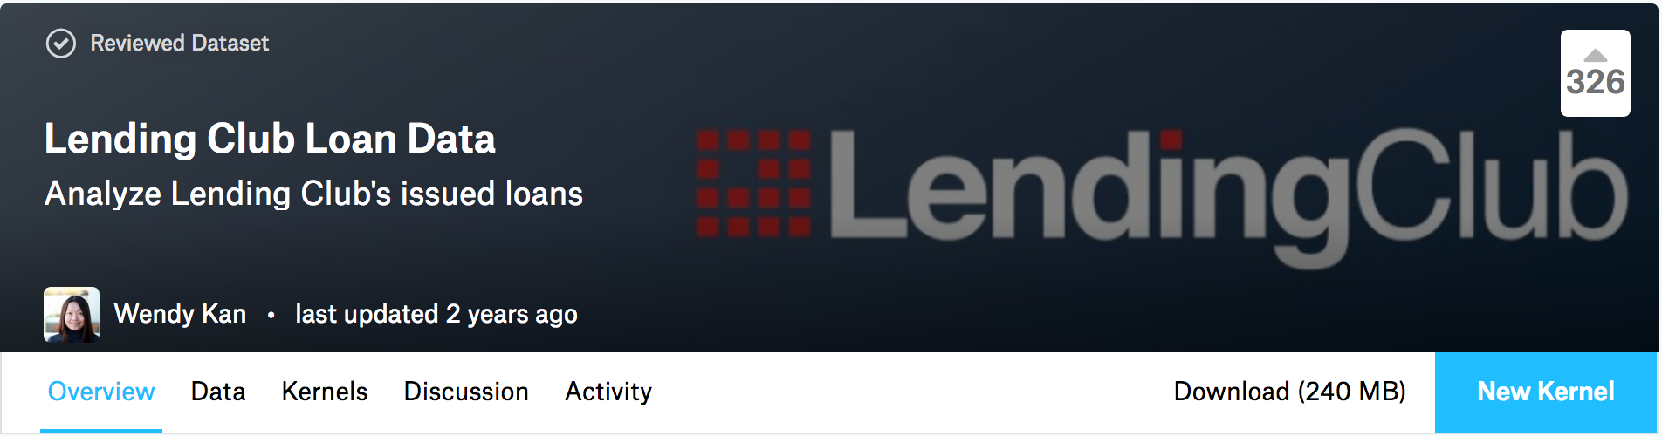
Using already collected data
Download from https://www.kaggle.com/wendykan/lending-club-loan-data
61 factors(columns) including Loan status, grade, interest rate, and Loan amount.

Slide 6
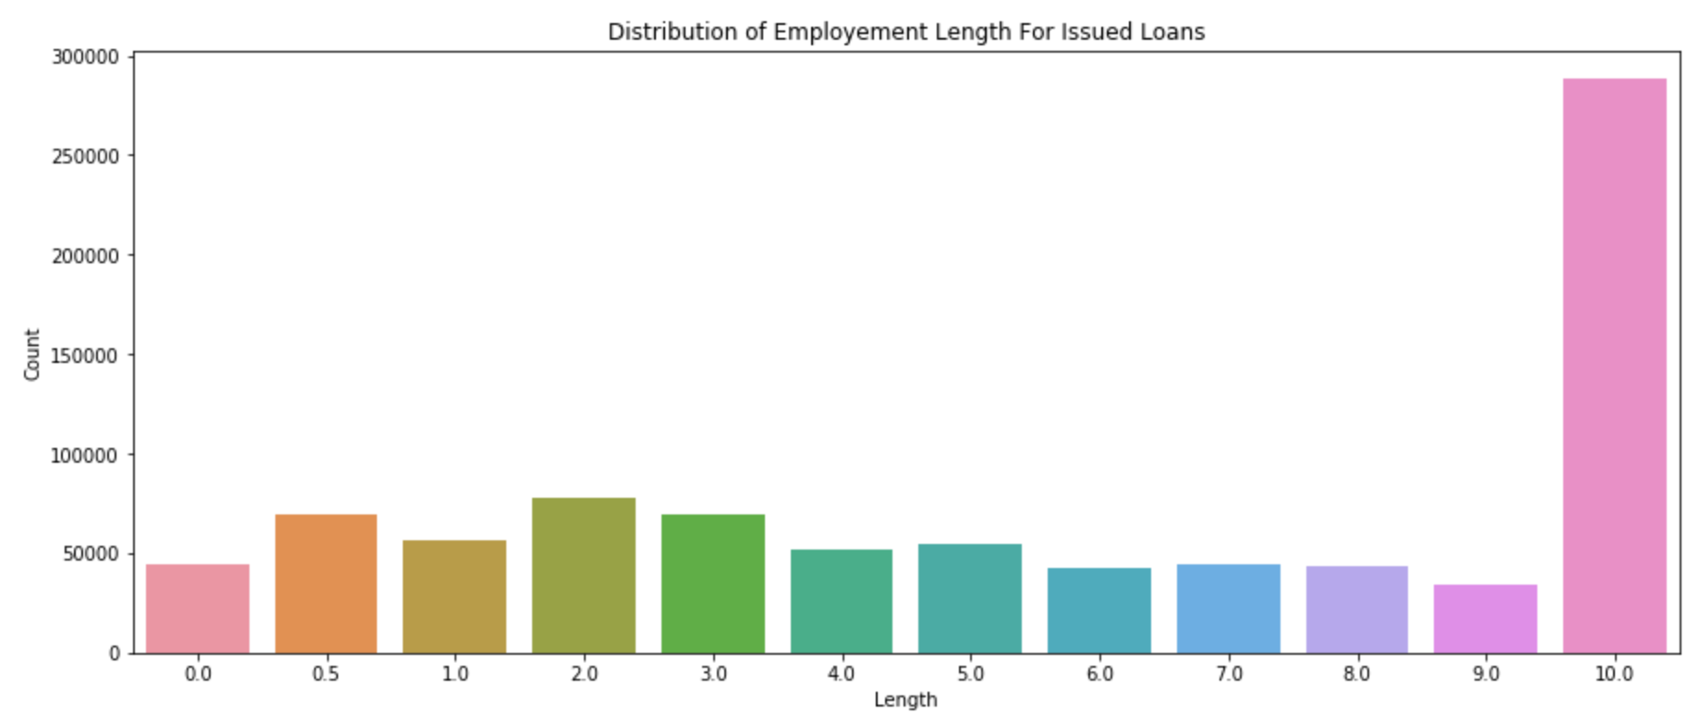
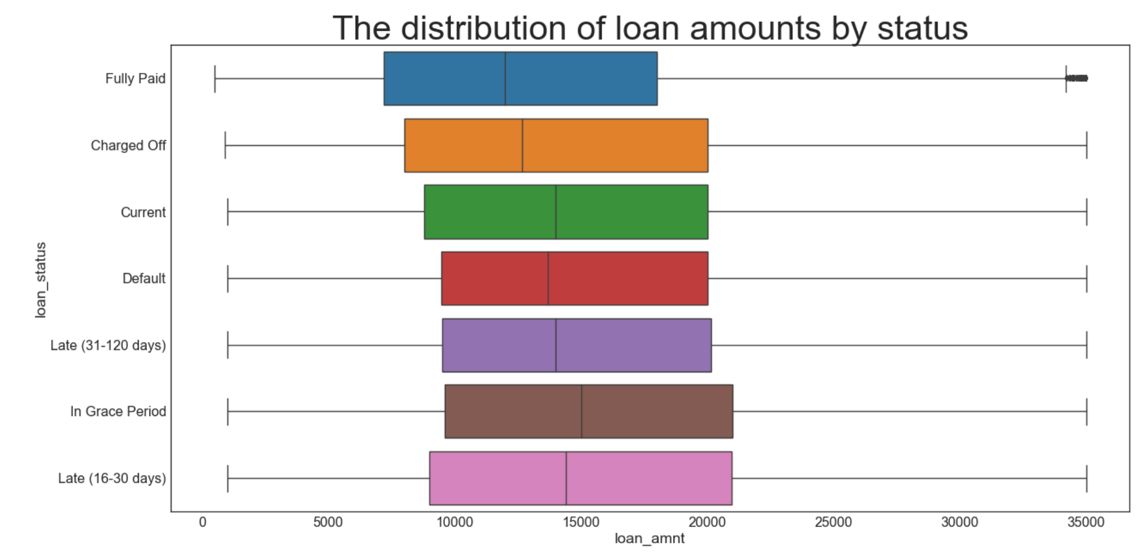
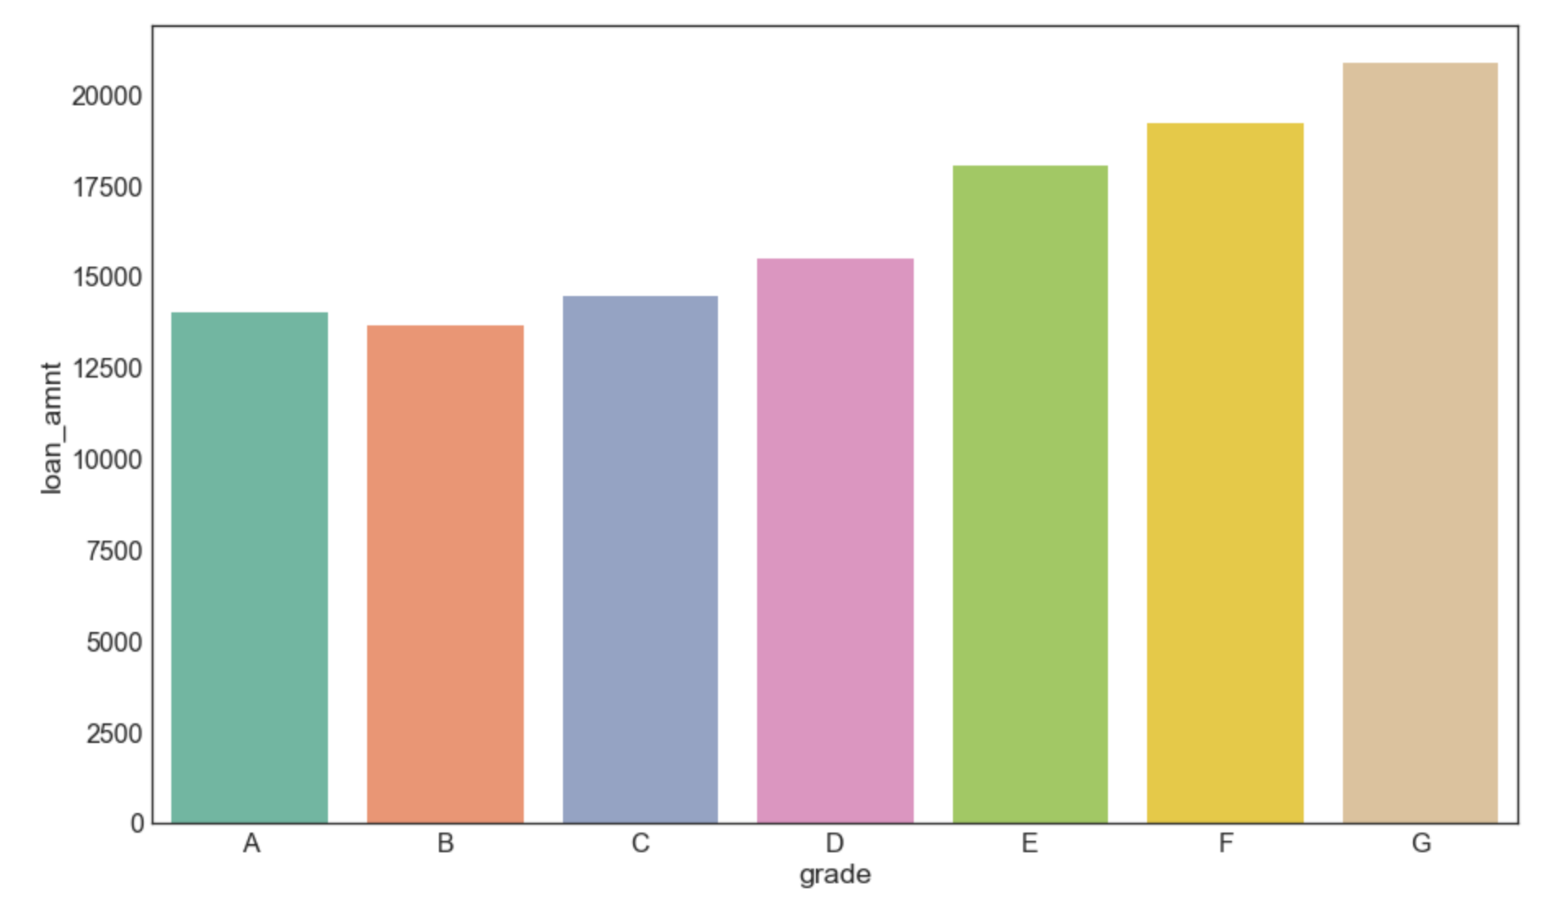
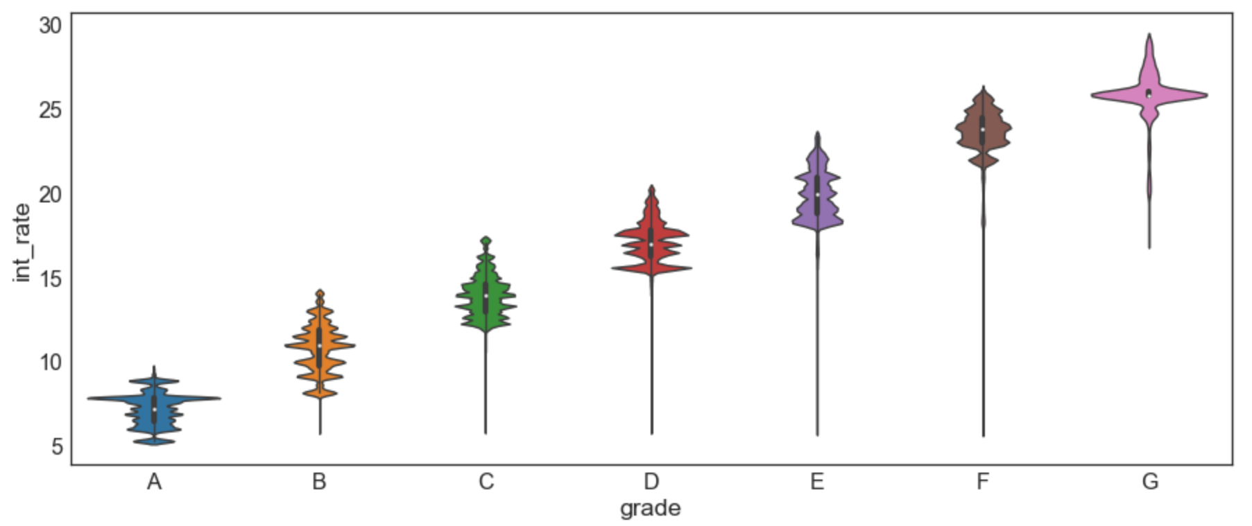
Data Visualization
Notes:
The longer you are working, the higher amount you borrow.
As we see in the graph most of borrowers working 10 years or more than 10 years, so we can assume borrowers are older than 30 years(usually people start working after 20’s)
Fairly all status has similar amount, but paid late(16-30days) has highest amount loan.
As Lending club is young company, there are still on-going debts
Grade G borrows the loans the most
The lower grade, the higher interest rate
With last two graphs, we can find out surpring facts. The lower your grade, you borrow more money. And they pay a lot of interest rate so that we can assume that it is difficult to pay back for people who have lower grade

Slide 7
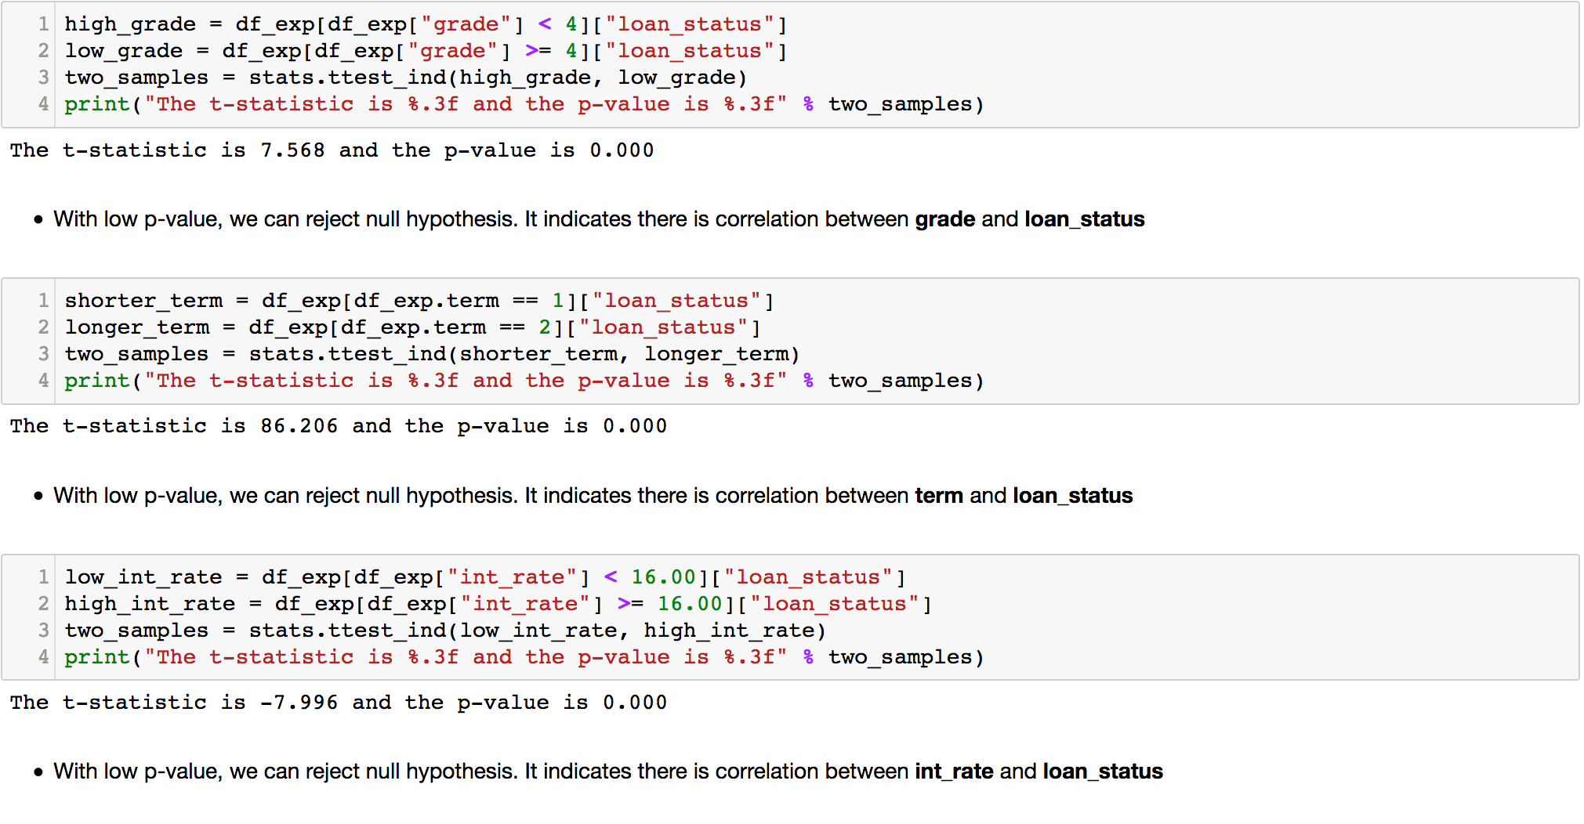
Notes:
We also conducted correlation analysis and we barely see any noticable correlation between loan_status and other factors. So we conducted t-test with some columns with loand_status factor.
As you see here, we set multiple null hypotheses.
first null hypothese is there is no correlation between grade and loan_status and we got 0.000 p-value and it indicates that we need other analysis.
Also interest rate and loan status have 0 p-value and it makes us do other analysis

Slide 8

Predicting the future
Notes:
We use decision tree algorithm and random forest algorithm

Slide 9
6 way multi-classification
Late 16-30 days, late 30-120 days
Charged off, in default
Current, fully paid off
Standard 70% train 30% test split: 64.3% accurate
One-sided Selection undersampling: 88.8% accurate

Slide 10
Outstanding loans
Late
Current
Default
 | Late | Current | Default
Late | 5,994 | 7,954 | 0
Current | 2 | 601,777 | 0
Default | 0 | 329 | 890

