Slide 1
Application of Rao-Blackwell Theorem to Variance Reduction in Markov Chain Monte Carlo Simulation
Di Wang
EN 660.664

Slide 2
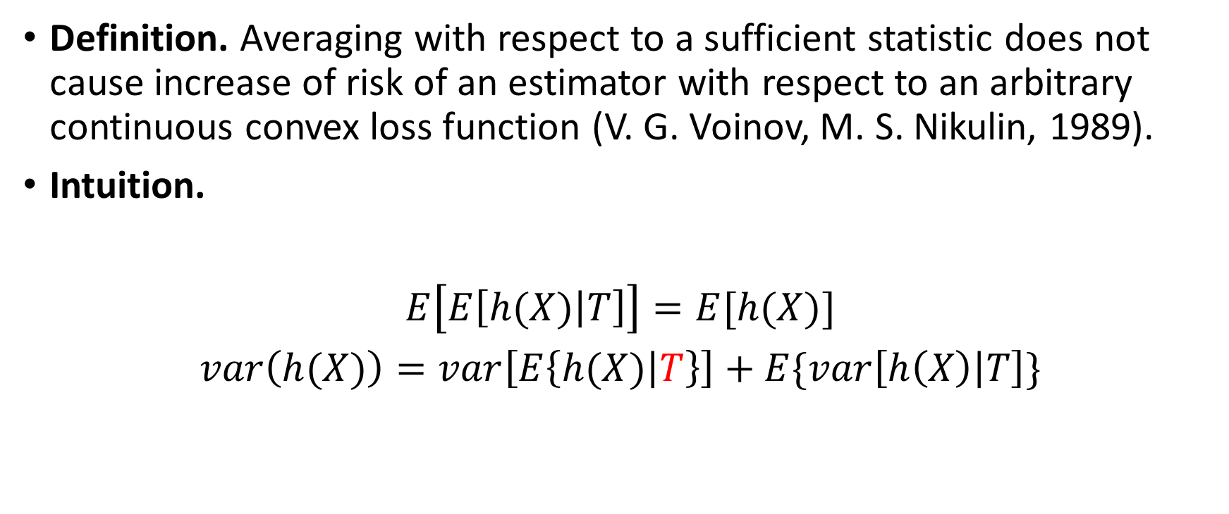
Rao-Blackwell Theorem
Definition. Averaging with respect to a sufficient statistic does not cause increase of risk of an estimator with respect to an arbitrary continuous convex loss function (V. G. Voinov, M. S. Nikulin, 1989).
Intuition.
$E\left[E\left[h(X) | T\right]\right]=E[h(X)]$
$var\left(h(X)\right)=var\left[E\left\{h(X) | T\right\}\right]+E\{var\left[h\left(X\right) | T\right]\}$
sufficient
>0

Slide 3

Sufficiency
A statistic $T=T(𝕏)$ is sufficient for a parameter θ if the conditional distribution for any fixed value $T\left(𝕏\right)=t$ of a random vector $𝕏$does not depend on θ.

Slide 4

Metropolis-Hastings models - Independence Sampler
Original
$$τ=\frac{1}{n+1}\sum_{i=0}^{n}{h(Z_{i})}$$
Rao-Blackwellised:
$$τ^{′}=\frac{1}{n+1}\sum_{i=0}^{n}{φ_{i}h\left(Y_{i}\right)},$$
With
${ φ}_{i}=δ_{i}\sum_{j=i}^{n}{ξ_{ij}}$

Slide 5

Metropolis-Hastings models - Independence Sampler
Implementation:
Target: $X\sim Gamma\left(2.0, 0.5\right)$
Proposal: $N(1.0, 0.5)$
$h\left(X_{i}\right)=E\left[X\right]=1.0$
M-H sampling to $Gamma(2.0, 0.5)$ with normal proposal distribution

Slide 6
Metropolis-Hastings models - Independence Sampler
 | Sample Mean (RB Metro) | Sample Mean(Metrop)
N=10 | 1.05074222067 | 1.00505328912
N=15 | 1.11333643423 | 1.03013167617
 | Sample Var (RB Metro) | Sample Var (Metrop)
N=10 | 0.220772540984 | 0.235231103452
N=15 | 0.179379932536 | 0.22260909921

Slide 7

Metropolis-Hastings models – Random Walk
$Y_{t}$ = $X_{t}+$ $ε_{t}$ where $ε_{t}$ $\sim g\left(σ\right)$ -> spherically symmetric
$X_{t+1}=\left\{\begin{aligned}Y_{t } if U≤f(Y_{t })/f(X_{t }) \\ X_{t} other wise\end{aligned}\right.$
Or
$Y_{t}\sim N\left(X_{t}, σ𝕀\right)$ or $Y_{t}\sim U\left(X_{t}− δ𝕀, X_{t}+ δ𝕀 \right)$

Slide 8
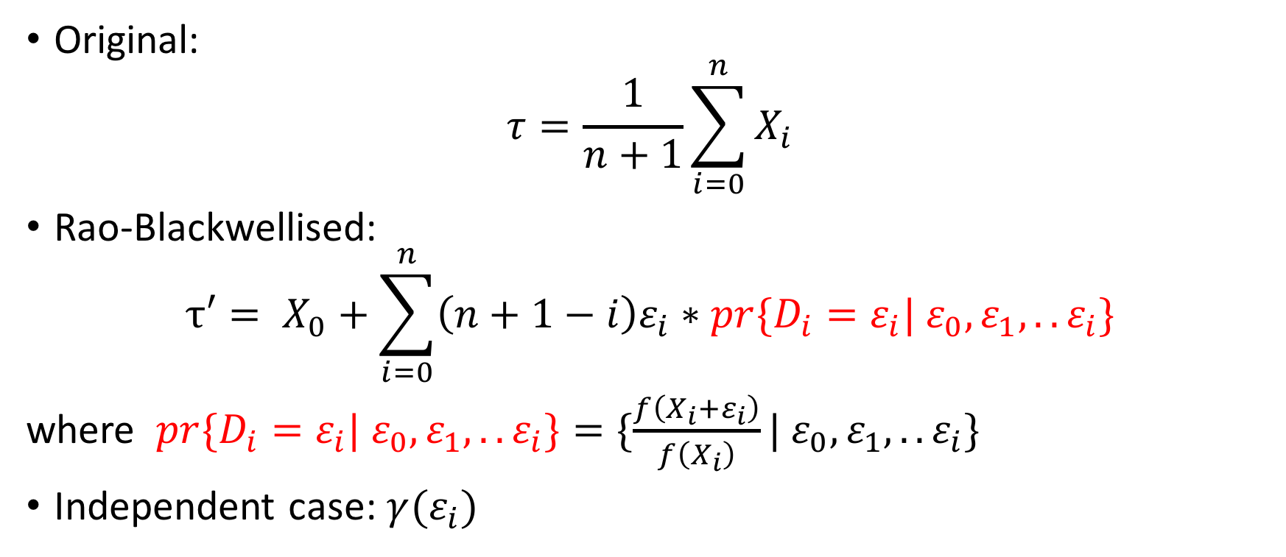
Metropolis-Hastings models – Random Walk
Original:
$$τ=\frac{1}{n+1}\sum_{i=0}^{n}{X_{i}}$$
Rao-Blackwellised:
$$τ′= X_{0}+\sum_{i=0}^{n}{\left(n+1−i\right)ε_{i}∗pr\{D_{i}=ε_{i}| ε_{0}, ε_{1},..ε_{i}\}}$$
where $pr\{D_{i}=ε_{i}| ε_{0}, ε_{1},..ε_{i}\}=\{\frac{f\left(X_{i}+ε_{i}\right)}{f\left(X_{i}\right)}| ε_{0}, ε_{1},..ε_{i}\}$
Independent case: $γ(ε_{i})$

Slide 9
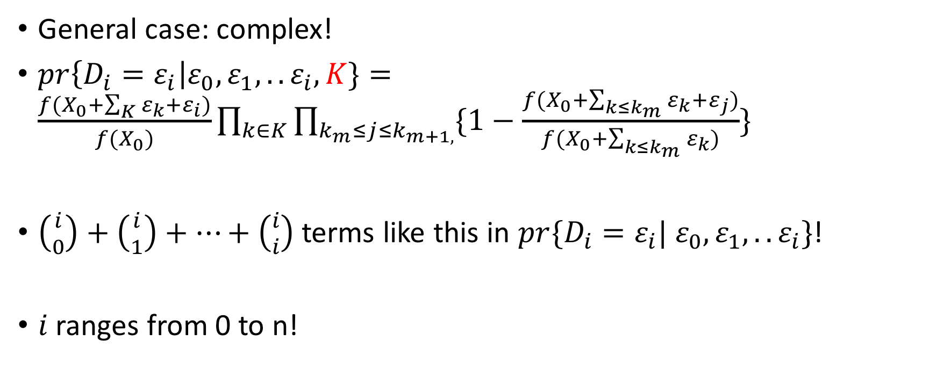
Metropolis-Hastings models – Random Walk
General case: complex!
$pr\left\{D_{i}=ε_{i}\right|ε_{0}, ε_{1},..ε_{i},K\}=\frac{f(X_{0}+\sum_{K}{ε_{k}}+ε_{i})}{f(X_{0})}\prod_{k∈K}{\prod_{k_{m}≤j≤k_{m+1,}}{\{1−\frac{f(X_{0}+\sum_{k≤k_{m}}{ε_{k}}+ε_{j})}{f(X_{0}+\sum_{k≤k_{m}}{ε_{k}})}}\}}$
$\left({i \atop 0}\right)+\left({i \atop 1}\right)+…+\left({i \atop i}\right)$ terms like this in $pr\{D_{i}=ε_{i}| ε_{0}, ε_{1},..ε_{i}\}$!
$i$ranges from 0 to n!

Slide 10
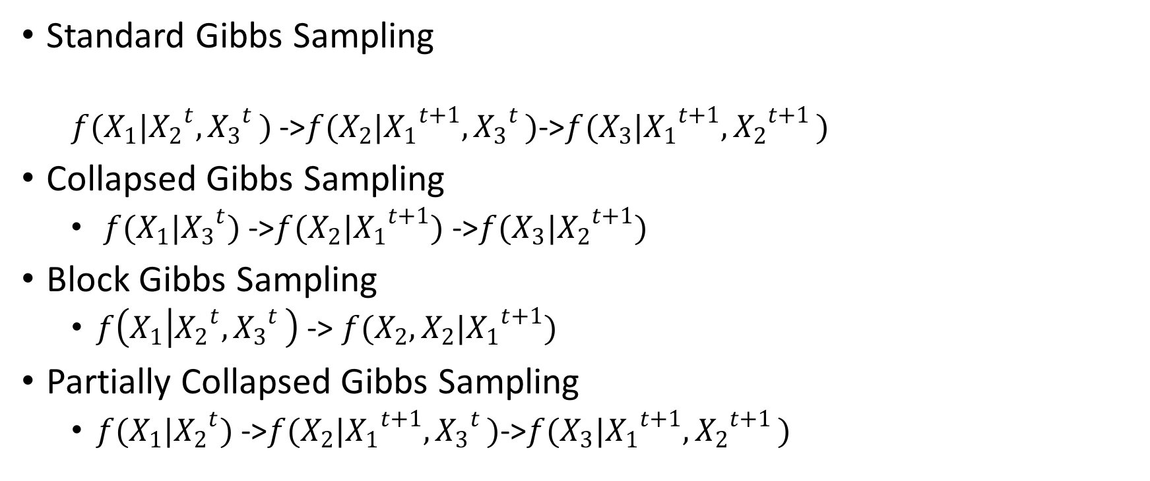
Gibbs Sampling
Standard Gibbs Sampling
$f(X_{1}|{X_{2}}^{t}{{,X}_{3}}^{t})$ ->$f(X_{2}|{X_{1}}^{t+1}{{,X}_{3}}^{t})$->$f(X_{3}|{X_{1}}^{t+1}{{,X}_{2}}^{t+1})$
Collapsed Gibbs Sampling
$f(X_{1}|{X_{3}}^{t})$ ->$f(X_{2}|{X_{1}}^{t+1})$ ->$f(X_{3}|{X_{2}}^{t+1})$
Block Gibbs Sampling
$f\left(X_{1} | {X_{2}}^{t}{{,X}_{3}}^{t}\right)$-> $f(X_{2},X_{2}|{X_{1}}^{t+1})$
Partially Collapsed Gibbs Sampling
$f(X_{1}|{X_{2}}^{t})$ ->$f(X_{2}|{X_{1}}^{t+1}{{,X}_{3}}^{t})$->$f(X_{3}|{X_{1}}^{t+1}{{,X}_{2}}^{t+1})$
Rao-Blackwellised!

Slide 11
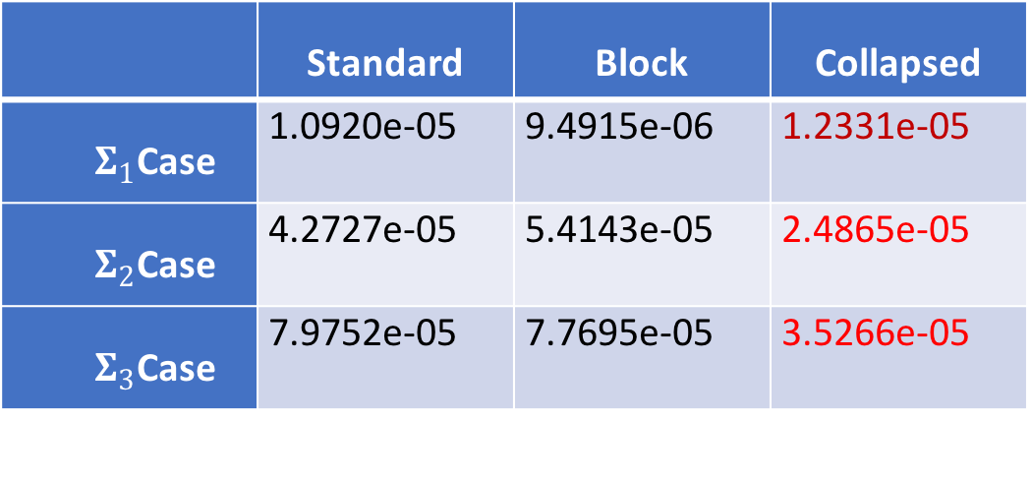
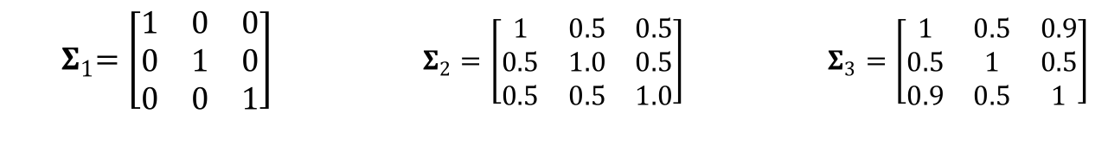
Standard vs Block vs Collapsed
Implementation: Multivariate Normal Dist.
 | Standard | Block | Collapsed
${ Σ}_{1}$Case | 1.0920e-05 | 9.4915e-06 | 1.2331e-05
${ Σ}_{2}$Case | 4.2727e-05 | 5.4143e-05 | 2.4865e-05
${ Σ}_{3}$Case | 7.9752e-05 | 7.7695e-05 | 3.5266e-05
${ Σ}_{1}=\left[\begin{matrix}1 & 0 & 0 \\ 0 & 1 & 0 \\ 0 & 0 & 1\end{matrix}\right]$ $Σ_{2}=\left[\begin{matrix}1 & 0.5 & 0.5 \\ 0.5 & 1.0 & 0.5 \\ 0.5 & 0.5 & 1.0\end{matrix}\right]$ $Σ_{3}=\left[\begin{matrix}1 & 0.5 & 0.9 \\ 0.5 & 1 & 0.5 \\ 0.9 & 0.5 & 1\end{matrix}\right]$

Slide 12
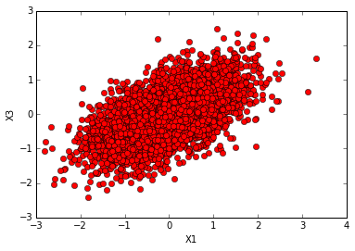
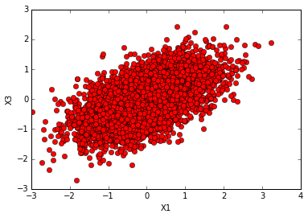
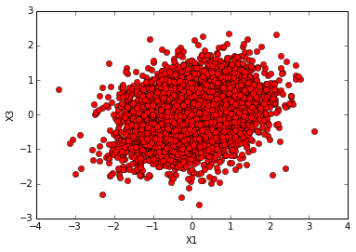
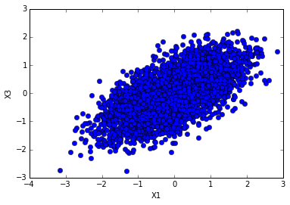
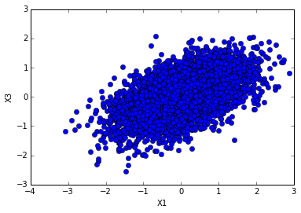
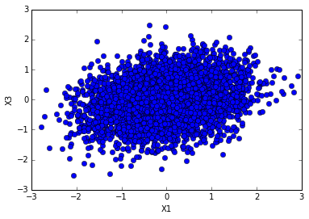
Change order
standard
Partially collapsed
Order 1
Partially collapsed
Order 2

Slide 13
Discussion
Advantage: reduce variance
Disadvantage: computational complexity
Future Improvements
Use Dynamic Programming or Data Structures to avoid repeated calculations
Combine with other variance reduction methods

