Slide 1
通信感知自适应权重
headline evidence
31.98%
用于分布式 GA-LMB / KLA 融合
consensus OSPA 下降
当前主线不是重做滤波器，而是在 unknown cross-correlation 下重做融合权重分配：让权重同时感知后验质量、实际链路质量和存在性决断度。
34.57%
consensus RMSE 下降
GA-LMB
distributed KLA
consensus-oriented
91.46%
cardinality disagreement 下降
20 paired trials, seeds 2-21
main tiered heterogeneous packet-loss scenario
8-sensor distributed fusion
Source: docs/paper/README.md; RUN/GA/GA_TIERED_LINK_ABLATION_N20_SEED1_20260512_155714.md
01

Slide 2
POSITIONING
论文边界要先收紧：贡献是自适应融合权重，而不是新滤波器家族
这会让方法、实验和结论都围绕 distributed KLA-based LMB fusion 的同一个成功标准展开。
问题设定
方法焦点
成功标准
通信受限的分布式 GA-LMB / KLA 融合
三因子权重 backbone + 分支化 refinement
优先改善跨节点 consensus
unknown cross-correlation 下 KLA 仍是合理基线；真正脆弱的是固定或纯拓扑权重。
covariance、realized link quality、existence confidence 是主干；FID-FIA 只进 existence 分支。
consensus OSPA/RMSE/cardinality 是 primary；local tracking 作为 safeguard，防止一致到错误答案。
不要把正文写散：history / freshness / association ambiguity / NIS 只能作为 secondary 或 appendix evidence。
主 claim 必须能回到：adaptive weight allocation under communication constraints。
Source: docs/paper/00_positioning.md; docs/paper_line/PAPER_MAIN_NARRATIVE_LOGIC_CN.md
02

Slide 3
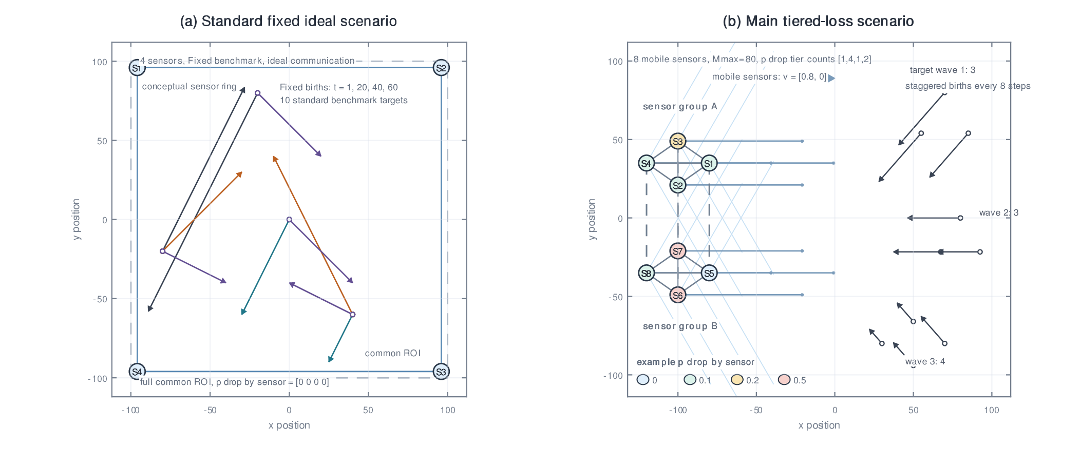
SCENARIO
主场景保留原 4+4 编队，但用异构通信把固定权重的弱点放大
evaluation frame
8
mobile sensors, two 4-sensor formations
10
targets in 3 + 3 + 4 staggered births
100
simulation steps; MC means reported
tiered packet loss: [0, 0.1, 0.2, 0.5]
level counts: [1, 4, 1, 2]
mean pDrop preserved at 0.2
通信图：formation 内部强连接，跨 formation 一对一连接。
固定基线：local neighborhood 内 Metropolis weights；main paper evidence 以 tiered-drop GA 为主。
Source: docs/paper/06_experimental_setup.md; docs/paper/figures/figure_simulation_scenario.pdf
03

Slide 4
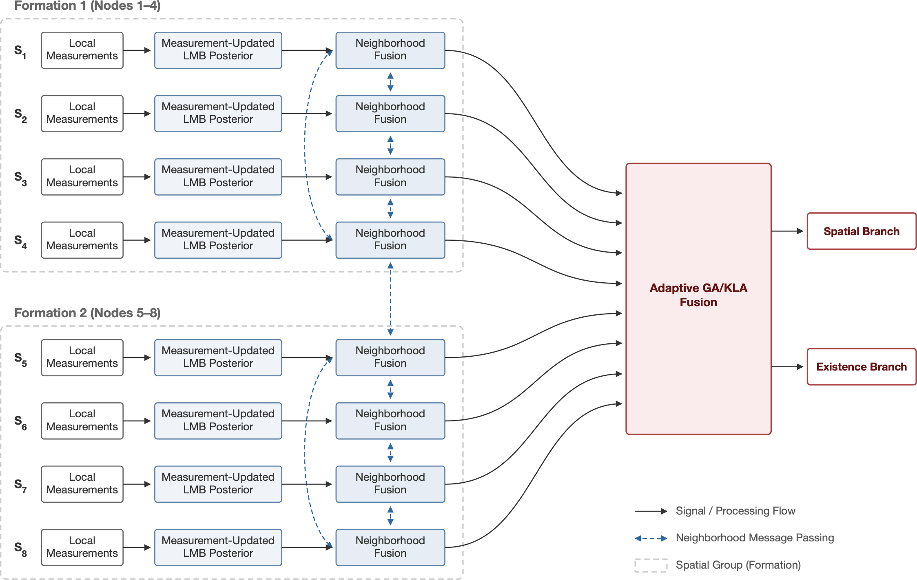
PIPELINE
方法嵌入现有分布式 GA-LMB 流水线，只改变邻域融合权重
1
local measurement update
各节点先得到自己的 LMB posterior
2
neighborhood communication
带 bandwidth / packet loss 的消息交换
3
adaptive fusion weights
按 posterior quality + link + existence 重分配权重
4
branch-decoupled KLA
spatial 与 existence 分支分别融合
因此 slide 里的技术说法应保持克制：这是 conservative KLA fusion 的权重分配改进，而不是替换 LMB/GA/KLA 框架。
Source: docs/paper/05_method_adaptive_kla.md; docs/paper/els-cas-templates/figs/paper-figure1-crop.png
04

Slide 5
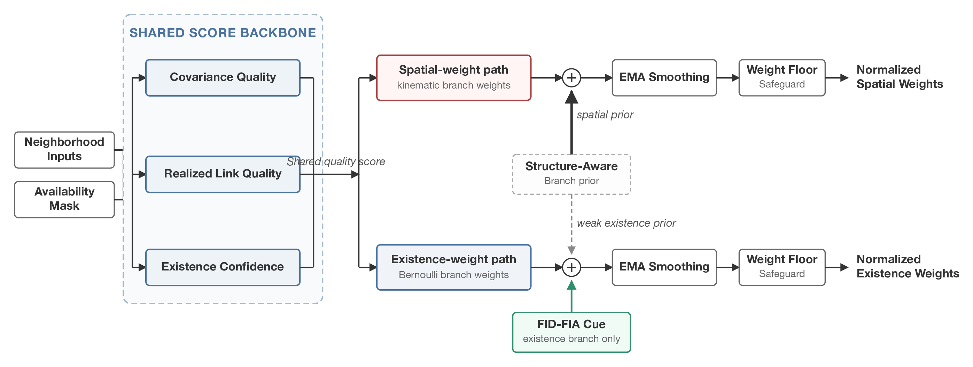
METHOD
三因子 backbone 是主干；branch decoupling 和 FID-FIA 是分支化 refinement
shared backbone
spatial branch
existence branch
mask x covariance x link quality x existence confidence
cov/link + weak structure prior, keep RMSE-oriented path
existence confidence + FID-FIA cue, target cardinality agreement
NIS / history / freshness: optional, not headline
讲法重点：不是“模块越多越好”，而是把能被证据支持的信号放进对应分支。
Source: docs/paper/05_method_adaptive_kla.md; docs/paper/els-cas-templates/figs/paper-figure2-crop.png
05

Slide 6
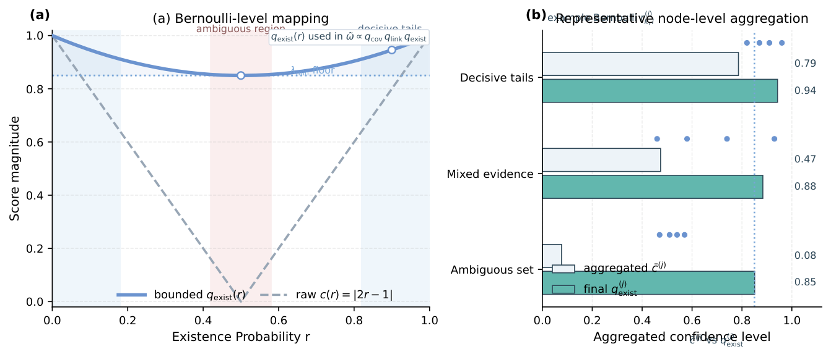
EXISTENCE CONFIDENCE
existence confidence 补上 covariance 和 link quality 看不到的一维
Bernoulli decisiveness
c = |2r - 1|
r 接近 0 或 1 时更果断；r 接近 0.5 时更模糊。
covariance: 只看空间集中度，不表达目标是否存在。
link quality: 只看信息是否送达，不表达 posterior content 是否可信。
existence confidence: 给 cardinality / existence 分支一个直接信号。
这也是为什么最终方法不把 FID-FIA 作为 whole-posterior scalar weight，而是只把它作为 existence/cardinality cue。
Source: docs/paper/05_method_adaptive_kla.md; docs/paper/figures/figure3_existence_confidence_curve.png
06

Slide 7
EVIDENCE STACK
证据要分层：主线讲最强结果，弱模块留作 appendix 解释取舍
PRIMARY
tiered packet-loss main result
deck rule
20 paired trials: fixed / FID-FIA / backbone / proposed
1
DIAGNOSTIC
factor ablation
每页一个 claim
fixed -> cov -> link -> exist -> decoupled -> FID-FIA existence
1
ideal communication + AA
一个 proof object
SUPPORT
回答是否只是补救丢包；AA 只作外推迹象
0
NIS / history / freshness
不讲未被证据支持的创新
APPENDIX
记录探索过的方向，但当前证据弱、混合或负向
这样排布能解释为什么 main paper 不把 NIS/history/freshness 写成贡献，同时也不浪费已有负结果材料。
Source: docs/paper/09_figures_tables_and_gaps.md; docs/paper/Appendix_B_additional_attempts.md
07

Slide 8
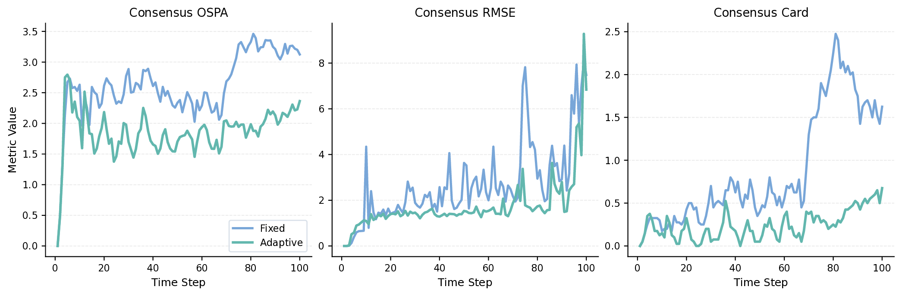
MAIN RESULT
tiered-drop 20-trial 主结果：proposed arm 在三项 consensus 指标上全优
OSPA
fixed
2.454
FID-FIA
1.820
backbone
1.786
proposed
1.669
RMSE
fixed
2.336
FID-FIA
1.647
backbone
1.563
time-series proof: adaptive method 在主要轨迹上持续低于 fixed baseline
proposed
1.528
CARD
fixed
0.715
31.98%
34.57%
91.46%
FID-FIA
0.126
backbone
0.193
OSPA reduction vs fixed
RMSE reduction vs fixed
cardinality reduction vs fixed
proposed
0.061
解释口径：FID-FIA baseline 已经是强 cardinality baseline；新的 branch-decoupled fusion 同时超过它和旧 backbone。
Source: RUN/GA/GA_TIERED_LINK_ABLATION_N20_SEED1_20260512_155714.md; docs/paper/figures/figure4_main_ga_consensus.pdf
08

Slide 9
SAFEGUARD
local metrics 说明：一致性提升不是靠错误局部目标数换来的
Arm
E-OSPA
RMSE
CardErr
safeguard verdict
fixed weights
2.853
1.638
1.455
best local E-OSPA
best local CardErr
Scalar FID-FIA
2.183
1.716
0.392
branch-decoupled backbone
2.329
1.599
0.579
local RMSE 不如旧 backbone，但仍略优于 scalar FID-FIA baseline。
proposed refinement
2.009
1.705
0.222
fixed CardErr
1.455
讲法
FID-FIA CardErr
0.392
最终方法的 cardinality consensus 优势，同时体现在 truth-referenced local CardErr 上；这比只展示 consensus 更容易 defend。
backbone CardErr
0.579
proposed CardErr
0.222
因此结论应写成“consensus-first with local safeguards”，不要写成所有 local metric 无条件全面提升。
Source: RUN/GA/GA_TIERED_LINK_ABLATION_N20_SEED1_20260512_155714.md
09

Slide 10
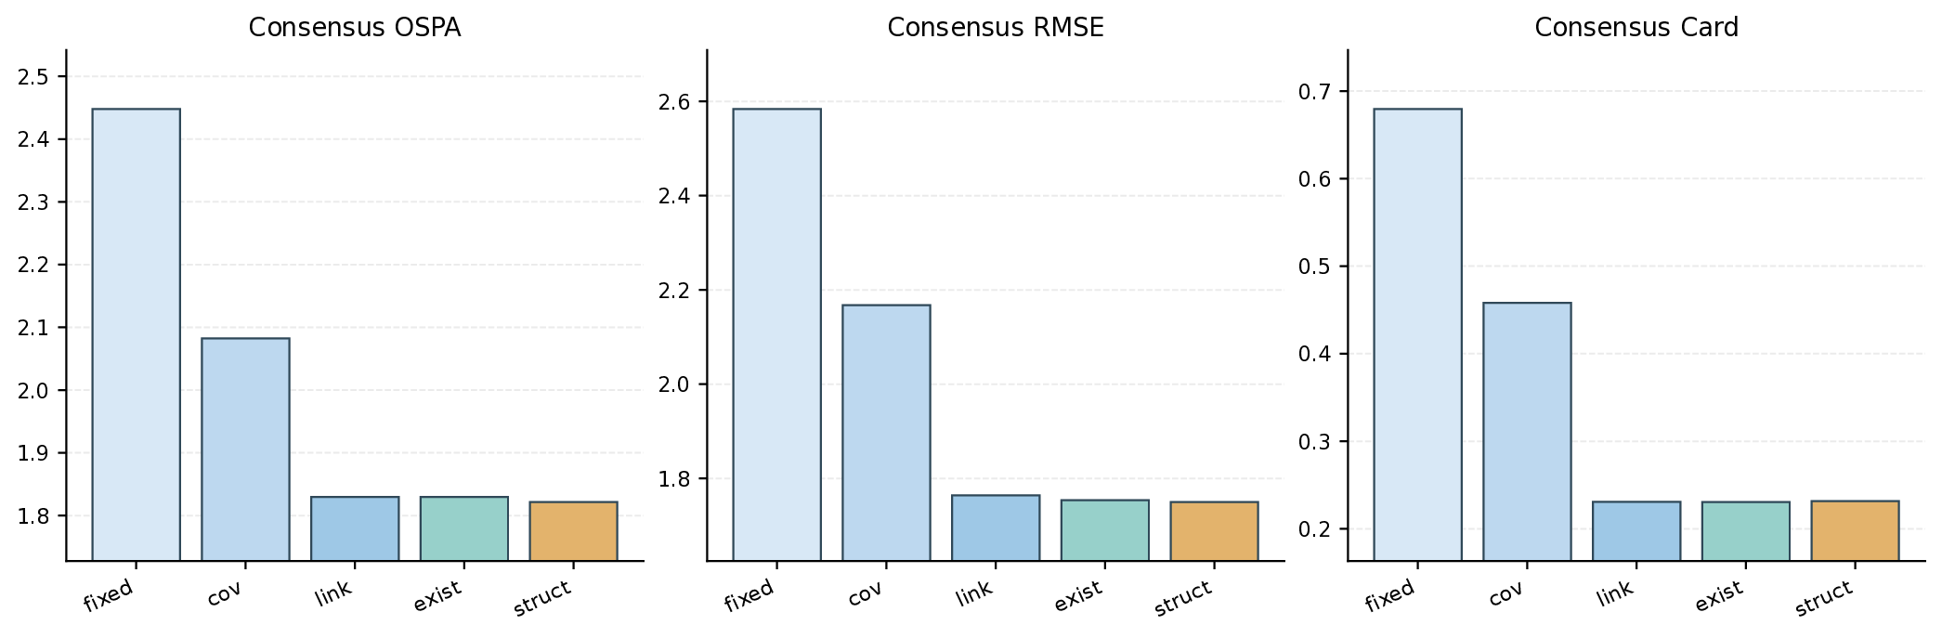
ABLATION
消融表明：link quality 是最大通信增益，FID-FIA existence cue 给最终跨越
fixed
cov
+link
+exist
decoupled
proposed
2.448
2.082
1.830
1.830
1.821
1.669
OSPA
OSPA
OSPA
OSPA
OSPA
OSPA
0.679
0.458
0.231
0.231
0.232
0.061
CARD
CARD
CARD
CARD
CARD
CARD
读法
covariance 必要但不充分；link quality 带来最大通信增益；20-trial 下 existence confidence 的结论要收窄；最终 FID-FIA existence 分支给 cardinality 跨越。
Source: RUN/GA/GA_TIERED_LINK_ABLATION_MAIN20_20260507.md; docs/paper/els-cas-templates/sections/06_results.tex
10

Slide 11
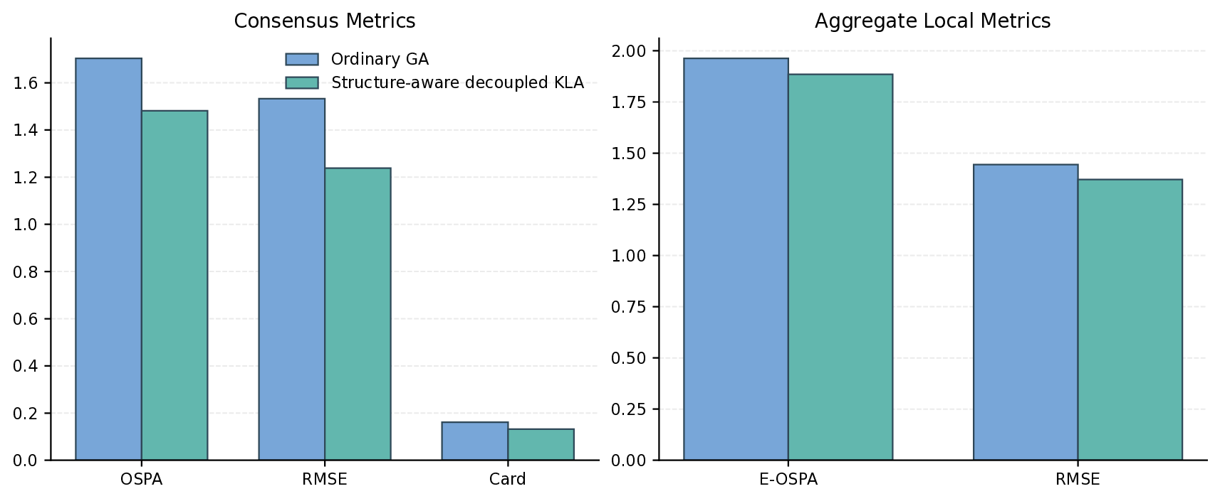
SUPPORTING EVIDENCE
理想通信下仍有效：方法不是只在补救 packet loss
Arm
OSPA
RMSE
Card
Ordinary GA
1.704
1.532
0.162
Branch backbone
1.482
1.238
0.132
Scalar FID-FIA
1.532
1.332
0.054
Proposed
1.433
1.309
0.050
15.9%
69.1%
10.6%
AA secondary generalization
ideal OSPA reduction vs ordinary GA
ideal cardinality reduction
local E-OSPA reduction
consensus OSPA 4.349 -> 3.811
consensus RMSE 19.098 -> 16.472
cardinality 0.421 -> 0.307
讲法：ideal communication 支撑“更合理的 distributed fusion weighting rule”；AA 只作为外推迹象，不与 GA/KLA 主线并列。
Source: RUN/GA/GA_IDEAL_COMM_MAIN20_PAIRED_20260507.md; RUN/GA/GA_TIERED_LINK_ABLATION_N20_SEED1_20260513_014211.md
11

Slide 12
CLOSE
最终可讲的故事：通信约束下，权重分配才是分布式 KLA 的关键杠杆
keep in main story
move to appendix or future work
fixed KLA weights are brittle under heterogeneous communication
NIS: plain harmful; robust not better than no-NIS in latest table
covariance + realized link quality + existence confidence is the backbone
history / freshness: mixed or effectively flat
branch decoupling preserves the spatial path while existence-FID-FIA supplies cardinality gain
association ambiguity / cardinality consensus: pilot-level or negative
consensus metrics are primary; local metrics are safeguards
state-dependent quality + false tracks: useful next scenario, framed as baseline plus perturbations
下一步最值得补的不是新模块，而是把 final method 的 paired baseline reuse 和更大 Monte Carlo 统计补齐，再把 4+4 新扰动场景作为 robustness extension。
Source: docs/paper/README.md; docs/paper/Appendix_B_additional_attempts.md; memory-backed 4+4 framing
12

