Slide 1

Interfaces
The briefest way I can possibly sell it without losing you
Feat. A split second of Abstract methods – K. Surratt

Slide 2
Interfaces are…
A completely abstract class that groups together related abstract methods with empty bodies with the intent of of specifying common behaviours
When create, they cannot contain constructors, because they are not capable of being instantiated, they must be implemented by the subclass by using the implements keyword
Syntax:
modifier interface InterfaceName{…}
Simply put, think of an interface as a place to store all of your abstract methods that can be referenced by various subclasses as needed
Notes:
Interfaces are completely abstract classes that group together abstract methods with common behaviours. They cannont contain constructors because they are not capable of being instantiated, only implemented with the implements keyword.
The syntax for declaring an interface uses modifer interface interface name followed by constants and methods

Slide 3
Hold on, what’s an abstract method?!
It’s a bodiless method that’s only used in abstract classes (and interfaces)
The method only gets a body once overridden in the subclass that implements it
Any class that contains an abstract method is now abstract
Syntax:
modifier abstract returnVal methodName();
Because it has no body, it is written as though it’s being declared like a variable
Simply put: A method that can be implemented within various subclasses, but is dependent on the thing implementing it
Notes:
An abstract method is a bodiless method that's only used in abstract classes as well as interfaces. They only get a body once overridden in the subclass that implements them. Any class that has an abstract method must be declared abstract.

Slide 4
Why interfaces??
With interfaces, you can implement many abstract methods without affecting the superclass
This allows for flexibility and a cheat to multiple inheritance (will explain later)

Slide 5
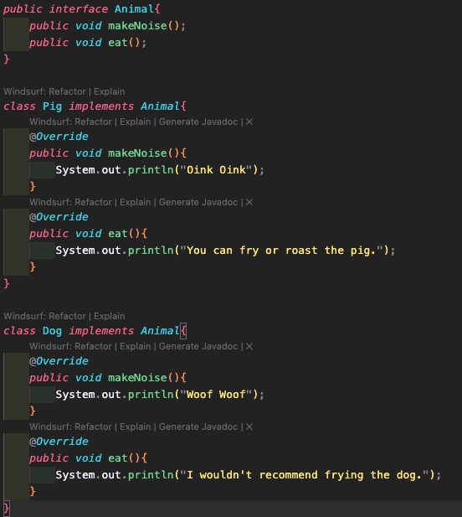
How to use an interface
As seen here, the interface Animal consists of two abstract methods makeNoise() and eat(). Each of these methods are then overridden in the classes Pig and Dog but the output for each is different.
Where the pig says oink, the dog says bark. Where there are recommendations for eating the pig, there are none for the dog because you (hopefully) wouldn’t eat a dog.
Using interfaces allows you to decide exactly how each method is defined for that class without having to worry about there being an error.
However, if you use interfaces, you must be sure to use every method within the interface.
Notes:
Here we have the interface Animal that consists of two abstract methods (make noise and eat). Each method is overridden in the classes of pig and dog, but the output is different such as make noise is oink for the pig and woof for the dog. when it comes to the eat method, for the dog it says not to eat it because you hopefully wouldn't eat it.
With interfaces, you are capable of more flexibility with every class that implements the methods, however, when you use interfaces, EVERY method MUST be used.

Slide 6
Loopholing Multiple Inheritance
With Java, you cannot have a subclass inherit multiple superclasses, however, with interfaces, you can do just that
With interfaces, you can extend a class and then implement multiple interfaces so that you can call upon all methods as needed
That is done by:

Slide 7
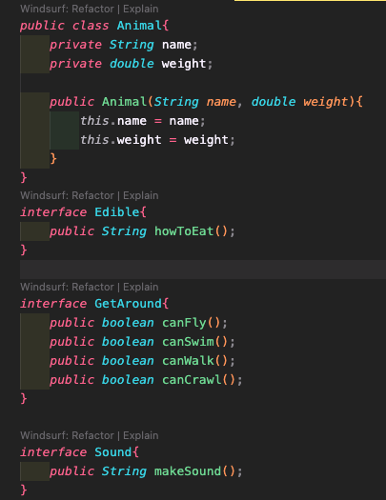
First, create a class and multiple interfaces:
Notes:
here we have an example class of Animal and example interfaces of Edible, GetAround, and Sound that return a string of how to/can eat, booleans of how they get around, and a string of the sound they make respectively

Slide 8
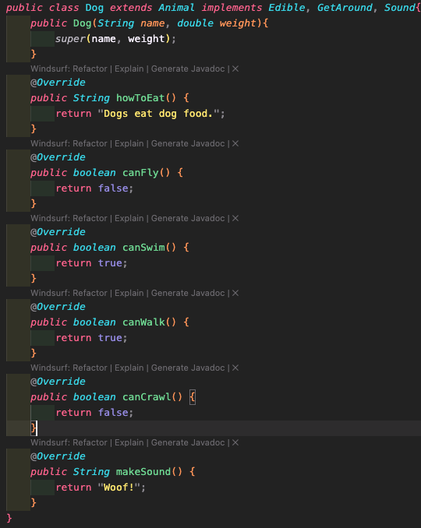
Then create the subclass, extend the super class and implement the interfaces
Notes:
with the subclass of Dog, it extends Animal, meaning that it inherits Animals methods and attributes, as well as implementing the three interfaces. This way we can change the information they return when implemented for this subclass specifically

Slide 9


Key Notes about Interfaces:
They are always abstract and never have constructors
Can only be used with the implements keyword
Can be declared with the public keyword, or package-private by just using interface InterfaceName
Since all variables are final and all methods are abstract you can declare an interface with:
or

Slide 10
Key Notes Con’t:
Interfaces can extend other interfaces (but not classes)
They can also be used as reference variables
They can “loophole” multiple inheritance

