Slide 1
FINAL-YEAR PROJECT PRESENTATION
EduMind AI
An Agentic AI Platform for Personalized Learning and Assessment
Project Progress Review
Presented by: [Your Name]
Guide: [Guide Name] • [Department / College] • [Date]
Course materials → grounded tutoring → practice → review
Notes:
Opening: “Good morning. My project is EduMind AI, a course-centered learning platform. A student organizes course material by subject, asks questions grounded in selected documents, can inspect citations and graph context, and can practise with generated quizzes.” Replace the bracketed name, guide, department and date. The title uses “Agentic AI”; describe actual service orchestration rather than claiming an autonomous multi-agent framework not established by the source.

Slide 2
INTRODUCTION
EduMind AI at a glance
Organize
Understand
Practise and review
Store learning material under student-owned subjects.
Ask questions about selected course documents; inspect citations and graph context.
Generate MCQ quizzes, record attempts, and view quiz-based progress.
Example: “In my uploaded networking notes, what does DNS do?”
EduMind retrieves relevant passages, asks the configured model to explain them, and returns source references.
EduMind AI | Project implementation review
02
Notes:
Explain the value proposition: EduMind links course files to tutoring and assessment in one account. Example: a student uploads networking notes and asks “What does DNS do?” Chat searches selected documents and can return citations with page ranges. It can also return graph context. Students should inspect the cited source; citations do not guarantee correctness.

Slide 3
MOTIVATION
Problem statement
Study workflow challenges
Project response
Course files, questions and quiz practice can be scattered across tools.
Group course documents by subject.
Retrieve relevant passages from selected documents for chat.
A general answer may not reflect a particular lecture note.
Link extracted concepts in a Neo4j knowledge graph.
It can be difficult to verify where an AI explanation came from.
Connect quizzes, attempts and progress summaries.
Students need a repeatable path from reading to practice and review.
Goal: improve workflow and traceability—not claim guaranteed correctness or proven learning gains.
EduMind AI | Project implementation review
03
Notes:
These are design motivations, not measured research findings. EduMind does not claim that general-purpose AI systems cannot use uploaded files. It focuses on organizing a learner’s materials and linking them to chat, graph context, quizzes and stored attempts. Example: the student chooses relevant course documents and can inspect retrieved citations.

Slide 4
PROJECT OVERVIEW
Project objectives and scope
01
Secure access
Register, log in and manage password recovery.
02
Course organization
Create subjects and manage learning documents.
03
Grounded tutor
Retrieve relevant passages and produce document-informed responses.
04
Concept context
Store and retrieve entity relationships through Neo4j.
05
Assessment loop
Generate quizzes, score attempts and summarize results.
Uses configured LLM providers
EduMind AI | Project implementation review
04
Notes:
Scope includes account access, course materials, document-grounded chat, knowledge-graph context, quizzes and progress. EduMind uses configured external LLM providers for several operations; optional local quiz model weights are absent in the inspected checkout. This is an application workflow, not a new foundation model.

Slide 5
SYSTEM COMPARISON
Existing approach and proposed system
Typical disconnected workflow
Proposed: EduMind AI
Documents may be separate from tutoring and quizzes.
One student account organizes subjects and documents.
A student may copy context between tools.
Chat is scoped to selected, processed course files.
Neo4j graph context can complement retrieved passages.
Quiz results may not connect to the same course library.
Quizzes, attempts, review and progress use the same app data.
General AI tools may overlap; EduMind’s focus is the integrated course workflow.
EduMind AI | Project implementation review
05
Notes:
Compare at a high level; do not make unsupported claims about every alternative. General assistants may support uploads and study features. EduMind’s intended distinction is persistence and integration: subjects, selected documents, chat citations, graph context, attempts and progress are linked in this app. Do not claim better accuracy than ChatGPT or Gemini without a fair measured comparison.

Slide 6
ARCHITECTURE
System architecture and data flow
React + TypeScript
ASP.NET Core API
FastAPI + Python
Hangfire
Browser interface
Auth • workflow • storage
AI processing
Background jobs
PostgreSQL + pgvector
Neo4j
records • chunks • vectors
concept graph
Files are stored by the backend; relational records and vectors are in PostgreSQL; graph relations are in Neo4j.
EduMind AI | Project implementation review
06
Notes:
The browser calls the .NET API. The backend authenticates, enforces ownership, stores records, and queues longer jobs through Hangfire. It calls FastAPI for document and quiz AI workflows. PostgreSQL stores application records and chunks; pgvector supports vector similarity on embeddings. Neo4j stores entities and relationships. Example: uploading queues processing rather than parsing the PDF in the browser. Source areas: Frontend/src, Backend/AgenticAITutor/AgenticAITutor, ai_service/app. Program.cs configures backend services; ai_service/app/main.py registers FastAPI routers.

Slide 7
TECHNOLOGY
Technologies and why they are used
React + TypeScript + Vite
Builds the browser UI and typed API calls.
ASP.NET Core 8 + EF Core
Main API, authentication, rules and PostgreSQL access.
Python FastAPI + Pydantic
AI service endpoints and request validation.
PostgreSQL + pgvector
Relational records plus vector storage/search for text chunks.
Neo4j
Stores concept nodes and typed relationships.
Sentence Transformers / E5
Turns text into vectors for semantic matching.
Hangfire
Runs document, quiz and email tasks in the background.
JWT + BCrypt + MailKit
Session tokens, password hashing and OTP email delivery.
EduMind AI | Project implementation review
07
Notes:
React builds the interface; ASP.NET is the application API; FastAPI is the Python AI API; PostgreSQL stores records and pgvector supports semantic search; Neo4j stores connected graph data; E5 encodes text meaning; Hangfire runs long tasks; JWT identifies requests, BCrypt hashes passwords, and MailKit sends reset emails. The embedding model is intfloat/e5-base-v2 in ai_service/app/embedding.py. Active chat uses dense pgvector retrieval plus KG retrieval/fusion. BM25/RRF/BGE reranking exists on a separate /search path, not the integrated /chat path.

Slide 8
FEATURES
Registration, login and password-reset OTP
Register / sign in
OTP: password reset only
React sends credentials to /api/Auth/register or /login.
Backend generates a six-digit code and 15-minute expiry.
Backend stores a BCrypt password hash, not the original password.
Hangfire queues email delivery through MailKit / SMTP.
Reset checks code and expiry, then replaces the password hash.
Successful login returns a signed JWT for protected API calls.
OTP is not signup verification or second-factor login.
Registration does not require OTP in this implementation.
EduMind AI | Project implementation review
08
Notes:
Example: register a test account, sign out, and log in. Account data lives in auth.users; password is BCrypt-hashed. The browser stores a JWT in localStorage and sends it on protected requests. Forgot-password generates a random six-digit OTP, stores password_reset_otp and otp_expiry_time for 15 minutes, and queues email through Hangfire. Reset checks code server-side and clears it after a successful password change. Exact files: Frontend/src/app/pages/Welcome.tsx, ForgotPassword.tsx, ResetPassword.tsx; Frontend/src/services/authService.ts; Backend/.../Controllers/AuthController.cs; Services/Auth/AuthService.cs; Services/Email/SmtpEmailService.cs; Models/user.cs. APIs: POST /api/Auth/register, /login, /forgot-password, /reset-password.

Slide 9
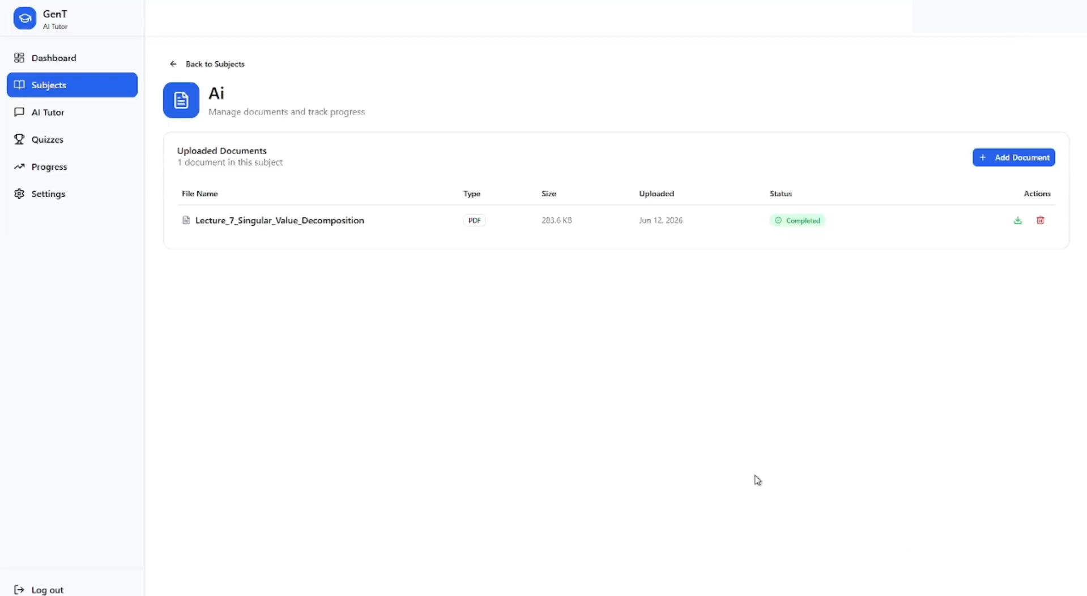
FEATURES
Subjects and document management
Student actions
Create, list, rename and delete subjects.
Upload, view, download, delete or retry failed documents.
Subject ownership is checked using the authenticated user.
Subject UI snapshot — refresh from the running app
Tables: content.subjects • content.documents
PDF, DOCX, PPTX and TXT; 10 MB upload limit.
EduMind AI | Project implementation review
09
Notes:
Example: create “Computer Networks”, open it, and upload notes. The frontend calls /api/Subject and /api/Document routes. The backend obtains owner identity from the JWT, checks ownership, permitted extension, 10 MB limit and duplicate SHA-256 hash, saves original under wwwroot/uploads and stores metadata. Exact files: Frontend/src/app/pages/Subjects.tsx, SubjectDetail.tsx, app/components/subject/DocumentsTab.tsx; services/subjectService.ts and documentService.ts; Backend Controllers/SubjectController.cs and DocumentController.cs; Services/Subject/SubjectService.cs and Services/Document/DocumentService.cs. Tables content.subjects and content.documents. Deleting a subject also deletes its documents; avoid deleting important data in a demo.

Slide 10
IMPLEMENTATION
What happens after document upload?
1
2
3
4
5
6
Validate
Save
Queue
Extract
Index
Build KG
type • size • owner
file + PENDING record
Hangfire job
parse • clean • chunk
E5 vectors → pgvector
relations → Neo4j
PENDING → PROCESSING → COMPLETED / FAILED • failed processing can be retried
Tables: content.documents • content.document_chunks • content.quiz_chunks • Neo4j graph
EduMind AI | Project implementation review
10
Notes:
Hangfire separates slow processing from the upload request. Python parses supported documents (PyMuPDF for PDF, python-docx and python-pptx; optional Tesseract OCR), cleans text, chunks it, and generates E5 vectors. .NET stores text, page ranges and embeddings as document_chunks; it also copies quiz chunks. A continuation builds the KG. Files: Backend/BackgroundJobs/DocumentChunkingJob.cs; Services/DocumentChunk/DocumentChunkService.cs; ai_service/app/extract.py, parsers.py, chunker.py, embedding.py, chunk_kg.py. The normal .NET upload does not accept CSV even though parser code can parse CSV.

Slide 11
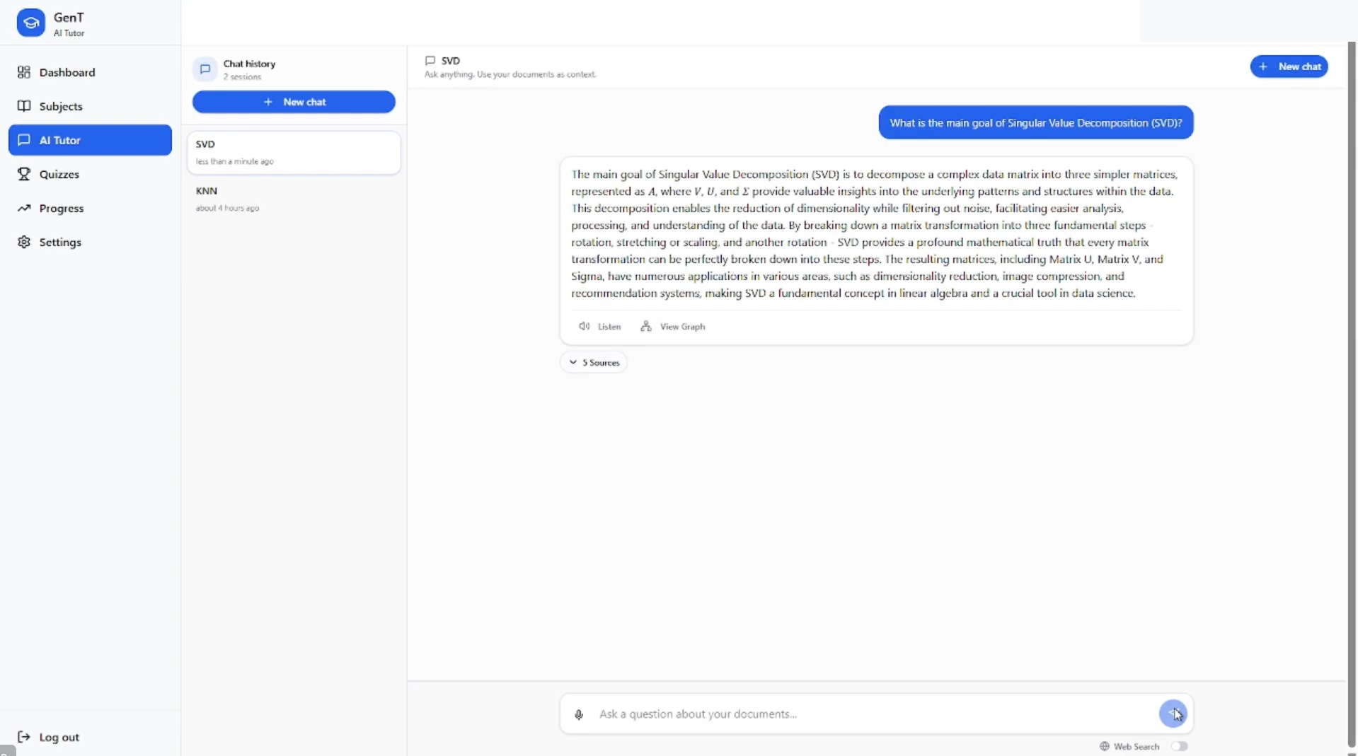
AI FEATURES
AI tutor: how document-grounded answers work
RAG in simple words
Question is turned into a meaning vector (embedding).
pgvector finds similar chunks in selected documents.
The AI model receives retrieved text as context.
Answer can include chunk/page citations for checking.
Chat UI snapshot; sample account header is redacted
Example: ask “What is DNS?” using networking notes.
EduMind AI | Project implementation review
11
Notes:
RAG means Retrieval-Augmented Generation: retrieve source passages, then ask a language model to answer using that material. Example: ask “What is DNS?” in a chat scoped to networking notes; E5 encodes the question, pgvector ranks permitted chunks, and the prompt supplies context. The chat returns citations with document and page information and can return KG context. Files: Frontend/src/app/pages/Chat.tsx, components/chat/NewChatModal.tsx, MessageBubble.tsx; hooks/useChat.ts; services/chatService.ts; Backend Controllers/ChatMessageController.cs, Services/ChatMessage/ChatMessageService.cs; ai_service/app/chat.py, chat_service.py, vector_store.py, rag_service.py and embedding.py. Main route POST /api/ChatMessage/SendMessage → FastAPI /chat/. Integrated chat uses dense retrieval plus KG; it does not invoke the separate BM25/RRF/reranker chain. Confidence is currently hardcoded to 0.0; citations help verification but do not guarantee correctness.

Slide 12
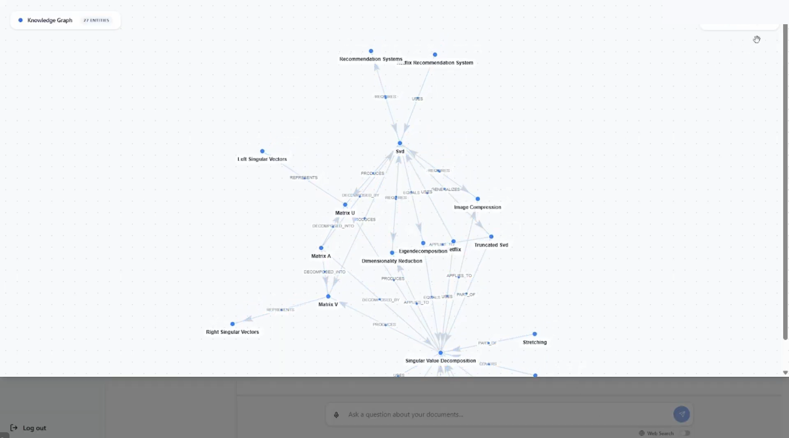
AI FEATURES
Knowledge Graph: connected course concepts
How KG is used
Concepts become graph nodes; relationships become edges.
Neo4j stores user → subject → document → entity structure.
Question-related entities retrieve a bounded subgraph.
Graph context may complement document-text retrieval.
Knowledge graph viewer UI snapshot
Example: “How does B relate to A?”
EduMind AI | Project implementation review
12
Notes:
A graph is named ideas connected by typed relationships. For example, a node “DNS” and node “domain name” can be connected by “translates”. After document chunks are available, the KG continuation extracts entities/relations with an LLM and stores them in Neo4j. Chat retrieves a user/subject/document-scoped subgraph around question entities; KG errors are non-fatal, so text RAG can still work. Files: ai_service/app/chunk_kg.py, kg_extractor.py, kg_store.py, kg_db.py, kg_service.py; frontend components/chat/KnowledgeGraphViewer.tsx and MessageBubble.tsx. The viewer displays graph context returned with chat, not an unrestricted Neo4j browser. Extracted relations need source validation.

Slide 13
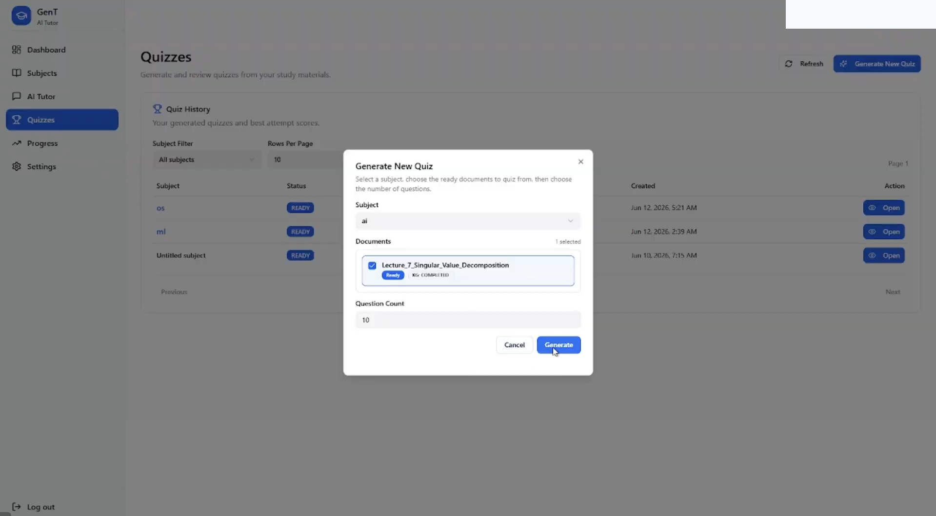
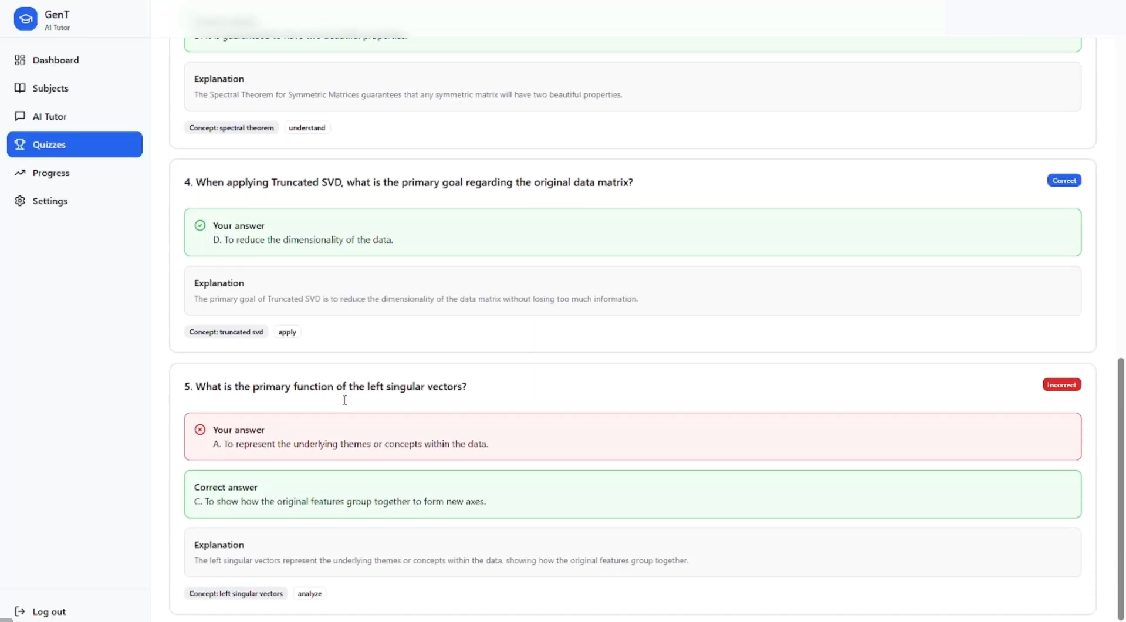
FEATURES
Quiz: generate, attempt, score and review
Quiz generation UI snapshot
Quiz review UI snapshot; account header redacted
Choose subject + ready documents
AI generates MCQs
Server shuffles options
Server scores and saves review
EduMind AI | Project implementation review
13
Notes:
User chooses subject, processed documents and question count. POST /api/Quiz/initiate validates ownership/readiness, reuses an identical ready quiz where possible, or queues QuizGenerationJob. The job reads content.quiz_chunks and calls FastAPI /quiz/generate; backend persists questions/options. Starting an attempt creates quiz_attempts and a server-side option shuffle map; correct answers are not sent in the start response. Submission reverses shuffled labels, scores answers, and persists quiz_answers. Tables: quiz.quizzes, quiz.quiz_documents, quiz.quiz_questions, quiz.quiz_options, quiz.quiz_attempts, quiz.quiz_answers. Files: Backend Controllers/QuizController.cs, Services/Quiz/QuizService.cs, BackgroundJobs/QuizGenerationJob.cs; ai_service/app/quiz/quiz_generate_router.py and quiz_generator.py; frontend pages/Quiz.tsx, ActiveQuiz.tsx, QuizReview.tsx. Local fine-tuned Qwen weights are absent; configured external fallback is needed. Normal upload assigns fixed quiz metadata, so avoid claiming fully adaptive Bloom-level alignment.

Slide 14
FEATURES
Progress and other implemented features
Progress dashboard
Additional code paths
Counts saved quiz attempts and active subjects.
Web search (requires configured Tavily key).
Shows average attempt scores by month and subject.
Speech-to-text and text-to-speech (provider/runtime dependent).
Lists concepts often missed in quiz answers.
Profile update and authenticated password change.
“Mastery” is an average quiz score, not validated learning mastery.
Chat history, session rename/delete, document download/retry.
Not fully integrated: notifications show static examples; study-plan tables exist but a complete API workflow was not verified.
EduMind AI | Project implementation review
14
Notes:
GET /api/Analytics/progress is calculated from persisted quiz attempts/scores. AnalyticsService returns overall average score, monthly and subject averages, counts and commonly incorrect concepts. “Study time” is a fixed 15-minute-per-quiz estimate, not measured time. Frontend Dashboard.tsx and Progress.tsx display it. Other code paths include Tavily web search, Faster-Whisper STT, TTS depending on configured provider/browser support, and profile/password settings. Notifications page uses static arrays in Notifications.tsx; study-plan tables alone do not prove a complete feature. Demonstrate optional features only if configured and tested.

Slide 15
CURRENT STATUS
Implementation evidence and results
Authentication and reset OTP
Implemented
Subjects and document processing
Implemented
Chat: retrieval + KG context
Implemented; provider dependent
Quiz generation / attempt / review
Implemented; provider dependent
Progress analytics
Implemented from saved attempts
Notifications / study plans
Partial / not fully integrated
No verified EduMind accuracy or learning-gain percentage is claimed.
EduMind AI | Project implementation review
15
Notes:
This reports implementation status from source review, not a fabricated percentage or benchmark. AI features depend on configured providers and available data. Existing screenshots show UI and sample values; they are not evaluation results. No verified accuracy or learning-gain measurement was established. If asked, demonstrate the workflow and describe a future evaluation using a documented test set and defined metrics. Evidence reviewed includes ARCHITECTURE.md, backend controllers/services/jobs, ai_service routers and frontend pages.

Slide 16
HONEST ASSESSMENT
Limitations and next steps
Current limitations
Practical next steps
LLM answers and graph relations can be wrong; citations do not guarantee correctness.
Test course questions and verify each cited source.
Improve metadata in the connected quiz pipeline.
Chat confidence is 0.0; it is not calibrated.
Record reproducible functional and retrieval evaluations.
Integrated chat uses dense retrieval + KG; hybrid search is a separate route.
Complete notification/study-plan integration if in project scope.
Normal upload gives quiz chunks limited default metadata.
EduMind AI | Project implementation review
16
Notes:
Be transparent. Source review found confidence_score always 0.0; chat uses dense retrieval and separate KG retrieval while BM25/RRF/BGE reranking is on another route; normal upload assigns fixed understand/definition metadata and empty concepts/keywords; local Qwen weights are absent; notifications are static and full study-plan API integration was not verified. Next steps are recommendations, not completed features.

Slide 17
CONCLUSION
A connected course-learning workflow
EduMind links a student’s subjects and materials to document-grounded tutoring, graph context, assessment attempts and progress summaries.
Organize
Learn
Practise
Subjects + documents
Chat + citations + KG context
Quiz + review + progress
Thank you • Questions?
Notes:
Closing: “EduMind is a course-centered learning application. It organizes materials and connects them to grounded tutoring, graph context, quizzes and progress. It uses existing model providers rather than claiming a new foundation model, and still needs measured evaluation to support accuracy or learning-effect claims. Thank you; I welcome your questions.”

