Slide 1





HR LEAVE MANAGEMENT BOT
Introduction to Robotic Process Automation
Your Register No:220701056 Name:DEEKSHA R
Guide Name:Jinu Sophia
Designation and Department: B.E-CSE

Slide 2
Abstract
The HR Leave Management Bot is a comprehensive automation solution designed to transform employee leave management by ensuring efficiency,
accuracy, and transparency. Built using UiPath, this bot automates the end- to-end process, starting with the extraction of leave requests from employee emails. It integrates with an Excel-based system to verify leave balances against company policies and seamlessly forwards requests to the appropriate manager for approval. Upon receiving the manager’s decision, the bot processes the response, updates leave records in real time, and promptly notifies employees. By eliminating manual intervention in repetitive tasks, the bot reduces errors, minimizes delays, and frees HR teams to focus on strategic initiatives. Capable of handling high volumes of requests with precision, the HR Leave Management Bot enhances collaboration among employees, HR, and managers, fostering a structured, reliable, and scalable system that ensures efficiency and employee satisfaction, making it a smarter approach to workplace automation.

Slide 3
Need for the Proposed System
The traditional leave management process is often plagued by challenges such as manual data handling, delays in approvals, and errors in tracking
leave balances, leading to wasted time, reduced employee satisfaction, and decreased organizational productivity. As organizations grow, managing a high volume of leave requests while maintaining accuracy becomes increasingly complex. The proposed HR Leave Management Bot addresses these issues by automating the end-to-end leave management process, ensuring faster processing, error reduction, and seamless integration with systems like email and Excel for verifying leave balances, forwarding requests, and notifying stakeholders. By enhancing transparency, accountability, and collaboration among employees, HR, and managers, the bot offers a reliable, scalable, and efficient solution that reduces operational burdens, saves time, and contributes to a more productive and satisfied workforce.

Slide 4
Advantages of the Proposed System
Efficiency and Speed: Automates leave management, significantly reducing processing time.
Accuracy: Minimizes manual errors, ensuring reliable tracking and
policy adherence.
Transparency: Provides a structured workflow, keeping all stakeholders informed.
Real-Time Updates: Instantly updates leave records for accurate
tracking.
Cost and Time Savings: Reduces HR workload, allowing focus on strategic activities.
Improved Employee Satisfaction: Delivers a faster and error-free leave management experience, boosting morale.

Slide 5
Literature Survey
Paper 1: "Automated Leave Management Systems“
Advantages: Streamlines operations, reduces errors, enhances employee satisfaction, and saves time for HR teams.
Disadvantages: Resource-intensive setup, potential system malfunctions, limited personalization for unique leave requests.
Paper 2: "AI in Workforce Management“
Advantages: Optimizes scheduling, improves decision-making with data analysis, and reduces manual errors.
Disadvantages: Reliant on accurate data, requires regular updates, and needs investment in AI infrastructure.

Slide 6
Main Objective
The main objective of the HR Leave Management Bot is to automate and streamline the entire process of leave management, from request submission to approval and notification. The system aims to reduce manual intervention, improve efficiency, and minimize errors by automating leave request extraction, verifying leave balances, forwarding requests to managers, and updating records in real-time. By providing an integrated, error-free, and transparent process, the bot enhances collaboration between employees, HR, and managers, ensuring faster decision-making and a more efficient leave management system. The ultimate goal is to create a scalable solution that optimizes time and resources while improving employee satisfaction and organizational productivity.

Slide 7
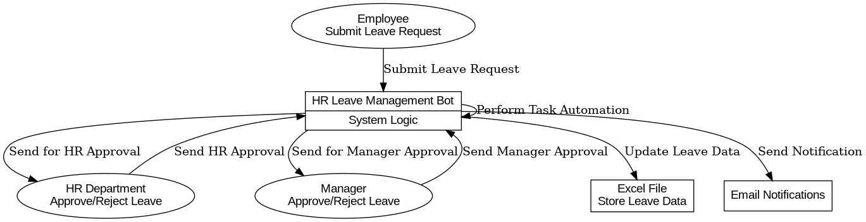
Architecture

Slide 8
System Requirements
Hardware:
Processor: Minimum 2.0 GHz dual-core processor or equivalent
RAM: Minimum 4 GB (8 GB recommended for optimal performance)
Network: Stable internet connection for email and cloud integrations
Software:
Operating System: Windows 10 or later (for UiPath and other related software)
UiPath Studio: For building automation workflows
Microsoft Excel: For leave balance tracking and integration

Slide 9
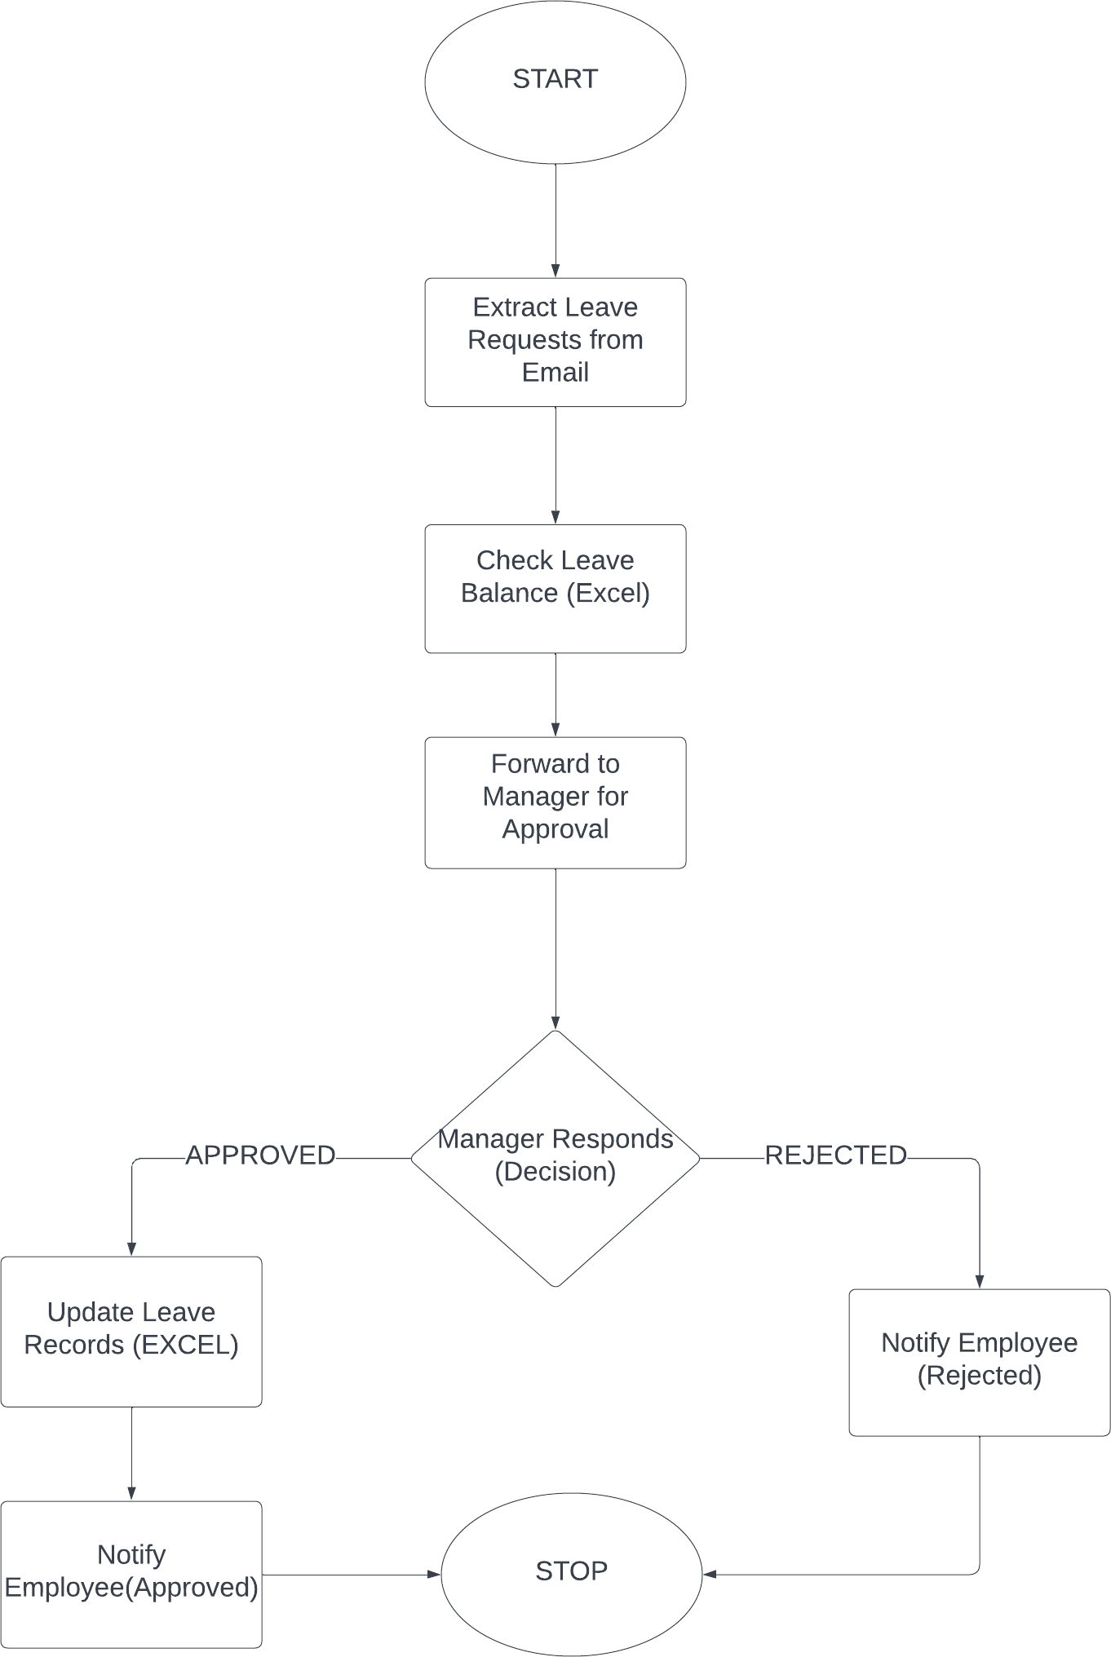
Functional Description
Module 1: Leave Request Extraction and Validation:
Short Description:
This module focuses on automating the process of extracting leave requests from employee emails and validating leave balances against company policies.
Module 2: Leave Approval and Record Update
Short Description:
This module handles the manager's approval process, updates leave records, and notifies employees about their leave request status.

Slide 10
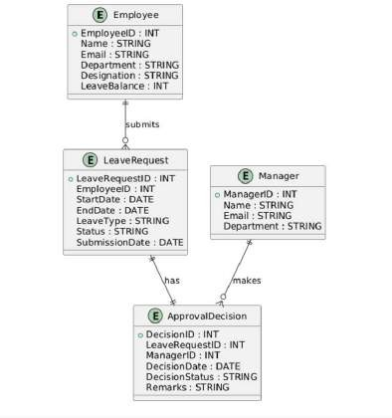
Table Design

Slide 11
Process Design
Main Process:
Automate the leave request management process from submission to
notification
Sub Process:
Extraction and Parsing: Retrieve and extract leave request data.
Validation: Ensure compliance with leave policies.
Approval Workflow: Route requests for manager approval.
Decision Processing: Update leave records based on decisions.
Notification: Inform employees about the request outcome.

Slide 12
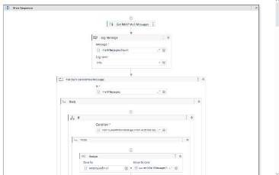
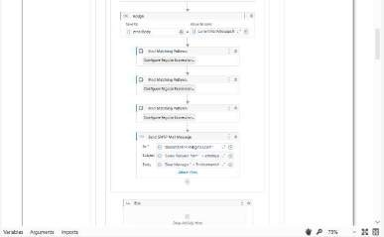
Implementation
Module 1: Leave Request Extraction and Validation:
This module automates the process of extracting leave requests from employee emails, parsing the required details, and validating them against
the company’s leave policies. It ensures that only valid requests proceed to the next stage by checkin leave balances and policy constraints.
g

Slide 13
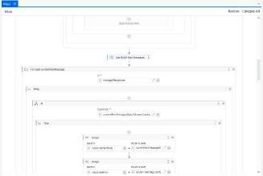
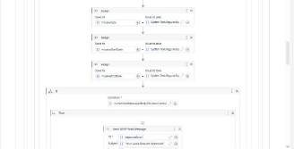
Implementation
Module 2: Manager Approval and Decision Processing:
This module handles the routing of validated leave requests to the appropriate manager for approval. It processes the manager’s decision, updates the leave records, and notifies the employee about the status of their leave request.

Slide 14
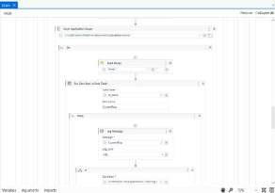
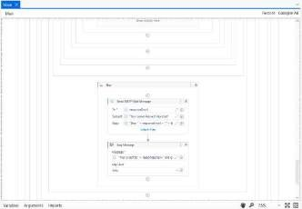
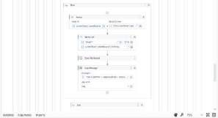
Implementation

Slide 15
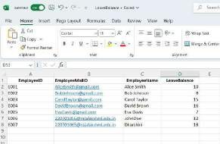

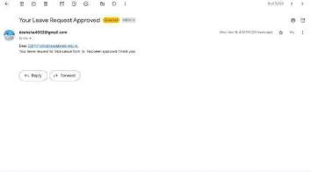

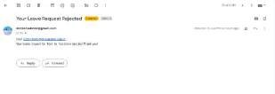
Testing
The testing phase ensures the HR Leave Management Bot functions correctly and meets requirements. It includes unit testing of individual modules (leave request extraction and manager approval), integration testing to verify smooth data flow between modules, functional testing to confirm the bot performs all required tasks, performance testing to assess its ability to handle large volumes, and user acceptance testing (UAT) to validate its effectiveness in real-world scenarios. This comprehensive testing ensures accuracy, efficiency, and reliability.

Slide 16
Conclusions
The HR Leave Management Bot offers a significant advancement in automating the employee leave request process. By integrating email
extraction, leave validation, manager approvals, and real-time notifications, the system reduces manual intervention, minimizes errors, and enhances overall efficiency. The successful implementation of both modules has streamlined the leave management process, ensuring compliance with company policies while improving communication between employees, managers, and HR teams.
The testing phase confirmed the bot’s functionality, performance, and reliability under various scenarios, ensuring that it meets the desired outcomes. This automation solution not only saves valuable time for HR teams but also contributes to a more transparent and accurate leave management system, fostering a more efficient and collaborative work environment.

Slide 17
Future Enhancement
Self-Service Employee Portal:
Empower employees by allowing them to view leave balances, submit requests, and track their leave status through a web portal or mobile app. This increases transparency, reduces HR workload, and enhances the overall user experience.
Advanced Reporting and Analytics:
Implement advanced reporting features to provide insights into leave trends, peak leave times, and departmental usage. Data visualizations like charts and graphs can help HR managers make more informed decisions, improving workforce planning and resource allocation.
These enhancements will provide both automation and valuable insights, making the leave management process more efficient and data-driven.

Slide 18
IEEE Paper
Title
Authors

Slide 19
References
Kuppusamy, Palanivel & Joseph K, Suresh. (2020). Robotic Process Automation to Smart Education.
International Journal of Advanced Research in Computer Science, 3775.
Patil, Dr & Mane, Vinod & Patil, Dr. (2019). Social Innovation in Education System by using Robotic Process Automation (RPA). International Journal of Innovative Technology and Exploring Engineering, 8, 3757-3760. https://doi.org/10.35940/ijitee.K2148.0981119
Prakash, S., & Tiwari, A. (2022). Automation of HR Processes using UiPath. International Journal of Advanced Automation Technology, 6(2), 101-108.
D. Kumar, R. Sharma, “Automation in HR Management: Using UiPath for Employee Leave Management,” International Journal of Business Automation and Intelligence, vol. 7, no. 4, pp. 134-142, 2023.
B. Smith, A. Johnson, “Robotic Process Automation in HR Systems: A Review of Benefits and Challenges,” Journal of Human Resource Technology, 15(3), 245-250, 2021. https://doi.org/10.1109/JHRTech.2021.3150738
R. Patel, “Leveraging RPA for HR Process Automation: A Case Study on Leave Management Systems,”
Global Journal of Computer Science and Applications, vol. 19, no. 2, pp. 77-84, 2022.
P. N. Aggarwal, K. Singh, “Effective Leave Management Systems through Automation,” International
Journal of Software Engineering and Applications, 2023, 12(1), 55-63.
D. Wright, J. Lewis, “Exploring the Benefits of RPA for Human Resource Management,” Journal of Workplace Automation, 6(4), 211-220, 2022.

Slide 20

Queries

Slide 21

Demonstration

Slide 22

Thank You

