Slide 1


CHINOOK
MUSIC STORE
Presented by:
DEEKSHA BK
NEWTON SCHOOL
SQL Project | Chinook Database

Slide 2
Agenda
02
OVERVIEW
A structured story from data to recommendations
01
Business context
Problem statement & objectives
DATA
Data foundation
Schema, tables & analytical flow
↓
02
SQL
↓
03
SQL analysis
Data quality + objective questions
INSIGHT
↓
04
Business insights
Customer, product & regional findings
ACTION
Recommendations
Retention, cross-sell & growth actions
Management-ready
analytics
05
CHINOOK • SQL DATA ANALYTICS
2

Slide 3
Problem Statement
03
CONTEXT
The project brief positions the analyst as an advisor to Chinook management
“Analyze music record sales data to gain insights and make recommendations for the company's strategy in the physical music market.”
What management needs to know
• Where are sales and high-value customers concentrated?
• Which tracks, artists, albums and genres drive demand?
• Which customers are active, at risk, or likely to churn?
• Which product combinations can support cross-selling?
• How should limited marketing effort be prioritized?
CHINOOK • SQL DATA ANALYTICS
3

Slide 4
Project Objectives
04
CONTEXT
Turn raw relational data into evidence-based recommendations
DATA QUALITY
SALES
CUSTOMERS
Validate missing values, duplicates and joins
Measure revenue, invoices and geographic performance
Understand frequency, spending, churn and risk
PRODUCT
STRATEGY
Identify top tracks, genres, artists and affinities
Translate findings into promotion, retention and cross-sell actions
Core analytical lens
Who buys • What they buy • Where they buy • How often • What to do next
CHINOOK • SQL DATA ANALYTICS
4

Slide 5
Data Description
05
DATA
The Chinook schema connects customers, transactions and music products
CUSTOMER
customer
customer_id • country • city • support_rep_id
TRANSACTIONS
invoice / invoice_line
invoice_id • customer_id • total • track_id • quantity
PRODUCT
track / album
track_id • album_id • genre_id • artist_id
REFERENCE
artist / genre / media_type
artist_id • genre_id • descriptive attributes
ENGAGEMENT
playlist / playlist_track
playlist_id • track_id • playlist membership
Source structure follows the project-provided Chinook database schema.
CHINOOK • SQL DATA ANALYTICS
5

Slide 6
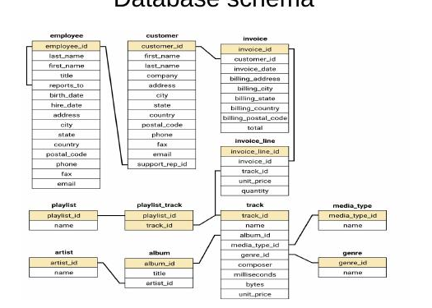
Database Schema
06
DATA
Primary relationships used in the SQL analysis
Key relationship chain
01
Customer
who buys
02
Invoice
what they spend
03
Invoice_Line
what they purchased
04
Track → Album → Artist
what product
05
Genre
what category
CHINOOK • SQL DATA ANALYTICS
6

Slide 7
OBJECTIVE Q3 · CUSTOMER DEMOGRAPHICS
Where Chinook's Customers Are
Age and gender fields don't exist in Chinook, so the demographic breakdown is built entirely from location. The USA leads by a wide margin.
KEY FIGURES
22.03%
of all customers are based in the USA — the single largest market (13 customers)
Canada (13.56%) and Brazil / France (8.47% each) round out the top markets — together the top 4 countries hold over half the customer base.
Chinook Music Store — Sales Analysis
6

Slide 8
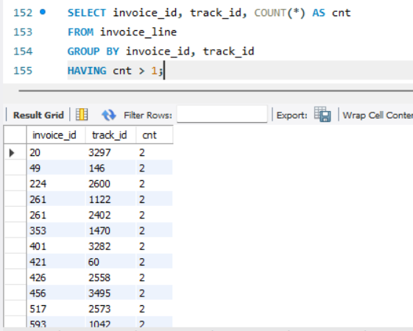
Data Quality & Validation
08
METHOD
Checks performed before interpreting business results
DUPLICATES
MISSING VALUES
JOIN INFLATION
Checked
Validate
Corrected
Repeated invoice_id + track_id pairs were identified and treated as line-level purchase records, not blindly as customer duplicates.
Missingness should be assessed column-by-column before modeling or aggregation.
Q11 was corrected by calculating customer spending separately from track quantity.
Evidence from SQL
Result: duplicate-looking rows in invoice_line represent repeated track purchases within invoices; they are not automatically duplicate customer records.
CHINOOK • SQL DATA ANALYTICS
8

Slide 9
Objective Analysis — Sales & Customers
09
ANALYSIS
Selected objective questions that anchor the management story
TOP USA MARKET
TOP AVG SPEND
TOP TRACK VOLUME
USA
Czech Republic
Czech Republic
Largest customer base in Q11 output: 13
$136.62 per customer • 2 customers
138 average tracks per customer
Interpretation
• High averages in small countries should be treated cautiously because the sample is small.
• Large markets such as the USA matter because customer scale can outweigh a lower average value.
• Country performance should be evaluated using both customer count and customer value.
Q11: average spending and tracks were calculated at customer level first, then aggregated by country.
CHINOOK • SQL DATA ANALYTICS
9

Slide 10
Product Affinity Analysis
10
INSIGHT
Co-purchase behavior creates a measurable cross-selling opportunity
GENRE PAIR
ARTIST PAIR
ALBUM PAIR
Rock + Metal
Led Zeppelin + Green Day
Are You Experienced? + Mezmerize
268 invoices together • 43.65% support
19 co-purchases
14 co-purchases
How to use it
• Build “customers also bought” recommendations.
• Create genre-based bundles and cross-sell offers.
• Use artist/album pairs for personalized discovery.
• Do not treat association as proof of causation.
CHINOOK • SQL DATA ANALYTICS
10

Slide 11
Customer Risk Profiling
11
INSIGHT
Recency, frequency and spending turn transaction history into retention signals
HIGH RISK
MEDIUM RISK
LOW RISK
5 purchases • 178 days inactive
13 purchases • $111.87 • 168 days
18 purchases • $144.54 • 18 days
Example: Diego Gutiérrez
Example: Manoj Pareek
Example: Franktísek Wichter…
Retention strategy by segment
HIGH
MEDIUM
LOW
Reactivation + personalized incentive
Reminder + value recovery
Loyalty + cross-sell
Priority rule: high historical value + long inactivity = highest-value retention target.
CHINOOK • SQL DATA ANALYTICS
11

Slide 12
Regional Market Analysis
12
INSIGHT
Customer purchasing behavior and churn vary materially by geography
What management should do
• Germany: highest observed churn among the selected markets — investigate retention immediately.
• Brazil: high purchasing activity but 60% churn — strong recovery opportunity.
• USA: 13 customers and 23.08% churn — scale makes retention strategically important.
• Small countries need cautious interpretation because one customer can materially change the rate.
Churn is defined in the project analysis as no purchase in the 3 months before the latest invoice date.
CHINOOK • SQL DATA ANALYTICS
12

Slide 13
Customer Purchasing Behavior
13
INSIGHT
Long-term value is not only about recency — frequency and spend matter together
LONG-TERM CUSTOMER
NEWER CUSTOMER
ANALYTICAL LENS
Higher cumulative value
Lower observed history
Frequency × basket × spend
More purchase history → stronger basis for loyalty segmentation
Needs activation and repeat-purchase encouragement
Compare cohorts rather than raw customer totals
Retention insight
• High-frequency customers are natural loyalty-program candidates.
• Customers with historically high spending but growing purchase gaps are prime win-back targets.
• New customers should be moved from first purchase → second purchase → habitual purchase.
• Track repeat rate, average basket size and purchase frequency by cohort.
CHINOOK • SQL DATA ANALYTICS
13

Slide 14
Promotion Measurement Framework
14
INSIGHT
The current Chinook schema does not contain campaign exposure data — so the correct answer is a measurement design
Required experimental setup
TREATMENT
CONTROL
OUTCOME
Customers exposed to campaign
Comparable customers not exposed
Revenue, retention, acquisition
Core formulas
Acquisition uplift = (Campaign rate − Control rate) / Control rate × 100
Sales uplift = (Campaign sales − Expected sales) / Expected sales × 100
ROI = (Incremental revenue − Campaign cost) / Campaign cost × 100
This prevents raw post-campaign sales from being mistaken for incremental impact.
CHINOOK • SQL DATA ANALYTICS
14

Slide 15
Data Limitations & Analytical Caveats
16
CAVEAT
Strong analytics also requires knowing what the dataset cannot answer
AGE & GENDER
PROMOTION HISTORY
Not present in the provided Chinook customer schema
No campaign exposure, discount or marketing-cost fields
Do not invent demographic conclusions.
Q8 requires a proposed measurement framework.
ECONOMIC FACTORS
SMALL COUNTRY SAMPLES
No local income, market-size or macroeconomic fields
Some countries have 1–2 customers
External enrichment would be required.
Use averages carefully; prioritize both scale and value.
CHINOOK • SQL DATA ANALYTICS
16

Slide 16
Management Recommendations
17
ACTION
Prioritize actions that are directly supported by the analysis
1
RETENTION
Target high-value inactive customers first.
Use recency + historical spend to drive win-back campaigns.
2
CROSS-SELL
Operationalize product affinity.
Recommend Rock → Metal and strong artist/album pairs.
3
MARKET FOCUS
Balance scale with customer value.
Protect the USA base while investigating high-value smaller markets.
4
REGIONAL RECOVERY
Investigate high churn.
Germany and Brazil warrant targeted retention diagnostics.
5
MEASUREMENT
Build campaign tracking.
Add campaign exposure, cost and response fields to quantify incremental ROI.
CHINOOK • SQL DATA ANALYTICS
17

Slide 17
A SQL project that answers
business questions — not just queries.
Thank you

