Slide 1
Movie RECOMMENDATION SYSTEM
Created by:
DEEKSHA GUPTA

Slide 2
Introduction
The recommendation system helps to recommend relevant movies to the user based on users’ preferences and taste.
Here the user-user collaborative filtering is used to build a recommendation system
Similar users are identified
Cold Start problem is tackled

Slide 3
Data
MovieLens (100k) data is used:
http://files.grouplens.org/datasets/movielens/ml-100k.zip

Slide 4
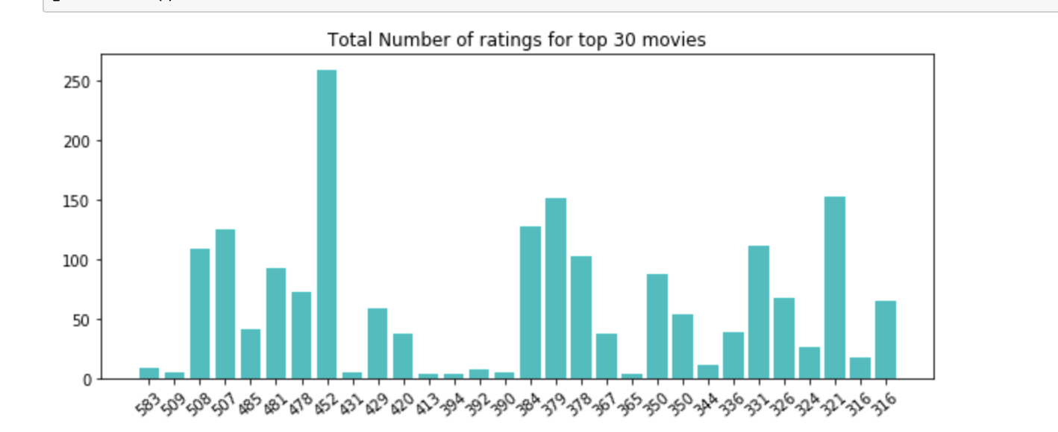
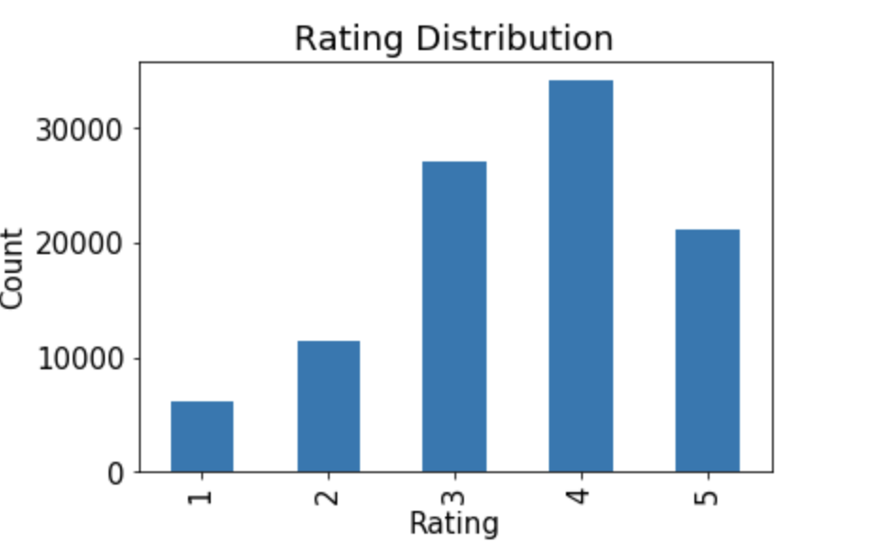
Data Exploration

Slide 5
Cold Start Probelm
Movies recommended to new users are:
'Empire Strikes Back, The (1980)', 'Fargo (1996)', 'Fugitive, The (1993)', 'Godfather, The (1972)', 'Monty Python and the Holy Grail (1974)', 'Princess Bride, The (1987)', 'Pulp Fiction (1994)', 'Raiders of the Lost Ark (1981)', 'Return of the Jedi (1983)', 'Silence of the Lambs, The (1991)', 'Star Wars (1977)', 'Titanic (1997)'

Slide 6
Results
A fairly accurate model is built which recommends 5 movies to any input user.
The movie recommendation is based on the predicted rating of that user on unwatched movies.
Movie Recommendation system is tuned to find five similar users.

Slide 7
Thank You

