Slide 1



Slide 2
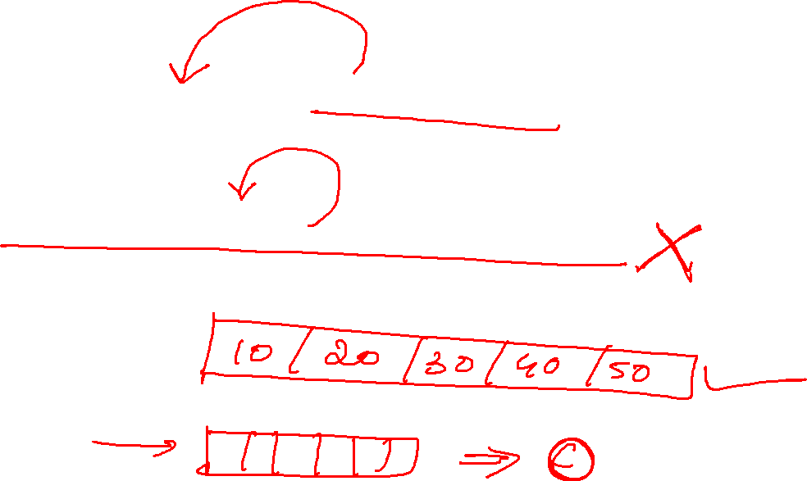
WebElement ele = driver.findElement(By.name("q"));
ele.sendKeys("seleni");
Thread.sleep(3000);
List<WebElement> ele1 = driver.findElements(By.xpath("//li[@class='sbct656555']"));
System.out.println(ele1.size());

