Slide 1
WIPRO CAPSTONE PROJECT
ON
TCP CALCULATOR WITH CHAT CLIENT MESSAGING
C++ Programming || Linux System Programming
Submitted by
DEEKSHA R SAPATE [Resume Number :22992538]

Slide 2
INTRODUCTION
The project implements a client-server application in C that provides both chat and calculator functionalities.
The server handles client requests for chat or calculation and logs the results of calculations to a file. the client can choose between chatting with the server or performing calculations, and it communicates with the server using tcp sockets.
Tcp chat client/server programming involves communication between clients and a central server over a network using sockets.
Tcp ensures reliable, ordered, and error-checked data delivery between applications running on different devices.
The server code demonstrated socket creation, binding, listening for connections, and relaying messages between clients.
The client code showed socket creation, connection to the server, and sending/receiving messages.

Slide 3
Objectives
Implement TCP/IP socket communication: Develop a client and server application using TCP sockets to communicate over a network.
Chat functionality: Allow clients to send and receive text messages in real-time.
Calculator functionality: Provide a range of arithmetic operations including addition, subtraction, multiplication, division, percentage, and square root.
Result logging: Log the results of calculator operations to a file for record-keeping and analysis.
Error handling: Ensure robust error handling for invalid inputs and edge cases.

Slide 4
Software and Hardware Requirements
Software Requirements
Operating System: Linux-based OS
Development Tools:
Compiler: GCC (GNU Compiler Collection) for C or C++.
Editor/IDE: Any text editor or IDE for coding, such as VS Code, Vim, Emacs, or Eclipse.
Libraries:
Standard Libraries: Standard C library (libc), which is generally included with GCC.
Networking Libraries: Standard networking libraries that come with the OS (e.g., arpa/inet.h, sys/socket.h).
Networking:
TCP/IP Stack: The application relies on the TCP/IP stack, which is included in the OS.
Utilities:
File System Access: Ability to read from and write to files for logging calculations and chat messages.

Slide 5
Software and Hardware Requirements
HARDWARE Requirements
Processor:
A processor with a minimum of 1 ghz, preferably multi-core (e.G., Intel core i3 or better).
Memory (ram):
At least 512 MB RAM; 1 GB or more recommended for better performance.
Storage:
At least 10 MB of free disk space for the application and logs. More space may be required based on log file size.
Network:
A network interface capable of handling TCP connections (e.G., Ethernet or wi-fi).

Slide 6
Application Tools Used
Programming Languages: C
Development Environment: Any standard C development environment (e.g., GCC on Linux)
Libraries:
a) sys/socket.h: For socket programming
b) arpa/inet.h: For address and port conversions
c) math.h: For mathematical operations like square root
4. Operating System: Linux (for socket programming and compilation)

Slide 7
Project Modules and Functions
Server Module (server.c)
Socket Creation: socket()
Binding: bind()
Listening: listen()
Accepting Connections: accept()
Chat Handling: chat()
Calculator Handling: perform_calculation()
Logging: log_calculation()
Error Handling: Handles errors in socket operations and file operations.

Slide 8
Project Modules and Functions
Client Module (client.c)
Socket Creation: socket()
Connecting to Server: connect()
Chat Functionality: chat()
Calculator Functionality: perform_calculation()
User Input Handling: Handles user input for both chat and calculator operations.
Error Handling: Handles errors in communication with the server.

Slide 9
Functions Overview
SERVER FUNCTIONS
perform_calculation(int connfd): Handles the calculation operations based on client requests and logs results.
log_calculation(const char *operation, float num1, float num2, float result): Logs the details of the calculation to a file.
chat(int connfd): Manages the chat session with the client.
main(): Initializes the server, accepts connections, and processes client requests.
CLIENT FUNCTIONS
perform_calculation(int sockfd): Sends calculation requests to the server and displays the results.
chat(int sockfd): Manages the chat session with the server.
main(): Initializes the client, connects to the server, and allows the user to choose between chat and calculator functionalities.

Slide 10
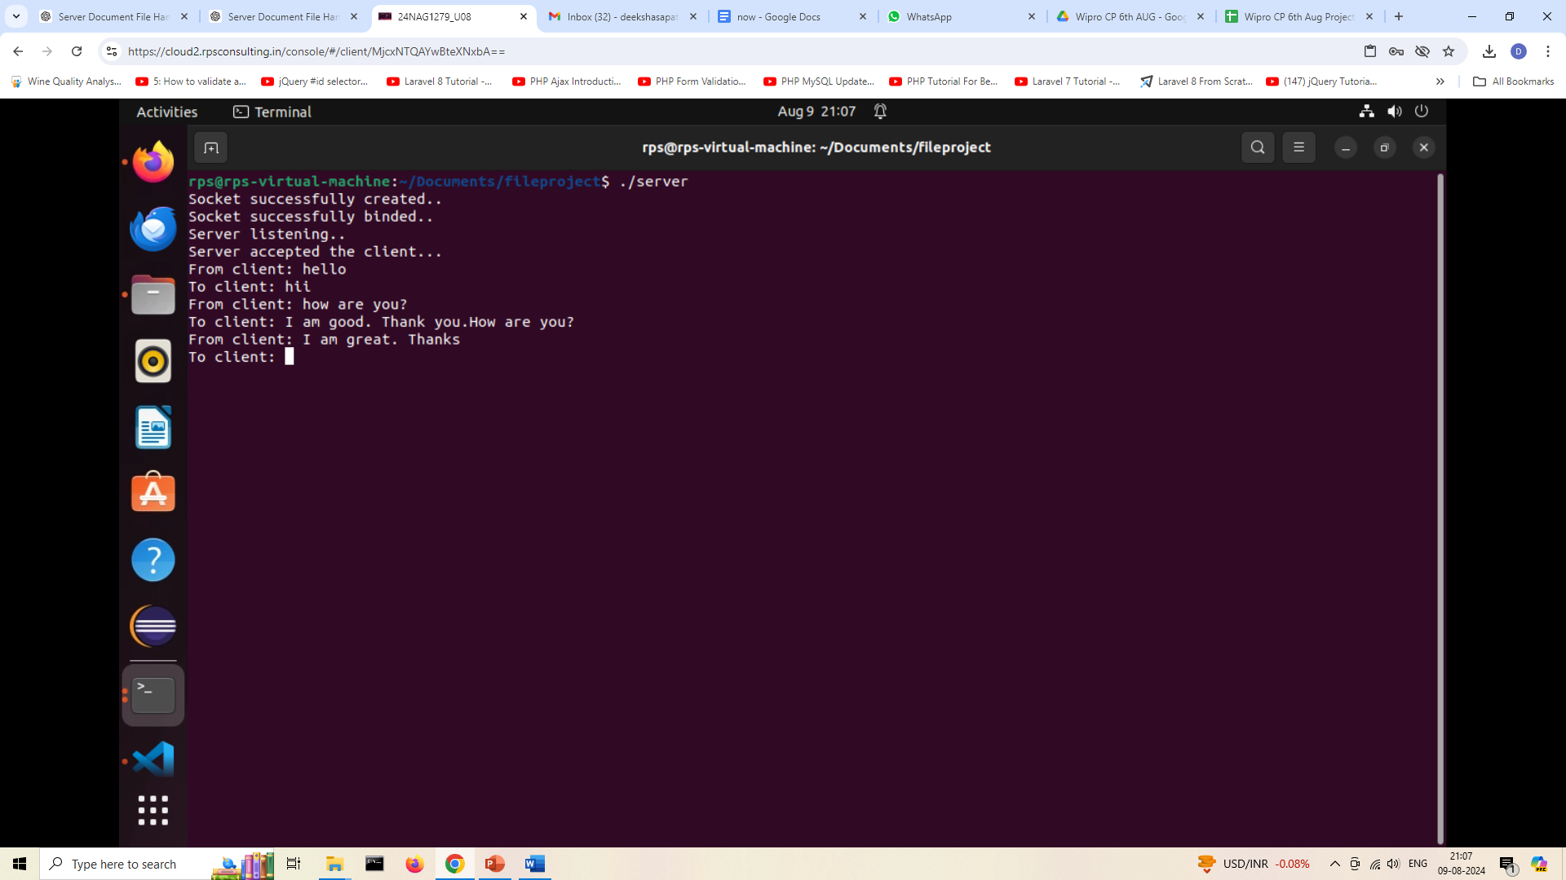
OUTPUT
Server

Slide 11
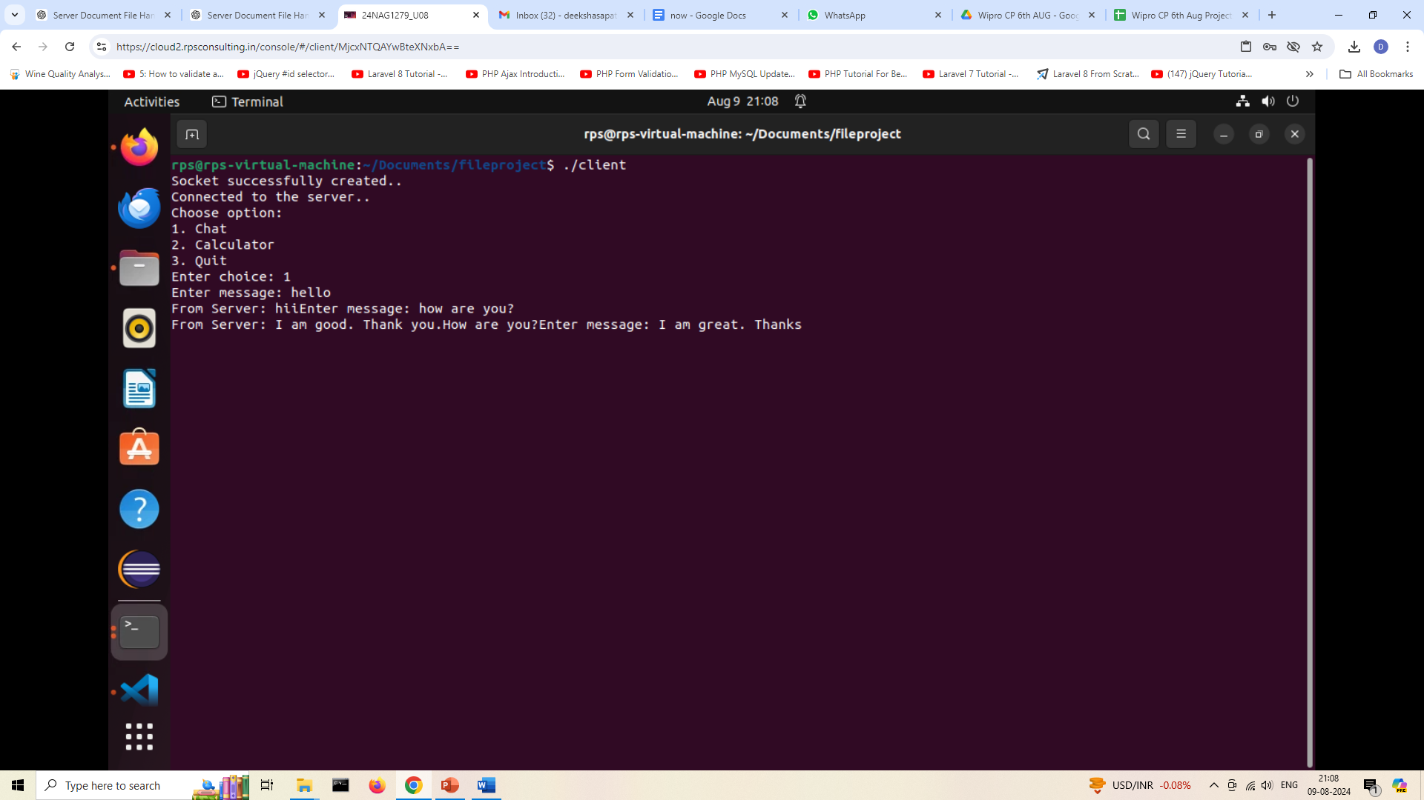
OUTPUT
CLIENT

Slide 12
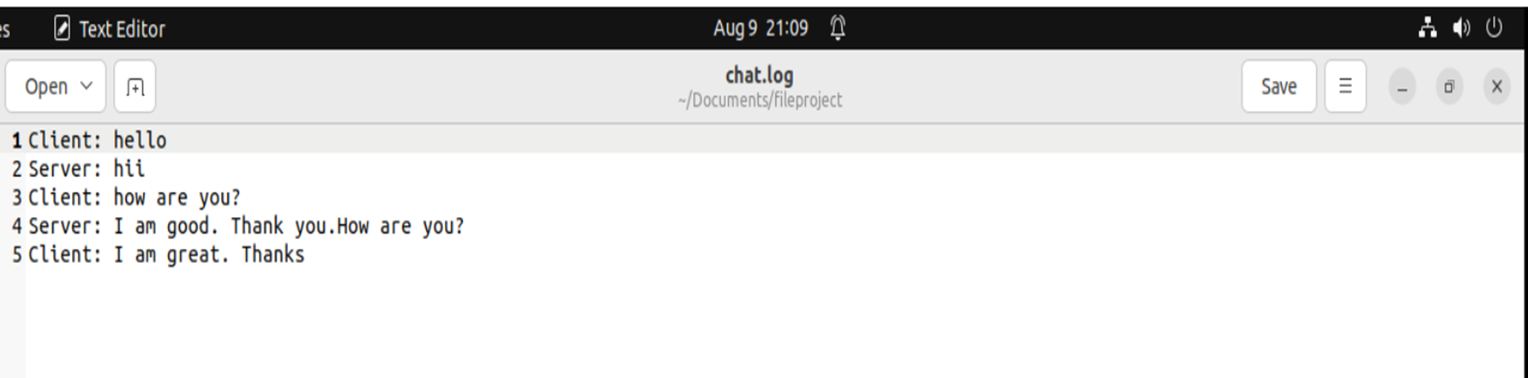
OUTPUT
CLIENT – Server messages are stored in a document called chat.log

Slide 13
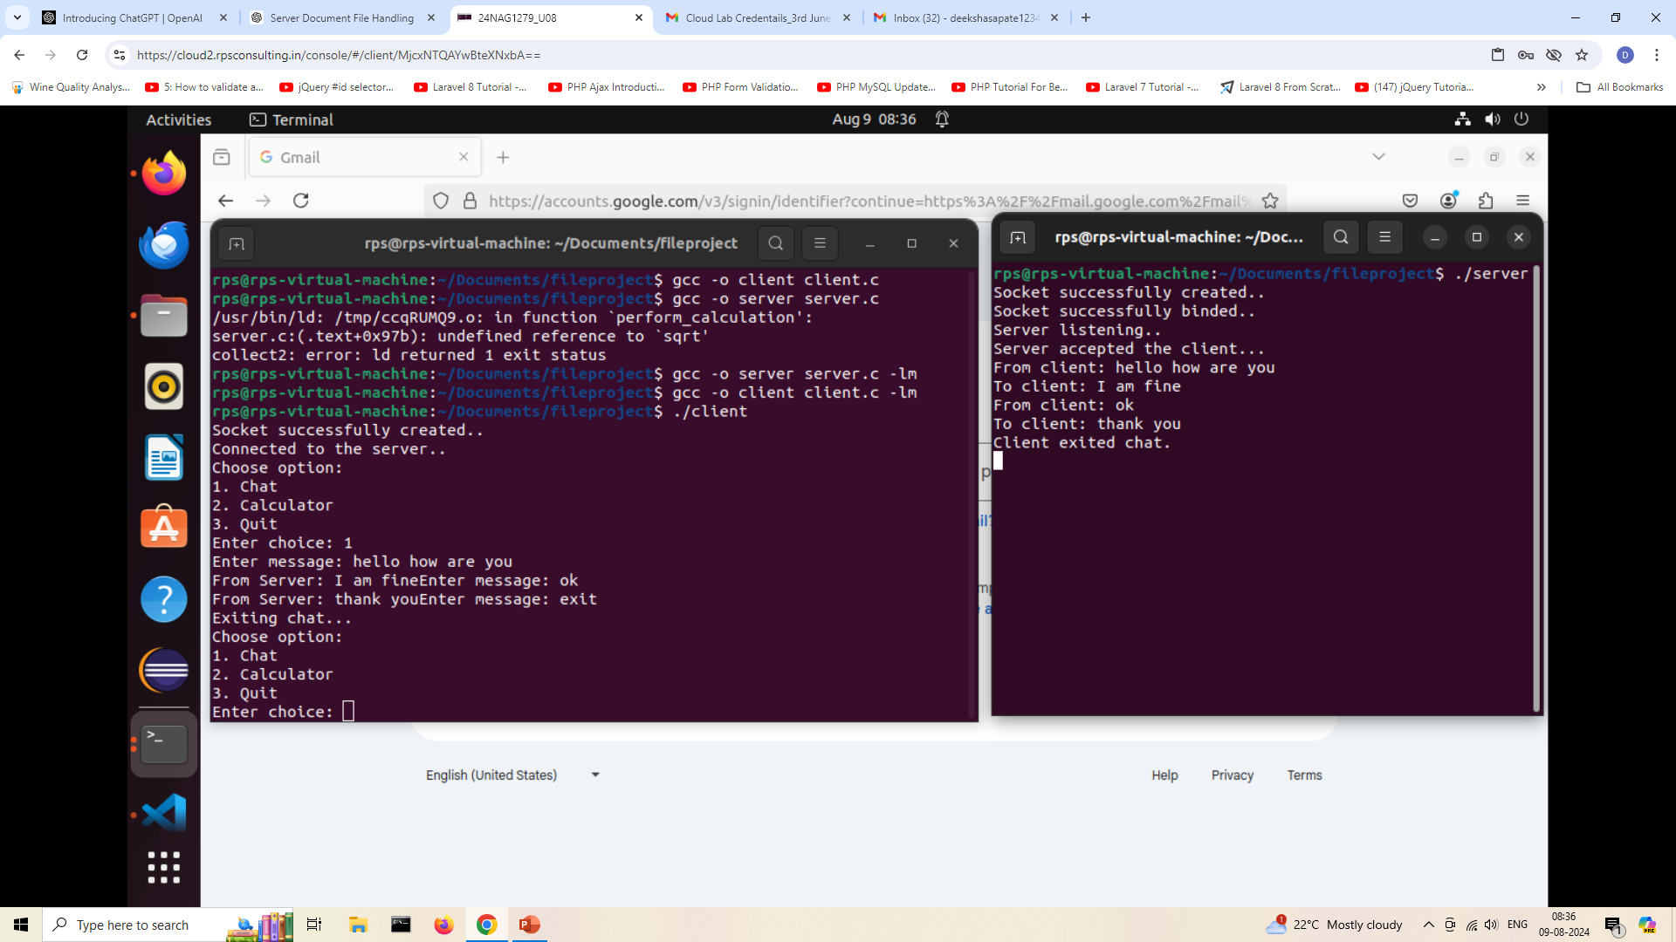
OUTPUT

Slide 14
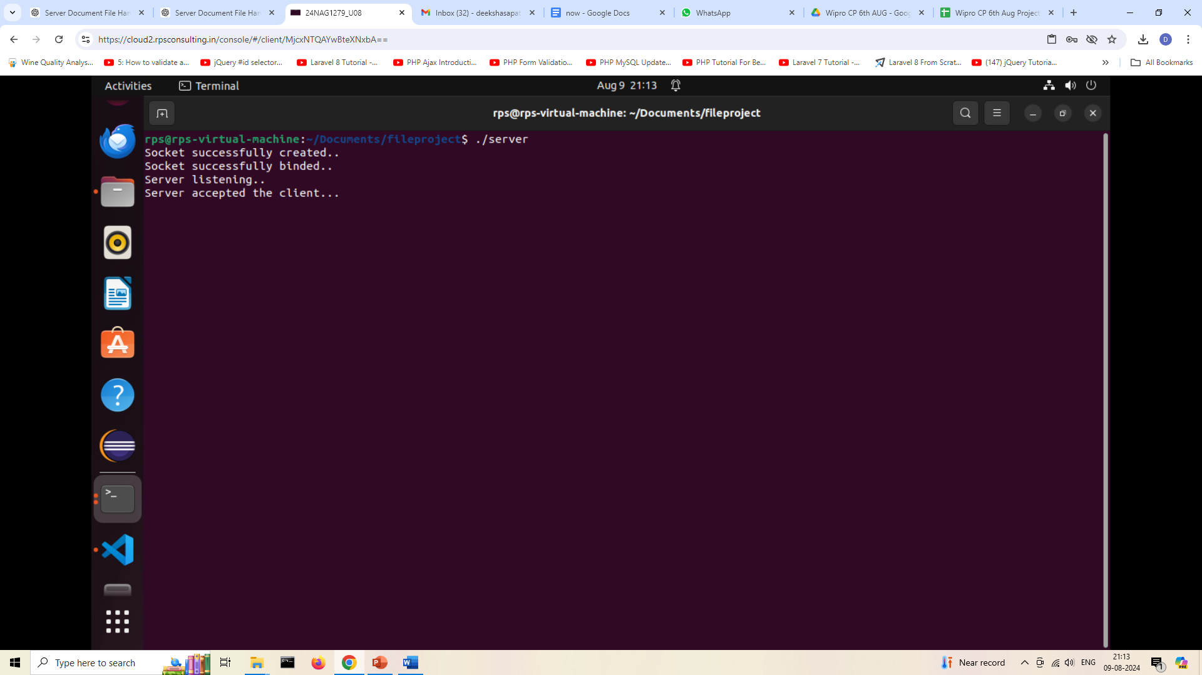
OUTPUT
SERVER

Slide 15
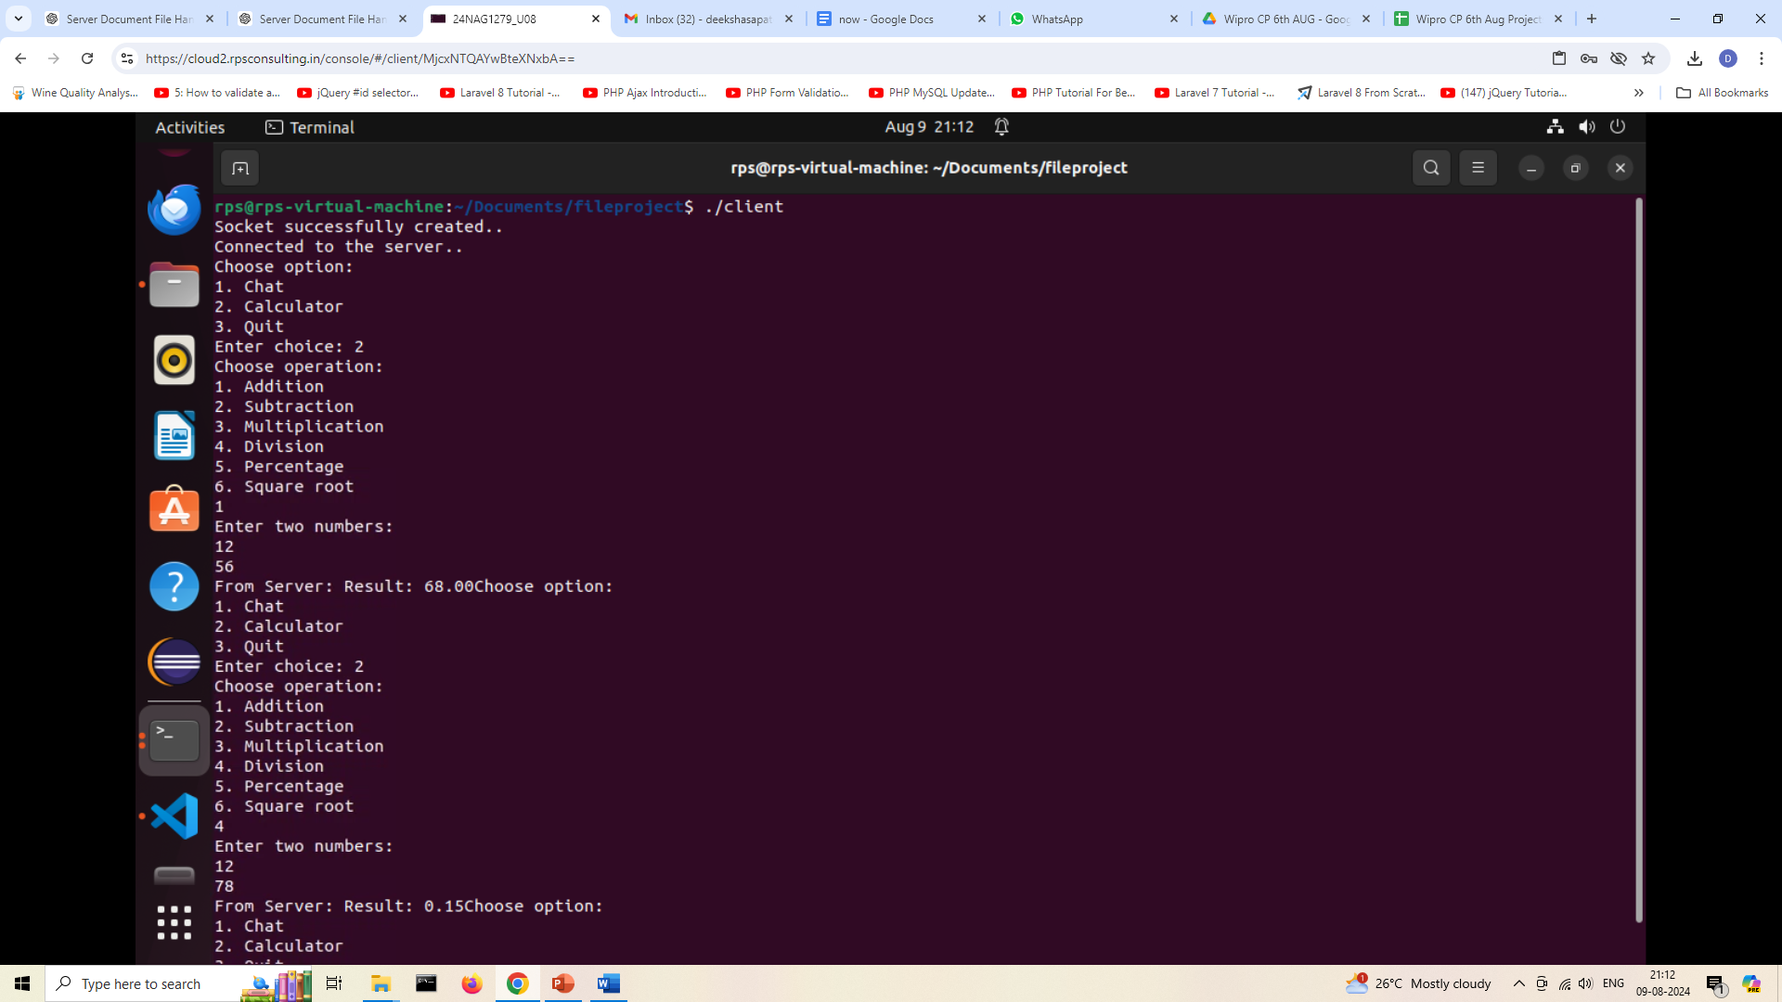
OUTPUT
Client CALCULATOR OPERATIONS

Slide 16
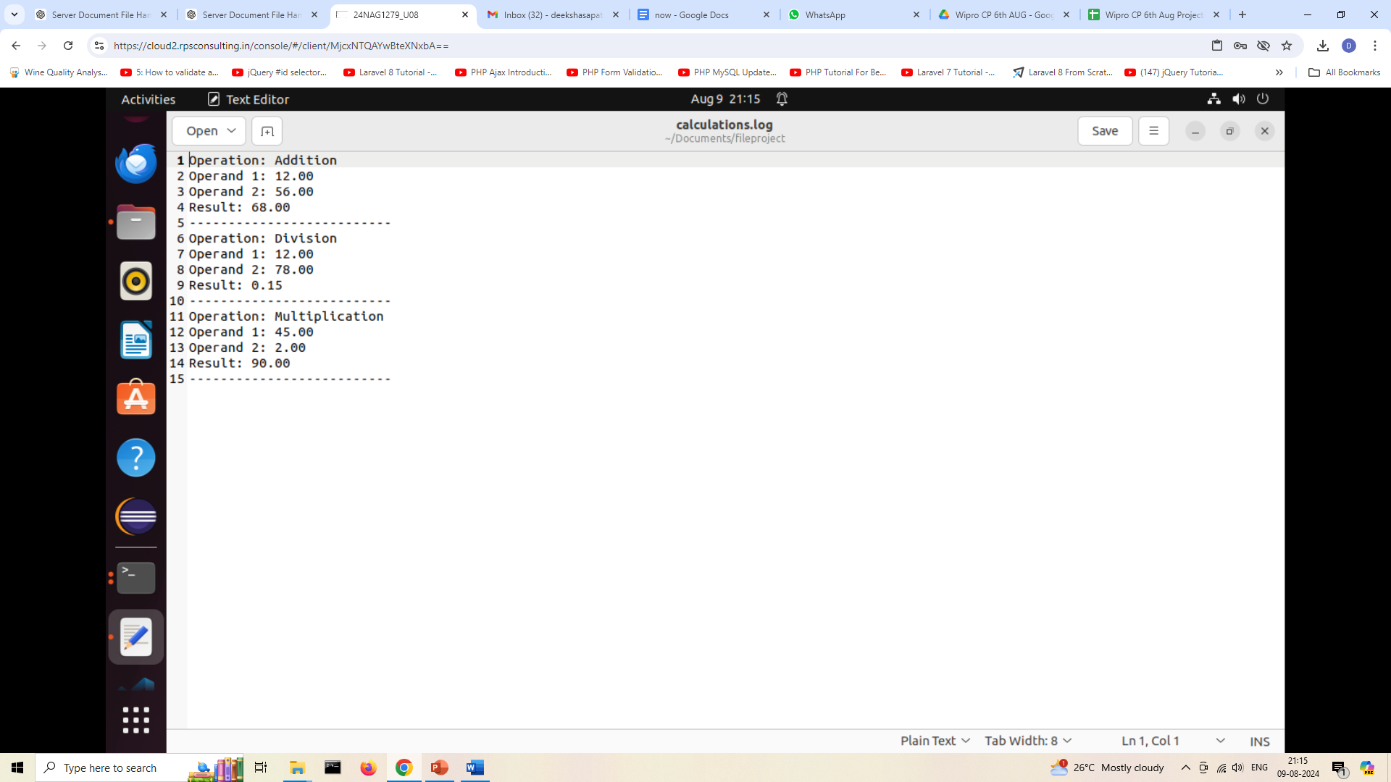
OUTPUT
Client CALCULATOR OPERATIONS are stored in a document called cALCULATIONS.log

Slide 17
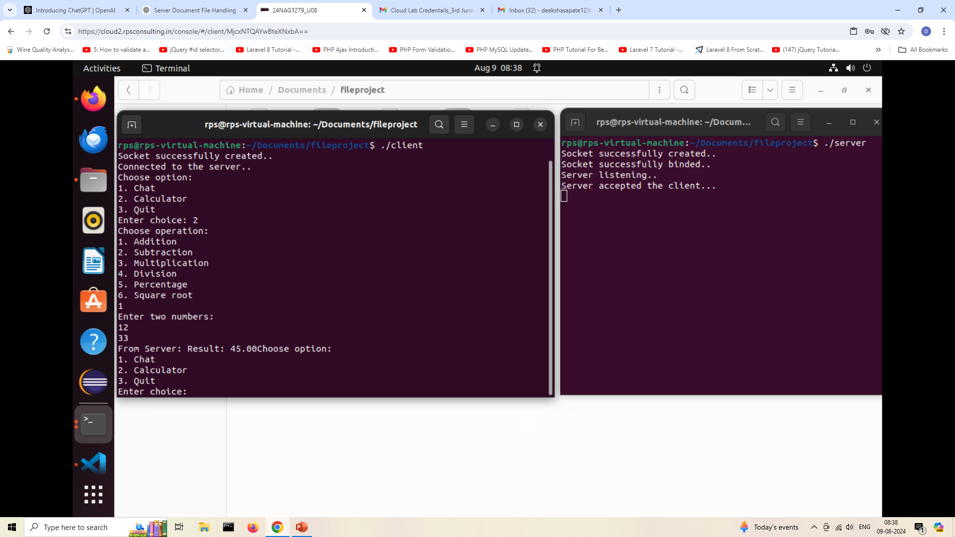
OUTPUT

Slide 18
Future Implementations
Enhanced User Interface: Develop a graphical user interface (GUI) for a more intuitive user experience.
Extended Calculator Features: Add more complex mathematical functions such as exponentiation, logarithms, and trigonometric functions.
Encryption and Security: Implement encryption for secure communication between client and server.
Multi-Client Support: Extend the server to handle multiple clients simultaneously.
Persistent Data Storage: Implement a database to store chat history and calculation results persistently.
Web-based Client: Develop a web-based client using technologies like HTML, CSS, and JavaScript for broader accessibility.

Slide 19
CONCLUSION
The development of this client-server application has successfully demonstrated the integration of basic network programming and user interaction through a TCP socket-based architecture. The project comprises two main components: a server that handles client requests for both chat and calculation functionalities, and a client that interacts with the server to perform these operations. The project provides a demonstration of a client-server application, with a focus on communication and arithmetic operations. The chat details as well as the calculator operations are stored in separate files. It serves as a foundation for building more complex and feature-rich networked applications.

