Slide 1
Profit Prediction using Regression Algorithms
Exploring the most suitable regression model for profit forecasting using ‘50_Startups’ dataset

Slide 2
Objective
To find the best way to predict profits
To understand the data in "50_Startups.csv"
To test different prediction
To pick the top-performing method and explain why it's the best choice using metrics like RMSE

Slide 3
Dataset Overview
“50_Startups” which contains information on various startups
The columns in the "50_Startups.csv" dataset typically include:
R&D Spend: amount of money spent on research and development
Administration cost: expenditures on administrative functions
Marketing Spend: funds allocated to marketing and promotional activities
Profit: net profit generated by each startup

Slide 4
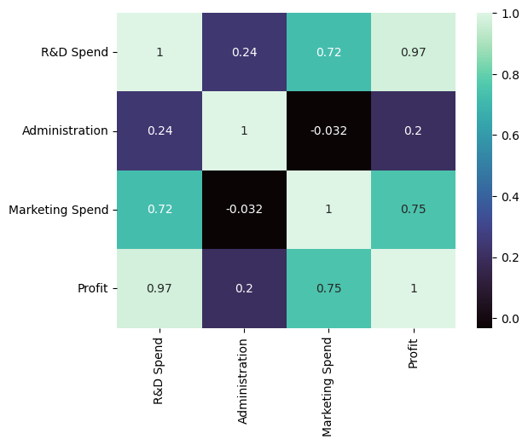
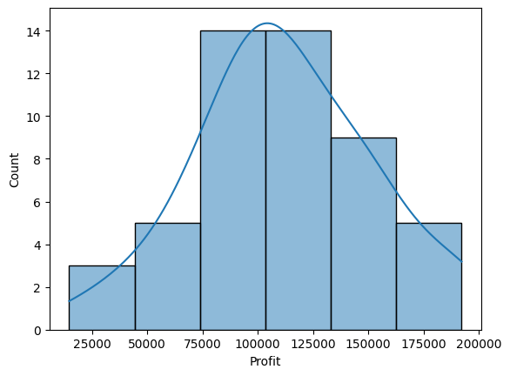
Data Visualization
Heatmap visualizing correlations
Histogram of profit values

Slide 5
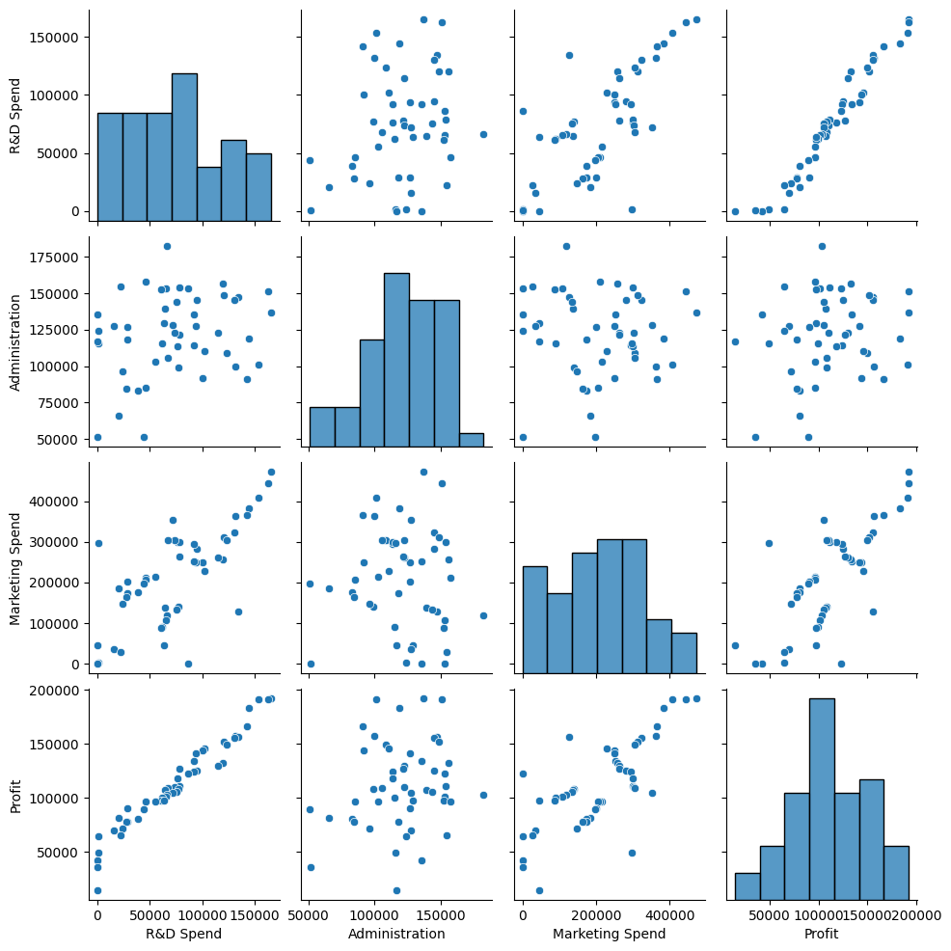
Pairwise relationships (scatter plots & histograms)

Slide 6
Data Preprocessing
Splitting the dataset into dependent (y) & independent (X) variables
Splitting the data into training and testing data
Checking shape of train and test sample
Scaling the data

Slide 7
Regression Models
Linear Regression
Decision Tree Regression
Elastic Net Regression
Random Forest Regression
K-Nearest Neighbors Regression

Slide 8
Model Training and Evaluation
Creating the dictionary of regression models
Training the model on the training data using the fit method
Predicting profit values on the testing data using the trained model
Calculating evaluation metrics
Metrics used: MSE, RMSE, MAE, R-squared, MAPE

Slide 9
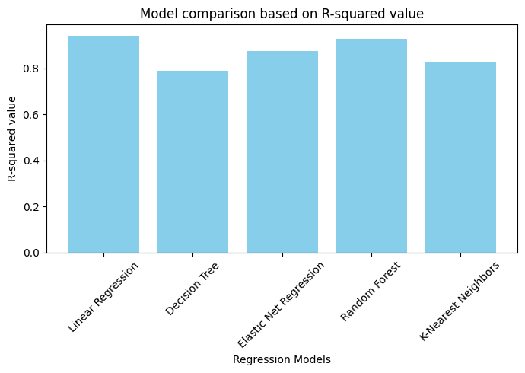
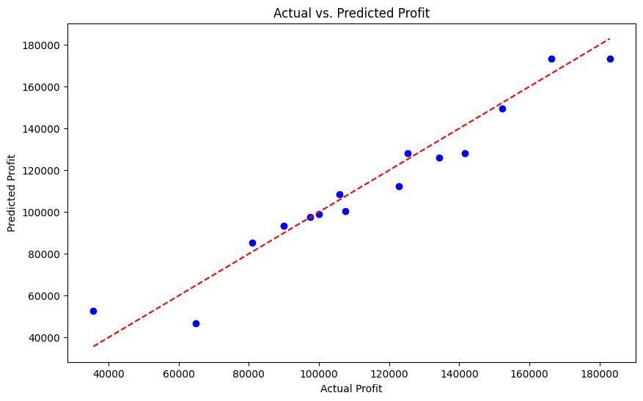
Best Model Selection
Comparing the performance of the different models
Choosing best model based on lowest RMSE
Re-training the chosen model on the entire training dataset
Validating the model using the testing dataset
Visualizing the predicted vs. actual profit values to assess its accuracy

Slide 10
Thank You

